Slide 1



Quantum Three Card Monte
|1
|1
|1
|0
|0
|0
Dave Bacon
University of California Berkeley
Whaley Group

Slide 2

Cult of Universality
Universal Quantum Computer
 a quantum computer which can be programmed to perform any algorithmic manipulation on quantum information.
U(2)
Set of Universal Quantum Gates
 a set of operations/gates which, acting on the quantum information, can be used to implement (to any desired accuracy) any unitary evolution of the quantum info.
The Royal King and Queen of Universal Quantum Gates
CNOT and 1-qubit rotations

Slide 3

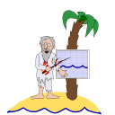
An Engineer and a Physicist
are stranded on a deserted island...
Look, Al, I’ve got this quantum system in my lab where I can turn on and off such-and-such an interaction and perform such-and-such procedures. Can I quantum compute?
Hmmm…..
Well, Bob, your such-and-such and interactions are not CNOT plus single qubit rotation on you qubits.
But…..?!
Lets talk about...
DECOHERENCE-FREE SUBSPACES and DECOHERENCE-FREE SUBSYSTEMS (DFSs)

Slide 4
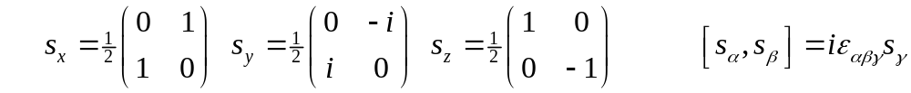
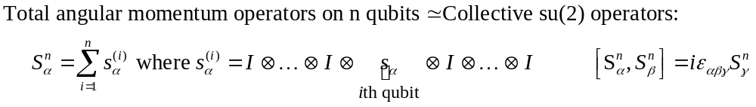
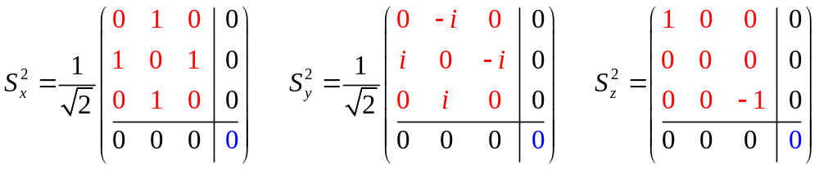
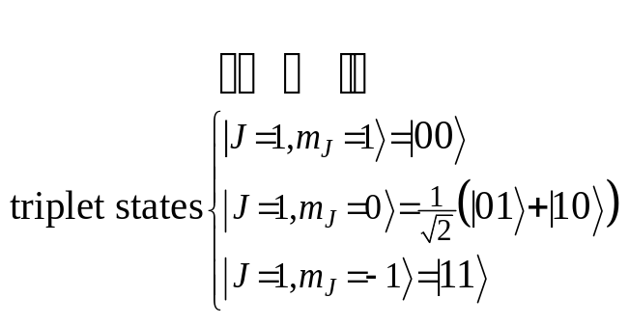
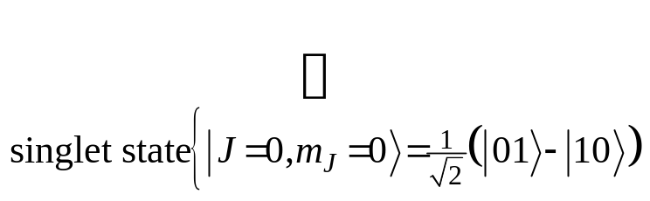
Collective Operations
Intro quantum mechanics: addition of angular momentum for two spin-1/2 particles. •Two spin-1/2 can be combined into a spin-1 triplet and a spin-0 singlet.
(Bob is a bit insulted by Al. He remembers this from QM 101.)

Slide 5
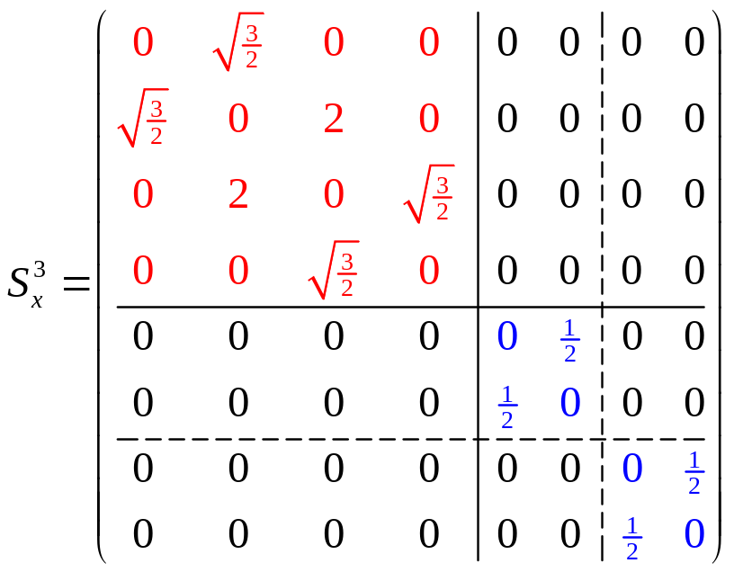
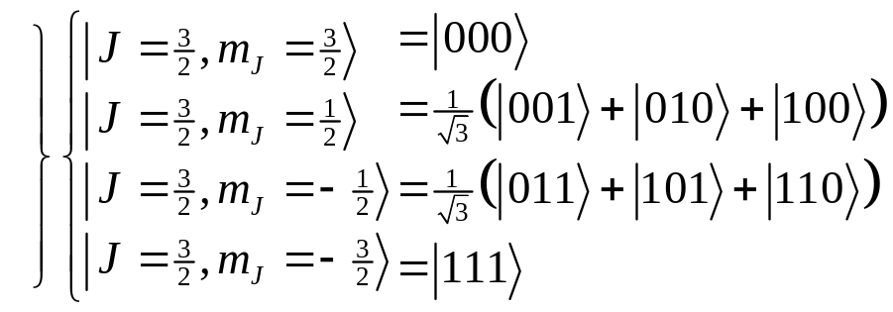
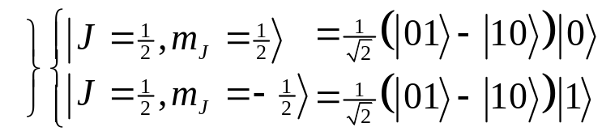
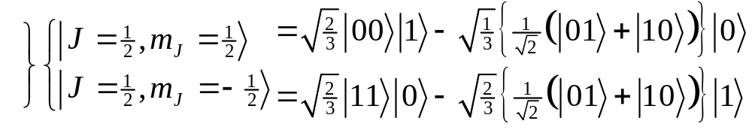
Degeneracy
Something special happens with three particles…
spin-1 (triplet) plus spin-1/2 can produce either a spin-1/2 or a spin-3/2.
spin-0 (singlet) plus spin-1/2 can produce spin 1/2.
These spin-1/2 states come from combining a spin-0 two qubit state and a spin-1/2 single qubit state
These spin-1/2 states come from combining a spin-1 two qubit state and a spin-1/2 single qubit state
There is a DEGENERACY in the action of the 3 qubit collective su(2) operation!

Slide 6
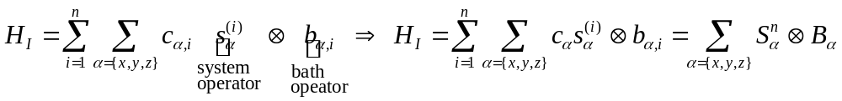
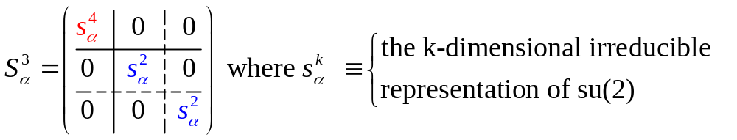
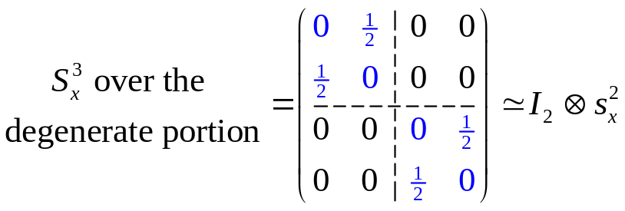
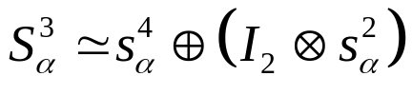
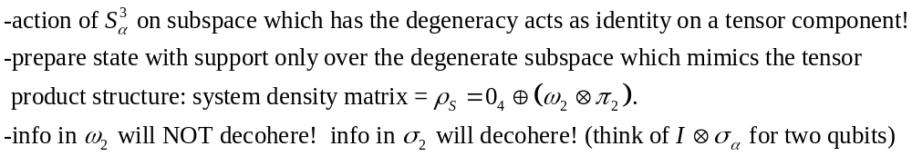
Collective Decoherence
Bath mode with a wavelength much larger than the inner qubit spacing
system-bath Hamiltonian
(KLV) Emanuel Knill, Raymond Laflamme, Lorenza Viola, Phys. Rev. Lett. 84, 2525 (2000)

Slide 7
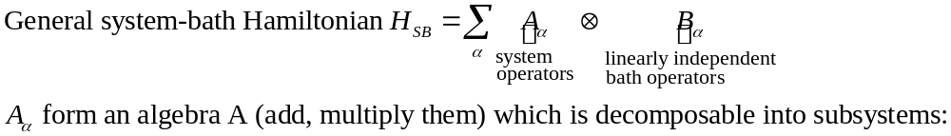
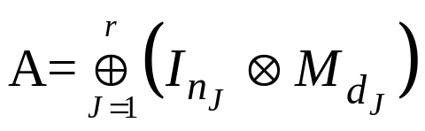


Decoherence-Free Subsystems (KLV)

