Slide 1



Quantum Three Card Monte
|1
|1
|1
|0
|0
|0
Dave Bacon
University of California Berkeley
Whaley Group

Slide 2

Cult of Universality
Universal Quantum Computer
 a quantum computer which can be programmed to perform any algorithmic manipulation on quantum information.
U(2)
Set of Universal Quantum Gates
 a set of operations/gates which, acting on the quantum information, can be used to implement (to any desired accuracy) any unitary evolution of the quantum info.
The Royal King and Queen of Universal Quantum Gates
CNOT and 1-qubit rotations

Slide 3

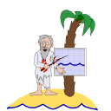
An Engineer and a Physicist
are stranded on a deserted island...
Look, Al, I’ve got this quantum system in my lab where I can turn on and off such-and-such an interaction and perform such-and-such procedures. Can I quantum compute?
Hmmm…..
Well, Bob, your such-and-such and interactions are not CNOT plus single qubit rotation on you qubits.
But…..?!
Lets talk about...
DECOHERENCE-FREE SUBSPACES and DECOHERENCE-FREE SUBSYSTEMS (DFSs)

Slide 4
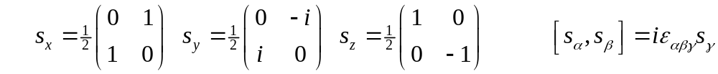
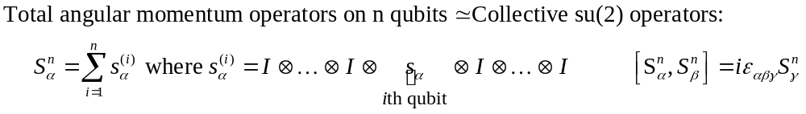
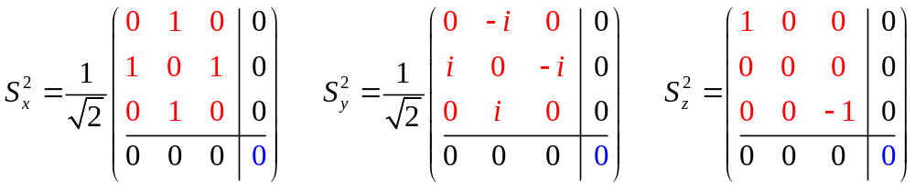
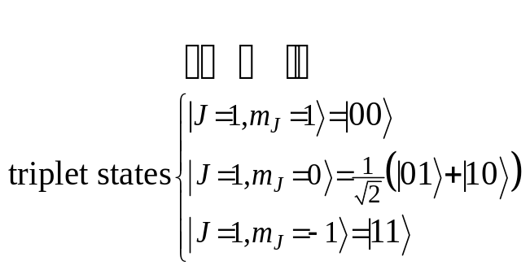
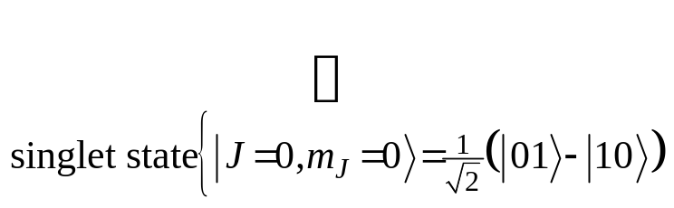
Collective Operations
Intro quantum mechanics: addition of angular momentum for two spin-1/2 particles. •Two spin-1/2 can be combined into a spin-1 triplet and a spin-0 singlet.
(Bob is a bit insulted by Al. He remembers this from QM 101.)

Slide 5
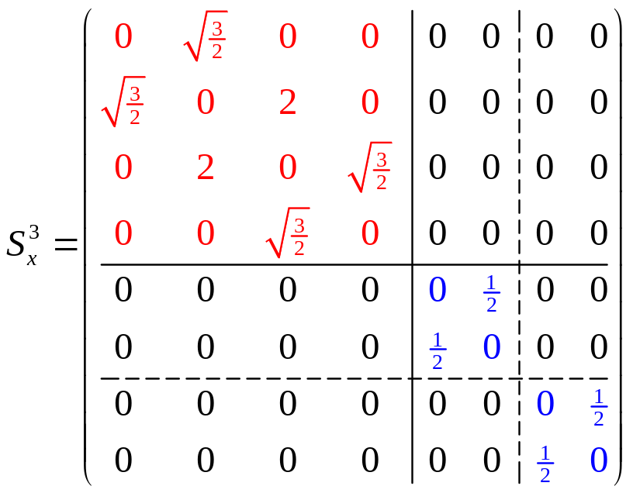
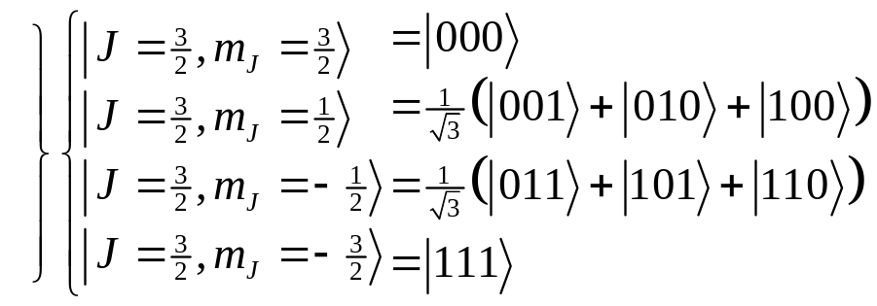
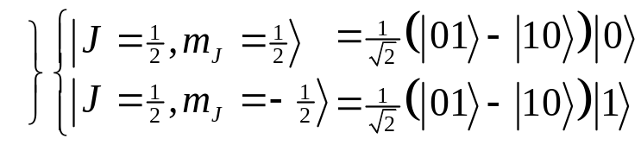
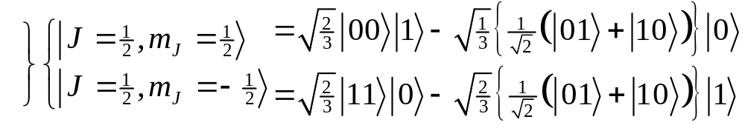
Degeneracy
Something special happens with three particles…
spin-1 (triplet) plus spin-1/2 can produce either a spin-1/2 or a spin-3/2.
spin-0 (singlet) plus spin-1/2 can produce spin 1/2.
These spin-1/2 states come from combining a spin-0 two qubit state and a spin-1/2 single qubit state
These spin-1/2 states come from combining a spin-1 two qubit state and a spin-1/2 single qubit state
There is a DEGENERACY in the action of the 3 qubit collective su(2) operation!

Slide 6
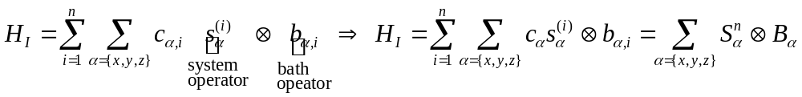
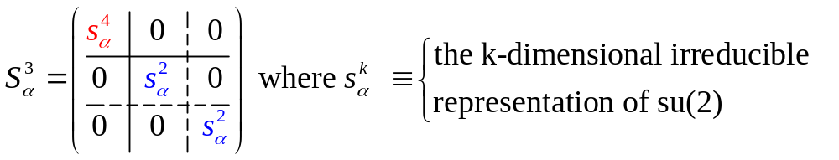
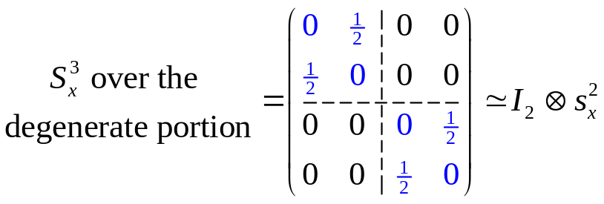
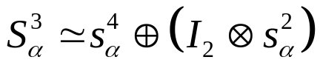
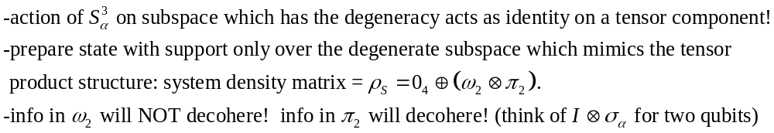
Collective Decoherence
Bath mode with a wavelength much larger than the inner qubit spacing
system-bath Hamiltonian
(KLV) Emanuel Knill, Raymond Laflamme, Lorenza Viola, Phys. Rev. Lett. 84, 2525 (2000)

Slide 7
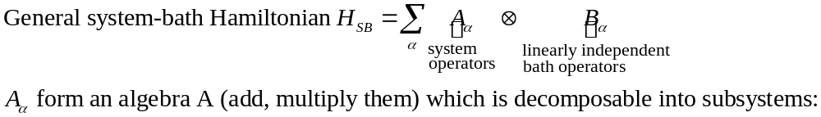
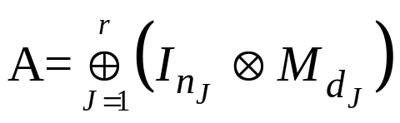


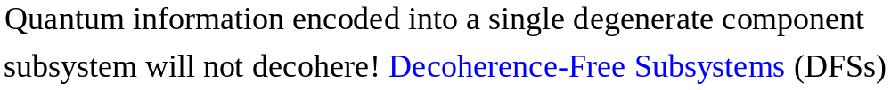


Decoherence-Free Subsystems (KLV)
Great, Al! This is a neat possible way of avoiding decoherence! But what does this have to do with my question: will my system be able to quantum compute?
Hold your horses, Bob! These subsystems are only useful if we can compute on them…then I think you’ll get my gist...

Slide 8





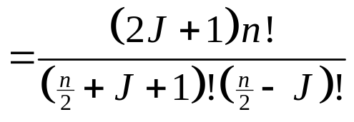






Collective DFSs
1
1
Degeneracy of the n qubit, total angular momentum J collective su(2) operators
= dimension of quantum information which can be encoded into the corresponding DFS.
1
6
1
5
1
4
14
1
3
9
1
2
5
14
The J=0 irreps of su(2) are 1 dimensional Decoherence-Free Subspaces.
1
2
5
1
2
3
4
5
6
7
A nice set of basis states for a (n,J) DFS can be labeled by the path taken when constructing the (n,J) DFS via addition of angular momentum.
How do we perform quantum computation on the information of a (n,J) DFS?

Slide 9

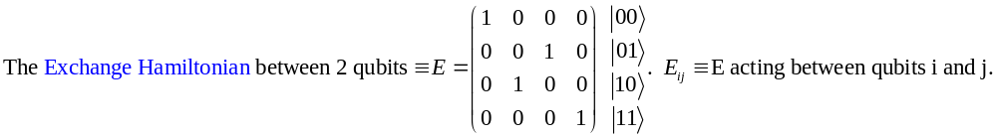
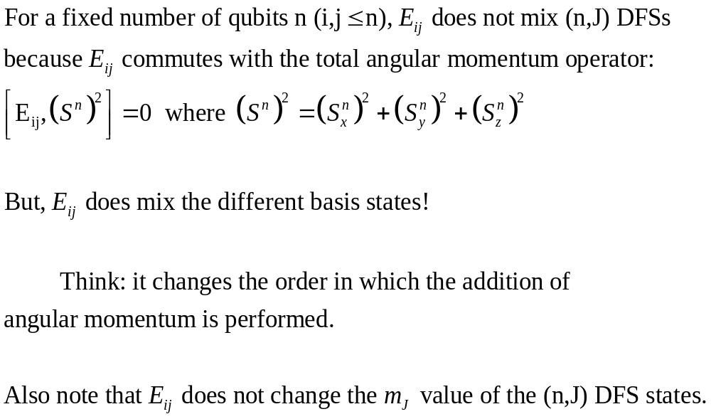

Exchange
1
2
3
4
5

Slide 10
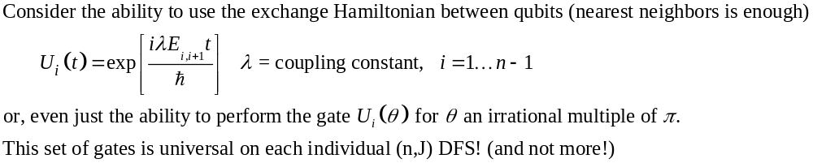
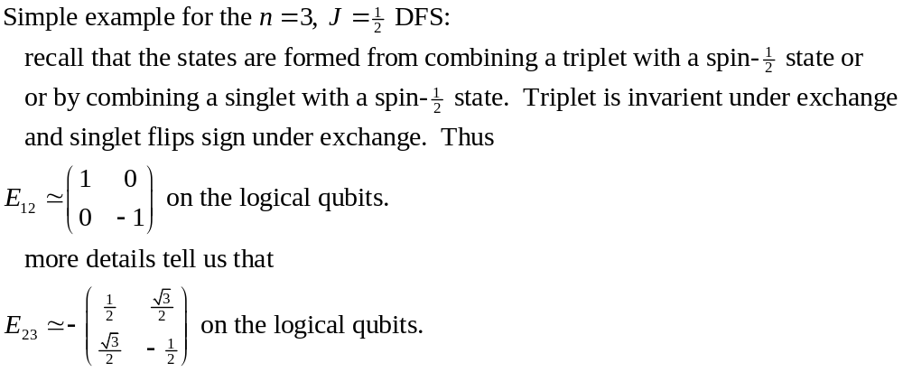
Exchange's Universality
The exchange Hamiltonian is universal on the encoded states of a collective DFS
Julia Kempe, Dave Bacon, Daniel Lidar, K. B. Whaley, “Theory of Decoherence-Free Fault-Tolerant Universal Quantum Computation.” quant-ph /0004064. 2000.

Slide 11
Asymptotic Universality

Slide 12
Concatenation

Slide 13
Heisenberg Coupling

Slide 14
A Duality

Slide 15
What Do I Need To Quantum Compute?

Slide 16
Conclusions

Slide 17
Acknowledgements

