Slide 1



Quantum Three Card Monte
|1
|1
|1
|0
|0
|0
Dave Bacon
University of California Berkeley
Whaley Group

Slide 2

Cult of Universality
Universal Quantum Computer
 a quantum computer which can be programmed to perform any algorithmic manipulation on quantum information.
U(2)
Set of Universal Quantum Gates
 a set of operations/gates which, acting on the quantum information, can be used to implement (to any desired accuracy) any unitary evolution of the quantum info.
The Royal King and Queen of Universal Quantum Gates
CNOT and 1-qubit rotations

Slide 3

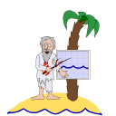
An Engineer and a Physicist
are stranded on a deserted island...
Look, Al, I’ve got this quantum system in my lab where I can turn on and off such-and-such an interaction and perform such-and-such procedures. Can I quantum compute?
Hmmm…..
Well, Bob, your such-and-such and interactions are not CNOT plus single qubit rotation on you qubits.
But…..?!
Bob
Lets talk about...
DECOHERENCE-FREE SUBSPACES and DECOHERENCE-FREE SUBSYSTEMS (DFSs)
Al

Slide 4
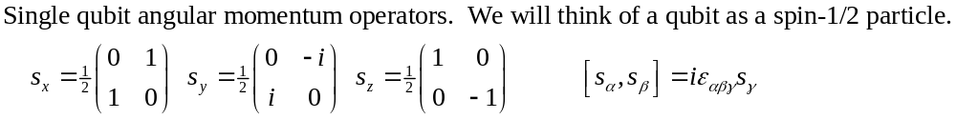
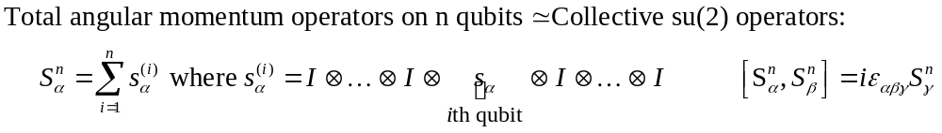
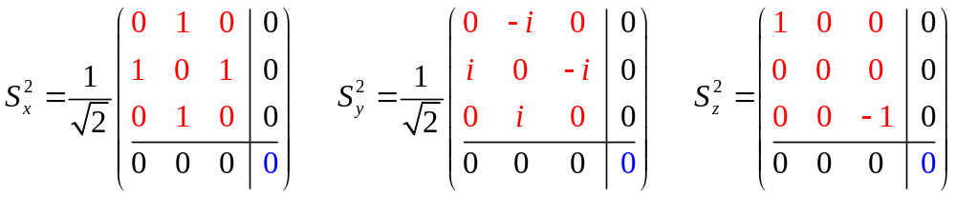
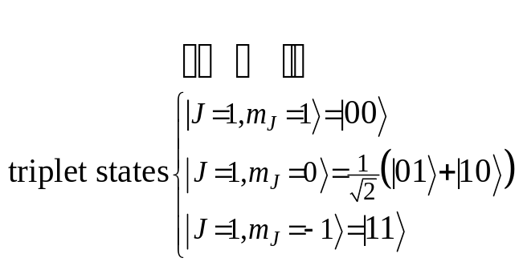
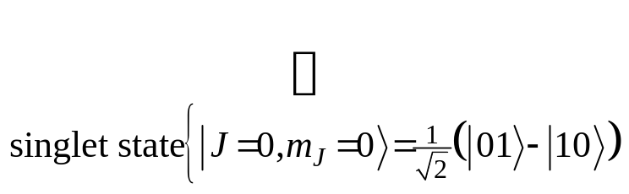
Collective Operations
Intro quantum mechanics: addition of angular momentum for two spin-1/2 particles. •Two spin-1/2 can be combined into a spin-1 triplet and a spin-0 singlet.
(Bob is a bit insulted by Al. He remembers this from QM 101.)

Slide 5
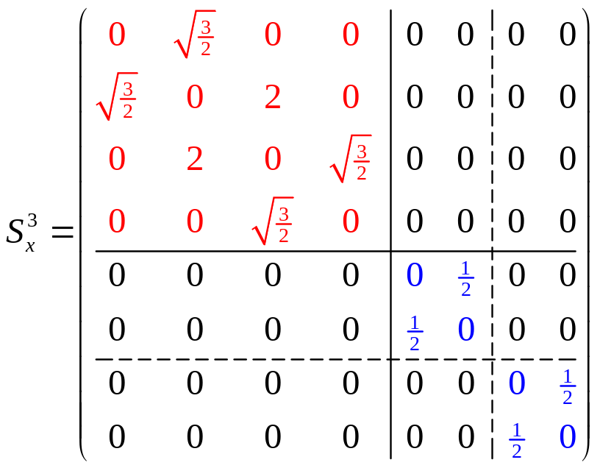
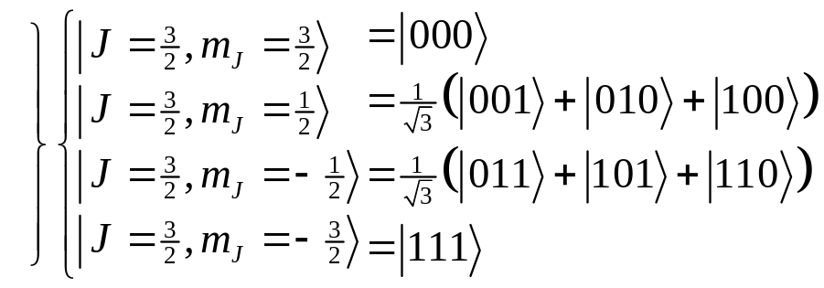
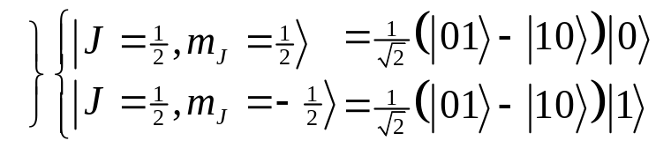
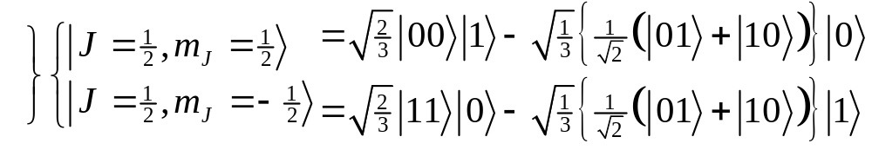
Degeneracy
Something special happens with three particles…
spin-1 (triplet) plus spin-1/2 can produce either a spin-1/2 or a spin-3/2.
spin-0 (singlet) plus spin-1/2 can produce spin 1/2.
These spin-1/2 states come from combining a spin-0 two qubit state and a spin-1/2 single qubit state
These spin-1/2 states come from combining a spin-1 two qubit state and a spin-1/2 single qubit state
There is a DEGENERACY in the action of the 3 qubit collective su(2) operation!

Slide 6
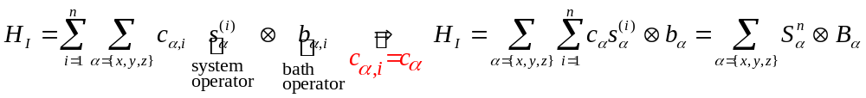
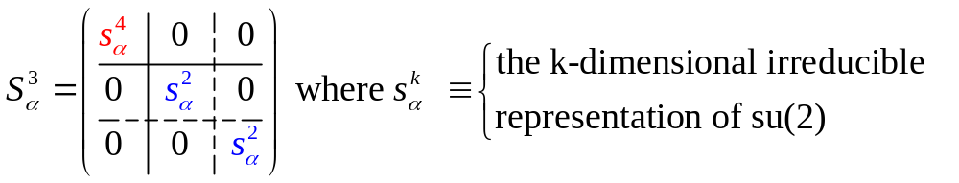
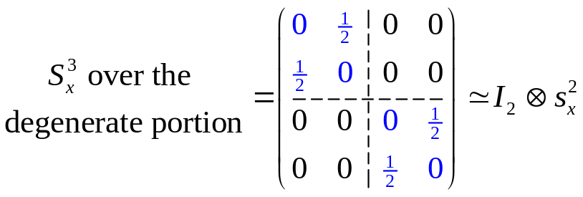
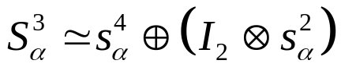
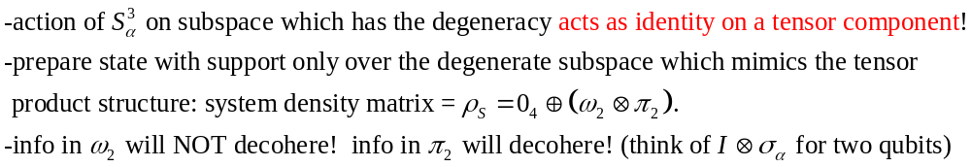
Collective Decoherence
Bath mode with a wavelength much longer than the inner qubit spacing
system-bath Hamiltonian
(KLV) Emanuel Knill, Raymond Laflamme, Lorenza Viola, Phys. Rev. Lett. 84, 2525 (2000)

Slide 7
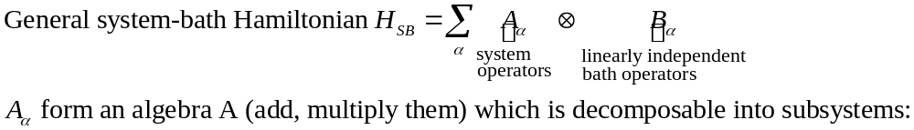
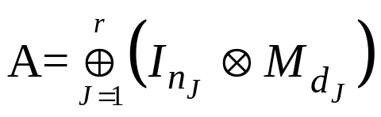


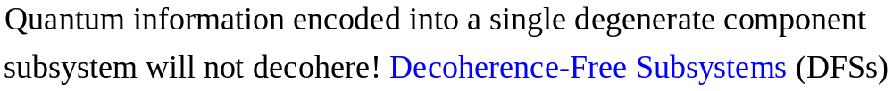


Decoherence-Free Subsystems (KLV)
“The universe is an enormous direct product of representations of symmetry groups” - Steve Weinberg
Great, Al! This is a neat possible way of avoiding decoherence! But what does this have to do with my question: will my system be able to quantum compute?
Hold your horses, Bob! These subsystems are only useful if we can compute on them…then I think you’ll get my gist...
Al
Bob

Slide 8






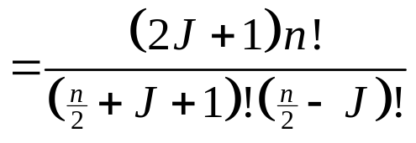





Collective DFSs
1
1
Degeneracy of the n qubit, total angular momentum J collective su(2) operators
= dimension of quantum information which can be encoded into the corresponding DFS.
1
6
1
5
1
4
14
1
3
9
1
2
5
14
The J=0 irreps of su(2) are 1 dimensional Decoherence-Free Subspaces.
1
2
5
1
2
3
4
5
6
7
A nice set of basis states for a (n,J) DFS can be labeled by the path taken when constructing the (n,J) DFS via addition of angular momentum.
How do we perform quantum computation on the information of a (n,J) DFS?
Can we do this using only one or two-qubit interactions?

Slide 9

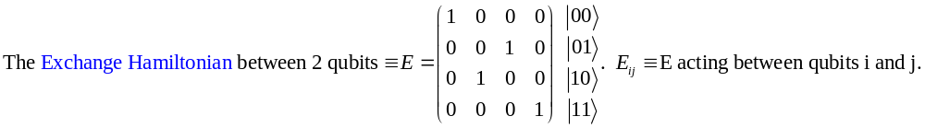
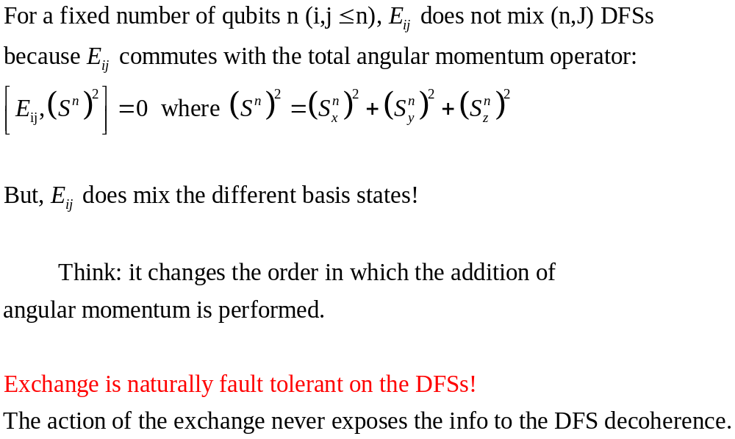

Exchange
1
2
3
4
5

Slide 10
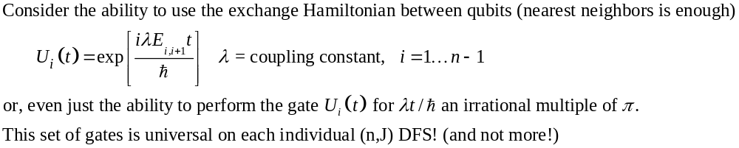
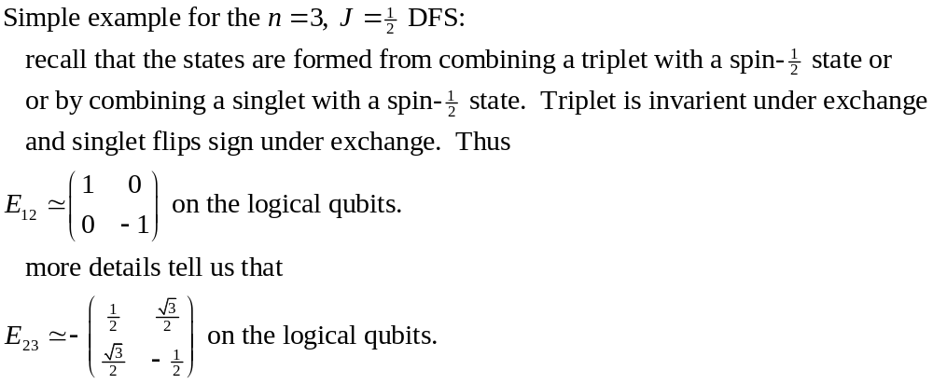
Exchange's Universality
The exchange Hamiltonian is universal on the encoded states of a collective DFS
Julia Kempe, Dave Bacon, Daniel Lidar, K. B. Whaley, “Theory of Decoherence-Free Fault-Tolerant Universal Quantum Computation.” quant-ph /0004064. (2000)

Slide 11



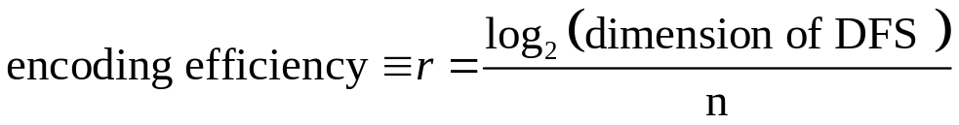
Universality Amazing!
3
1
Can perform su(d)’s on each of the DFSs
encode information into the DFSs and the EXCHANGE interaction can be used to perform any su(d) on each of the su(d)’s for a given n independently!
su(d) means we have a d dimensional Hilbert space (encoded) and we can perform all unitary manipulations on this d dimensional Hilbert space!
2
5
1
9
5
0
1
2
3
4
5
6
The Exchange Hamiltonian is ASYMPTOTICALLY UNIVERSAL

Slide 12
Issues
Concatenation of collective DFSs.
Leakage detection between collective DFSs.
Fault-tolerant measurement on collective DFS states.
Quantification of gate times required to perform actual operations.
For fixed J, quantum computation and computation on collective DFSs are computationally equivalent for large n (qcdfs trivial, dfsqc a bit harder)
Dave Bacon, Julia Kempe, Daniel Lidar, K. B. Whaley, “Universal Fault-Tolerant Computation on Decoherence-Free Subspaces” quant-ph/9909058. (1999)
Julia Kempe, Dave Bacon, Daniel Lidar, K. B. Whaley, “Theory of Decoherence-Free Fault-Tolerant Universal Quantum Computation.” quant-ph/0004064. (2000)
David DiVincenzo, Guido Burkard, Julia Kempe, Dave Bacon, work in progress (2000)

Slide 13
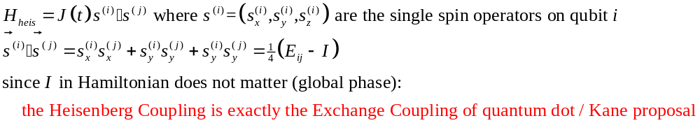
Heisenberg Coupling
Al, I’m still waiting for your answer? Can I quantum compute?
Look at those spin-coupled quantum dots you have. What is the coupling between the dots?
Bob
Al
Not necessary to supplement the Heisenberg coupling with single qubit operations!
Heisenberg interaction in quantum dot / Kane proposal are easily tuned using local magnetic fields.
Heisenberg operation is fast (GHz range) and has an on-off ratio of several orders of magnitude.
Encoding into low J DFSs is easily performed using a simple cooling routine: let there be an exchange interaction between alternating neighboring dots and cool the system.
Many more details of the application of this simple universality result have been worked out and are being detailed in work with David DiVincenzo, Guido Burkard, and Julia Kempe.

Slide 14
A Duality
For DFSs, since the decoherence avoidence is independent of the coupling strength, in order to perform fault-tolerant computation for strong coupling,
computation should NEVER force the states outside of the DFS.
This is true for the exchange interaction. Naturally fault tolerant!
Contrast standard independent error quantum error correction (QEC). In this case any single or two body gate MUST take the state outside of the code during the operation time of the gate:
U(t)=exp[iHt] for small t = I+iHt but if H is single or two body interaction
then I+iHt will be an ERROR on the QEC and so will not preserve the subspace.
The reason for this is a nice DUALITY:
collective error model has errors which are global so local operations can preserve the subspace
independent error model has errors which are local so global operations are needed to preserve the subspace

Slide 15

What Do I Need To Quantum Compute?
Hey I found this new quantum system with these crazy interactions, Al. Can I quantum compute?
Many interactions, with a bit of encoding, can be used to do quantum computation.
This question is a simple application of the representation theory of Lie Algebras (take it to your local particle theorist for a quick answer!)
A few more qubits and a few more operations may be required.
The hope, however, is that the requirements for engineering a quantum computer using encoded universal interactions will be simplified.
Fault-tolerant computation on collective DFSs is possible!
Controlled-Not and single qubit gates are not the only way to go!
U(2)

Slide 16

Acknowledgements
This work was done in collaboration with
Julia Kempe (UC Berkeley, Mathematics)
Dr. Daniel Lidar (UC Berkeley, Chemistry, soon University of Toronto, Chemistry)
Professor K. B. Whaley (UC Berkeley, Chemistry)
Dr. David DiVincenzo (IBM)
Guido Burkard (University of Basel)
Support for this work was provided by
U. S. ARO grant DAAG-55-98-1-0371
Dave Bacon, Julia Kempe, Daniel Lidar, K. B. Whaley, “Universal Fault-Tolerant Computation on Decoherence-Free Subspaces” quant-ph/9909058. (1999)
Julia Kempe, Dave Bacon, Daniel Lidar, K. B. Whaley, “Theory of Decoherence-Free Fault-Tolerant Universal Quantum Computation” quant-ph/0004064. (2000)
Daniel Lidar, Dave Bacon, K. B. Whaley “Concatenating Decoherence Free Subspaces with Quantum Error Correcting Codes,” Phys. Rev. Lett. 82, 4556. quant-ph/9809081. (1999)

