Slide 1
Making Decoherence Run Uphill
(carrying 99 lbs., uphill both ways, in the snow)
Will this hill
ever end?
Dave Bacon
Department of Physics and Department of Chemistry
University of California, Berkeley

Slide 2



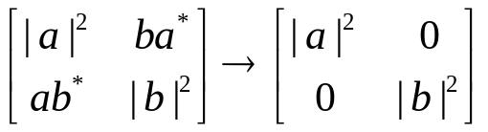

Fight the Gap
Fault-Tolerant Quantum Error Correction
Experimental Coherent Control of Quantum Systems
Great White Decoherence Sharks

Slide 3
Simpleton
“few qubit” methods for suppression of decoherence
realistic physical interactions (no ten-body interactions, consider geometry)
tailor to decoherence mechanisms
1
2

Slide 4
Quantum Error Correction Philosophy
prepare
Fix
compute
out
Error
“cold” ancilla
“hot” ancilla
Competetion between errors and cooling
cooling
Make It More Natural?
Kitaev’s
Topological codes.
Majorana Fermions.
smaller scale realistic
versions of these
techniques?

Slide 5
Making Decoherence Work Hard
system
bath
E_{sys}
~
E_{bath}
H_{I} = perturbative system-bath coupling
H_{I} energy small compared to E_{sys} and E_{bath} implies decoherence dominated by pathways that nearly conserve unperturbed energies
|1
|0

Slide 6
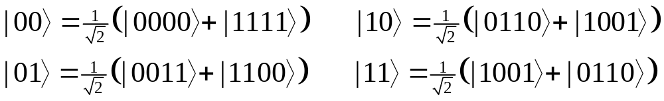
Stabilizer 101(Physics 229)
recall Pauli Stabilizer codes:
“Pauli group P” = set of all tensor products of Pauli spin operators X, Y, Z , I (1, i) (example element: IXXIIIZ)
“Pauli Stabilizer group S” = abelian subgroup of the Pauli group, generated by S_{i}
example: S₁=XXXX, S₂=ZZZZ
“Code” = simultaneous +1 eigenstates of S_{i} elements
for example:

Slide 7
“Normalizer N” = Pauli elements which fix S under conjugation. (N/S = logical operators)
normalizer elements = operations on encoded qubits
Errors which can be detected anticommute with elements of S (for S={I, S₁, S₂, S₁S₂} above: all single qubit errors)

Slide 8
Simple
Keeping it Real Real Simple
[4,2,2] quantum error detecting code: ↑j_{L}|E_{k}|i_{L}= 0 (E_{k} single qubit error)
Stabilizer generators (S_{i}|i_{L}=|i_{L})
S₁=XXXX, S₂=ZZZZ
Logical operators for 2 encoded qubits (|i_{L}= |i₁|i₂)
X₁=XXII, Z₁=IZZI, X₂=IXXI, Z₂=ZZII
Use to understand the spectrum of the Hamiltonian (stabilizer is a symmetry):
H₀=XXII+IIXX+IZZI+ZIIZ ( [H₀,S_{i}]=0 )
H₀=X₁(I+S₁) + Z₁(I+S₂)
( 2nd encoded qubit not envolved)
1
XX
2
ZZ
ZZ
4
XX
3

Slide 9

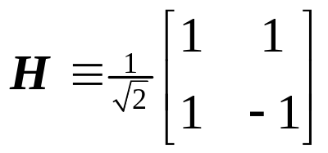
S₁ S₂ H₀= X₁(I+S₁) + Z₁(I+S₂) eigenvalues (E)
+1 +1 2(X₁+Z₁)=2 H₁ 2
+1 1 2X₁ 2
1 +1 2Z₁ 2
1 1 0 0
E
(+1, +1)
+2
(S₁, S₂) label the stabilizer eigenvalues
|0₂, |1₂ label the second encoded qubit
(note extra degeneracy of (1, 1))
(+1, 1)
|0₂
|1₂
(1, +1)
+2
|0₂
|1₂
|0₂
|1₂
( 1, 1)
0
|0₂
|1₂
|0₂
|1₂
(+1, 1)
(1, +1)
2
|0₂
|1₂
(+1, +1)
|0₂
|1₂
2
|0₂
|1₂
degenerate ground state: degeneracy = second encoded qubit

Slide 10
effect of ZIII
E
ALL single qubit errors take degenerate ground state to higher energy levels.
Single qubit errors change value of (S₁,S₂) and hence take ground state to higher energy level.
(S₁, S₂)
(+1, +1)
+2
(+1, 1)
|0₂
|1₂
(1, +1)
+2
|0₂
|1₂
|0₂
|1₂
( 1, 1)
0
|0₂
|1₂
|0₂
|1₂
(+1, 1)
(1, +1)
2
|0₂
|1₂
(+1, +1)
|0₂
|1₂
2
|0₂
|1₂
compare to:
two-level nondegenerate system two-level degenerate system
_{z}: no change of energy
₋: |1 goes to lower energy
₊: |0 goes to higher energy
|1
|0
|1
|0
: no change of energy

Slide 11
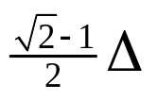
Supercoherence
Ground state = single qubit error detecting code
independent errors…couple to independent baths of temperature T
Bath 1
T
T
Bath 2
:
:
degenerate levels
1
XX
2
ZZ
ZZ
4
XX
3
 = gap
Bath 4
T
Bath 3
|0_{L}
|1_{L}
T
H₀()= (XXII+IIXX+IZZI+ZIIZ)

