Slide 1
Making Decoherence Run Uphill
(carrying 99 lbs., uphill both ways, in the snow)
Institute for Quantum Information Seminar (1/19/01)
Will this hill
ever end?
Dave Bacon
Department of Physics and Department of Chemistry
University of California, Berkeley

Slide 2



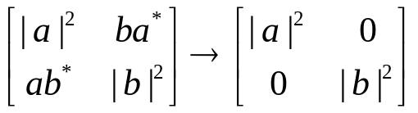

Fight the Gap
Fault-Tolerant Quantum Error Correction
Experimental Coherent Control of Quantum Systems
Great White Decoherence Sharks

Slide 3
Simpleton
Number of qubits
0 (1?)
2
4
everyone must cite Feynman era
good enough to be science fiction era
future era = ? startup explosion?
“few qubit” methods for suppression of decoherence
realistic physical interactions (no ten-body interactions, consider geometry)
tailor to decoherence mechanisms
1
2

Slide 4
Quantum Error Correction Philosophy
prepare
Fix
compute
out
Error
“cold” ancilla
“hot” ancilla
Competetion between errors and cooling
cooling
Make It More Natural?
Kitaev’s
Topological codes.
Majorana Fermions.
smaller scale realistic
versions of these
techniques?

Slide 5
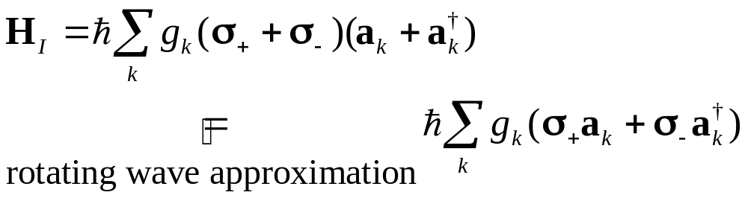
Making Decoherence Work Hard
system
bath
E_{sys}
~
E_{bath}
H_{I} = perturbative system-bath coupling
H_{I} energy small compared to E_{sys} and E_{bath} implies decoherence dominated by pathways that conserve unperturbed energies
|1
“cooling”
|0
|1
“heating”
|1
e^{i}|1
|0
|0
|0
“non-dissipative”

Slide 6

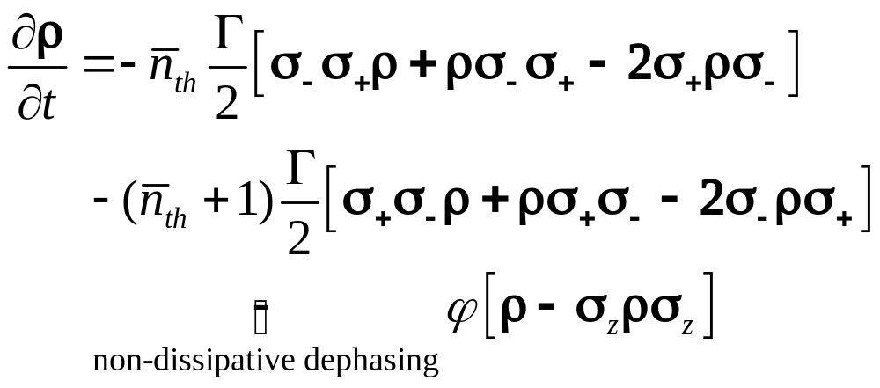

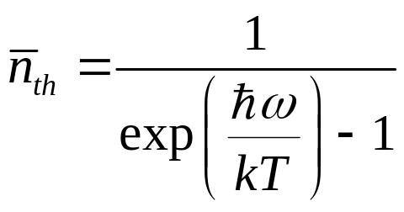
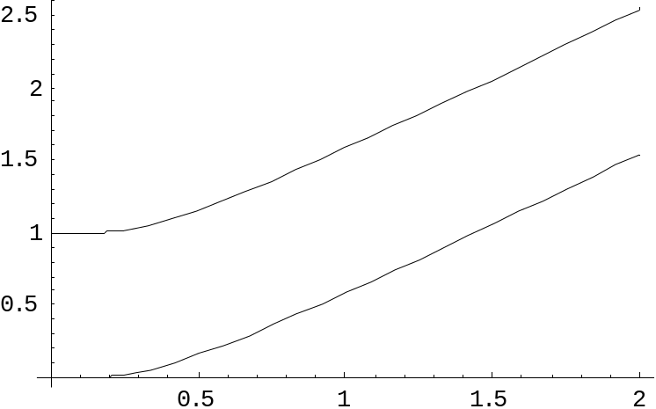

two-level atom radiatively coupled to a thermal reservoir:
“heating”
“cooling”
“non-dissipative”
At low bath temperatures, heating disappears……..
Can We Make All Quantum Errors Run Uphill?

Slide 7
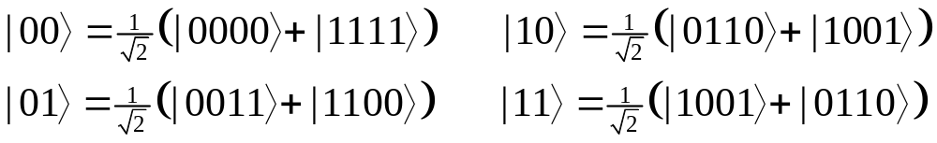
Stabilizer 101(Ph/CS 219)
recall Pauli Stabilizer codes:
“Pauli group P” = set of all tensor products of Pauli spin operators X, Y, Z , I (1, i) (example element: IXXIIIZ)
“Pauli Stabilizer group S” = abelian subgroup of the Pauli group, generated by S_{i}
example: S₁=XXXX, S₂=ZZZZ
“Code” = simultaneous +1 eigenstates of S_{i} elements
example:

Slide 8
“Normalizer N” = Pauli elements which fix S under conjugation. (N/S = logical operators)
normalizer elements = operations on encoded qubits
“Errors which can be detected” anticommute with elements of S
example: S={I, S₁, S₂, S₁S₂} above: all single qubit errors anitcommute with an element of S

Slide 9
Simple
Keeping it Real Real Simple
[4,2,2] quantum error detecting code: ↑j_{L}|E_{k}|i_{L}= 0 (E_{k} single qubit error)
Stabilizer generators (S_{i}|i_{L}=|i_{L})
S₁=XXXX, S₂=ZZZZ
Logical operators for 2 encoded qubits (|i_{L}= |i₁|i₂)
X₁=XXII, Z₁=IZZI, X₂=IXXI, Z₂=ZZII
Use to understand the spectrum of the Hamiltonian (stabilizer is a symmetry):
H₀=XXII+IIXX+IZZI+ZIIZ ( [H₀,S_{i}]=0 )
H₀=X₁(I+S₁) + Z₁(I+S₂)
( 2nd encoded qubit not envolved)
1
XX
2
ZZ
ZZ
4
XX
3

Slide 10

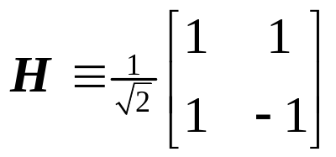
S₁ S₂ H₀= X₁(I+S₁) + Z₁(I+S₂) eigenvalues (E)
+1 +1 2(X₁+Z₁)=2 H₁ 2
+1 1 2X₁ 2
1 +1 2Z₁ 2
1 1 0 0
E
(+1, +1)
+2
(S₁, S₂) label the stabilizer eigenvalues
|0₂, |1₂ label the second encoded qubit
(note extra degeneracy of (1, 1))
(+1, 1)
|0₂
|1₂
(1, +1)
+2
|0₂
|1₂
|0₂
|1₂
( 1, 1)
0
|0₂
|1₂
|0₂
|1₂
(+1, 1)
(1, +1)
2
|0₂
|1₂
(+1, +1)
|0₂
|1₂
2
|0₂
|1₂
degenerate ground state: degeneracy = second encoded qubit
Non-additive code

Slide 11
effect of ZIII
E
ALL single qubit errors take degenerate ground state to higher energy levels.
Single qubit errors change value of (S₁,S₂) and hence take ground state to higher energy level.
(S₁, S₂)
(+1, +1)
+2
(+1, 1)
|0₂
|1₂
(1, +1)
+2
|0₂
|1₂
|0₂
|1₂
( 1, 1)
0
|0₂
|1₂
|0₂
|1₂
(+1, 1)
(1, +1)
2
|0₂
|1₂
(+1, +1)
|0₂
|1₂
2
|0₂
|1₂
compare to:
two-level nondegenerate system two-level degenerate system
_{z}: no change of energy
₋: |1 goes to lower energy
₊: |0 goes to higher energy
|1
|0
|1
|0
: no change of energy

Slide 12
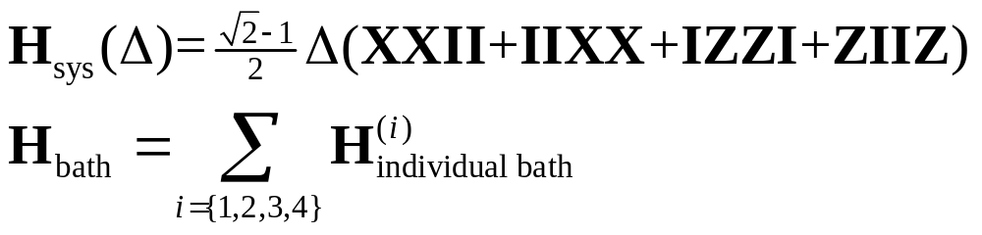
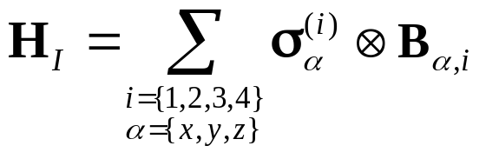
Supercoherence
Ground state = single qubit error detecting code
independent errors…couple to independent baths of temperature T
Bath 1
T
T
Bath 2
:
:
degenerate levels
1
XX
2
ZZ
ZZ
4
XX
3
 = gap
Bath 4
T
Bath 3
|0_{L}
|1_{L}
T
Interaction picture + rotating wave: all single qubit (with individual baths) decoherence processes must be “heating” processes: exponential suppression at low temperatures!
Acts on i^{th} bath
Acts on i^{th} qubit

Slide 13
To Compute or Not to Compute
Information encoded in the second logical qubit.
Manipulation of this information can be obtained by control over these two-body interactions:
X₂=IXXI, Z₂=ZZII
control via turning on and off these interactions with strength 
gap is shrunk by turning on the control Hamiltonian
gap =  c , speed of operations = ,
decoherence rate  exp(gap/kT)
number of operations in a decoherence time   exp(( c  )/kT)
maximum when   kT: number of operations still exponential in T
ZZ
1
XX
2
XX
ZZ
ZZ
4
XX
3

 c 
|a_{L}
|0_{L}, |1_{L}

|b_{L}

Slide 14
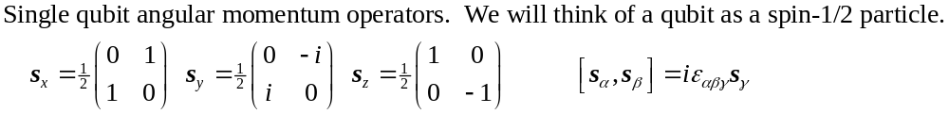
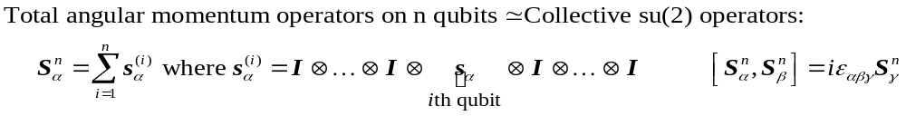
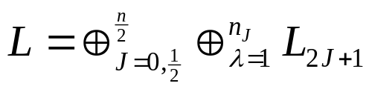
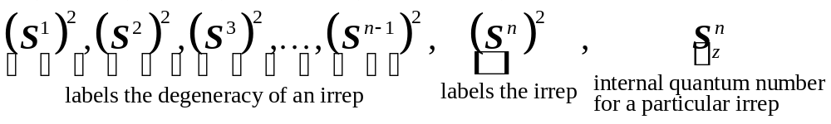
More Than One Qubit?...
Lie algebra su(2)
n_{J} = degeneracy of Jth irrep
2J+1 dimensional irreducible representation of su(2)
J labels irrep
● labels degeneracy
Complete set of commuting observables on n qubits:

Slide 15









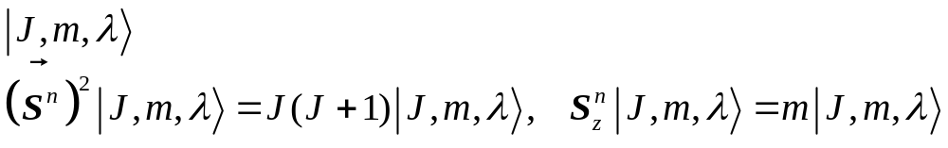
1
create a spin-J particle out of n spin-1/2 particles
degeneracy = different routes to such a construction
1
1
5
1
4
1
1
3
9
1
1
1
3
1
2
5
3
3
1
2
5
3
3
1
2
3
4
5
6
3
5
Basis:
5
Information encoded into the degeneracy index  is immune to collective errors: noiseless (decoherence-free) subsystem
Emanuel Knill, Raymond Laflamme, Lorenza Viola, Phys. Rev. Lett. 84, 2525 (2000)

Slide 16
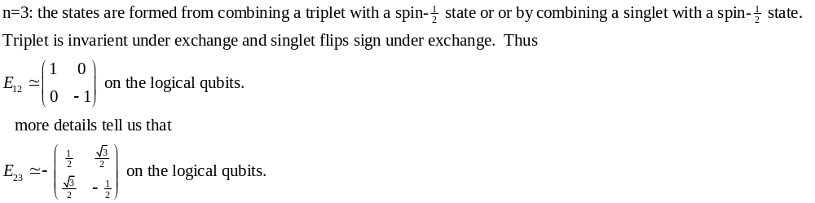


Computing on the Degeneracy
Heisenberg coupling between i^{th} and j^{th} qubits:
Heisenberg coupling between qubits can be used to perform any operation on the degeneracy index .
Heisenberg = exchange interaction = changes order of addition of angular momentum.
Bacon, Kempe, Lidar, and Whaley, PRL 85 (2000) 1758.
Kempe, Bacon, Lidar, and Whaley, accepted for publication in PRA, quant-ph/0004064

Slide 17
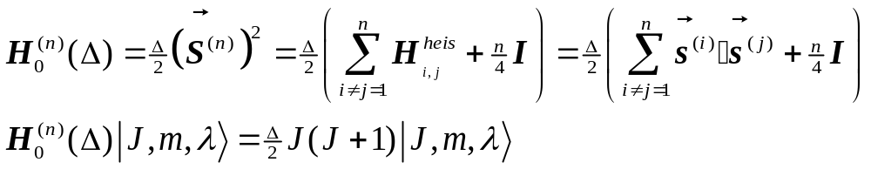



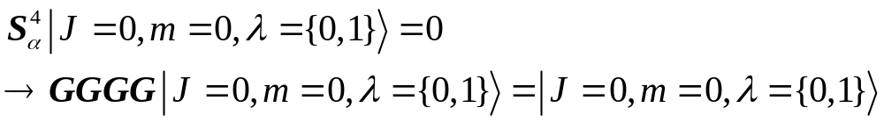
Another Supercoherent Qubit
1
2
n=4
4
3
2

“Supercoherent Quantum Bits” Bacon, Brown, and Whaley quant-ph/0012018 (2000) submitted to PRL
Ground state J=0 stabilized by collective operations implies
all single qubit operators take states to higher energy levels

Slide 18
Exchange Supercoherent Qubits
n=even single qubit allowed transitions
Exchange is universal on the degeneracy of each J irrep
J=n/2
:
1
2
Encoded qubit 1
:
J=2
4
3
J=1
5
6
Encoded qubit 2
J=0
8
7
Computing on two conjoined encoded qubits
turn on extra exchange interactions between all 8 to make the supercoherent n=8 Hamiltonian
compute using additional exchanges
(respect gap condition)

Slide 19
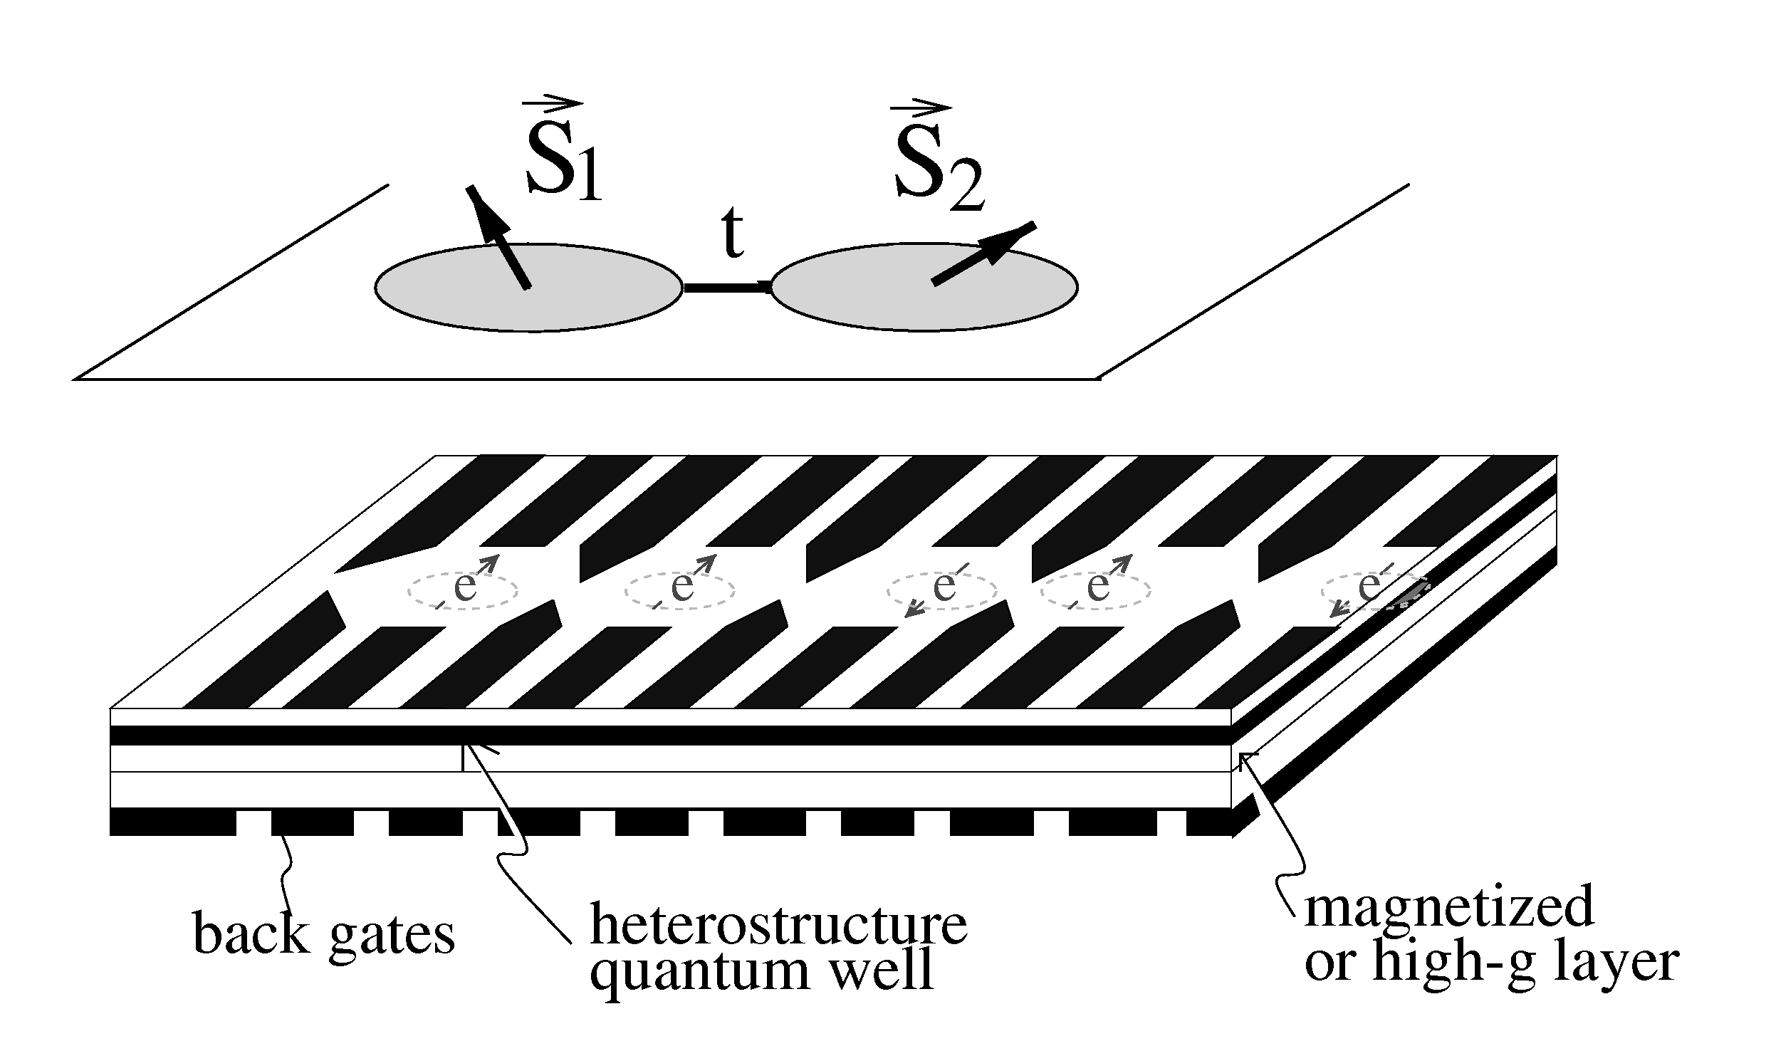
Spintronic Quantum Computer
D.P. DiVincenzo, G. Burkard, D. Loss, E.V. Sukhorukov, in Quantum Mesoscopic Phenomena And Mesoscopic Devices In Microelectronics, eds. I.O. Kulik and R. Elliatioglu (NATO Advanced Study Institute, Turkey) 1999
qubit = spin of single electron
exchange interaction between qubits used for two-qubit interaction: tuned by raising and lowering barrier between dots to change overlap.
coupling strength: on 0.1 meV, off many orders of magnitude smaller
at temperatures below 1 K supercoherence
difficulty of geometry for n=8
- combine vertical and lateral coupling schemes?

Slide 20
“As long as you’re going to think anyway, think big” - Donald Trump
XX
XX
XX
XX
XX
ZZ
ZZ
ZZ
ZZ
ZZ
XX
XX
ZZ
ZZ
ZZ
ZZ
XX
XX
Ground state is a quantum error correcting code (non-additive)
encodes 1 qubit of information in a single error detecting code

Slide 21
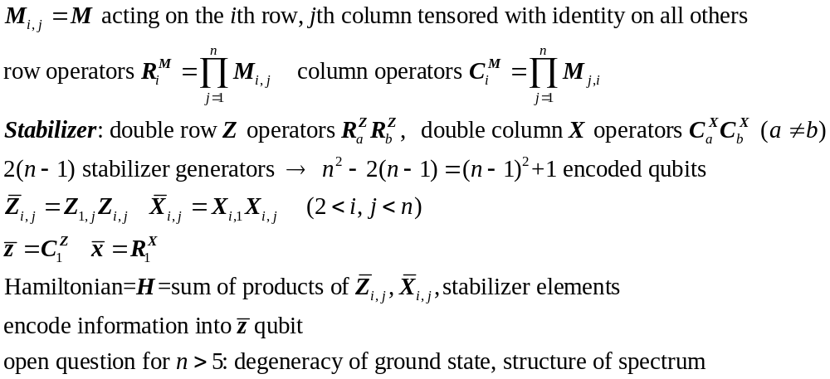
j
n by n Rectangular Toric lattice with qubits on vertices
XX coupling between qubits on adjacent columns, same row
ZZ coupling between qubits on adjacent rows, same column
i

Slide 22
Instant Replay
general idea: make decoherence mechanisms run uphill
two qubit interactions used to construct a ground state for which any single qubit operation takes the system to a higher energy level (supercoherence)
two qubit interactions understood using Pauli stabilizer symmetry
exchange supercoherence allows for a fully universal quantum computer with realistic interactions and (pseudo-realistic) geometry
quantum error correcting ground state
Work done in collaboration with
Professor K. B. Whaley (U. C. Berkeley, Chemistry)
Kenneth Brown (graduate student, U. C. Berkeley, Chemistry)
“Supercoherent Quantum Bits”, Bacon, Brown, and Whaley quant-ph/0012018 (2000)

Slide 23
Thoughts I Think I Think
- finite bit simulations of entanglement (Brassard, Cleve, Tapp)
- continuous time versions of quantum algorithms (Farhi, Gutmann)
- noiseless (decoherence-free) subspaces, subsystems (Zanardi, Lidar, etc.)
- applications of “the ideas of information” to physics (opposite of quantum computation?)
Dave Bacon
visiting Institute for Quantum Information
Jan.17 - Feb. 14, April 9 - April 27
Office: 305 Steele
contact: dabacon@holmium.cchem.berkeley.edu
tidbit of the day: Is “laws of physics same in all reference frames” equivalent to “value of a bit the same in all reference frames”?

