Slide 1
Symmetry and Decoherence in
Quantum Computers
Qualifying Exam Talk
March, 2001
Dave Bacon
Department of Physics
University of California, Berkeley
Whaley group (Department of Chemistry)

Slide 2
Outline
Motivation
Quantum error correction
Decoherence and symmetry
Decoherence-free subspaces and subsystems
Fault-tolerant Quantum Computation
Fungible quantum information
Conclusion

Slide 3
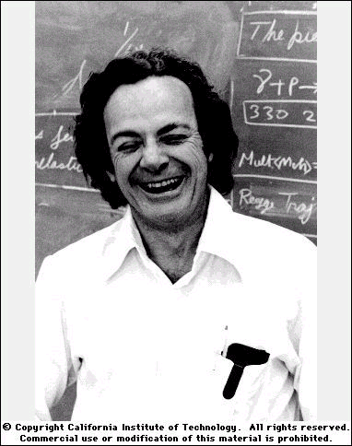
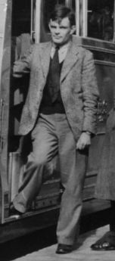
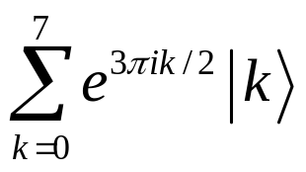
Information is Physical + Physics is Quantum
= Quantum Computation
Quantum information processor (unbeautified model)
information: states of multiple quantum systems
qubit: |0, |1: pure state is |=|0+|1
qubits: pure state is |=_{k}c_{k}|k n qubits = 2^{n} basis states
manipulation of information: 1. unitary action (gates)
2. measurements
Feynman
Turing
|1
H
S
T
input
H
output
|6=
|1
S
|0
H
Quantum Fourier Transform on 3 qubits

Slide 4
Why Quantum Compute?
Quantum computers can compute algorithmically faster
(provable vs classical computation relative to an oracle)
Grover’s search algorithm, Shor’s factoring algorithm
Distributed computation requires less communication vs classical
two parties (one with x, one with y) wish to compute f(x,y)
# bits of communication required is less in quantum world
Efficient simulation of quantum systems
    fermions, bosons, topological quantum field theories, ….
Quantum cryptography: provably secure key distribution

Slide 5

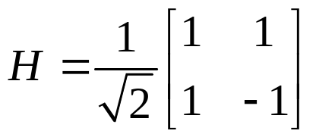

Sample Quantum Communication Complexity
B: y₀y₁
A, B, C each given a two bit string
guarantee: x₀y₀z₀{000, 011, 101, 110}
f(x,y,z)= x₁y₁z₁(x₀y₀z₀) ( is OR)
A: x₀x₁
C: z₀z₁
Parties share 1 qubit of tripartite
Each party: if first bit u₀=1 then apply to given qubit
Each party: measure given qubit (a,b,c)
abc= x₀y₀z₀
Parties broadcast- A: (x₁a) B: (y₁b) C: (z₁c)
(x₁a)(y₁b)(z₁c)= x₁y₁z₁(x₀y₀z₀) f(x,y,z) with 3 bits
classical result requires: 4 bits
action on
Buhrman, Cleve, Tapp 1997

Slide 6
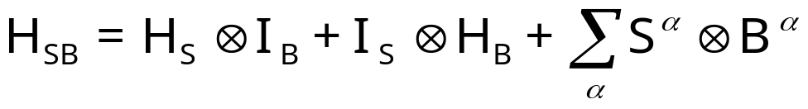
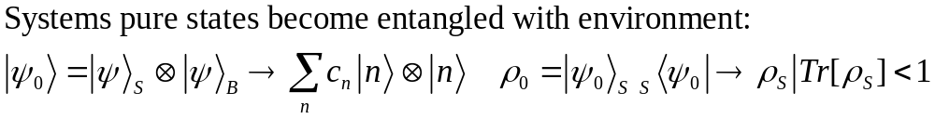
Great Benefits! Why Not Quantum Compute?
Real quantum systems are open quantum systems!
system
bath
full Hamiltonian:
Interaction causing
DECOHERENCE
System evolution
Bath evolution
Expansion into
system and bath
operators
System evolution is no longer unitary
Coherent properties of system’s quantum information lost

Slide 7
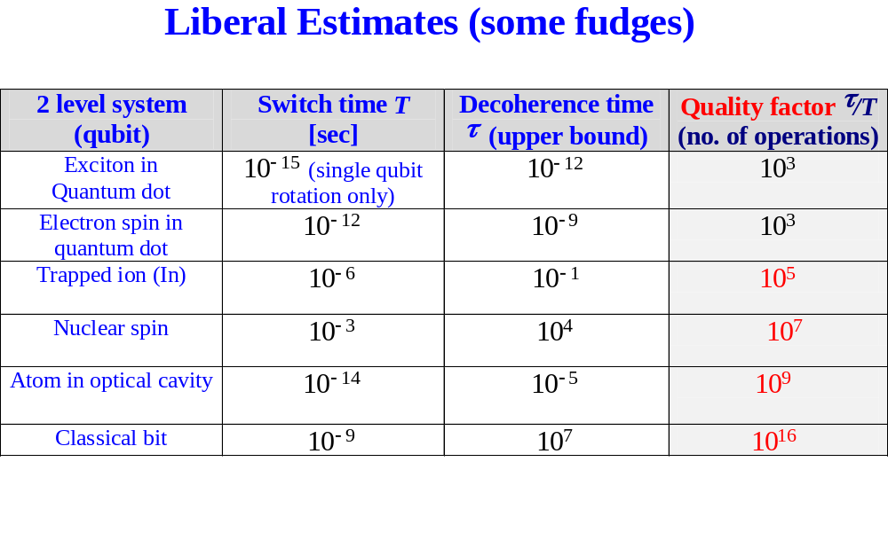
Is Decoherence Really a Problem?
!!
!!
Decoherence problem
not much can be done before quantum information is destroyed

Slide 8
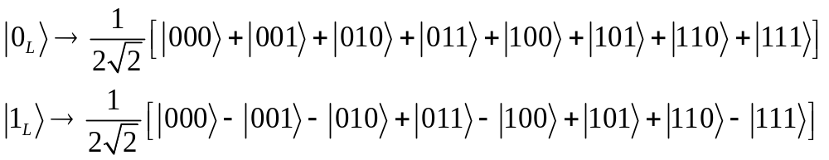

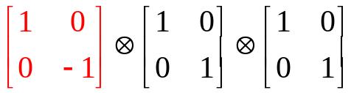
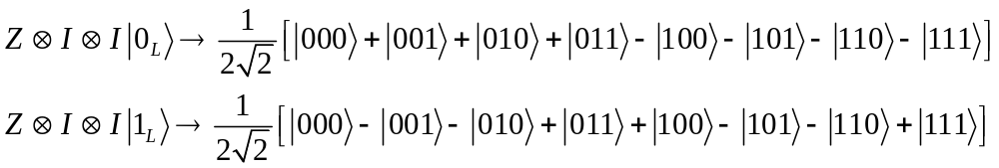
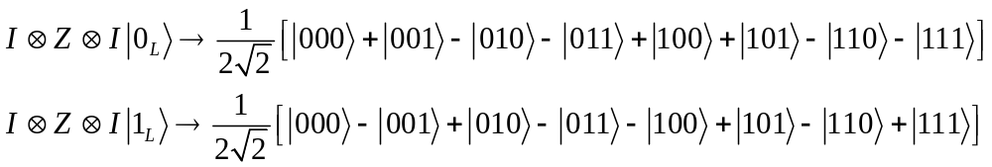
Encoding
Quantum information can be encoded, for example
Quantum information can now be stored as
Single phase error can now be fixed!
can be distinguished from

Slide 9


Quantum Error Correction
Quantum Computation
|Φ>
decode
fix error
unitary
“encoder”
|Φ>
error
|Ω>
measure, diagnose error
entropy dump
(cool ancillas)
extra qubits for encoding
cold ancilla qubits
errors have been “digitized”: expanded in a basis which picks out the “most likely” errors
independent decoherence: qubits couple to independent baths
errors take codewords to orthogonal subspace (diagnosable!)

Slide 10
Threshold for Quantum Computation
code level 1
Concatenate k levels of codes.
code level 2
Error rate p cp² at each level of concatenation.
Fail with probability (cp)^{2k}/c. Can make arbitrarily small if p<1/c=p_{threshold}
1
2
k
protected
protected
protected
error rate competes with volume of protected states
Threshold Theorem: if quality factor is > 10⁴ to 10⁶, no decoherence

Slide 11
Decoherence Models
qubits
Threshold theorem holds for
“independent decoherence”
baths
Correlated errors are “small” (at least “smaller” as # qubits increases)
How generic?
as spacing betweeen qubits gets smaller:
independent environments??
coupling of qubits to a field:
if qubit space << wavelength
then field cannot distinguish qubits
CAN DIFFERENT DECOHERENCE MECHANISM BE EXPLOITED FOR QUANTUM COMPUTATION?

Slide 12
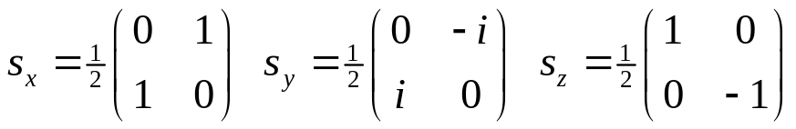
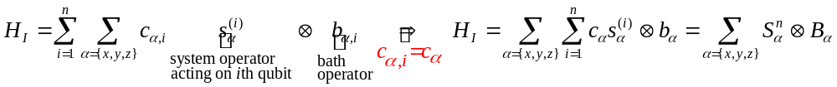
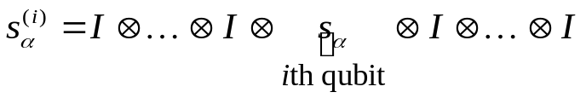
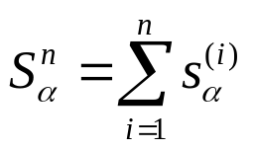


Collective Decoherence
spins coupled to bath field, N qubits
Bath mode with a wavelength much longer than the inner qubit spacing
system-bath Hamiltonian
collective spin operators:
bath couples identically to each qubit
su(2) Lie algebras

Slide 13
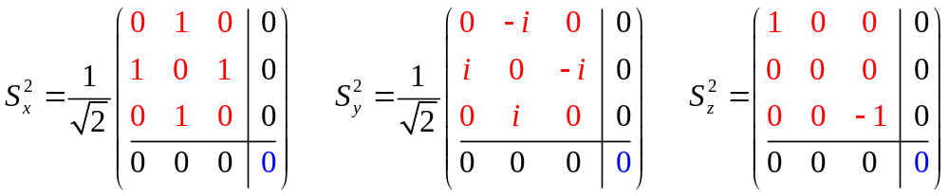
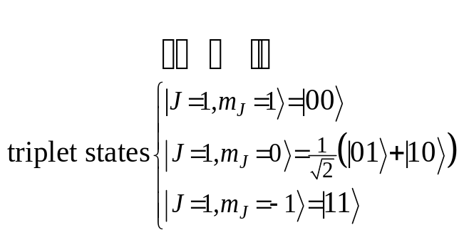
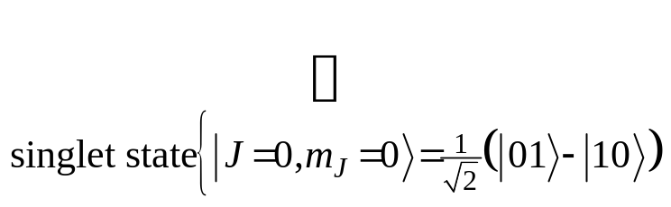
Just Angular Momentum Addition
Collective su(2) for n=2 qubits:
red is the 3 dimensional irreduciple representation of su(2) (J=1)
blue is the 1 dimensional irreduciple representation of su(2) (J=0)
simple addition of angular momentum…
nothing to see here, but:
spin 1
spin 1/2
+
spin 1/2
spin 0

Slide 14
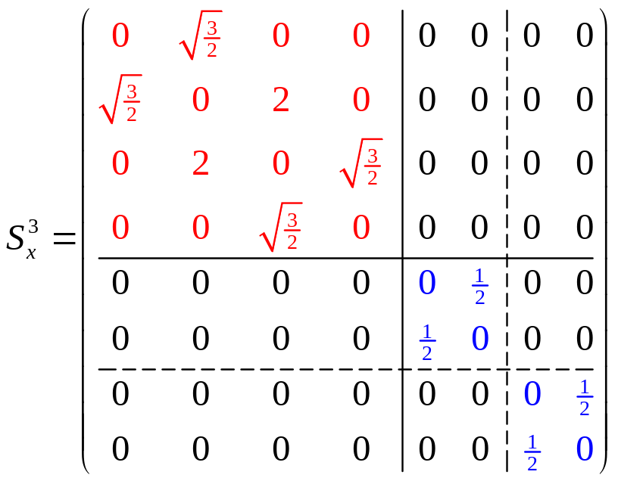
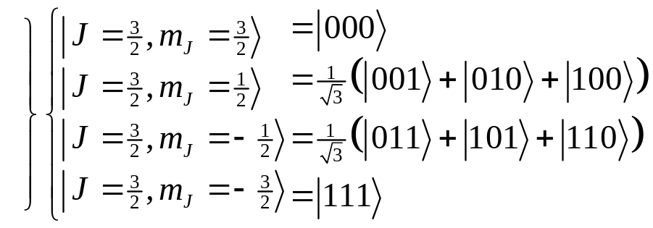
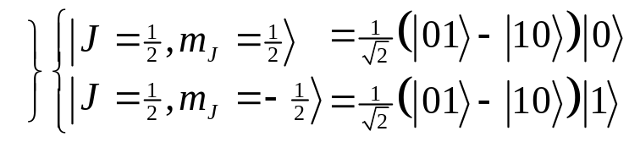
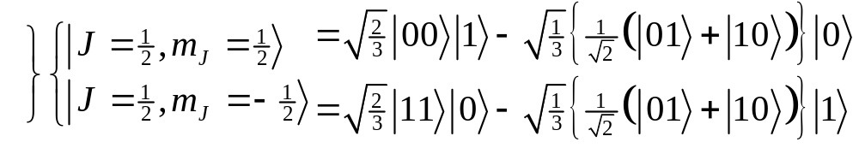
Degeneracy
Something special happens with n=3:
spin-1 (triplet) plus spin-1/2 can produce either a spin-1/2 or a spin-3/2.
spin-0 (singlet) plus spin-1/2 can produce spin 1/2.
These spin-1/2 states come from combining a spin-0 two qubit state and a spin-1/2 single qubit state
These spin-1/2 states come from combining a spin-1 two qubit state and a spin-1/2 single qubit state
There is a DEGENERACY in the action of the 3 qubit collective su(2) operation.

Slide 15
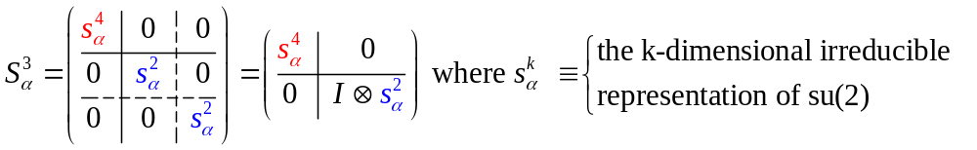
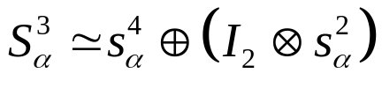

Degeneracy Implies Safety

protected qubit
unprotected qubit
Information encoded into the DEGENERACY is immune to collective decoherence
(KLV) Emanuel Knill, Raymond Laflamme, Lorenza Viola, Phys. Rev. Lett. 84, 2525 (2000)

Slide 16
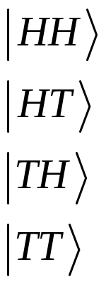
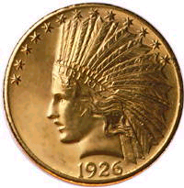
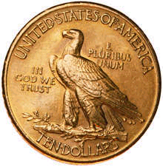
Classical Example
clumsy hands channel: both coins get fipped with probability p
(1-p)
+p
|coin 1, coin 2 
|parity,coin 1
Information can be immune to this channel if
encode into the parity
|1H=
|1T=
|0H=
|0T=
|parity=|0 if coins differ, |parity=|1 if coins same

Slide 17
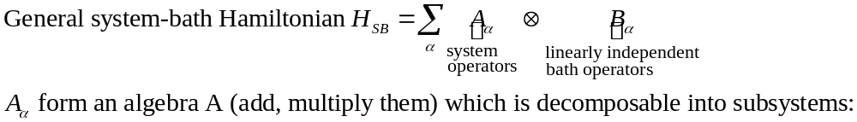
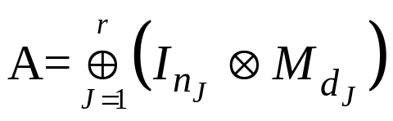


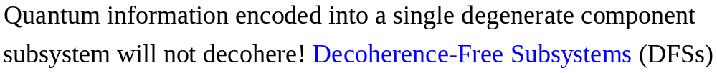
Decoherence-free Subsystems (KLV)
“The universe is an enormous direct product of representations of symmetry groups” - Steve Weinberg
for open system becomes
“The universe is an enormous direct product of full matrix algebras” - not Steve Weinberg
(KLV) Emanuel Knill, Raymond Laflamme, Lorenza Viola, Phys. Rev. Lett. 84, 2525 (2000)

Slide 18






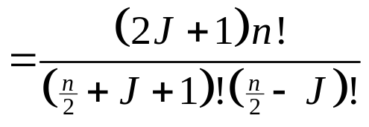



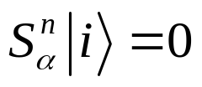
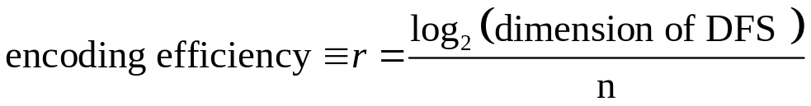
Collective DFSs
1
1
Degeneracy of the n qubit, total angular momentum J collective su(2) operators
= dimension of quantum information which can be encoded into the corresponding DFS.
1
6
1
5
1
4
14
1
3
9
1
2
5
14
The J=0 irreps of su(2) are 1 dimensional Decoherence-Free Subspaces.
1
2
5
1
2
3
4
5
6
7
however, physical collective DFS only for small n.

Slide 19
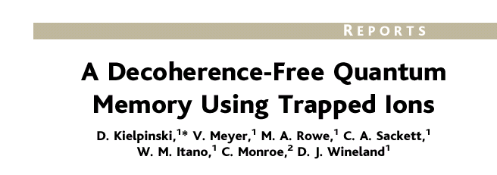
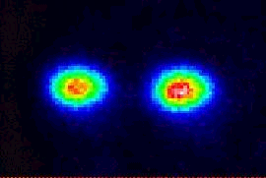
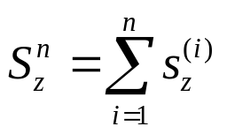

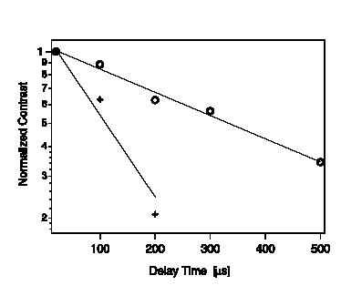
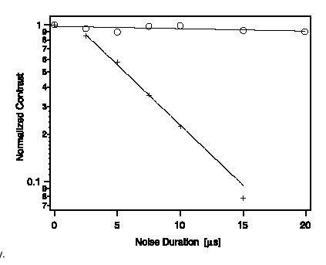


Experimental Demonstration
collective phase errors:
engineered noise (detuned laser)
ambient conditions!
(see also Kwiat et al., Science 2000)
DFS
non-DFS

Slide 20
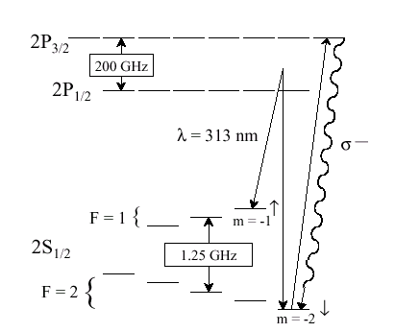
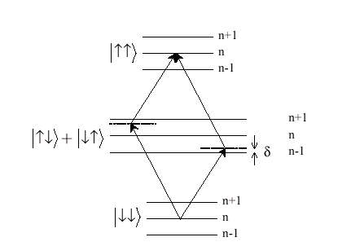
Ion Trap Experiment
⁹Be⁺
|1
center of mass motion used as a bus to couple ions: ~5 MHz
|0

Slide 21
Using DFSs in Quantum Computers
Philosophy:how can the collective DFSs be used to build a quantum computer?
How to analyze perturbing interactions? (Do they make DFSs useless?)
How to work with error correction? (Can DFSs be used in error correcting codes?)
How can one compute on a DFS? (Can leaving a DFS be avoided?)
How do DFSs fit in with fault-tolerant quantum computation? (Fault-tolerant measurements?)

Slide 22



Poking DFSs
perturb a DFS with strength :
DFS
●
g >>  : g terms in perturbation could be huge?
DFSs are robust to perturbations to first order: g terms vanish
Lindblad master equation (markovian approximation)
Exact operator sum representation (no markovian approximation)
Lidar, Chuang, Whaley, PRL 81, 2595 (1998)
Bacon, Lidar, Whaley, PRA 60, 1944 (1999)

Slide 23
Concatenation of DFS in QECC
Philosophy: “USE SYMMETRY FIRST!”
DFS encoded
Quantum Error Correcting Code
Issues:
symmetry breaking decoherence couple to symmetric decoherence?
leakage detectection?
quantum computation on encoded states?
POKING: OK
DFS
non-DFS
leakage OK in: Lidar, Bacon, Whaley, PRL 82, 4556 (2000)

Slide 24
Universal Quantum Computation on DFS?
Problem: given a subsystem is it possible to perform computation on the encoded information?
Existential result: always possible
Real world result: using two-body interactions?
respecting geometry?
Computation on a subsystem of dimension d
= ability to perform su(d) rotation to good accuracy
More general question for quantum information:
what interactions do we need to quantum compute?

Slide 25

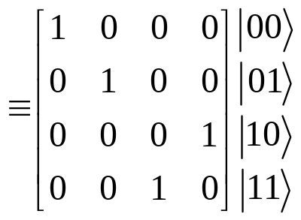

The Standard
SU(2)
SU(2)
The Royal King and Queen of Universal Quantum Gates
CNOT and 1-qubit rotations
Combining CNOT and 1-qubit rotations on n qubits gives su(2^{n})

Slide 26
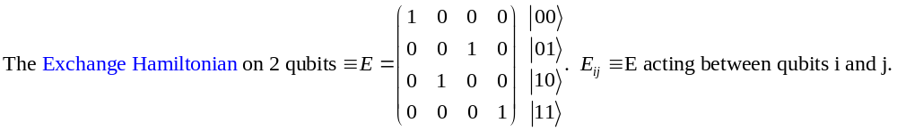
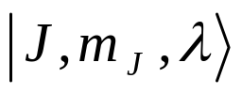
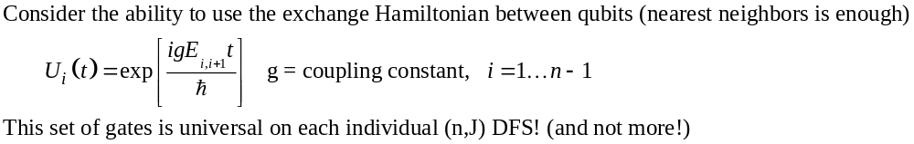
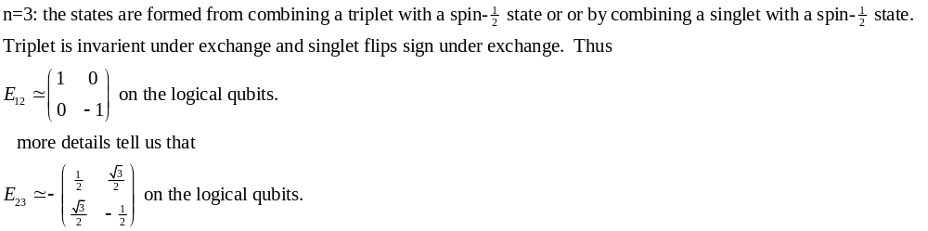


Exchange’s Universality?
Exchange does not change J or m_{J}, does mix degeneracy!

Slide 27



Exchange’s Universality
3
1
Can perform su(d)’s on each of the DFSs
encode information into the DFSs and the EXCHANGE interaction can be used to perform any su(d) on each of the DFSs (for a given n) independently!
su(d) means we have a d dimensional Hilbert space (encoded) and we can perform all unitary manipulations on this d dimensional Hilbert space!
2
5
1
9
5
0
1
2
3
4
5
6
Trick to proof: pathway in one-to-one correspondence with degeneracy
fault-tolerant quantum computation on collective DFSs:
Bacon, Kempe, Lidar, Whaley, PRL 85, 1758 (2000)
Kempe, Bacon, Lidar, Whaley, to appear in PRA (2001)

Slide 28
Quantum Information is Fungible
Fungible adj. (New Latin fungibilis, from Latin fungi to perform) 1. being of such a nature that one part or quantity may be replaced by another equal part or quantity in the satisfaction of an obligation. 2. interchangable.
Value of classical information is independent of the medium:
spin of millions of electrons
presence or absence of a chad[1]
etc.
Classical information is fungible. (can be encoded)
Quantum information is fungible. (can be encoded)
[1] U.S. Supreme Court case no. 00-949, George W. Bush vs. Albert Gore Jr.

Slide 29
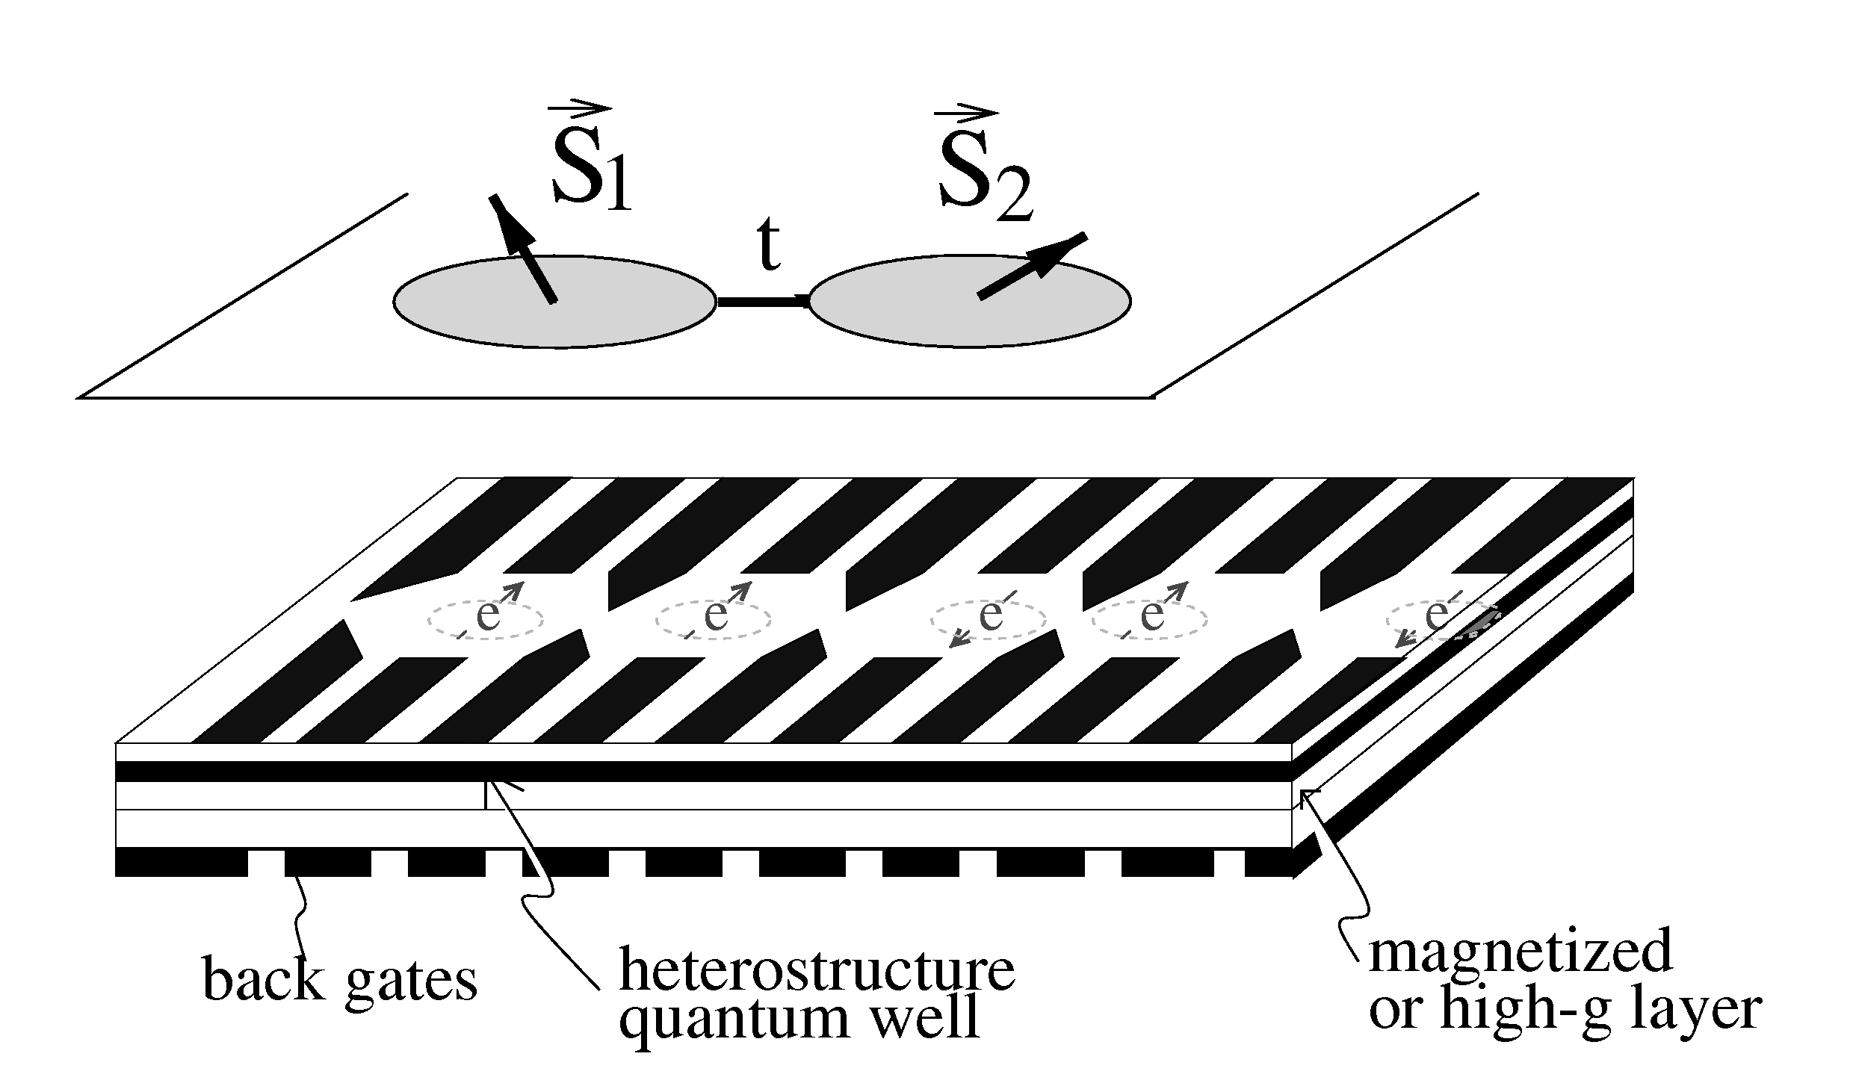
Spintronic Quantum Computer
D.P. DiVincenzo, G. Burkard, D. Loss, E.V. Sukhorukov, in Quantum Mesoscopic Phenomena And Mesoscopic Devices In Microelectronics, eds. I.O. Kulik and R. Elliatioglu (NATO Advanced Study Institute, Turkey) 1999
qubit = spin of single electron
exchange interaction between qubits used for two-qubit interaction: tuned by raising and lowering barrier between dots to change overlap.
coupling strength: on 0.1 meV, off many orders of magnitude smaller
single qubit gates need to supplement exchange to make “fully universal”
single qubit gates = huge demands on g-factor engineering, strong inhomogeneous magnetic fields, slow microwave manipulations.

Slide 30
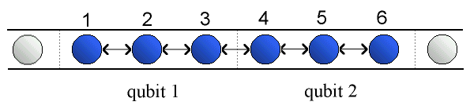
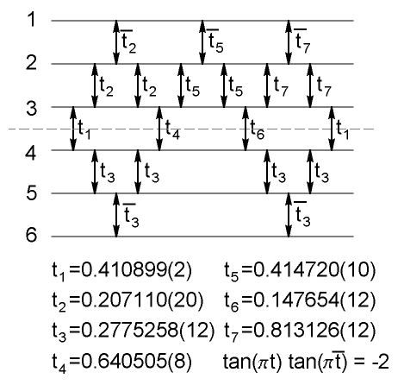

Fungible Nature = Encoded Universality
Nearest neighbor exchange coupling
exchange gate
i
j
DiVincenzo, Bacon, Kempe, Burkard, Whaley, Nature 408, 339 (2000)
Tradeoffs
factor of 3 in space
factor of ~ 10 time

Slide 31


What is Necessary to Quantum Compute?
Hey I found this new quantum system with these crazy interactions. Can I quantum compute?
“Encoded universality” changes the rules for physical implementations of quantum computers
Exchange is universal with a bit of encoding
Other interactions besides exchange have similar properties (simple application of representation theory of Lie algebras: take it to your local particle theorist for a quick answer!)
Controlled-Not and single qubit gates are not the only way to build a quantum computer!
SU(2)

Slide 32



The Future: Supercoherence
exchange
n=4
1
2
2
4
3

degenerate ground state
All single qubit operators must take J=0 to J=1 states (selection rule)
Low bath temperatures, single qubit errors must heat system
_{z}: no change of energy
₋: |1 goes to lower energy
₊: |0 goes to higher energy
|1
|0
|1
|0
: no change of energy

Slide 33
Conclusion
Decoherence-free subsystems use symmetry of system-bath coupling to avoid decoherence
Use symmetry first: concatenate DFSs into quantum error correction codes
DFSs robust to perturbation
Fault-tolerant quantum computation on collective DFSs
Exchange has “encoded universality”
Fungible nature of quantum information impacts engineering of quantum computer architectures

