Slide 1

Quantum Computing with the Exchange Interaction
spin quantum computers without single spin control
Dave Bacon
Department of Physics and Department of Chemistry
University of California, Berkeley
work done in collaboration with:
David P. DiVincenzo (IBM, T. J. Watson Research Center)
Julia Kempe (Berkeley, Mathematics)
Daniel A. Lidar (University of Toronto, Chemistry)
K. B. Whaley (Berkeley, Chemistry)
Guido Burkard (University of Basel, Physics)

Slide 2
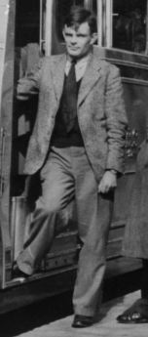
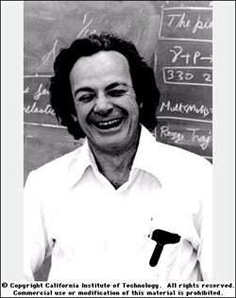
Cult of Universality
Turing Machine: basic computing machine that quantifies our notion of “carrying out an algorithmic task”
Universal Turing Machine: Turing machine which can be used to efficiently simulate any Turing machine.
but…. “Information is physical”
+ “Nature is quantum mechanical” =
Theory of Computation based on Quantum Mechanics
Universal Quantum Computer: physical device which can be used to efficiently simulate any “algorithmic task” carried out on information presented in a quantum system
(Feynman, Deutsch, Benioff, Barenco, Ekert, Yao, DiVincenzo, Lloyd, Kitaev, Solovay)
Alan
Turing
Richard
Feynman

Slide 3
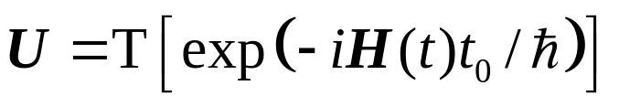
Universal Sets of Quantum Gates
Quantum Circuit Model
wire = carrier of quantum information (qubit {|0, |1}, qudit {|0, |1,…., |d}
gate = time evolution of the quantum information
Universal Sets of Quantum Gates
A set of gates G is a universal set of gates if
each U_{i}G acts on a bounded number of qubits (locality)
any quantum circuit (performing any desired unitary operation) can be efficiently simulated to arbitrary accuracy by a circuit with gates in G
(arbitrary accuracy: arbitrary distance(U,V) =max|||(U-V)|||)
U

Slide 4
Information is Fungible
Fungible adj. (New Latin fungibilis, from Latin fungi to perform) 1. being of such a nature that one part or quantity may be replaced by another equal part or quantity in the satisfaction of an obligation. 2. interchangable.
Value of classical information is independent of the medium:
spin of millions of electrons
presence or absence of a chad[1]
etc.
Classical information is fungible. (can be encoded)
Quantum information is fungible. (can be encoded)
[1] U.S. Supreme Court case no. 00-949, George W. Bush vs. Albert Gore Jr.

Slide 5
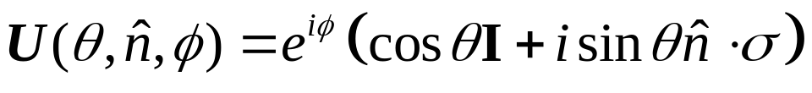
The Stereotypical Quantum Comptuer
1. Physical identification of qubits (spin, hyperfine levels, etc.)
2. Interactions for single qubit gates
(phase  is not relevant)
3. Interactions for a non-trivial two-body gate (controlled-not gate, controlled-phase gate, etc.)
|0|0|0|0, |0|1|0|1,
|1|0|1|1, |1|1|1|0,
controlled-not
+ = universal set of quantum gates
SU(2)

Slide 6
Encoded Universality
Physical System  single qubit gates + CNOT
independent of systems natural talents (fast, robust interactions)
only need to simulate a quantum circuit  encode the quantum information
many interactions between qubits are not “fully universal” but can be made universal with a little bit of encoding: “encoded universal”
“fully universal”: unit space efficiency - gates acting on n qubits can be used to implement any unitary gate on n qubits
“encoded universal”: non-unit space efficiency - gates acting on n qubits can be used to simulate unitary gates on En qubits (E=encoding efficiency)

Slide 7
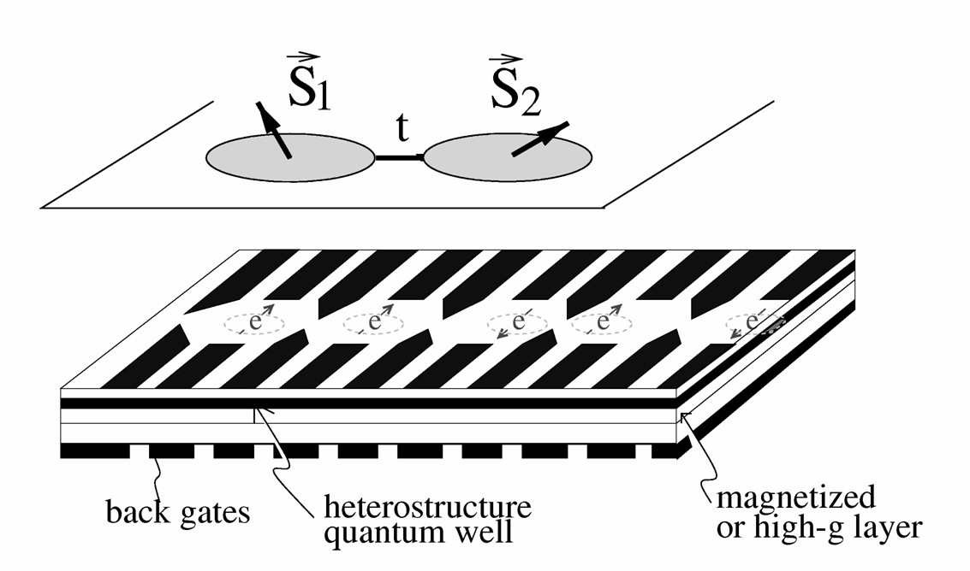
Spintronic Quantum Computer
D.P. DiVincenzo, G. Burkard, D. Loss, E.V. Sukhorukov, in Quantum Mesoscopic Phenomena And Mesoscopic Devices In Microelectronics, eds. I.O. Kulik and R. Elliatioglu (NATO Advanced Study Institute, Turkey) 1999
qubit = spin of single electron
exchange interaction between qubits used for two-qubit interaction: tuned by raising and lowering barrier between dots to change overlap.
coupling strength: on 0.1 meV, off many orders of magnitude smaller
single qubit gates need to supplement exchange to make “fully universal”
single qubit gates = huge demands on g-factor engineering, strong inhomogeneous magnetic fields, slow microwave manipulations.

Slide 8
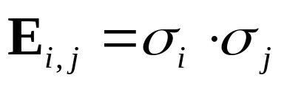
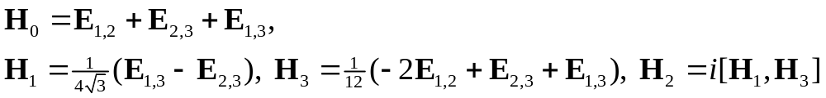
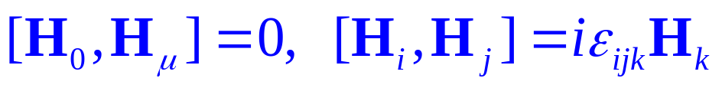
Exchange Alone Universal?
Exchange (Heisenberg) coupling between qubits i,j:
three qubits:
such that
Question: Given a set of interaction Hamiltonians H_{i}, what operations can be performed by turning on and off these interactions?
Answer: interactions in the Lie algebra generated by the H_{i} (Lloyd, DiVincenzo, Deutsch et. al.)
su(2)!
Abelian invariant subalgebra = irrelevant phase

Slide 9
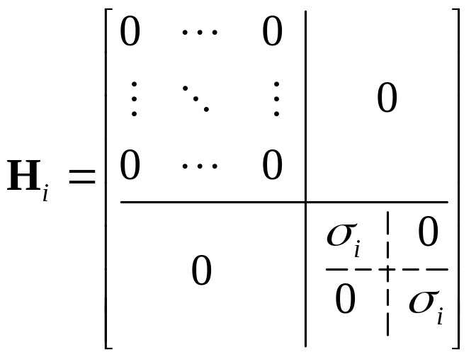
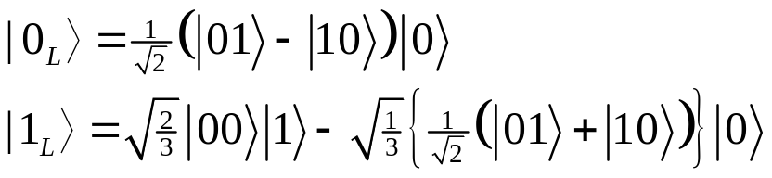
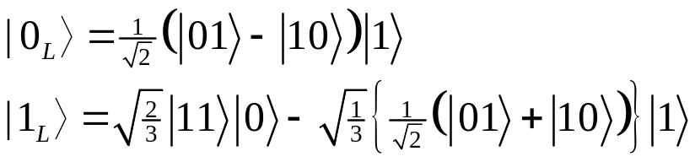
Encoded Action
4 fold degenerate, 1 dimensional irreducible representation of su(2)
2 fold degenerate, 2 dimensional irreducible representation of su(2)
Encode one qubit of information into three physical qubits:
H_{i} acts as _{i} on these encoded qubits
or

Slide 10
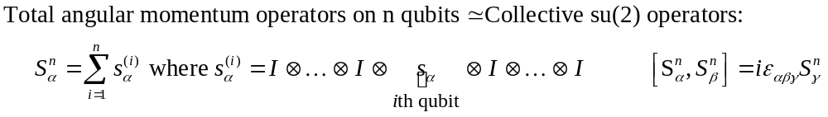








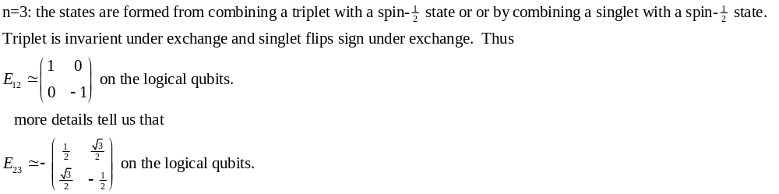


1
1
Degeneracy in the creation of a spin-s particles out of n spin-1/2 particle = encoded qubits
Exchange commutes with total angular momentum operators, but mixes degeneracy: changes order of addition of angular momentum!
1
5
1
4
1
3
9
1
2
5
1
2
5
1
2
3
4
5
6

Slide 11
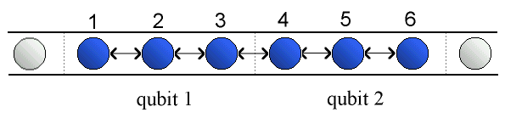
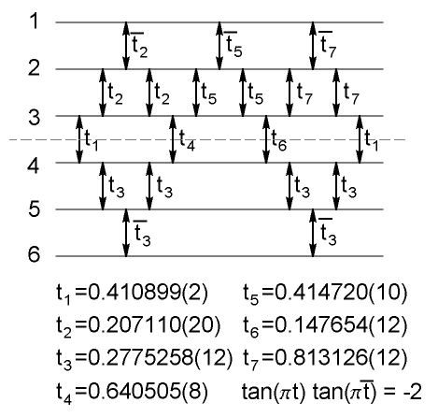

Explicit Gate Construction
Nearest neighbor exchange coupling
How to couple encoded qubits?
exchange gate
i
j
DiVincenzo, Bacon, Kempe, Burkard, Whaley, Nature 408, 339 (2000)
Tradeoffs
factor of 3 in space
factor of ~ 10 time

Slide 12


What Do I Need To Quantum Compute?
Hey I found this new quantum system with these crazy interactions. Can I quantum compute?
“Encoded universality” changes the rules for physical implementations of quantum computers
Exchange is universal with a bit of encoding
Other interactions besides exchange have similar properties (simple application of representation theory of Lie algebras: take it to your local particle theorist for a quick answer!)
Controlled-Not and single qubit gates are not the only way to build a quantum computer!
SU(2)

Slide 13


Acknowledgements
This work was done in collaboration with
Julia Kempe (UC Berkeley, Mathematics)
Professor Daniel Lidar (University of Toronto, Chemistry)
Professor K. B. Whaley (UC Berkeley, Chemistry)
Dr. David DiVincenzo (IBM, T.J. Watson Research Center)
Guido Burkard (University of Basel, Physics)
Support for this work was provided by
U. S. ARO grant DAAG-55-98-1-0371

