Slide 1

Quantum Computing with the Exchange Interaction
spin quantum computers without single spin control
Dave Bacon
Department of Physics
University of California, Berkeley
work done in collaboration with:
David P. DiVincenzo (IBM, T. J. Watson Research Center)
Julia Kempe (Berkeley, Mathematics)
Daniel A. Lidar (University of Toronto, Chemistry)
K. B. Whaley (Berkeley, Chemistry)

Slide 2
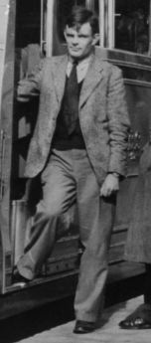
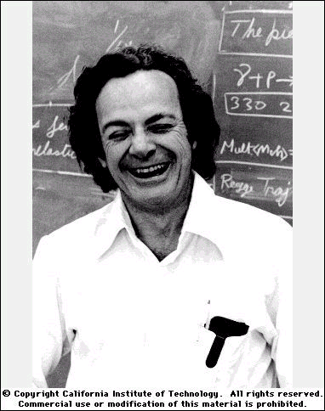
Cult of Universality
Turing Machine: basic computing machine that quantifies our notion of “carrying out an algorithmic task”
Universal Turing Machine: Turing machine which can be used to efficiently simulate any Turing machine.
but…. “Information is physical”
+ “Nature is quantum mechanical” =
Theory of Computation based on Quantum Mechanics
Universal Quantum Computer: physical device which can be used to efficiently simmulate any “algorithmic task” carried out on information presented in a quantum system
(Feynman, Deutsch, Bennioff, Barenco, Yao, DiVincenzo, Lloyd, Kitaev, Solovay)
Alan
Turing
Richard
Feynman

Slide 3
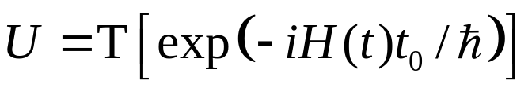
Universal Sets of Quantum Gates
Quantum Circuit Model
wire = carrier of quantum information (qubit {|0, |1}, qudit {|0, |1,…., |d}
gate = time evolution of the quantum information
U

