Slide 1
Nothing Here

Slide 2
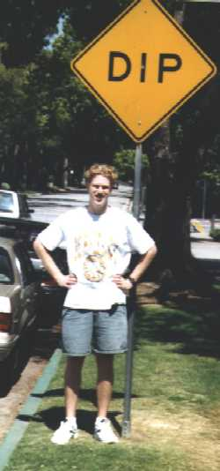



Fast Quantum Algorithms
or
How we learned to put our pants on two legs at a time.
Dave Bacon
Institute for Quantum Information
California Institute of Technology

Slide 3

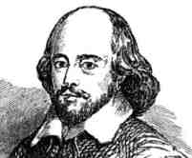
?
A sudden bold and unexpected question doth many times surprise a man and lay him open.
A prudent question is one-half of wisdom.
Iway amway Akespeareshay!
Sir Francis Bacon
(1561-1628)
William Shakespeare
(1568-1623)
“small Latin, less Greek” ?

Slide 4
WarNING
This Talk Under
Constant Acceleration
DB and CBSSS assume no responsibility
for injuries sustained while zoning out.

Slide 5
Quantum Computers Can Do
Amazing Things!
THIS TALK
Understanding what makes quantum evolution different
How quantum evolution can used to do something cool.
How quantum evolution can be used to exponentially speed up an oracle problem over classical deterministic algorithms.
How quantum evolution can be used to exponentially speed up an oracle problem over classical probabilistic algorithms.

Slide 6
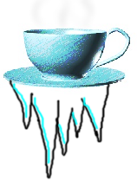
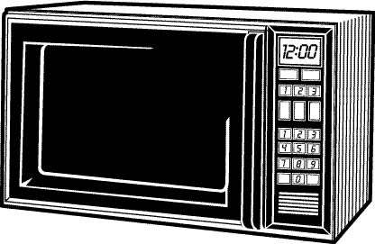


Randomizing Microwave
Digital Coffee
(Not Java!)
Mystery Markov Microwave
Scalding Hot
Freezing Cold
H
C

Slide 7

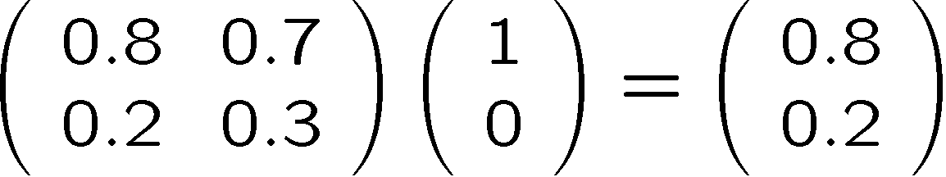
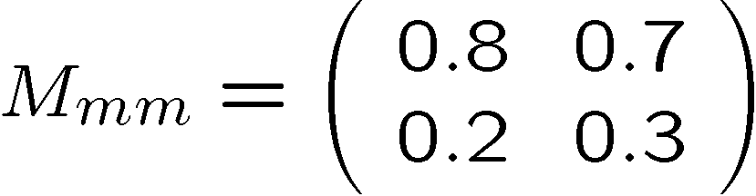

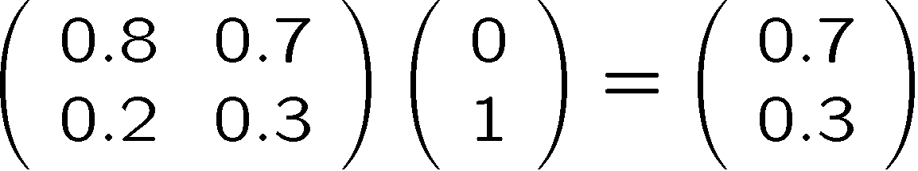
Markov
The true method of knowledge is experiment. - William Blake 1788
Run Experiments To Understand MMM Machine
If you put in C, 70% of the time you get H out
and 30% of the time you get C out
If you put in H, 80% of the time you get H out
and 20% of the time you get C out
A nice little formalism
H
C
columns sum to 1
0  matrix entry  1

Slide 8

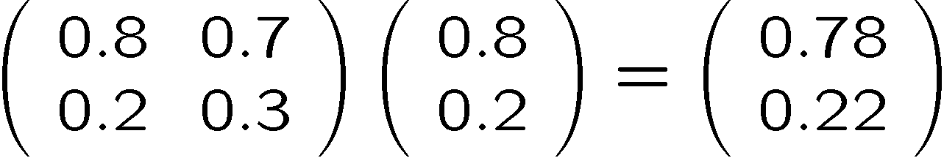
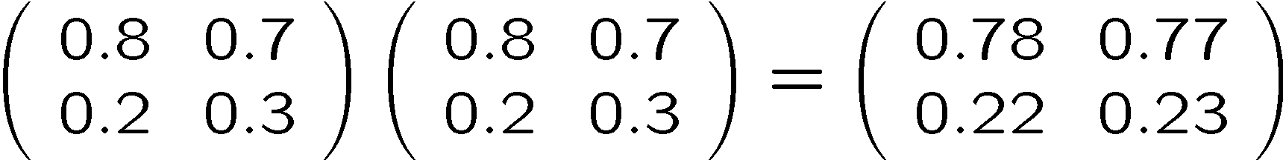
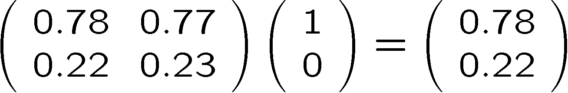
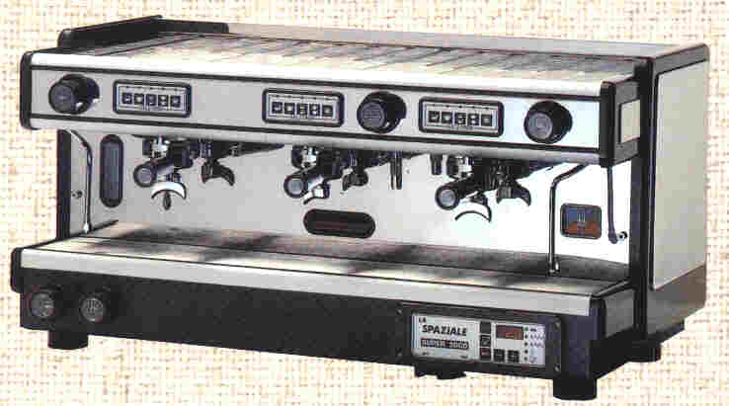
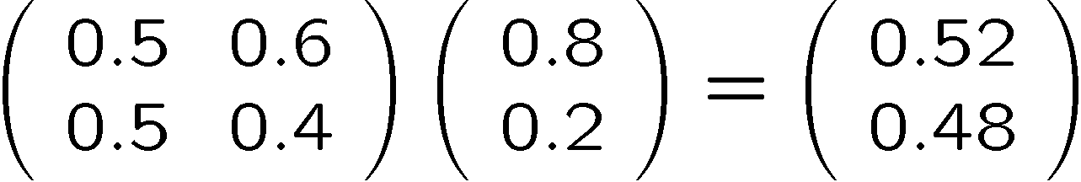
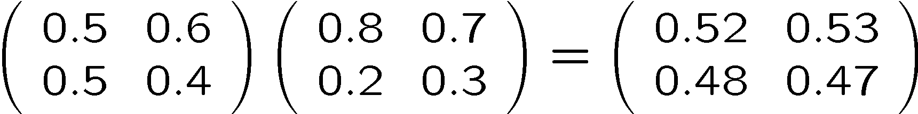
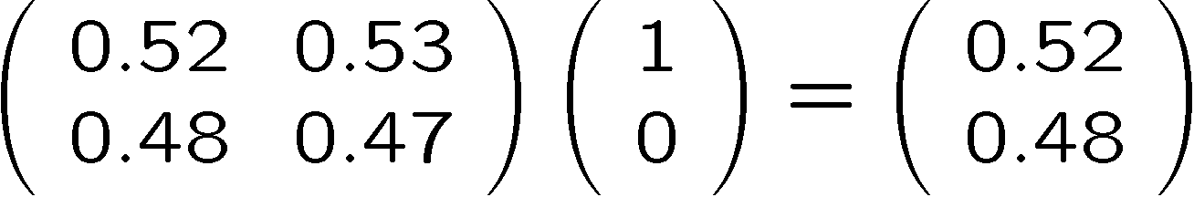
arkov Chains
78 % H
22 % C
or
52 % H
48 % C
or

Slide 9



Quantum Microwave
Quantum Digital Coffee
Quantum Microwave (QM)
Scalding Hot
Freezing Cold
H
C
What are the rules for the Quantum Microwave?

Slide 10


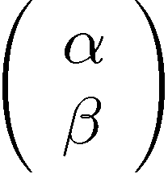



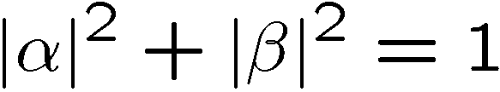




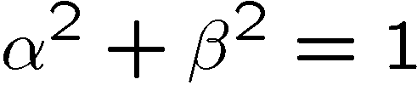
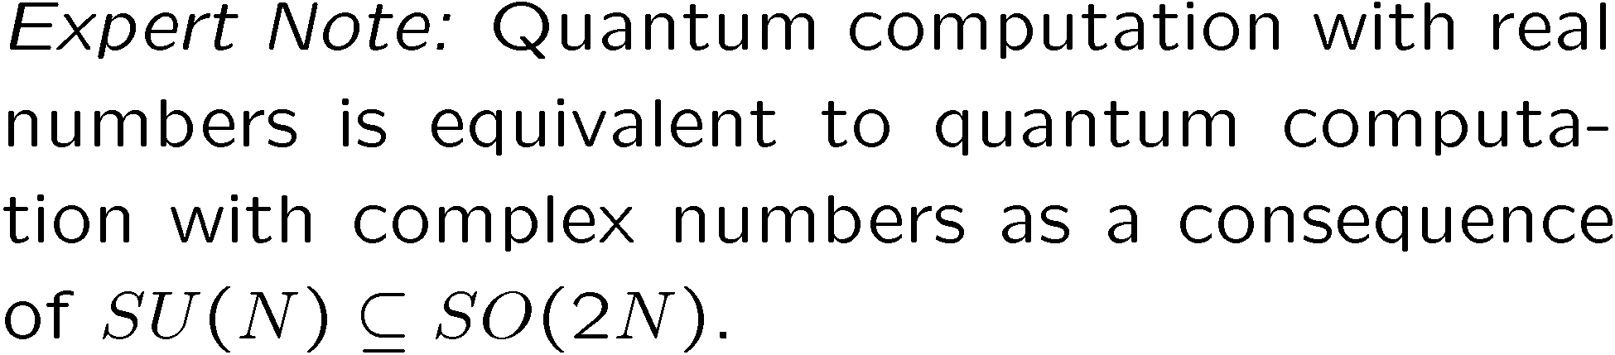
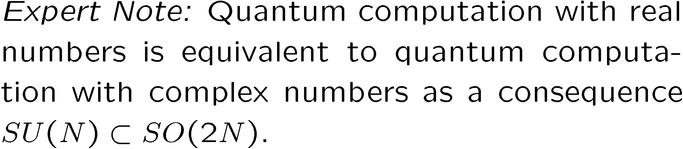
The Amplitude Attitude
H
C
For Our Purposes

Slide 11


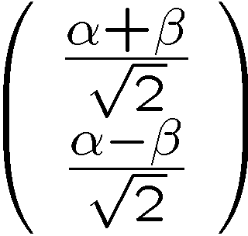
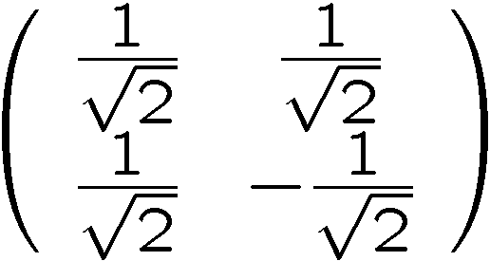
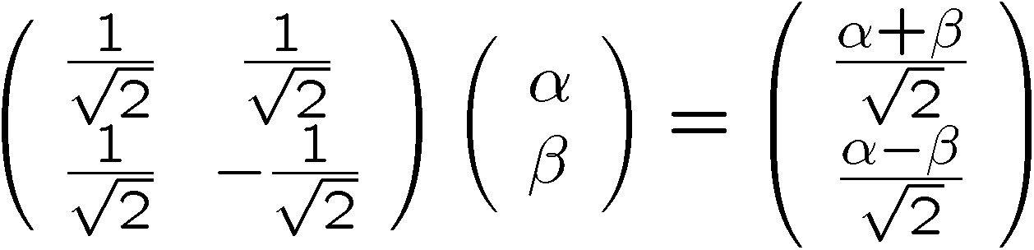
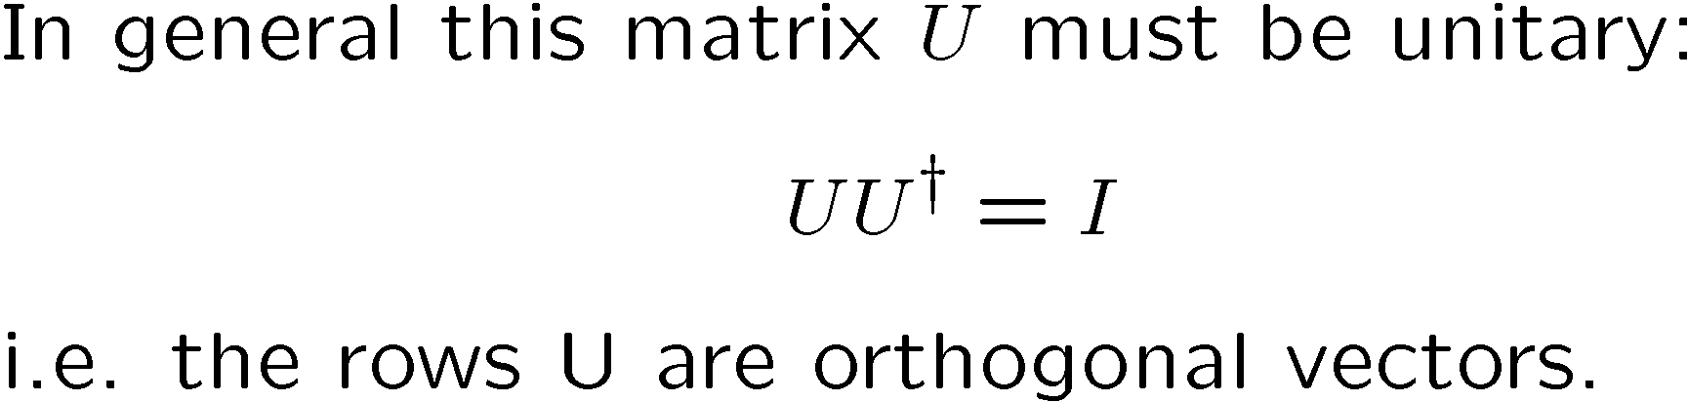

Unitary

Slide 12

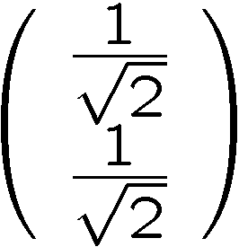

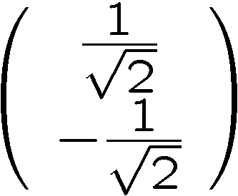
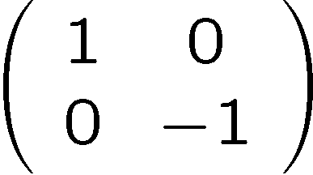
Interference
50 % H
50 % C
100 % H
0 % C
50 % H
50 % C
0 % H
100 % C

Slide 13
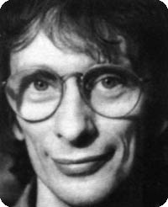


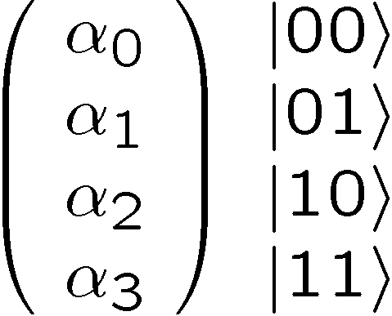
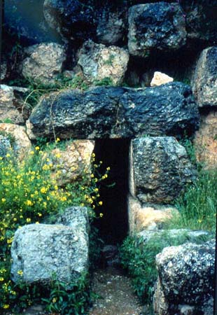

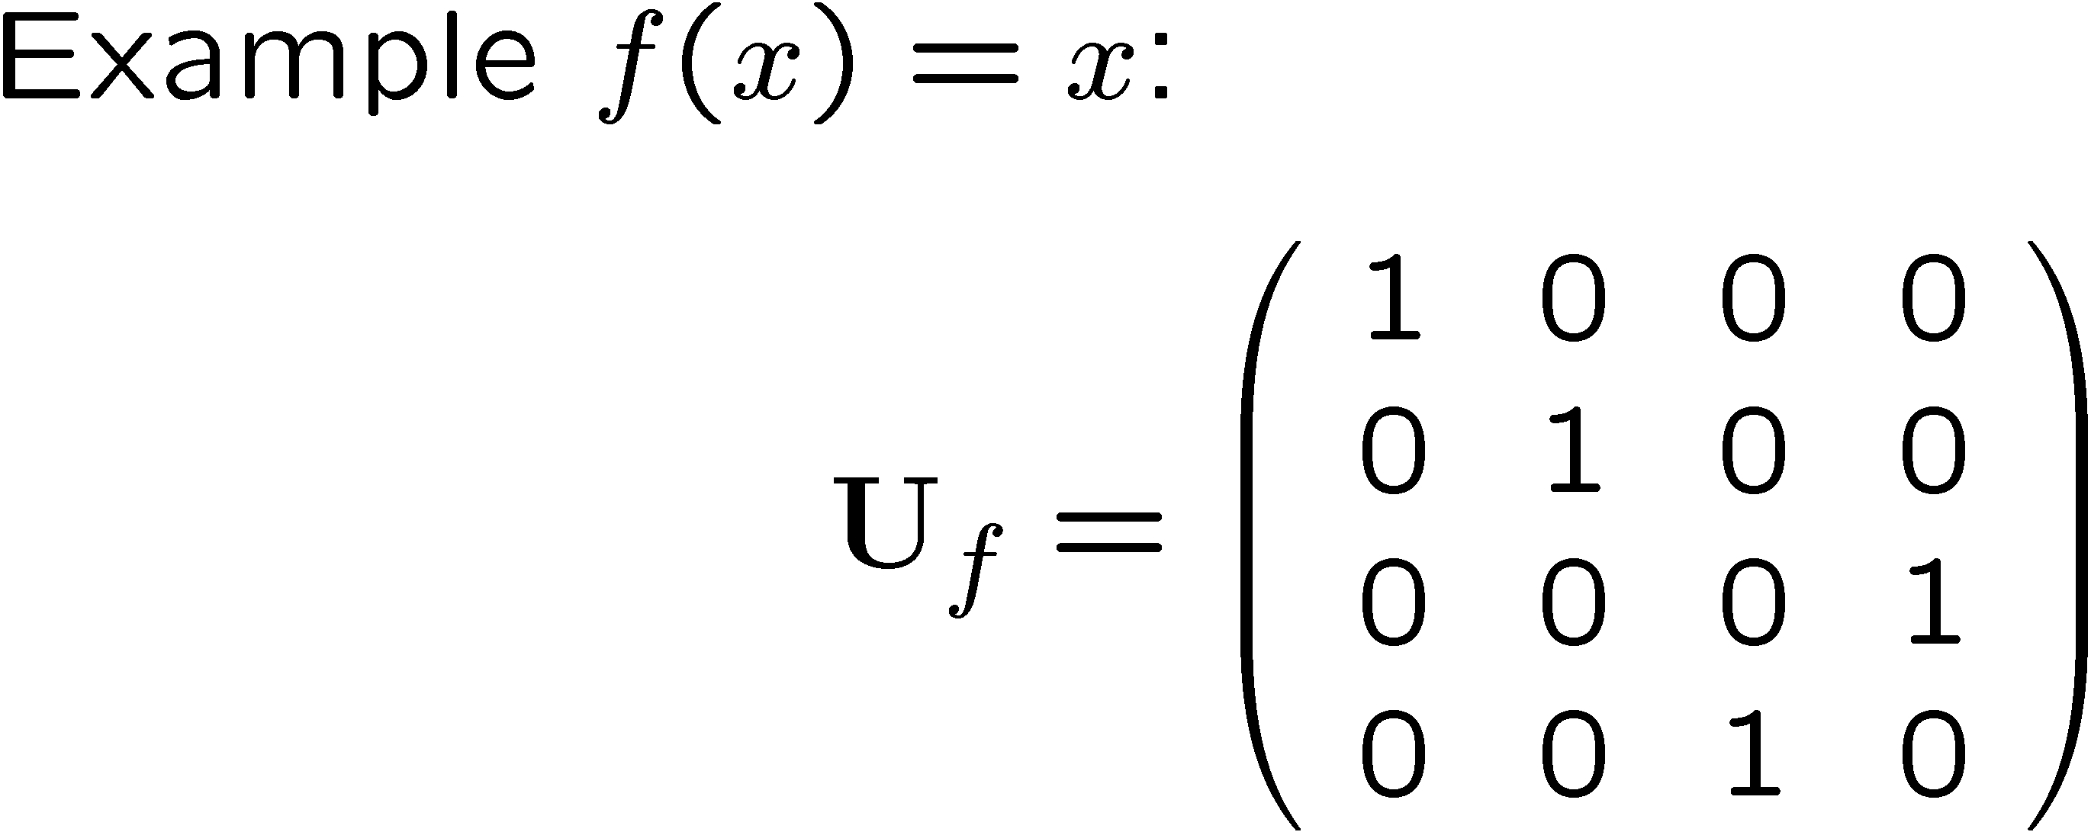





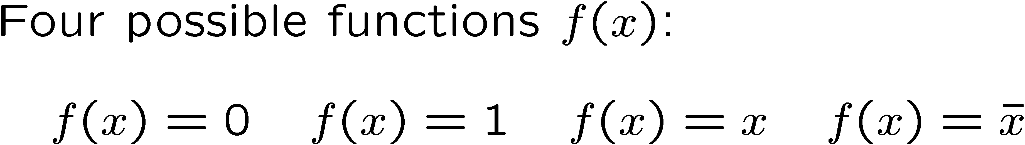
Deutsch’s Problem
(1985)
David Deutsch
Dr. Falcon
Delphi
Deutsch’s Problem
Determine whether f(x) is constant or balanced using as few queries to the oracle as possible.

Slide 14

Classical Deutsch
Classically we need to query the oracle two
times to solve Deutsch’s Problem

Slide 15





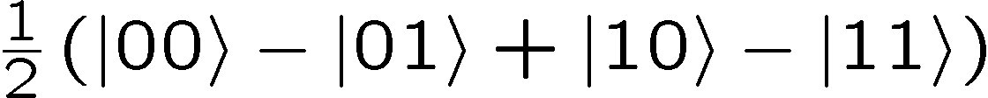
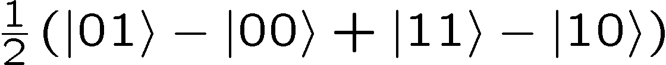
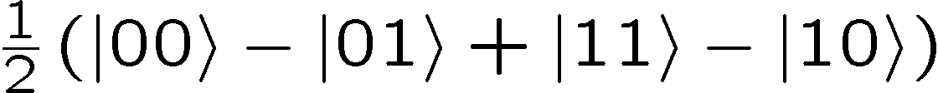
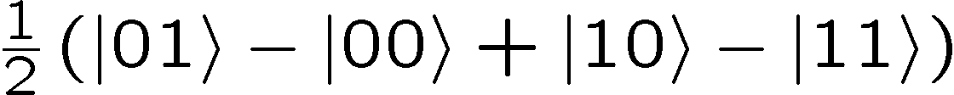
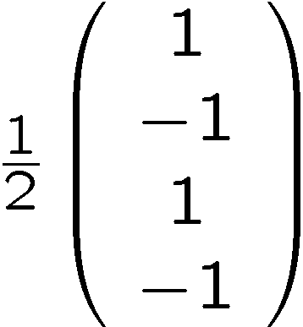
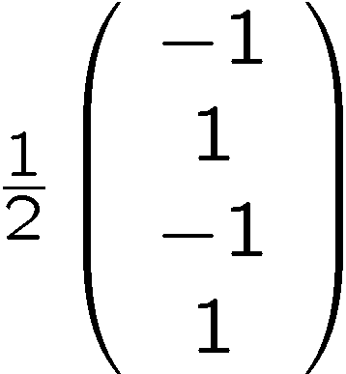
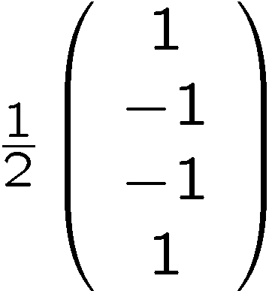
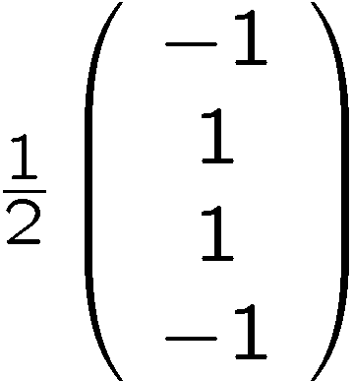
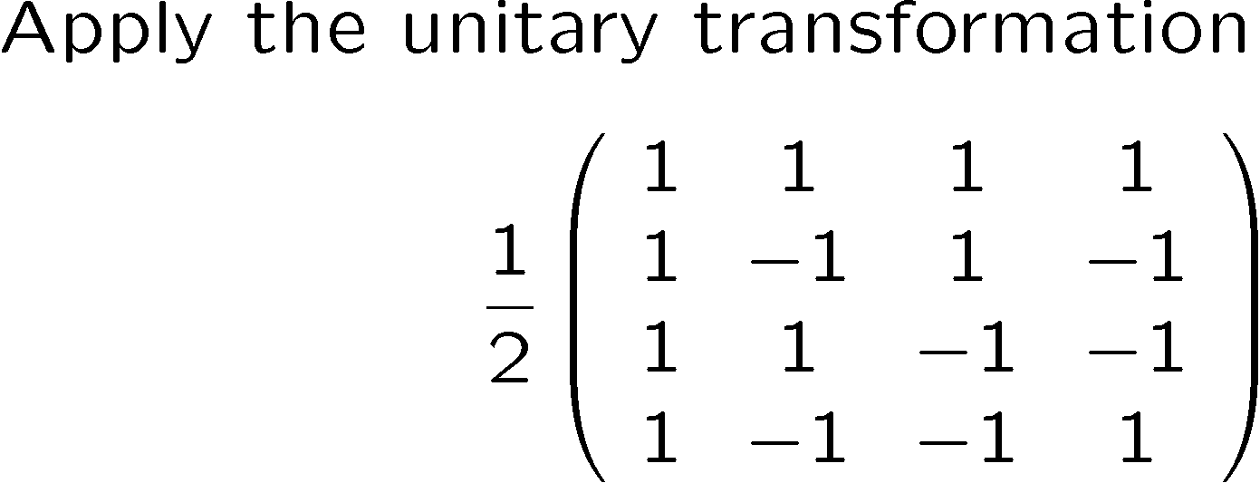

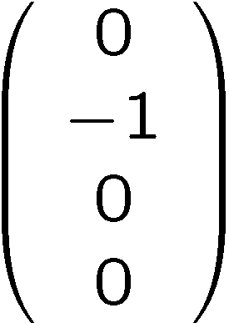


Quantum Deutsch
1.
2.
3.
100 % |01
100 % |01
100 % |11
100 % |11

Slide 16



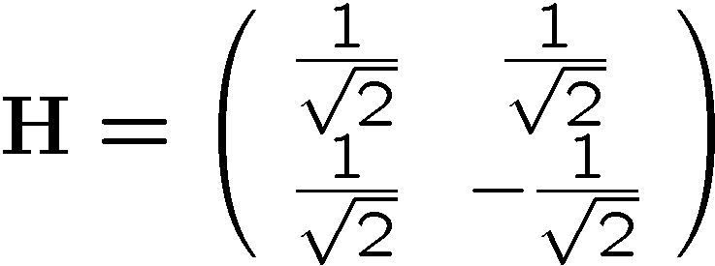
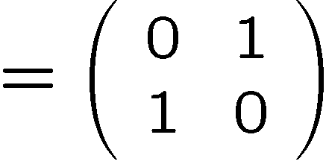
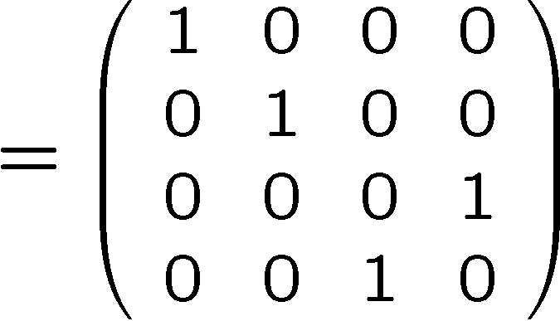




Deutsch Circuit
measure

Slide 17

A Different View

Slide 18





Deutsch-Jozsa Problem
(1993)
Deutsch-Jozsa Problem
Determine whether f(x) is constant or balanced using as few queries
to the oracle as possible.

Slide 19

Classical DJ
1
0
x
1
0
x

Slide 20


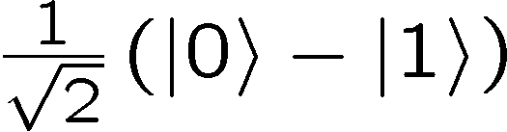
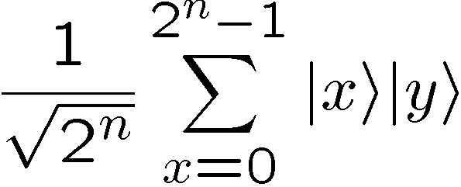
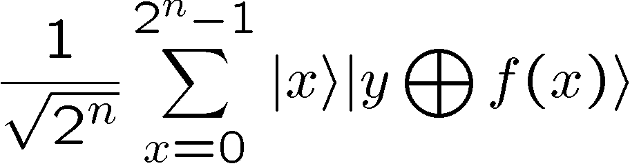
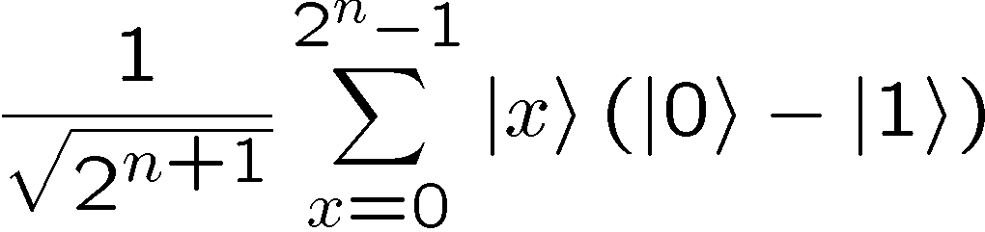

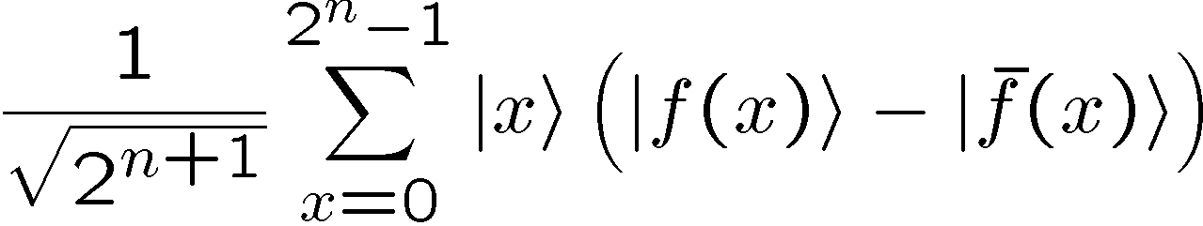
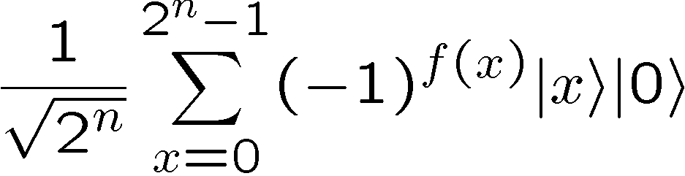
Quantum DJ

Slide 21





Quantum DJ

Slide 22
Full Quantum DJ
Solves DJ with a SINGLE query vs 2^{n-1}+1 classical deterministic!!!!!!!!!

Slide 23



Simon’s Problem
(is that no one does what “Simon says”?)
(1994)
Simon’s Problem
Determine whether f(x) has is distinct on an XOR mask or distinct
on all inputs using the fewest queries of the oracle. (Find s)

Slide 24

Classical Simon

Slide 25




Quantum Simon

Slide 26
Quantum Simon

Slide 27




Quantum Simon

