Slide 1
Nothing Here

Slide 2
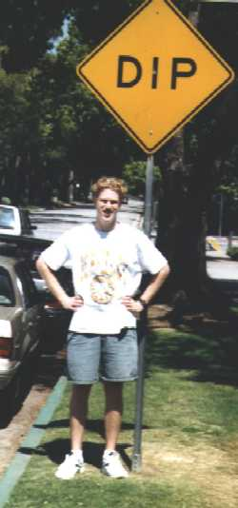



Fast Quantum Algorithms
or
How we learned to put our pants on two legs at a time.
Dave Bacon
Institute for Quantum Information
California Institute of Technology

Slide 3
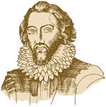
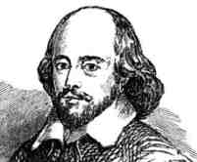
?
A sudden bold and unexpected question doth many times surprise a man and lay him open.
A prudent question is one-half of wisdom.
Iway amway Akespeareshay!
Sir Francis Bacon
(1561-1628)
William Shakespeare
(1568-1623)
“small Latin, less Greek” ?

Slide 4
WarNING
This Talk Under
Constant Acceleration
DB and CBSSS assume no responsibility
for injuries sustained while zoning out.

Slide 5
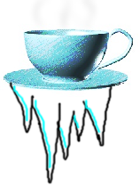
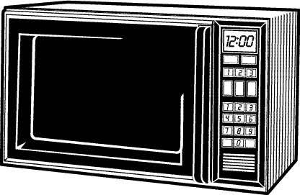


Randomizing Microwave
Digital Coffee
(Not Java!)
Mystery Markov Microwave
Scalding Hot
Freezing Cold
H
C

Slide 6
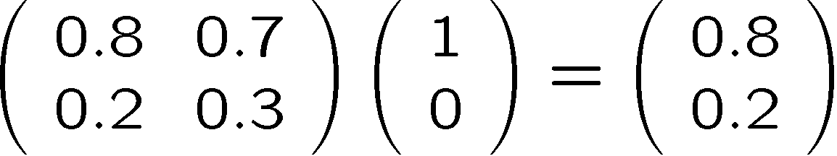

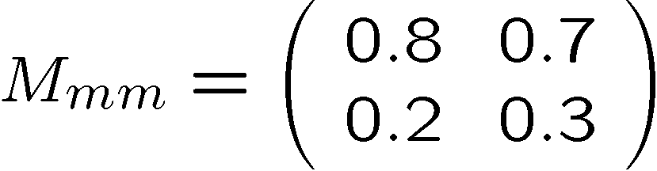
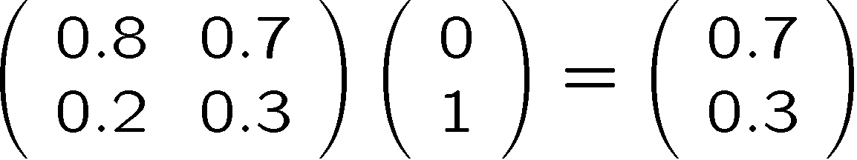

Markov
The true method of knowledge is experiment. - William Blake 1788
Run Experiments To Understand MMM Machine
If you put in C, 70% of the time you get H out
and 30% of the time you get C out
If you put in H, 80% of the time you get H out
and 20% of the time you get C out
A nice little formalism
H
C

