Slide 1
Nothing Here

Slide 2
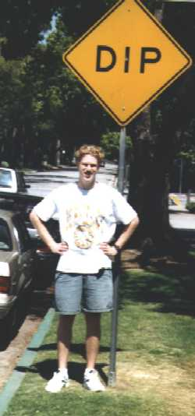



Fast Quantum Algorithms
or
How we learned to put our pants on two legs at a time.
Dave Bacon
Institute for Quantum Information
California Institute of Technology

Slide 3
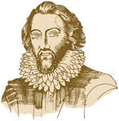
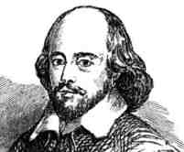
?
A sudden bold and unexpected question doth many times surprise a man and lay him open.
A prudent question is one-half of wisdom.
Iway amway Akespeareshay!
Sir Francis Bacon
(1561-1628)
William Shakespeare
(1568-1623)
“small Latin, less Greek” ?

Slide 4
WarNING
This Talk Under
Constant Acceleration
DB and CBSSS assume no responsibility
for injuries sustained while zoning out.

Slide 5
Quantum Computers Can Do
Amazing Things!
THIS TALK
Understanding what makes quantum evolution different.
How quantum evolution can used to do something cool.
How quantum evolution can be used to exponentially speed up an oracle problem over classical deterministic algorithms.
How quantum evolution can be used to exponentially speed up an oracle problem over classical probabilistic algorithms.

Slide 6
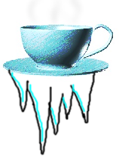
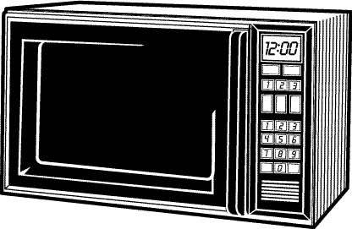


Randomizing Microwave
Digital Coffee
(Not Java!)
Mystery Markov Microwave
Scalding Hot
Freezing Cold
H
C

Slide 7
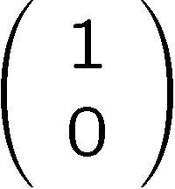
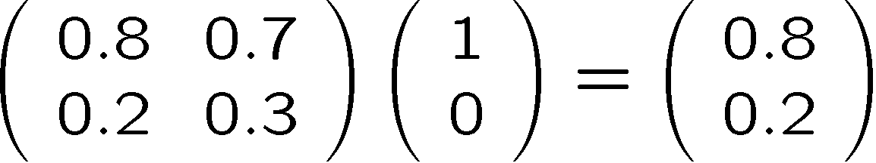
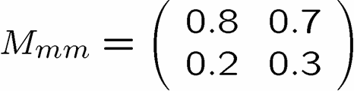
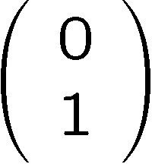
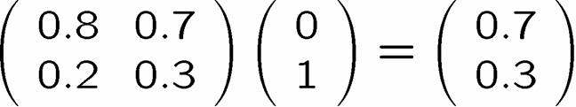
Markov
The true method of knowledge is experiment. - William Blake 1788
Run Experiments To Understand MMM Machine
If you put in C, 70% of the time you get H out
and 30% of the time you get C out
If you put in H, 80% of the time you get H out
and 20% of the time you get C out
A nice little formalism
H
C
columns sum to 1
0  matrix entry  1

Slide 8

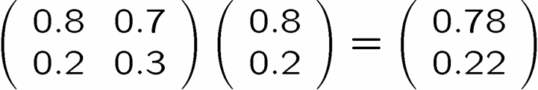
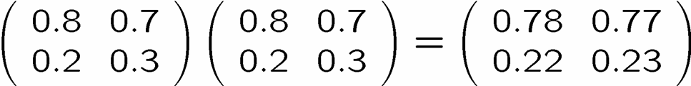
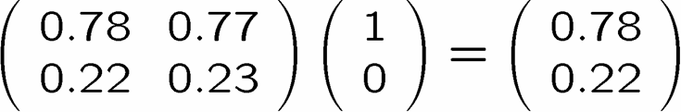
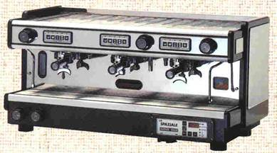
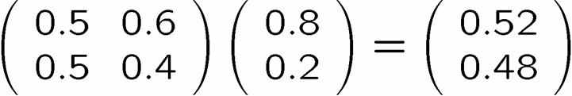
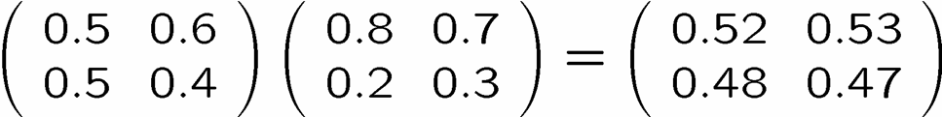
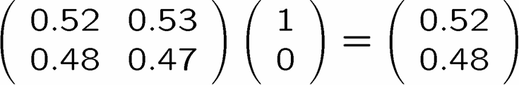
arkov Chains
78 % H
22 % C
or
52 % H
48 % C
or

Slide 9



Quantum Microwave
Quantum Digital Coffee
Quantum Microwave (QM)
Scalding Hot
Freezing Cold
H
C
What are the rules for the Quantum Microwave?

Slide 10


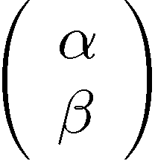








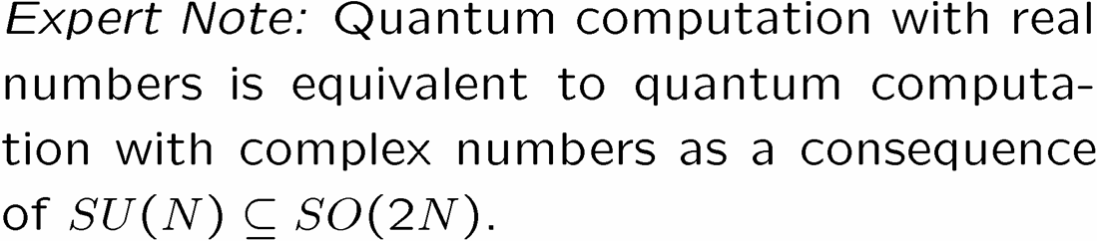
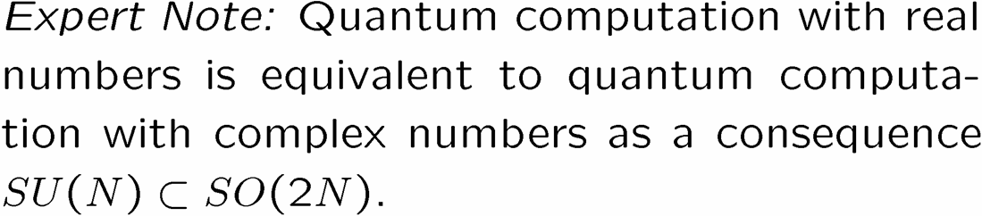
The Amplitude Attitude
H
C
For Our Purposes

Slide 11


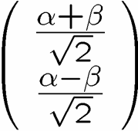
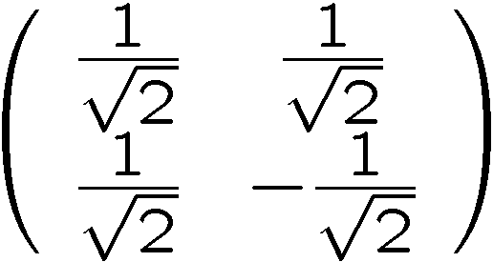
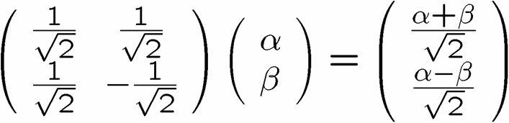
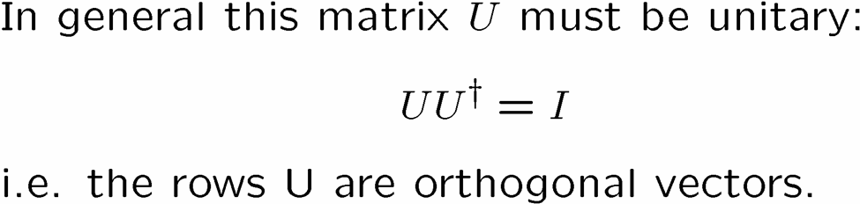

Unitary

Slide 12

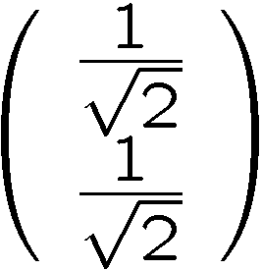

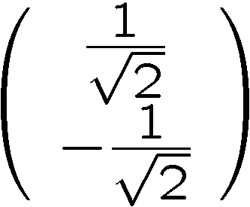
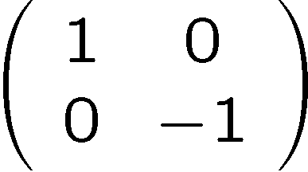
Interference
50 % H
50 % C
100 % H
0 % C
50 % H
50 % C
0 % H
100 % C

Slide 13
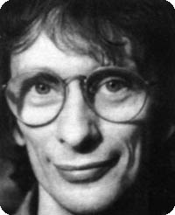


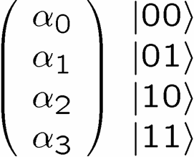
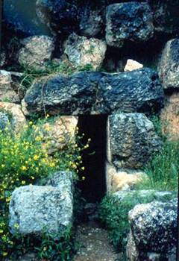

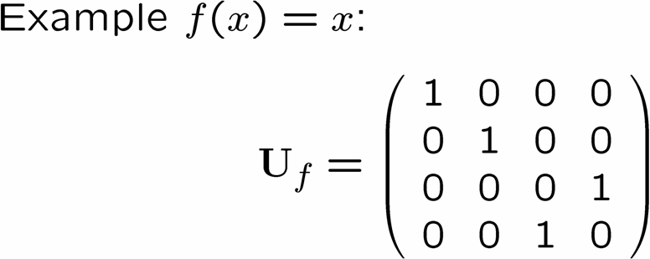





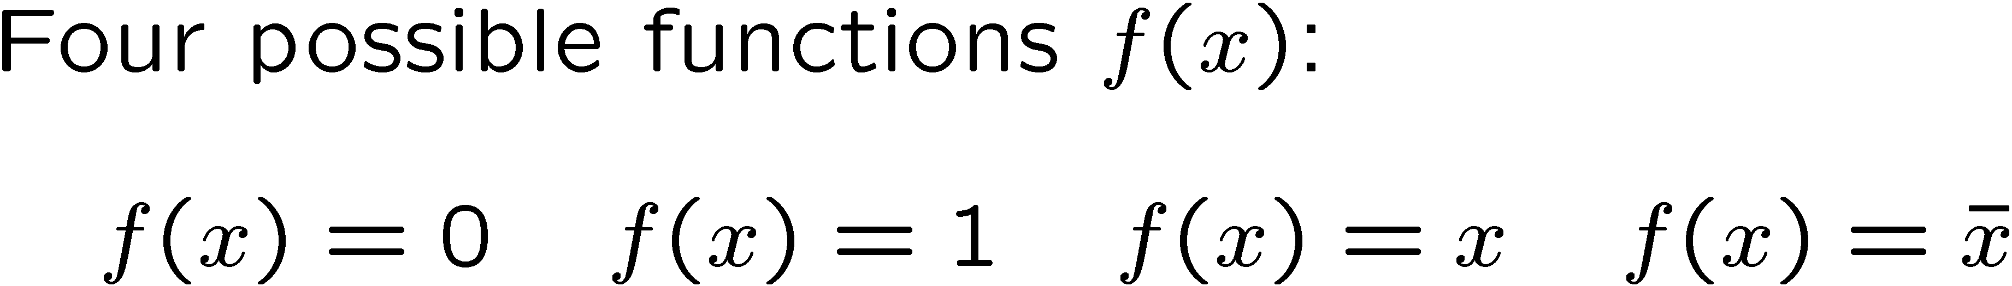
Deutsch’s Problem
(1985)
David Deutsch
Dr. Falcon
Delphi
Deutsch’s Problem
Determine whether f(x) is constant or balanced using as few queries to the oracle as possible.

Slide 14

Classical Deutsch
Classically we need to query the oracle two
times to solve Deutsch’s Problem

Slide 15





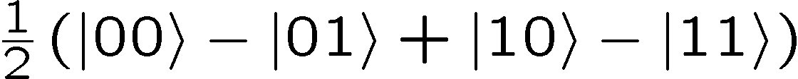
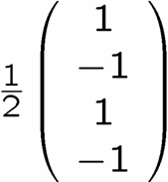
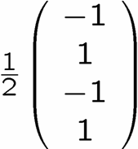
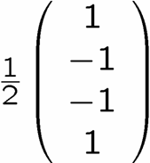
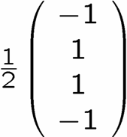
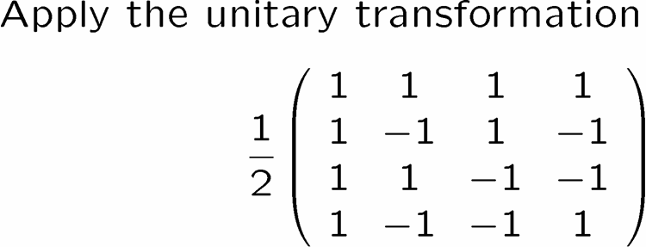

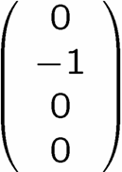

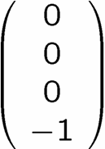
Quantum Deutsch
1.
2.
3.
100 % |01
100 % |01
100 % |11
100 % |11

Slide 16



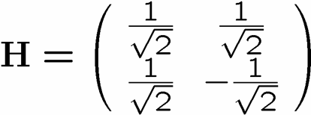
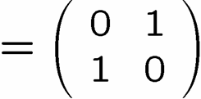
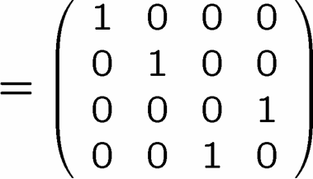




Deutsch Circuit
measure

Slide 17

A Different View

Slide 18
Deutsch In Perspective
Quantum theory allows us to do in a single query what classically requires two queries.
What about problems where the computational complexity is exponentially more efficient?

Slide 19





Deutsch-Jozsa Problem
(1992)
Deutsch-Jozsa Problem
Determine whether f(x) is constant or balanced using as few queries
to the oracle as possible.

Slide 20

Classical DJ
1
0
x
1
0
x

Slide 21


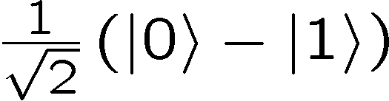
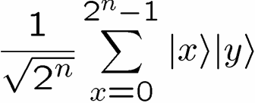
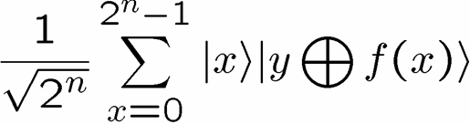
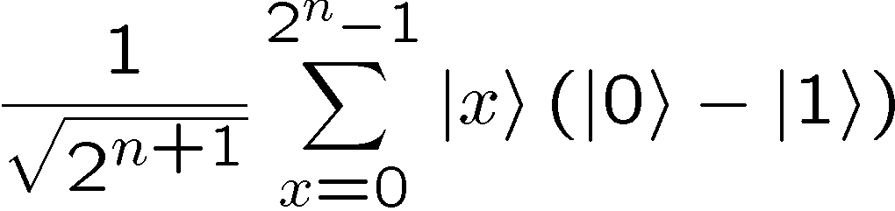

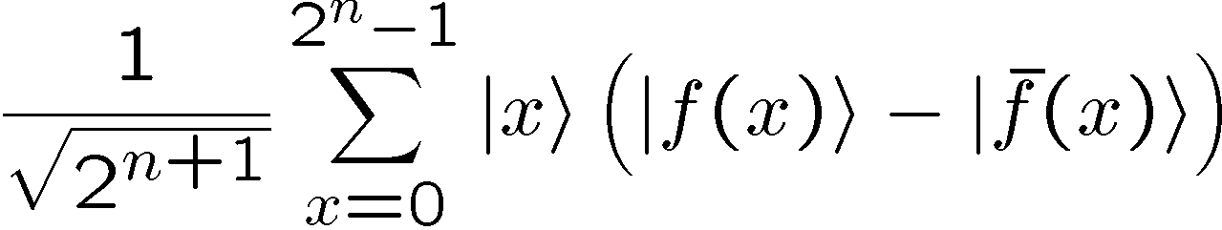
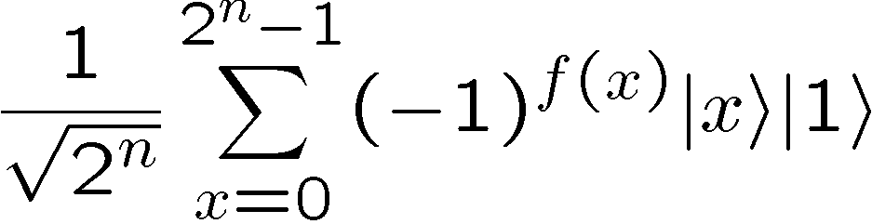
Quantum DJ

Slide 22
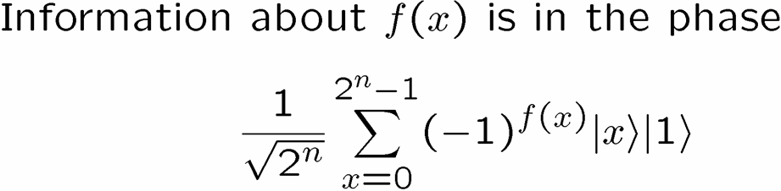




Quantum DJ

Slide 23
Full Quantum DJ
Solves DJ with a SINGLE query vs 2^{n-1}+1 classical deterministic!!!!!!!!!

Slide 24



Simon’s Problem
(is that no one does what “Simon says”?)
(1994)
Simon’s Problem
Determine whether f(x) has is distinct on an XOR mask or distinct
on all inputs using the fewest queries of the oracle. (Find s)

Slide 25


Classical Simon

Slide 26




Quantum Simon

Slide 27
Quantum Simon

Slide 28





Quantum Simon

Slide 29





An Open Question
(you could be famous!)

Slide 30
Shor Type Algorithms
Deutsch’s algorithm demonstrates task quantum computer can perform in one shot that classically takes two shots.
1992 Deutsch-Jozsa algorithm demonstrates an exponential separation between classical deterministic and quantum algorithms.
1993 Bernstein-Vazirani demonstrates a superpolynomial algorithm separation between probabilistic and quantum algorithms.
1994 Simon’s algorithm demonstrates an exponential separation between probabilistic and quantum algorithms.
1994 Shor’s algorithm demonstrates that quantum computers can efficiently factor numbers.

Slide 31


Sample Quantum Communication Complexity
B: y₀y₁
Three parties A, B, C given inputs x,y,z
Want to compute f(x,y,z) via a set protocol of communication.
Ability to “broadcast” information to other two parties. cost=# bits broadcast
A: x₀x₁
C: z₀z₁
SAMPLE WHERE PRESHARED ENTANGLEMENT LOWERS COST
A, B, C each given a two bit string.
guarantee: x₀y₀z₀{000, 011, 101, 110}, x₁y₁z₁ unrestricted
f(x,y,z)= x₁y₁z₁(x₀y₀z₀) ( is XOR,  is OR)
Quantum: each party has one part of a tripartite entangled state:
A
B
C

Slide 32


Protocol:
1. For each given party, if first bit (x₀,y₀, or z₀) is 1, then apply the Hadamard gate to given part of |
2. Next, measure the respective qubit. Denote the given parties output as a,b,c respectively.
If x₀y₀z₀=000, then | unchanged, abc=0
If x₀y₀z₀=110, then , abc=1 (etc)
abc= x₀y₀z₀
3. Parties broadcast- A: (x₁a) B: (y₁b) C: (z₁c)
Each party can now compute (x₁a)(y₁b)(z₁c)= x₁y₁z₁(x₀y₀z₀)
f(x,y,z) with 3 bits classical result requires: 4 bits
Buhrman, Cleve, Tapp 1997

Slide 33
Quantum Communication
Complexity
Less communication needed to compute certain functions if either (a) qubit used to communicate or (b) shared entangled quantum states are available.
How much less communication?
Exponentially less: Ran Raz “Exponential Separation of Quantum
and Classical Communication Complexity”, 1998

Slide 34

A final word from my sponsors
Physics says to computer science, “your information carriers should be quantum mechanical” and out pops quantum computation!
What can computer science tell us about physics?!?!
Dave Bacon, 156 Jorgensen, dabacon@cs.caltech.edu

