Slide 1


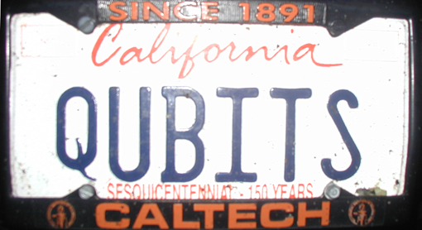
Entanglement at the
Institute for Quantum Information
Dave Bacon
Postdoctoral Scholar at IQI

Slide 2

«Entanglement»
VIEW
Entanglement as the basic proving ground for understanding what makes quantum information science different
LOCALITY
COMMUNICATION
Entanglement as the answer to all our questions?
…probably asking too much (dynamics?!)
Entanglement as a quintessential quantum phenomenon
…use as test bed, jumping off point, inspiration!

Slide 3

Entanglement Questions
When is a mixed state entangled?
(when has an experiment generated entanglement?)
What states admit local classical theories?
(when does nature act like a classical computer?)
What is communication cost of simulating quantum correlations?
(when can quantum computers lessen communication?)
What is the entanglement cost of a mixed state?
How can we develop a theory of multipartite entanglement?
What is the role of entanglement in quantum critical phenomena?
(what role does entanglement play in many body ground
states?)

Slide 4
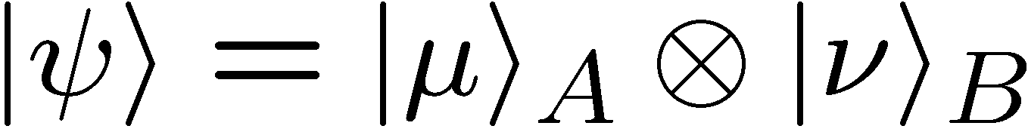
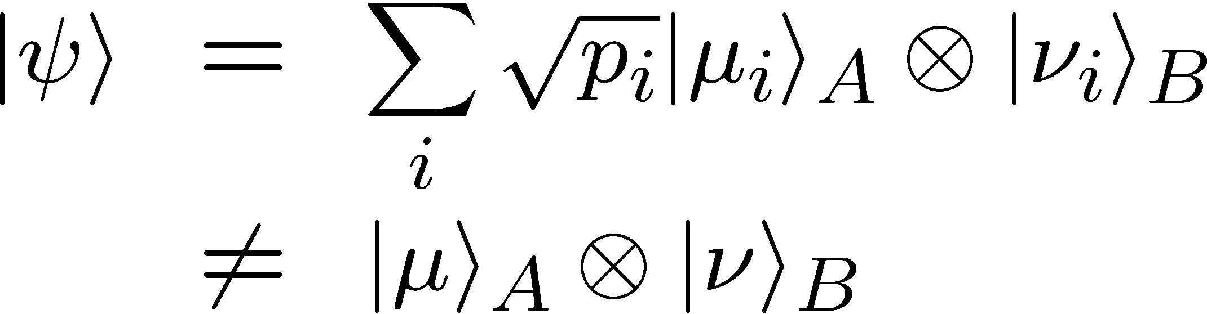
So You Think You’re Entangled?
Separable
Entangled
pure states
mixed states
How do we determine if a mixed state is entangled?
Experimentally how do we prove entanglement?

Slide 5
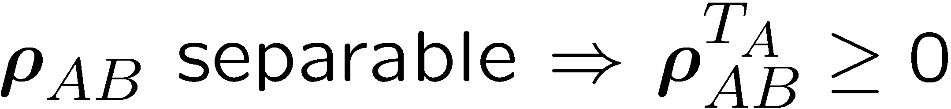
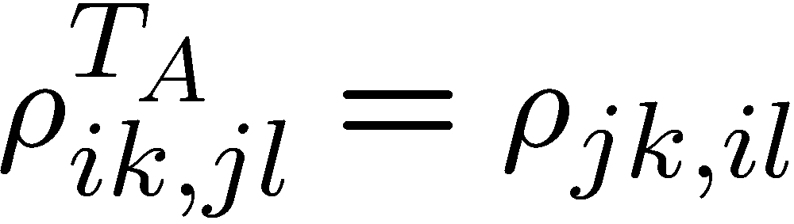
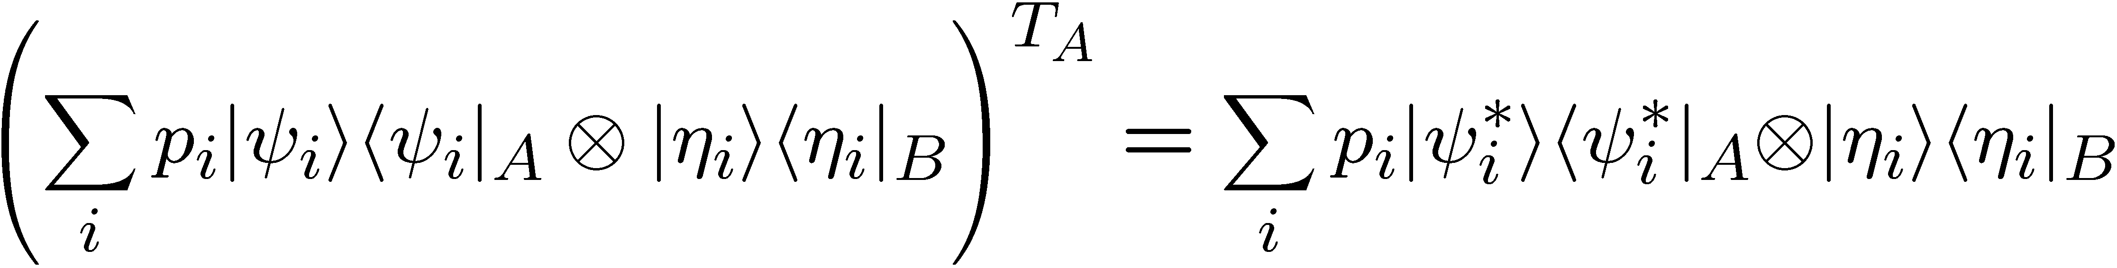


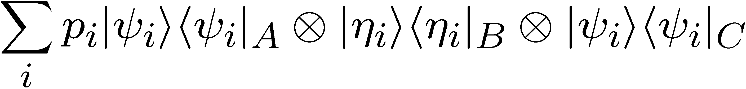
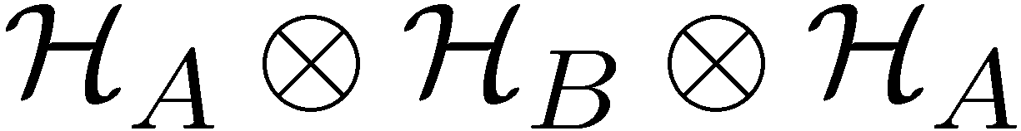

Separability Criteria
Peres-Horodecki Partial Transpose Separability Criteria:
partial transpose on A
Separable state extension on copy of A:

Slide 6
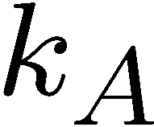
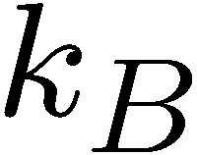

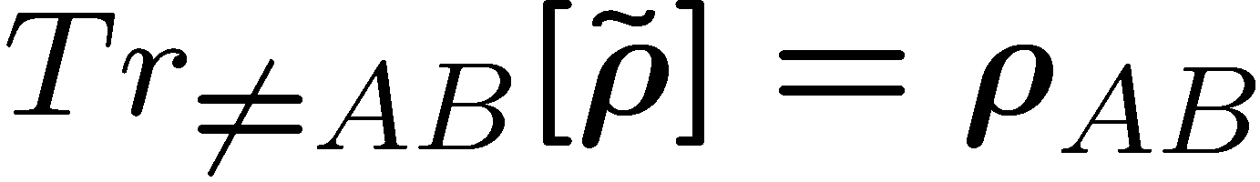
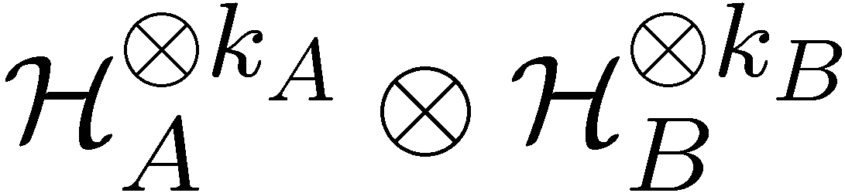
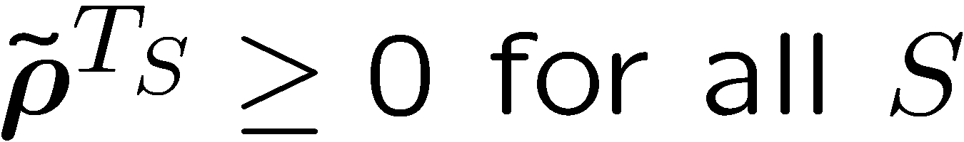
A Family of Separability Criteria
“Distinguishing Separable and Entangled States,” Doherty, Parrillo, Spedalieri, PRL, 88 187904 (2002)
Strictly stronger separability criteria than Peres-Horodecki!
k_{A}=2
separable
PPT entangled
NPPT entangled
k_{A}=3

Slide 7


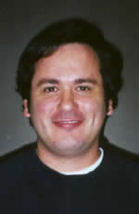
Usefulness
measure in lab to prove entanglement
Constructive, efficient, complete criteria
for mixed state separability!
Doherty
Spedalieri

Slide 8
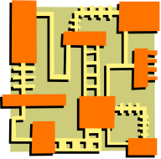



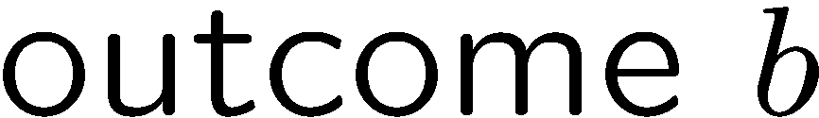

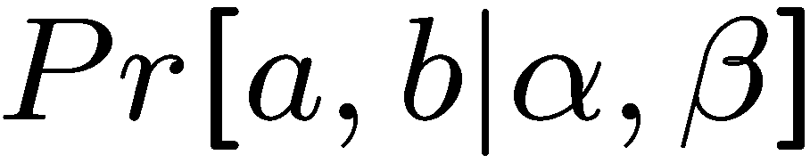
Local Realist Theories
1. Distribute quantum state
2. Parties select WHICH measurement
to perform
BOB
ALICE
3. Parties get measurement OUTCOMES
Can we explain via local classical hidden variables?

Slide 9
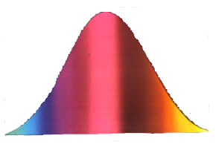


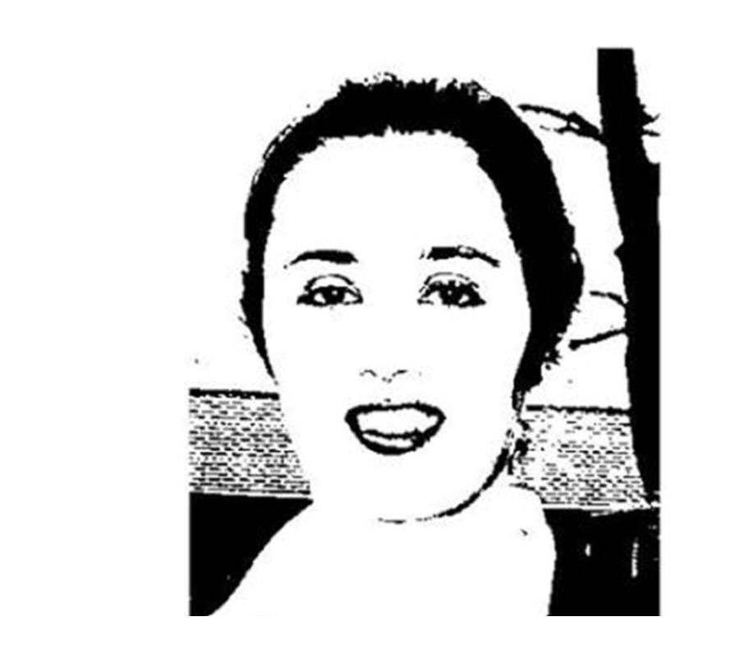
Nonlocality of All Entangled States?
Bell’s Theorem: Correlations produced by measurements on
some entangled states can not be explained by
local realistic theories.
What is the relationship between entanglement and nonlocality
for mixed states?
For certain entangled mixed states, all measurements on a single copy of the entangled state can be explained by local realistic theories (Werner).
General methods for constructing local
realistic theories for quantum states?
Doherty
Terhal

Slide 10
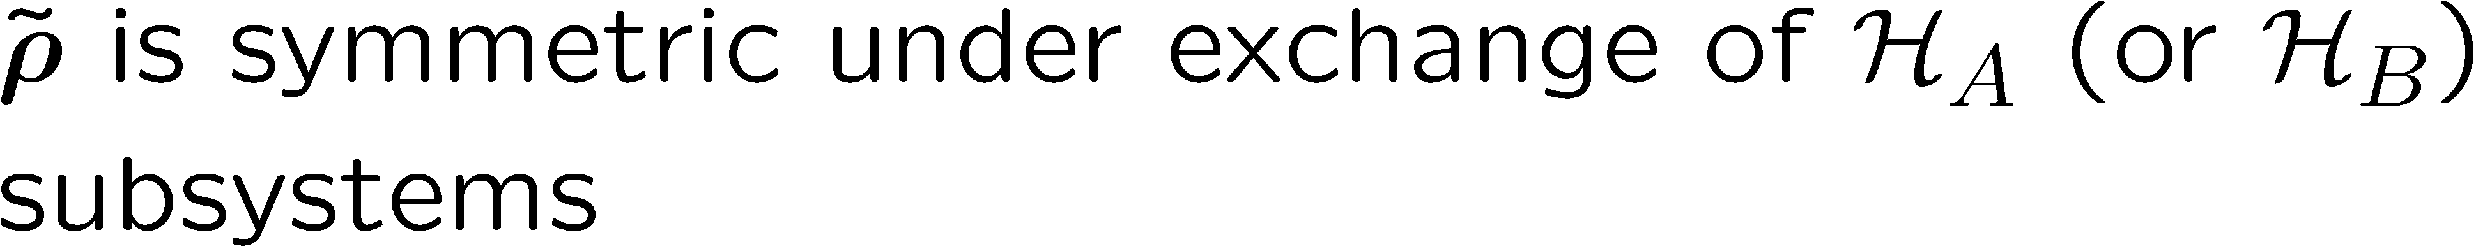
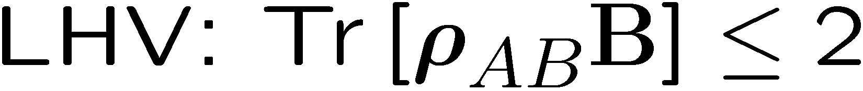
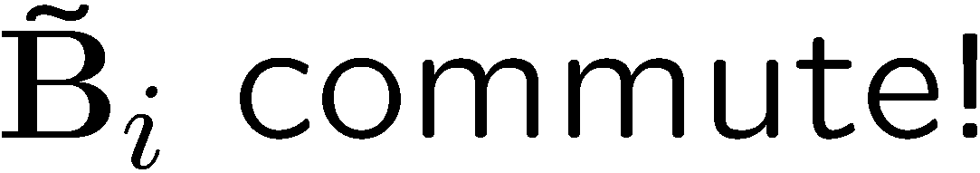
Local Realistic Theories for Quantum States
“Local Hidden Variable Theories for Quantum States,” Terhal, Doherty, quant-ph/0210053 (2002)
weaker but more intuitive version:

Slide 11
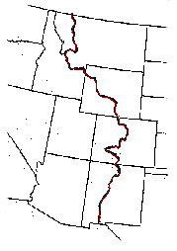


Capitalism for Correlations

Slide 12









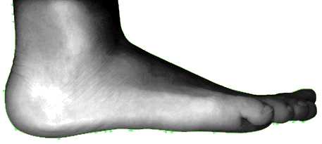


Simulating Quantum Correlations

Slide 13


Bell Inequalities with Auxiliary Communication
Bell Inequalities: what correlations can be simulated with shared
randomness and no communication.
Bell Inequalities with Auxiliary Communication:
what correlations can be simulated with shared
randomness and bounded communication
1 bit inequality
Quantify nonlocality!
“Bell Inequalities with Auxiliary Communication”, D. Bacon and B. F. Toner, quant-ph 0208057

Slide 14
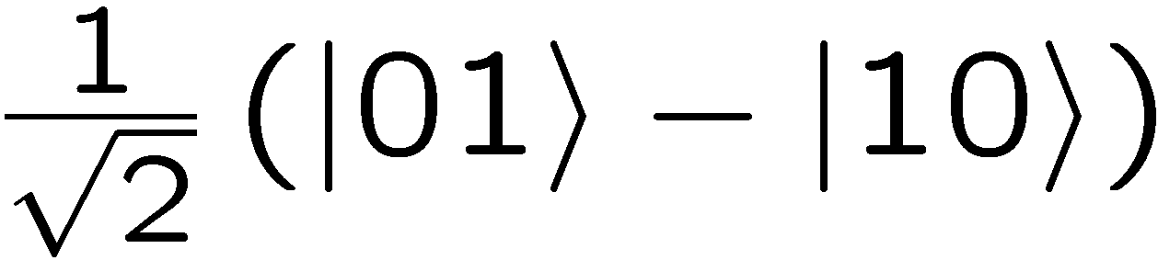


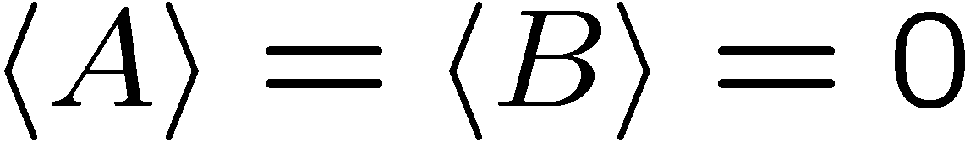
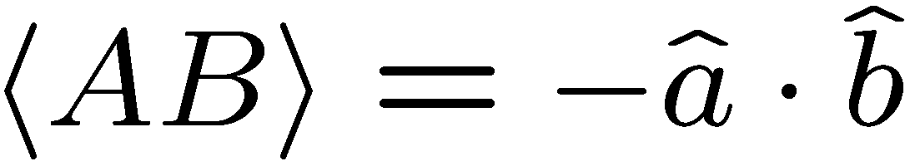
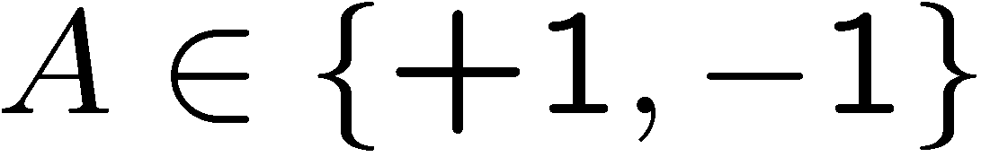
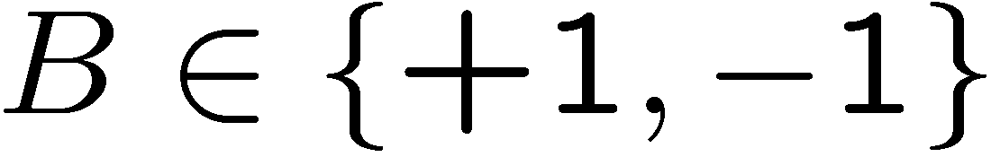

Simulating Measurements On a Bell Pair
ALICE
BOB
Sending from Alice to Bob requires bits of communication
Protocol for simulating Bell pair quantum correlations using
(1) shared randomness and (2) a single bit of communication!
“Correlations on Bell pair” =
“shared randomness” + “1 bit”
Bacon
Toner

Slide 15
More IQI Entanglement Work
Entanglement of purification (Terhal, Horodecki, Leung, DiVincenzo)
measure of both quantum and classical correlations
First calculation of entanglement cost (Vidal, Dur, Cirac)
additivity of entanglement of formation for some states
Continuity of asymptotic entanglement measures (Vidal)
general property of asymptotic entanglement measures
Entanglement entropy for multipartite pure states (Bravyi)
multipartite entropy leading to near-maximally entangled multipartite states
Generating set for tripartite state (Acin, Vidal, Cirac)
copies of Bell pair and GHZ states is not enough to assymptotically
produce all tripartite states.
Entanglement in symmetric states (Stockton, Geremia, Doherty, Mabuchi)
entanglement in many-qubit symmetric states
Local transformations of three-qubit pure state (Spedalieri)
deterministic LOCC transforms for three-qubits

Slide 16

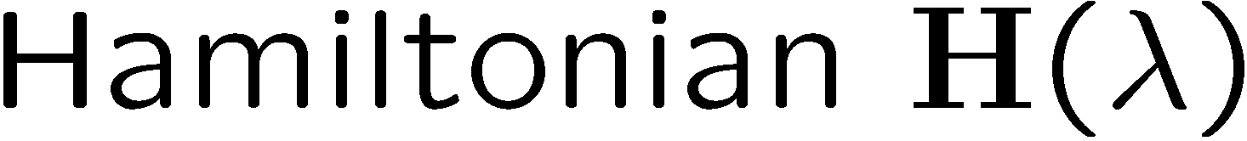


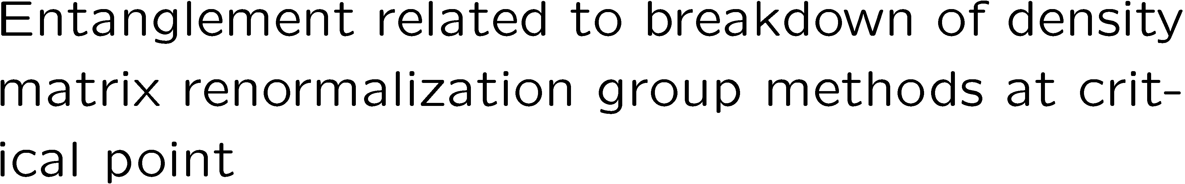
Entanglement in Quantum Critical Phenomena
“Entanglement in quantum critical phenomena”, G. Vidal, J.I. Latorre, E. Rico, and A. Kitaev, quant-ph 0211074

Slide 17
Entanglement Directions
Can we show all entangled states violate local realism or converse?
Does “little entanglement” mean classically easily simulatable?
How can we understand why entanglement achieves higher winning
probabilities for certain games?
Does there exist “The Game” from which one can derive quantum theory as the best strategy for this game?
Does multipartite entanglement theory lead to better algorithms for
Simulating condensed matter systems?
What is does theory of entanglement look like for quantum gravity where the notion of locality is not a priori given?

Slide 18


Brought To You By
Collaborators
Antonia Acin
J. Ignacio Cirac
Wolfgang Dur
Michal Horodecki
Jose Latorre
Debbie Leung
Pablo Parrilo
Enrique Rico
David Schwab
Dave Bacon
Sergei Bravyi
David DiVincenzo
Andrew Doherty
JM Geremia
Alexei Kitaev
Hideo Mabuchi
Federico Spedalieri
John Stockton
Barbara Terhal
Ben Toner
Guifre Vidal

