Slide 1
Ths Pg Hs N Vwls

Slide 2
i ae a o oe

Slide 3


Three Quantum Computing Tapas
Tonight’s Menu
adiabatic quantum computer………….... $money in your wallet
or $?
topological quantum computation…………………………………… ~$10⁹
quantum computer with only measurements………………… $0.37
Chez Quantum
Dave Bacon
“After Bugs Bunny”
Institute for Quantum Information
California Institute of Technology

Slide 4
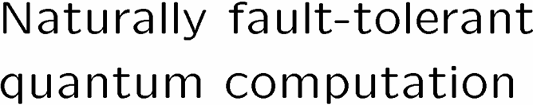

Novel Models for Quantum Computation
or “Why is Dave blabbing?”
a physics bigot?”

Slide 5
Adiabatic Quantum Computation

Slide 6






Hamiltonians

Slide 7
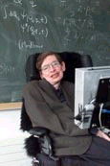
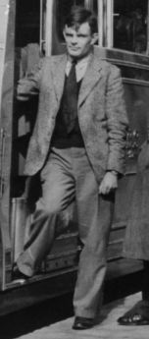
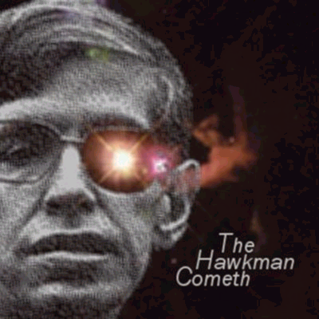
Hamiltonian
=
Ham and melted cheese sandwich
NP
=
Not Polynomial
Alan Turing
Stephen Hawking

Slide 8




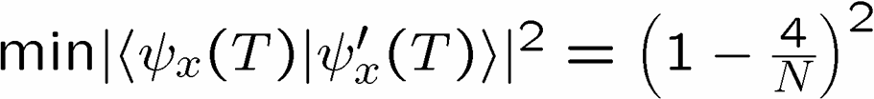

Precursor
A “Continuous-time” Search Algorithm

Slide 9


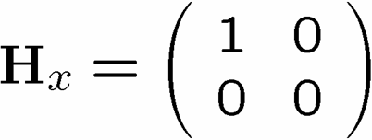
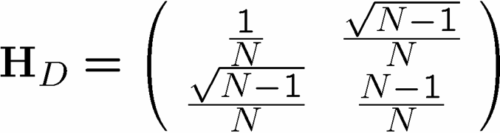


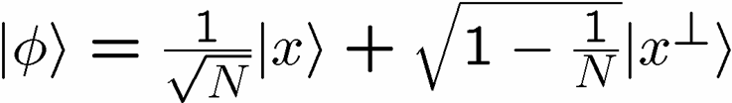


Drivers License

Slide 10
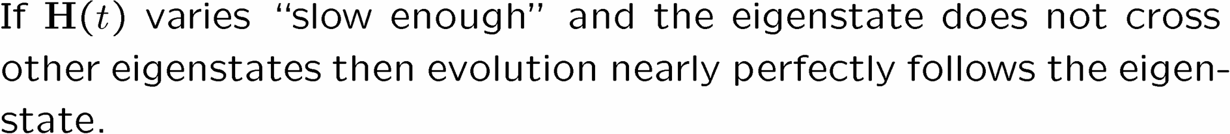

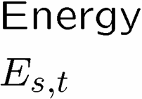





The Adiabatic Theorem

Slide 11
What Does Slow Mean?

Slide 12

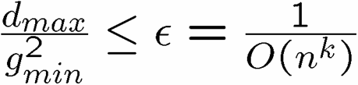

Adiabatic Algorithms

Slide 13



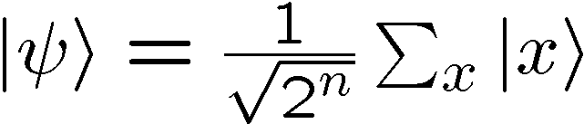



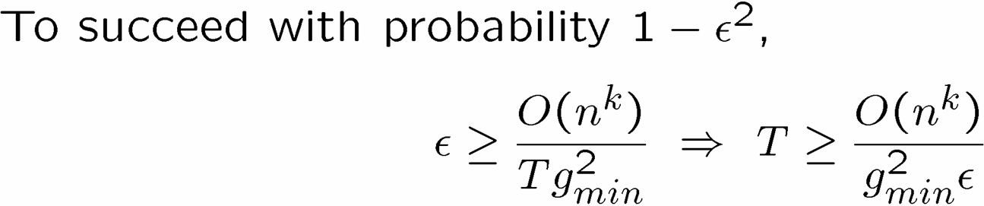
Example

Slide 14


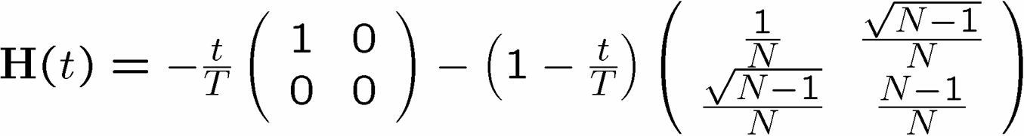


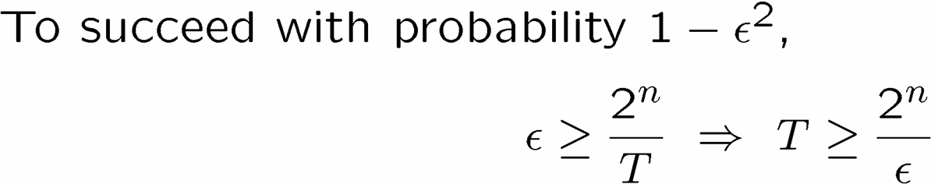
What is the Power?

Slide 15

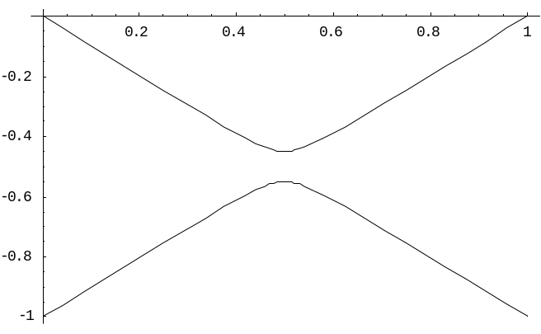


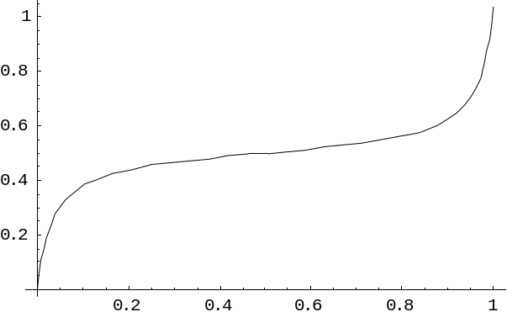
The Power of Change

Slide 16

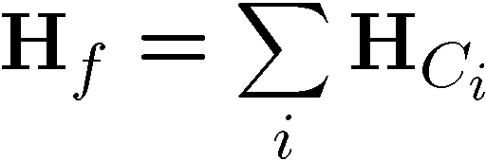


3SAT Adiabatically?

Slide 17



Not Yet, Not Ever?

Slide 18
Topological Quantum Computation

Slide 19
Damnit!
PARENTAL
Rant Mode On
ADVISORY
EXPLICIT LYRICS

Slide 20




Damnit! Part II
Rant Mode On

Slide 21




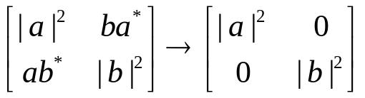

Fight the Gap
Rant Mode Shutting Down
Fault-Tolerant Quantum Error Correction
Experimental Coherent Control of Quantum Systems
Great White Decoherence Sharks

Slide 22





A Lesson

Slide 23

















What Have We Learned?

Slide 24


Fixing Funnel

Slide 25

Natural Fault Tolerance

Slide 26







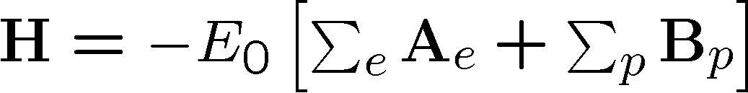
Toric Codes

Slide 27
There’s a Code in my Hamiltonian
(…but no Wocket in my Pocket)

Slide 28






Anticommuting is Not a
Conservative Agenda Item

Slide 29

Mmmm…Topology

Slide 30


Where Are We?

Slide 31
Room Temperature Quantum Computer?

Slide 32
Measurement Based Quantum
Computation

Slide 33
Two qubit projective measurements via teleportation
Linear optics plus photon preparation and counting
Quantum computing with prior entanglement and measurements

Slide 34


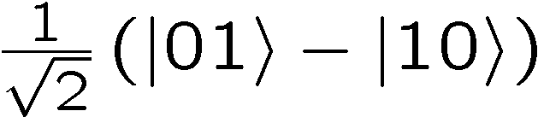





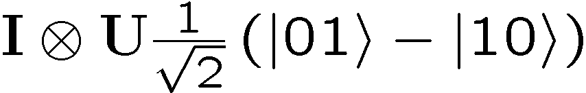
Random Gate

Slide 35













Slide 36









If at First You Don’t Succeed…

Slide 37




Remote Controlling a NOT

Slide 38
Food For Thought
Tonight’s Menu
adiabatic quantum computer………….... $money in your wallet
or $?
topological quantum computation…………………………………… ~$10⁹
quantum computer with only measurements………………… $0.37
Chez Quantum

