Slide 1
Do Not Read This

Slide 2


Introduction to Quantum Error Correction
Weatherproofing Quantum Computers
Error Clouds
Intel Quantum Computer
Dave Bacon
Institute for Quantum Information
California Institute of Technology
Notes:
Thanks
Most amazing discovery of the past ten years
High quality of the lectures … trying to discover why Michael Nielsen gives such smooth lectures

Slide 3
Technology is the Quest for Control
“To be an Error and to be Cast out is Part of [Nature’s] Design.” -William Blake
Things Fall Apart
-Chinua Achebe
EVENTUALLY your desktop computer hardware will ERROR.
EVENTUALLY the information on a hard drive will be CORUPTED.
Amount of useful computer cycles before such an error occurs (CURRENTLY) = large large number
Exist robust physical systems which serve as classical computers
Quantum Things Fall Apart Fast
Amount of quantum computer cycles before an error  large number
(CURRENTLY?)

Slide 4
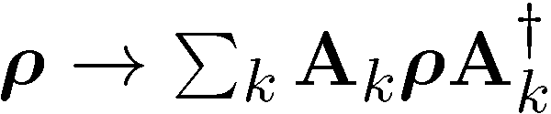
Quantum Computing is Bunk
9
Ways Quantum Computers Fail to Quantum Compute
Decoherence
Lack of Unitary Control
attempting to apply unitary evolution U instead results in V
or (worse) results in non-unitary evolution
Measurements are faulty
measurement result is noisy, incorrect result obtained
Quantum Computing Disappearing Act
qubits disappear (leakage of computing states)

Slide 5
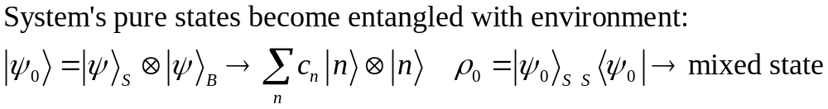
What is the Problem?
19
Real quantum systems are open quantum systems!
system
environment
Full Hamiltonian:
Interaction causing
DECOHERENCE
System evolution
environment evolution
System evolution (by itself) is no longer unitary
Coherent properties of system’s quantum information lost

Slide 6




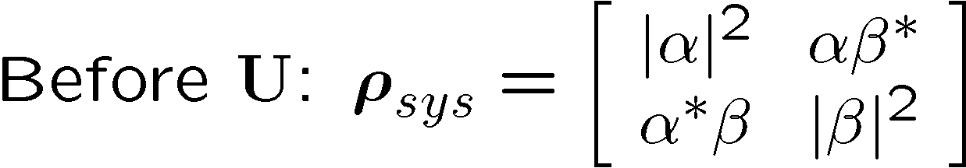
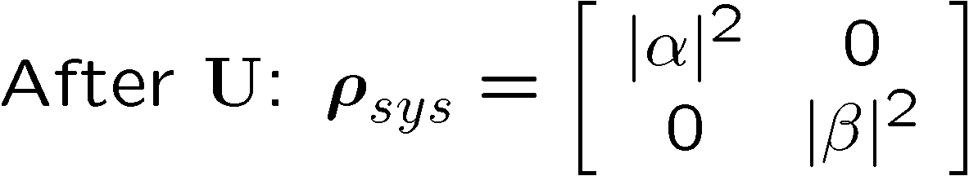
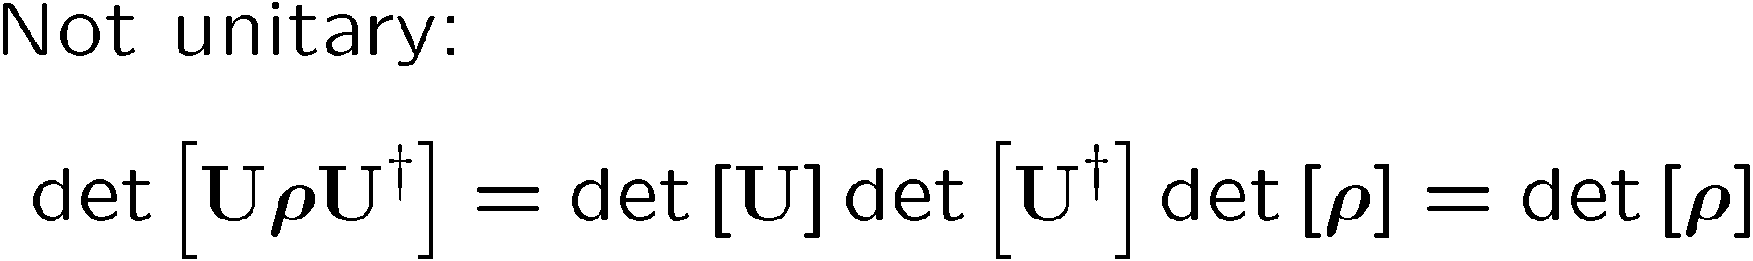
Quantum Error Example
“To err is human, to really foul things up requires a computer.” -Anonymous
system
environment

Slide 7





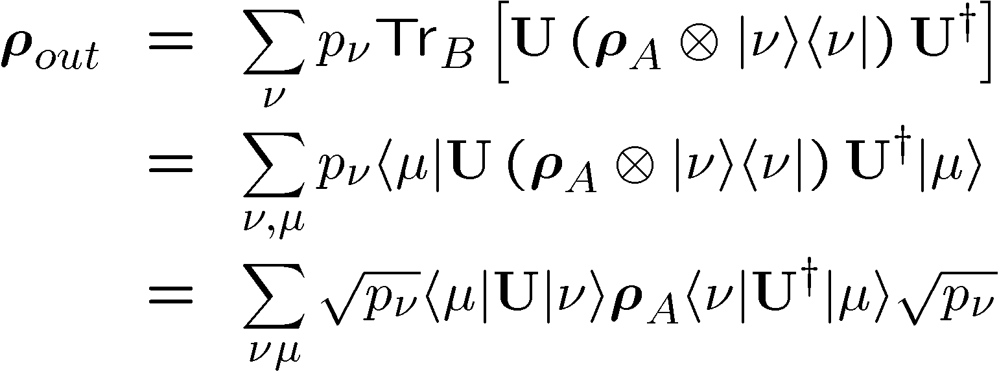
Operator Sum Representation
20
U
B states

Slide 8

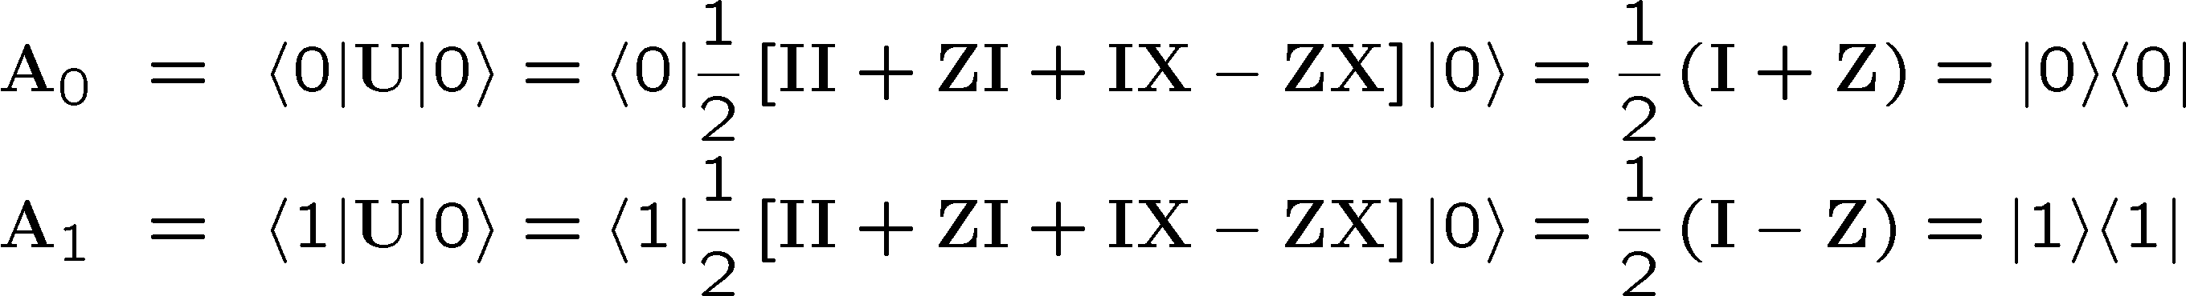
OSR Example
8
U

Slide 9
Noisy Cell Phone
9
Hello? Hello? Hello? Hello?
I have a flat tire. I said, I have a flat time! A flat tire.
No, I’m not trying to flatter you…No, your not getting fatter. I have a flat tire!
Communication over a noisy CHANNEL can be overcome via
ENCODING
“Hello?” = “Hello? Hello? Hello? Hello?” [using redundancy to encode “Hello”]

Slide 10
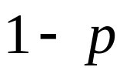
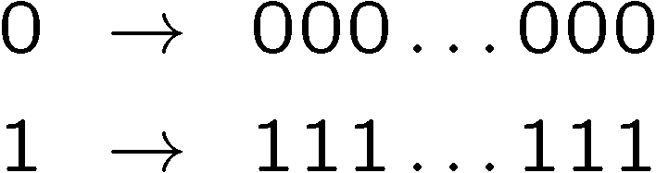

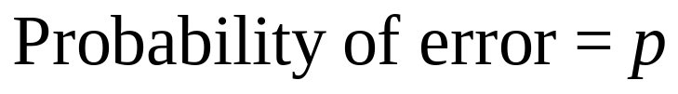
Simple Repetition Code
19
Encode:
0
0
n copies
1
1
No encoding:
Binary Symmetric Channel
b
measure
Encoding (n=3):
b
encode
b
b
b
decode
and correct
measure
Probability of error

Slide 11
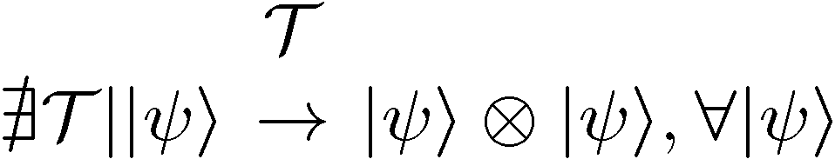

1994 Reasons to be a Pessimist
No cloning:
No cloning of quantum information:
Quantum repetition code impossible:
Continuous set of errors:
Classical errors on digital information are discrete.
Quantum errors on classical information are continuous.
Continuous set of operations:
Continuous set of unitary operations: infinite precision needed to implement a gate?
Measurement destroys coherence:
How can one decode without destroying the information?

Slide 12
Baby Steps
20
Bit Flip Channel:
WWCCD? (What Would Classical Coders Do?)
measure
b
b
0 000, 1 111
0
b
0
b
encode
error
decode
fix
identities
100  111  101 110  110
b
b
=
b
1
0
1
1
1
=
0
error #@%

Slide 13



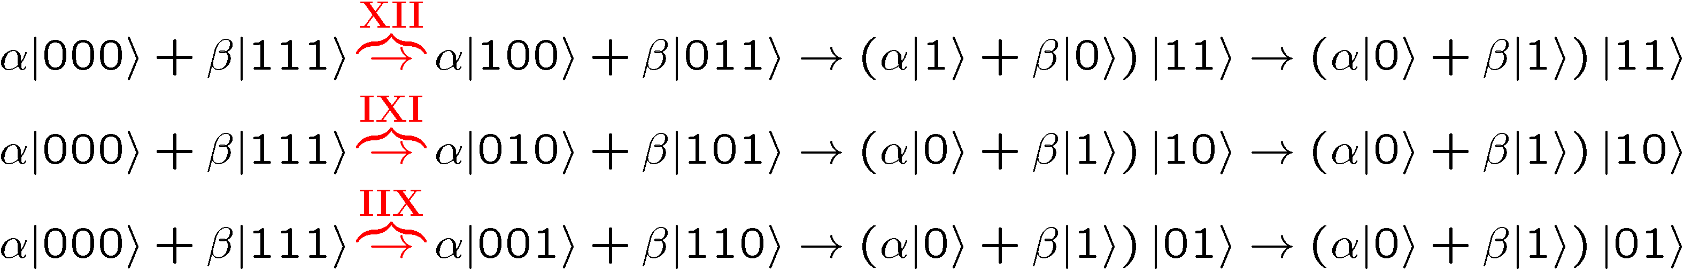
Naïve
1
4. operator identities still hold
Lets be naïve, take classical and move over to quantum
encode
error
decode fix
?
error
decode
fix
encoded into subspace:
2. errors take to orthogonal
subspaces + maintain orthogonality
3. syndrome
(no-cloning evaded!)

Slide 14
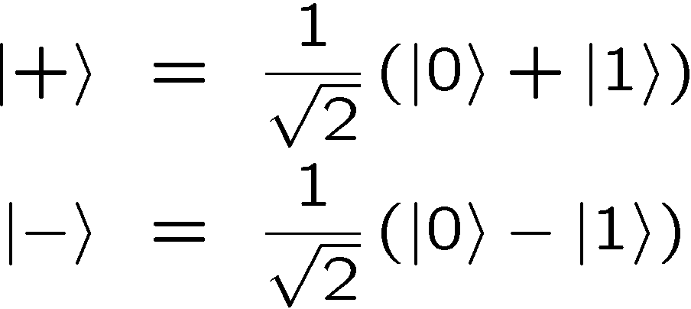
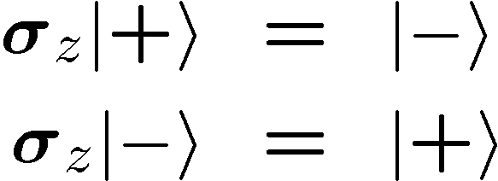


OK Wise Guy
12
What about “phase” errors?
…sort of not classical error
phase error:
Wise guy says “basis change please”:
looks like bit flit error in this new basis!
H
H
H
H
H
H
phase errors
bit flip errors

Slide 15
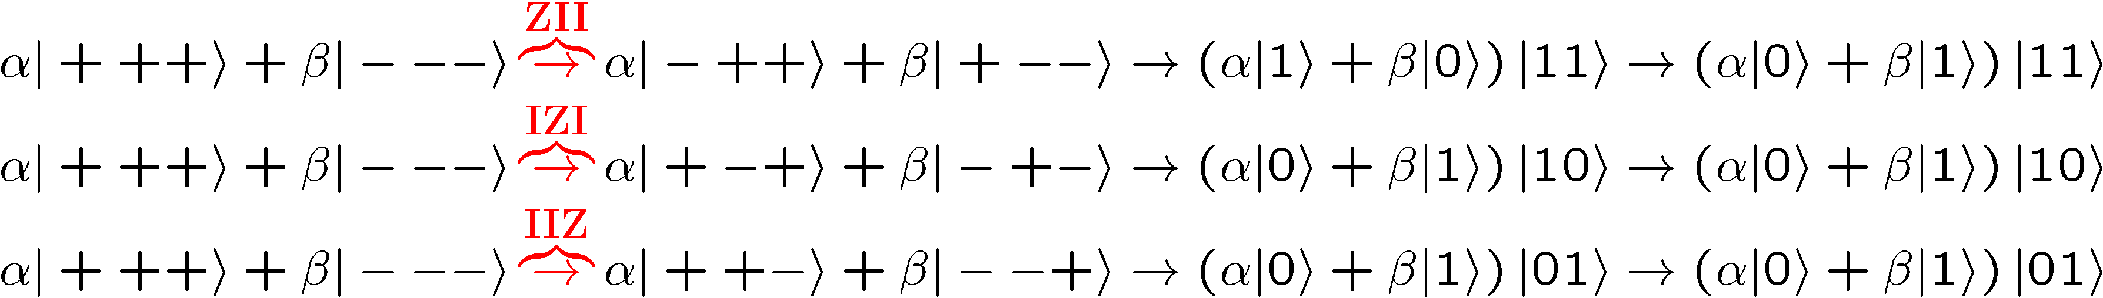
Molly: “I love you, I really love you”
Sam: “Ditto.”
11
encode
error
decode
fix
H
H
?
H
H
H
H
error
decode
fix
encoded into subspace:
2. errors take to orthogonal
subspaces + maintain orthogonality
3. syndrome
(no-cloning evaded!)

Slide 16


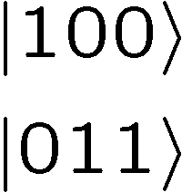




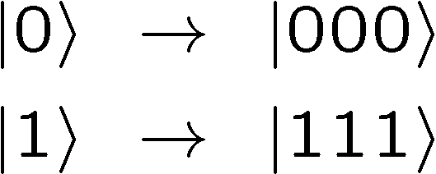

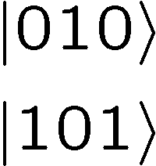



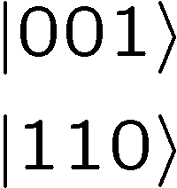

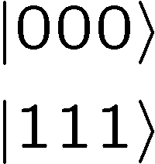
Perspective
Orthogonal subspaces can be distinguished by measurements
without measuring information encoded into the subspace!!!

Slide 17


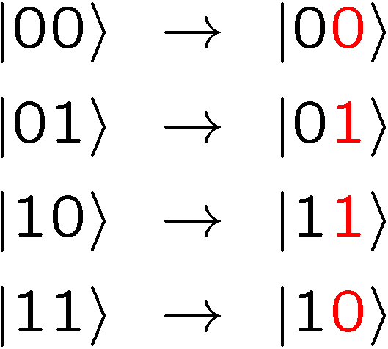
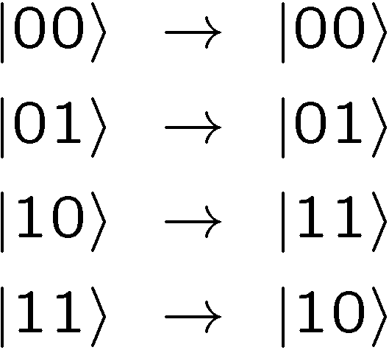



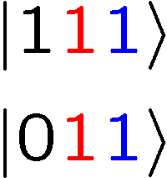
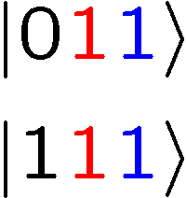
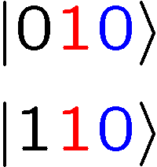
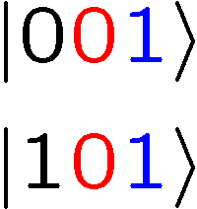
Not An Optical Illusion
2
fix
error

Slide 18
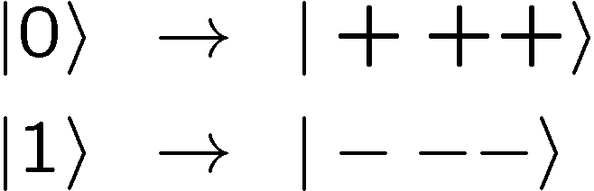


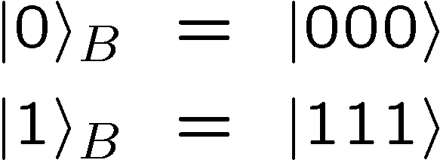
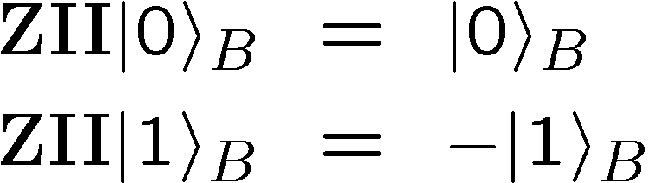
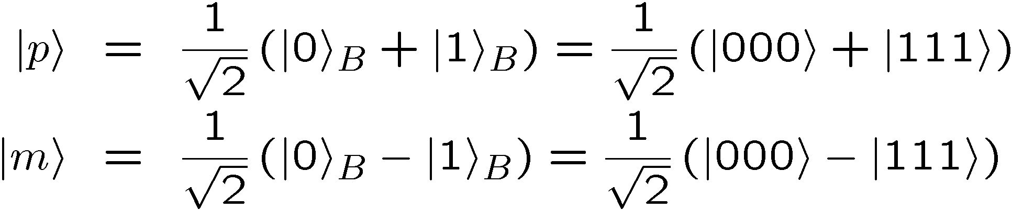
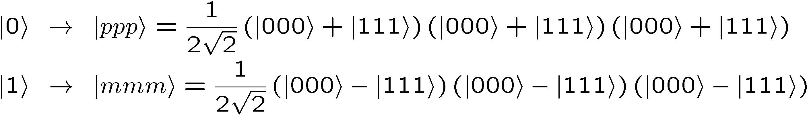
Encoding Away Your Ills
15
3 qubit bit flip code
3 qubit phase flip code
phase errors act as on bit flip code qubits:
define:
Shor Code: (Peter Shor, 1995)

Slide 19
Inside Shor
17
H
H
H
H
H
H
bit flip code
phase flip code

Slide 20
9
Mysterious Extra Slide

Slide 21






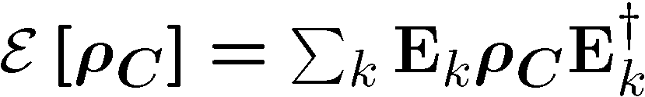

Do the Hokey Pokey
14
Take a step back:
encode
error
diagnose
error
fix
encode
Here quantum information has simply been encoded into
Then an error occurs
Then a recovery procedure
An miraculously we recover the encoded state

Slide 22
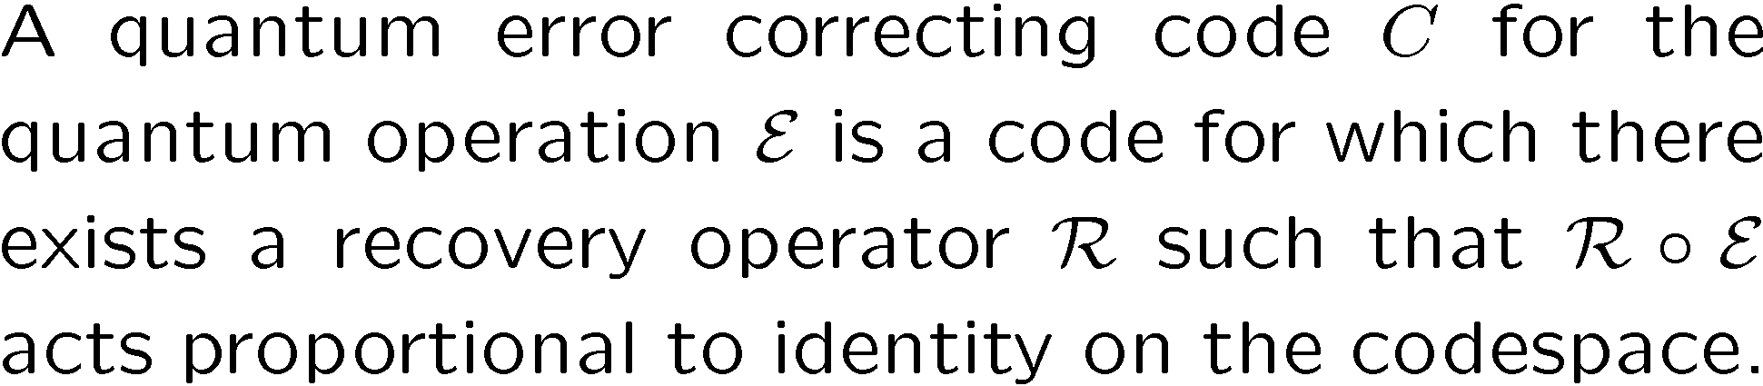
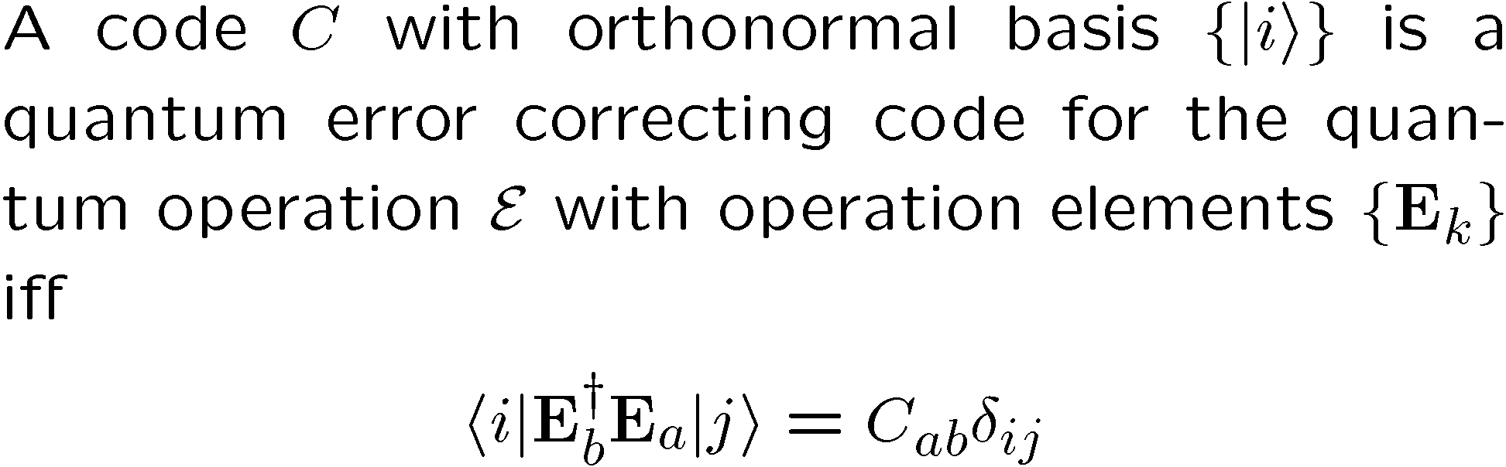
Lets Get Definitional
7
subsystem
Quantum Error Correcting Code
Iff Condition for Quantum Error Correcting Code

Slide 23
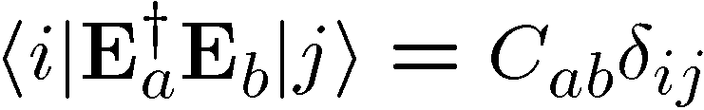
Pictures
Orthogonality maintained
Orthogonality not maintained
codespace
Orthogonal subspaces
Errors not distinguishable
BAD
GOOD

Slide 24

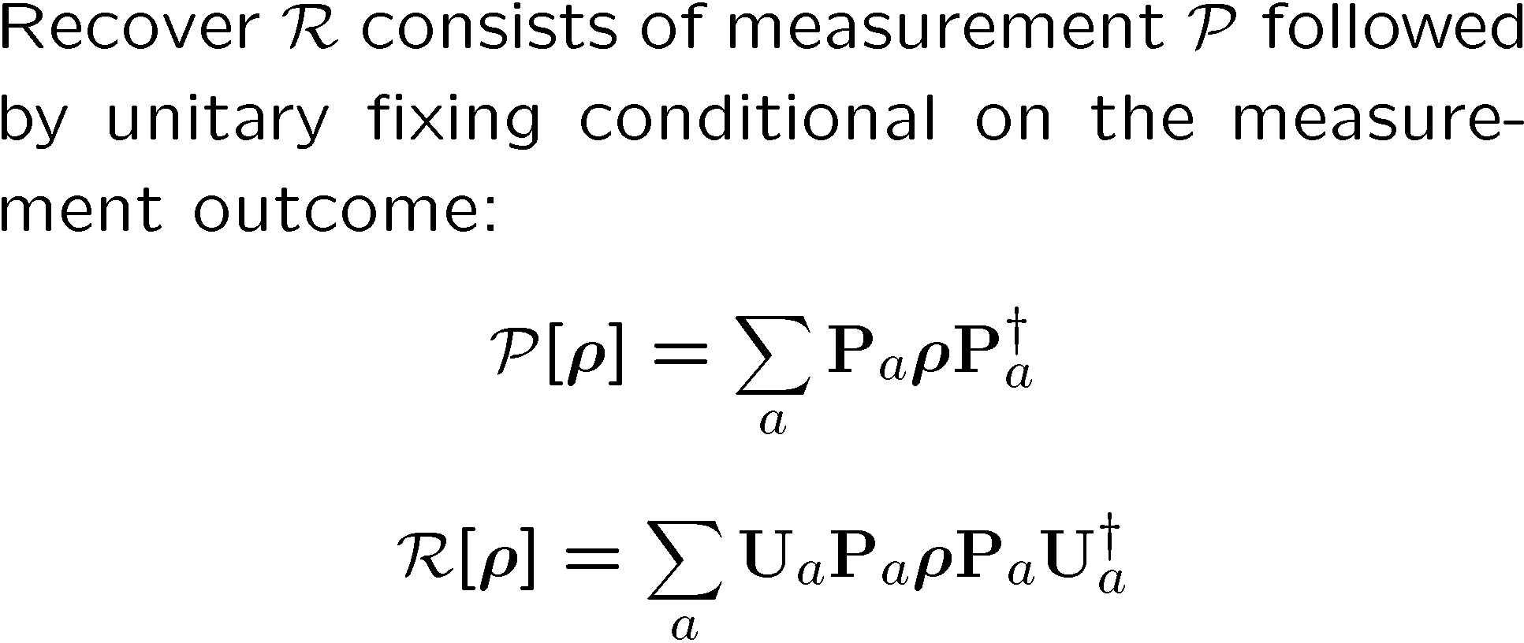

The Recovery Room
25
diagnose
error
fix
encode

Slide 25
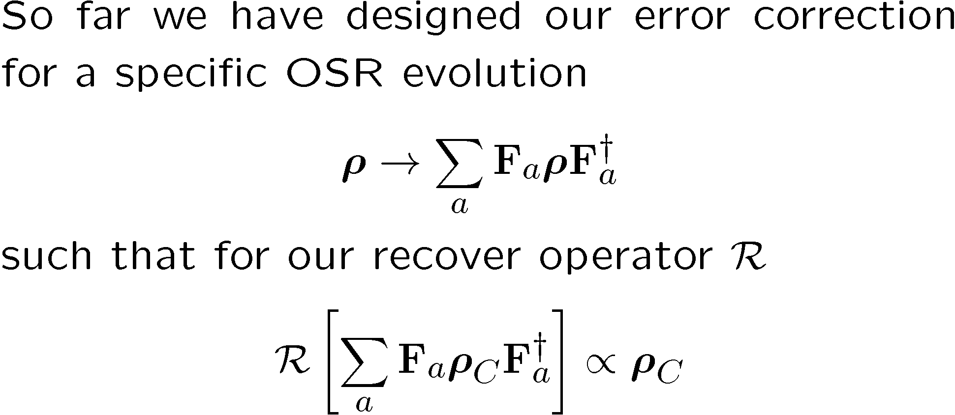
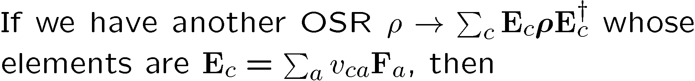
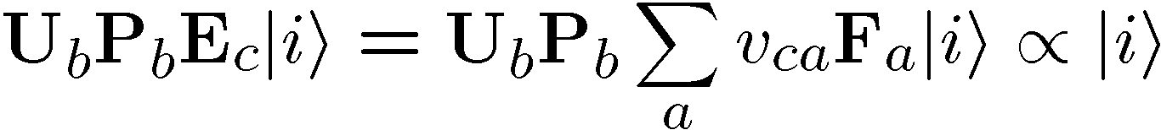
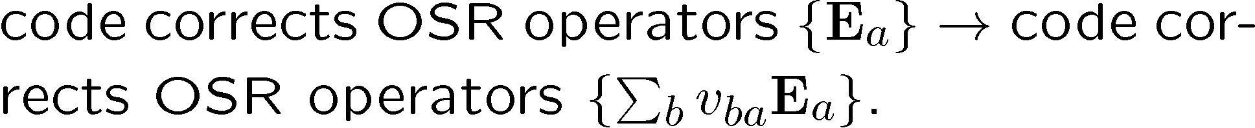
Digitizing Errors
15

Slide 26
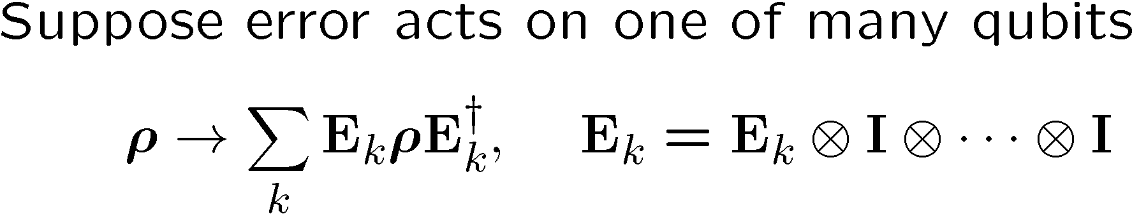
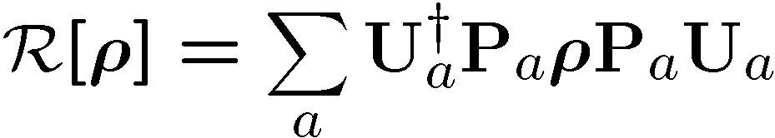
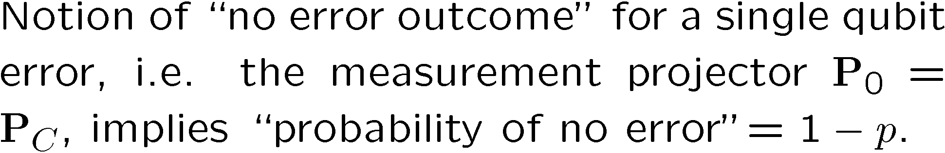
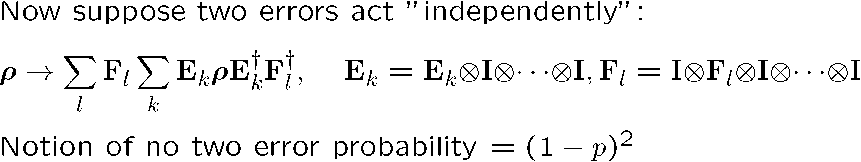
How Have We Helped?
21

Slide 27
Independent Error Model
?
WARNING: “An approximation only a physicist could love.”
qubits/subsystems
local environments
Evolution dominated by interaction with different environment modes which do not interact with each other:
Notion of “no error probability” gives credence to standard argument for error correction success.
Really we can weaken this requirement (exponentially decreasing correlation [time and space] between errors).

Slide 28
Mysterious Extra Slide II

Slide 29
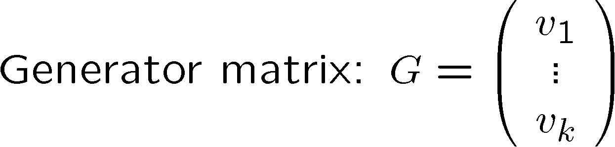

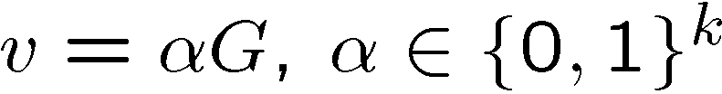
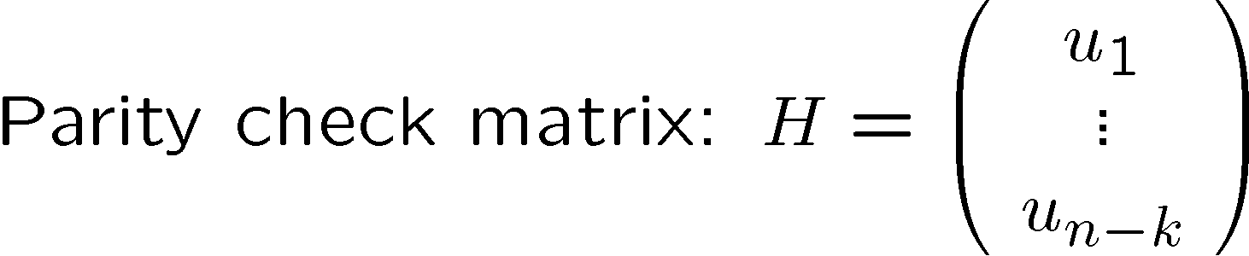


Linear Classical Codes

Slide 30


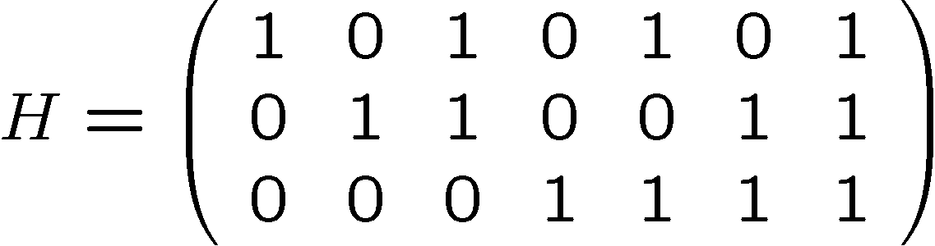
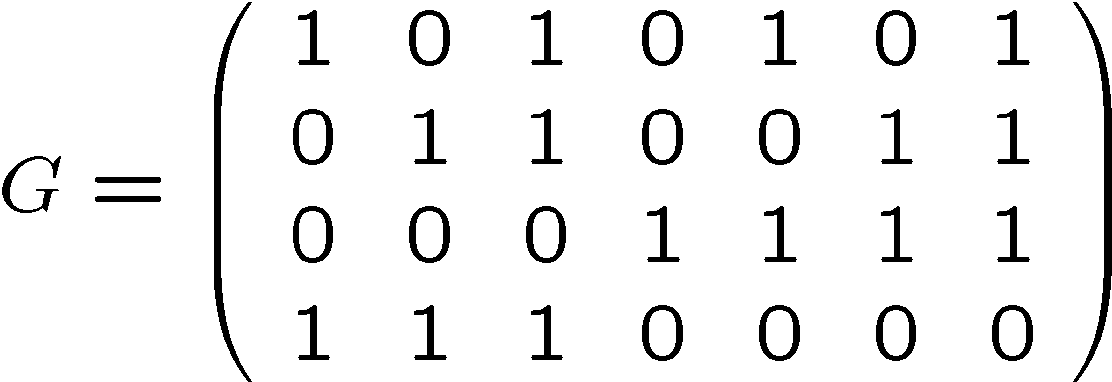
Linear Classical Codes II

Slide 31





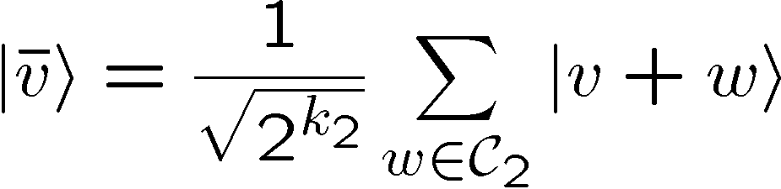





Calderbank-Shor-Steane Codes

Slide 32









CSS Codes at Work and Play
D
D
D
F
F

Slide 33










Set Your Phasors To Stun
D
D
F
H
H
D
F

Slide 34




Examplicious

Slide 35





For Those Who Just Woke Up

Slide 36


Unmixing Simplification
U
Purification of system B
U
Purification of system B

Slide 37




Necessary

Slide 38






OSR Unitary Freedom
U
U
V
Equivalent from system A’s perspective

Slide 39

Diagonal Error Condition

Slide 40

Sufficient
fix/diagnose error/error/code
fix/diagnose no error/error/code

Slide 41

recovery
error

