Slide 1


Does Time Travel Imply NP is in BQP?
or
How I learned to stop worrying about patricidal paradoxes and love closed timelike curves.
Dave Bacon
Institute for Quantum Information, Caltech
Preskill Group meeting, September 13, 2001

Slide 2
Seminar on time travel to be held two weeks ago.

Slide 3
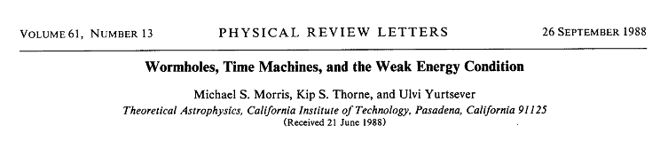
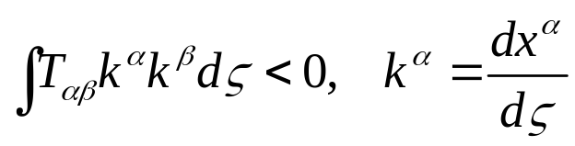
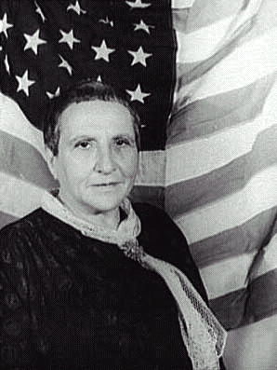
Normally theoretical physicists ask, “What are the laws of physics?” and/or “What do those laws predict about the Universe?” … We ask, instead, “What constraints do the laws of physics place on the activities of an arbitrarily advanced civilization?” … whether the laws of physics permit an arbitrarily advanced civilization to construct and maintain wormholes. Morris, Thorne, Yurtsever PRL, 61, 1446 (1988)
Argue: stable wormholes can exist, thread with averaged weak energy condition violating material:
Gertrude Stein
“There are two theres there.”

Slide 4
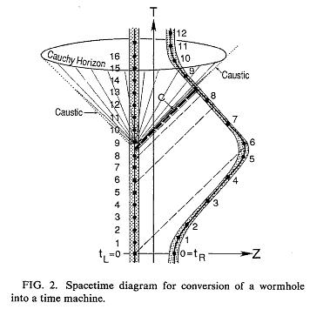
Turning Wormholes into Time Machines
Use “twin paradox” (also could use gravitational redshift)
time delay between wormhole throats
initial conditions uniquely determine solution up to “Cauchy Horizon”
Cauchy Horizon is set of measure zero: MTY conjecture unique evolution through the Cauchy Horizon.
Initial conditions
Morris, Thorne, Yurtsever (1984)
Horizon is stable? …

Slide 5
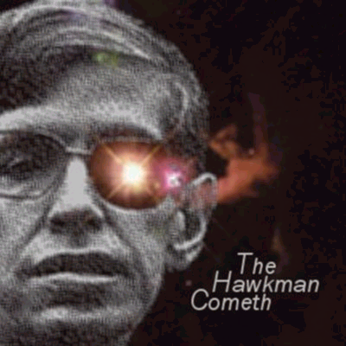
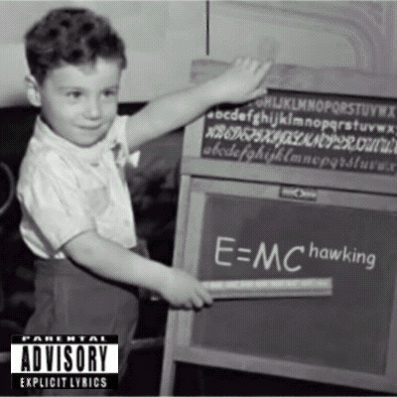
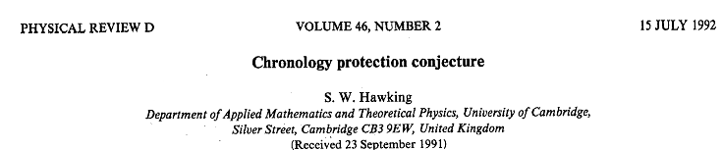
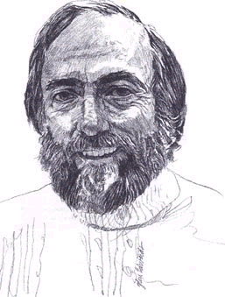
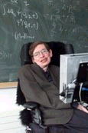
I am NOT the Mighty Stephen Hawking
(http://www.mchawking.com/)

Slide 6
Closed Timelike Curves
time
time
V₋
V₊
V₊
V₋
space
space
time
time
RuhRoh!
CTC
Cauchy horizon
Region
of CTCs
space
space
Politzer, PRD 49, 3981 (1994)

Slide 7
Qubits in Spacetime

