Slide 1


Does Time Travel Imply NP is in BQP?
or
How I learned to stop worrying about patricidal paradoxes and love closed timelike curves.
Dave Bacon
Institute for Quantum Information, Caltech
Preskill Group meeting, September 13, 2001

Slide 2
Seminar on time travel to be held two weeks ago.

Slide 3
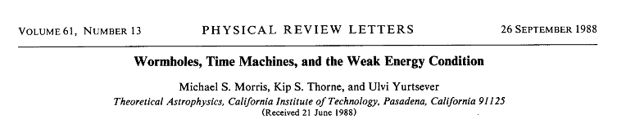
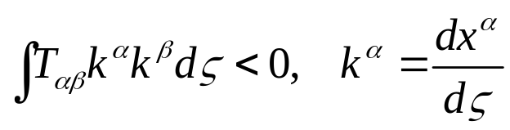
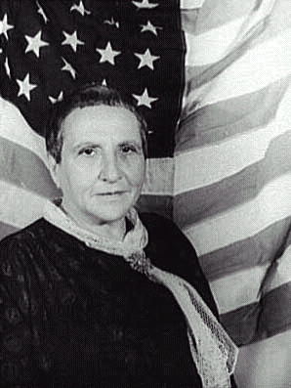
Normally theoretical physicists ask, “What are the laws of physics?” and/or “What do those laws predict about the Universe?” … We ask, instead, “What constraints do the laws of physics place on the activities of an arbitrarily advanced civilization?” … whether the laws of physics permit an arbitrarily advanced civilization to construct and maintain wormholes. Morris, Thorne, Yurtsever PRL, 61, 1446 (1988)
Argue: stable wormholes can exist, thread with averaged weak energy condition violating material:
Gertrude Stein
“There are two theres there.”

Slide 4
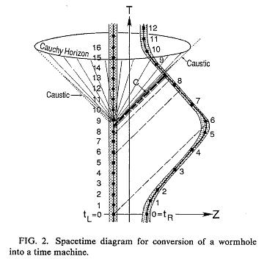
Turning Wormholes into Time Machines
Use “twin paradox” (also could use gravitational redshift)
time delay between wormhole throats
initial conditions uniquely determine solution up to “Cauchy Horizon”
Cauchy Horizon is set of measure zero: MTY conjecture unique evolution through the Cauchy Horizon.
Initial conditions
Morris, Thorne, Yurtsever (1984)
Horizon is stable? …

Slide 5
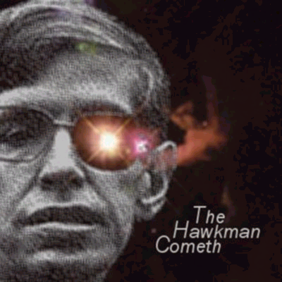
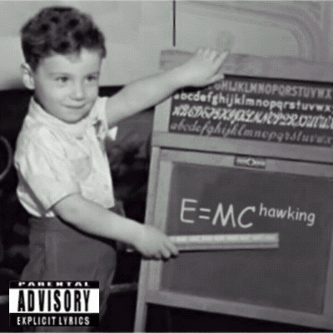
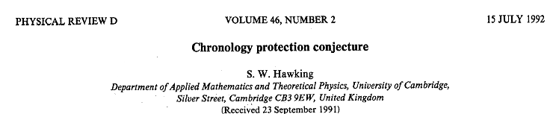
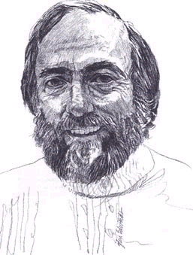
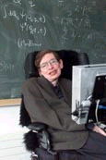
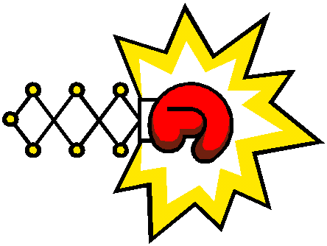

I am NOT the Mighty Stephen Hawking
(http://www.mchawking.com/)
Quantum vacuum polarizations prevent formation of closed timelike curves.
General result, no CTCs, still conjecture, no proof (yet).
Hawking Thorne
“Tonight on FOX:”
When Scientists Attack!

Slide 6
Closed Timelike Curves
time
time
V₋
V₊
V₊
V₋
space
space
time
time
RuhRoh!
CTC
Cauchy horizon
Region
of CTCs
space
space
Politzer, PRD 49, 3981 (1994)

Slide 7
Qubits in Spacetime
time
allow qubits which travel on CTCs
time
Initial conditions specifying CTC qubit (input?!)
space
Initial conditions specifying gates and input.
space
allow CTC qubits to interact with nonCTC qubits
Complexity: resource quantification as size of computational problem
time
Argue: some fixed energy expendature to create CTC qubit
space

Slide 8
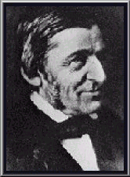
Consistency
Closed Timelike Curves
Quantum Theory
Consistency
To add in the presence of
Principle of self-consistency
“the only solutions to the laws of physics that can occur locally are those which are globally self-consistent.”
I.D. Novikov, Evolution of the Universe (1983)
Friedman et al. “Cauchy problem in spacetimes with closed timelike curves” PRD 42 1915 (1990)
D. Deutsch “Quantum mechanics near closed timelike lines” PRD 44 3197 (1991)
“A foolish consistency is the hobgoblin of little minds, adored by little statemen and philosophers and diviners.”
Emerson

Slide 9
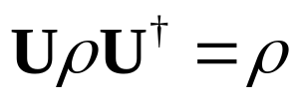


EZ Consistency 123
Case I (BORING)
No operations on the CTC qubit
All CTC qubit states are consistent.
Output of circuit unaffected by existence of CTC
Case II (LESS BORING)
Operation on the CTC qubit
Any mixture of eigenstate of U consistent (if degeneracy, then superpositions of eigenstates)
Output of circuit unaffected by existence of CTC
U
Question of temporal origin? or

Slide 10




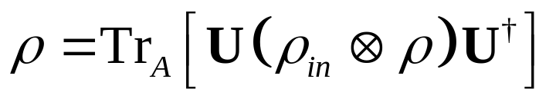
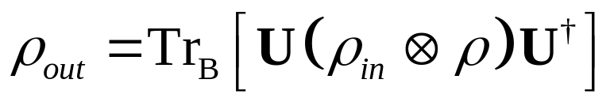
Case III (OHSO NONBORING)
U
Most general circuit
Consistency:
Output:
Question: Is there always a consistent solution?
Question: More than one consistent solution?

Slide 11
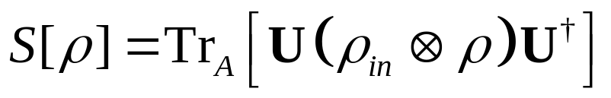
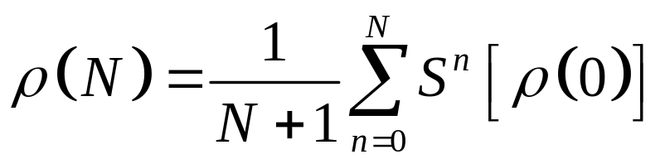
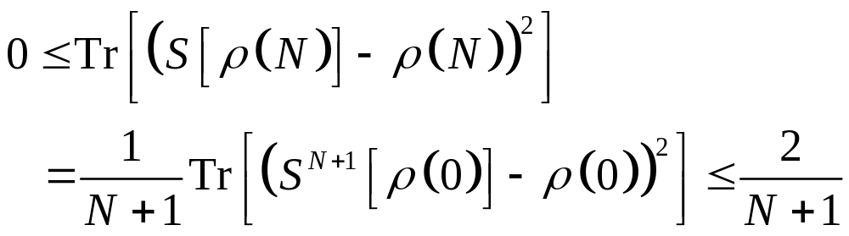
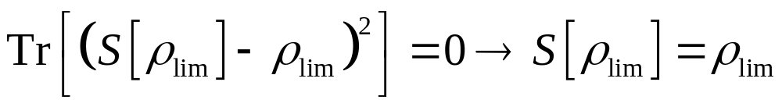
“42,” Douglas Adams
D. Deutsch “Quantum mechanics near closed timelike lines” PRD 44 3197 (1991)
Fixed point of superoperator S:
Define density operators (0) and (N):
Sequence {(N)} must have at least one accumulation point _{lim}
Bound:
Such that:

Slide 12
Argument by Example

