Slide 1


Does Time Travel Imply NP is in BQP?
or
How I learned to stop worrying about patricidal paradoxes and love closed timelike curves.
Dave Bacon
Institute for Quantum Information, Caltech
Preskill Group meeting, September 13, 2001

Slide 2
Seminar on time travel to be held three weeks ago.

Slide 3
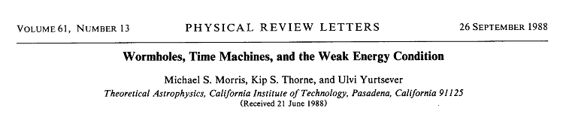
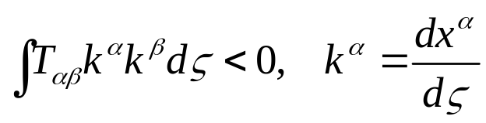
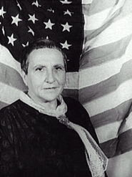
Normally theoretical physicists ask, “What are the laws of physics?” and/or “What do those laws predict about the Universe?” … We ask, instead, “What constraints do the laws of physics place on the activities of an arbitrarily advanced civilization?” … whether the laws of physics permit an arbitrarily advanced civilization to construct and maintain wormholes. Morris, Thorne, Yurtsever PRL, 61, 1446 (1988)
Argue: stable wormholes can exist, thread with averaged weak energy condition violating material:
Gertrude Stein
“There are two theres there.”

Slide 4
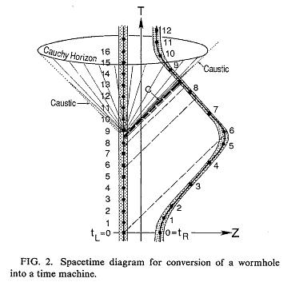
Turning Wormholes into Time Machines
Use “twin paradox” (also could use gravitational redshift)
time delay between wormhole throats
initial conditions uniquely determine solution up to “Cauchy Horizon”
Cauchy Horizon is set of measure zero: MTY conjecture unique evolution through the Cauchy Horizon.
Initial conditions
Morris, Thorne, Yurtsever (1984)
Horizon is stable? …

Slide 5
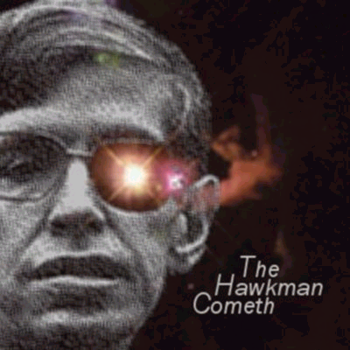
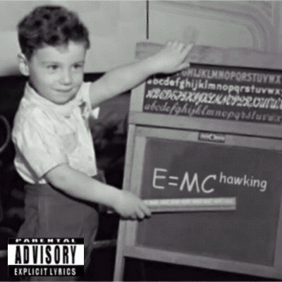
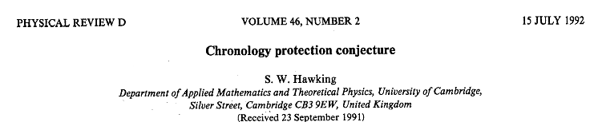
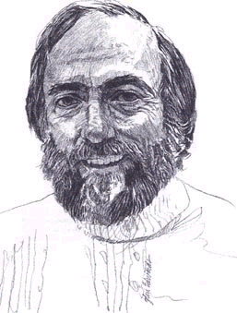
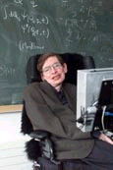


I am NOT the Mighty Stephen Hawking
(http://www.mchawking.com/)
Quantum vacuum polarizations prevent formation of closed timelike curves.
General result, no CTCs, still conjecture, no proof (yet).
Hawking Thorne
“Tonight on FOX:”
When Scientists Attack!

Slide 6
Closed Timelike Curves
time
time
V₋
V₊
V₊
V₋
space
space
time
time
RuhRoh!
CTC
space
space
Politzer, PRD 49, 3981 (1994)

Slide 7
Qubits in Spacetime
time
allow qubits which travel on CTCs
time
Initial conditions specifying CTC qubit (input?!)
space
Initial conditions specifying gates and input.
space
allow CTC qubits to interact with nonCTC qubits
Complexity: resource quantification as size of computational problem
time
Argue: some fixed energy expendature to create CTC qubit
space

Slide 8
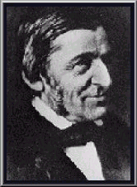
Consistency
Closed Timelike Curves
Quantum Theory
Consistency
To add in the presence of
Principle of self-consistency
“the only solutions to the laws of physics that can occur locally are those which are globally self-consistent.”
I.D. Novikov, Evolution of the Universe (1983)
Friedman et al. “Cauchy problem in spacetimes with closed timelike curves” PRD 42 1915 (1990)
D. Deutsch “Quantum mechanics near closed timelike lines” PRD 44 3197 (1991)
“A foolish consistency is the hobgoblin of little minds, adored by little statesmen and philosophers and diviners.”
Emerson

Slide 9
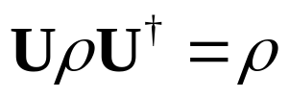


EZ Consistency 123
Case I (BORING)
No operations on the CTC qubit
All CTC qubit states are consistent.
Output of circuit unaffected by existence of CTC
Case II (LESS BORING)
Operation on the CTC qubit
Any mixture of eigenstates of U consistent (if degeneracy, then superpositions of eigenstates)
Output of circuit unaffected by existence of CTC
U
Question of temporal origin? or
“no unique time ordering of spacelike surfaces”

Slide 10




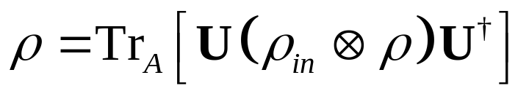
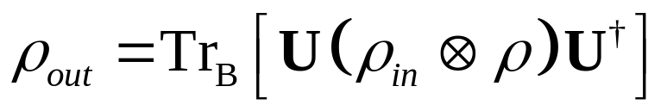
Case III (OHSO NONBORING)
U
Most general circuit
Consistency:
Output:
Question: Is there always a consistent solution?
Question: More than one consistent solution?

Slide 11
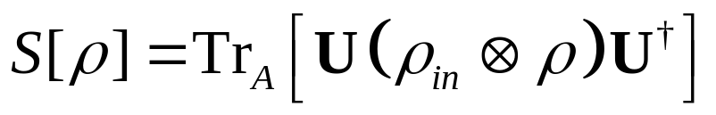
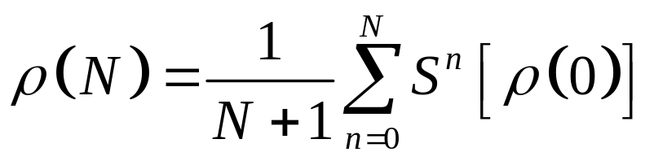
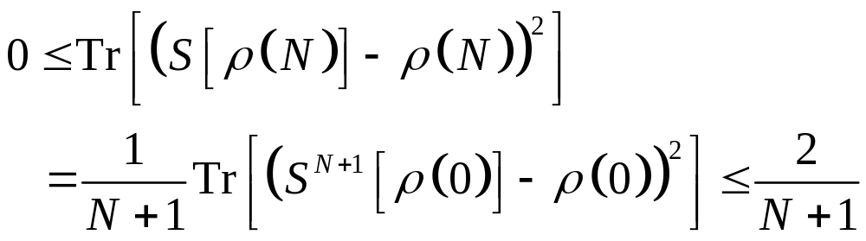
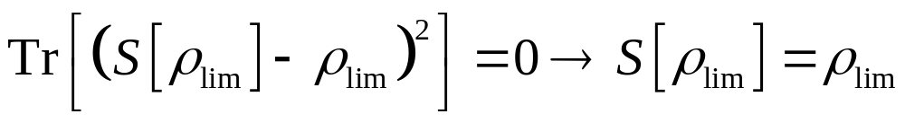
“42,” said Douglas Adams
D. Deutsch “Quantum mechanics near closed timelike lines” PRD 44 3197 (1991)
Fixed point of superoperator S:
Define density operator (N) for arbitrary(0):
Sequence {(N)} must have at least one accumulation point _{lim}
Bound:
Such that:

Slide 12
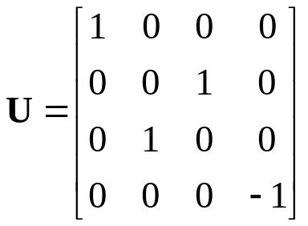
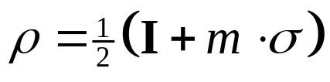
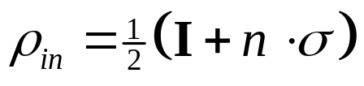

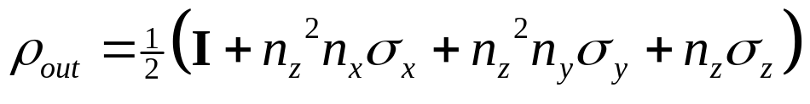
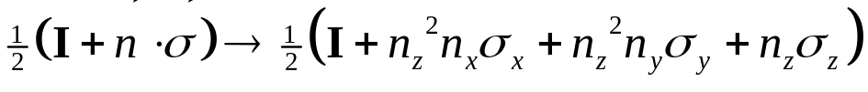
Argument by Example
two qubits
Consistency implies:
single consistent CTC qubit states.
Output is unambiguous though:
NONLINEAR transformation:

Slide 13
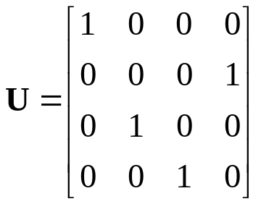

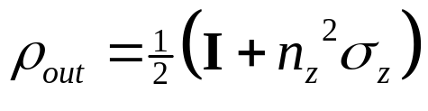
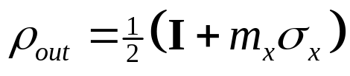
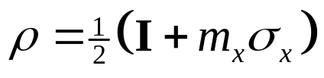
“Controlled-Not”ing Oneself
Consistency implies:
Output is unambiguous if n_{x} 1
however CTC qubit and output is ambiguous if n_{x} =1
Question: What to do with ambiguous solutions?

Slide 14
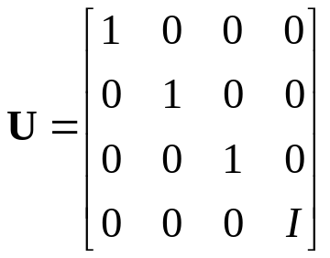
“Controlled-S”ing
S
Ambiguity not just for a single input state.
Ambiguous for all input states except n_{x}= n_{y} =0

Slide 15
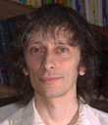
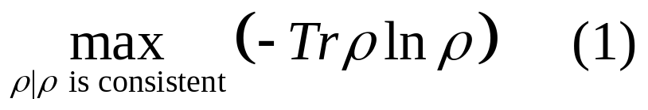
Deutsch’s Ambiguous Solution?
“[Philosophical posture deleted]…the state of the supplementary data is the state of greatest entropy compatible with the initial data.”
David Deutsch
i.e.
Open Question I: Is Deutsch’s solution to the consistency condition ambiguous? Are there multiple solutions to (1) which lead to different _{in}_{out} mappings?
Open Question II: Can the ambiguity be explained via evolution from initial conditions which created the CTC qubits?
See Politzer, PRD 49, 3981 (1994) for another view on the ambiguity

Slide 16
Dave, look at your watch to see how long you’ve been yacking.

Slide 17
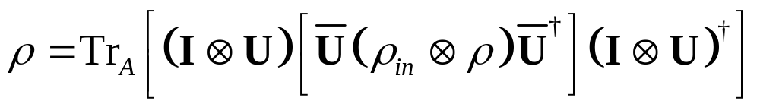
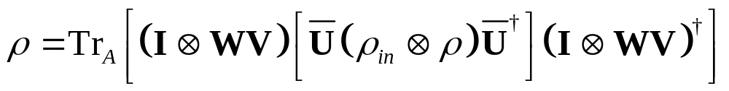
What Time is it?
W
U
V
V
U=WV
W
Consistency:
Open Question III: Temporal origin problem?

Slide 18
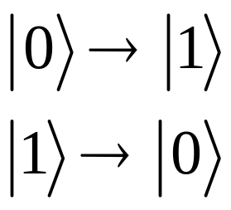
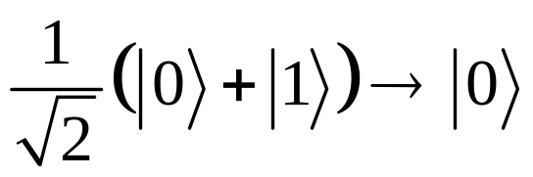
Nonlinear Evolution
BUT
(mostly discussed in context of “solution to measurement problem”)
“If you hit a tuning fork twice as hard it will ring twice as loud. That’s a linear response. If you hit a person twice as hard, they’re unlikely just to shout twice as loud. That property lets you learn more about the person than the tuning fork” - Neil Gershenfeld.

Slide 19
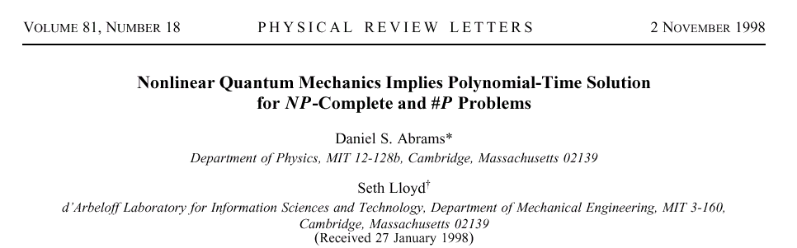

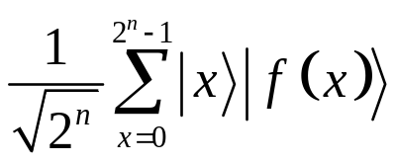
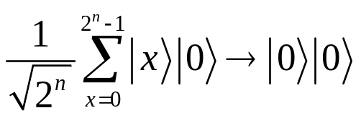
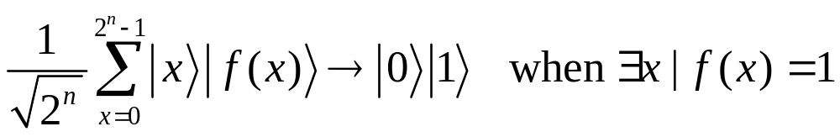
“Superman don’t need no seat belt”-Muhammad Ali
Nonlinear evolution of a quantum system can lead to efficient solution of NP-complete and #P-complete problems.
The Superman Nonlinear Transform
U_{f}

Slide 20
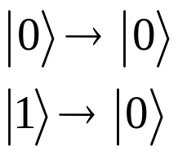
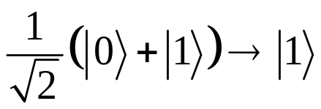
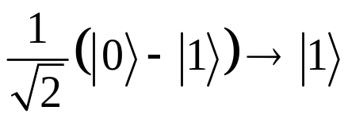
Just a Spoonful of Nonlinearity Makes the Medicine Go Down
Abrams and Lloyd showed a single qubit nonlinear transformation could be used to solve NP-complete problems:
BUT
Specific nonlinear QM (Weinberg, Ann. Of Phys. 194 336 (1989))
can produce needed transformations.

Slide 21
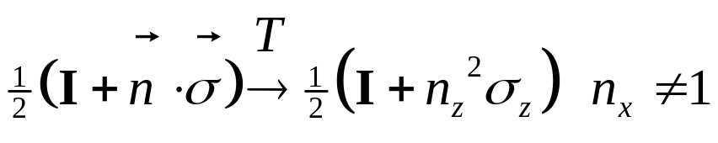
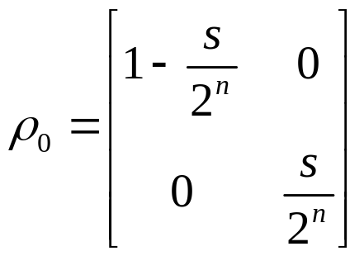
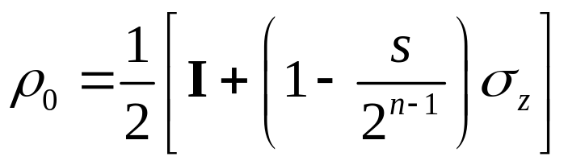
got nonlinearity?
n
U_{f}
s is number of x’s such that f(x)=1

Slide 22
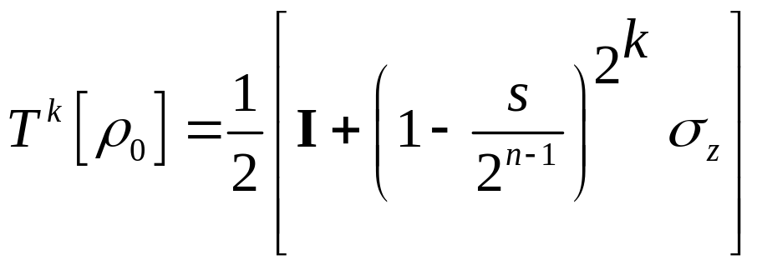
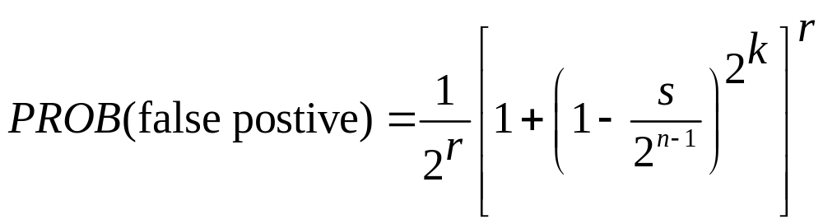
got nonlinearity?
Apply T k times:
If s=0, state is still |0. If s 0, state is exponentially close, for polynomial k, to 1/2(|0↑0|+|1↑1|).
Polynomial application of routine will determine whether s=0.

Slide 23
Time Machines imply NP is in BQP
NPBQP^{TT}????
“For a successful technology, reality must take precedence over public relations, for nature cannot be fooled.” - Richard P. Feynman

Slide 24
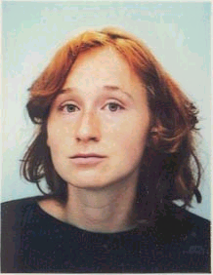
Collaborator: Dr. Dr. Julia Kempe, U.C. Berkeley
CTC Guru: Mike (Jun) Cai a.k.a. STUDBUD

