Slide 1
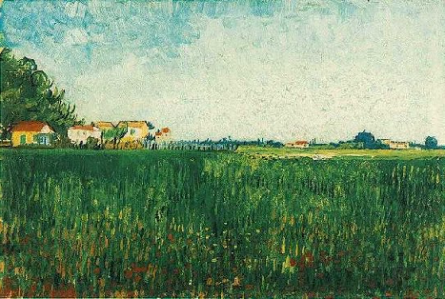
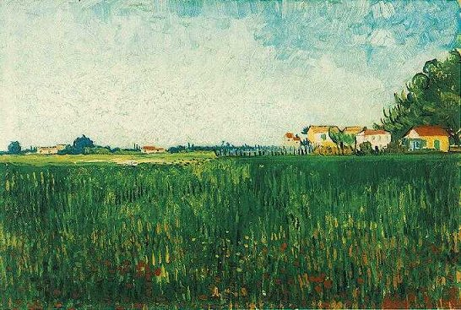
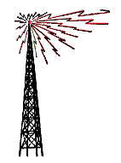

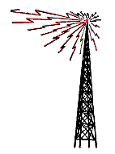


Bell Tolls
the quest for the bandwidth of the quantum
never forget for whom the Bell Tolls
it tolls for MIT
Dave Bacon
Institute for Quantum Information
California Institute of Technology

Slide 2








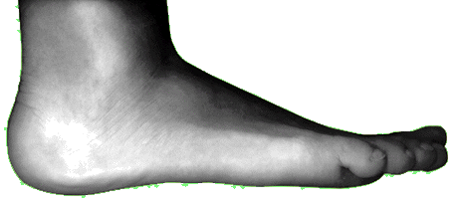

Communication Breakdown

Slide 3
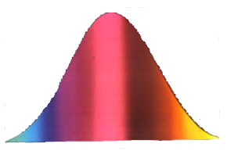




Bell Inequalities

Slide 4
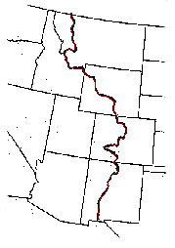


Capitalism for Correlations

Slide 5


What Can We Do?

Slide 6





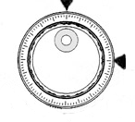








Scenario EZ

Slide 7
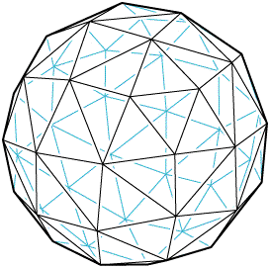

Bell Inequalities with Communication

Slide 8
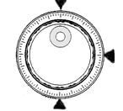


Three Choices

Slide 9

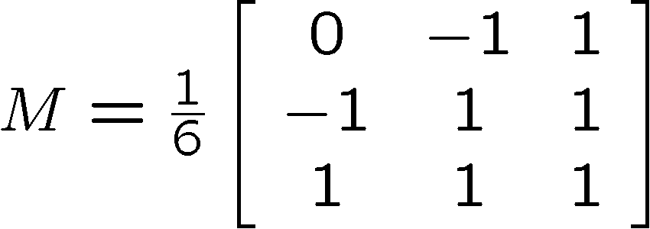
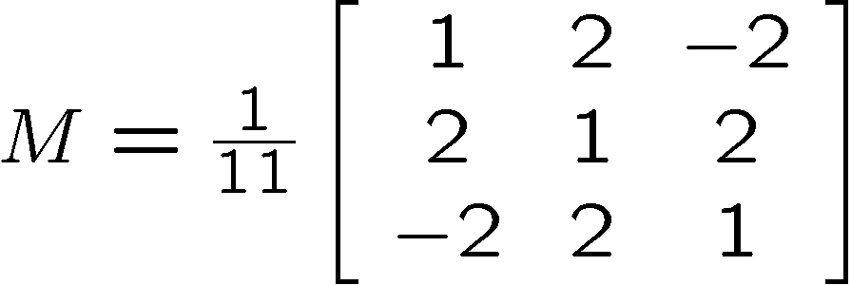

Bell Observable Inequalities with Communication

Slide 10




Anything You Can Do, I Can Do Better

Slide 11



Morals

Slide 12
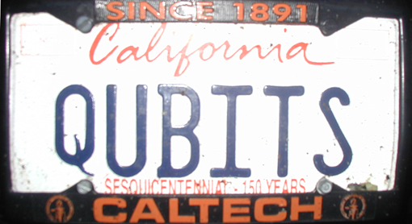



Fin

Slide 13
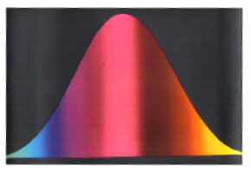

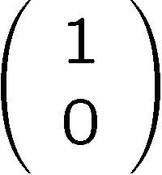


Title

