Slide 1
You Didn’t Just Read This.

Slide 2
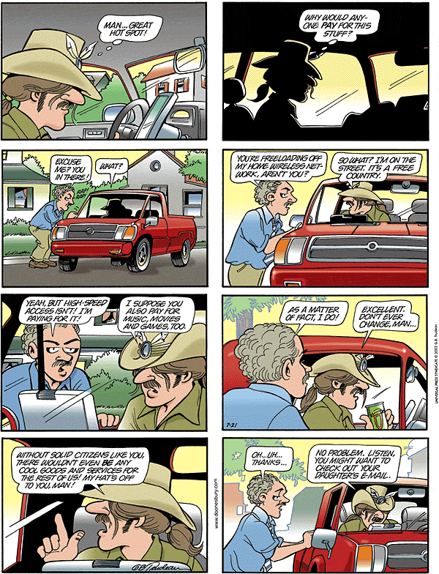

Pay Attention Jonathan!

Slide 3
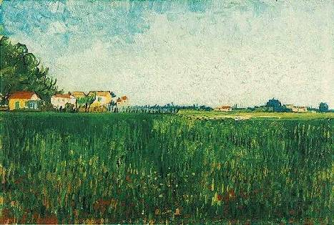
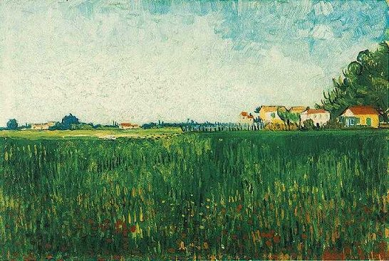





Bell Tolls
the quest for the bandwidth of the quantum
Dave Bacon
Institute for Quantum Information
California Institute of Technology

Slide 4








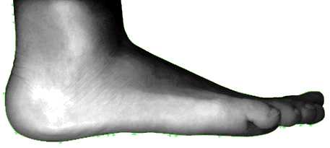

Communication Breakdown

Slide 5
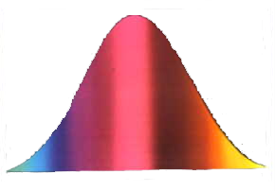




Bell Inequalities

Slide 6
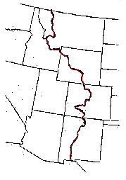


Capitalism for Correlations

Slide 7






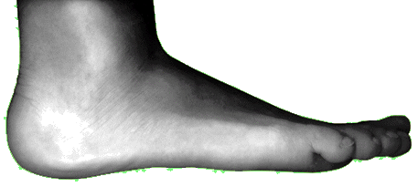

What Can We Do?

Slide 8





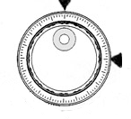








Scenario EZ

Slide 9
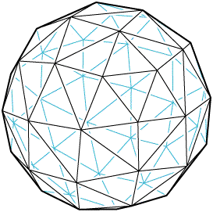

Bell Inequalities with Communication

Slide 10
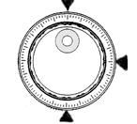


Three Choices

Slide 11

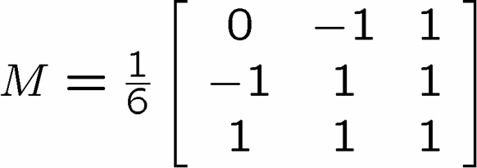
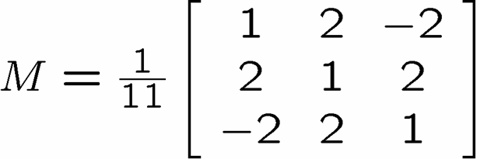

Bell Observable Inequalities with Communication

Slide 12




Anything You Can Do, I Can Do Better

Slide 13



Morals

Slide 14
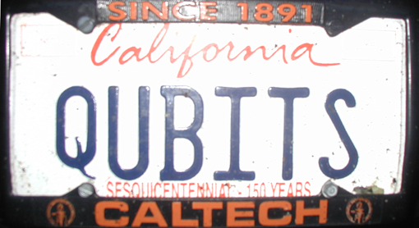



Fin

Slide 15
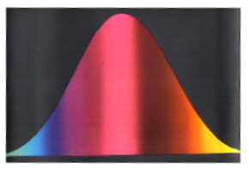

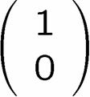


Title

