Slide 1
Quantum Error Correction
Weatherproofing Quantum Computers
Error Clouds
Intel Quantum Computer
Dave Bacon
Institute for Quantum Information
California Institute of Technology

Slide 2
Mystery Slide Here

Slide 3
Technology is the Quest for Control
“To be an Error and to be Cast out is Part of [Nature’s] Design.” -William Blake
Things Fall Apart
-Chinua Achebe
EVENTUALLY your desktop computer hardware will ERROR.
EVENTUALLY the information on a hard drive will be CORUPTED.
Amount of useful computer cycles before such an error occurs (CURRENTLY) = large large number
Exist robust physical systems which serve as classical computers
Quantum Things Fall Apart Fast
Amount of quantum computer cycles before an error  large number
(CURRENTLY?)

Slide 4
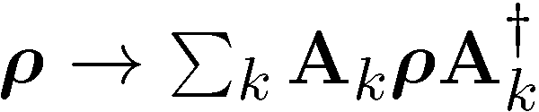
Quantum Computing is Bunk
Ways Quantum Computers Fail to Quantum Compute
Decoherence
Lack of Unitary Control
attempting to apply unitary evolution U instead results in V
or (worse) results in non-unitary evolution
Measurements are faulty
measurement result is noisy, incorrect result obtained
Quantum Computing Disappearing Act
qubits disappear (leakage of computing states)

Slide 5
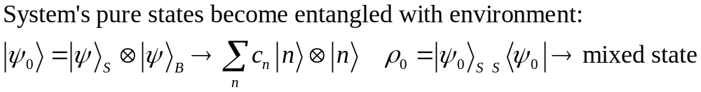
What is the Problem?
Real quantum systems are open quantum systems!
system
environment
Full Hamiltonian:
Interaction causing
DECOHERENCE
System evolution
environment evolution
System evolution (by itself) is no longer unitary
Coherent properties of system’s quantum information lost

Slide 6




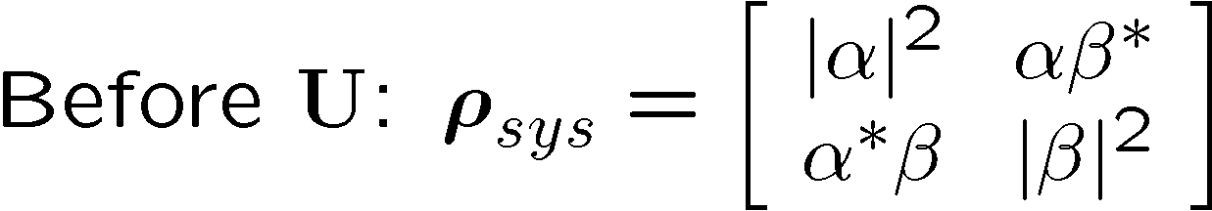
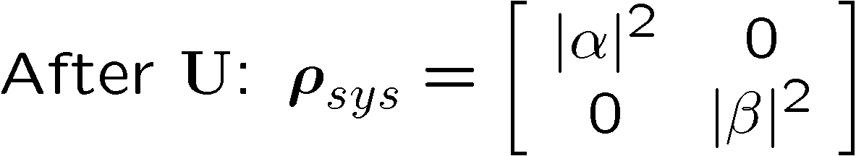
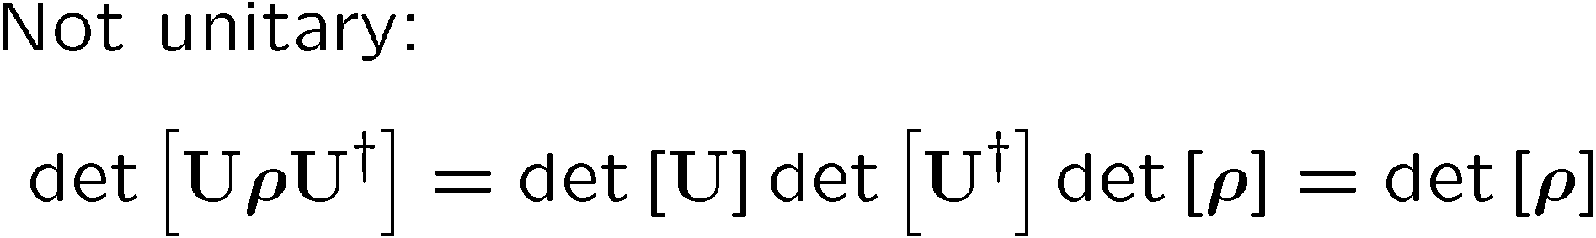
Quantum Error Example
“To err is human, to really foul things up requires a computer.” -Anonymous
system
environment

Slide 7





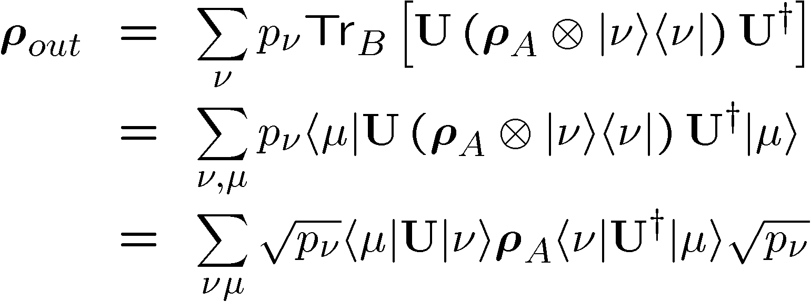
Operator Sum Representation
U
B states

Slide 8


Unmixing Simplification
U
Purification of system B
U
Purification of system B

Slide 9

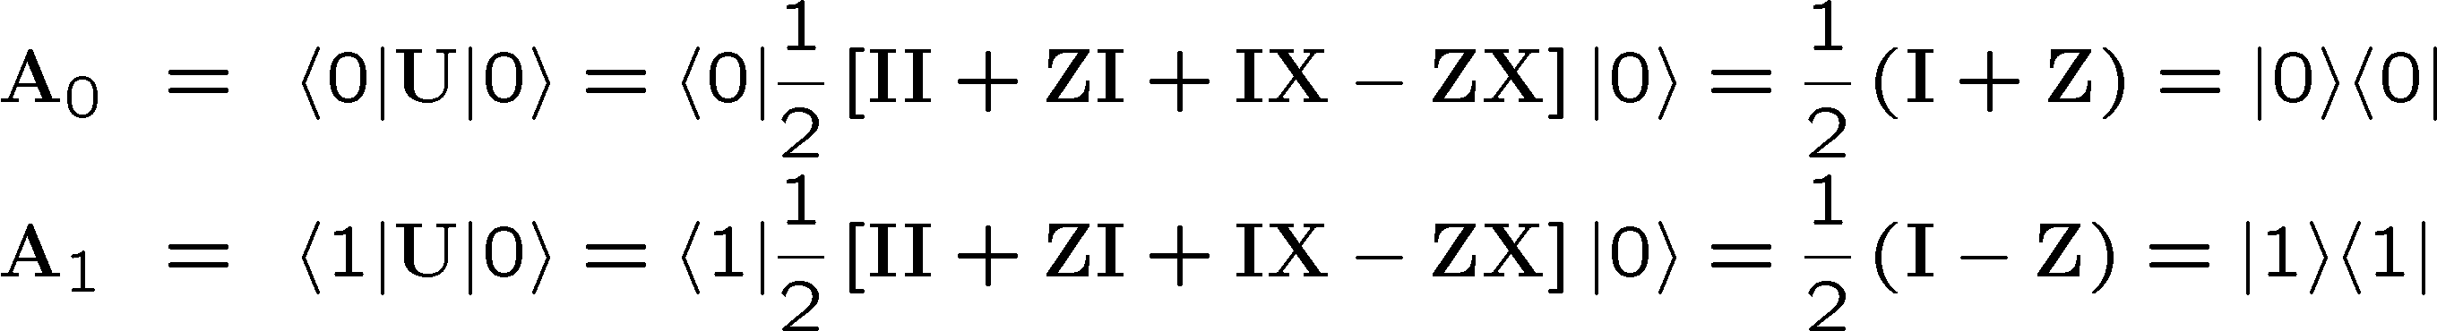
OSR Example
U

Slide 10
Noisy Cell Phone
Hello? Hello? Hello? Hello?
I have a flat tire. I said, I have a flat time! A flat tire.
No, I’m not trying to flatter you…No, your not getting fatter. I have a flat tire!
Communication over a noisy CHANNEL can be overcome via
ENCODING
“Hello?” = “Hello? Hello? Hello? Hello?” [using redundancy to encode “Hello”]

Slide 11
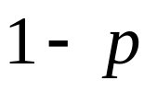
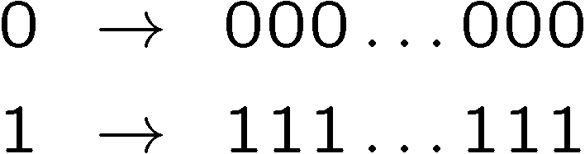

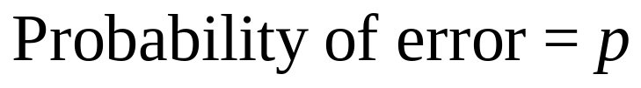
Simple Repetition Code
Encode:
0
0
n copies
1
1
No encoding:
Binary Symmetric Channel
b
measure
Encoding (n=3):
b
encode
b
b
b
decode
and correct
measure
Probability of error

Slide 12
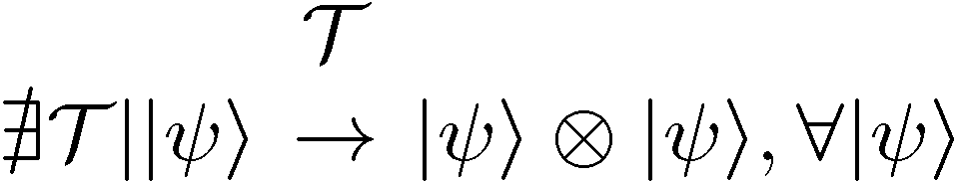

1994 Reasons to be a Pessimist
No cloning:
No cloning of quantum information:
Quantum repetition code impossible:
Continuous set of errors:
Classical errors on digital information are discrete.
Quantum errors on classical information are continuous.
Continuous set of operations:
Continuous set of unitary operations: infinite precision needed to implement a gate?
Measurement destroys coherence:
How can one decode without destroying the information?

Slide 13
Baby Steps
Bit Flip Channel:
WWCCD? (What Would Classical Coders Do?)
measure
b
b
0 000, 1 111
0
b
0
b
encode
error
decode
fix
identities
100  111  101 110  110
b
b
=
b
1
0
1
1
1
=
0
error #@%

Slide 14



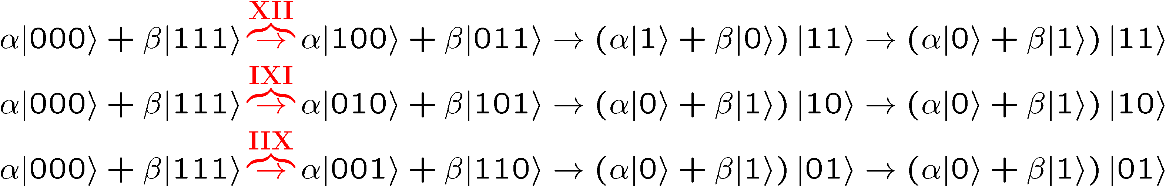
Naïve
4. operator identities still hold
Lets be naïve, take classical and move over to quantum
encode
error
decode fix
?
error
decode
fix
encoded into subspace:
2. errors take to orthogonal
subspaces + maintain orthogonality
3. syndrome
(no-cloning evaded!)

Slide 15
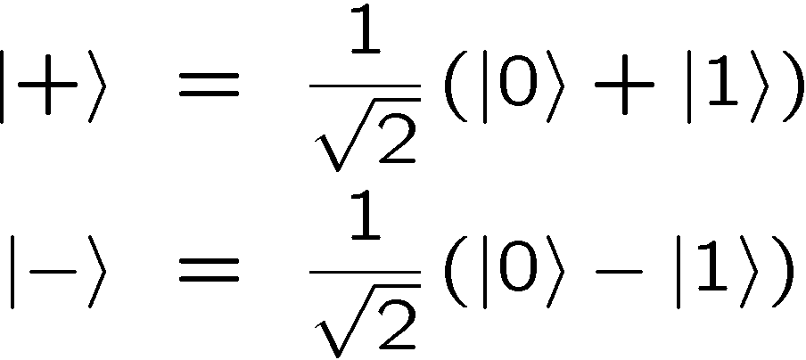
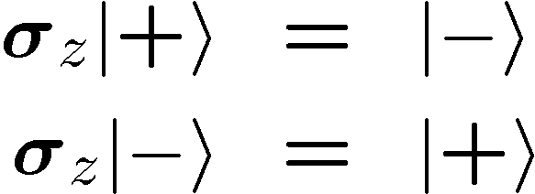


OK Wise Guy
What about “phase” errors?
…sort of not classical error
phase error:
Wise guy says “basis change please”:
looks like bit flit error in this new basis!
H
H
H
H
H
H
phase errors
bit flip errors

Slide 16
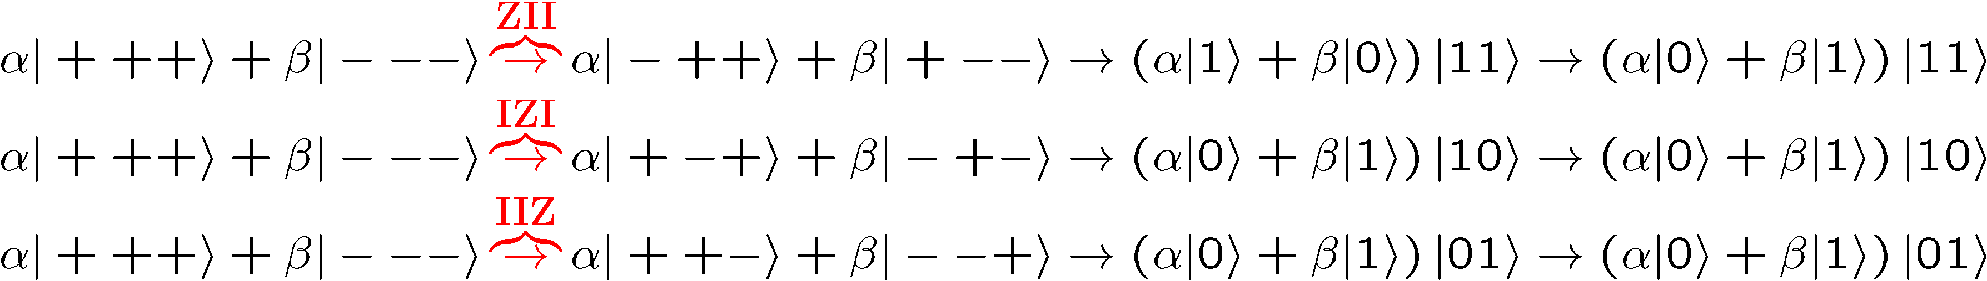
Molly: “I love you, I really love you”
Sam: “Ditto.”
encode
error
decode
fix
H
H
?
H
H
H
H
error
decode
fix
encoded into subspace:
2. errors take to orthogonal
subspaces + maintain orthogonality
3. syndrome
(no-cloning evaded!)

Slide 17


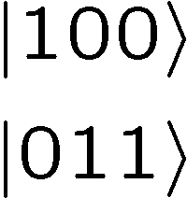




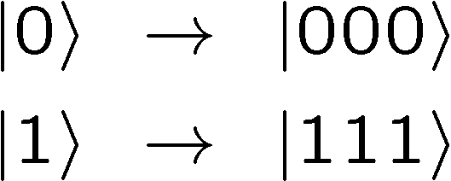

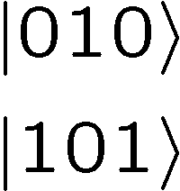



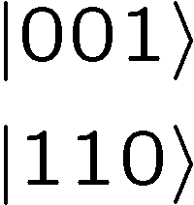

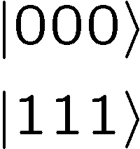
Perspective
Orthogonal subspaces can be distinguished by measurements
without measuring information encoded into the subspace!!!

Slide 18


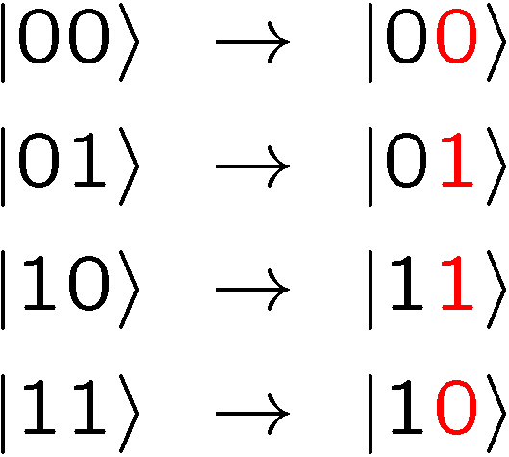
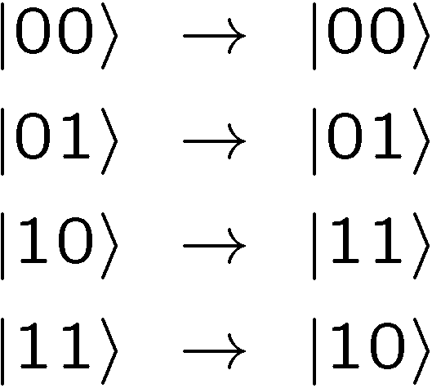



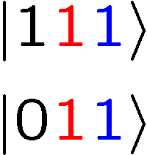
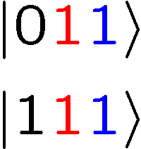
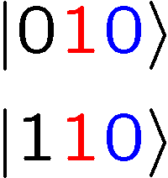
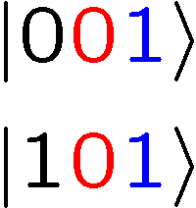
Not An Optical Illusion
fix
error

Slide 19
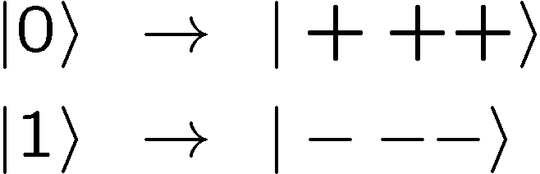


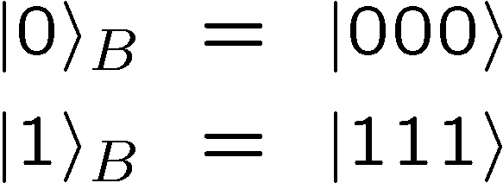
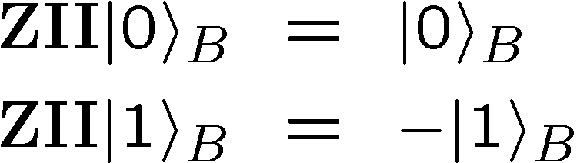
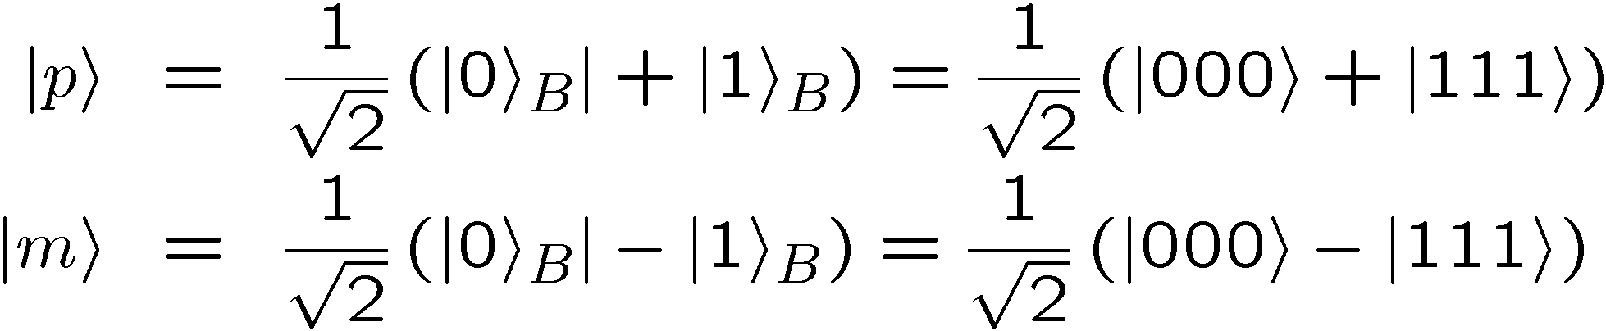
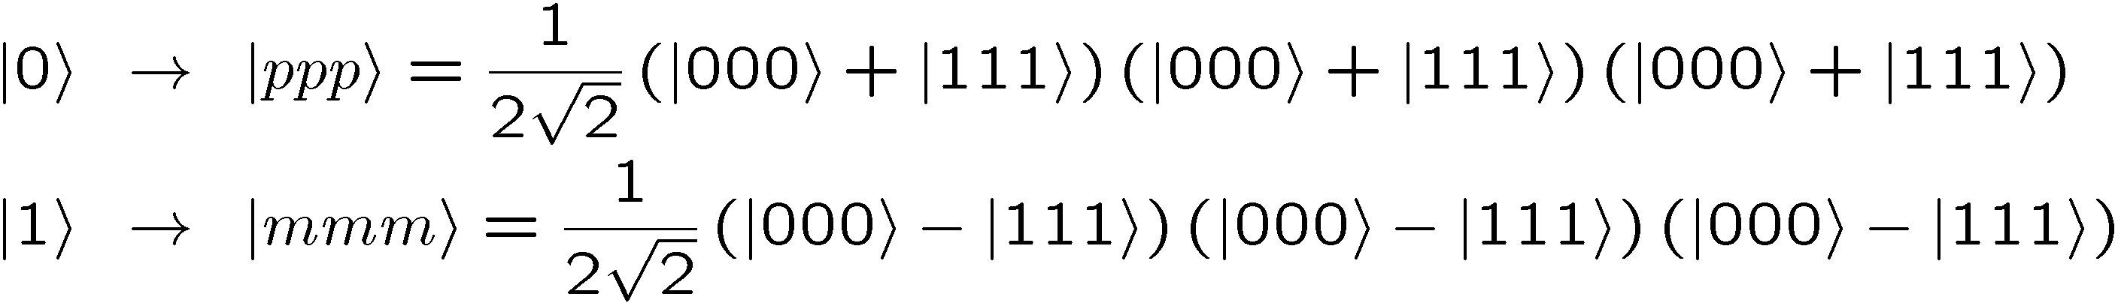
Encoding Away Your Ills
3 qubit bit flip code
3 qubit phase flip code
phase errors act as on bit flip code qubits:
define:
Shor Code: (Peter Shor, 1995)

Slide 20
Inside Shor
H
H
H
H
H
H
bit flip code
phase flip code

Slide 21






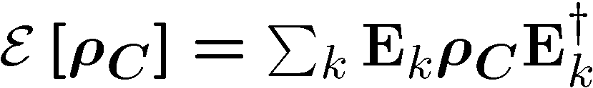

Do the Hokey Pokey
Take a step back:
encode
error
diagnose
error
fix
encode
Here quantum information has simply been encoded into
Then an error occurs
Then a recovery procedure
An miraculously we recover the encoded state

Slide 22
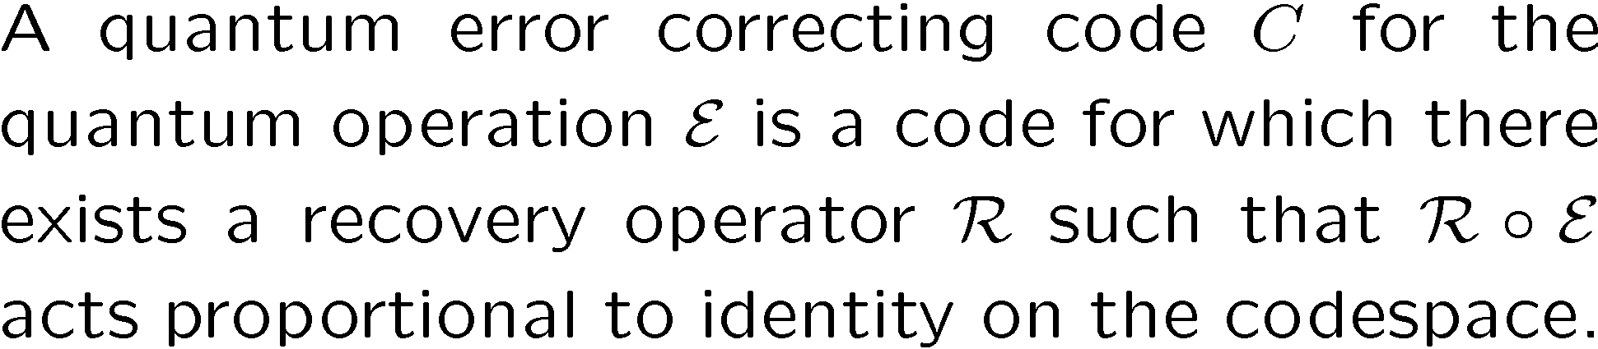
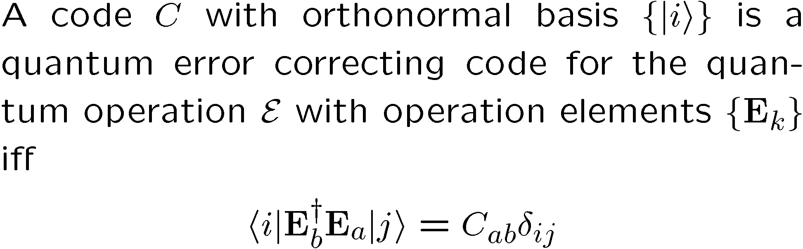
Lets Get Definitional
subsystem
Quantum Error Correcting Code
Iff Condition for Quantum Error Correcting Code

Slide 23
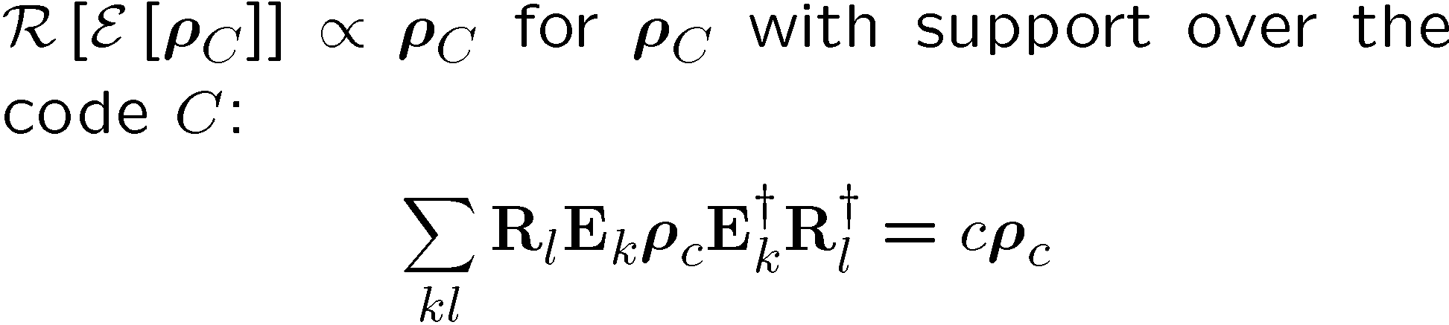
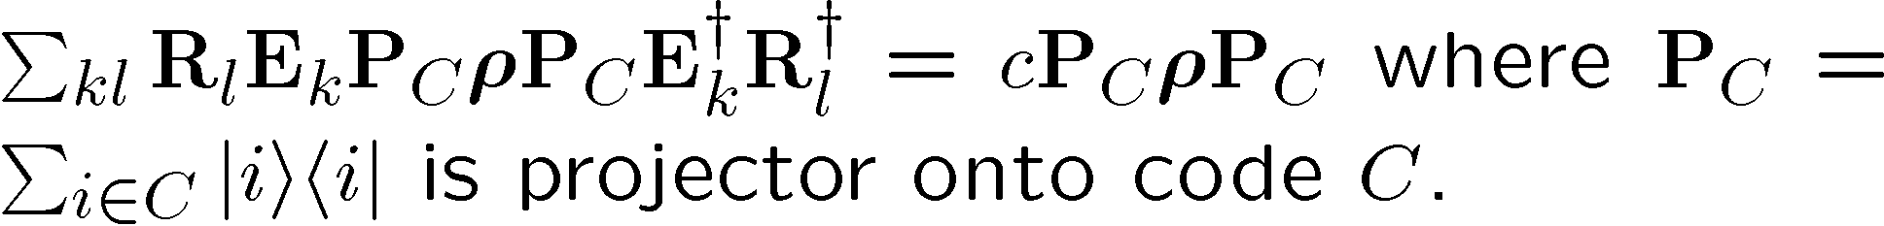
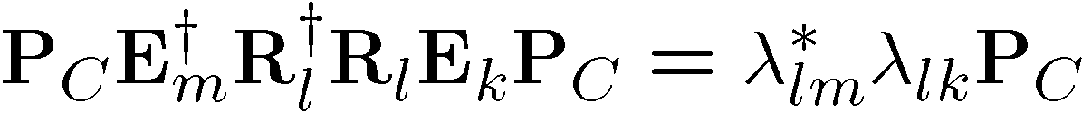
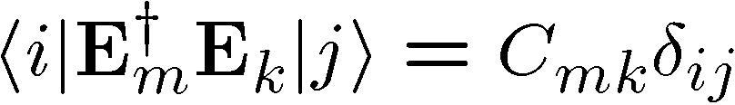
Necessary

Slide 24
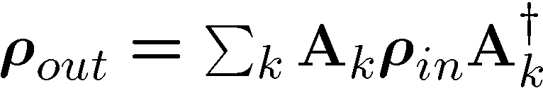


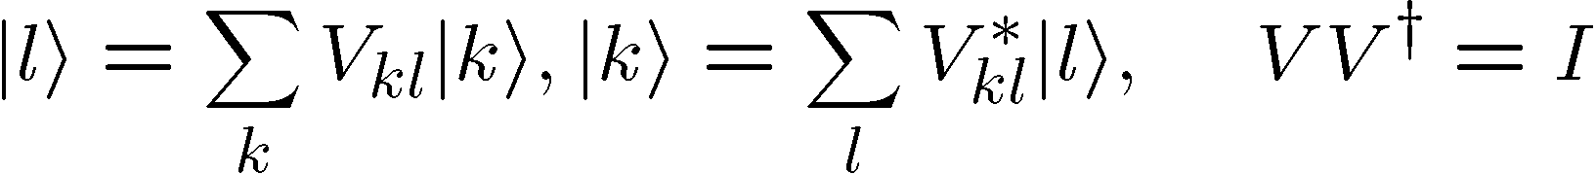
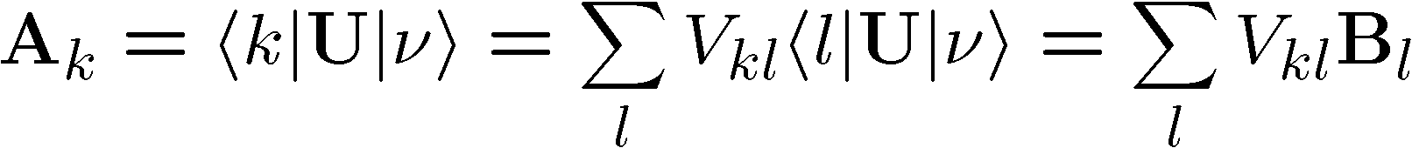
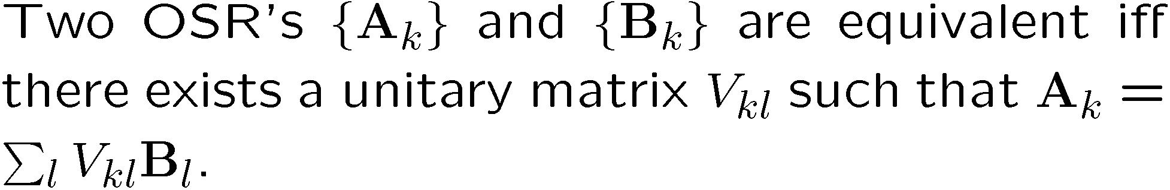
OSR Unitary Freedom
U
U
V
Equivalent from system A’s perspective

Slide 25
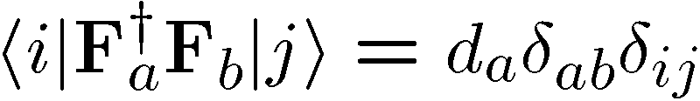
Diagonal Error Condition

Slide 26
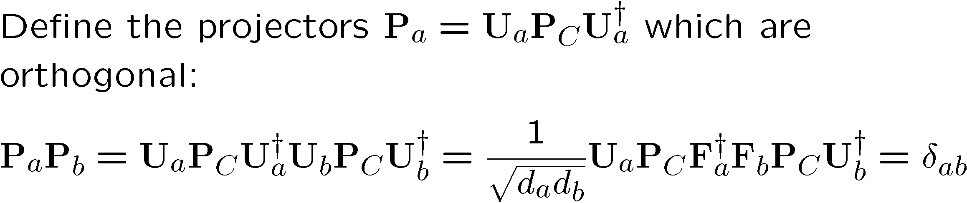
Sufficient
fix/diagnose error/error/code
fix/diagnose no error/error/code

Slide 27
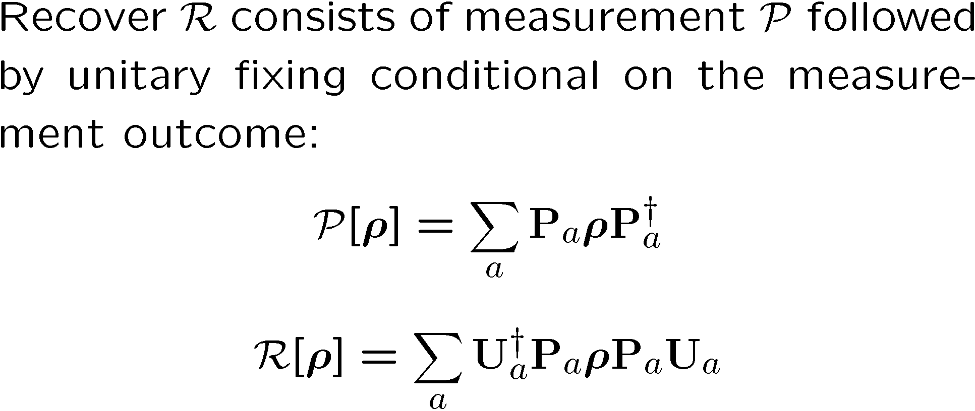
recovery
error

Slide 28
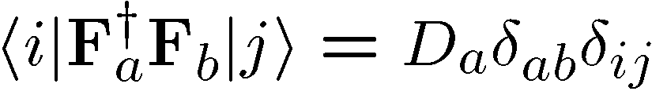
Pictures
Orthogonality maintained
Orthogonality not maintained
codespace
Orthogonal subspaces
Errors not distinguishable
BAD
GOOD

Slide 29
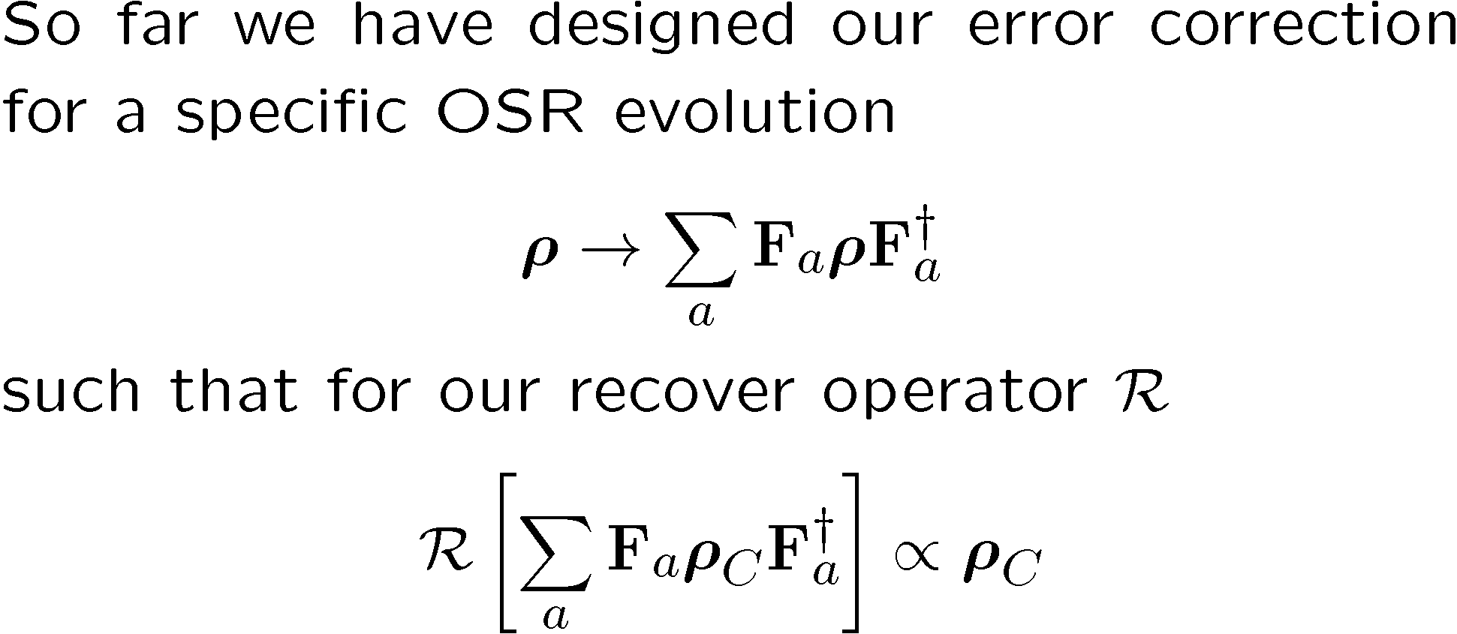
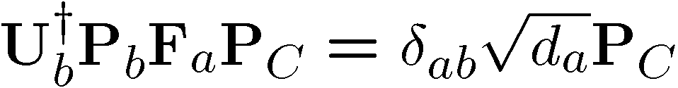
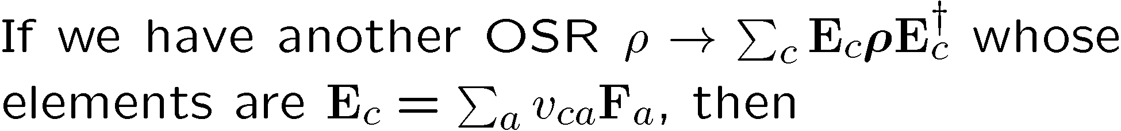
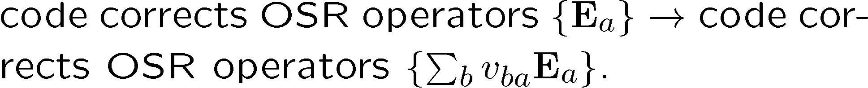
Digitizing Errors

Slide 30




How Have We Helped?

Slide 31
Independent Error Model
WARNING: “An approximation only a physicist could love.”
qubits/subsystems
local environments
Evolution dominated by interaction with different environment modes which do not interact with each other:
Notion of “no error probability” gives credence to standard argument for error correction success.
Really we can weaken this requirement (exponentially decreasing correlation [time and space] between errors).

Slide 32
Coming Attractions
How to become a quantum error correction coder in minutes (get rich quick scheme, I think not)
the Pauli stabilizer formalism
Doing something useful with a quantum codes
the normalizer
Finding out that the something which was useful isn’t
the Knill-Gottesman theorem
Doing what many thought impossible
intro to fault-tolerance

Slide 33
H
H
H
H
H
H

