Slide 1
Quantum Error Correction
Weatherproofing Quantum Computers
Error Clouds
Intel Quantum Computer
Dave Bacon
Institute for Quantum Information
California Institute of Technology
Notes:
Thanks
Most amazing discovery of the past ten years
High quality of the lectures … trying to discover why Michael Nielsen gives such smooth lectures

Slide 2
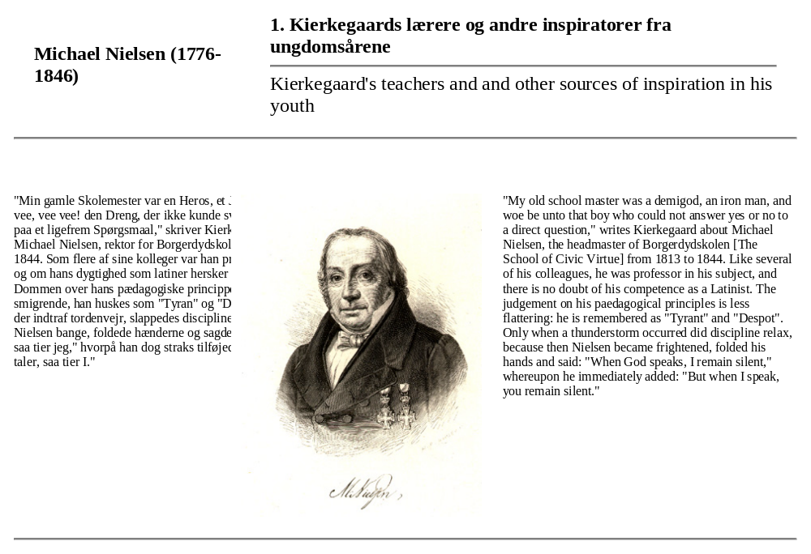
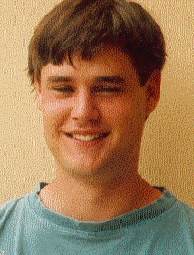
“‘My old school master was a demigod, an iron man, and woe be unto that boy who could not answer yes or no to a direct question,’ writes Kierkegaard about Michael Nielsen.”
“The judgement on his pedagogical principles is less flattering: he is remembered as ‘Tyrant’ and ‘Despot’.”
“Only when a thunderstorm occurred did discipline relax, because then Nielsen became frightened, folded his hands and said: ‘When God speaks, I remain silent,’ whereupon he immediately added ‘But when I speak you remain silent.’”

Slide 3
All Of The Subjects Previous Speakers Said I Would Talk About

Slide 4
Technology is the Quest for Control
“To be an Error and to be Cast out is Part of [Nature’s] Design.” -William Blake
Things Fall Apart
-Chinua Achebe
EVENTUALLY your desktop computer hardware will ERROR.
EVENTUALLY the information on a hard drive will be CORUPTED.
Amount of useful computer cycles before such an error occurs (CURRENTLY) = large large number
Exist robust physical systems which serve as classical computers
Quantum Things Fall Apart Fast
Amount of quantum computer cycles before an error  large number
(CURRENTLY?)

Slide 5
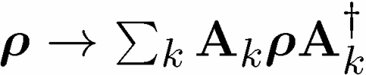
Quantum Computing is Bunk
Ways Quantum Computers Fail to Quantum Compute
Decoherence
Lack of Unitary Control
attempting to apply unitary evolution U instead results in V
or (worse) results in non-unitary evolution
Measurements are faulty
measurement result is noisy, incorrect result obtained
Quantum Computing Disappearing Act
qubits disappear (leakage of computing states)

Slide 6
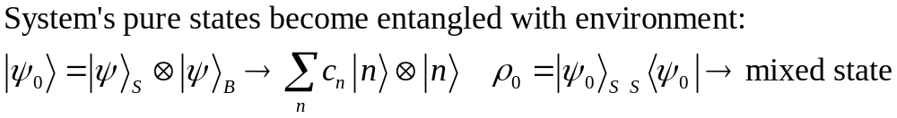
What is the Problem?
Real quantum systems are open quantum systems!
system
environment
Full Hamiltonian:
Interaction causing
DECOHERENCE
System evolution
environment evolution
System evolution (by itself) is no longer unitary
Coherent properties of system’s quantum information lost

Slide 7




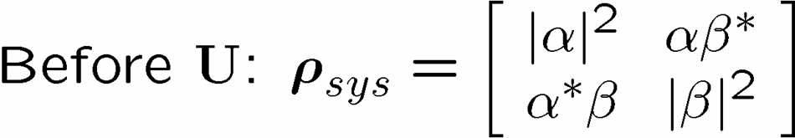

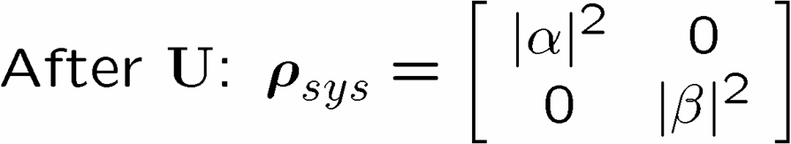
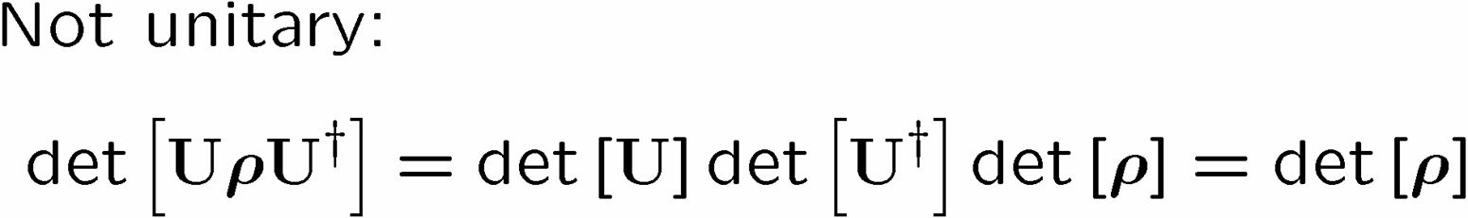
Quantum Error Example
“To err is human, to really foul things up requires a computer.” -Anonymous
system
environment

Slide 8





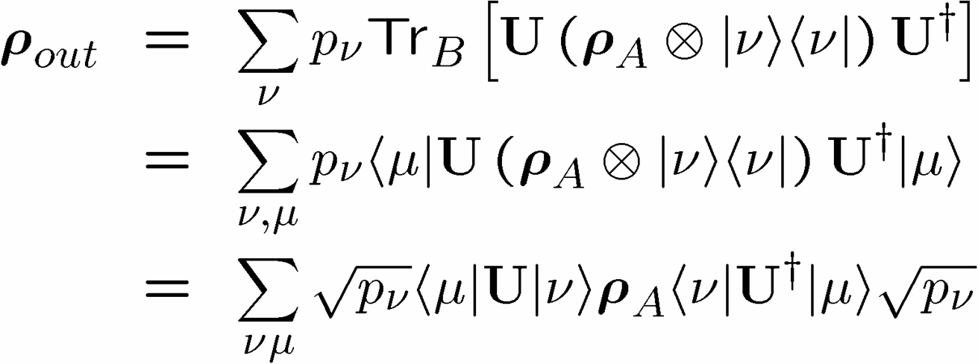
Operator Sum Representation
U
B states

Slide 9


Unmixing Simplification
U
Purification of system B
U
Purification of system B

Slide 10

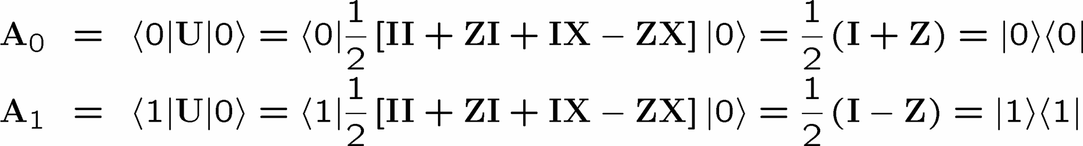
OSR Example
U

Slide 11
Noisy Cell Phone
Hello? Hello? Hello? Hello?
I have a flat tire. I said, I have a flat time! A flat tire.
No, I’m not trying to flatter you…No, your not getting fatter. I have a flat tire!
Communication over a noisy CHANNEL can be overcome via
ENCODING
“Hello?” = “Hello? Hello? Hello? Hello?” [using redundancy to encode “Hello”]

Slide 12
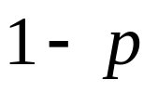
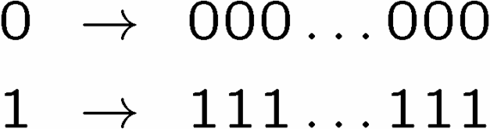

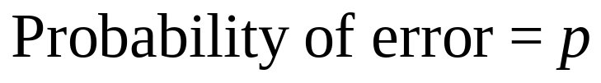
Simple Repetition Code
Encode:
0
0
n copies
1
1
No encoding:
Binary Symmetric Channel
b
measure
Encoding (n=3):
b
encode
b
b
b
decode
and correct
measure
Probability of error

Slide 13
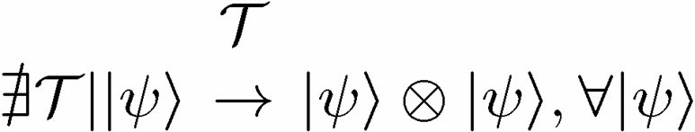

1994 Reasons to be a Pessimist
No cloning:
No cloning of quantum information:
Quantum repetition code impossible:
Continuous set of errors:
Classical errors on digital information are discrete.
Quantum errors on classical information are continuous.
Continuous set of operations:
Continuous set of unitary operations: infinite precision needed to implement a gate?
Measurement destroys coherence:
How can one decode without destroying the information?

Slide 14
Baby Steps
Bit Flip Channel:
WWCCD? (What Would Classical Coders Do?)
measure
b
b
0 000, 1 111
0
b
0
b
encode
error
decode
fix
identities
100  111  101 110  110
b
b
=
b
1
0
1
1
1
=
0
error #@%

Slide 15



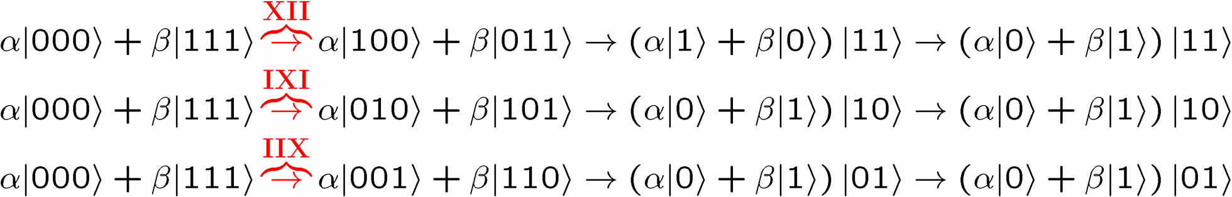
Naïve
4. operator identities still hold
Lets be naïve, take classical and move over to quantum
encode
error
decode fix
?
error
decode
fix
encoded into subspace:
2. errors take to orthogonal
subspaces + maintain orthogonality
3. syndrome
(no-cloning evaded!)

Slide 16
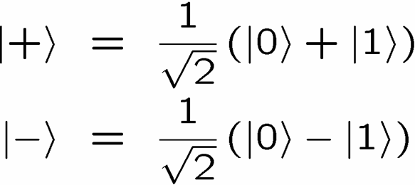
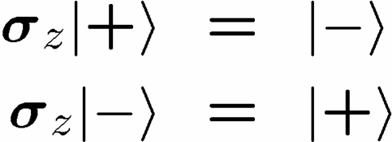


OK Wise Guy
What about “phase” errors?
…sort of not classical error
phase error:
Wise guy says “basis change please”:
looks like bit flit error in this new basis!
H
H
H
H
H
H
phase errors
bit flip errors

Slide 17
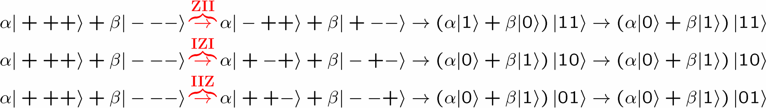
Molly: “I love you, I really love you”
Sam: “Ditto.”
encode
error
decode
fix
H
H
?
H
H
H
H
error
decode
fix
encoded into subspace:
2. errors take to orthogonal
subspaces + maintain orthogonality
3. syndrome
(no-cloning evaded!)

Slide 18


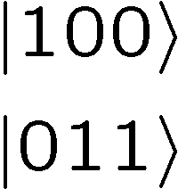




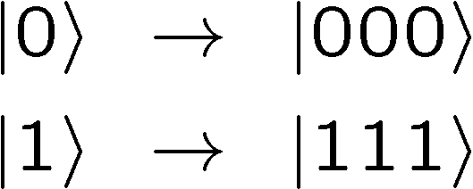

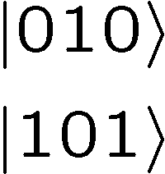



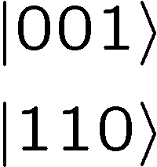

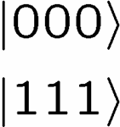
Perspective
Orthogonal subspaces can be distinguished by measurements
without measuring information encoded into the subspace!!!

Slide 19

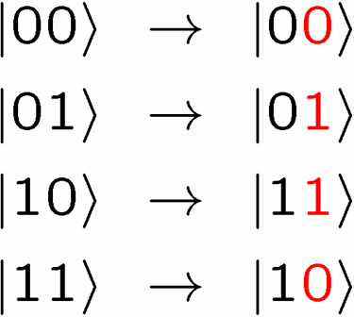
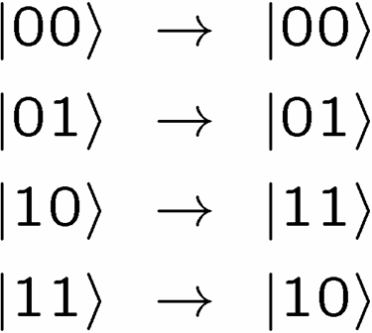



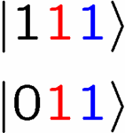
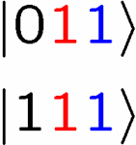
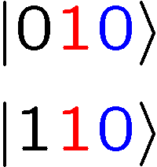
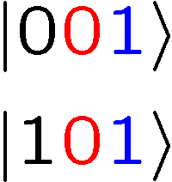
Not An Optical Illusion
fix
error

Slide 20
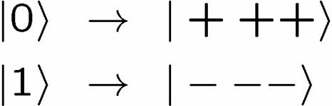


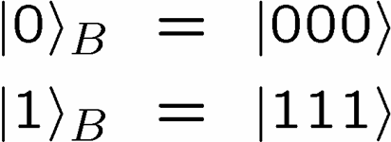
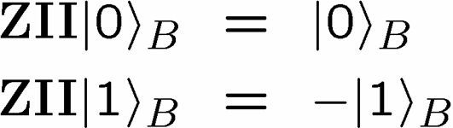
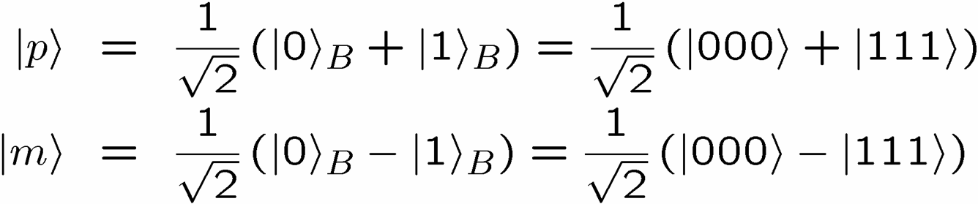
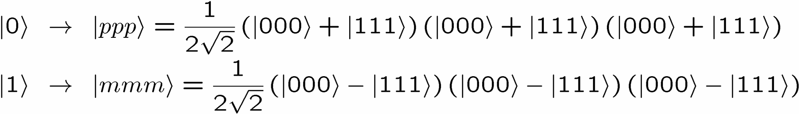
Encoding Away Your Ills
3 qubit bit flip code
3 qubit phase flip code
phase errors act as on bit flip code qubits:
define:
Shor Code: (Peter Shor, 1995)

Slide 21
Inside Shor
H
H
H
H
H
H
bit flip code
phase flip code

Slide 22








Do the Hokey Pokey
Take a step back:
encode
error
diagnose
error
fix
encode
Here quantum information has simply been encoded into
Then an error occurs
Then a recovery procedure
An miraculously we recover the encoded state

Slide 23
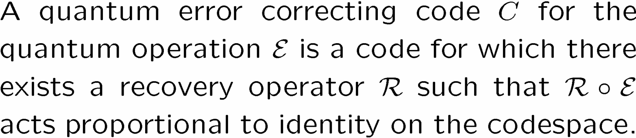
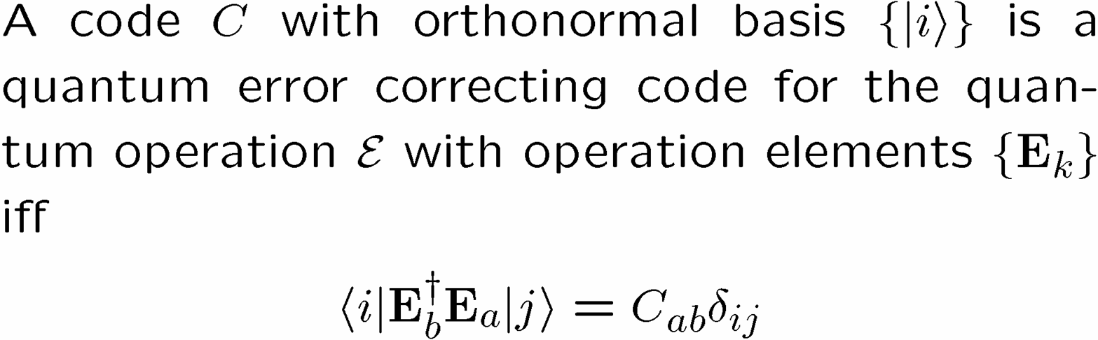
Lets Get Definitional
subsystem
Quantum Error Correcting Code
Iff Condition for Quantum Error Correcting Code

Slide 24
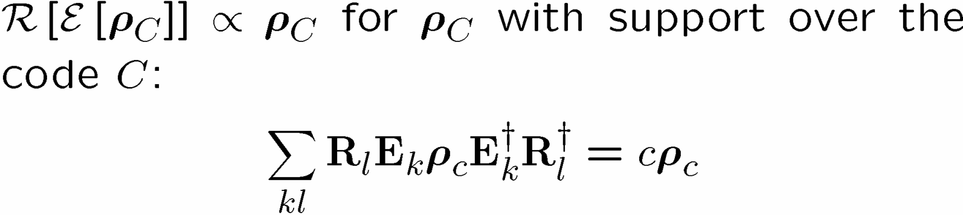
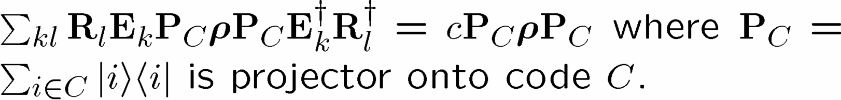
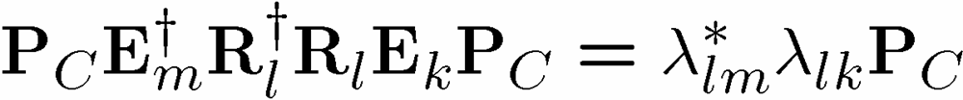

Necessary

Slide 25
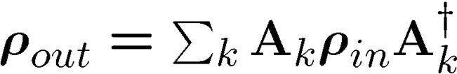


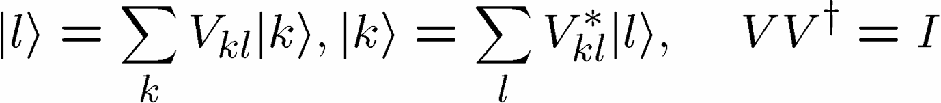
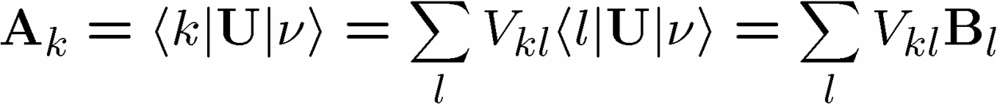
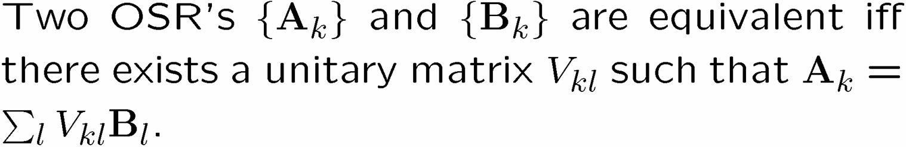
OSR Unitary Freedom
U
U
V
Equivalent from system A’s perspective

Slide 26
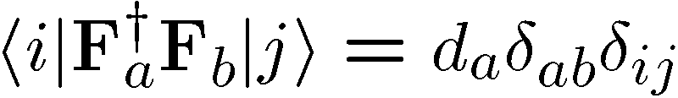
Diagonal Error Condition

Slide 27
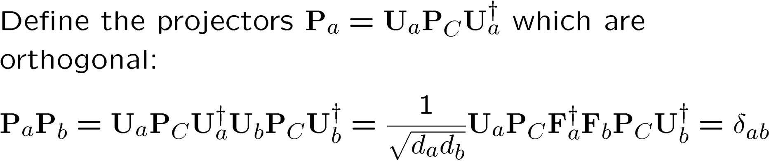
Sufficient
fix/diagnose error/error/code
fix/diagnose no error/error/code

Slide 28
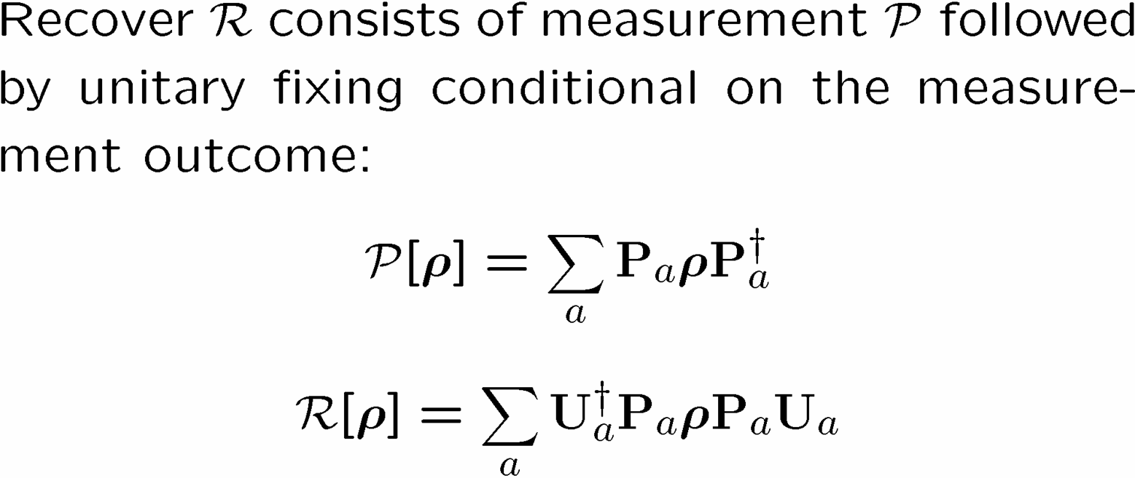
recovery
error

Slide 29

Pictures
Orthogonality maintained
Orthogonality not maintained
codespace
Orthogonal subspaces
Errors not distinguishable
BAD
GOOD

Slide 30
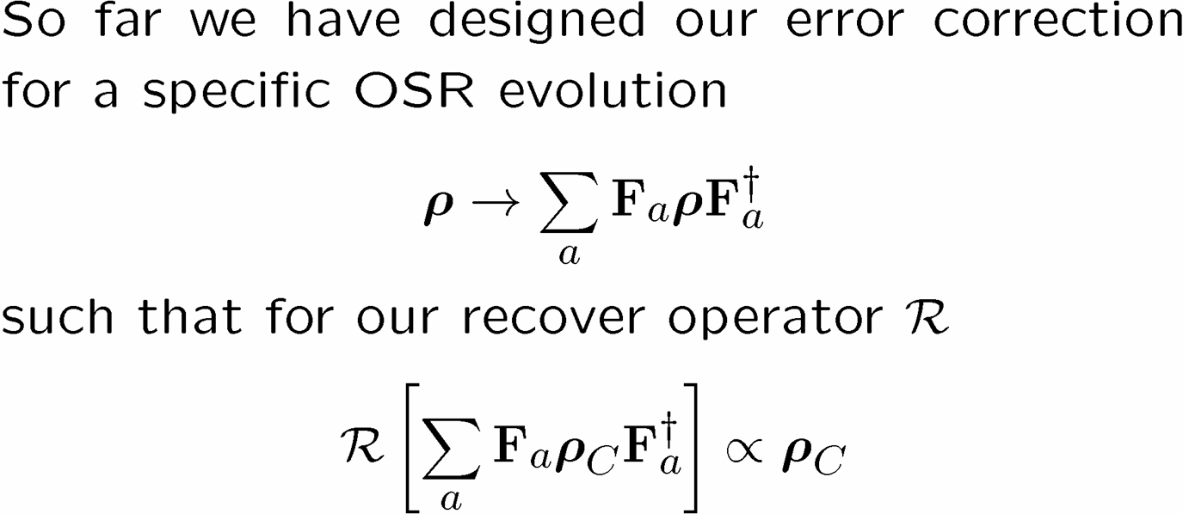

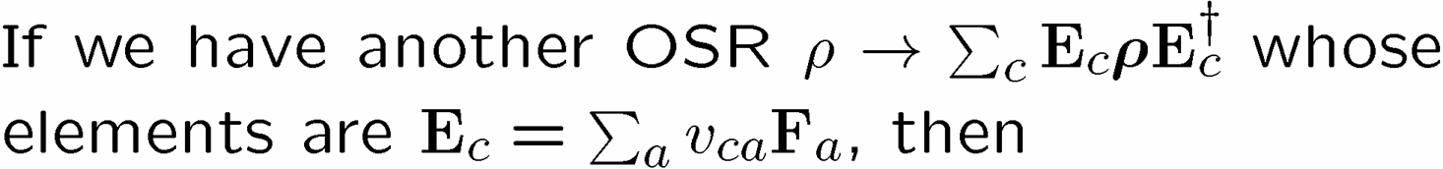
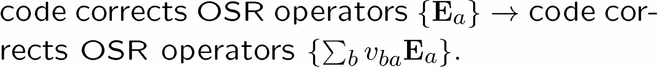
Digitizing Errors

Slide 31
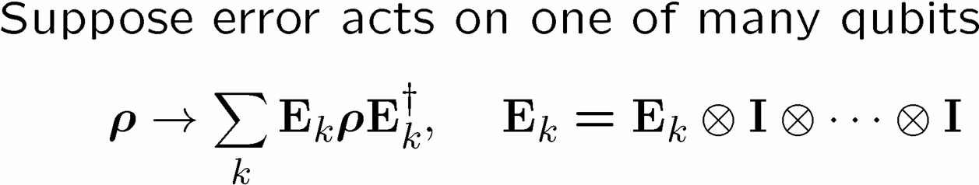
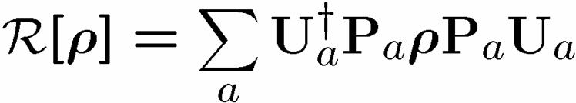


How Have We Helped?

Slide 32
Independent Error Model
WARNING: “An approximation only a physicist could love.”
qubits/subsystems
local environments
Evolution dominated by interaction with different environment modes which do not interact with each other:
Notion of “no error probability” gives credence to standard argument for error correction success.
Really we can weaken this requirement (exponentially decreasing correlation [time and space] between errors).

Slide 33
Coming Attractions
How to become a quantum error correction coder in minutes (get rich quick scheme, I think not)
the Pauli stabilizer formalism
Doing something useful with a quantum codes
the normalizer
Finding out that the something which was useful isn’t
the Knill-Gottesman theorem
Doing what many thought impossible
intro to fault-tolerance

