Slide 2
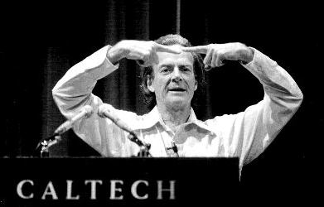


There’s Plenty of Room at the Top
(An invitation to new quantum technologies)
“There's plenty of room at the bottom: an invitation to open up
a new field of physics” Richard P. Feynman, approx. 1960
Dave Bacon
“After Bugs Bunny”
Institute for Quantum Information
California Institute of Technology

Slide 3
Bugger!
Damnit!
Damnit!
Rant Mode On

Slide 4




Damnit! Part II
Rant Mode On

Slide 5




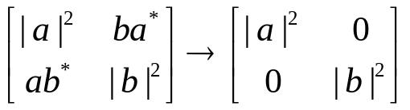

Fight the Gap
Rant Mode Shutting Down
Fault-Tolerant Quantum Error Correction
Experimental Coherent Control of Quantum Systems
Great White Decoherence Sharks

Slide 6





A Lesson

Slide 7

















What Have We Learned?

Slide 8


Fixing Funnel

Slide 9

Natural Fault Tolerance

Slide 10
Making Decoherence Run Uphill
(carrying 99 lbs., uphill both ways, in the snow)
Will this hill
ever end?

Slide 11
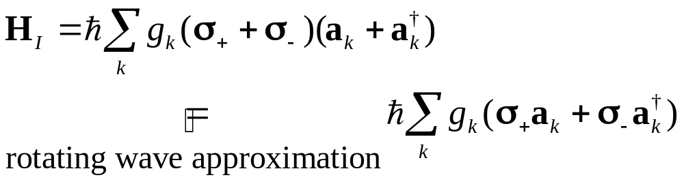
Making Decoherence Work Hard
system
bath
E_{sys}
~
E_{bath}
H_{I} = perturbative system-bath coupling
H_{I} energy small compared to E_{sys} and E_{bath} implies decoherence dominated by pathways that conserve unperturbed energies
|1
“cooling”
|0
|1
“heating”
|1
e^{i}|1
|0
|0
|0
“non-dissipative”

Slide 12

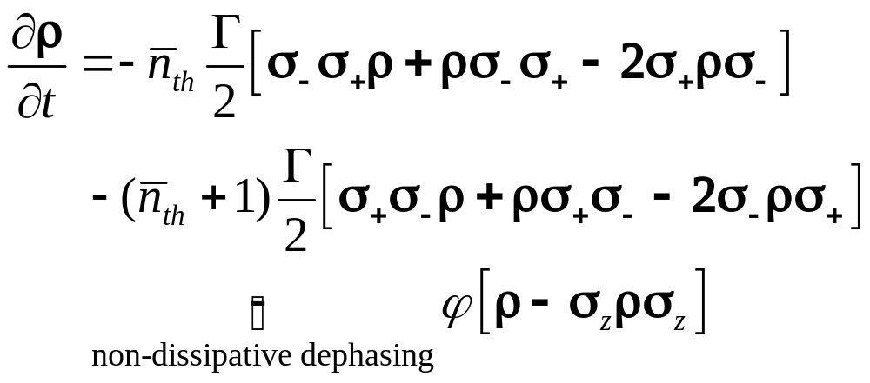

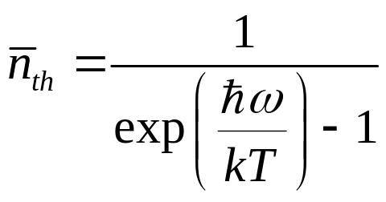
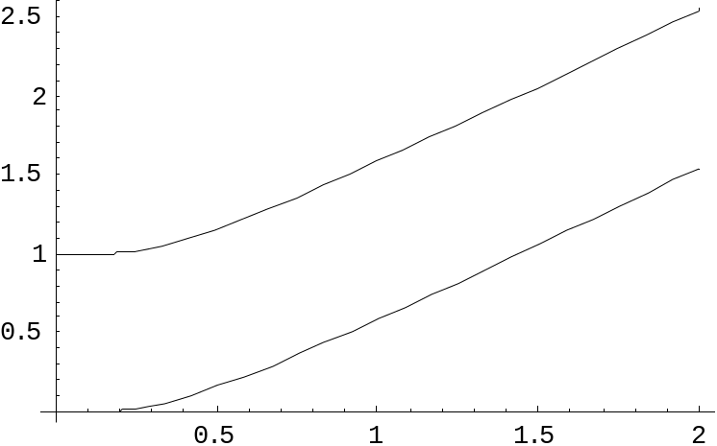

two-level atom radiatively coupled to a thermal reservoir:
“heating”
“cooling”
“non-dissipative”
At low bath temperatures, heating disappears……..
Can We Make All Quantum Errors Run Uphill?

Slide 13
Simple
Keeping it Real Real Simple
[4,2,2] quantum error detecting code: ↑j_{L}|E_{k}|i_{L}= 0 (E_{k} single qubit error)
Stabilizer generators (S_{i}|i_{L}=|i_{L})
S₁=XXXX, S₂=ZZZZ
Logical operators for 2 encoded qubits (|i_{L}= |i₁|i₂)
X₁=XXII, Z₁=IZZI, X₂=IXXI, Z₂=ZZII
Use to understand the spectrum of the Hamiltonian (stabilizer is a symmetry):
H₀=XXII+IIXX+IZZI+ZIIZ ( [H₀,S_{i}]=0 )
H₀=X₁(I+S₁) + Z₁(I+S₂)
( 2nd encoded qubit not envolved)
“Mmm beer..”
1
XX
2
ZZ
ZZ
4
XX
3

Slide 14

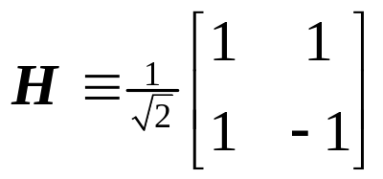
S₁ S₂ H₀= X₁(I+S₁) + Z₁(I+S₂) eigenvalues (E)
+1 +1 2(X₁+Z₁)=2 H₁ 2
+1 1 2X₁ 2
1 +1 2Z₁ 2
1 1 0 0
E
(+1, +1)
+2
(S₁, S₂) label the stabilizer eigenvalues
|0₂, |1₂ label the second encoded qubit
(note extra degeneracy of (1, 1))
(+1, 1)
|0₂
|1₂
(1, +1)
+2
|0₂
|1₂
|0₂
|1₂
( 1, 1)
0
|0₂
|1₂
|0₂
|1₂
(+1, 1)
(1, +1)
2
|0₂
|1₂
(+1, +1)
|0₂
|1₂
2
|0₂
|1₂
degenerate ground state: degeneracy = second encoded qubit
Non-additive code

Slide 15
effect of ZIII
E
ALL single qubit errors take degenerate ground state to higher energy levels.
Single qubit errors change value of (S₁,S₂) and hence take ground state to higher energy level.
(S₁, S₂)
(+1, +1)
+2
(+1, 1)
|0₂
|1₂
(1, +1)
+2
|0₂
|1₂
|0₂
|1₂
( 1, 1)
0
|0₂
|1₂
|0₂
|1₂
(+1, 1)
(1, +1)
2
|0₂
|1₂
(+1, +1)
|0₂
|1₂
2
|0₂
|1₂
compare to:
two-level nondegenerate system two-level degenerate system
_{z}: no change of energy
₋: |1 goes to lower energy
₊: |0 goes to higher energy
|1
|0
|1
|0
: no change of energy

Slide 16
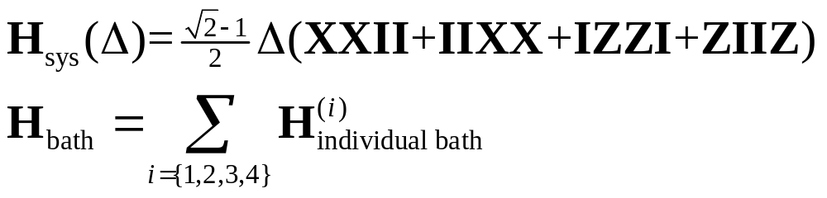
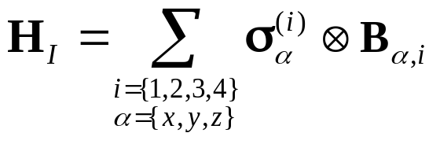
Supercoherence
Ground state = single qubit error detecting code
independent errors…couple to independent baths of temperature T
Bath 1
T
T
Bath 2
:
:
degenerate levels
1
XX
2
ZZ
ZZ
4
XX
3
 = gap
Bath 4
T
Bath 3
|0_{L}
|1_{L}
T
Interaction picture + rotating wave: all single qubit (with individual baths) decoherence processes must be “heating” processes: exponential suppression at low temperatures!
Acts on i^{th} bath
Acts on i^{th} qubit

Slide 17
To Compute or Not to Compute
Information encoded in the second logical qubit.
Manipulation of this information can be obtained by control over these two-body interactions:
X₂=IXXI, Z₂=ZZII
control via turning on and off these interactions with strength 
gap is shrunk by turning on the control Hamiltonian
gap =  c , speed of operations = ,
decoherence rate  exp(gap/kT)
number of operations in a decoherence time   exp(( c  )/kT)
maximum when   kT: number of operations still exponential in T
ZZ
1
XX
2
XX
ZZ
ZZ
4
XX
3

 c 
|a_{L}
|0_{L}, |1_{L}

|b_{L}

Slide 18
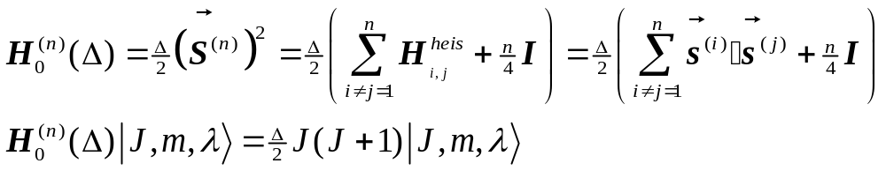



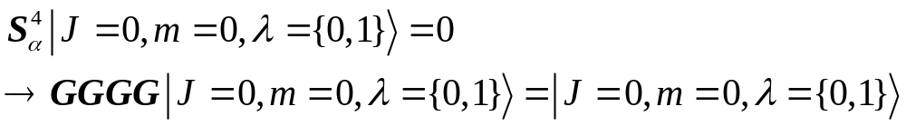
Another Supercoherent Qubit
1
2
n=4
4
3
2

“Coherence-Preserving Quantum Bits” Bacon, Brown, and Whaley quant-ph/0012018 (2000), PRL
Ground state J=0 stabilized by collective operations implies
all single qubit operators take states to higher energy levels

Slide 19
Exchange Supercoherent Qubits
n=even single qubit allowed transitions
Exchange is universal on the degeneracy of each J irrep
J=n/2
:
1
2
Encoded qubit 1
:
J=2
4
3
J=1
5
6
Encoded qubit 2
J=0
8
7
Computing on two conjoined encoded qubits
turn on extra exchange interactions between all 8 to make the supercoherent n=8 Hamiltonian
compute using additional exchanges
(respect gap condition)

Slide 20
Beyond Supercoherence
XX
XX
XX
ZZ
ZZ
ZZ
ZZ
XX
XX
XX
ZZ
ZZ
ZZ
ZZ
XX
XX
XX
ZZ
ZZ
ZZ
ZZ
XX
XX
XX
XX
XX
XX
ZZ
ZZ
ZZ
ZZ
XX
XX
XX

Slide 21



Impossible To Draw
YY
ZZ
XX
ZZ
XX
YY
YY
ZZ
ZZ
XX
XX
YY

Slide 22

Errors
XX
XX
XX
ZZ
ZZ
ZZ
ZZ
XX
XX
XX
ZZ
ZZ
ZZ
ZZ
XX
XX
XX
ZZ
ZZ
ZZ
ZZ
XX
XX
XX

Slide 23
Fin

