Slide 1
Fault-Tolerant Quantum
Computation
Error Free Quantum Computation
QC
Error Rate
Dave Bacon
Institute for Quantum Information
California Institute of Technology

Slide 2
Mysterious Extra Slide
Please Do Not Read This

Slide 3


Quick Review
“The past exists only as recorded in the present.”

Slide 4
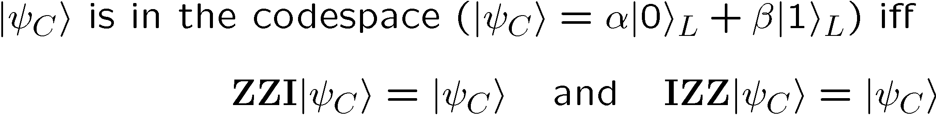
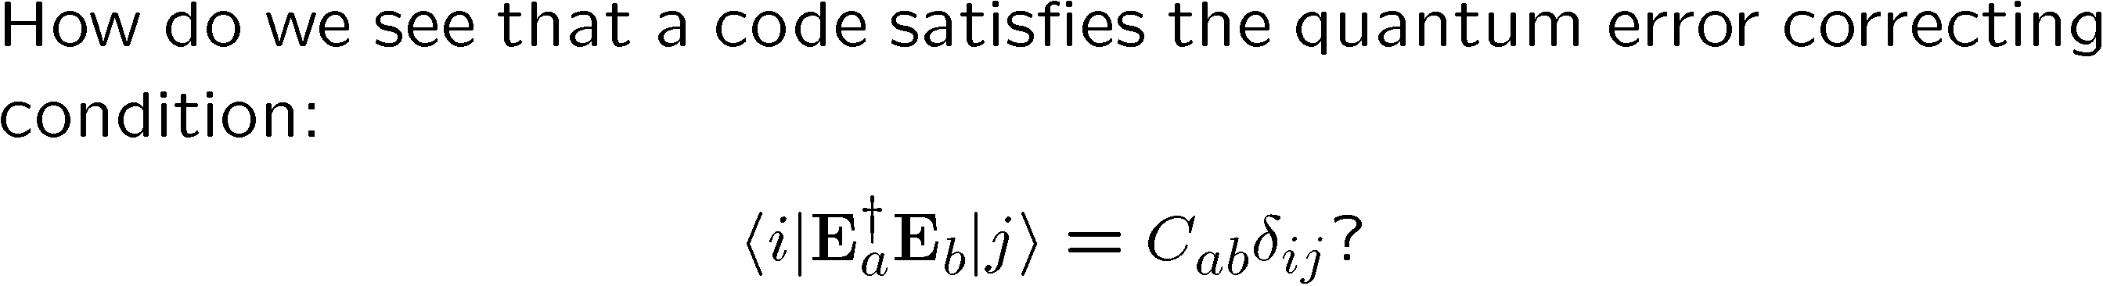


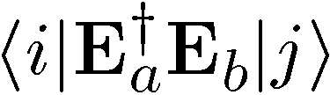
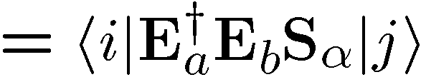



Old School

Slide 5
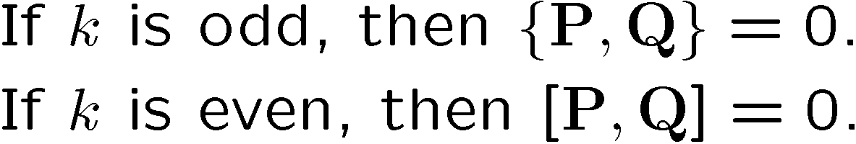

Slide 6
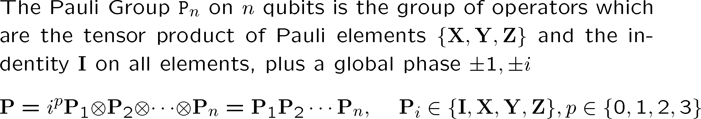
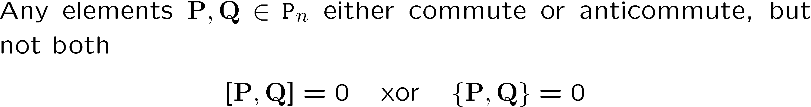
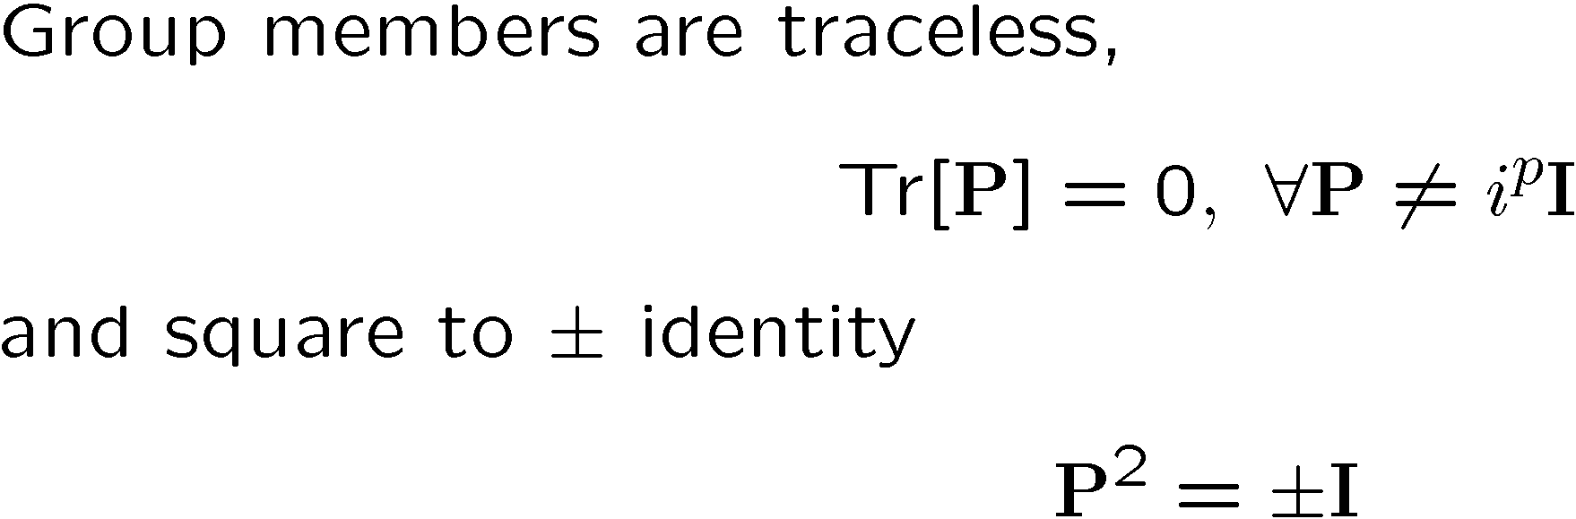
Pauli Group
Facts

Slide 7
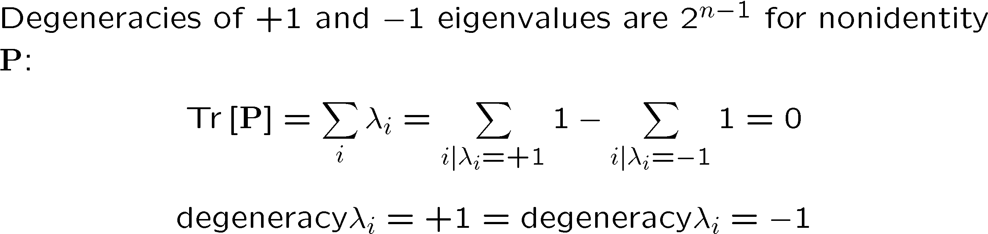

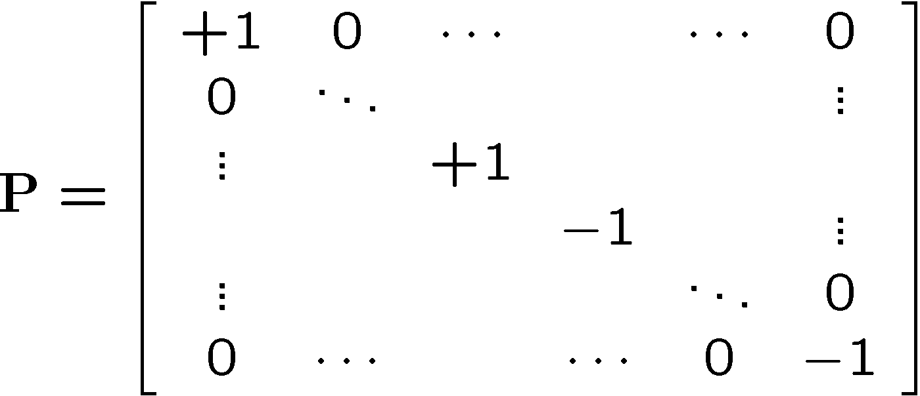


Set Your Square Phasors For +1

Slide 8
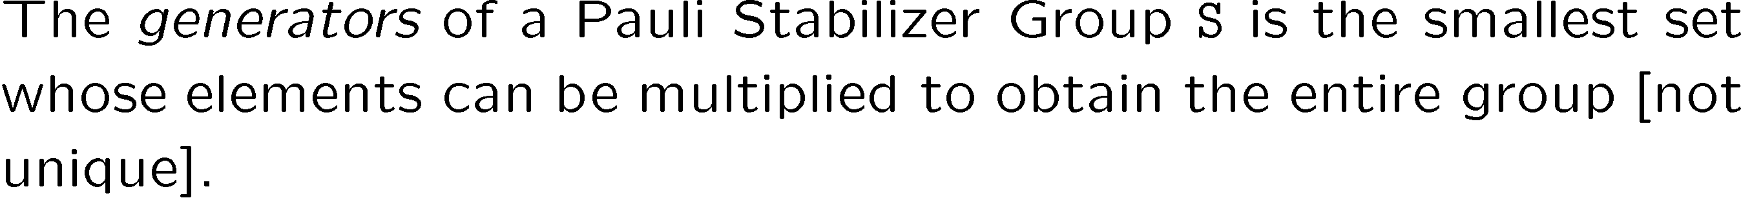
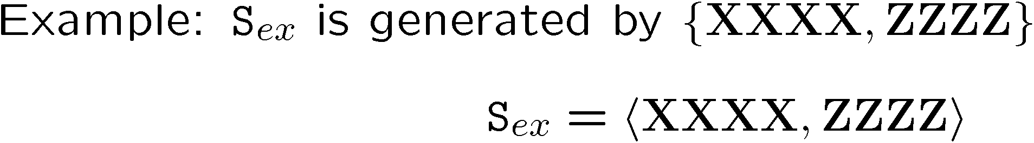
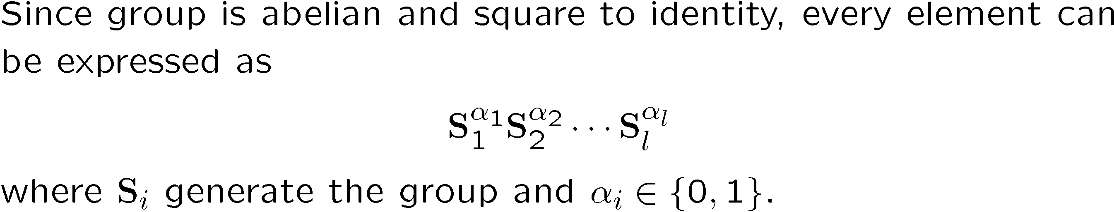
Abelian not Reptilian

Slide 9
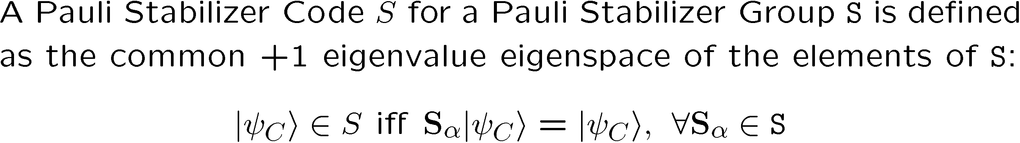
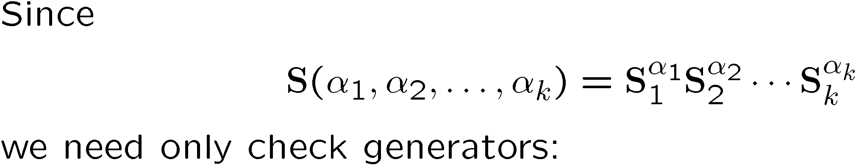
Pauli Stabilizer Code

Slide 10
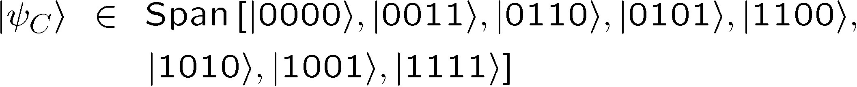
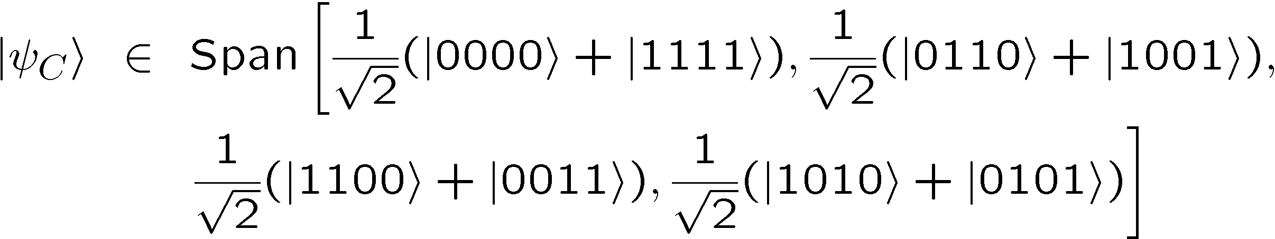
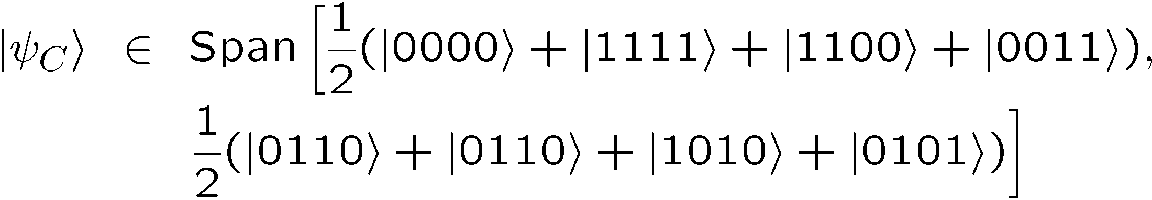
Truth By Example

Slide 11
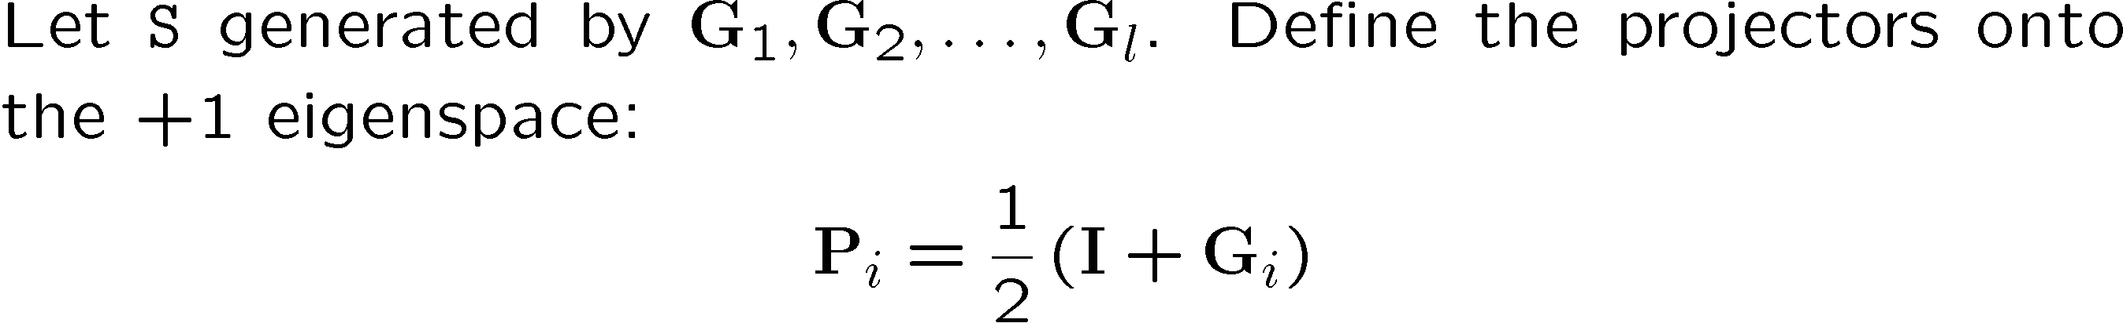

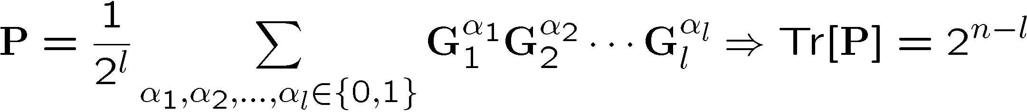
Sizing Up The Code

Slide 12






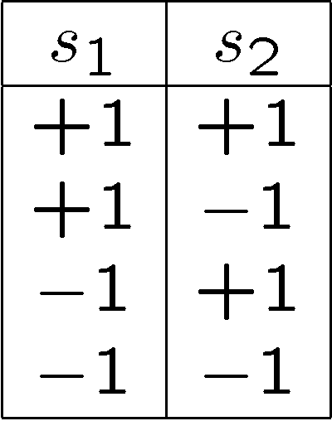
Stabilizer Subspaces

Slide 13
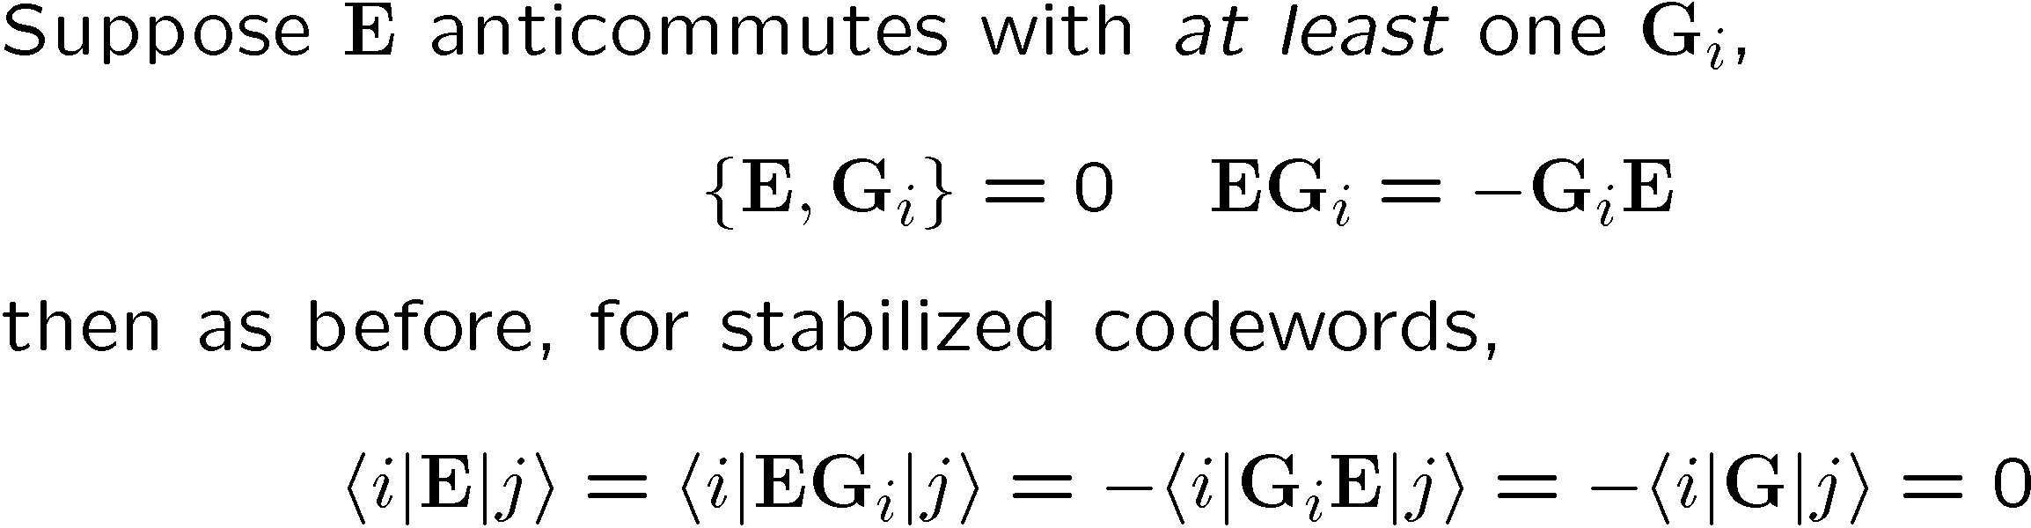
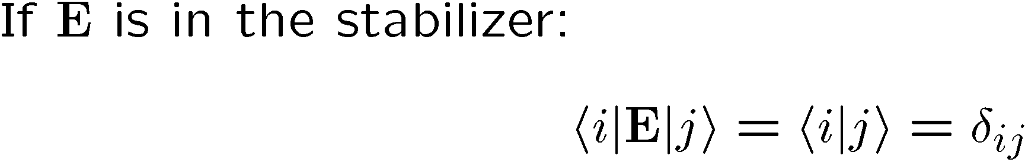
Stabilizer Nerror

Slide 14
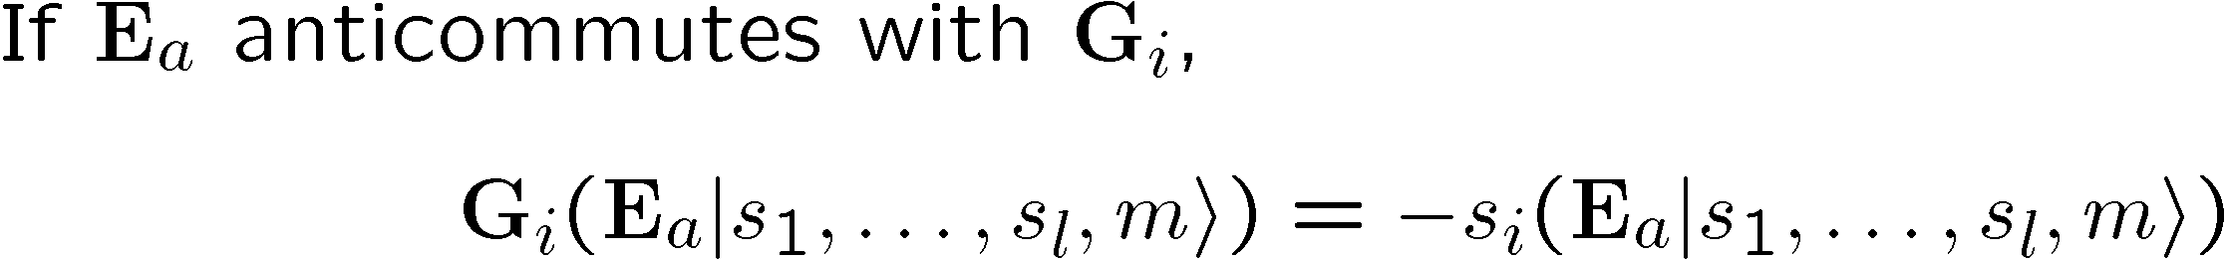







Surfing The Subspaces

Slide 15



Unsurfing The Subspaces

Slide 16
Examples

Slide 17
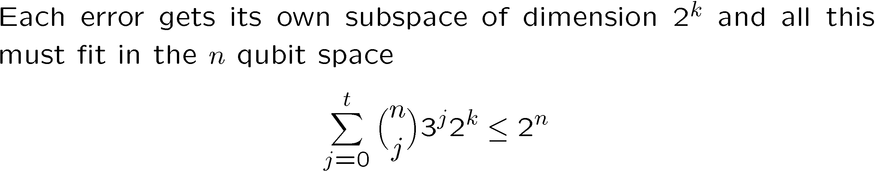
Quantum Hamming Bound
Research Problem: BEAT THE QUANTUM HAMMING BOUND

Slide 18










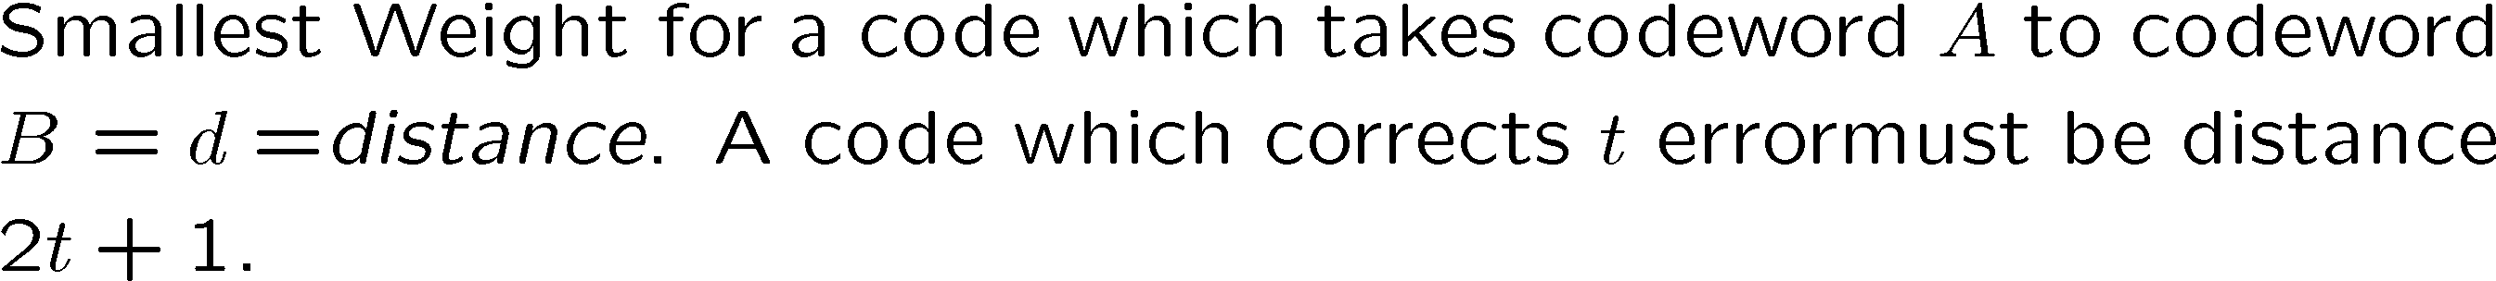



Detect Distinguishable Correct

Slide 19
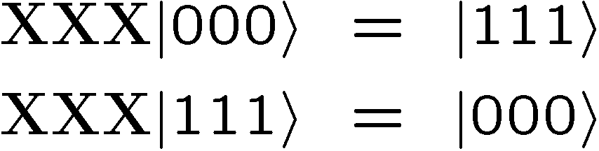
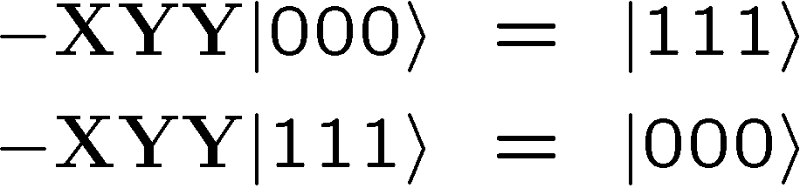
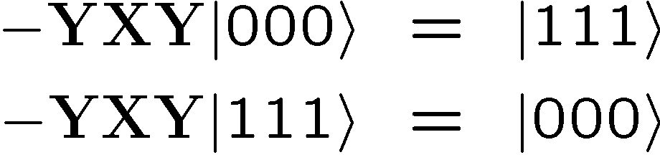
Pauli Want a Qubit?
Modulo the stabilizer S

Slide 20
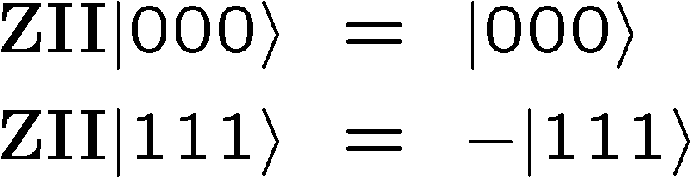
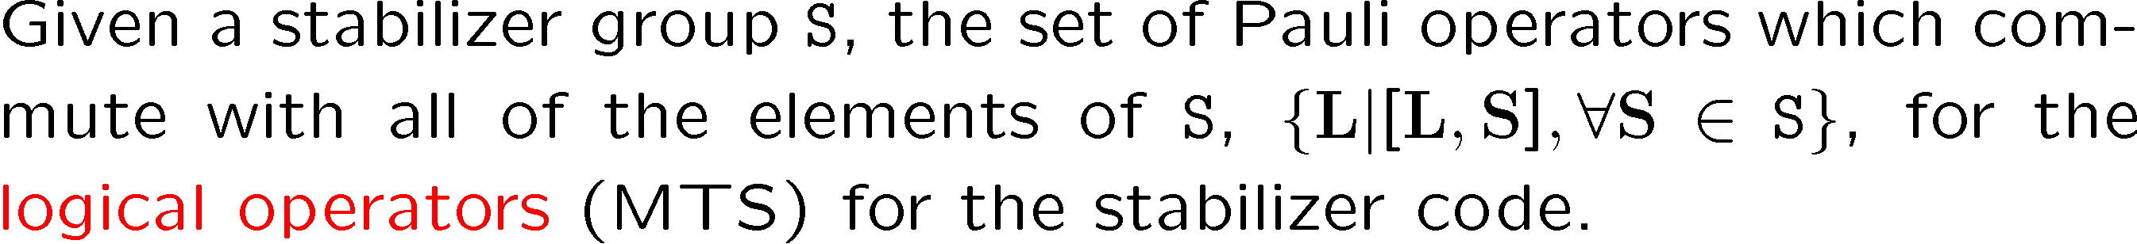
Modulo the stabilizer S
Feel free to randomly insert “Modulo the stabilizer S” into my sentence
Logical Operators for a Stabilizer Code

Slide 21
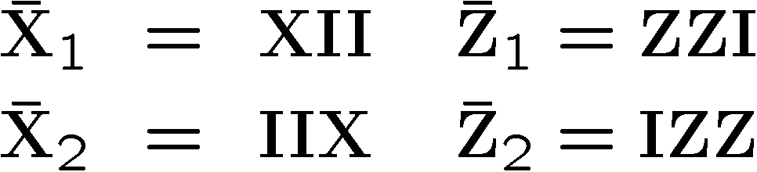



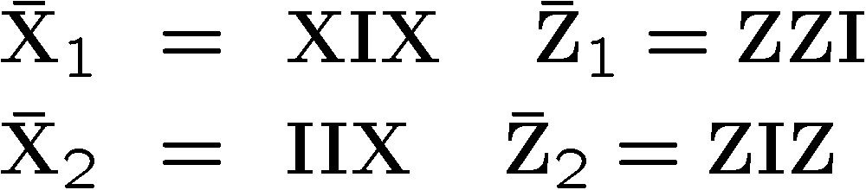
Pauli Wants Lots of Qubits
N
S
W
Who says north is up?
E
E
W
S
N

Slide 22
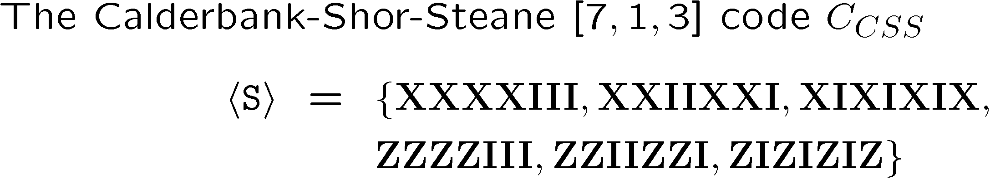

Real Life (I’m Plato) Example

Slide 23
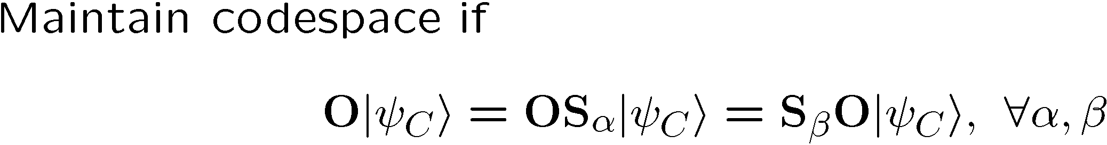
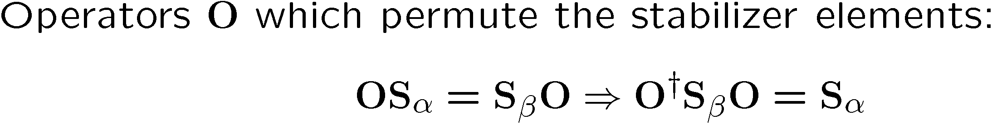



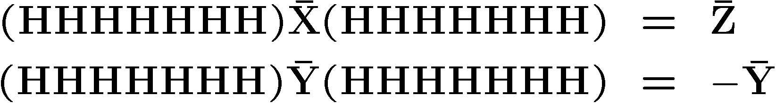
Clifford the Dog

Slide 24
Conjoining Subsystems

Slide 25
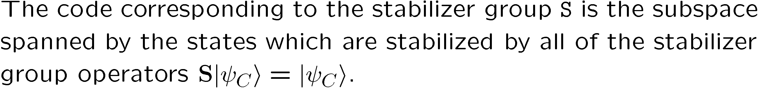
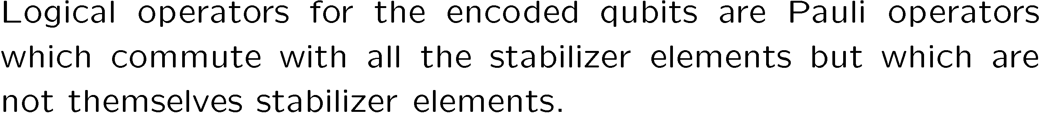
Stabilizer In Review

Slide 26
Fault-Tolerant Quantum
Computation
U
U
V
U
V
U

Slide 27


Perfection Through Concatenation
U
V
U
error
correction
error
correction
error
error
error

Slide 28



A Plague of Errors
=
U
=
U
H
H
H
H
H
=
H
H
H
H
H
H
H

Slide 29
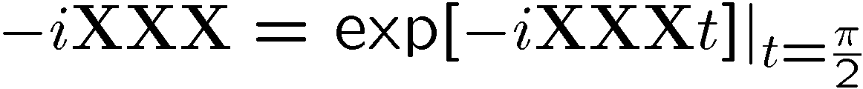

Be Careful Where You Rotate

Slide 30
Holy Grail of Fault Tolerant Computation
Block 1
Block 2

Slide 31
Beautiful Details

Slide 32
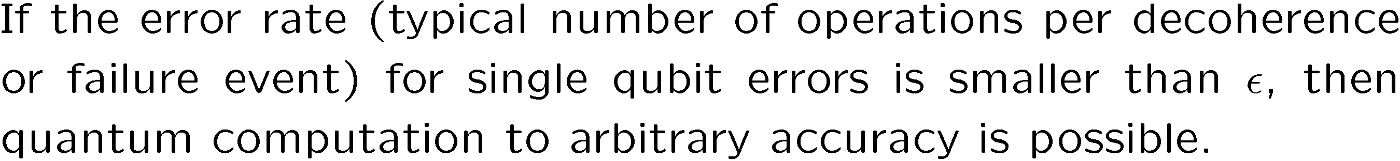
Threshing Out a Threshold
Error Free Quantum Computation
QC
Error Rate

Slide 33
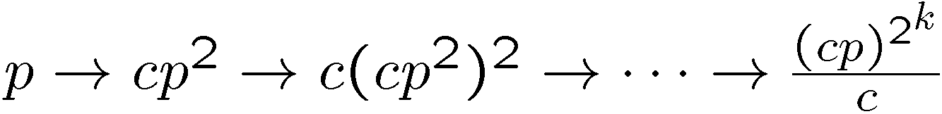
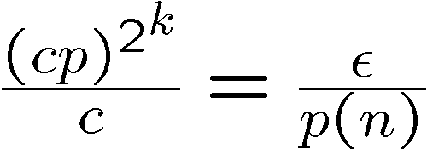
Some Rough Details
U
U
U
V
U
W

Slide 34
Profound Truth?
Fight entanglement with entanglement.

