Slide 1
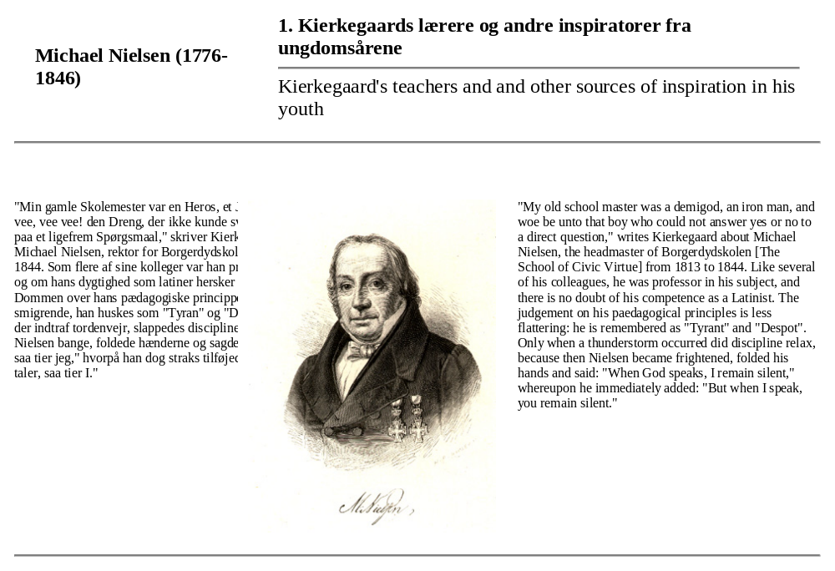
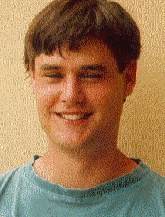
“‘My old school master was a demigod, an iron man, and woe be unto that boy who could not answer yes or no to a direct question,’ writes Kierkegaard about Michael Nielsen.”
“The judgement on his pedagogical principles is less flattering: he is remembered as ‘Tyrant’ and ‘Despot’.
“Only when a thunderstorm occurred did discipline relax, because then Nielsen became frightened, folded his hands and said: ‘When God speaks, I remain silent,’ whereupon he immediately added ‘But when I speak you remain silent.’”

