Slide 1
Fault-Tolerant Quantum
Computation
Error Free Quantum Computation
QC
Error Rate
Dave Bacon
Institute for Quantum Information
California Institute of Technology

Slide 2
Mysterious Extra Slide
Please Do Not Read This

Slide 3
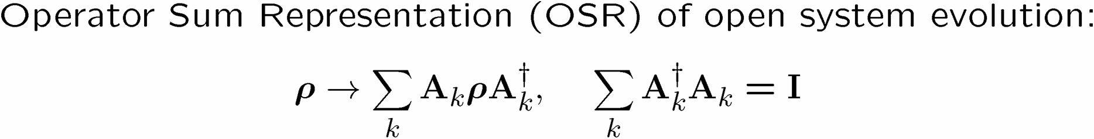
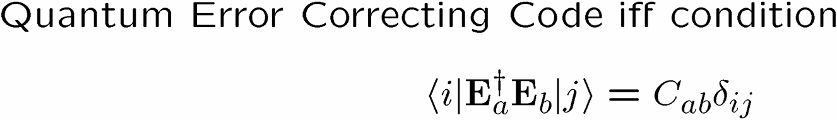
Quick Review
“The past exists only as recorded in the present.”

Slide 4
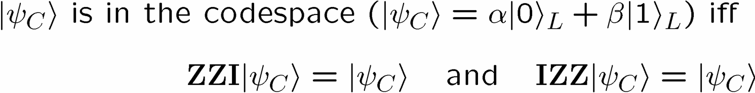
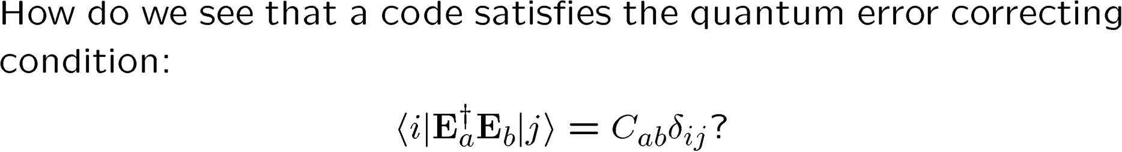







Old School

Slide 5
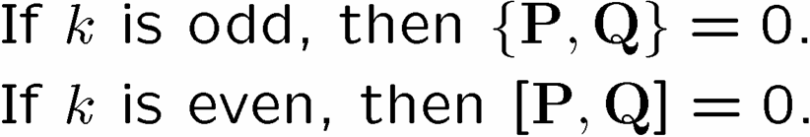

Slide 6
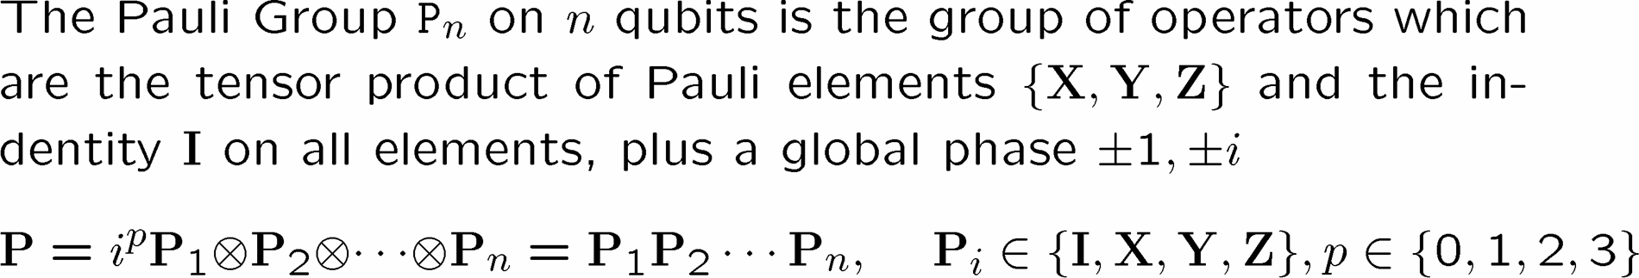
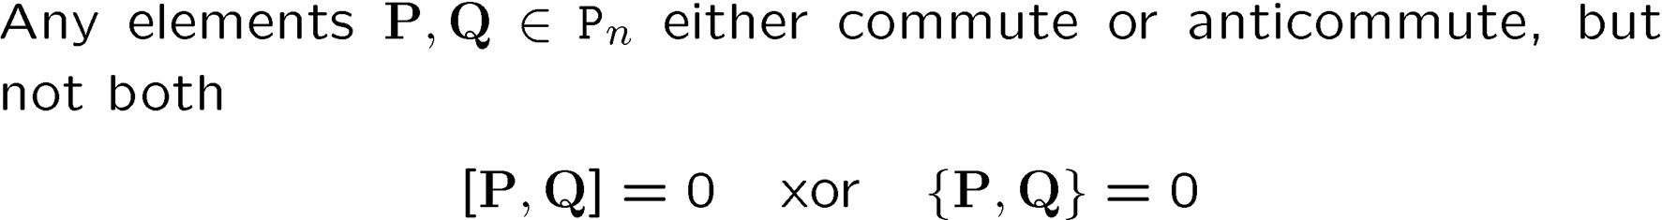
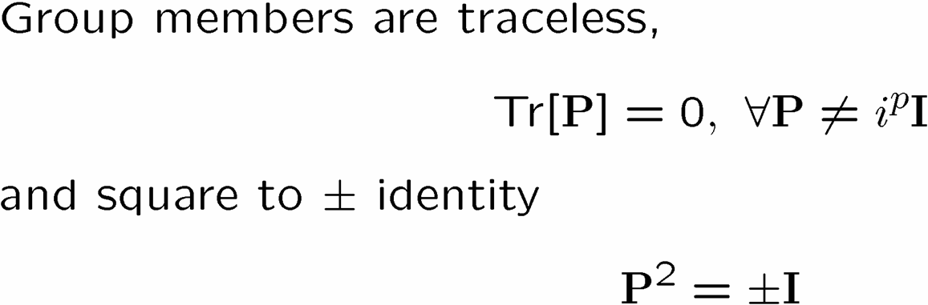
Pauli Group
Facts

Slide 7
Mysterious Extra Slide II

Slide 8
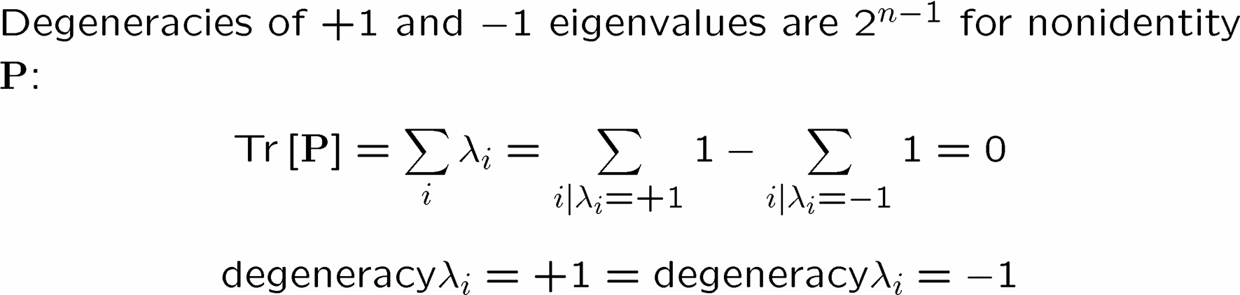

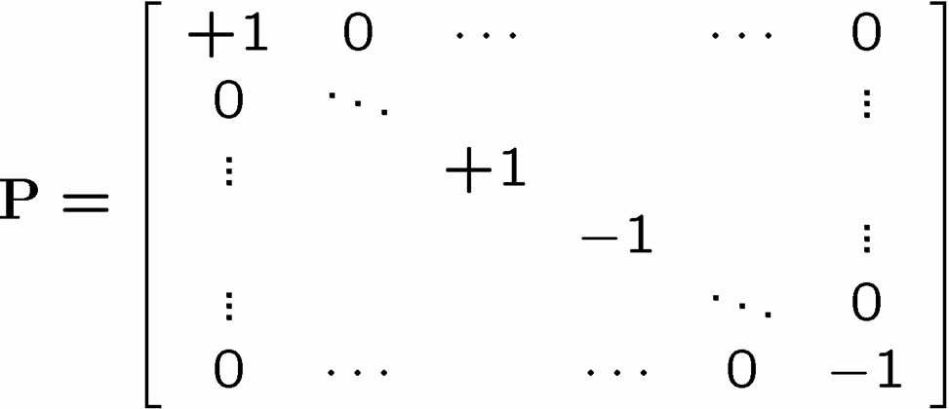


Set Your Square Phasors For +1

Slide 9
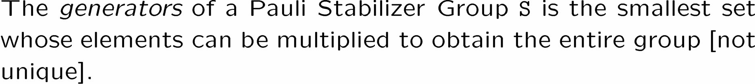
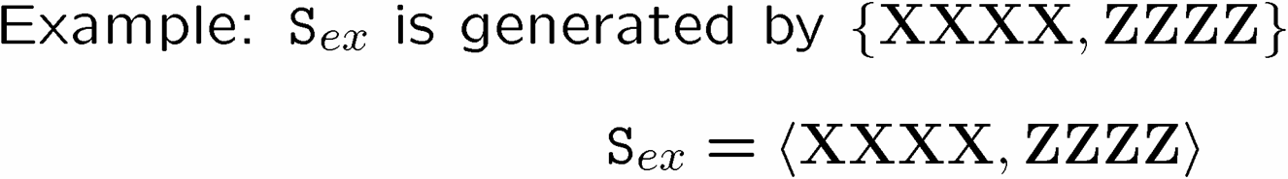
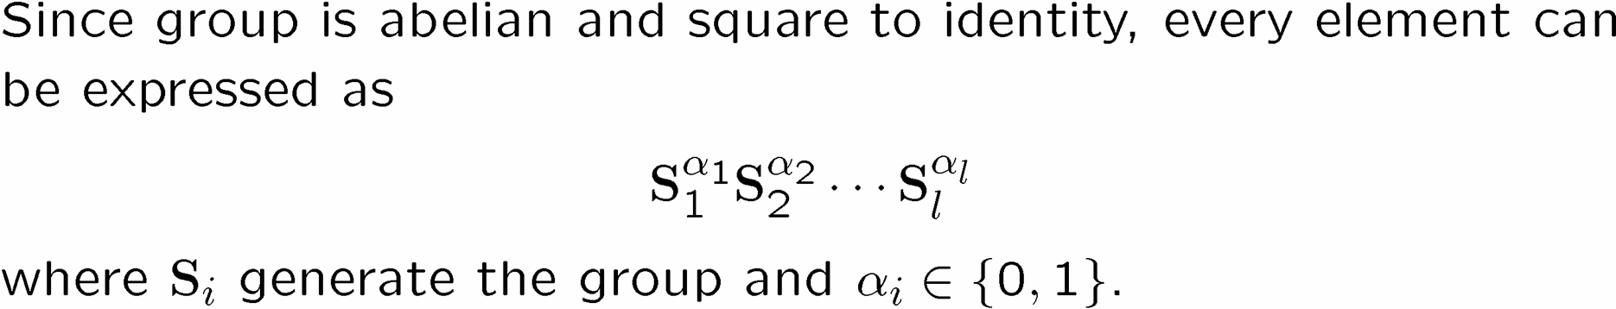
Abelian not Reptilian

Slide 10
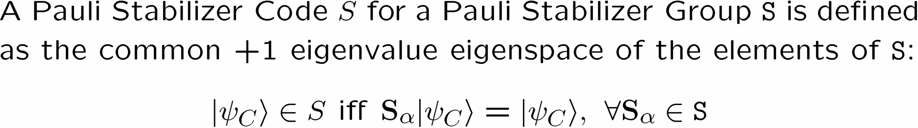
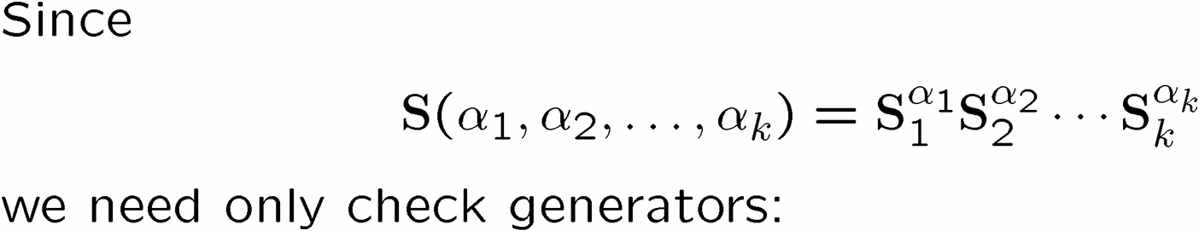
Pauli Stabilizer Code

Slide 11
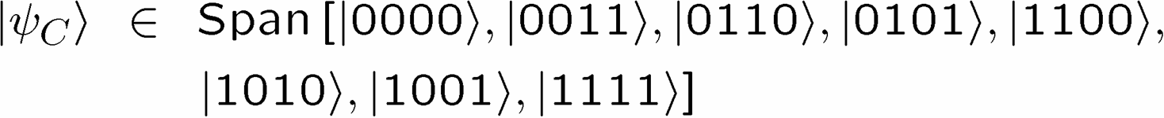
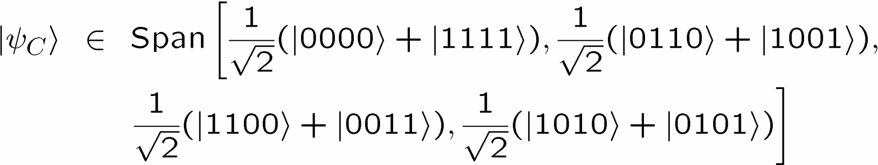
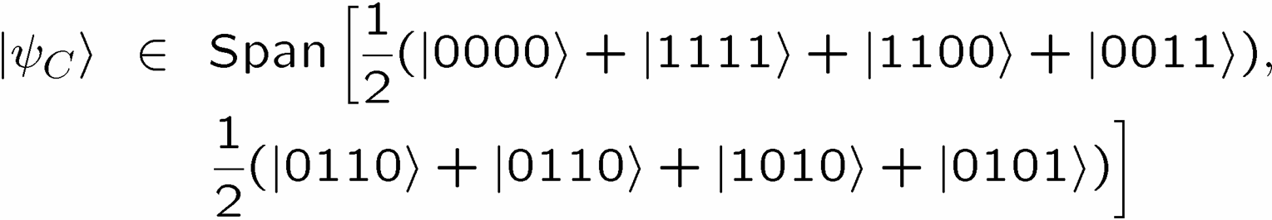
Truth By Example

Slide 12
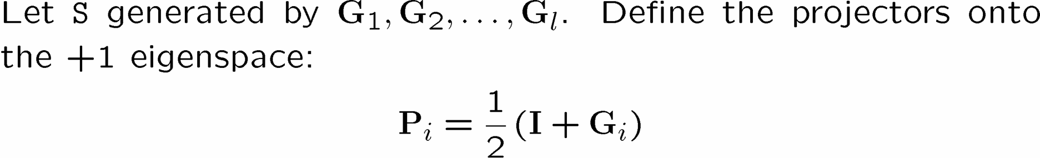
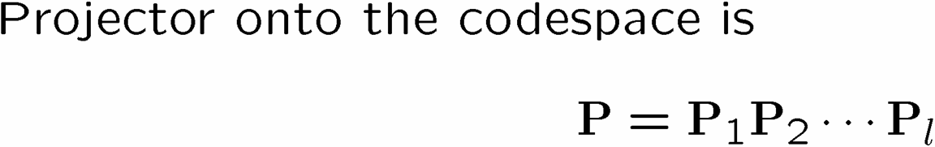
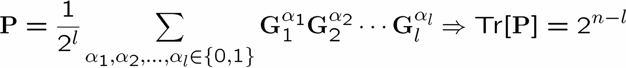
Sizing Up The Code

Slide 13






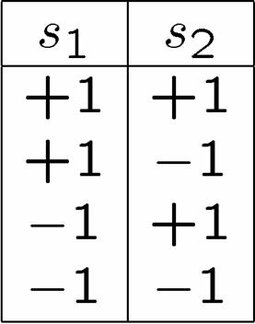
Stabilizer Subspaces

Slide 14
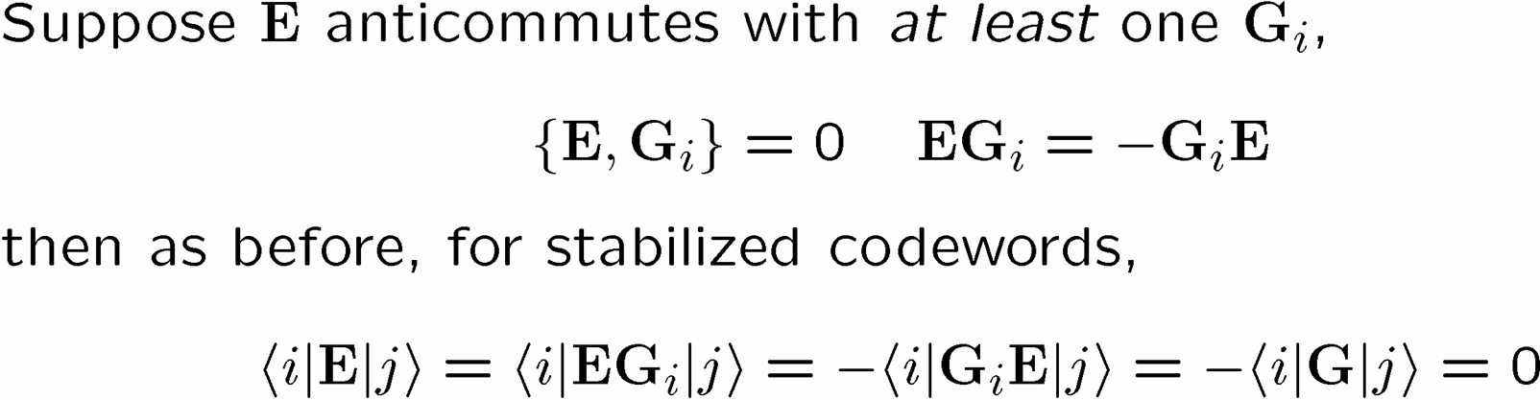
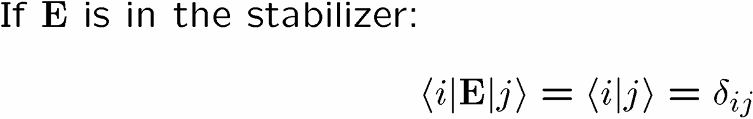
Stabilizer Nerror

Slide 15
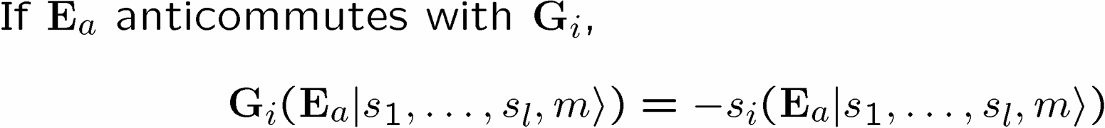







Surfing The Subspaces

Slide 16



Unsurfing The Subspaces

Slide 17
Examples

Slide 18
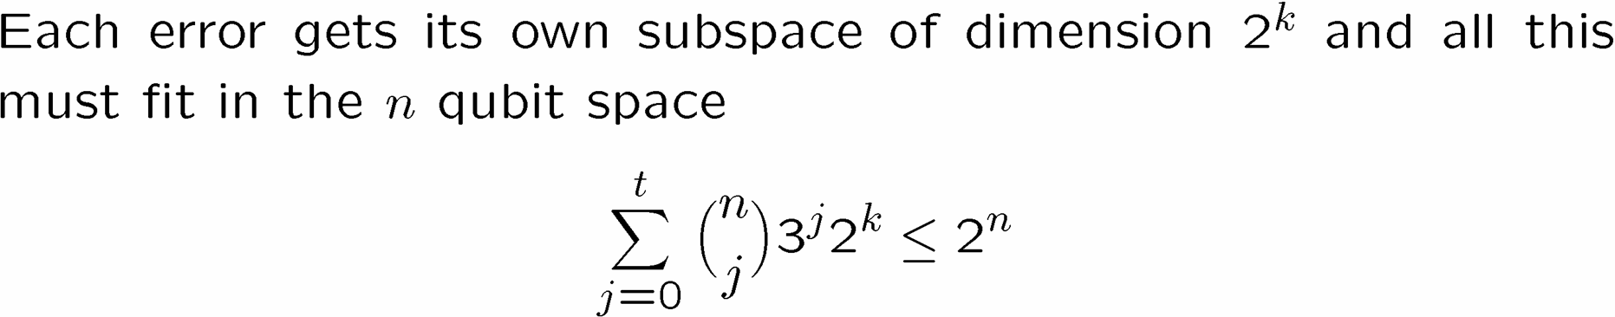
Quantum Hamming Bound
Research Problem: BEAT THE QUANTUM HAMMING BOUND

Slide 19










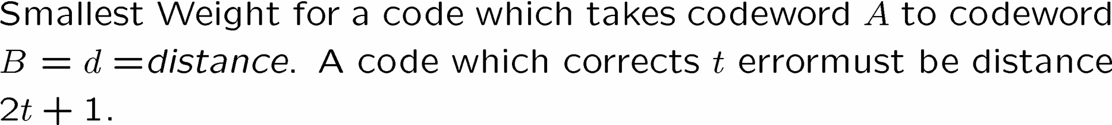



Detect Distinguishable Correct

Slide 20
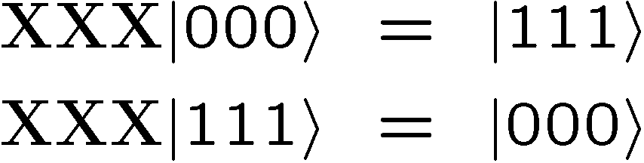
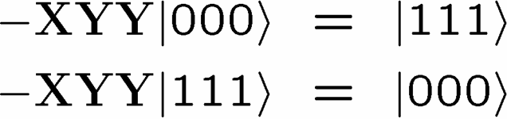
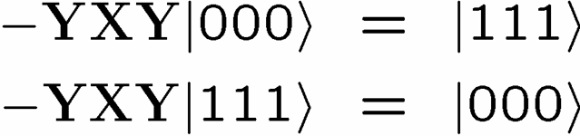
Pauli Want a Qubit?
Modulo the stabilizer S

Slide 21
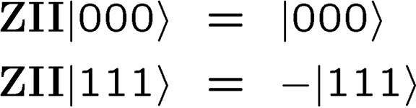
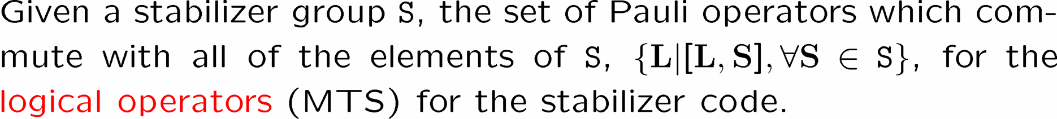
Modulo the stabilizer S
Feel free to randomly insert “Modulo the stabilizer S” into my sentence
Logical Operators for a Stabilizer Code

Slide 22
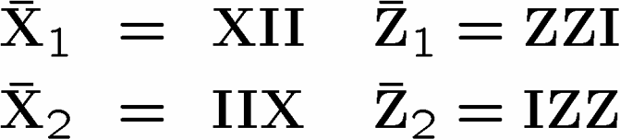



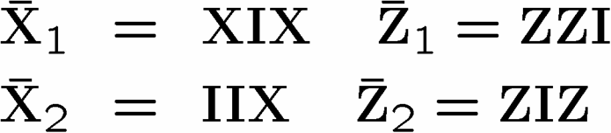
Pauli Wants Lots of Qubits
N
S
W
Who says north is up?
E
E
W
S
N

Slide 23
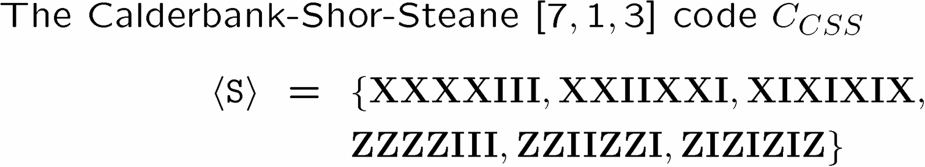
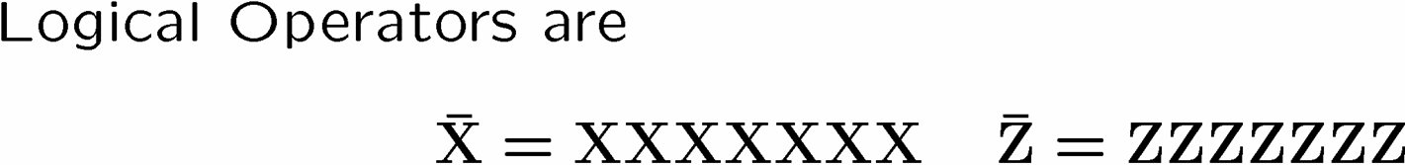
Real Life (I’m Plato) Example

Slide 24
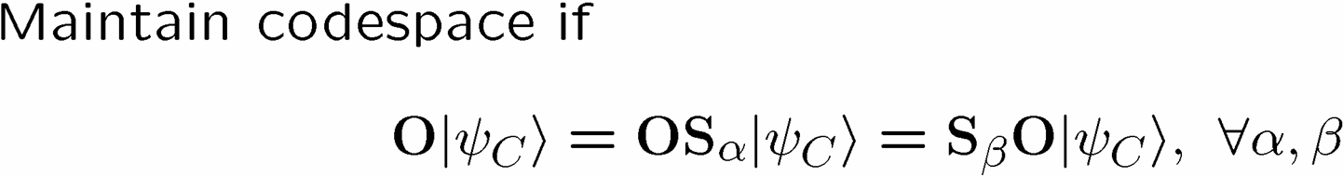
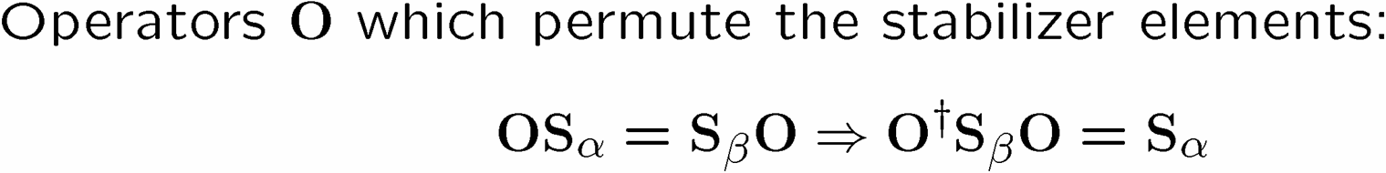
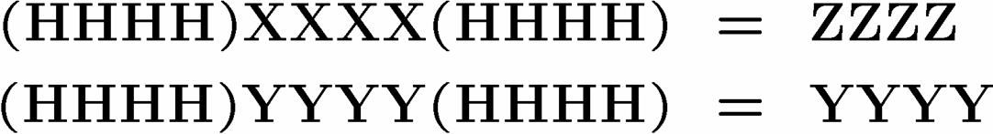

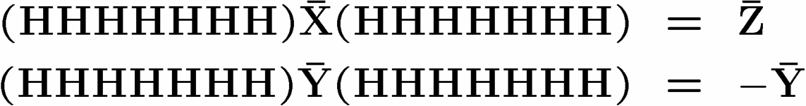
Clifford the Dog

Slide 25
Conjoining Subsystems

Slide 26
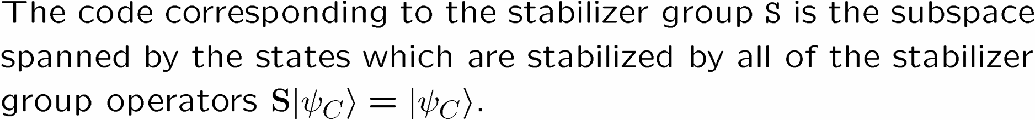
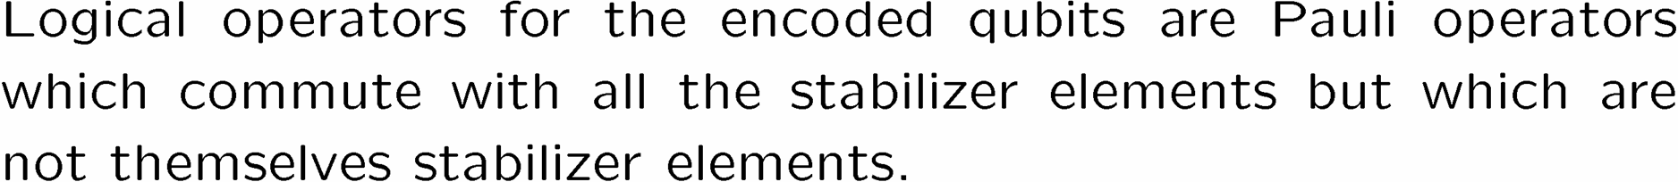
Stabilizer In Review

Slide 27
Used Quantum Computer Salesman
Welcome to Texas Tom’s used quantum computer mart.
Texas Tom wants to put YOU into the right quantum computer.
Quantum dot
Ion Traps
Linear Optics
Imported from down under
Silicon Phosphorus
Liquid NMR
Texas Tom cares.
www.qubitz.com

Slide 28
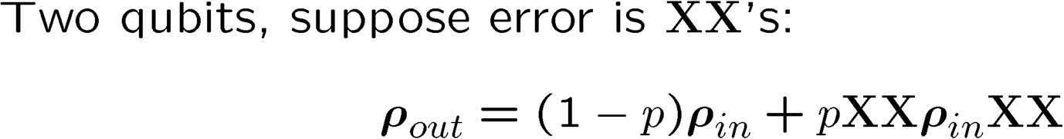


Decoherence Free Subspaces

Slide 29
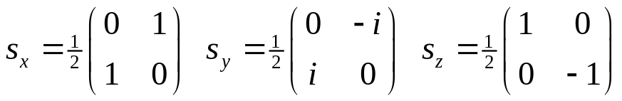
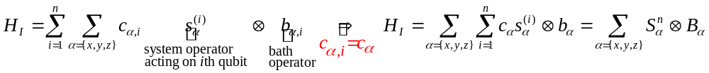
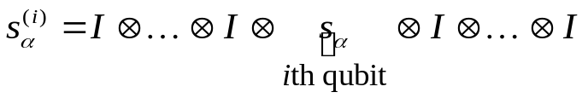
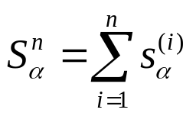


Collective Decoherence
spins coupled to bath field, N qubits
Bath mode with a wavelength much longer than the inner qubit spacing
system-bath Hamiltonian
collective spin operators:
bath couples identically to each qubit
su(2) Lie algebras

Slide 30
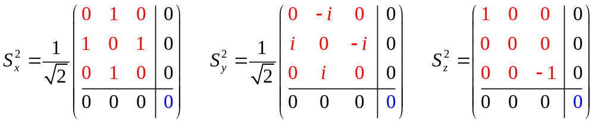
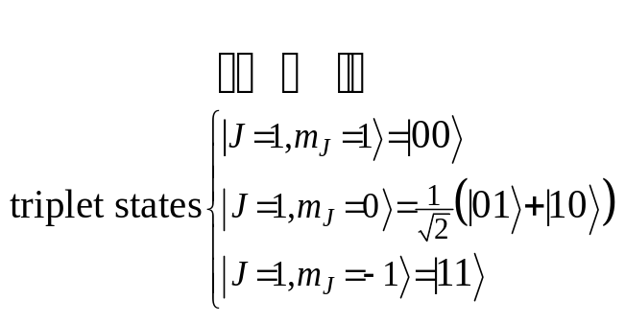
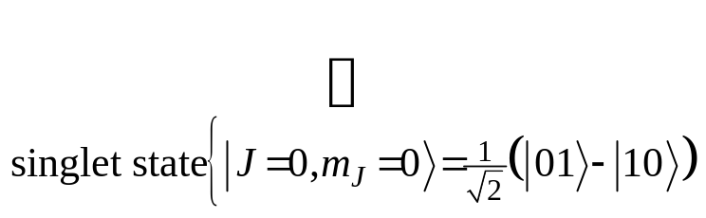
Just Angular Momentum Addition
Collective su(2) for n=2 qubits:
red is the 3 dimensional irreducible representation of su(2) (J=1)
blue is the 1 dimensional irreducible representation of su(2) (J=0)
simple addition of angular momentum…
nothing to see here, but:
spin 1
spin 1/2
+
spin 1/2
spin 0

Slide 31




Degeneracy
Something special happens with n=3:
spin-1 (triplet) plus spin-1/2 can produce either a spin-1/2 or a spin-3/2.
spin-0 (singlet) plus spin-1/2 can produce spin 1/2.
These spin-1/2 states come from combining a spin-0 two qubit state and a spin-1/2 single qubit state
These spin-1/2 states come from combining a spin-1 two qubit state and a spin-1/2 single qubit state
There is a DEGENERACY in the action of the 3 qubit collective su(2) operation.

Slide 32



Degeneracy Implies Safety

protected qubit
unprotected qubit
Information encoded into the DEGENERACY is immune to collective decoherence
(KLV) Emanuel Knill, Raymond Laflamme, Lorenza Viola, Phys. Rev. Lett. 84, 2525 (2000)

Slide 33



Classical Example
clumsy hands channel: both coins get flipped with probability p
(1-p)
+p
|coin 1, coin 2 
|parity,coin 1
Information can be immune to this channel if
encode into the parity
|1H=
|1T=
|0H=
|0T=
|parity=|0 if coins same, |parity=|1 if coins differ

Slide 34





Decoherence Free Subsystems
“The universe is an enormous direct product of representations of symmetry groups” - Steve Weinberg
for open system becomes
“The universe is an enormous direct product of full matrix algebras” - not Steve Weinberg

Slide 35
Fault-Tolerant Quantum
Computation
U
U
V
U
V
U

Slide 36


Perfection Through Concatenation
U
V
U
error
correction
error
correction
error
error
error

Slide 37



A Plague of Errors
=
U
=
U
H
H
H
H
H
=
H
H
H
H
H
H
H

Slide 38

Be Careful Where You Rotate

Slide 39
Holy Grail of Fault Tolerant Computation
Block 1
Block 2

Slide 40
Beautiful Details

Slide 41

Threshing Out a Threshold
Error Free Quantum Computation
QC
Error Rate

Slide 42


Some Rough Details
U
U
U
V
U
W

Slide 43
Profound Truth?
Fight entanglement with entanglement.

