Slide 1

Climbing Mount Fault-Tolerance
Fault
tolerance
A Trailhead:
Supercoherent Qubits
Error Correction
Dave Bacon
Institute for Quantum Information
California Institute of Technology
Error Detection

Slide 2
AU-US
CDEST, AAS
NSF
elong cumber
colloq, mate!
elongated cumbersome
colloquialisms
Coins size not correlated
with value.
Coins size not correlated
with value.
Vegemite
NA
JONATHAN
DOWLING!
ANDREW
WHITE!
Revenge slide I

Slide 3
Rant mode ON
Computer Revolution = Physics
The Computer Science Assumption: robust digital storage and digital
manipulation of information is possible.
In this NOISY (ANALOG) world HOW can anything be DIGITAL?
Theory: Von Neumann showed methods for fault-tolerant computation
Practice: no need for these methods because
THERE EXIST SYSTEMS WHOSE PHYSICS GUARANTEES ROBUST CLASSICAL COMPUTATION
THE BILLION DOLLAR QUANTUM QUESTION
Do there exist (or can we engineer) quantum systems whose
physics guarantees fault-tolerant quantum computation?

Slide 4
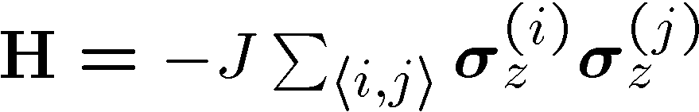
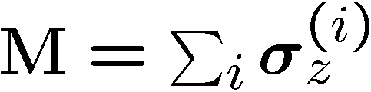



The Lesson of the Hard Drive
Classical Ising memory:
1D Ising model
2D Ising model
Code: all spins pointing up = 0, all spins pointing down = 1
Order parameter for this information = total magnetization
1D bad memory
2D good memory

Slide 5

















What Have We Learned?

Slide 6



A Quantum Hard Drive?
An example of Kitaev:
interactions
qubits

Slide 7

The GOAL of the many fancy models
constructed by Kitaev and Freedman
(topological quantum computation
[mmmm donuts])
is to find a naturally fault-tolerant
quantum computer
This talk: small scale example

Slide 8




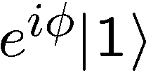
Making Decoherence Work Hard
system
bath
~
H_{I} = perturbative system-bath coupling
H_{I} energy small compared to E_{sys} and E_{bath} implies decoherence dominated by pathways that conserve unperturbed energies (essentially rotating wave approximation)
“cooling”
“heating”
“non-dissipative”

Slide 9


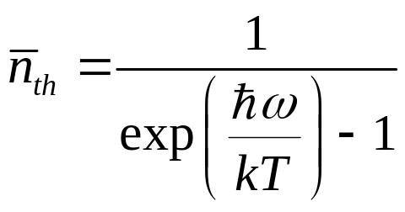

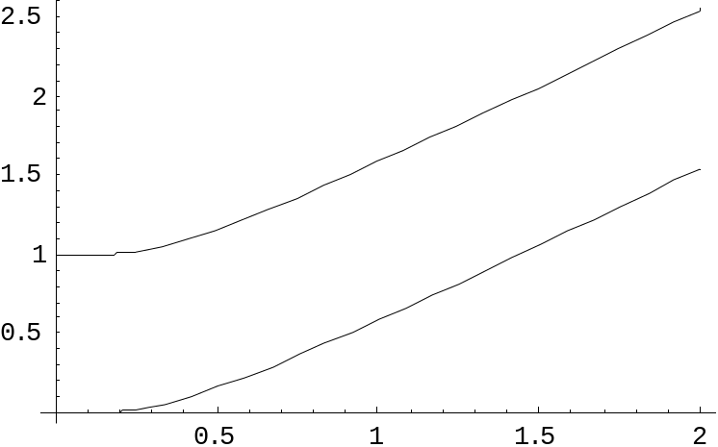

two-level atom radiatively coupled to a thermal reservoir:
“heating”
“cooling”
“non-dissipative”
At low bath temperatures, heating disappears……..
Can we make quantum errors “heating”?

Slide 10







A Small Example (You can build?)
Four spin systems with equal strength exchange interactions
between all spins:
1
2
4
3
Encode a qubit of quantum information in the degenerate ground state
Stabilized by collective operators:
Degenerate ground states are single qubit error detecting code
Ground state is a collective-decoherence decoherence-free subspace

Slide 11
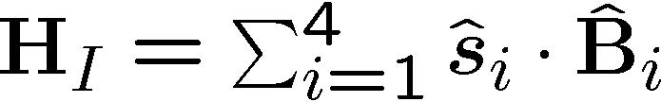

Supercoherence
Qubits coupling to baths:
1
2
4
3
All single qubit processes on
this system take the ground states
to states of higher energy.
forbidden
As temperature of the bath is decreased first-order decoherence processes will be eliminated…supercoherence
Limit to supercoherence is second order processes which act on two qubits
Bacon, Brown, and Whaley, PRL 87, 247902 (2001)
Notes:
higher energy.

Slide 12
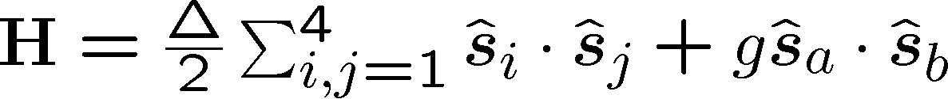


Computing on Supercoherence
Manipulation of the encoded qubit can be enacted by additional
exchange energy:
supercoherence
property not lost.
1
2
Extra exchange on
gives all SU(2) on encoded qubit
4
3
To compute on between two encoded qubits
exchange must be turned on between eight
physical qubits
Notes:
higher energy.

Slide 13

Beyond Supercoherence
Supercoherence is small step towards the ultimate goal of natural
fault tolerant quantum computation (it is physical error detection.)
XX
XX
This systems ground state is a quantum error
correcting code.
ZZ
ZZ
ZZ
XX
XX
Kitaev and Freedman’s topological codes are examples of systems whose energy eigenstates are quantum error correcting code states.
ZZ
ZZ
ZZ
XX
XX
Problem: find a system with a persistent coherence order parameter
All known
systems
The goal
Notes:
higher energy.

Slide 14
YY
XX
XX
ZZ
XX
ZZ
XX
ZZ
ZZ
ZZ
YY
YY
ZZ
ZZ
XX
XX
XX
XX
ZZ
ZZ
ZZ
YY
Fault
tolerance
XX
XX
XX
XX
XX
XX
XX
ZZ
ZZ
ZZ
ZZ
ZZ
ZZ
Error Correction
XX
XX
XX
XX
XX
Error Detection
1
2
XX
ZZ
ZZ
4
3
XX

Slide 15
Quantum Computer Revolution
= (Interesting!) Physics?
DO THERE EXIST SYSTEMS WHOSE PHYSICS GUARANTEES ROBUST QUANTUM COMPUTATION?
Collaborators: K. Birgitta Whaley and K. R. Brown
Department of Chemistry
U.C. Berkeley

