Slide 1
Computer Revolution = Physics
The Computer Science Assumption: robust digital storage and digital
manipulation of information is possible.
In this NOISY (ANALOG) world HOW can anything be DIGITAL?
Theory: Von Neumann showed methods for fault-tolerant computation
Practice: no need for these methods because
THERE EXIST SYSTEMS WHOSE PHYSICS GUARANTEES ROBUST CLASSICAL COMPUTATION
THE BILLION DOLLAR QUANTUM QUESTION
Do there exist (or can we engineer) quantum systems whose
physics guarantees fault tolerant quantum computation?

Slide 2
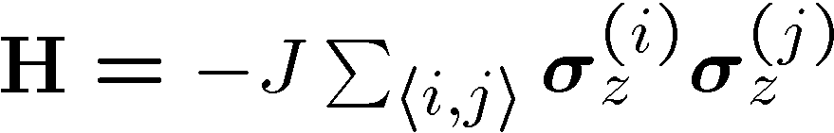
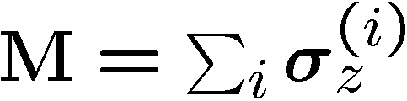



The Lesson of the Hard Drive
Classical Ising memory:
1D Ising model
2D Ising model
Code: all spins pointing up = 0, all spins pointing down = 1
Order parameter for this information = total magnetization
1D bad memory
2D good memory

Slide 3

The GOAL of the many fancy models
constructed by Kitaev and Freedman
(topological quantum computation)
is to find a naturally fault-tolerant
quantum computer

Slide 4








A Small Example (You Can Build?)
Four spin systems with equal strength exchange interactions
between all spins:
1
2
4
3
Encode a qubit
into the degenerate
ground state

Slide 5


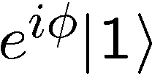
Making Decoherence Work Hard
system
bath
~
H_{I} = perturbative system-bath coupling
H_{I} energy small compared to E_{sys} and E_{bath} implies decoherence dominated by pathways that conserve unperturbed energies (essentially rotating wave approximation)
“cooling”
“heating”
“non-dissipative”

Slide 6


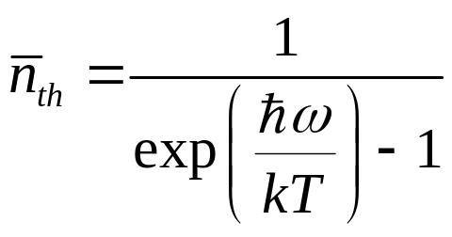

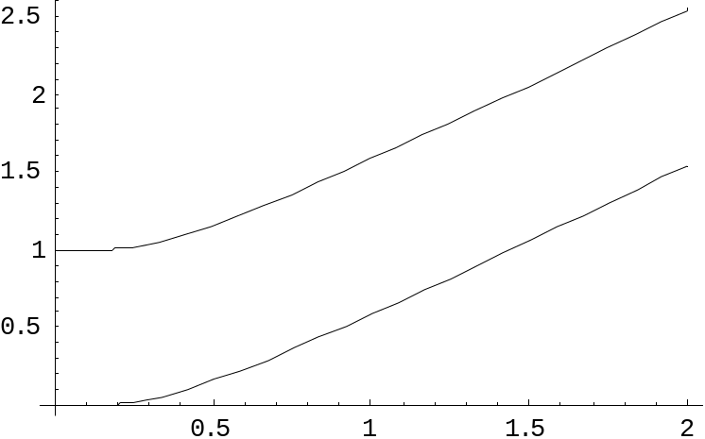

two-level atom radiatively coupled to a thermal reservoir:
“heating”
“cooling”
“non-dissipative”
At low bath temperatures, heating disappears……..
Can we make quantum errors “heating”?

Slide 7
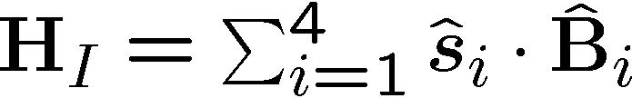

Supercoherence
Qubits coupling to baths:
1
2
4
3
All single qubit processes on
this system take the ground states
to states of higher energy.
forbidden
As temperature of the bath is decreased first-order decoherence processes will be eliminated…supercoherence
Limit to supercoherence is second order processes which act on two qubits
Bacon, Brown, and Whaley, PRL 87, 247902 (2001)
Notes:
higher energy.

Slide 8



$10⁹ Question
Topological quantum computation:
Engineering in optical lattices:
L.-M. Duan, E. Demler, M. D. Lukin,
cond-mat/0210564

Slide 9
Quantum Computer Revolution
= (Interesting!) Physics?
DO THERE EXIST SYSTEMS WHOSE PHYSICS GUARANTEES ROBUST QUANTUM COMPUTATION?

