Slide 1





There’s Plenty of Room
at the Top
An Invitation to Help Start the Quantum Computing Revolution
Dave Bacon
Institute for Quantum Information
Caltech

Slide 2
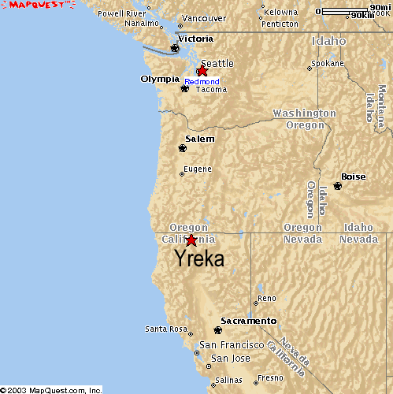
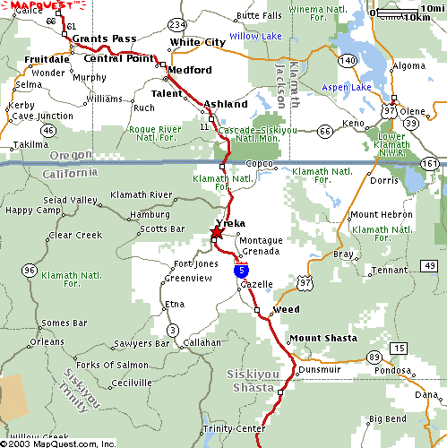
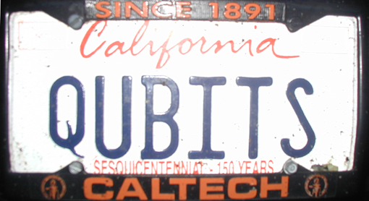

All Apologies

Slide 3
The Big Two
(what everyone should be working on in quantum computing)
Quantum Algorithms
What Will be THE Quantum
Computing Technology?

Slide 4
Rant mode ON
Physics and Computation
The Computer Science Assumption: robust digital storage and digital
manipulation of information is possible.
In this NOISY (ANALOG) world HOW can anything be DIGITAL?
Theory: Von Neumann showed methods for fault-tolerant computation
Practice: no need for these methods because
THERE EXIST SYSTEMS WHOSE PHYSICS GUARANTEES ROBUST CLASSICAL COMPUTATION
THE BILLION DOLLAR QUANTUM QUESTION
Do there exist (or can we engineer) quantum systems whose
physics guarantees fault-tolerant quantum computation?

Slide 5
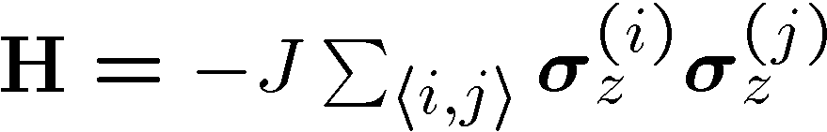



The Physics Guarantee
Rant mode
SHUTTING
OFF

Slide 6
Self Fixing

Slide 7
The Problem

Slide 8
Two Paths

Slide 9
No Quantum Transistor

Slide 10
The Quantum Hard Drive

Slide 11
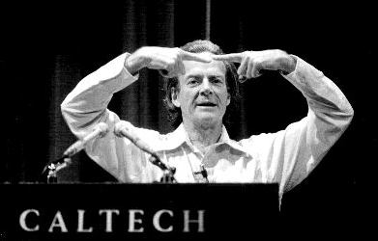
There’s Plenty of Room at the
Bottom
Richard P. Feynman
“There's plenty of room at the bottom: an invitation to open
up a new field of physics,” talk given approximately 1960
Macro
Meso
Micro

Slide 12
Quantum Error Correcting
Order Paramter

Slide 13
Roadmap

Slide 14
Supercoherence

Slide 15
Half Way There

Slide 16
3x3

Slide 17
Bad Fermions

Slide 18
Into the Third Dimension

