Slide 1





There’s Plenty of Room at
the Top
An Invitation to Help Start the Quantum Computing Revolution
Dave Bacon
Institute for Quantum Information
Caltech

Slide 2
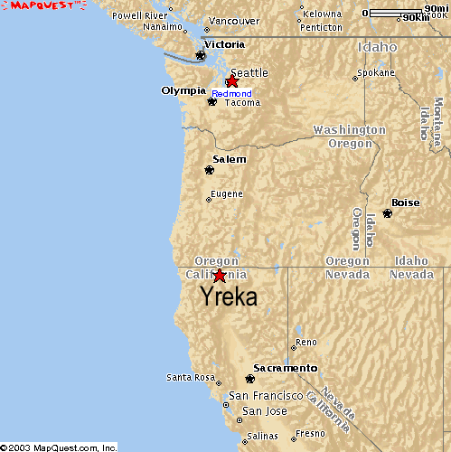
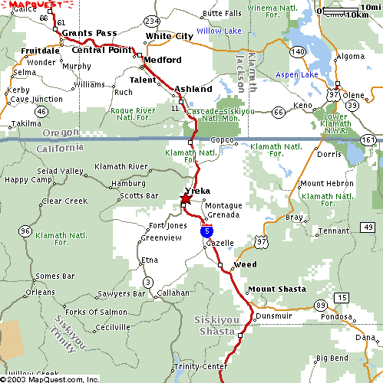
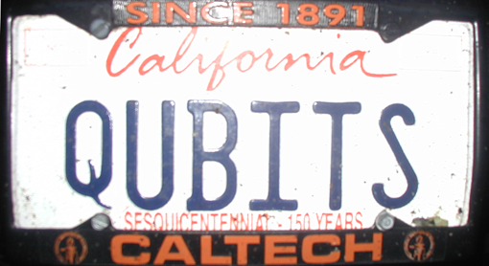
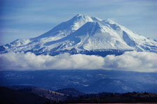
All Apologies

Slide 3
2
The Big Two
(what everyone should be working on in quantum computing)
Quantum Algorithms
What Will be THE Quantum
Computing Technology?

Slide 4
Rant mode ON
Physics and Computation
The Computer Science Assumption: robust digital storage and digital
manipulation of information is possible.
In this NOISY (ANALOG) world HOW can anything be DIGITAL?
Theory: Von Neumann showed methods for fault-tolerant computation
Practice: no need for these methods because
THERE EXIST SYSTEMS WHOSE PHYSICS GUARANTEES ROBUST CLASSICAL COMPUTATION
THE BILLION DOLLAR QUANTUM QUESTION
Do there exist (or can we engineer) quantum systems whose
physics guarantees fault-tolerant quantum computation?

Slide 5
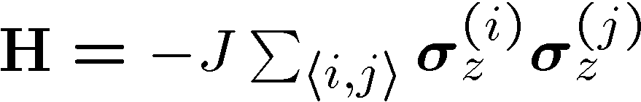



The Physics Guarantee
Rant mode
SHUTTING
OFF

Slide 6

















Self Fixing

Slide 7



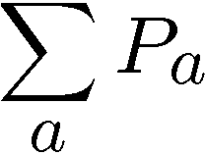
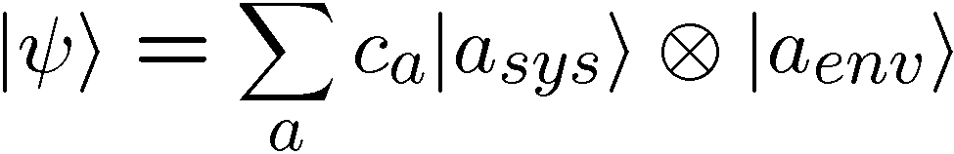
The Quantum Problem
Classical
Quantum
system
environment
system
environment
V_{ini}
W_{ini}
initial
V_{a}
W_{a}
final
Other Issues of Control / Noise SIMILAR.
Current State: like Von Neumann
theory of fault-tolerant quantum computation

Slide 8
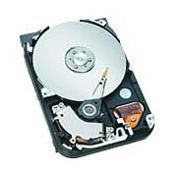
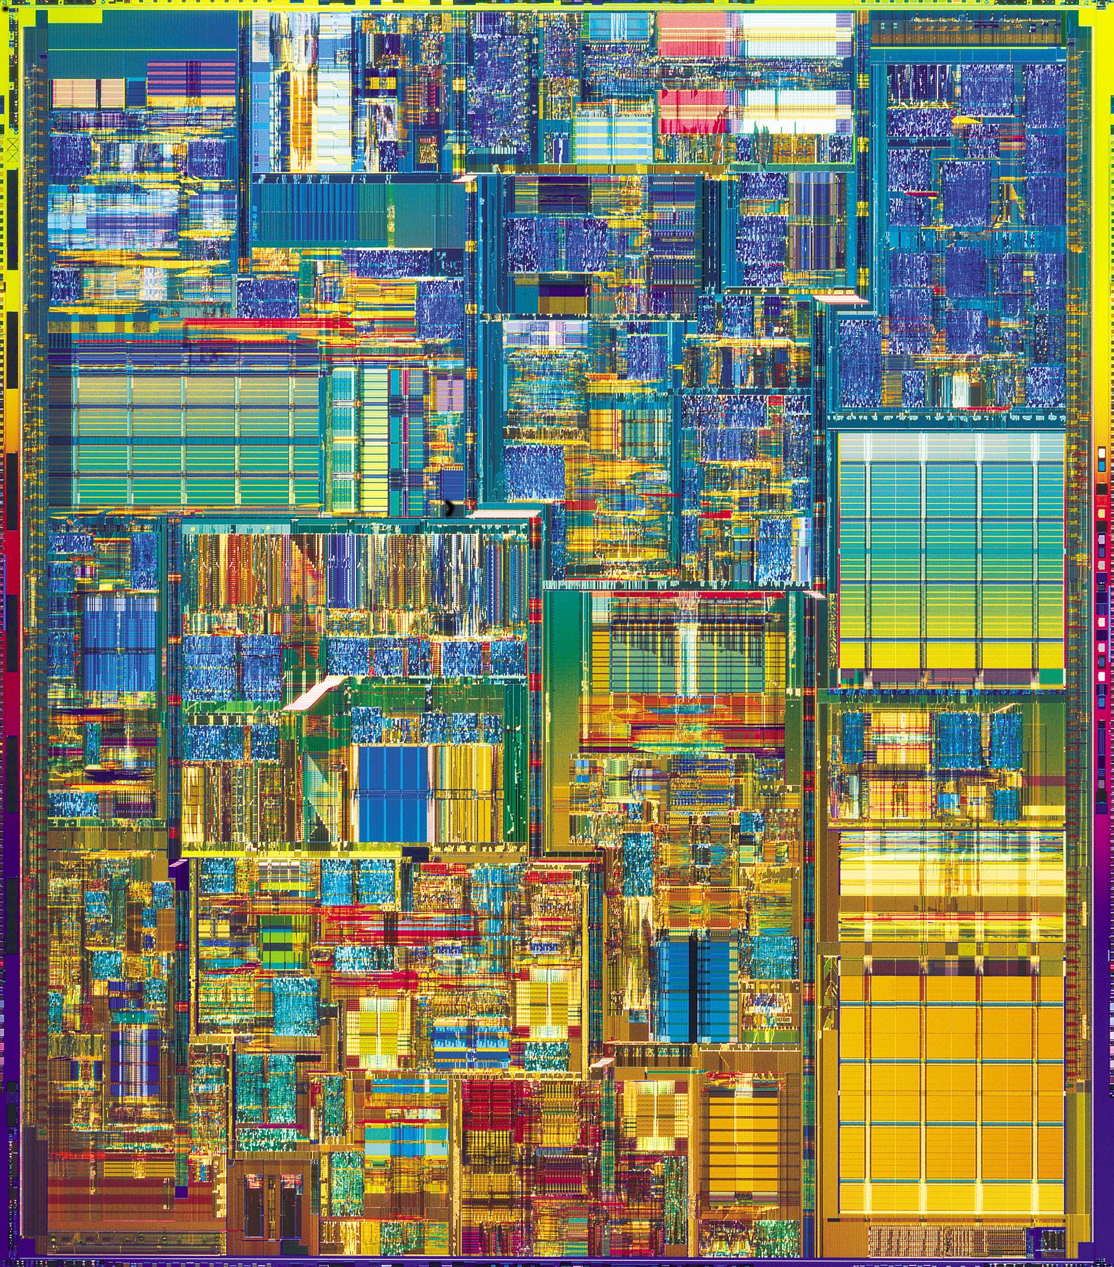
Two Paths
Hard Drive
Transistor
Coding: majority vote of
magnetism
Coding: majority vote of
current
Error correction: local energy
minimization
Error correction: amplification
Fault-tolerant: macro applied
field.
Fault-tolerant: conducting / insulating phase transition
More than storage?

Slide 9
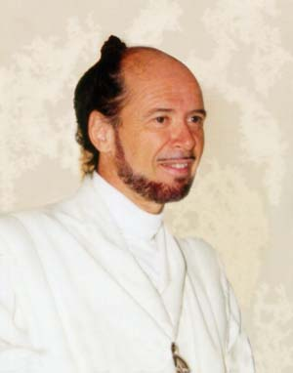



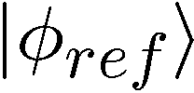




No Quantum Transistor
Quantum Cloning Machine
“A single quantum cannot be cloned,” Wootters and Zurek, Nature, 1982

Slide 10



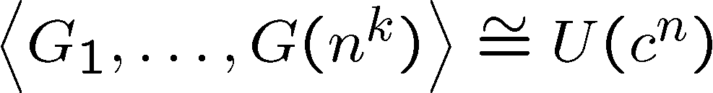
The Quantum Hard Drive?
Alexei Kitaev, Michael Freedman, John Preskill, …
Do there exist (or can we engineer) quantum systems whose
physics guarantees fault-tolerant quantum computation?
1. Coherence preserving.
2. Accessible Fault-Tolerant
Operations
3. Universality

Slide 11
Towards Quantum Hard Drives
Kitaev – “computation by anyons”
first suggestion of natural fault-tolerance (1997).
fault-tolerant universal quantum computation when
actively used
gapped, but thermal fluctuations disorder system
>2 body interactions, many-many level systems
Dennis, Kitaev, Landahl, and Preskill – “four dimensional code”
local four dimensional code
should have natural ordered phase
>2 body interactions
Freedman – “quantum loop gas”
2-dimensional
analogy with classical loop gas argues for ordered phase
>2 body interactions

Slide 12
Interactions
What can be done with two-body interactions?
interactions from proposed quantum computers

Slide 13
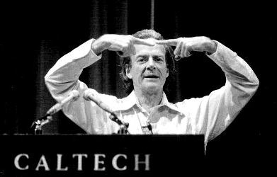
“Worship no one” mode ON
There’s Plenty of Room at the
Bottom
Richard P. Feynman
“There's plenty of room at the bottom: an invitation to open
up a new field of physics,” talk given approximately 1960
The Computer Revolution
Macro
Meso
Micro
The Quantum Computer Revolution? NO! NO! NO!

Slide 14

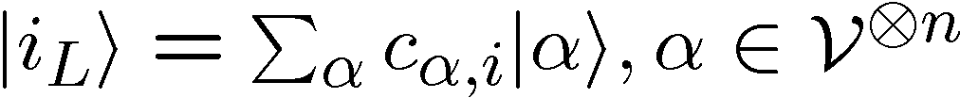
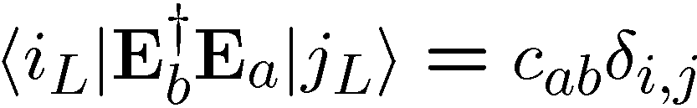
Old School
prepare
Fix
compute
out
Error
“cold” ancilla
“hot” ancilla
Competition between errors and cooling
Quantum error correcting code
Error correcting criteria:
If criteria holds, then fixing procedure possible

Slide 15




Into The Fray
Thermodynamic limit
guarantees robustness
Strongly Interacting Many Body Quantum System
energy
eigenstates
Hamiltonian

Slide 16




Quantum Error Correcting
Order Parameter
The quantum information is
still here. How do we see it?
diagnose
fix
measure encoded info
j
Encoded quantum information

Slide 17
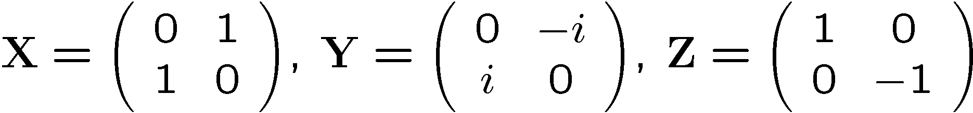






A Simple Start
“To be an Error and to be Cast out is Part of [Nature’s] Design.” -William Blake
[4,2,2] quantum error detecting code:

Slide 18

Supercoherence
4 qubit system
1
XX
2
ZZ
ZZ
4
XX
3
System Hamiltonian:

Slide 19
























Slide 20

Supercoherence
ALL single qubit errors take degenerate ground state to higher energy levels.
Single qubit errors change value of (S₁,S₂) and hence take ground state to higher energy level.
FORBIDDEN
D. Bacon, Ph.D. thesis, U.C. Berkeley, 2001

Slide 21



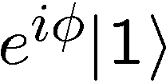
Making Decoherence Work Hard
system
bath
~
H_{I} = perturbative system-bath coupling
H_{I} energy small compared to E_{sys} and E_{bath} implies decoherence dominated by pathways that conserve unperturbed energies (essentially rotating wave approximation)
“cooling”
“heating”
“non-dissipative”

Slide 22


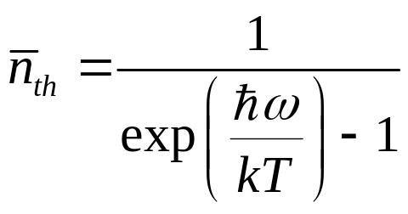

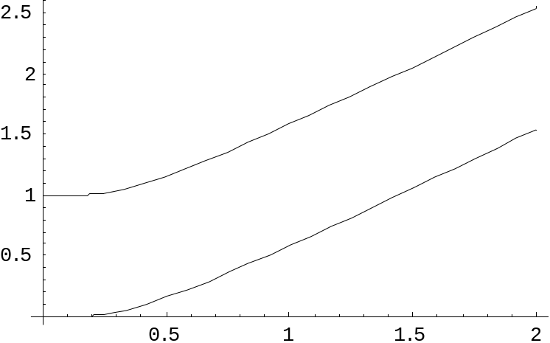

two-level atom radiatively coupled to a thermal reservoir:
“heating”
“cooling”
“non-dissipative”
At low bath temperatures, heating disappears……..
Supercoherence
made all quantum errors “heating”!

Slide 23
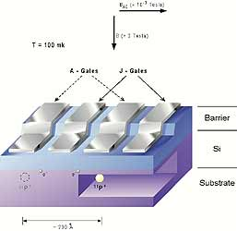
In a Few Years Time…
Four spin systems with equal strength exchange interactions
between all spins:
1
2
4
3
Supercoherent qubit
single P atoms in Silicon
exchange controlled by voltage
mediated barriers
Bacon, Brown, and Whaley, PRL 87, 247902 (2001)
DiVincenzo, Bacon, Kempe, Burkard, and Whaley, Nature 408, 399 (2001)

Slide 24

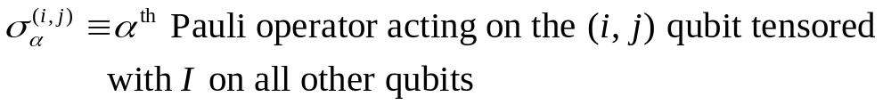
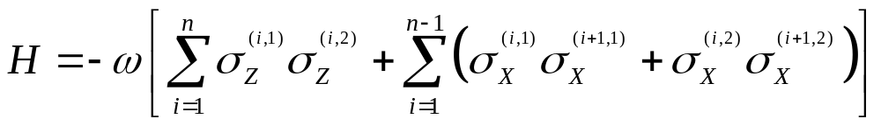
Ladder Qubits
1
2
1
2
i-1
i
i+1
n-3
n-2
n-1
n
qubit (i,1)
qubit (i,2)
The Hamiltonian
X X
X X
X X
Z Z
Z Z
D. Bacon, Ph.D. thesis, U.C. Berkeley, 2001
X X
X X
X X

Slide 25
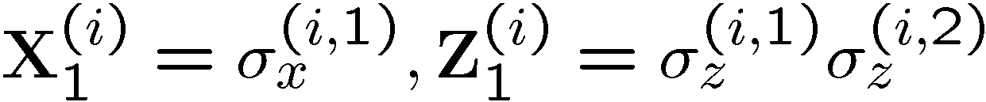
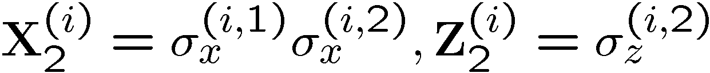
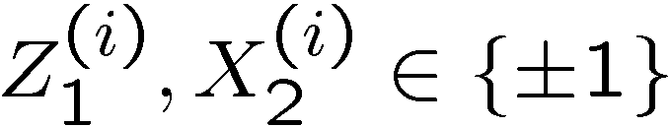
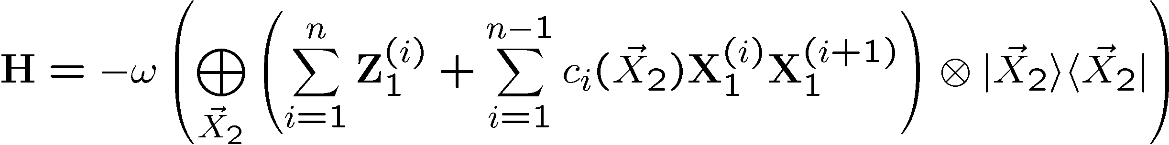
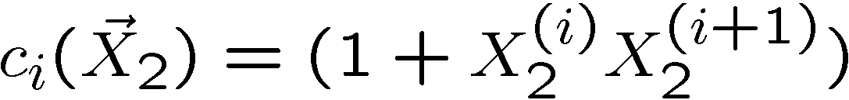
Basis Change
X X
X X
X X
Z Z
Z Z
1
New basis:
X X
X X
X X
2
i
i+1

Slide 26
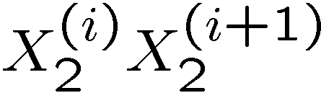
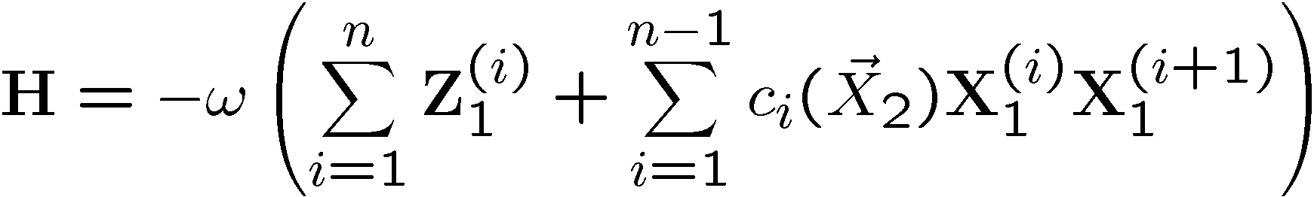
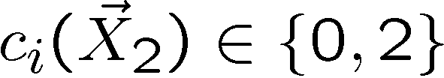
Everybody’s Favorite
transverse
field
only
transverse
field
only
Ising + transverse field
Ising + transverse field

Slide 27
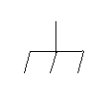

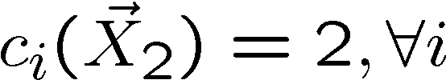
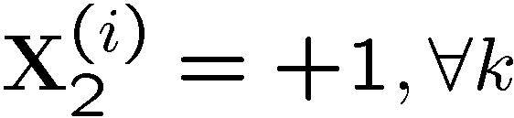
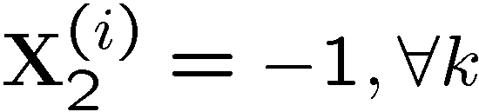
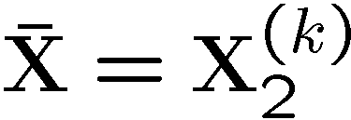

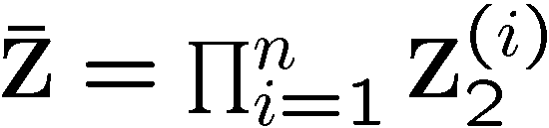
Grounded
Ground state is two-fold degenerate
1
X
X
2
k
Z Z Z

Slide 28
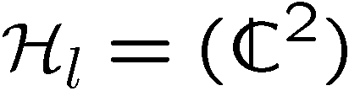

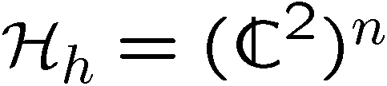

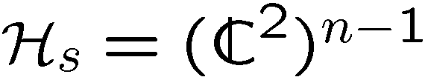


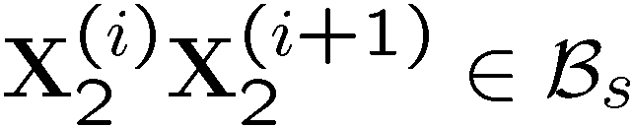
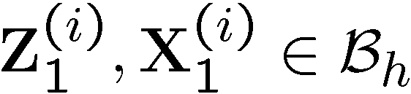


Detect and Correct
X X
X X
X X
Z Z
Z Z
X X
X X
X X

Slide 29
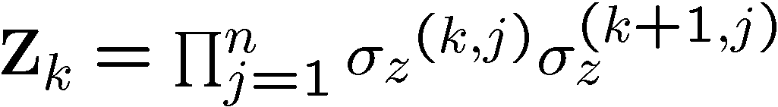
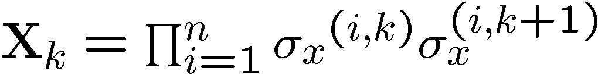
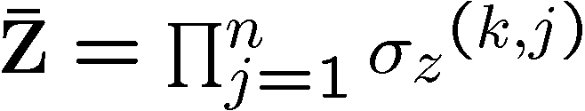
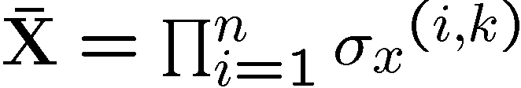
Into the 2nd Dimension
j-1
j
j+1
i-1
XX
XX
ZZ
ZZ
ZZ
i
XX
XX
ZZ
ZZ
ZZ
i+1
XX
XX

Slide 30
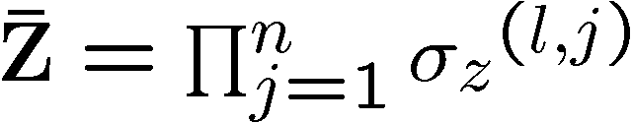
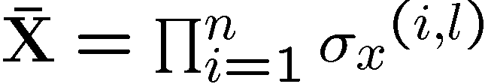

Tic-Tac-“DOH!”
XX
ZZ
XX
XX
XX
ZZ
ZZ
ZZ
ZZ
XX
XX
XX
ZZ
ZZ
ZZ
ZZ
XX
XX
XX

Slide 31
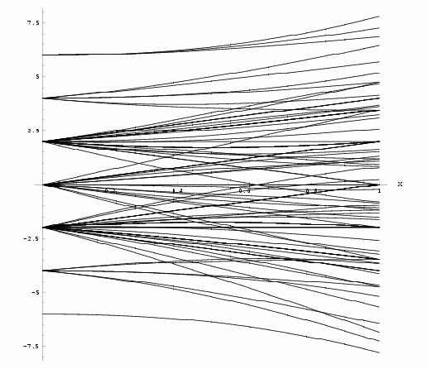
Loading 3x3
j-1
j
j+1
i-1
ZZ
ZZ
ZZ
ZZ
ZZ
i
ZZ
ZZ
ZZ
ZZ
ZZ
i+1
ZZ
ZZ
x
j-1
j
j+1
i-1
XX
XX
ZZ
ZZ
ZZ
i
XX
XX
ZZ
ZZ
ZZ
i+1
XX
XX

Slide 32





Into the Third Dimension
YY
ZZ
XX
ZZ
XX
YY
YY
ZZ
ZZ
XX
XX
YY
YY
ZZ
XX

Slide 33



Logical Operators

Slide 34


Errors
j-1
j
j+1
i-1
YY
YY
ZZ
ZZ
ZZ
i
YY
YY
ZZ
ZZ
ZZ
i+1
YY
YY

Slide 35




Order Parameter and Beyond
stabilizer
Logical qubit
Hamiltonian
Subsystem code:
This allows us to write down a subsystem order parameter.
Current project: Quantum Monte Carlo for this order parameter.

Slide 36
Fin
Error correcting codes
Geometry, Topology
classical
quantum
Statistical Physics
theory of strongly interacting
quantum systems
Fault-tolerance
        local structures giving rise
to global robustness (CA)
Real Physics
physical implementation
optical lattices, squids, donor electrons, etc.
Representation theory
identification of qubits
and logic
Naturally Fault-Tolerant Quantum Computation

