Slide 1

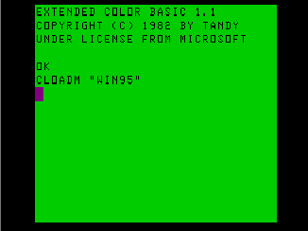
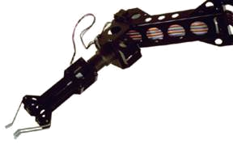
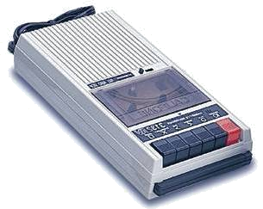

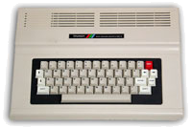
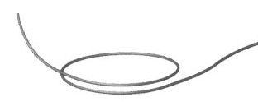


Quantum Computers
That Fix Themselves
Dave Bacon
Caltech
Department of Physics
Institute for Quantum Information

Slide 2

The Enemy?

Slide 3



Caltech
MIT
The California Tech
Quantum Computing Mecca
Quantum Computing Mecca
27 Nobel Prizes
57 Nobel Prizes
0.01 Nobel Prizes / Capita
0.005 Nobel Prizes / Capita
“lies, damn lies, and statistics.” – Leonard Henry Courtney

Slide 4
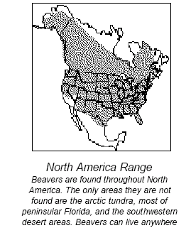
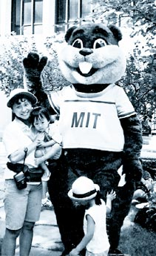
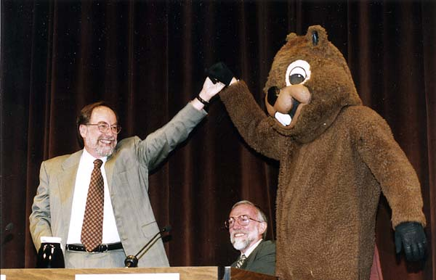
Caltech
Castor canadenis

Slide 5
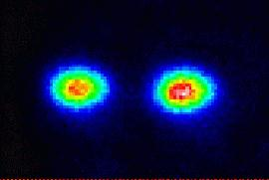




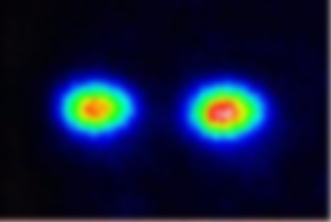
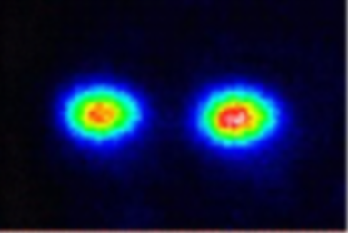
The Quantum Computing Roadmap
NIST Boulder Ions

Slide 6
1941 – First programmable electronic calculator.
mechanical relays.
1943 – ENIAC.
18000 vacuum tubes: “nature abhors the vacuum tube.”
1947 – Bell labs develops the transistor.
1952 – G. W. Dummer proposes manufacturing electronic equipment in one
block with no connecting wires.
1959 – Texas Instruments and Fairchild Semiconductor invent the integrated
circuit.
1964 – first IBM 360 series (the concept of an “architecture”)
1964 – Integrated circuit which cost $1000 in 1959 now costs $10. Moore
describes his law.
1972 – Intel 8008 and 8 bit microprocessor.
1975 – First personal computer the Altair.
1982 – IBM PC introduced. Personal computer revolution begins.
Have We Learned Anything?

Slide 7
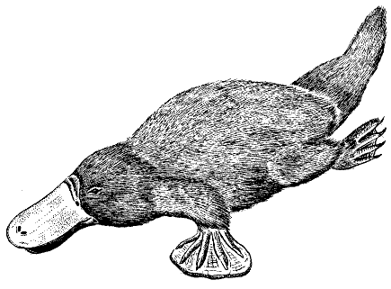
History Only Teaches Me Physics
Isolated
Interacting
What happens when many units (defined isolated) interact?
ordered
regular
reducible
turbulent
complex
not reducible
Platyputor
Computers are strange beasts in this world:
  built from parts which order and are regular
  reductionist’s dream come true
yet:
  complexity of computer running a program is high
  algorithmic complexity implies reduction cannot be
  compressed beyond running the algorithm

Slide 8
The Physics Guarantee
Rant mode ON
What is the phase of matter corresponding to the computer?
PRACTICAL QUESTION (as opposed to philosophical)
There are distinct PHYSICAL reasons why robust classical
computation is possible.
not all physical systems are equally good for computation:
there exists systems whose PHYSICS guarantees
their ability to enact robust classical computation.
Are there (or can we engineer) physical systems whose
PHYSICS guarantees robust quantum computation?
This talk: (1) this point of view for classical computers
(2) attempts to port these ideas to a quantum computer

Slide 9
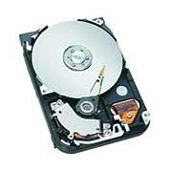
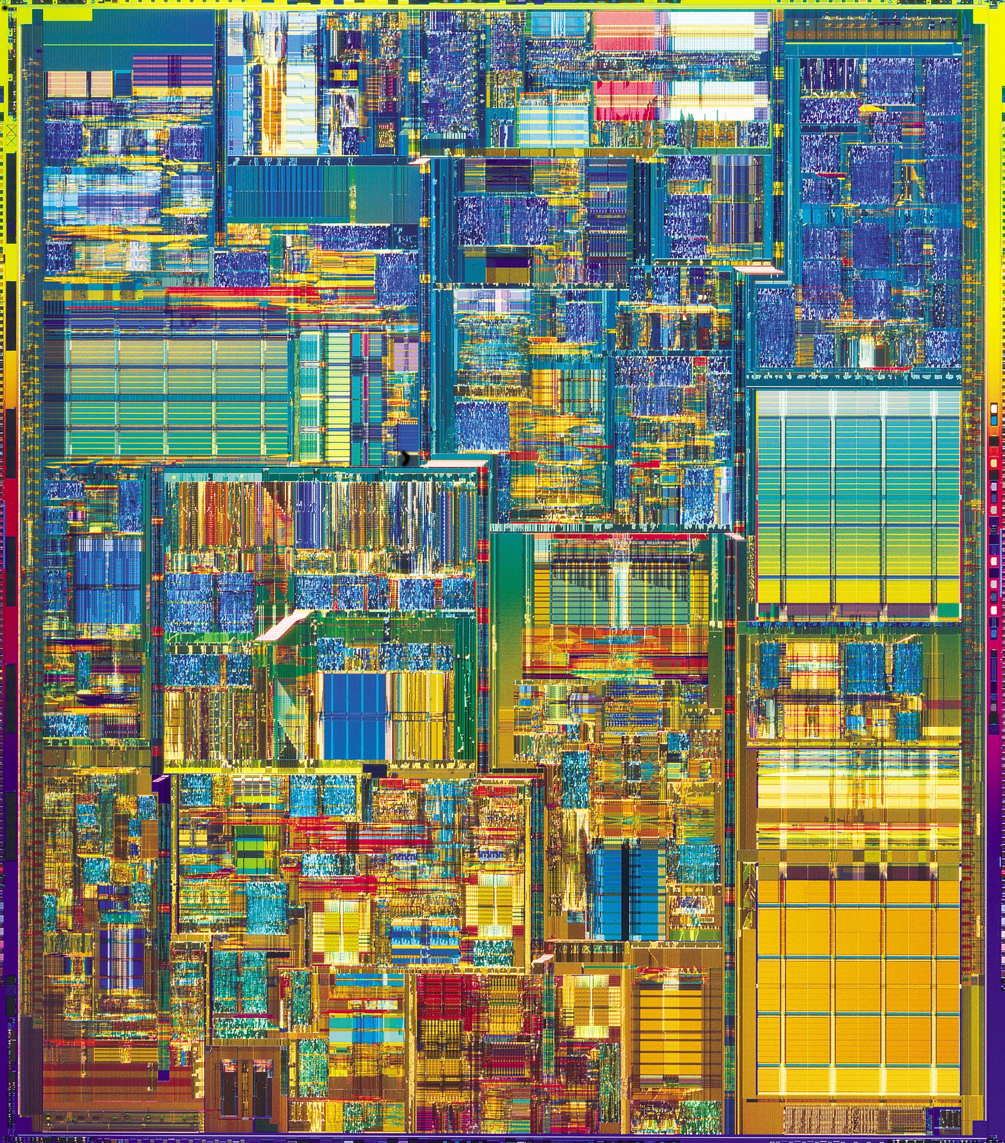
Two Paths
Hard Drive
Transistor
Coding: majority vote of
magnetism
Coding: majority vote of
current
Error correction: local energy
minimization
Error correction: amplification
Fault-tolerant: conducting / insulating phase transition
Fault-tolerant: macro applied
field.
More than storage?

Slide 10
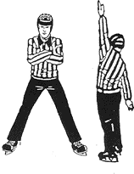




A Dynamic Ising Model
Ising model
Dynamic Ising model

Slide 11
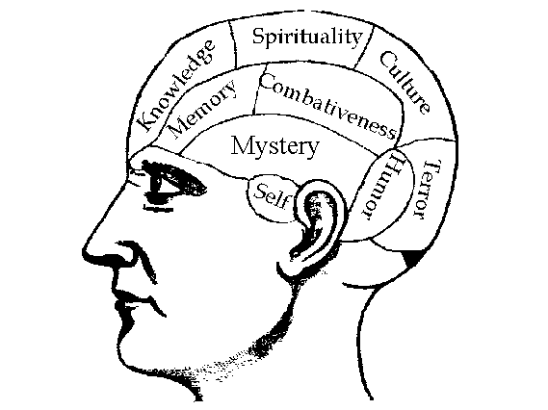


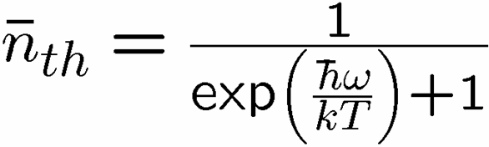

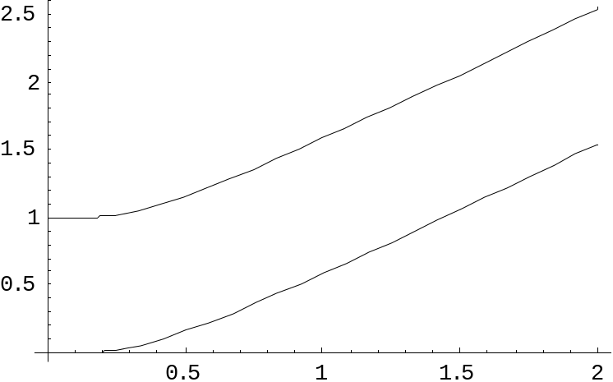
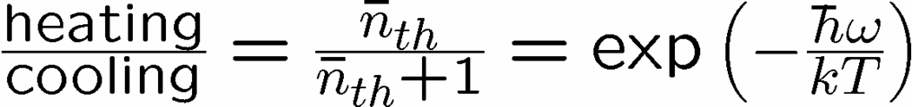


Reminder
two-level system radiatively coupled to a thermal reservoir:
“heating”
“cooling”
“non-dissipative”

Slide 12


A Dynamic Ising Model
Ising model
Dynamic Ising model (Metropolis update)

Slide 13



Storage and Manipulation
Compare 1D and 2D Ising models at different temperatures for
a) storage of information
b) manipulation of information
1st attempt:
Storage in thermal state (infinite time - ensemble is thermal)
1D Ising
2D Ising
Criticism: (1) thermodynamic limit taken (N infinite)
(2) what if relaxation to equilibrium takes a long time?

Slide 14
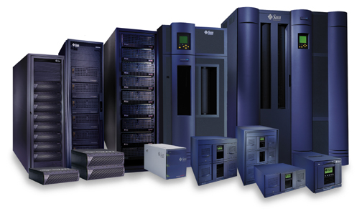



Storage
2nd attempt:
Relaxation to thermal
1D Ising
2D Ising
Imperfect preparation

Slide 15
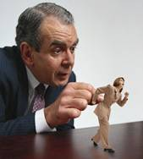



Manipulation
Flipping spins is imperfect
1D Ising
2D Ising
1D Ising
temperature less than gap
manipulation error must be small
2D Ising
temperature less than critical temp
self correcting

Slide 16
















Self Fixing

Slide 17
Two Paths
Hard Drive
Transistor
Coding: majority vote of
magnetism
Coding: majority vote of
current
Error correction: local energy
minimization
Error correction: amplification
Fault-tolerant: conducting / insulating phase transition
Fault-tolerant: macro applied
field.
More than storage?

Slide 18





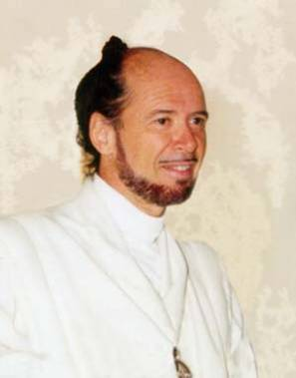



No Quantum Transistor
Quantum Cloning Machine
“A single quantum cannot be cloned,” Wootters and Zurek, Nature, 1982

Slide 19
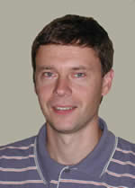
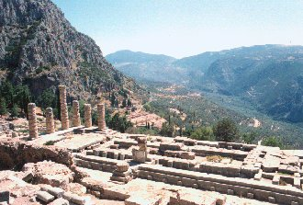




The Quantum
Hard Drive?
(Kitaev)
Do there exist (or can we engineer) quantum systems whose
physics guarantees fault-tolerant quantum computation?
1. Coherence preserving.
2. Accessible Fault-Tolerant
Operations
“self-correcting”
3. Universality

Slide 20
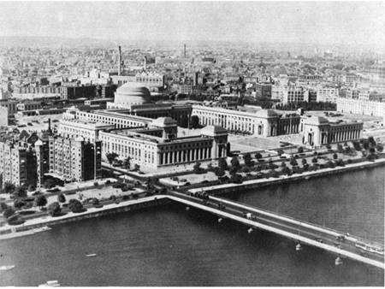



Old School
prepare
Fix
compute
out
Error
“cold” ancilla
“hot” ancilla
Competition between errors and cooling
Quantum error correcting code
Error correcting criteria:
If criteria holds, then fixing procedure possible

Slide 21




Into The Fray
Thermodynamic limit
guarantees robustness
Strongly Interacting Many Body Quantum System
energy
eigenstates
Hamiltonian
Barnes and Warren, PRL 85, 856 (2000) [but is only “classical”]

Slide 22




Quantum Error Correcting
Order Parameters
The quantum information is
still here. How do we see it?
diagnose
fix
measure encoded info
j
Encoded quantum information

Slide 23
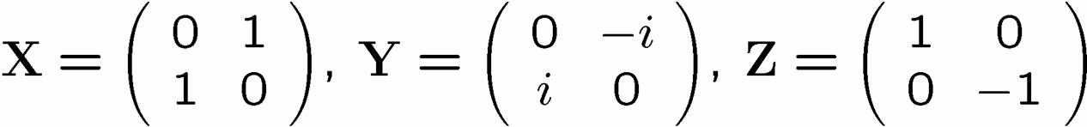






A Simple Start
“To be an Error and to be Cast out is Part of [Nature’s] Design.” -William Blake
[4,2,2] quantum error detecting code:

Slide 24

Supercoherence
4 qubit system
1
XX
2
ZZ
ZZ
4
XX
3
System Hamiltonian:

Slide 25























Slide 26

Supercoherence
ALL single qubit errors take degenerate ground state to higher energy levels.
Single qubit errors change value of (S₁,S₂) and hence take ground state to higher energy level.
FORBIDDEN
D. Bacon, Ph.D. thesis, U.C. Berkeley, 2001

Slide 27




Making Decoherence Work Hard
system
bath
~
H_{I} = perturbative system-bath coupling
H_{I} energy small compared to E_{sys} and E_{bath} implies decoherence dominated by pathways that conserve unperturbed energies (essentially rotating wave approximation)
“cooling”
“heating”
“non-dissipative”

Slide 28

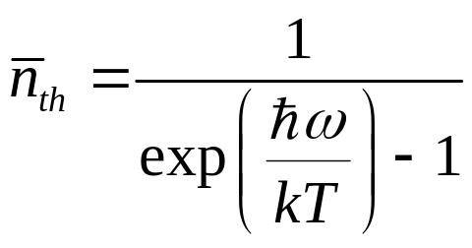
two-level atom radiatively coupled to a thermal reservoir:
“heating”
“cooling”
“non-dissipative”
At low bath temperatures, heating disappears……..
Supercoherence
made all quantum errors “heating”!

Slide 29
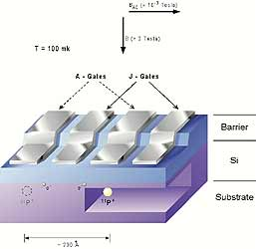
In a Few Years Time…
Four spin systems with equal strength exchange interactions
between all spins:
1
2
4
3
Supercoherent qubit
single P atoms in Silicon
exchange controlled by voltage
mediated barriers
Bacon, Brown, and Whaley, PRL 87, 247902 (2001)
DiVincenzo, Bacon, Kempe, Burkard, and Whaley, Nature 408, 399 (2001)
See: Hellberg, quant-ph/0304150 (2003)

Slide 30
Supercoherence
As the First Step To
Achieving the Threshold
For Fault-Tolerant
Quantum Computation?

Slide 31
Mysterious Extra Slide

Slide 32

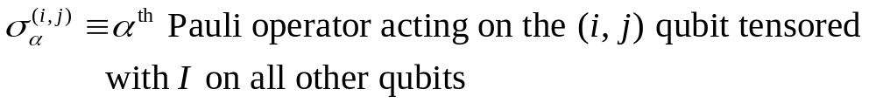
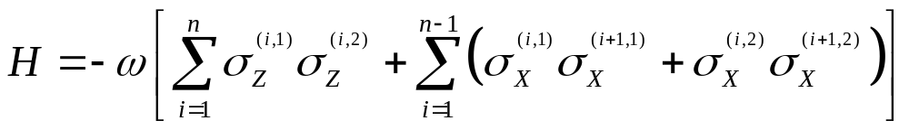
Ladder Qubits
1
2
1
2
i-1
i
i+1
n-3
n-2
n-1
n
qubit (i,1)
qubit (i,2)
The Hamiltonian
X X
X X
X X
Z Z
Z Z
D. Bacon, Ph.D. thesis, U.C. Berkeley, 2001
X X
X X
X X

Slide 33



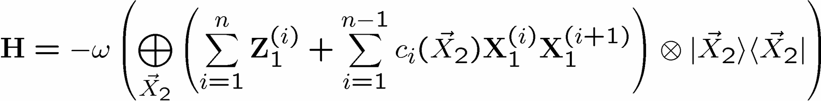

Basis Change
X X
X X
X X
Z Z
Z Z
1
New basis:
X X
X X
X X
2
i
i+1

Slide 34

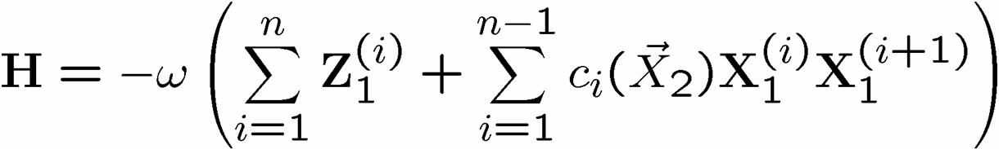

Everybody’s Favorite
transverse
field
only
transverse
field
only
Ising + transverse field
Ising + transverse field

Slide 35
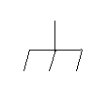







Grounded
Ground state is two-fold degenerate
1
X
X
2
k
Z Z Z

Slide 36











Detect and Correct
X X
X X
X X
Z Z
Z Z
X X
X X
X X

Slide 37
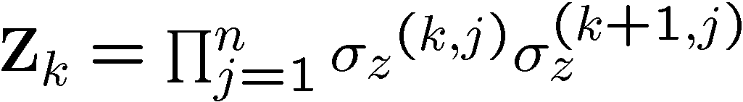
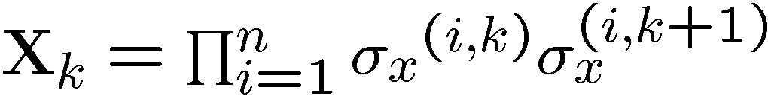


Into the 2nd Dimension
j-1
j
j+1
i-1
XX
XX
ZZ
ZZ
ZZ
i
XX
XX
ZZ
ZZ
ZZ
i+1
XX
XX

Slide 38



Tic-Tac-“DOH!”
XX
ZZ
XX
XX
XX
ZZ
ZZ
ZZ
ZZ
XX
XX
XX
ZZ
ZZ
ZZ
ZZ
XX
XX
XX

Slide 39


Subsystem Codes

Slide 40
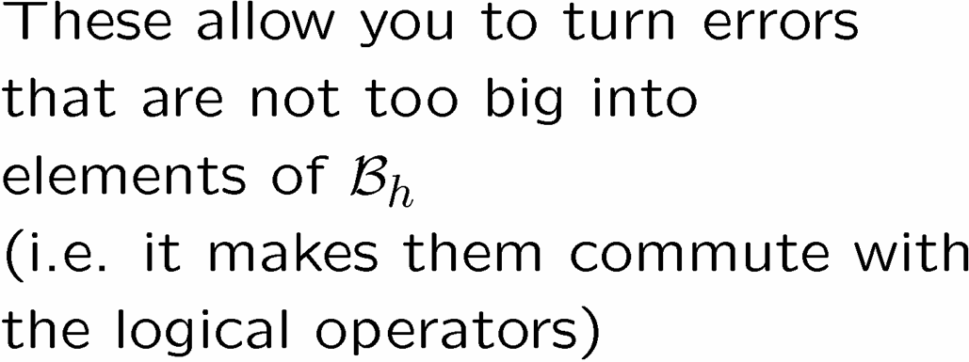
X
X
X
X
X
X
Z
Z
Z
Z
Z
Z
Z
Z
Z
Z
Z
Z
Z
Z
Z
Z
X
X
X
X
X
X
X
X

Slide 41




Into the Third Dimension
YY
ZZ
XX
ZZ
XX
YY
YY
ZZ
ZZ
XX
XX
YY
YY
ZZ
XX

Slide 42



Logical Operators

Slide 43


Errors
j-1
j
j+1
i-1
YY
YY
ZZ
ZZ
ZZ
i
YY
YY
ZZ
ZZ
ZZ
i+1
YY
YY

Slide 44





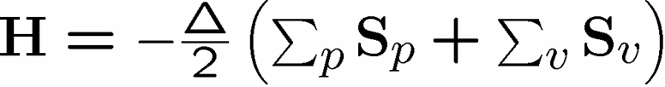


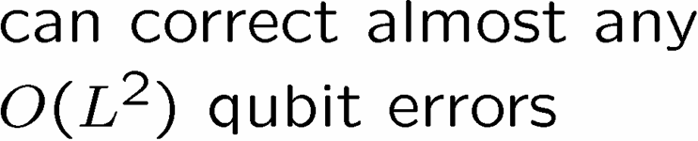



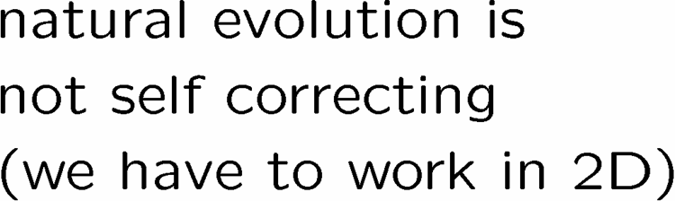




Wherefore Art Toric Codes?

Slide 45
Summary
Learn from our past!
Let physics do the work!
Supercoherence as first step?
Towards self-correcting quantum memories

Slide 46
Fin
Error correcting codes
Geometry, Topology?
classical
quantum
Statistical Physics
theory of strongly interacting
quantum systems
Fault-tolerance
local structures giving rise
to global robustness (CA)
Real Physics
physical implementation
optical lattices, donor
electrons, superconducting
circuits, etc.
Representation theory
identification of qubits
and logical operations
Naturally Fault-Tolerant Quantum Computation

