Slide 2
Test Slide
SAT
MCAT
GRE

Slide 3






When Is Teleportation Quantum?
(and other musings on the relationship between physics and computation)
Dave Bacon
Department of Physics
Institute for Quantum Information
Caltech
Talk given at the Perimeter Institute
Waterloo, Ontario, Jan 21 2003

Slide 4

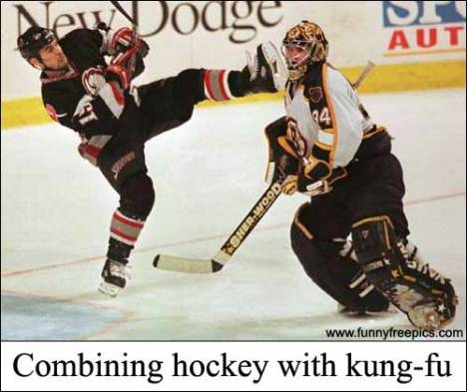
Canadian Bacon

Slide 5
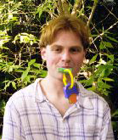
In Collaboration With…
Ben Toner
graduate student (advisor: John Preskill)
Department of Physics
Institute for Quantum Information
Caltech

Slide 6
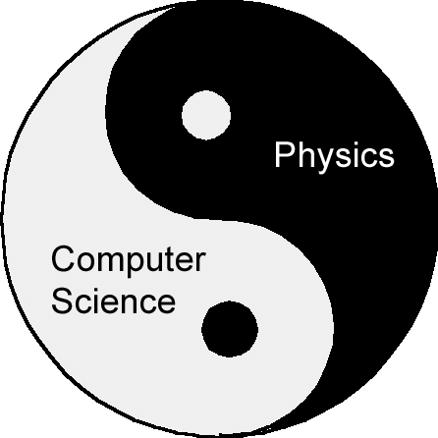
Computers Obey Physics
Physics As Computation (?)

Slide 7
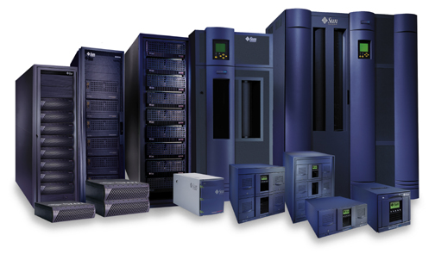
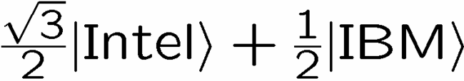
Computers Obey Physics
Quantum Computers
Physical Theories imply computational complexity classes?
(locality?, locality!, locality?)
Economics of Information Technology

Slide 8
Physics As Computation
The Universe as a Quantum Computer?
Quantum theory as a theory of our information about reality.
Computer Science can motivate questions about Physics

Slide 9
What Can We Learn About
Physics From Theoretical
Computer Science?

Slide 10
Silly Futurist Prediction?
Theoretical Computer Science, especially ideas
originating in Quantum Information Science will
greatly impact Theoretical Physics

Slide 11
In the Beginning There Was…

Slide 12








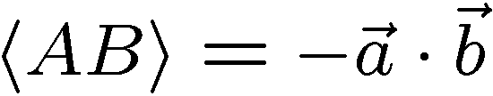
Bell Experiment
-1
-1
+1
+1
A
B
ALICE
BOB
A B Probability
- 1 - 1 - 1 +1 +1 - 1 +1 +1

Slide 13


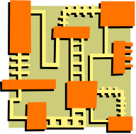

1
1
2
2
45º
1
2
1
2
?
“Can a quantum system be probabilistically simulated by a classical (probabilistic, I’d assume) universal computer?” - R.P. Feynman.
ALICE
BOB

Slide 14








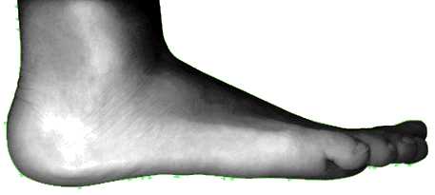

Communication Breakdown

Slide 15
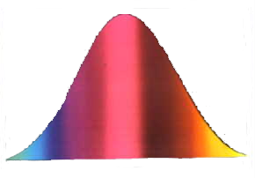




Bell Inequalities

Slide 16
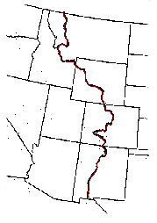


Capitalism for Correlations

Slide 17






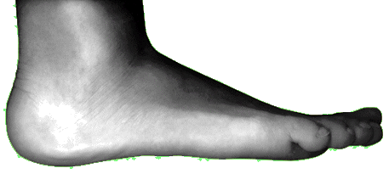
What Can We Do?

Slide 18








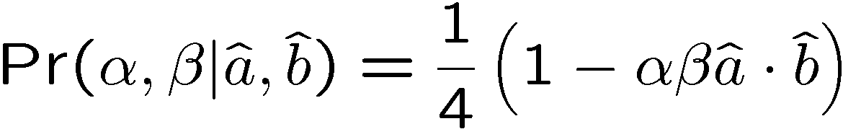
Simulating Bell Correlations

Slide 19

Why Is It Hard?

Slide 20


Towards Simulating Bell

Slide 21

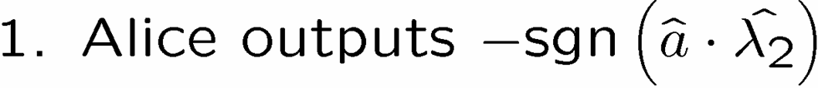

A 1 Bit Protocol

Slide 22
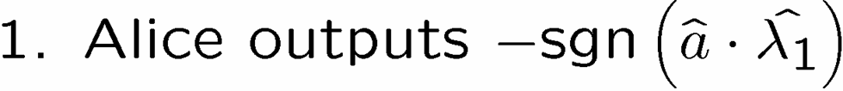








The Intuition

Slide 23


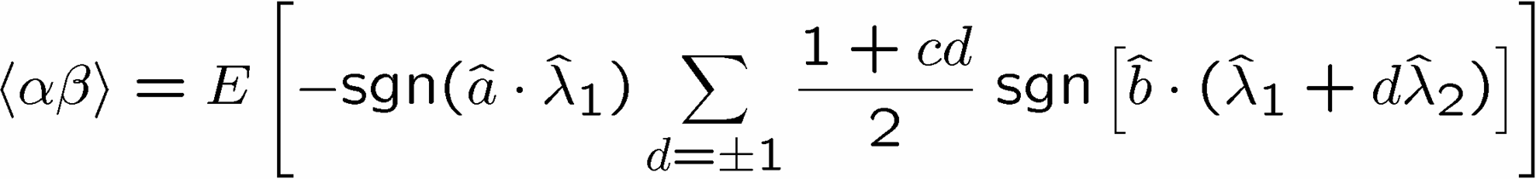
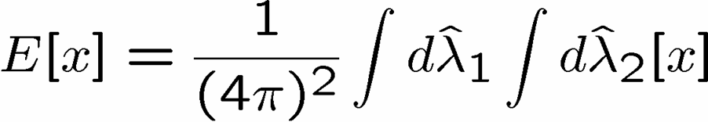
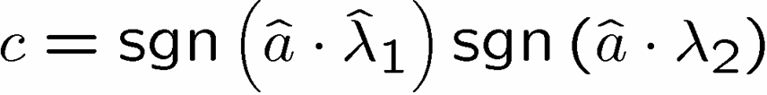
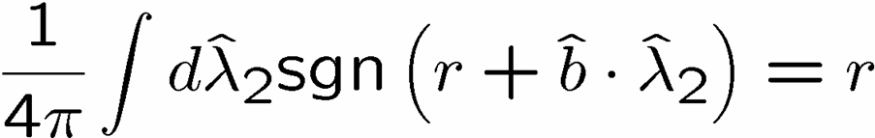
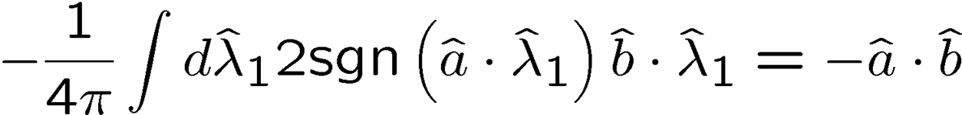

It Works!

Slide 24

1 Bell Pair’s Worth of Correlations

Slide 25


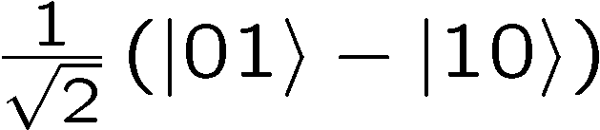
Average Communication

Slide 26
1 Bell Pair’s Worth of Correlations Implications
1. Produces “Detector Inefficiency” local hidden variable
model.

Slide 27


Connection to Detector Inefficiency

Slide 28
Computer Science Giving
Back To Physics

Slide 29
1 Bell Pair’s Worth of Correlations Implications
1. Produces “Detector Inefficiency” local hidden variable
model.
2. Simulating all two outcome correlation observables
with bounded communication

Slide 30



Correlation Observable
ALICE
BOB

Slide 31



Generalized Bell Correlations
A’s output:
:Bob’s output
Alice
Bob

Slide 32


Chain Letter
+
=

Slide 33
1 Bell Pair’s Worth of Correlations Implications
1. Produces “Detector Inefficiency” local hidden variable
model.
2. Simulating all two outcome correlation observables
with bounded communication
3. Helps delineate “when quantum teleportation is really
quantum”

Slide 34
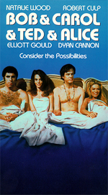








Teleportation
Alice
Bob
Alice
Bob

Slide 35

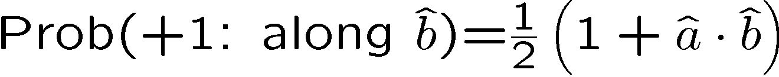
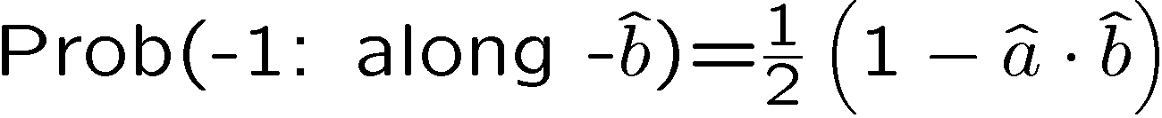


An Experiment
“qubit
teleporation”
In what sense is this experiment “quantum”?
Alice
Bob

Slide 36
Simulating Classically
1. Respect
locality and
causality
2. replace
by
quantum wire
classical wire carrying
any amount of
classical info
by
classical wire
b bits
classical wire
b bits
Alice
Bob

Slide 37

Simulating Bell Correlations
A’s output:
:Bob’s output
Alice
Bob
simulating Bell Correlations
with b bits communication
and shared randomness
simulating qubit teleportation
with b+1 bits communication
and shared randomness
“Classical teleportation of a qubit” Cerf, Massar, Gisin (2000)

Slide 38
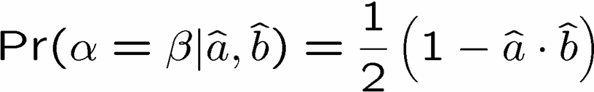
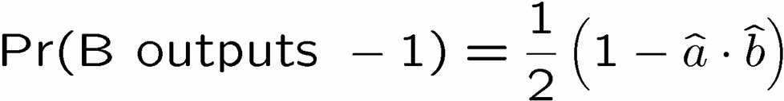
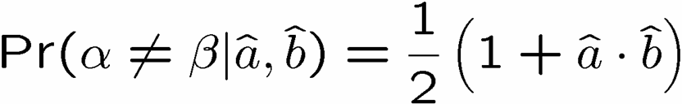
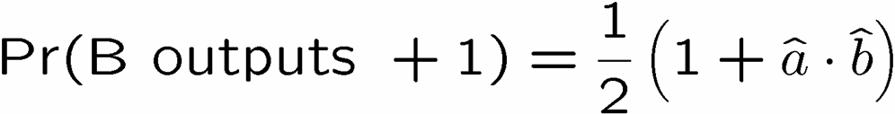
Bell Pair to Qubit Teleportation
Alice and Bob can produce
Alice sends her output bit (α) to Bob
If Alice’s output bit equals Bob’s output bit,
Bob outputs -1
Otherwise
Bob outputs +1
qubit teleportation

Slide 39
Qubit Teleportation
Alice
Bob

Slide 40



Quantum Teleportation
?
Alice
Bob
Alice
Bob

Slide 41
1 Bell Pair’s Worth of Correlations Implications
1. Produces “Detector Inefficiency” local hidden variable
model.
2. Simulating all two outcome correlation observables
with bounded communication
3. Helps delineate “when quantum teleportation is really
quantum”
4. Simulating projective measurements on non maximally
entangled two qubit states with two bits of communication

Slide 42

Correlations on Non-maximally Entangled 2 Qubit States

Slide 43

A Cryptographic Interpretation of Quantum Theory?
Nonlocal theories need to explain why only
correlations between entangled parties exist?

Slide 44
References
Bacon and Toner, “Bell Inequalities with Communication” PRL 90 157904 (2003)
Toner and Bacon, “The Communication Cost of Quantum Correlations” PRL 91 187904 (2003)
Bacon and Toner, “The Communication Cost of Simulating Joint Observable Correlations” in preparation (2004)

Slide 45
Open Problems

Slide 46
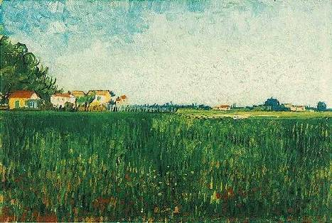
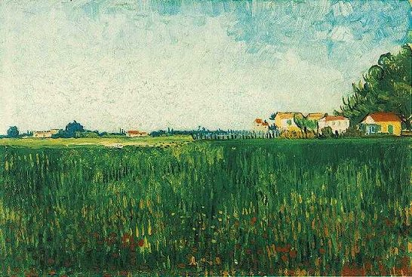
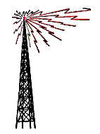
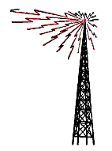
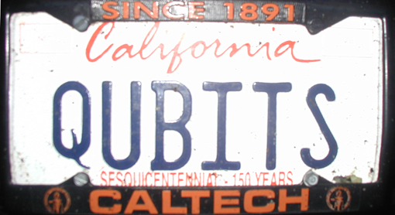
Fin
Correlations on Bell Pair = shared randomness + 1 bit
Qubit teleportation can be simulated classically!

