Slide 1


Statistical Physics, Fault-Tolerance, Subsystem Codes, and Quantum Monte Carlo
Rhapsody on a Theme by Kitaev
Dave Bacon
Preskill Group Meeting, April 24 2003
University of Queensland Quantum Annex
Right-side-Up Hemisphere

Slide 2


Slide 3
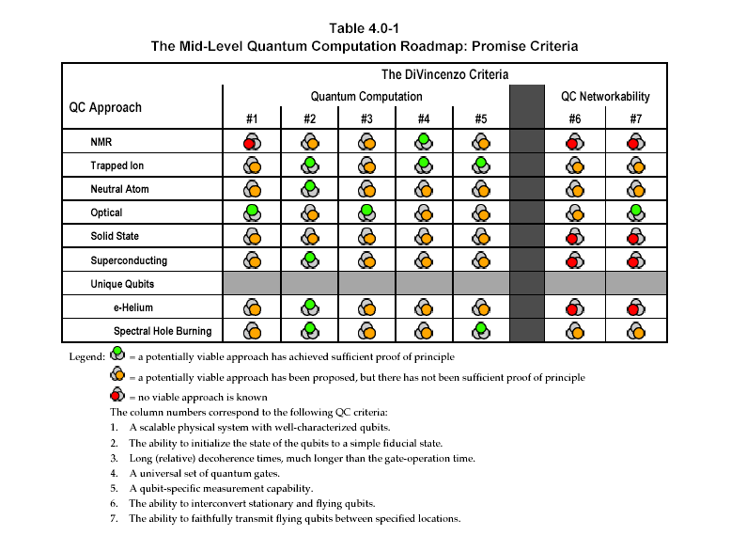

The Quantum Computing Roadmap

Slide 4
1941 – First programmable electronic calculator.
mechanical relays.
1943 – ENIAC.
18000 vacuum tubes: “nature abhors the vacuum tube.”
1947 – Bell labs develops the transistor.
1952 – G. W. Dummer proposes manufacturing electronic equipment in one
block with no connecting wires.
1959 – Texas Instruments and Fairchild Semiconductor invent the integrated
circuit.
1964 – first IBM 360 series (the concept of an “architecture”)
1964 – Integrated circuit which cost $1000 in 1959 now costs $10. Moore
describes his law.
1972 – Intel 8008 and 8 bit microprocessor.
1975 – First personal computer the Altair.
1982 – IBM PC introduced. Personal computer revolution begins.
Have We Learned Anything?

Slide 5
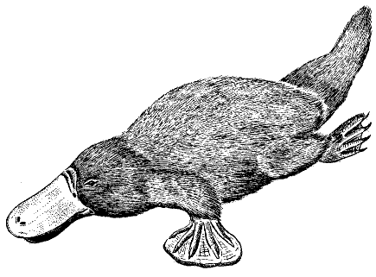
History Only Teaches Me Physics
Interacting
Isolated
What happens when many units (defined isolated) interact?
ordered
regular
reducible
turbulent
complex
not reducible
Platyputor
Computers are strange beasts in this world:
  built from parts which order and are regular
  reductionist’s dream come true
yet:
  complexity of computer running a program is high
  algorithmic complexity implies reduction cannot be
  compressed beyond running the algorithm

Slide 6
The Physics Guarantee
What is the phase of matter corresponding to the computer?
PRACTICAL QUESTION (as opposed to philosophical)
There are distinct PHYSICAL reasons why robust classical
computation is possible.
not all physical systems are equally good for computation:
there exists systems whose PHYSICS guarantees
their ability to enact robust classical computation.
Are there (or can we engineer) physical systems whose
PHYSICS guarantees robust quantum computation?
This talk: (1) this point of view for classical computers
(2) an attempt to port these ideas to a quantum computer

Slide 7
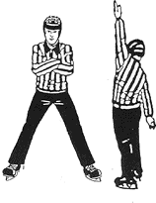




A Dynamic Ising Model
Ising model
Dynamic Ising model

Slide 8
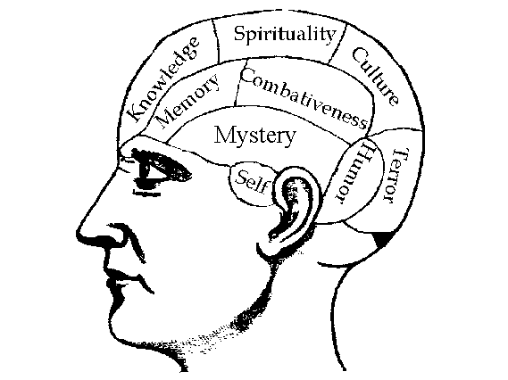


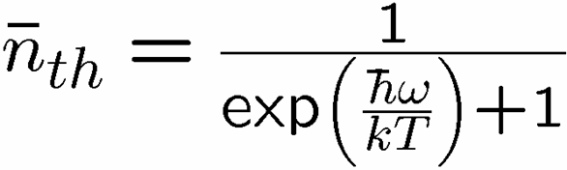

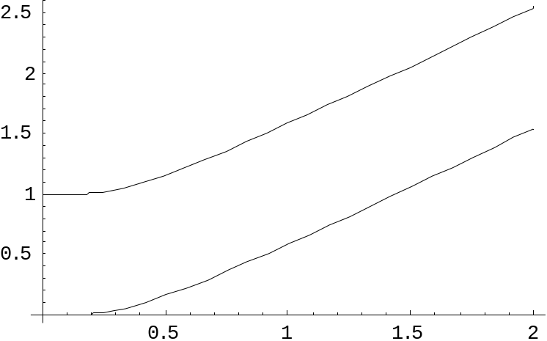
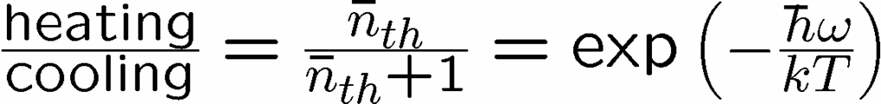


Reminder
two-level system radiatively coupled to a thermal reservoir:
“heating”
“cooling”
“non-dissipative”

Slide 9

A Dynamic Ising Model
Ising model
Dynamic Ising model (Metropolis update)

Slide 10



Storage and Manipulation
Compare 1D and 2D Ising models at different temperatures for
a) storage of information
b) manipulation of information
1st attempt:
Storage in thermal state (infinite time - ensemble is thermal)
1D Ising
2D Ising
Criticism: (1) thermodynamic limit taken (N infinite)
(2) what if relaxation to equilibrium takes a long time?

Slide 11
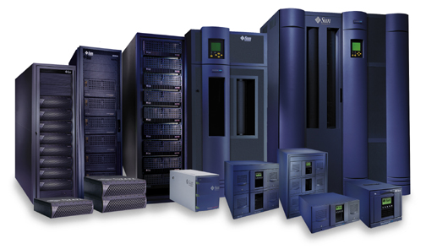



Storage
2nd attempt:
Relaxation to thermal
1D Ising
2D Ising
Imperfect preparation

Slide 12
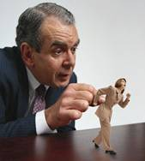



Manipulation
Flipping spins is imperfect
1D Ising
2D Ising
1D Ising
temperature less than gap
manipulation error must be small
2D Ising
temperature less than critical temp
self correcting

Slide 13
















Self Fixing

Slide 14




The Quantum Hard Drive?
(Kitaev)
Do there exist (or can we engineer) quantum systems whose
physics guarantees fault-tolerant quantum computation?
1. Coherence preserving.
2. Accessible Fault-Tolerant
Operations
“self-correcting”
3. Universality

Slide 15





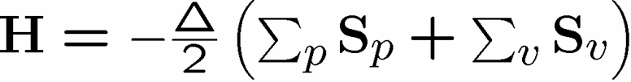


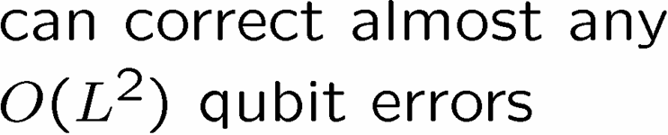



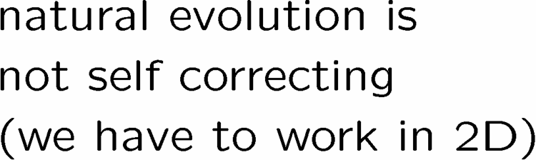




Wherefore Art Toric Codes?

Slide 16
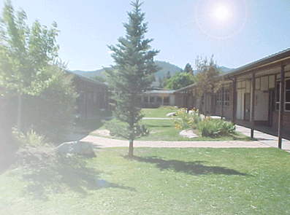
Old School
prepare
Fix
compute
out
Error
“cold” ancilla
“hot” ancilla
encoded quantum information
information is still here (but erred)
if weight of errors is small enough
How do we reveal erred quantum information?

Slide 17





Quantum Error Correcting
Order Parameter
The quantum information is
still here. How do we see it?
diagnose
fix
measure encoded info
j
Encoded quantum information

Slide 18


Subsystem Codes
The most generic error correction encoding of quantum
information is not into a subspace, but into a subsystem
trivial example:
two qubits, one is errored
info in first is not destroyed
slightly less
trivial example:
parity qubit is never erred
Generically, we can encode information into the a tensor factor of some subspace:
Error correction condition is NOT that a subspace is recoverable, but that information in a subsystem is recoverable (KLV)

Slide 19

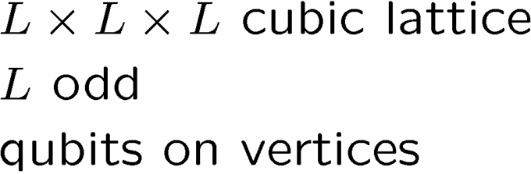

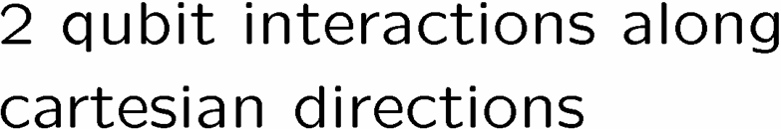





Into the Third Dimension
Some of you may remember my old favorite Hamiltonian:
Fudgy arguments about why persistent coherence…
How to proceed: simulate! But this systems has a “sign” problem.

Slide 20
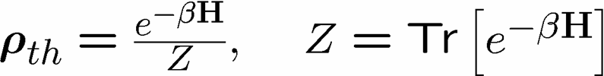


Quantum Monte Carlo

Slide 21
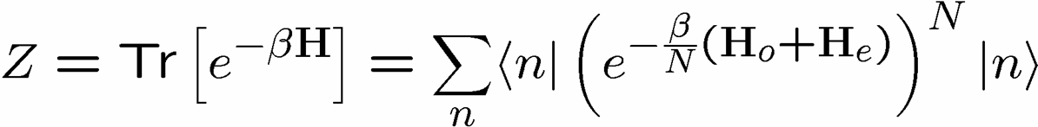
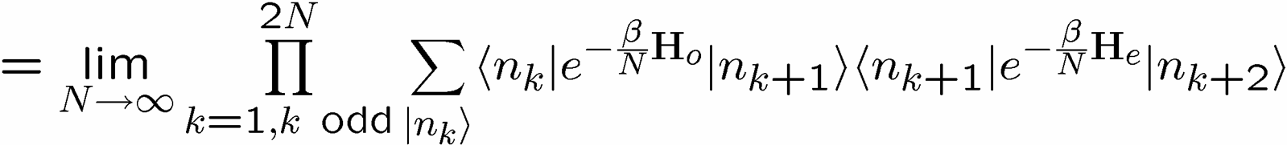
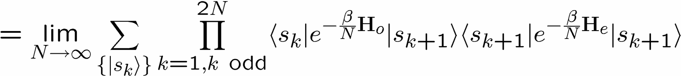

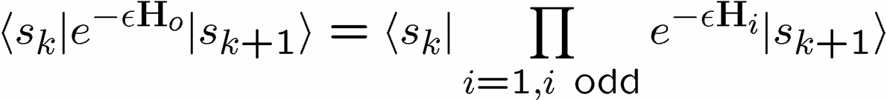
QMC Example Continued

Slide 22



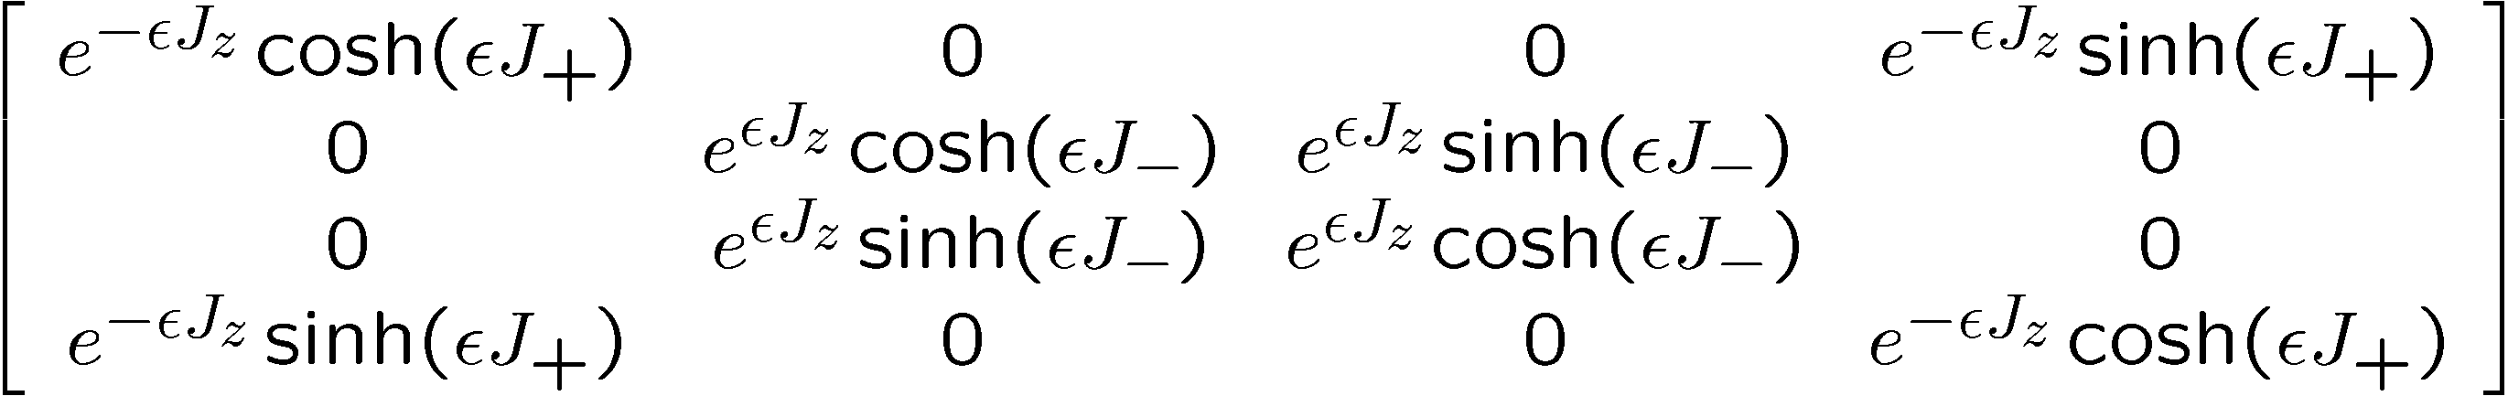







QMC III

Slide 23
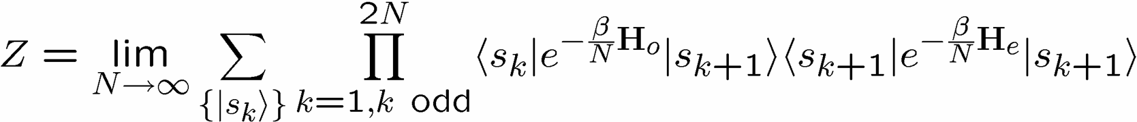

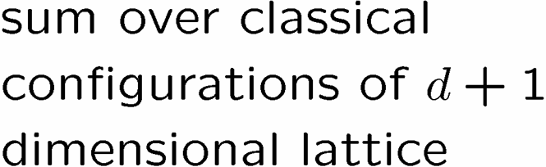
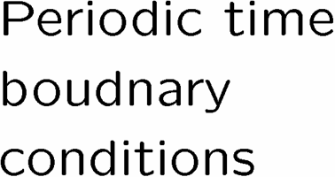


QMC III

Slide 24
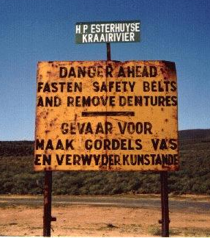
Partition-Like = Sign Problem
SIGN PROBLEM

Slide 25
Back to the Third Dimension

Slide 26



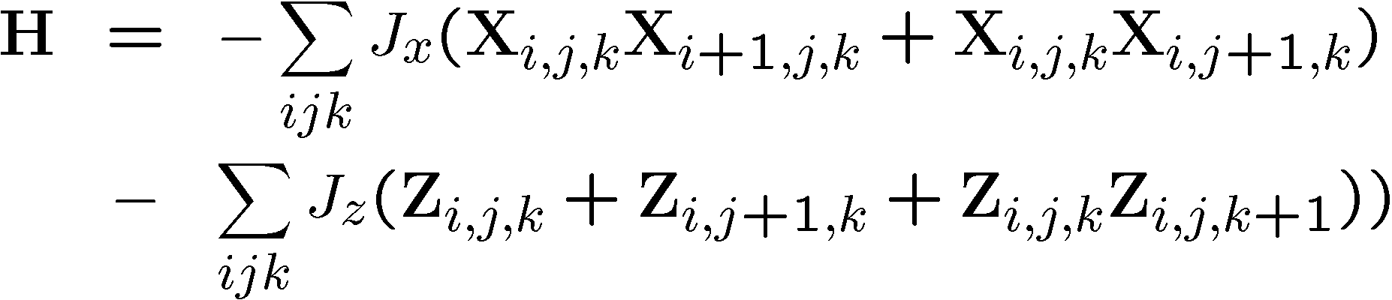
The Third Dimension: Take II

Slide 27
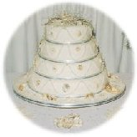
Stacks of Ising

Slide 28
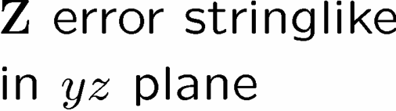

Me Like-y

Slide 29
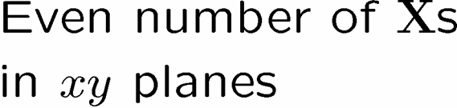
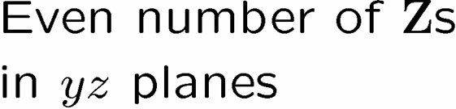
Group of Bonds (Bobby and Barry)

Slide 30




Abelian Invariant Subgroup

Slide 31
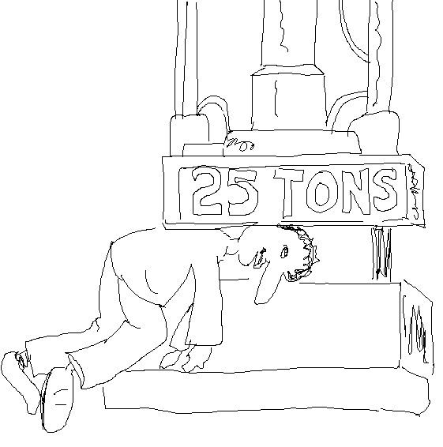
Painful Construction

Slide 32



The Subsystem Code

Slide 33
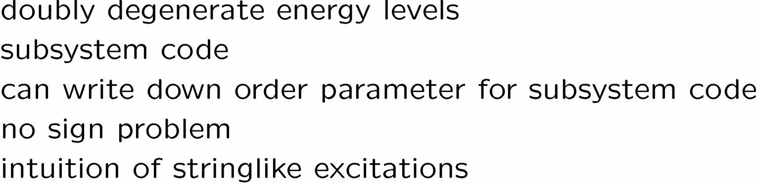
Status

Slide 34
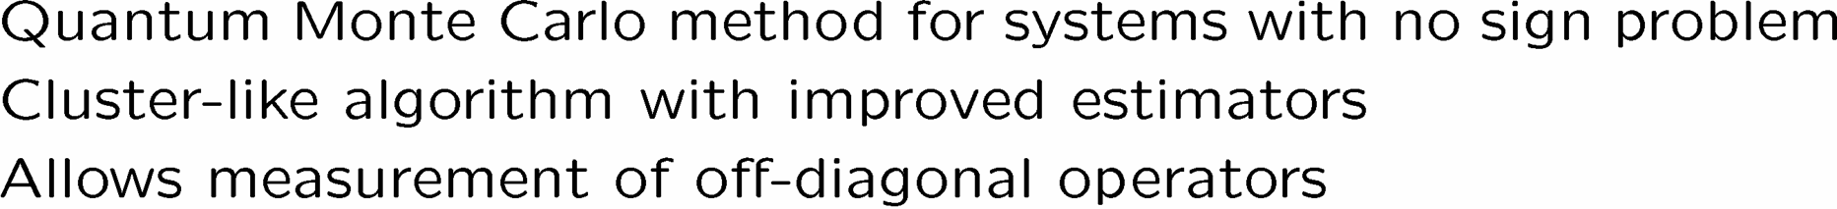
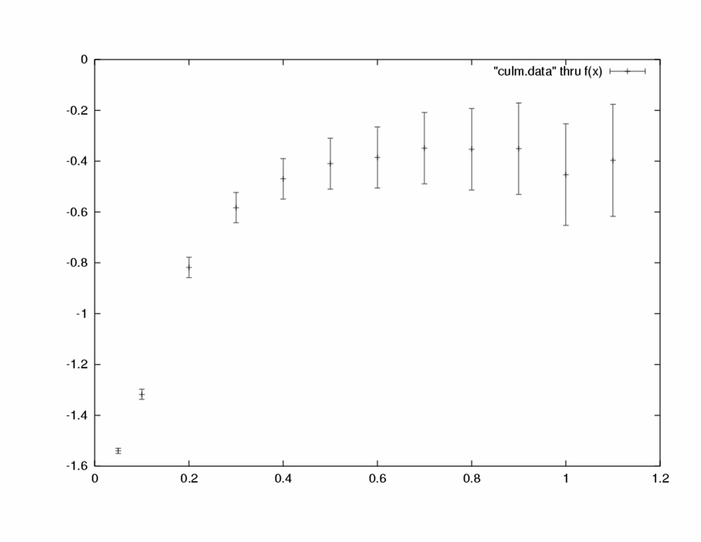

Loop Algorithm
Energy density
Temperature

Slide 35

Fin
Platyputor

