Slide 1
Test Slide
SAT
MCAT
GRE

Slide 2

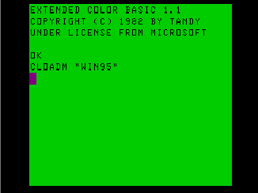
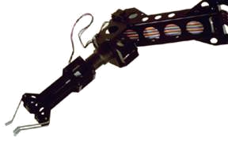
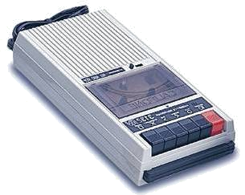

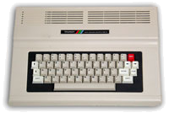
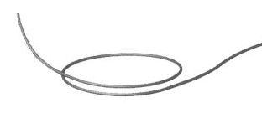


Quantum Computers
That Fix Themselves
Dave Bacon
Caltech
Department of Physics
Institute for Quantum Information

Slide 3
?

Slide 4
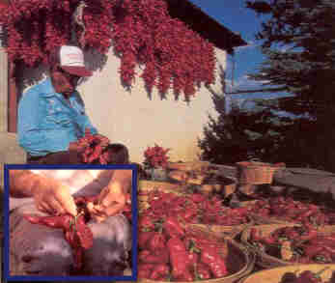
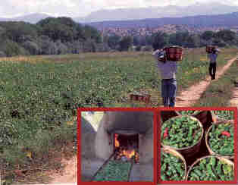
Red or Green?
Unanswerable

Slide 5
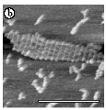
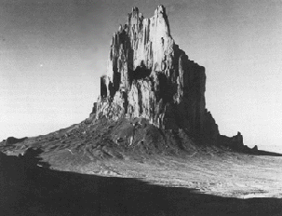
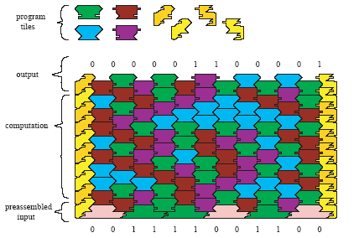
Is it a Computer?
Ship Rock
DNA Universal Computing
(pics from Eric Winfree’s lab)
Is it a ROBUST Computer?

Slide 6
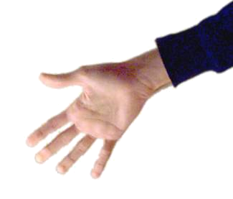
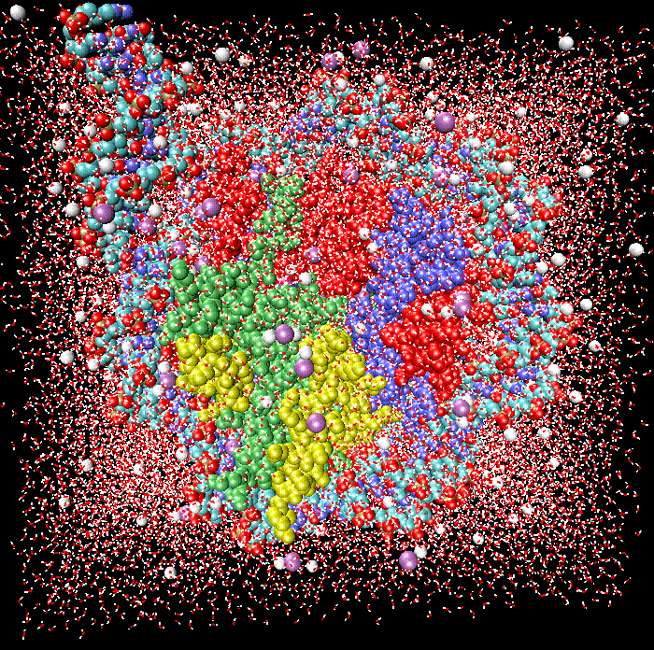
The Computer Phase
Control
System
Controllable yet Decoupled
Switching, Digital
Regular yet Complex
Reducible yet Irreducible
Computerology
Environment

Slide 7
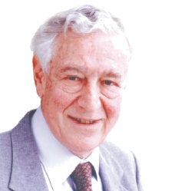
Computation Is Physical
“Information Is Physical.”
Information Carriers Are Physical
Rolf Landauer, IBM
Physics is the beginning (but not nearly the end)
of computerology

Slide 8


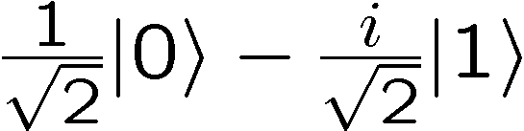
Quantum Computing
“Perhaps…we need a mathematical theory of quantum
automata…” – Yu Manin (Radio Moscow, 1980)
“How can we simulate quantum mechanics?...Can we do
it with a new kind of computer…a quantum computer? It’s
not a Turing machine but a machine of a different kind”
– Richard Feynman (1981)
0
bits
qubits
1
32% 0 68% 1
A computer whose state is quantum information and whose evolution obeys the laws of quantum theory

Slide 9
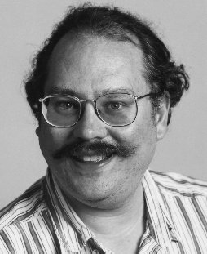

The Hopes
Peter Shor (1994) – An efficient algorithm for
factoring numbers using a quantum computer.
Breaks RSA Cryptography
“Only time will tell if and when the problems of building a
quantum computer can be overcome….As information
becomes the world’s most valuable commodity, the
economic, political and military fate of nations will depend
on the strength of ciphers. Consequently, the development
of a fully operational quantum computer would imperil
our personal privacy, destroy electronic commerce and demolish the concept of
national security. A quantum computer would jeopardise the stability of the world.
Whichever country gets there first will have the ability to monitor the communications
of its citizens, read the minds of its commercial rivals and eavesdrop on the plans
of its enemies. Although it is still in its infancy, quantum computing presents a
potential threat to the individual, to international business and to global security. “
-Simon Singh

Slide 10
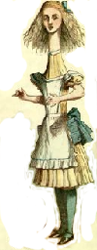

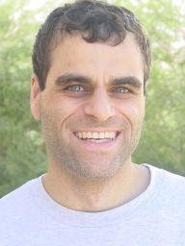
More Hopes
…
Hallgren (2002) – An efficient quantum algorithm for Pell’s equation and principle ideal problem
Hallgren, Ip, van Dam (2003) – Quantum algorithms for some
hidden shift problems.
Moore, Rockmore, Russell, Schulman (2003) – Quantum algorithm for the hidden subgroup problem in affine groups.
…
F(x,y)
x
y
Ran Raz
(1999)
ALICE
BOB
how much communication?
Exponentially less quantum communication than
classical communication!

Slide 11
The Big Themes
WHAT can we do with a quantum computer?
How can quantum information science
Influence the rest of science?
WHY is a quantum computer algorithmically powerful?
HOW can we build a quantum computer?
BIG IDEAS

Slide 12
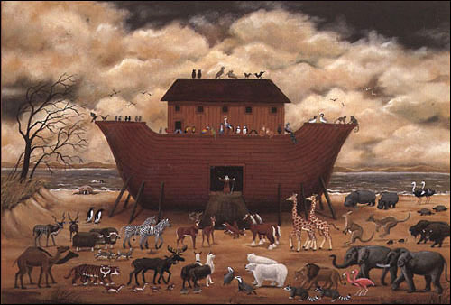
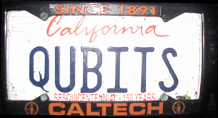
One Method?
“And this is the fashion which thou shalt make it of: The length of the
ark shall be three hundred cubits, the breadth of it fifty cubits, and
the height of it thirty cubits.” – Genesis 6:15

Slide 13
What is the Problem?
Real quantum systems are open quantum systems!
system
environment
Quantum systems readily couple to an environment…
qubits
0
System decoheres:
bits
1
50% 0 50% 1
Quantum
Classical
The Decoherence Problem (1996)
Notes:
Quantum systems readily couple to an environment.

Slide 14

What Is The Problem?
Decoherence is a lot like classical noise, BUT:
Strong coupling to
environment
causes
decoherence
Strong coupling to
control devices
needed to enact
computations
Yingyang of quantum computing

Slide 15
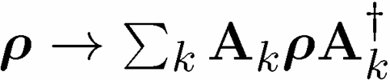
Quantum Computing is Bunk
Ways Quantum Computers Fail to Quantum Compute
Decoherence
Lack of Unitary Control
attempting to apply unitary evolution U instead results in V
or (worse) results in non-unitary evolution
Measurements are faulty
measurement result is noisy, incorrect result obtained
Quantum Computing Disappearing Act
qubits disappear (leakage of computing states)

Slide 16
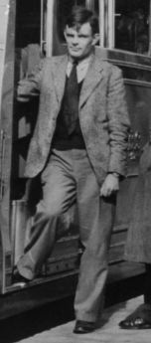
A Model Solution
Decoherence is a lot like classical noise
Turing was crazy!
Reliable components for a computer?
Theory History
Shannon (1948): error correcting codes
von Neumann (1956): how to perform fault-tolerant classical
computation
Alan Turing
Quantum Computing (1994): Can we construct a theory of fault-
tolerant quantum computation?

Slide 17
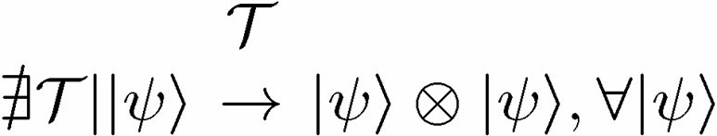

1994 Reasons to be a Pessimist
No cloning:
No cloning of quantum information:
Quantum repetition code impossible:
Continuous set of errors:
Classical errors on digital information are discrete.
Quantum errors on classical information are continuous.
Continuous set of operations:
Continuous set of unitary operations: infinite precision needed to implement a gate?
Measurement destroys coherence:
How can one decode without destroying the information?

Slide 18
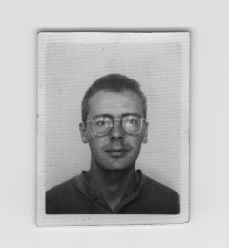
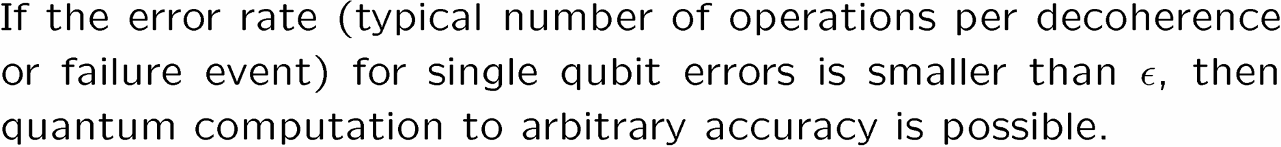
The Quantum Solution (1995-96)
Fault Tolerant Quantum
Computing is Possible!
Peter Shor
Andrew Steane
Threshold Theorem:
QC
Error Rate

Slide 19
1941 – First programmable electronic calculator.
mechanical relays.
1943 – ENIAC.
18000 vacuum tubes: “nature abhors the vacuum tube.”
1947 – Bell labs develops the transistor.
1952 – G. W. Dummer proposes manufacturing electronic equipment in one
block with no connecting wires.
1959 – Texas Instruments and Fairchild Semiconductor invent the integrated
circuit.
1964 – first IBM 360 series (the concept of an “architecture”)
1964 – Integrated circuit which cost $1000 in 1959 now costs $10. Moore
describes his law.
1972 – Intel 8008 and 8 bit microprocessor.
1975 – First personal computer the Altair.
1982 – IBM PC introduced. Personal computer revolution begins.
Have We Learned Anything?

Slide 20
The Physics Guarantee
Rant mode ON
What is the phase of matter corresponding to the computer?
PRACTICAL QUESTION (as opposed to philosophical)
There are distinct PHYSICAL and DYNAMICAL reasons why
robust classical computation is possible.
not all physical systems are equally good for computation:
there exists systems whose PHYSICS guarantees
their ability to enact robust classical computation.
Are there (or can we engineer) physical systems whose
PHYSICS guarantees robust quantum computation?
This talk: (1) this point of view for classical computers
(2) attempts to port these ideas to a quantum computer

Slide 21
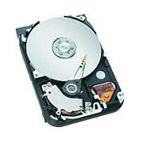
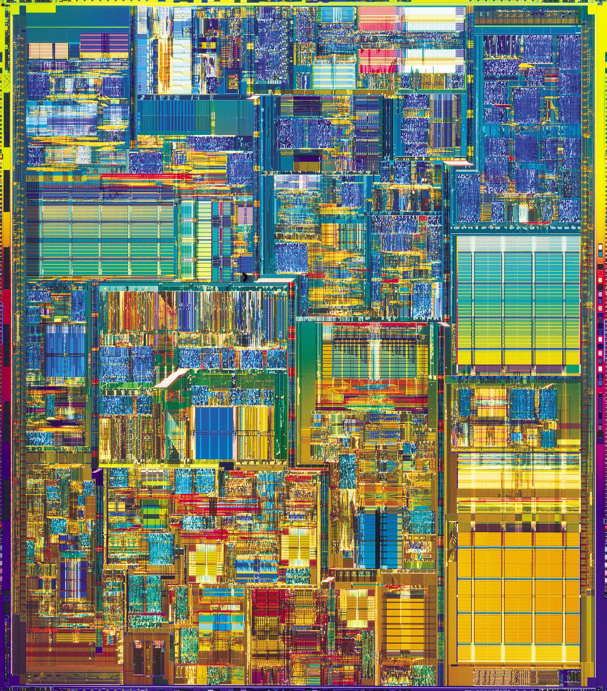
Two Paths
(“it’s made all the difference”)
Hard Drive
Transistor
Coding: majority vote of
magnetism
Coding: majority vote of
current
Error correction: local energy
minimization
Error correction: amplification
Fault-tolerant: conducting / insulating phase transition
Fault-tolerant: macro applied
field.
More than storage?

Slide 22
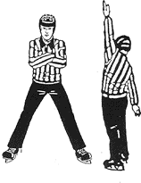




A Dynamic Ising Model
Ising model
Dynamic Ising model

Slide 23
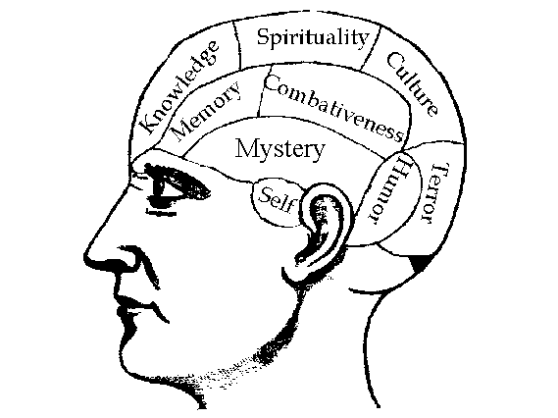


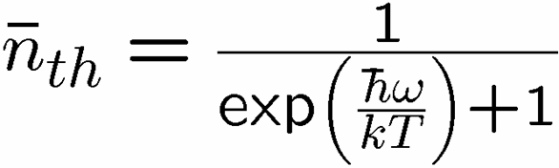

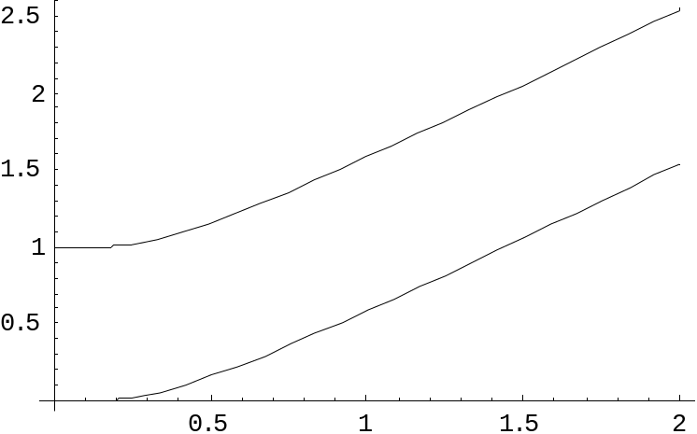
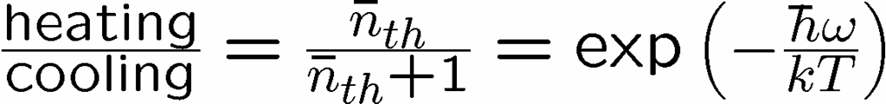


Reminder
two-level system radiatively coupled to a thermal reservoir:
“heating”
“cooling”
“non-dissipative”

Slide 24


A Dynamic Ising Model
Ising model
Dynamic Ising model (Metropolis update)

Slide 25



Storage and Manipulation
Compare 1D and 2D Ising models at different temperatures for
a) storage of information
b) manipulation of information
1st attempt:
Storage in thermal state (infinite time - ensemble is thermal)
1D Ising
2D Ising
Criticism: (1) thermodynamic limit taken (N infinite)
(2) what if relaxation to equilibrium takes a long time?

Slide 26
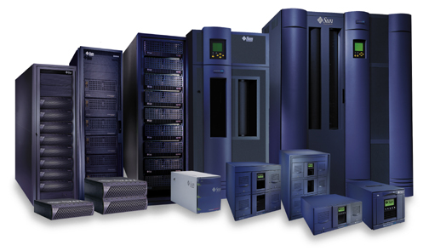



Storage
2nd attempt:
Relaxation to thermal
1D Ising
2D Ising
Imperfect preparation

Slide 27
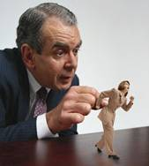



Manipulation
Flipping spins is imperfect
1D Ising
2D Ising
1D Ising
temperature less than gap
manipulation error must be small
2D Ising
temperature less than critical temp
self correcting

Slide 28
















Self Fixing

Slide 29
Two Paths
Hard Drive
Transistor
Coding: majority vote of
magnetism
Coding: majority vote of
current
Error correction: local energy
minimization
Error correction: amplification
Fault-tolerant: conducting / insulating phase transition
Fault-tolerant: macro applied
field.
More than storage?

Slide 30





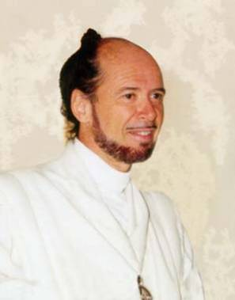



No Quantum Transistor
Quantum Cloning Machine
“A single quantum cannot be cloned,” Wootters and Zurek, Nature, 1982

Slide 31
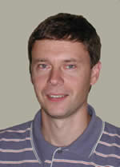
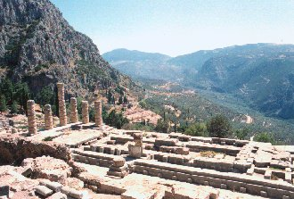




The Quantum
Hard Drive?
(Kitaev)
Do there exist (or can we engineer) quantum systems whose
physics guarantees fault-tolerant quantum computation?
1. Coherence preserving.
2. Accessible Fault-Tolerant
Operations
“self-correcting”
3. Universality

Slide 32



Old School
“Information is fungible!”
prepare
Fix
compute
out
Error
“cold” ancilla
“hot” ancilla
Competition between errors and cooling
Quantum error correcting code
Error correcting criteria:
If criteria holds, then fixing procedure possible

Slide 33




Into The Fray
Thermodynamic limit
guarantees robustness
Strongly Interacting Many Body Quantum System
energy
eigenstates
Hamiltonian
Barnes and Warren, PRL 85, 856 (2000) [but is only “classical”]

Slide 34




Quantum Error Correcting
Order Parameters
The quantum information is
still here. How do we see it?
diagnose
fix
measure encoded info
j
Encoded quantum information

Slide 35
Naturally Fault-Tolerant
Quantum Computers Will
Have New Phases and New
Order Parameters!

Slide 36
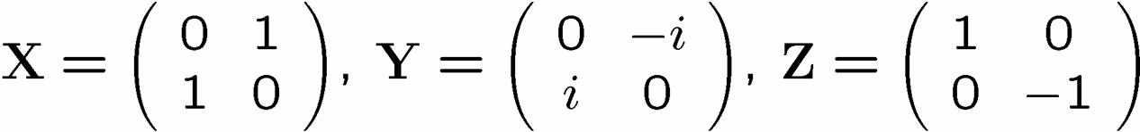






A Simple Start
“To be an Error and to be Cast out is Part of [Nature’s] Design.” -William Blake
[4,2,2] quantum error detecting code:

Slide 37

Supercoherence
4 qubit system
1
XX
2
ZZ
ZZ
4
XX
3
System Hamiltonian:

Slide 38























Slide 39

Supercoherence
ALL single qubit errors take degenerate ground state to higher energy levels.
Single qubit errors change value of (S₁,S₂) and hence take ground state to higher energy level.
FORBIDDEN
D. Bacon, Ph.D. thesis, U.C. Berkeley, 2001

Slide 40




Making Decoherence Work Hard
system
bath
~
H_{I} = perturbative system-bath coupling
H_{I} energy small compared to E_{sys} and E_{bath} implies decoherence dominated by pathways that conserve unperturbed energies (essentially rotating wave approximation)
“cooling”
“heating”
“non-dissipative”

Slide 41

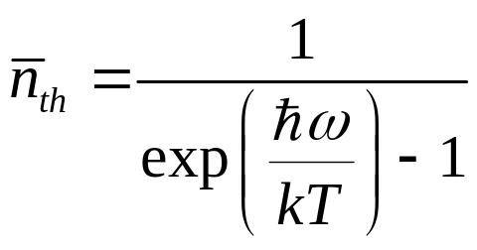
two-level atom radiatively coupled to a thermal reservoir:
“heating”
“cooling”
“non-dissipative”
At low bath temperatures, heating disappears……..
Supercoherence
made all quantum errors “heating”!

Slide 42
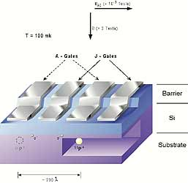
In a Few Years Time…
Four spin systems with equal strength exchange interactions
between all spins:
1
2
4
3
Supercoherent qubit
single P atoms in Silicon
exchange controlled by voltage
mediated barriers
Bacon, Brown, and Whaley, Physical Review Letter 87, 247902 (2001)
DiVincenzo, Bacon, Kempe, Burkard, and Whaley, Nature 408, 399 (2001)

Slide 43
Supercoherence
As the First Step To
Achieving the Threshold
For Fault-Tolerant
Quantum Computation?

Slide 44





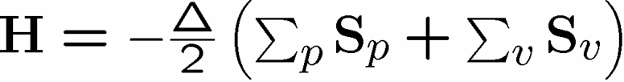


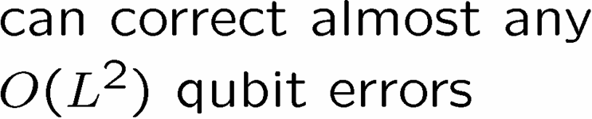



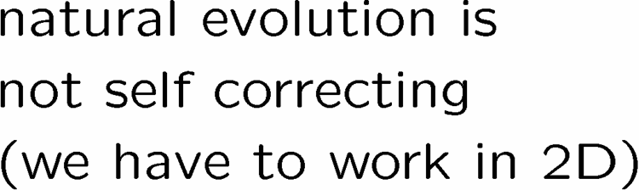




Kitaev’s Toric Codes

Slide 45

Towards Natural Fault-Tolerance
1
XX
Z
2
ZZ
ZZ
4
XX
3
YY
ZZ
XX
ZZ
XX
YY
YY
ZZ
ZZ
XX
XX
YY

Slide 46



Logical Operators

Slide 47


Errors
j-1
j
j+1
i-1
YY
YY
ZZ
ZZ
ZZ
i
YY
YY
ZZ
ZZ
ZZ
i+1
YY
YY

Slide 48
Summary
Learn from our past!
Let physics do the work!
Supercoherence as first step?
Towards self-correcting quantum memories

Slide 49
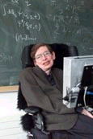
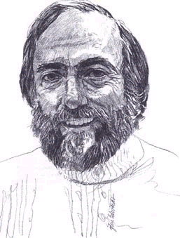
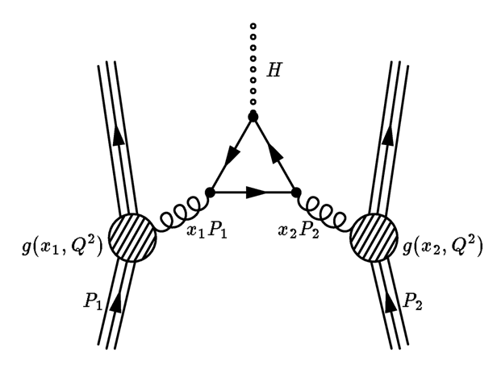
Is Nature Fault-Tolerant?
Information paradox for blackholes
Information is destroyed by a blackhole?
Stephen Hawking
Kip Thorne
John Preskill: “Could the universe be losing information
constantly and yet appear to be unitary and quantum
information preserving at our scales?”

Slide 50
Fin
Error correcting codes
Geometry, Topology?
classical
quantum
Statistical Physics
theory of strongly interacting
quantum systems
renormalization group
methods
Fault-tolerance
local structures giving rise
to global robustness (CA)
Real Physics
physical implementation
optical lattices, donor
electrons, superconducting
circuits, etc.
Representation theory
identification of qubits
and logical operations
Naturally Fault-Tolerant Quantum Computation

