Slide 1
Nothing To See Here
(Move Along)

Slide 2






When Is Teleportation Quantum?
Dave Bacon
Department of Physics
Caltech
Southwest Quantum Information and Technology Research Network (SQITRN)

Slide 3
SQI TRN:

Slide 4
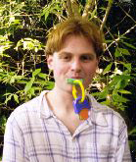
In Collaboration With…
Ben Toner
graduate student
Department of Physics
Institute for Quantum Information
Caltech
see Ben’s poster
for connections to reality

Slide 5









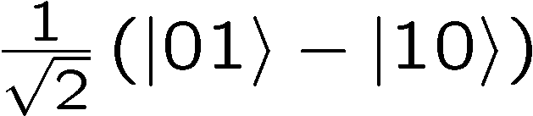
Teleportation
Alice
Bob
Alice
Bob

Slide 6


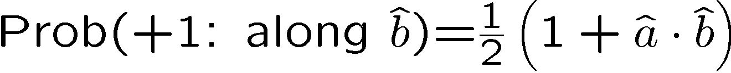




An Experiment
“qubit
teleporation”
In what sense is this experiment “quantum”?
Alice
Bob

Slide 7
Simulating Classically
1. Respect
locality and
causality
2. replace
by
quantum wire
classical wire carrying
any amount of
classical info
by
classical wire
b bits
classical wire
b bits
Alice
Bob

Slide 8



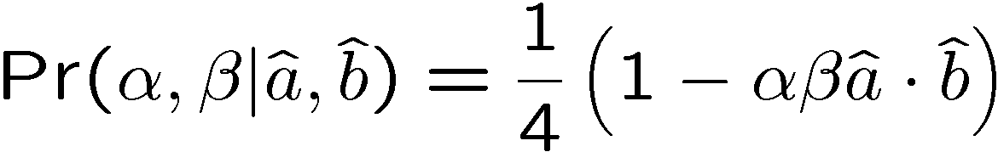

Simulating Bell Correlations
A’s output:
:Bob’s output
Alice
Bob
simulating Bell Correlations
with b bits communication
and shared randomness
simulating qubit teleportation
with b+1 bits communication
and shared randomness
“Classical teleportation of a qubit” Cerf, Massar, Gisin (2000)

Slide 9
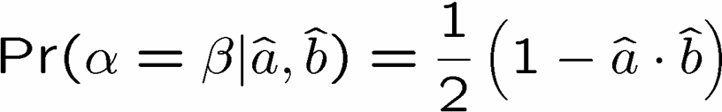
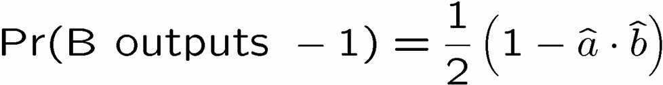
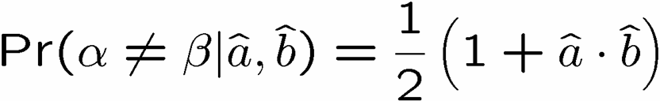
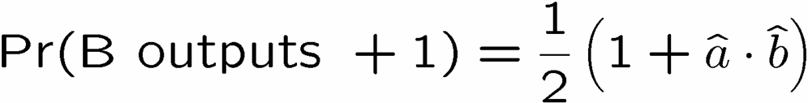
Bell Pair to Qubit Teleportation
Alice and Bob can produce
Alice sends her output bit (α) to Bob
If Alice’s output bit equals Bob’s output bit,
Bob outputs -1
Otherwise
Bob outputs +1
qubit teleportation

Slide 10








Simulating Bell Correlations

Slide 11

Why Is It Hard?

Slide 12


Towards Simulating Bell

Slide 13

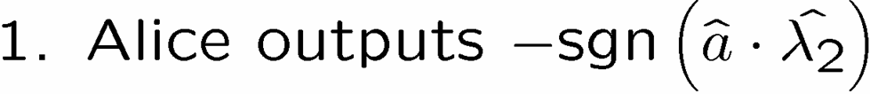

A 1 Bit Protocol

Slide 14
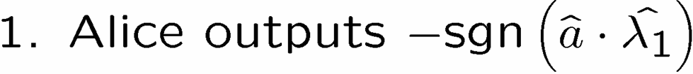








The Intuition

Slide 15


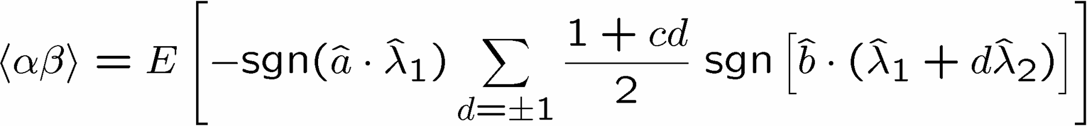
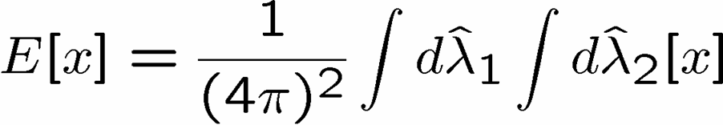
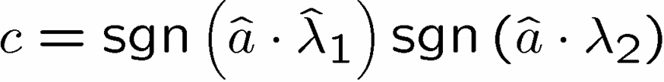
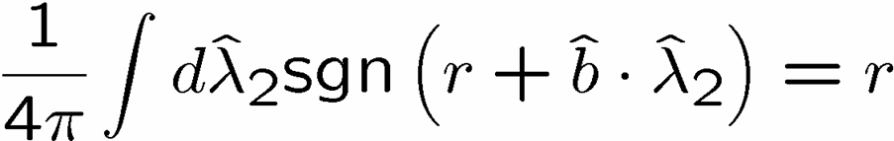
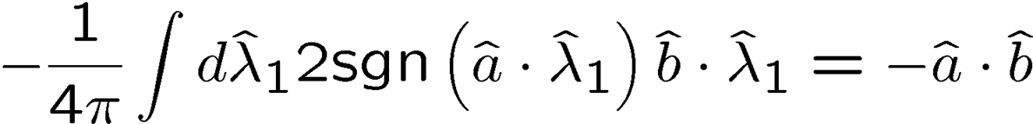

It Works!

Slide 16

1 Bell Pair’s Worth of Correlations

Slide 17
Qubit Teleportation
Alice
Bob

Slide 18



Quantum Teleportation
?
Alice
Bob
Alice
Bob

Slide 19

Correlations on Non-maximally Entangled 2 Qubit States

Slide 20
Average Communication

Slide 21


Connection to Detector Inefficiency

Slide 22
Futurama
Simulating correlations on general states with general measurements (communication bounded by size of Hilbert space)
Why does this work?
How do we justify connection between classical protocols and Hilbert space probabilities?
What is the two-party game with communication from which we can derive quantum theory?
Cryptographic interpretation of quantum theory

Slide 23
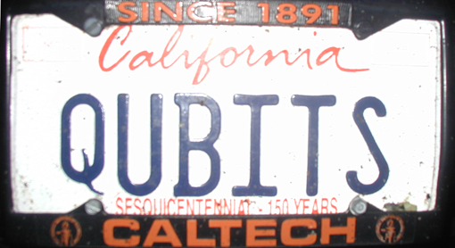
Fin
Correlations on Bell Pair = shared randomness + 1 bit
Qubit teleportation can be simulated classically!
see Ben Toner’s poster for connections to the detector inefficiency loophole for Bell inequalities

