Slide 1
Test Slide
SAT
MCAT
GRE
LSAT

Slide 2


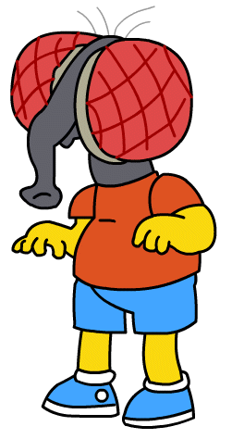


Quantum Communication
Dave Bacon
Department of Physics
Institute for Quantum Information
Caltech

Slide 3
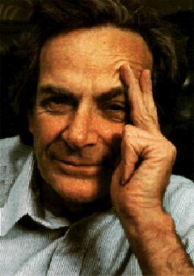
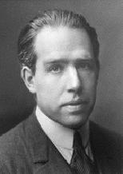
Quantum Propaganda
I think I can safely say that nobody
understands quantum mechanics.
Richard Feynman
Nobel Prize 1965
Anyone who is not shocked by quantum
theory has not understood it.
Niels Bohr
Nobel Prize 1922

Slide 4
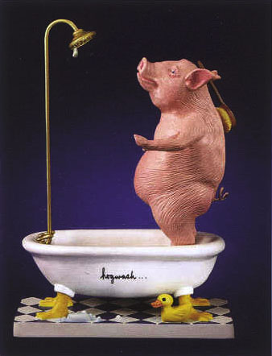
They understand it.
They use it.
But they don’t really believe it?

Slide 5
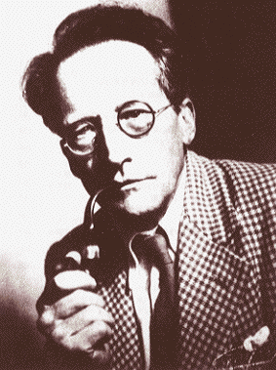
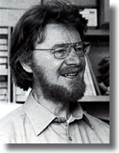
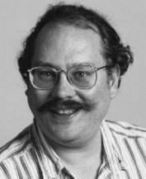
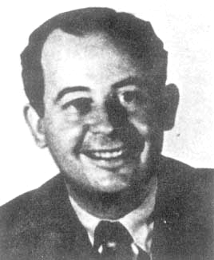
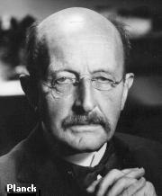
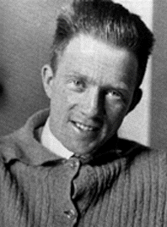

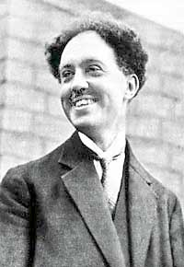
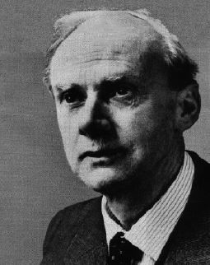
Quantum History
Inventing
Worrying
Accepting
1900
1910
1920
1930
1940
1950
1960
1970
1980
1990
2000
Erwin Schrodinger
Niels Bohr
John Bell
Peter Shor
John Von Neumann
Max Planck
Werner Heisenberg
John Archibald Wheeler
Louis de Broglie
Richard Feynman
P.A.M. Dirac

Slide 6
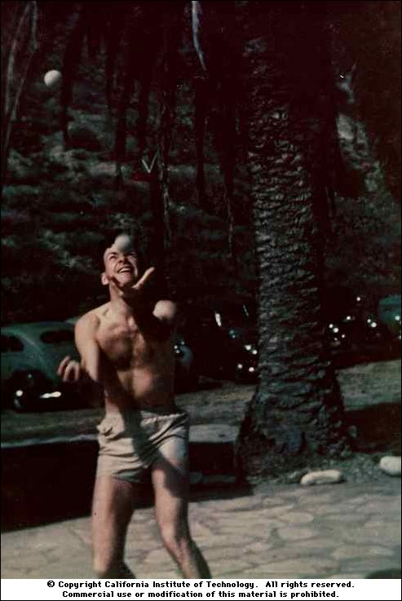
Acceptance
on quantum theory:
“Do not ask yourself, if you can possibly
avoid that, 'how can it be like that?'
because you will lead yourself down a
blind alley in which no one has ever
escaped.”
“For a successful technology, nature
must take precedence over public
relations, for nature cannot be fooled.”
“How can we simulate quantum
mechanics?...Can we do it with a new
kind of computer…a quantum computer?
It’s not a Turing machine but a machine
of a different kind” (1981)
Richard Feynman

Slide 7




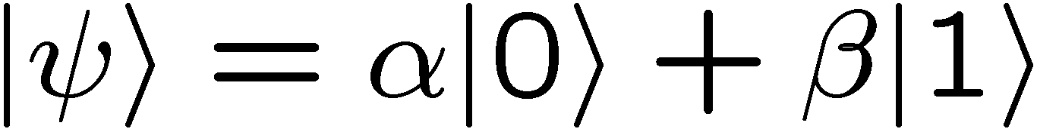

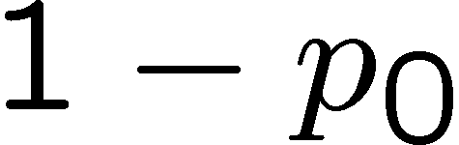

Quantum Radio
probability
amplitudes
bits
qubits
|Ψ⟩|φ⟩|σ⟩|Ψ⟩|Ψ⟩|ρ⟩|σ⟩|φ⟩
010010101011

Slide 8
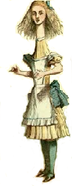



From Here to There
ALICE
some vast distance
(The shortest distance between two points
is under construction.)
BOB
ALICE
BOB

Slide 9
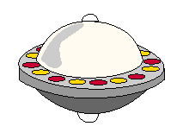
From Here to There
ALICE
some vast distance
(The shortest distance between two points
is under construction.)
BOB
Question: Other methods to transport quantum information?

Slide 10
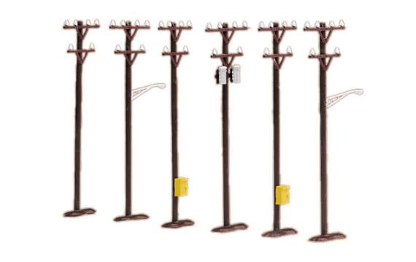
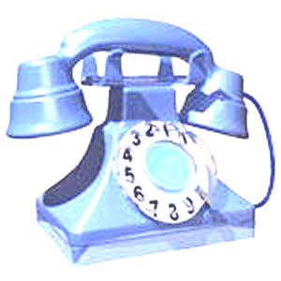
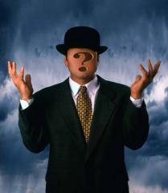
Silly Question, Silly Answer
ALICE
BOB
classical bits
two problems:
infinite number of bits to specify
cannot perfectly learn unknown

Slide 11
Silly Question?
ALICE
BOB
classical bits
+
shared entanglement
A Silly Question?

Slide 12



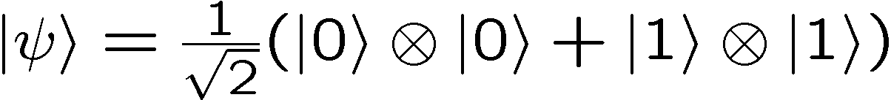
Entanglement
BOB
ALICE
separable
entangled

Slide 13



Entanglement Is Like…
measure in
basis
measure in
basis
outcome
BOB
ALICE
random correlated bits

Slide 14
Silly Question?
ALICE
BOB
classical bits
+
random correlated bits
classical bits
random correlated bits
A Silly Question!

Slide 15
Entanglement Is Like…
outcome
measure in
basis
measure in
basis
random correlated bits
BOB
ALICE
Is It Like Random Correlated Bits?

Slide 16
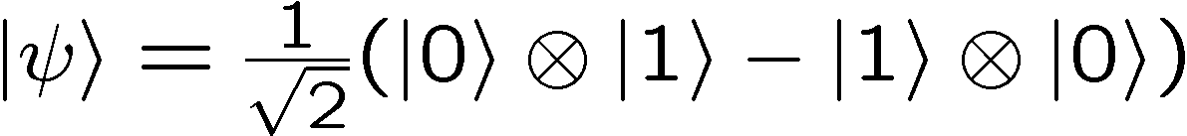


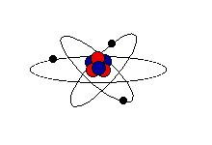







Bell’s Question
John Bell
A
B
BOB
ALICE
If then , i.e. outputs are always “anti”-correlated
Can these correlations be explained
by random correlated bits?

Slide 17






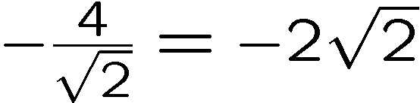
Bell Thinks
John Bell
1
1
2
2
45º
1
1
2
2
ALICE
BOB
Quantum:

Slide 18




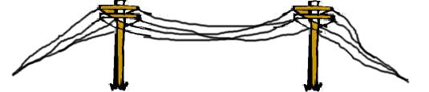



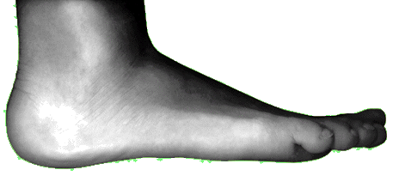

Communication Breakdown
random correlated bits

Slide 19


Bell’s Thinks II
“Convex”–iftying a probabilistic protocol
random variables could all be generated in first step of protocol
probabilistic protocol = deterministic protocol with certain probabilities
Alice’s output and measurement choice
cannot depend on
Bob’s output and measurement choice (and vice versa)
deterministic protocol
average over shared random bits

Slide 20


Bell Answers
John Bell
1
1
2
2
45º
1
1
2
2
ALICE
BOB
Quantum:
With correlated random bits: between and
Quantum correlations are DIFFERENT from correlated random bits!

Slide 21
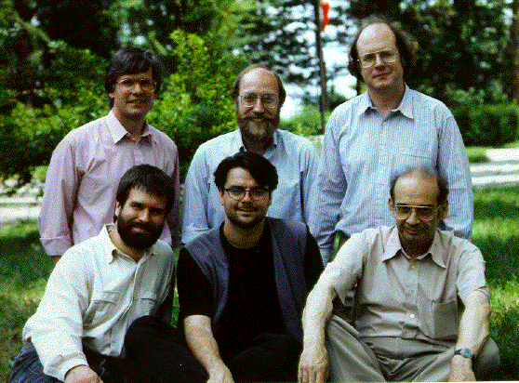
From Here to There
ALICE
BOB
classical bits
+
shared entanglement
R. Jozsa, W. Wootters, C.H. Bennet
G. Brassard, C. Crepeau, and A. Peres

