Slide 1
Test Slide
SAT
MCAT
GRE
LSAT

Slide 2





Quantum Communication
Dave Bacon
Department of Physics
Institute for Quantum Information
Caltech

Slide 3
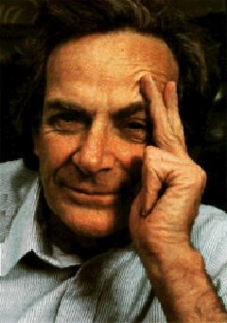
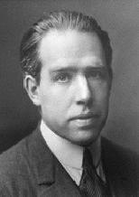
Quantum Propaganda
I think I can safely say that nobody
understands quantum mechanics.
Richard Feynman
Nobel Prize 1965
Anyone who is not shocked by quantum
theory has not understood it.
Niels Bohr
Nobel Prize 1922

Slide 4
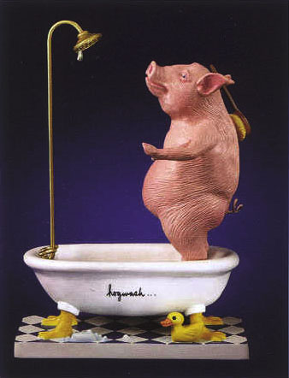
They understand it.
They use it.
But they don’t really believe it?

Slide 5
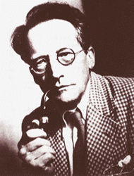
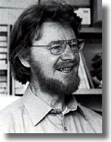
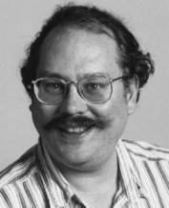
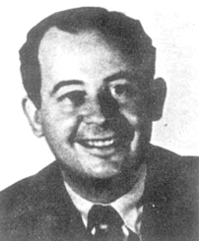
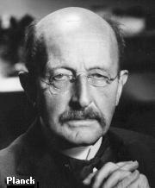
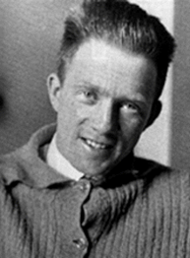

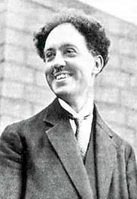
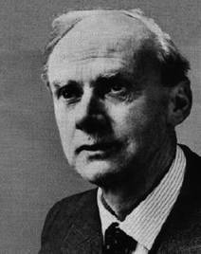
Quantum History
Inventing
Worrying
Accepting
1900
1910
1920
1930
1940
1950
1960
1970
1980
1990
2000
Erwin Schrodinger
Niels Bohr
John Bell
Peter Shor
John Von Neumann
Max Planck
Werner Heisenberg
John Archibald Wheeler
Louis de Broglie
Richard Feynman
P.A.M. Dirac

Slide 6
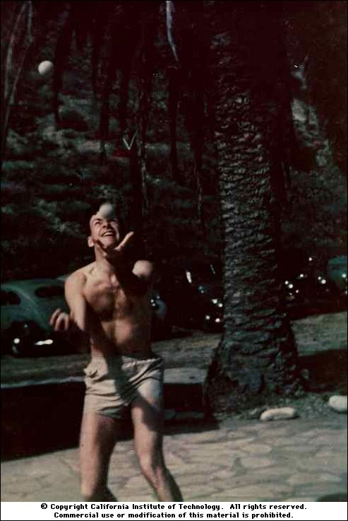
Acceptance
on quantum theory:
“Do not ask yourself, if you can possibly
avoid that, 'how can it be like that?'
because you will lead yourself down a
blind alley in which no one has ever
escaped.”
“For a successful technology, nature
must take precedence over public
relations, for nature cannot be fooled.”
“How can we simulate quantum
mechanics?...Can we do it with a new
kind of computer…a quantum computer?
It’s not a Turing machine but a machine
of a different kind” (1981)
Richard Feynman

Slide 7




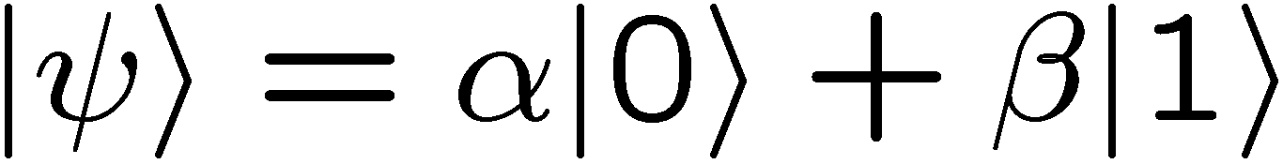

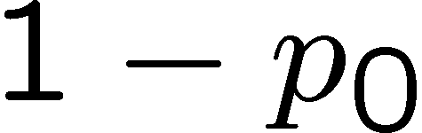

Quantum Radio
probability
amplitudes
bits
qubits
|Ψ⟩|φ⟩|σ⟩|Ψ⟩|Ψ⟩|ρ⟩|σ⟩|φ⟩
010010101011

Slide 8
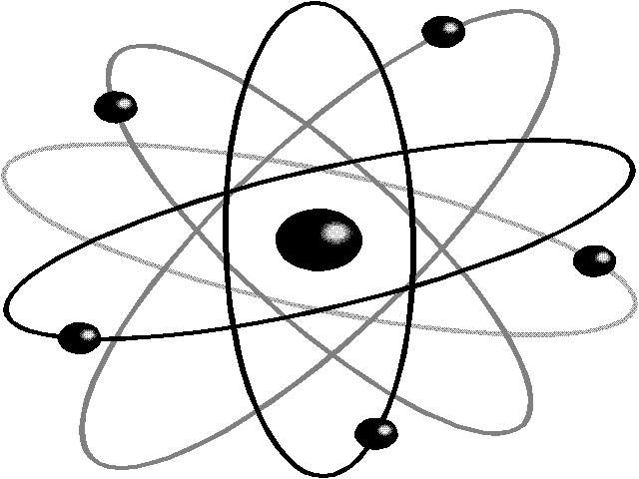
4 Minute Quantum Mechanic
Postulate 1: Associated with any isolated physical system is a
complex vector space with inner product known as the state
space of the system. The system is completely described by its
state vector, which is a unit vector in the system’s state space.
complex
vector
space
physical system

Slide 9






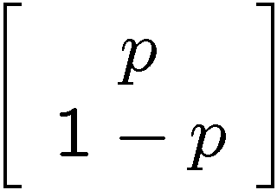
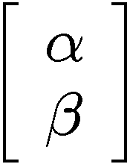


What’s a Qubit?
Classical State Descriptions
Suppose we don’t have information about the bit classically. How do we describe the state?
probability of system being in state
probability of system being in state
vector of
probabilities:
Quantum State Descriptions
vector of
amplitudes:
complex numbers
a qubit

Slide 10
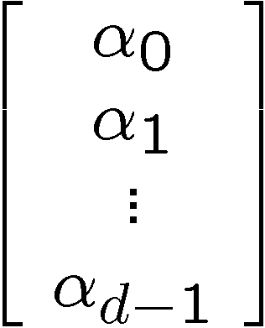

complex
vector
space
complex numbers
physical system
complex
unit
vector
state of system

Slide 11
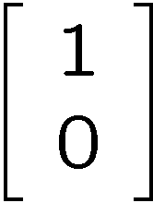

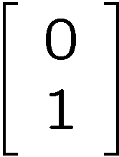

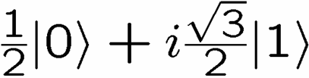
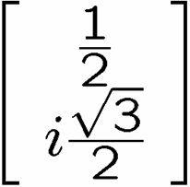
What’s a Qubit?

Slide 12





3 Minute Quantum Mechanic
Postulate 2: The evolution of a closed quantum system is described
by a unitary transformation. That is the state of the system at
time t₁ is related to the state of the system at time t₂ by a unitary
operator which depends only on the times t₁ and t₂,

Slide 13
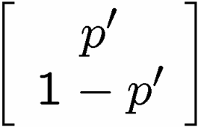
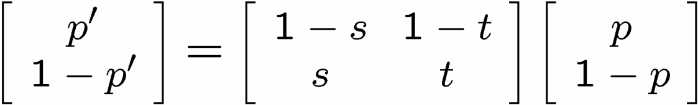
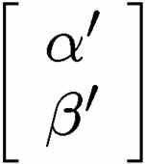
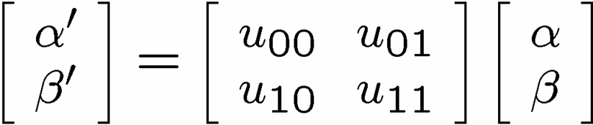
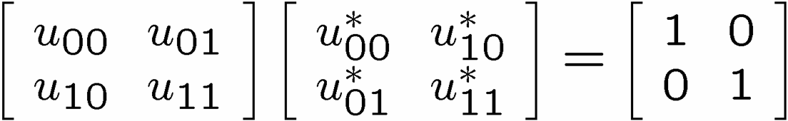
Classical State Evolution
If the state is 0 flip to 1 with probability s (to 0 with probability 1-s)
If the state is 1 flip to 1 with probability t (to 0 with probability 1-t)
Quantum State Evolution
unitarity

Slide 14

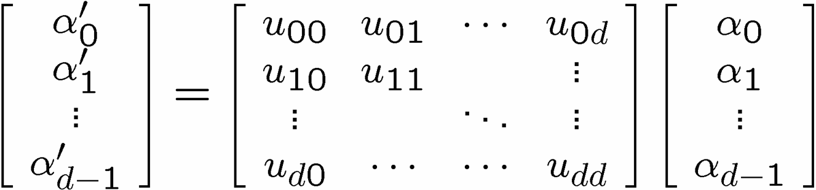
3 Minute Quantum Mechanic
Postulate 2: The evolution of a closed quantum system is described
by a unitary transformation. That is the state of the system at
time t₁ is related to the state of the system at time t₂ by a unitary
operator which depends only on the times t₁ and t₂,

Slide 15
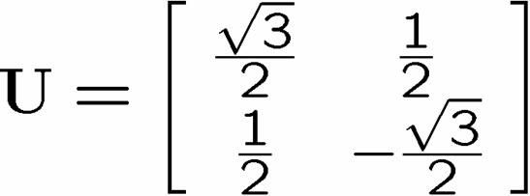
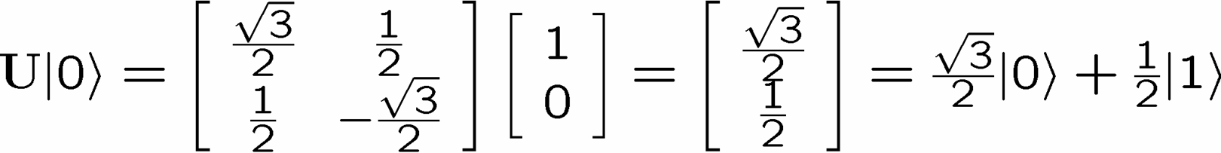
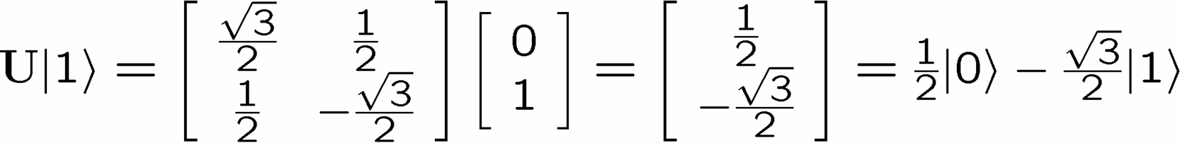
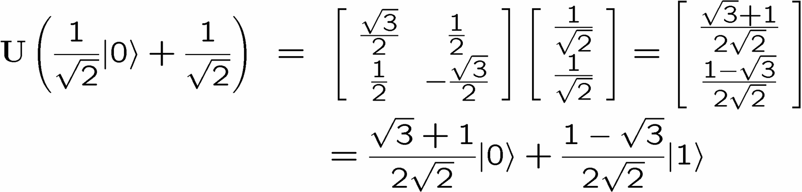
Some Quantum Evolutions

Slide 16



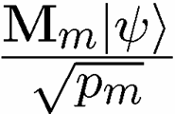

2 Minute Quantum Mechanic
Postulate 3: Quantum measurements are described by a collection
of measurement operators. These are operators acting on
the state space of the system being measured. The index refers to
The measurement outcomes that may occur in the experiment. If the
state of the quantum system is immediately before the
measurement, then the probability of result is given by
and the state of the system after the measurement is
The measurement operators satisfy

Slide 17

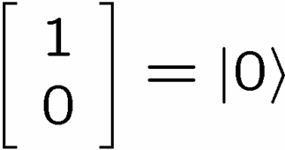

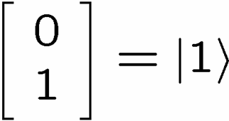
Classical State Measurement
probability p we get heads
probability 1-p we get tails
Quantum State Measurement
probability we get heads outcome
probability we get heads outcome

Slide 18


1 Minute Quantum Mechanic
Postulate 4: The state space of a composite physical system is the
Tensor product of the state spaces of the component physical systems.
Moreover, if we have systems numbered 1 through n, and system
number i is prepared in the state , then the joint state of the total
system is

Slide 19


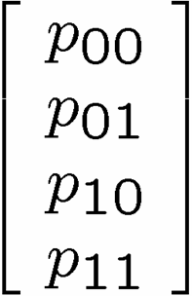
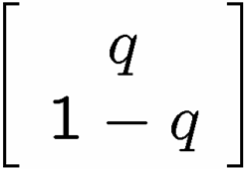


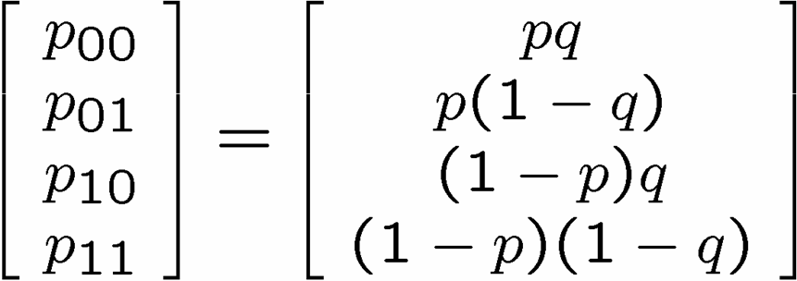
Two Classical Systems
Coin A
Coin B
If we prepare Coin A in
and if we prepare Coin B in
then

Slide 20








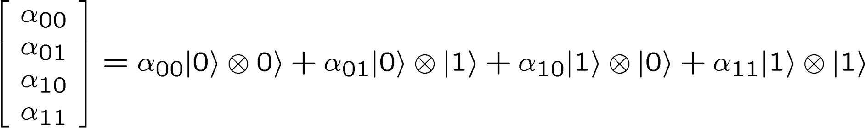
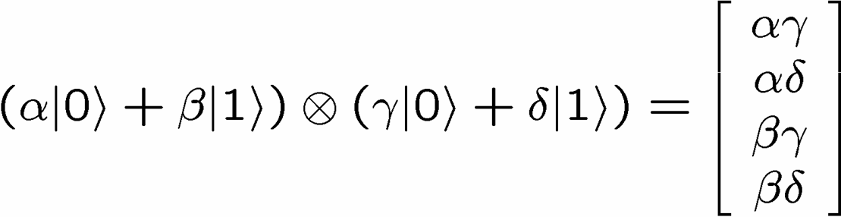

Two Quantum Systems
qubit A
qubit B
qubit A as
qubit B as
=

Slide 21
Quantum Radio
probability
amplitudes
bits
qubits
|Ψ⟩|φ⟩|σ⟩|Ψ⟩|Ψ⟩|ρ⟩|σ⟩|φ⟩
010010101011

Slide 22
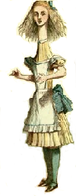


From Here to There
ALICE
some vast distance
(The shortest distance between two points
is under construction.)
BOB
ALICE
BOB

Slide 23

From Here to There
ALICE
some vast distance
(The shortest distance between two points
is under construction.)
BOB
Question: Other methods to transport quantum information?

Slide 24
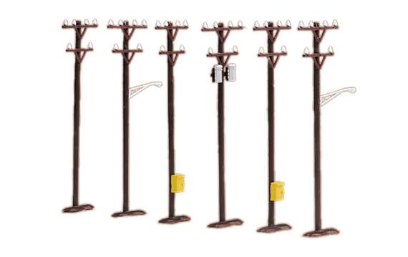
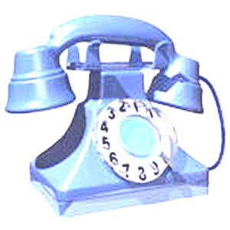

Silly Question, Silly Answer
ALICE
BOB
classical bits
two problems:
infinite number of bits to specify
cannot perfectly learn unknown

Slide 25
Silly Question?
ALICE
BOB
classical bits
+
shared entanglement
A Silly Question?

Slide 26



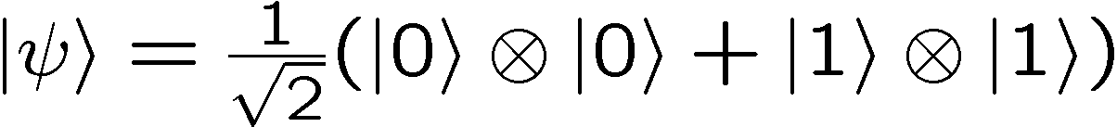
Entanglement
BOB
ALICE
separable
entangled

Slide 27



Entanglement Is Like…
measure in
basis
measure in
basis
outcome
BOB
ALICE
random correlated bits

Slide 28
Silly Question?
ALICE
BOB
classical bits
+
random correlated bits
classical bits
random correlated bits
A Silly Question!

Slide 29
Entanglement Is Like…
outcome
measure in
basis
measure in
basis
random correlated bits
BOB
ALICE
Is It Like Random Correlated Bits?

Slide 30
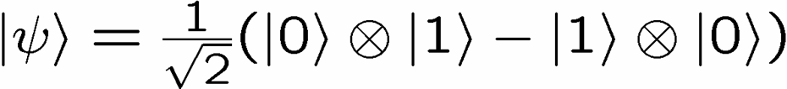


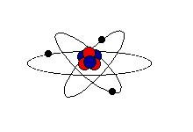





Bell’s Question
John Bell
A
B
BOB
ALICE
If then , i.e. outputs are always “anti”-correlated
Can these correlations be explained
by random correlated bits?

Slide 31






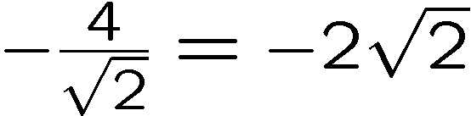
Bell Thinks
John Bell
1
1
2
2
45º
1
1
2
2
ALICE
BOB
Quantum:

Slide 32








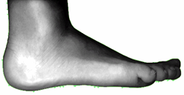

Communication Breakdown
random correlated bits

Slide 33


Bell’s Thinks II
“Convex”–iftying a probabilistic protocol
random variables could all be generated in first step of protocol
probabilistic protocol = deterministic protocol with certain probabilities
Alice’s output and measurement choice
cannot depend on
Bob’s output and measurement choice (and vice versa)
deterministic protocol
average over shared random bits

Slide 34


Bell Answers
John Bell
1
1
2
2
45º
1
1
2
2
ALICE
BOB
Quantum:
With correlated random bits: between and
Quantum correlations are DIFFERENT from correlated random bits!

Slide 35
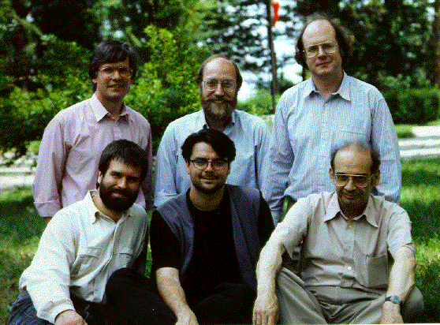
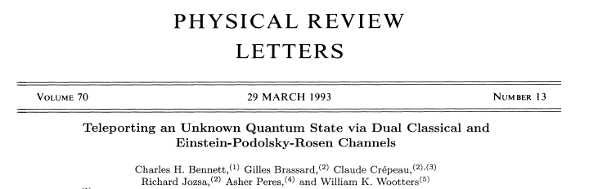
From Here to There
ALICE
BOB
classical bits
+
shared entanglement

Slide 36









Bell Pairs
computational basis
Bell basis
converting

Slide 37



Bell Pairs
ALICE
BOB

Slide 38









Bell
measurement
ALICE
BOB
If Alice gets outcome then Bob has
Bob can apply to and thus Bob now has
Alice can send her measurement result (2 classical bits) and then
Bob can perform the appropriate action to obtain
Quantum Teleportation!

Slide 39


Quantum Teleportation
Bell
measurement
ALICE
2 bits
BOB
=
ALICE
BOB
1 qubit ≤ 2 classical bits + 1 shared Bell pair
1 qubit ≤ 2 bits + 1 ebit

Slide 40

Quantum Communication
1. Given a physical resource (energy, time, bits, ebits, qubits, etc.)
2. Given an information processing task (information transmission,
  data compression, etc.)
3. Given a success criterion (exact, approximate, etc.)
How much of 2. do we need to achieve 1. while satisfying 3.?
(a.k.a. how to write a quant-ph paper!)
Quantum Teleportation
1. ebits and bit
2. transmit a qubit
3. exactly teleport the qubit
1 qubit ≤ 2 bits + 1 ebit
June 16, 2004

Slide 41






Those Ebits?
Each side can cycle through Bell pairs.

Slide 42



Cycling on Four States
Alice can cycle through 4 global states
ALICE
BOB
Charles Bennett
Stephen Wiesner

Slide 43



Superdense Coding
1. Alice and Bob share
2. Alice applies to her half of Bell pair
ALICE
3. Alice sends her half of Bell pair to Bob
4. Bob measures in Bell basis
BOB

Slide 44
Superdense Coding
1. Given a physical resource (energy, time, bits, ebits, qubits, etc.)
2. Given an information processing task (information transmission,
  data compression, etc.)
3. Given a success criterion (exact, approximate, etc.)
1. ebits and qubits
2. transmit a bit
3. exactly communicate bits
2 bits ≤ 1 ebit +1 qubit
Sharing ebits allows us to send 2 bits using 1 qubit
compare teleportation: 1 qubit ≤ 2 bits + 1 ebit

Slide 45


Flavors
1 ebit:
Quantum information tasks consume ebits, ebits are a resource
(ebits are a “nonlocal resource”, i.e. shared by localized parties)
Entanglement comes in flavors besides ebits
For example:
How do other flavors of entanglement compare to ebits?

Slide 46

Some Entanglement Is Created Equal
All Bell pairs are equal
When we allow local unitary evolution
(operations Alice and Bob perform separately)
States reachable from
States reachable from
by local unitaries
by local unitaries
all entangled states

Slide 47








Standardization
generic entangled state
dimension
dimension
ALICE
BOB
local unitary evolution
“Schmidt decomposition”
(pure state) two party entanglement
classified by Schmidt coefficients

Slide 48



Currency?
is different (under local unitaries) from
If we try to use to teleport a qubit, we can’t perfectly teleport
(we fail with some probability.)
Is equal to some fraction of ?
How many s equal how many s?
s
s

Slide 49

Entanglement Concentration
n copies
m<n copies
ALICE
BOB
ALICE
BOB
How to turn
into

Slide 50








Entanglement Concentration
Measurement’s don’t have to fully collapse a quantum state:
measurement outcome 1
measurement outcome 2
measurement outcome 3
Alice measures the number of 0s in bitstring. If outcome is k 0s, state is
ebits!
probability of k 0s:
Average number of ebits

Slide 51

Entanglement Concentration
n copies
m<n copies
ALICE
BOB
ALICE
BOB
n copies
is equal to
m copies
entropy of Schmidt coefficients measures entanglement!

Slide 52
Entanglement Dillution
n copies
m<n copies
ALICE
BOB
ALICE
BOB
What about the other direction?
How many ebits does it take to produce copies of ?

Slide 53





Schumacher Compression
One parties version of an entangle pure state
is not a pure state, it is mixed:
Ben Schumacher
ALICE
locally sees her state as
Mixed state: with probability we have one of the orthogonal states
Schumacher asked: Can we compress n mixed qubits into a
smaller number of mixed qubits?
n mixed
qubits
m mixed
qubits
n mixed
qubits
compress
decompress

Slide 54
Entanglement Dillution
1. Alice locally prepares n copies of
n copies
ALICE
2. Alice takes “Bob’s” half and
Schumacher compresses the mixed
state qubits.
m “halves” of
ALICE
compress

Slide 55
Entanglement Dillution
m “halves” of
3. Alice sends m “halves” of using
teleportation. This consumes m ebits.
ALICE
teleportation
m “halves” of
BOB
4. Bob decompresses
the “halves”
m qubit
“halves” of
ebits consumed
decompress
ALICE
BOB

Slide 56
Bipartite Pure State Entanglement
n copies
m<n copies
ALICE
BOB
ALICE
BOB
is the basic currency of two party pure state entanglement

Slide 57





Mixed State Entanglement
not given but with probability
Similar theory for converting to and from ?
ebits consumed to create n copies of
Entanglement cost of
n
ebits produced from n copies of
Entanglement of dilution
n
Entanglement of dilution
≤
Entanglement cost
Irreversibility!

Slide 58

Communication
Complexity
F(x,y)
How much (how many bits) do they
need to communicate to compute F?
Example
ALICE
BOB
F(x,y)=1 if x=y
F(x,y)=0 otherwise
x
y
Alice needs to communicate n bits to Bob
Example
x=010111
y=100101
F(x,y)=x⊕y
Odd # 1’s F=1
Even # 1’s F=0
110010
Alice needs to communicate 1 bit to Bob

Slide 59

Quantum Communication
Complexity
How much (how many qubits) do they need to communicate to compute F?
x
y
BOB
ALICE
Exponentially less quantum
communication than classical
communication!
Ran Raz
(1999)
Because of teleportation this implies exponentially less classical communication if we share entanglement!

Slide 60
Fin
Qubits, Qubits, everywhere and not a drop to drink!
1. Entanglement is different from classical correlation.
2. Entanglement is a resource which can be used
to teleport qubits
to double the capacity of a qubit channel
3. An ebit is the standard unit of entanglement
pure state concentration and dilution
irreversible mixed state cases!
4. Entanglement can be used to cut communication complexity
Exponentially!

Slide 61


Dave Bacon, 156 Jorgensen

