Slide 1
Test Slide
SAT
MCAT
GRE
LSAT

Slide 2
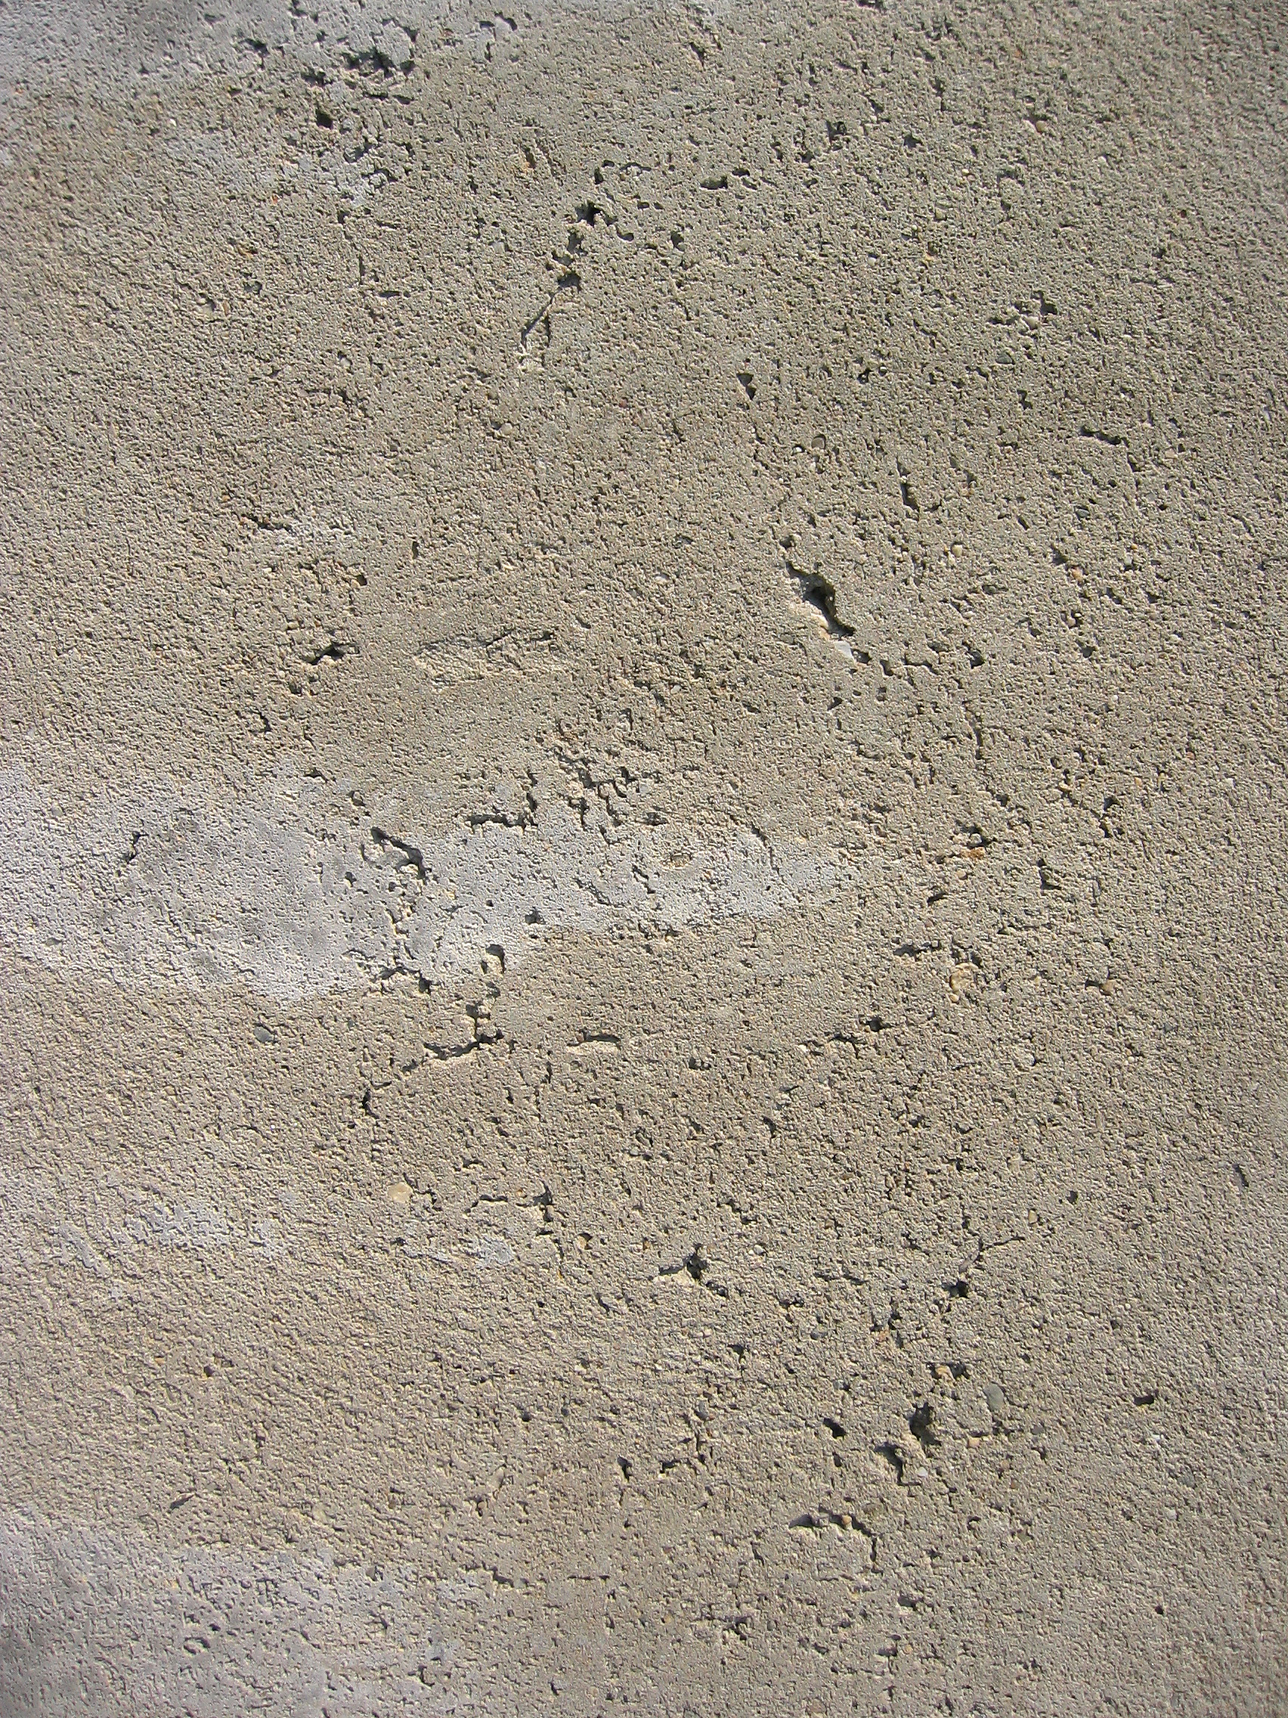

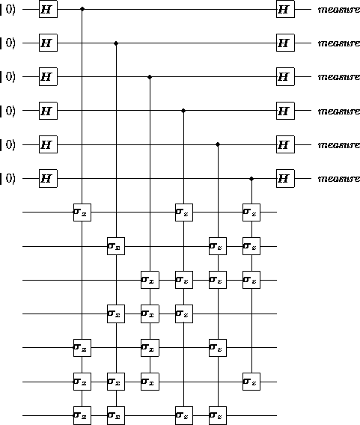
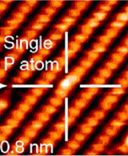
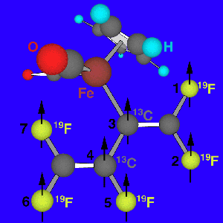
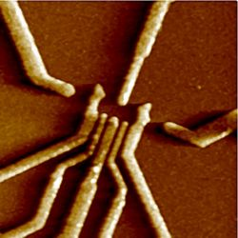
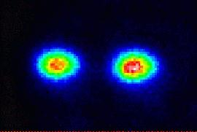
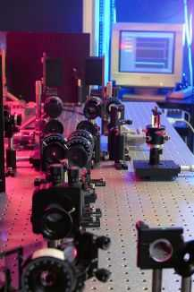
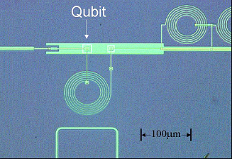
Towards Reliable
Quantum
Computers
Dave Bacon
Caltech

Slide 3
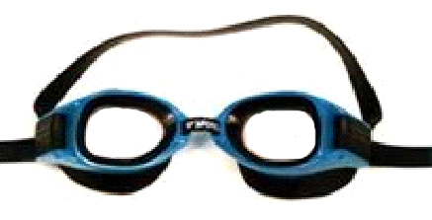
Theory Goggles
Threshold Theorem
Decoherence
Free
Subsystems
Fault-Tolerant
Preparation/
Measurement
Natural
Fault
Tolerance
Fault-
Tolerant
Quantum
Gates
Degenerate
Quantum
Codes
Linear
Quantum
Codes
Topological
Quantum
Codes
Encoded
Universality
Quantum Error Correcting Codes
Universal
Quantum
Gate Sets
Encoded Quantum Information

Slide 4
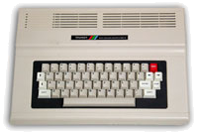
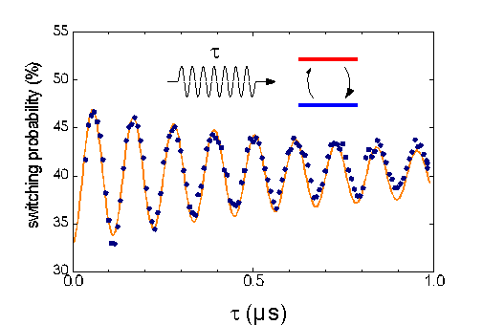

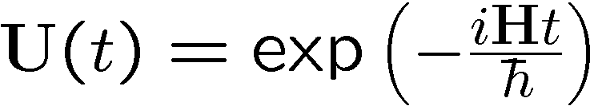
Quantum Digital?
Classical Computer
Quantum Physics Experiment
t
0
0
1
1
1
1
1
1
1
1
1
1
1
1
0
1
1
1
0
1
0
0
1
0
0
1
10 PRINT “BEEP!”
20 PRINT CHR$(7)
30 GOTO 10
0
1
1
0
1
1
Quantronium (CEA)
0
1
1
Quantum Data
0
1
1
x
Quantum
Classical
Transition
Digital Data
Digital Manipulations
Quantum Manipulations
Is a Quantum Computer really a Computer?

Slide 5
Five Problems with Physics Analogs
Five Problems
1. quantum data is analog
properly defined complexity class BQP
amplitudes like probabilities
2. quantum data likes to become classical data
quantum error correcting codes
selection rules, degeneracy, and cooling
3. quantum evolution is analog
fault-tolerant gate sets
thermodynamics of refrigeration
digitizing quantum errors
linearity of quantum theory
4. quantum preparation is imprecise
fault-tolerant encoded state preparation
5. quantum measurement is imprecise
fault-tolerant measurement procedures

Slide 6
Solutions (partial credit awarded)
Quantum Error Correction
Barbara Terhal (IBM)
Topological Codes and Geometric Methods
David Meyer (UC San Diego)
Decoherence-Free Methods and Decoupling Techniques
Daniel Lidar (U Toronto)
Architectural Aspects of Ion Trap Quantum Computers
Isaac Chuang (MIT)
This Talk
the big picture
robust
quantum
computation
physics
physics of the solutions

Slide 7
The Physics of
Quantum Error Correction

Slide 8
Selection Rules

Slide 9
Cooling and Error Detecting

Slide 10
Measuring Without Destroying

Slide 11
Quantum Error Correcting Codes

Slide 12
QEC Roadmap

Slide 13
Threshold Theorem

Slide 14
Decoherence Models

Slide 15
Decoherence Free Subspaces

Slide 16
Symmetrizing Evolutions

Slide 17
Natural Quantum Error Correction

Slide 18
Supercoherent Quantum Bits

Slide 19
Topological Quantum Computing

Slide 20
Natural Fault Tolerant Quantum
Computing

