Slide 1
Test Slide
SAT
MCAT
GRE
LSAT

Slide 2
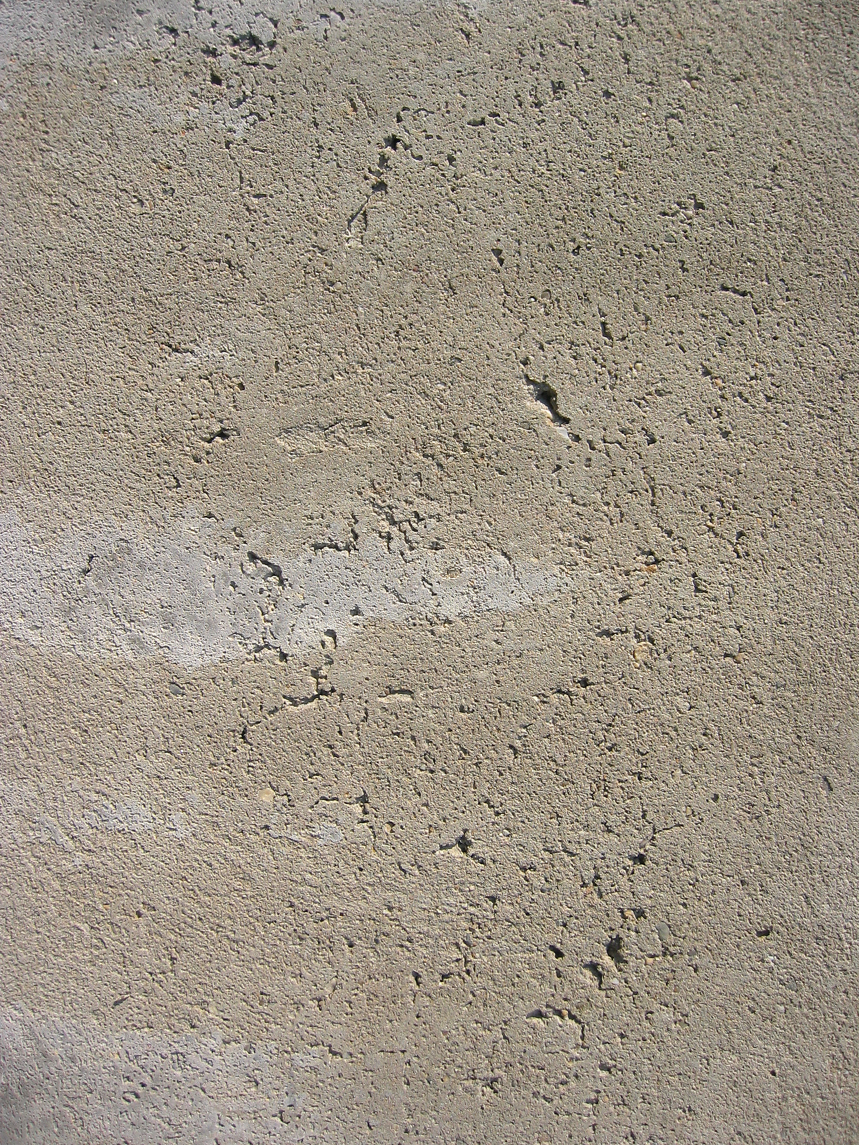

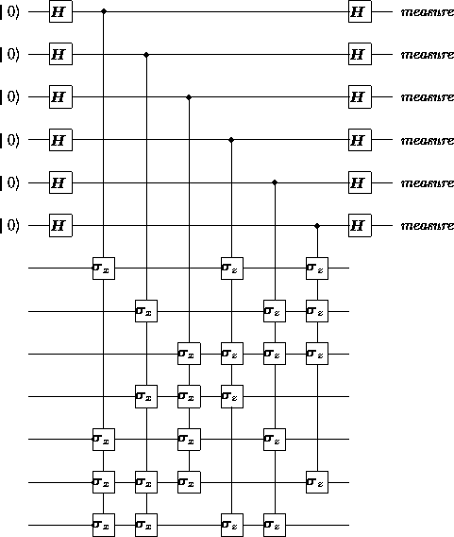
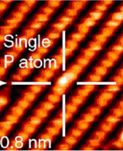
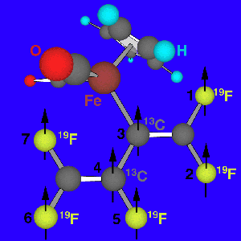
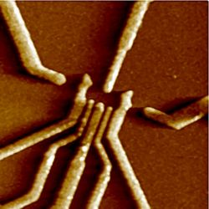
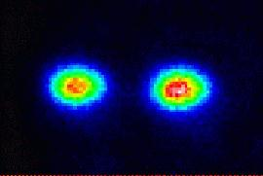
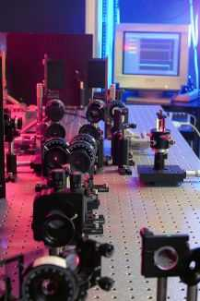
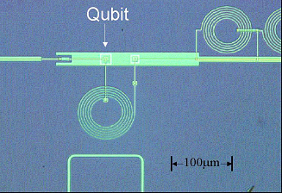
Towards Reliable
Quantum
Computers
Dave Bacon
Caltech

Slide 3
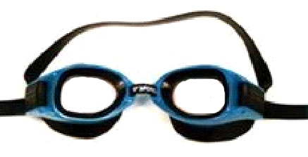
Theory Goggles
Threshold Theorem
Decoherence
Free
Subsystems
Fault-Tolerant
Preparation/
Measurement
Natural
Fault
Tolerance
Fault-
Tolerant
Quantum
Gates
Degenerate
Quantum
Codes
Linear
Quantum
Codes
Topological
Quantum
Codes
Encoded
Universality
Quantum Error Correcting Codes
Universal
Quantum
Gate Sets
Encoded Quantum Information

Slide 4
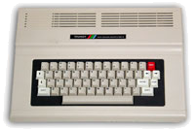
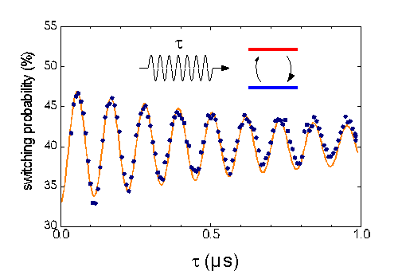

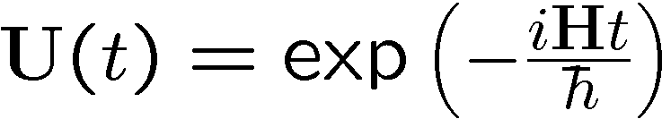
Quantum Digital?
Classical Computer
Quantum Physics Experiment
t
0
0
1
1
1
1
1
1
1
1
1
1
1
1
0
1
1
1
0
1
0
0
1
0
0
1
10 PRINT “BEEP!”
20 PRINT CHR$(7)
30 GOTO 10
0
1
1
0
1
1
Quantronium (CEA)
0
1
1
Quantum Data
0
1
1
x
Quantum
Classical
Transition
Digital Data
Digital Manipulations
Quantum Manipulations
Is a Quantum Computer really a Computer?

Slide 5
Five Problems with Physics Analogs
Five Problems
1. quantum data is analog
properly defined complexity class BQP
amplitudes like probabilities
2. quantum data likes to become classical data
quantum error correcting codes
error avoidance methods
selection rules, degeneracy, and cooling
3. quantum evolution is analog
fault-tolerant gate sets
thermodynamics of refrigeration
digitizing quantum errors
linearity of quantum theory
4. quantum preparation is imprecise
fault-tolerant encoded state preparation
5. quantum measurement is imprecise
fault-tolerant measurement procedures

Slide 6
Solution Set
Quantum Error Correction
Barbara Terhal (IBM)
Topological Codes
David Meyer (UC San Diego)
Decoherence-Free Methods and Decoupling Techniques
Daniel Lidar (Toronto)
Architectural Aspects of Ion Trap Quantum Computers
Isaac Chuang (MIT)
physics:
a.k.a. “the
real world”
This Talk
the big picture
robust
quantum
computation
physics of the solutions

Slide 7

Decoherence
2. quantum data likes to become classical data
amplitudes
open system dynamics
probabilities
System
Environment
How to guide the dynamics of system-environment coupling?

Slide 8
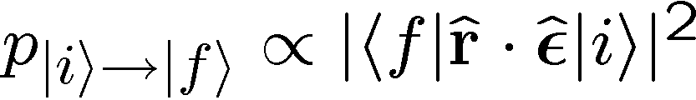




Selection Rules
electric dipole interaction:
orbital angular momentum
selection rule:
symmetry of
system-environment interaction
+
symmetry of states
=
restricted system dynamics
due to system-environment
interaction
Different methods differ mostly
in how they treat the symmetry
of the interaction!
Decoherenc-Free: use natural symmetry of interaction
Decoupling Methods: engineer effective interaction with a symmetry
Quantum Error Correction: use symmetry of noise model

Slide 9



Decoherence Free Methods
environment mode
two two-level systems
wavelength
environment mode cannot distinguish between qubits
symmetry
interaction
Hamiltonian
environment
qubit 1
qubit 2
symmetry

Slide 10
Linearity
electric dipole interaction
not very generic

Slide 11
Cooling and Error Detecting

Slide 12
Measuring Without Destroying

Slide 13
Quantum Error Correcting Codes

Slide 14
QEC Roadmap

Slide 15
Threshold Theorem

Slide 16
Decoherence Models

Slide 17
Decoherence Free Subspaces

Slide 18
Symmetrizing Evolutions

Slide 19
Natural Quantum Error Correction

Slide 20
Supercoherent Quantum Bits

Slide 21
Topological Quantum Computing

Slide 22
Natural Fault Tolerant Quantum
Computing

