Slide 1
Test Slide
SAT
MCAT
GRE
LSAT

Slide 2
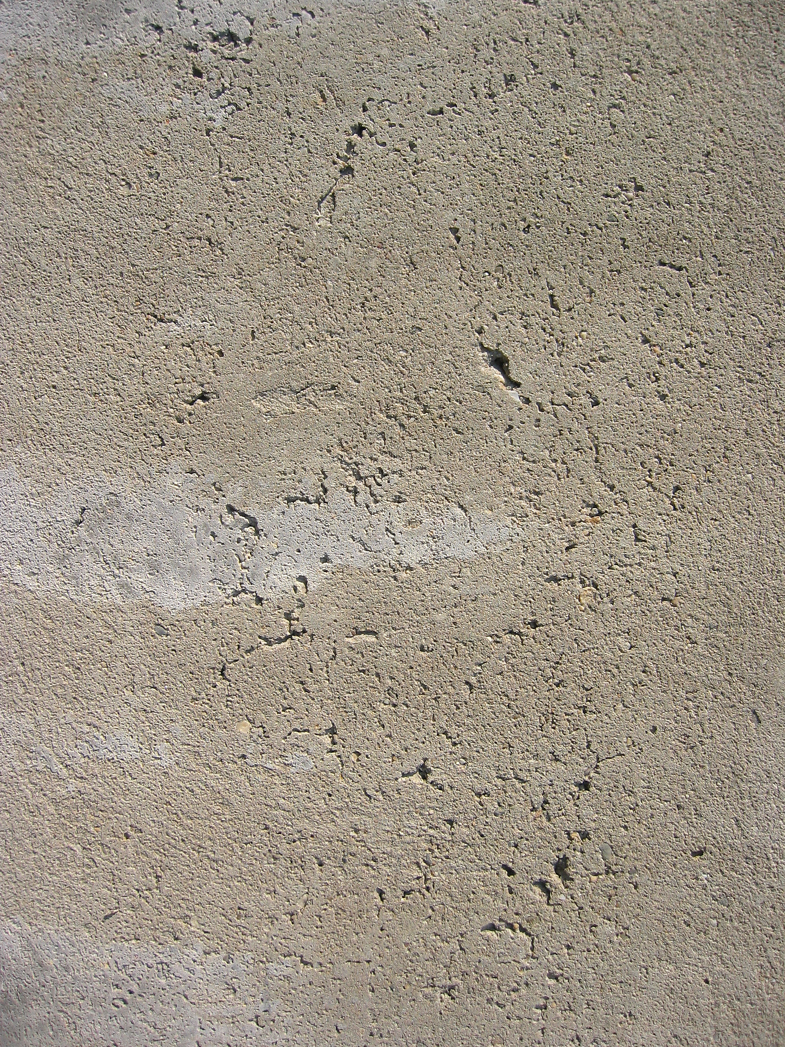

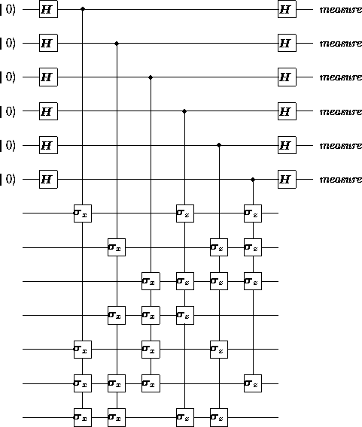
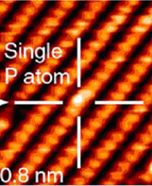
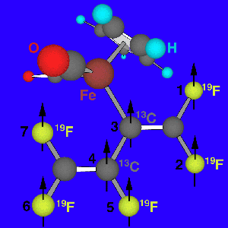
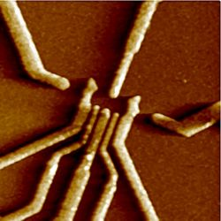
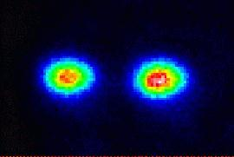
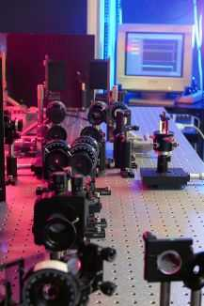
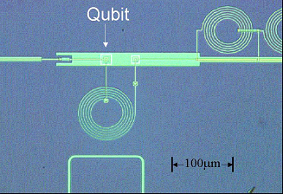
Towards Reliable
Quantum
Computers
Dave Bacon
IQI
Deptartment of Physics
Caltech

Slide 3
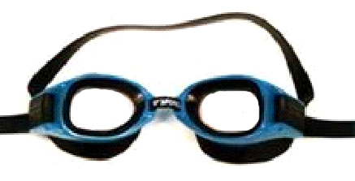
Theory Goggles
Threshold Theorem
Decoherence
Free
Subsystems
Fault-Tolerant
Preparation/
Measurement
Natural
Fault
Tolerance
Fault-
Tolerant
Quantum
Gates
Degenerate
Quantum
Codes
Linear
Quantum
Codes
Topological
Quantum
Codes
Encoded
Universality
Quantum Error Correcting Codes
Universal
Quantum
Gate Sets
Encoded Quantum Information

Slide 4
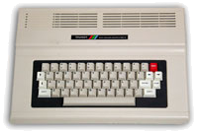
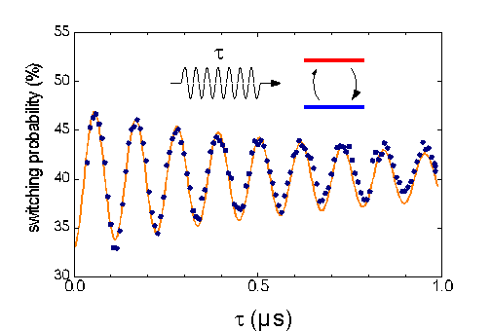

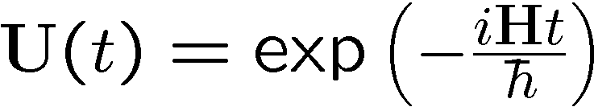
Quantum Digital?
Classical Computer
Quantum Physics Experiment
t
0
0
1
1
1
1
1
1
1
1
1
1
1
1
0
1
1
1
0
1
0
0
1
0
0
1
10 PRINT “BEEP!”
20 PRINT CHR$(7)
30 GOTO 10
0
1
1
0
1
1
Quantronium (CEA)
0
1
1
Quantum Data
0
1
1
x
Quantum
Classical
Transition
Digital Data
Digital Manipulations
Quantum Manipulations
Is a Quantum Computer really a Computer?

Slide 5
Five Problems with Physics Analogs
Five Problems
1. quantum data is analog
properly defined complexity class BQP
amplitudes like probabilities
2. quantum data likes to become classical data
quantum error correcting codes
error avoidance methods
selection rules, degeneracy, and cooling
3. quantum evolution is analog
fault-tolerant gate sets
thermodynamics of refrigeration
digitizing quantum errors
linearity of quantum theory
4. quantum preparation is imprecise
fault-tolerant encoded state preparation
5. quantum measurement is imprecise
fault-tolerant measurement procedures

Slide 6
Solution Set
Quantum Error Correction
Barbara Terhal (IBM)
Topological Codes
David Meyer (UC San Diego)
Decoherence-Free Methods and Decoupling Techniques
Daniel Lidar (Toronto)
Architectural Aspects of Ion Trap Quantum Computers
Isaac Chuang (MIT)
physics:
a.k.a. “the
real world”
This Talk
the big picture
robust
quantum
computation
physics of the solutions

Slide 7

Decoherence
2. quantum data likes to become classical data
amplitudes
open system dynamics
probabilities
System
Environment
How to guide the dynamics of system-environment coupling?

Slide 8
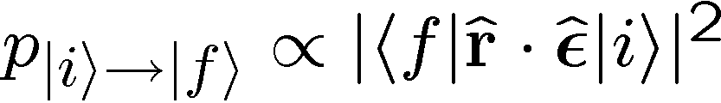




Selection Rules
electric dipole interaction:
orbital angular momentum
selection rule:
symmetry of
system-environment interaction
+
symmetry of states
=
restricted system dynamics
due to system-environment
interaction
Different methods differ mostly
in how they treat the symmetry
of the interaction!
Decoherenc-Free: use natural symmetry of interaction
Decoupling Methods: engineer effective interaction with a symmetry
Quantum Error Correction: use symmetry of noise model

Slide 9




System-Environment Symmetries
environment mode
two two-level systems
wavelength
environment mode cannot distinguish between qubits
interaction
Hamiltonian
symmetry
qubit 1
environment
qubit 2
symmetry
spin ½ Pauli
operators
collective decoherence model

Slide 10
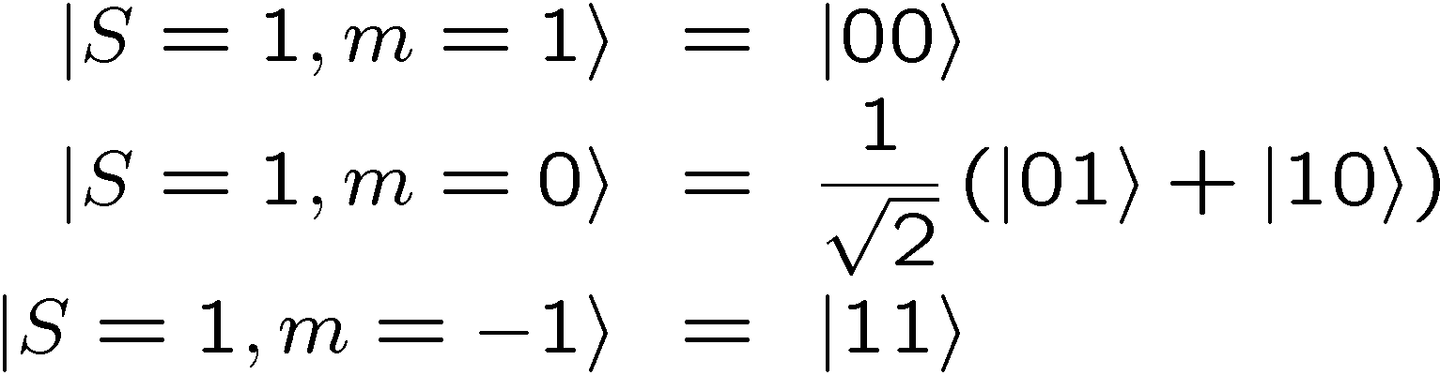
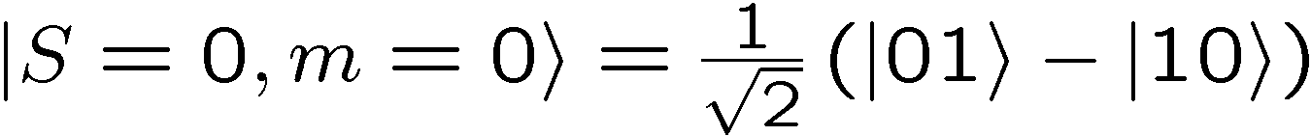


Decoherence-Free
total spin operators:
spin 1
spin ½
spin 0
add
spin ½
for all
singlet does not evolve due to system-environment coupling!

Slide 11


Decoherence-Free Subspaces
[QC origin: Zanardi, Rasetti, Duan, Gao, Lidar, Chuang, Whaley]
add
spin ½
=
spin 2
total spin operators for 4 qubits
spin 1½
spin 1
spin 1
spin ½
spin ½
spin 0
spin 0
two spin 0 states:
system-environment interaction does not evolve subspace
Decoherence-Free Subspace: encode quantum information
into a protected subspace of system. Protected due to
symmetry of system-environment interaction.

Slide 12




Bang and then Bang and then…
[QC origin: Viola, Lloyd, Duan, Gao, see also NMR]
DFS system-environment interaction had symmetry:
What if there is no such symmetry?
Engineer the symmetry
control over system evolution
evolution operator
1.
strong compared to
for short enough
time
BANG!
free evolution

Slide 13
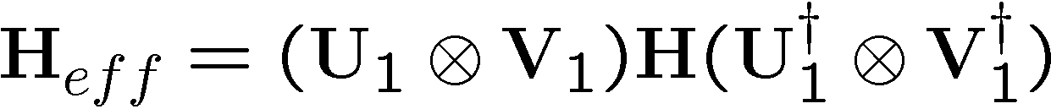

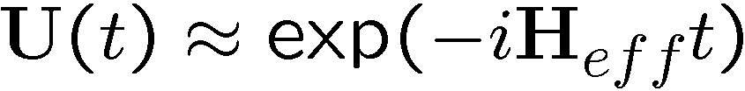
Bang and then Bang and then…
2.
3.
Engineered effective evolution
we control:
We have “symmetrized” the evolution

Slide 14

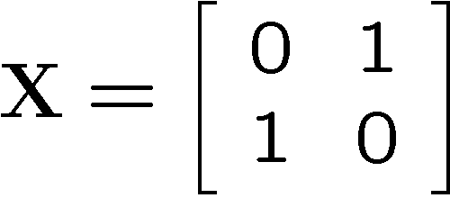

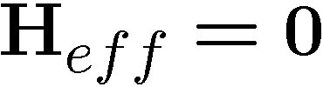
Decoupling
bare Hamiltonian:
system
environment
effective Hamiltonian:
Symmetrized evolutions can eliminate evolution
or
give interaction particular symmetry (DFS)

Slide 15
Go With the Flow
yes
Decoherence-Free
Subspace or Subsystem
Symmetry?
no
yes: engineer symmetry
Bath type in relation
to control speed?
non-Markovian
Control of limited form?
no
Markovian
Decouple Interaction
Quantum Error
Correction (QEC)
Failure modes
DFS: when symmetry is broken
Decoupling: not fast enough
higher-order interactions

Slide 16


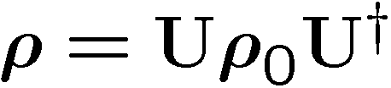
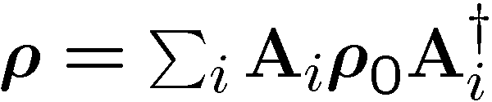

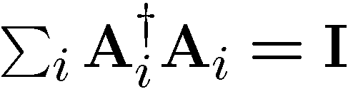
Quantum Error Correcting Symmetry
closed system evolution
open system evolution
generic
errors
spatially correlated
errors
independent
errors
no symmetry at all:
we are dead!
symmetry of single
qubit errors

Slide 17



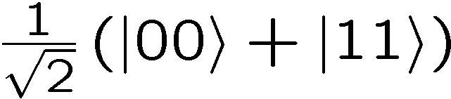
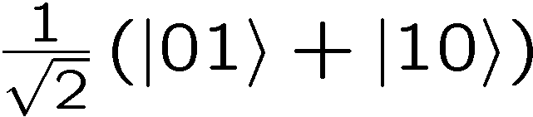
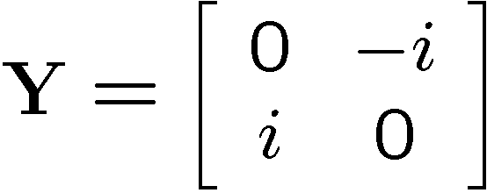

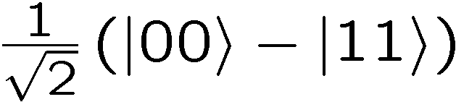
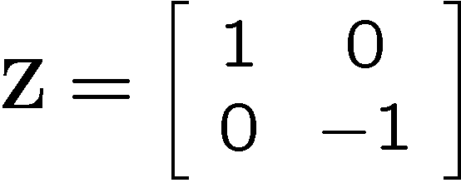
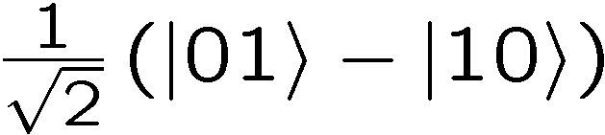



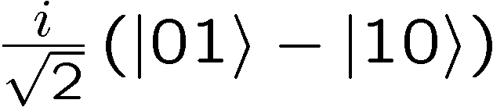


Single Qubit Symmetries
eigenstate
2 qubits
eigenstate:
orthogonal to
eigenstate
measuring
and
eigenstate:
detects single qubit errors

Slide 18






Quantum Error Correcting Code
[Shor, Calderbank, Steane, Lafflame, Knill, Gottesman, Bennett, DiVincenzo,
Smolin, Wootters...]
5 qubits
simultaneous +1 eigenvalues
NEWNESS
1.
encoded qubit
4 commuting operators
+1 eigenspace is two dimensional
2.
not only can we detect single qubit errors
we can detect where any single qubit error occurred

Slide 19








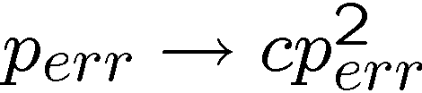
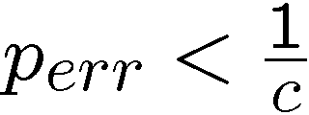
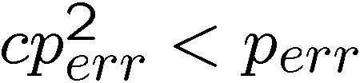
Quantum Error Correcting Cycle
encoded
qubit
single
qubit
error
diagnose
error
fix
error
hot
ancillas
cold
ancillas
syndrome:
a. where: 1,2,3,4, or 5
b. what:
probability of failure
unencoded
probability of failure
encoded (two qubit errors)
if improvement:

Slide 20

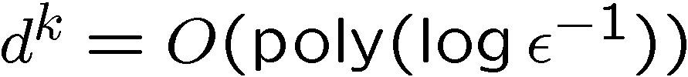
Concatenating for $$
k^{th} level
encoding
encode information which is itself encoded
(k-1)^{th} level
encoding
(k-2)^{th} level
encoding
1st level
encoding
error:
# qubits:
ultimate accuracy using qubits

Slide 21




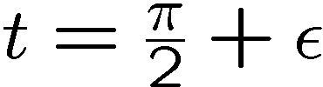
Fault-Tolerance
everything can fail:
unitary evolution used for error recovery
preparation of initial state
measurements (wrong result, wrong evolution)
loss of physical qubit
Example of fault-tolerance considerations:
Want gate to flip states:
extra evolution not fixable
extra evolution like single qubit errors!

Slide 22
Threshold Theorem
Fault Tolerant Quantum Computing is Possible!
[Shor, Gottesman, Preskill, Aharonov, Ben-Or, Kitaev, Knill, Laflamme, Zurek,
Terhal, Burkard, …]
Threshold Theorem:
If the error rate (typical number of operations per decoherence
time/ accuracy in quantum evolution / measurement error rate)
is smaller than a certain value (the threshold), then quantum
computation to arbitrary accuracy can be efficiently enacted.
QC
Error Rate
Quantum Computation is NOT Analog Computation

Slide 23
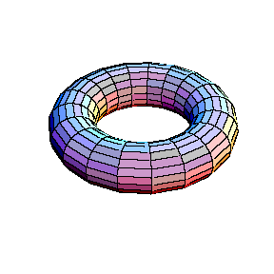






Topological Quantum Codes
[Kitaev, Preskill, Freedman, Meyer,…]
Concatentation is hierarchical solution to Threshold
Kitaev’s toric code
qubits on links
syndrome measurements local
information in topologically
nontrivial operators
planar codes also (torus not needed)
vertex operators
plaque operators

Slide 24
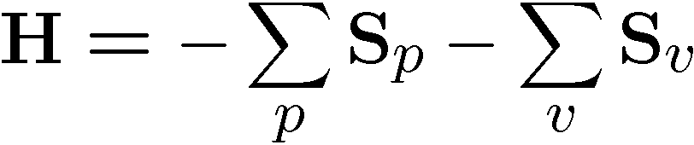
Natural Quantum Error Correction
[Kitaev]
qubits on links
ground state is gapped and is a
quantum error correcting code
vertex operators
plaque operators
Quantum error correction done naturally by the physics?

Slide 25
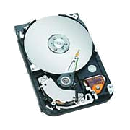
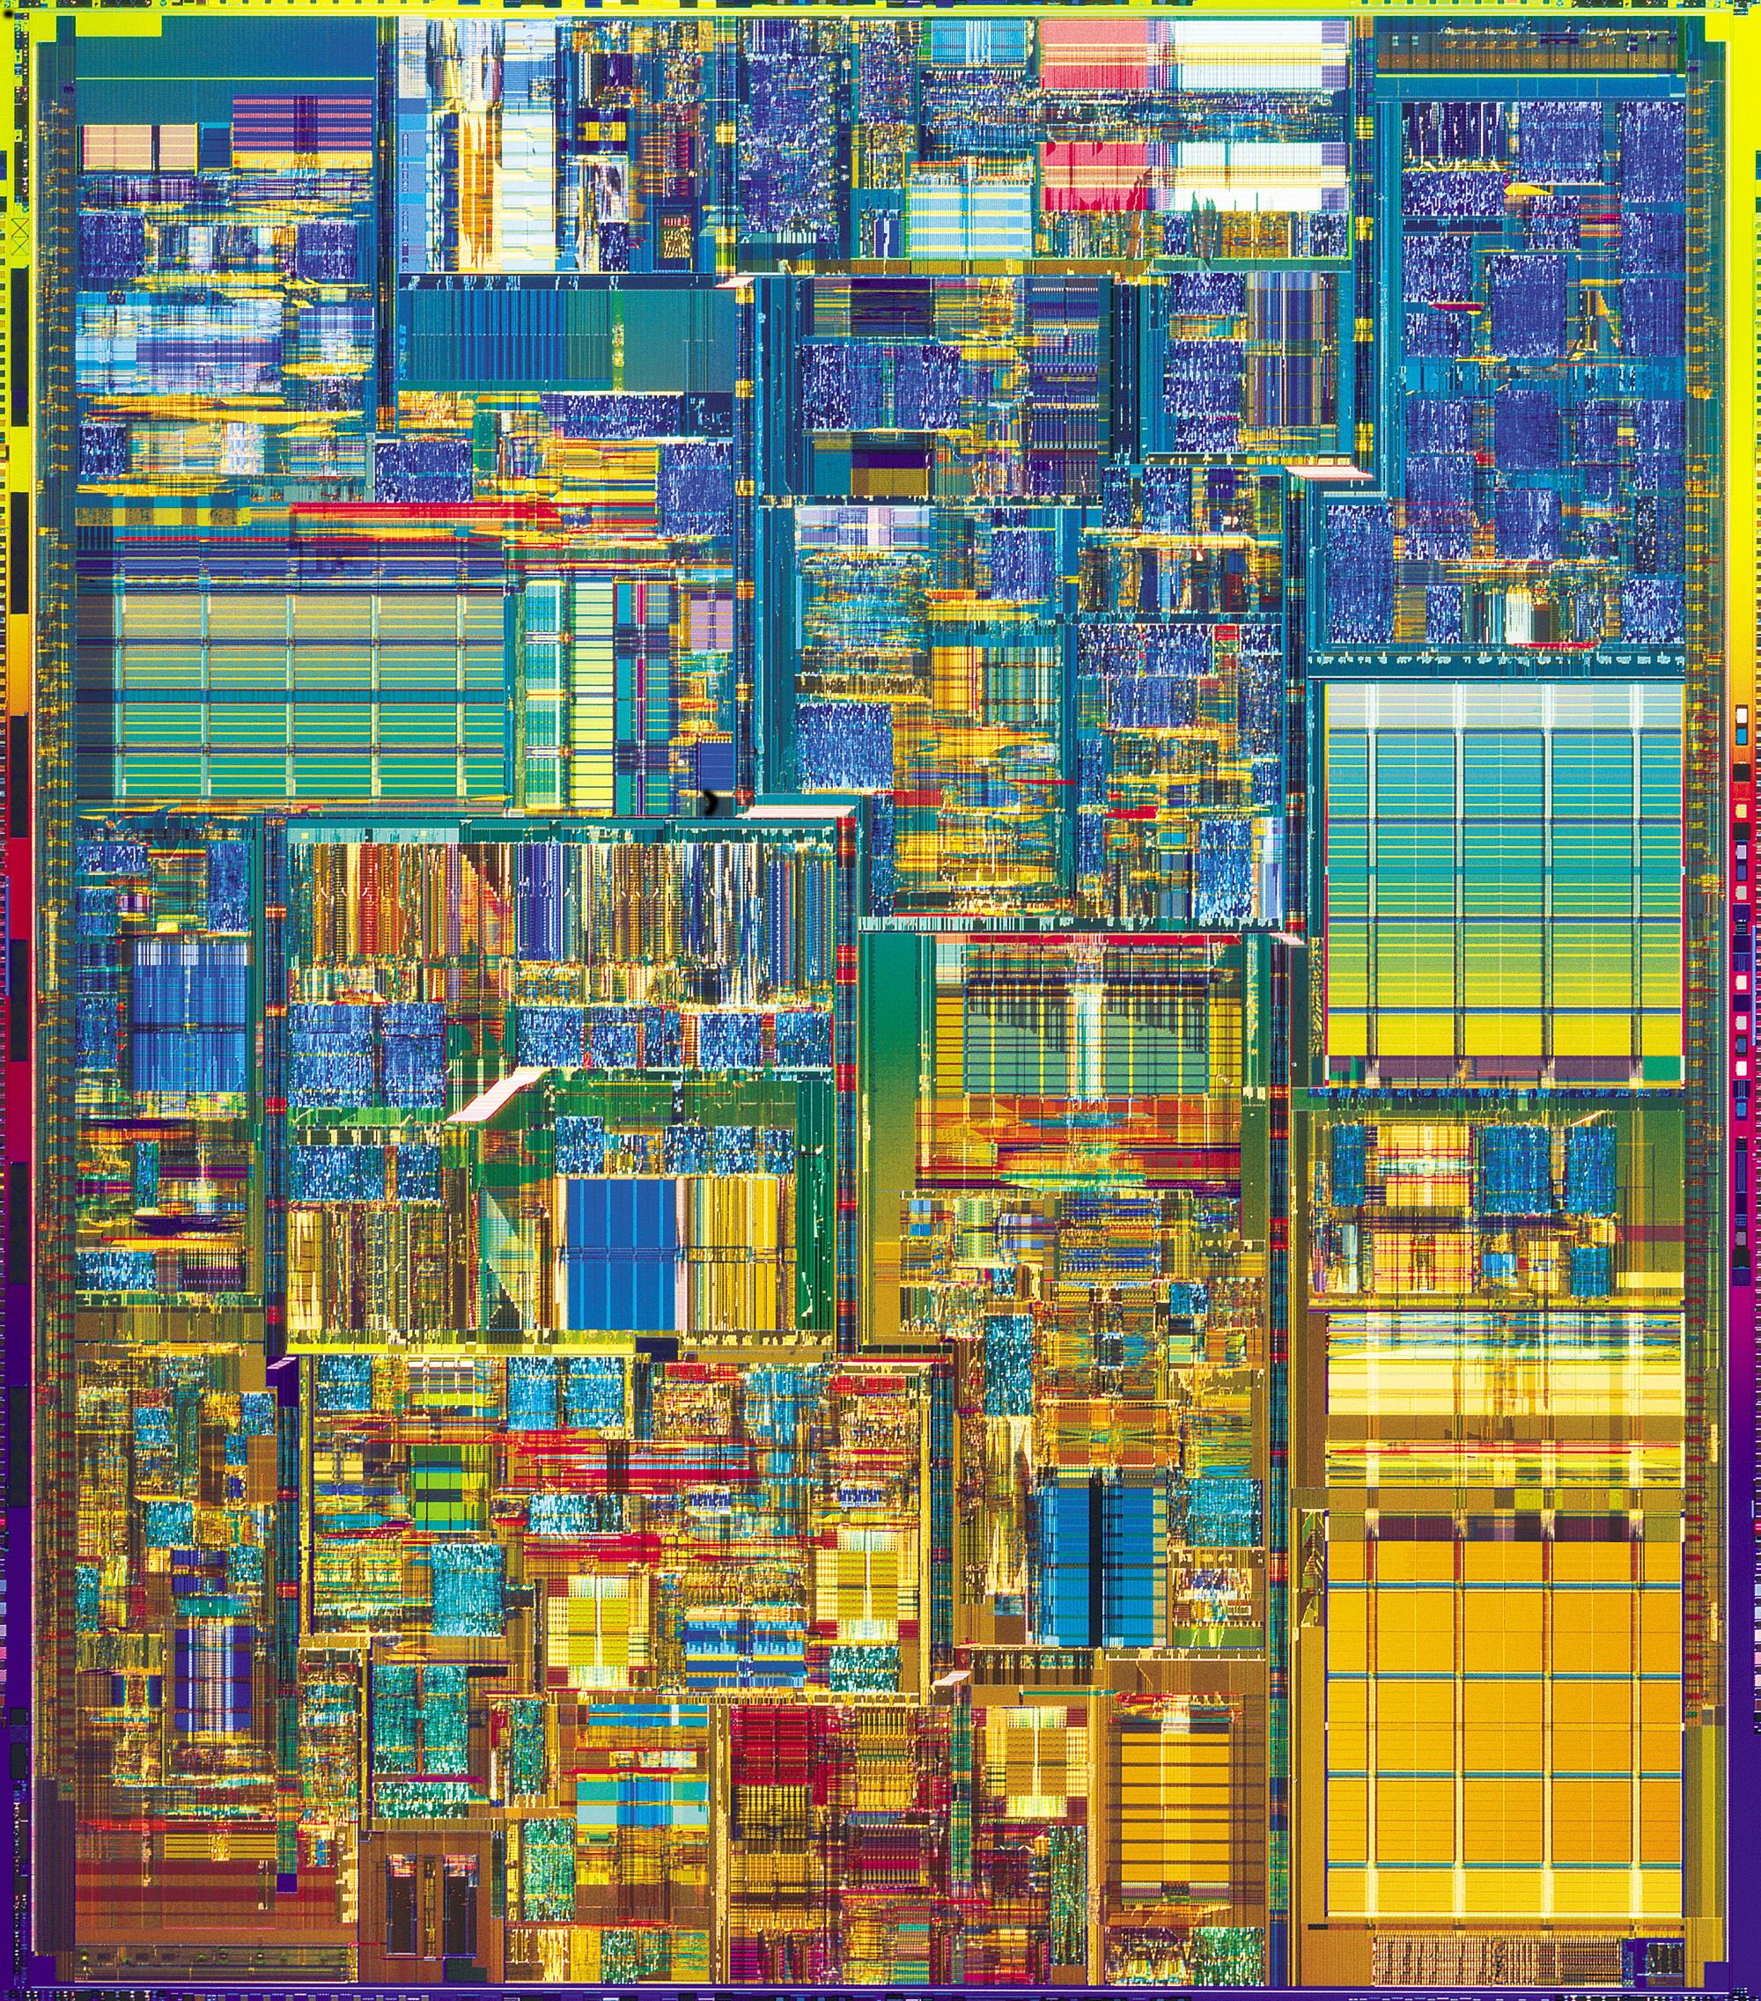
The Physics Guarantee
Rant mode ON
There are distinct PHYSICAL and DYNAMICAL reasons why
robust classical computation is possible.
not all physical systems are equally good for computation:
there exist systems whose PHYSICS guarantees
their ability to enact robust classical computation.
What is the phase of matter corresponding to the
quantum computer?
Are there (or can we engineer) physical systems whose
PHYSICS guarantees robust quantum computation?

Slide 26

Attack of the Theorists
Quantum Error Correction
Barbara Terhal (IBM)
Topological Codes
David Meyer (UC San Diego)
Decoherence-Free Methods and Decoupling Techniques
Daniel Lidar (Toronto)
Architectural Aspects of Ion Trap Quantum Computers
Isaac Chuang (MIT)
physics:
a.k.a. “the
real world”
robust
quantum
computation

