Slide 1
sihT esraP oT yrT

Slide 2
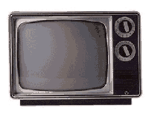
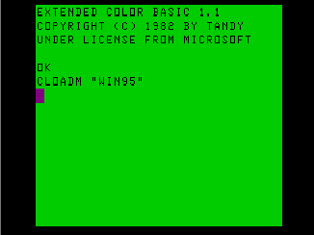
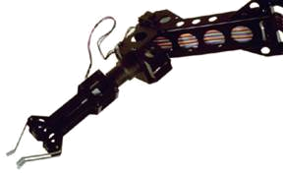
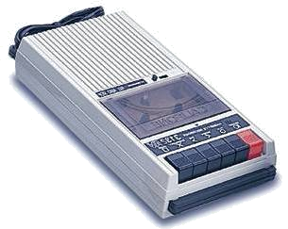

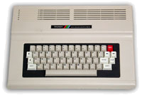
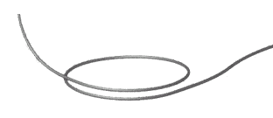


Quantum Computers
That Fix Themselves
Dave Bacon
Caltech
Department of Physics
Institute for Quantum Information

Slide 3
TRS-80 Color Computer II
The Trash 80
What happens when you try to
simulate orbits but you don’t know
trigonometry.

Slide 4
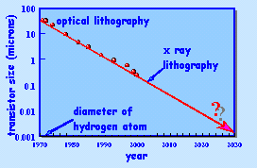
Quantum Machines
Moore’s Law
We are entering the age of quantum machines.

Slide 5
Outline
Introduction to Quantum Error Correction
A Supercoherent Qubit in an Ion Trap
An Interesting Spin Chain
Quantum Error Correcting Lattices
The Future

Slide 6
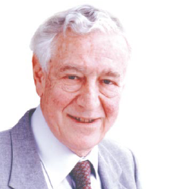
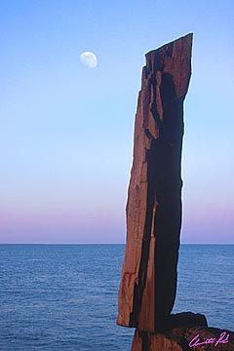
A Critical Ghost
All papers on quantum computing should carry a footnote: “This proposal, like all proposals for quantum computation, relies on speculative technology, does not in its current form take into account all possible sources of noise, unreliability and manufacturing error, and probably will not work.”
Rolf Landauer
IBM
Maintenance of giganto-coherence?
Faulty quantum gates?
Do we understand the physics of quantum errors in the system?
Nature abhors a quantum computer?

Slide 7

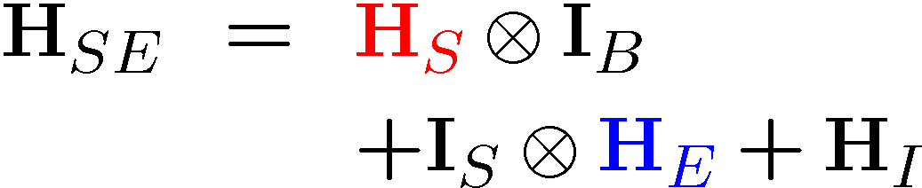


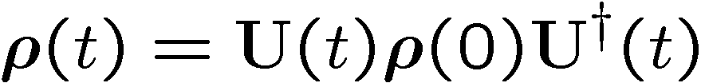
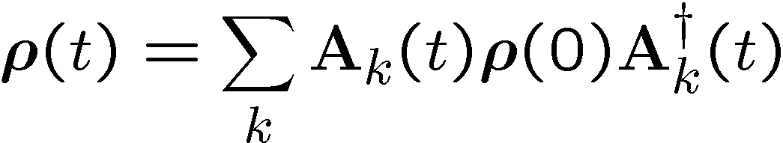
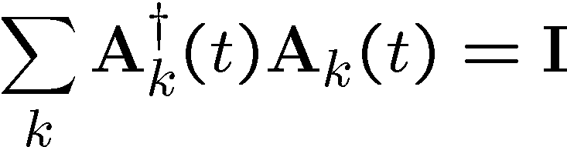
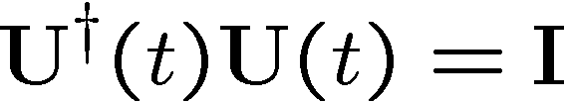
The Problem
T/F? The evolution of a quantum system is always unitary.
system
system
environment
Hamiltonian
Evolution

Slide 8
Evolution

Slide 9
Noisy Cell Phone
Hello? Hello? Hello? Hello?
I have a flat tire. I said, I have a flat tire! A flat tire.
No, I’m not trying to flatter you..No, you’re not getting fatter. I have a flat tire!
Communication over a noisy CHANNEL can be overcome via
ENCODING
“Hello?” = “Hello? Hello? Hello? Hello?” [using redundancy to encode “Hello”]

Slide 10
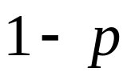




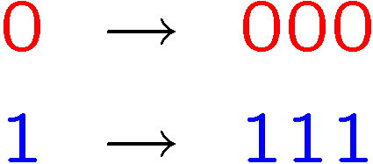








Classical Error Correction
0
0
b
1
1
1 bit
measure
Binary Symmetric Channel
Probability of error
Decode and correct:
Encode:
b
encode
b
b
b
decode
and correct
1 bit
3 bits
measure
Probability of error

Slide 11
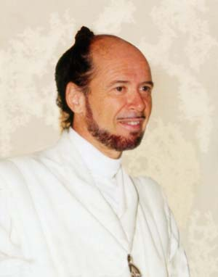





Reason to be a Pessimist
No cloning:
Quantum Cloning Machine
“A single quantum cannot be cloned,” Wootters and Zurek, Nature, 1982
No quantum repetition code:

Slide 12


Unrealistic Realistic Channel

Slide 13
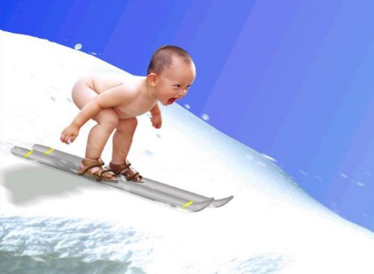
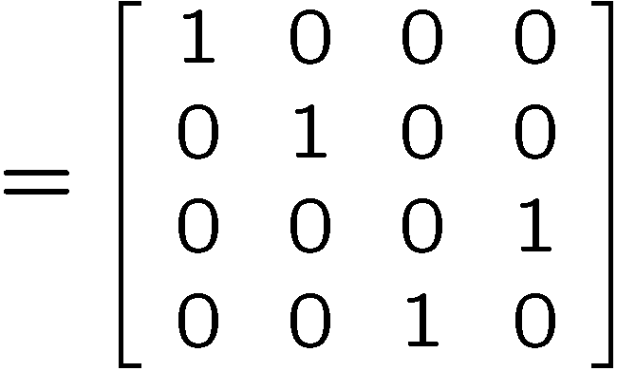
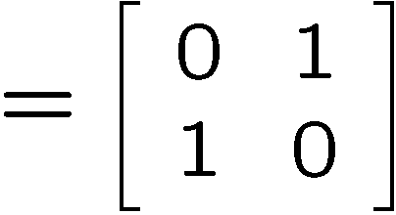
Baby Steps
WWCCD? (What Would Classical Coders Do?)
measure
b
b
0 →000, 1 → 111
0
b
0
b
encode
error
decode
fix
100 → 111→101 → 110 → 110
identities
b
b
=
b
1
0
1
1
1
=
0
error #@%

Slide 14



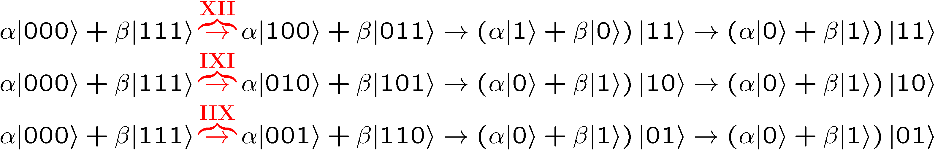
Naïve
4. operator identities still hold
Lets be naïve, take classical and move over to quantum
encode
error
decode fix
?
error
decode
fix
encoded into subspace:
2. errors take to orthogonal
subspaces + maintain orthogonality
3. syndrome
(no-cloning evaded!)

Slide 15






Identity
encode
error
decode fix

Slide 16
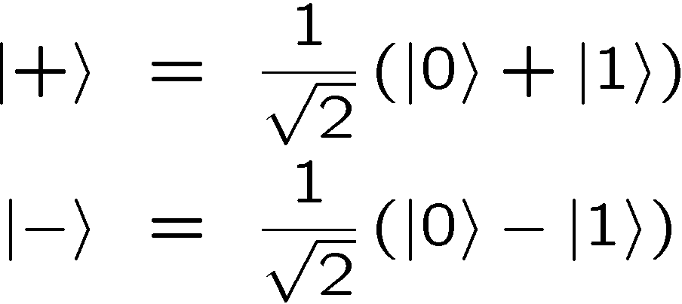
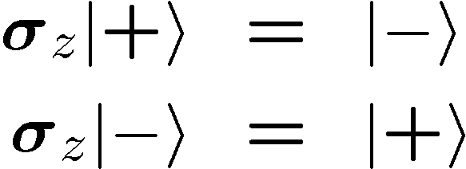


OK Wise Guy
What about “phase” errors?
…sort of not classical error
phase error:
Wise guy says “basis change please”:
looks like bit flit error in this new basis!
H
H
H
H
H
H
phase errors
bit flip errors

Slide 17
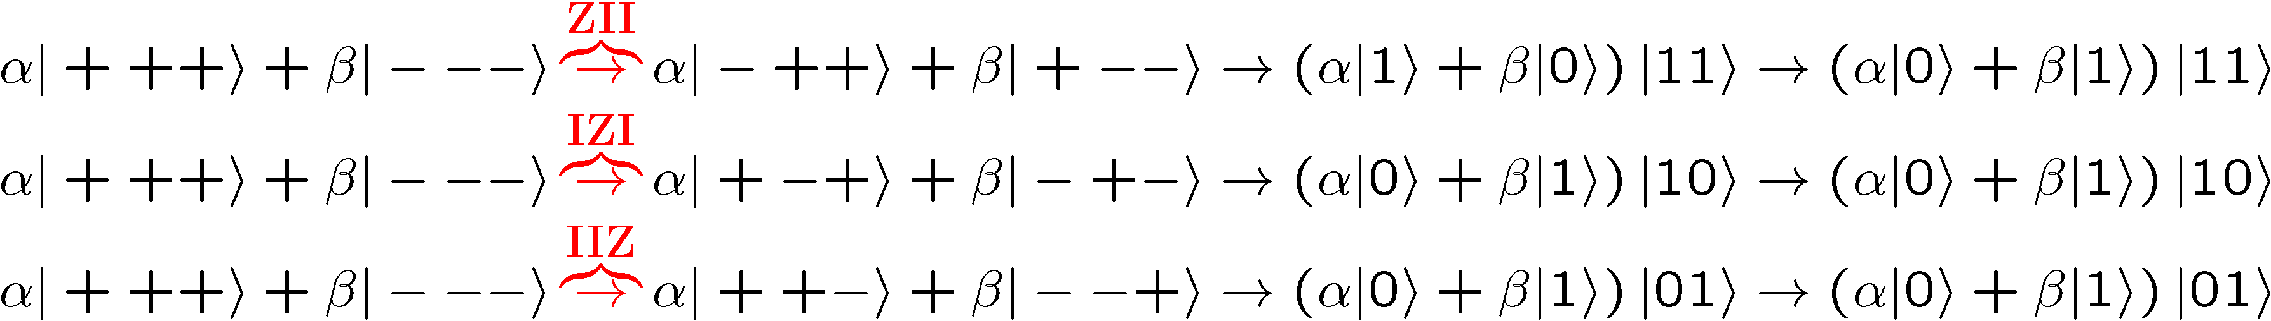
Molly: “I love you, I really love you”
Sam: “Ditto.”
encode
error
decode
fix
H
H
?
H
H
H
H
error
decode
fix
encoded into subspace:
2. errors take to orthogonal
subspaces + maintain orthogonality
3. syndrome
(no-cloning evaded!)

Slide 18


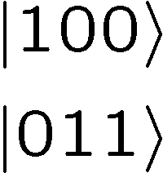




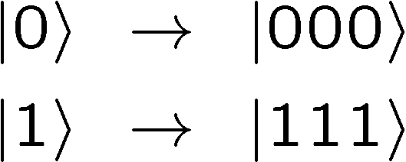

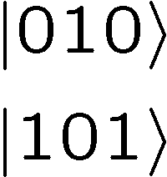



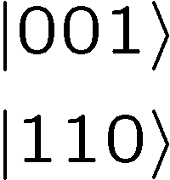

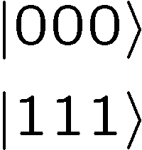
Perspective
Orthogonal subspaces can be distinguished by measurements
without measuring information encoded into the subspace!!!

Slide 19


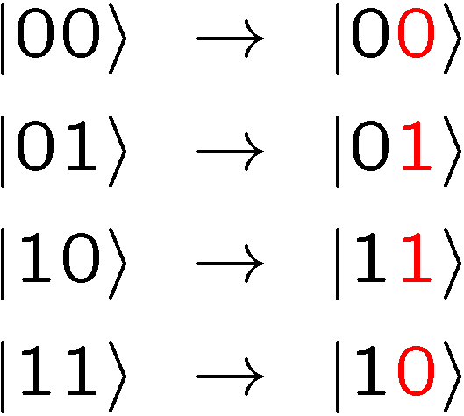
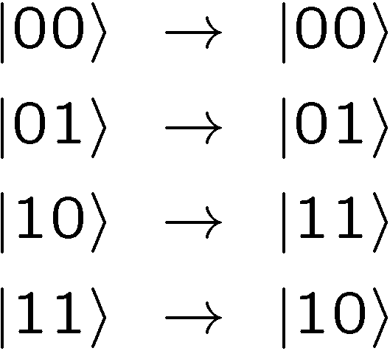



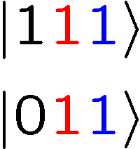
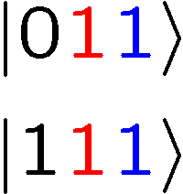
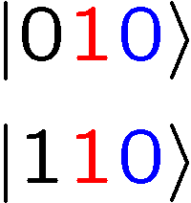
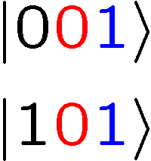
Not An Optical Illusion
fix
error

Slide 20
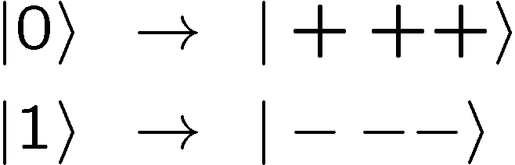


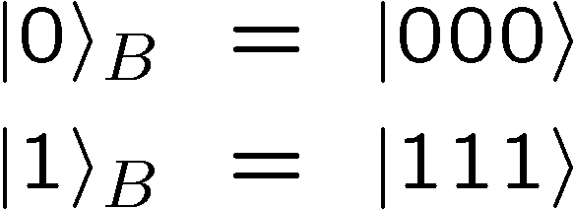
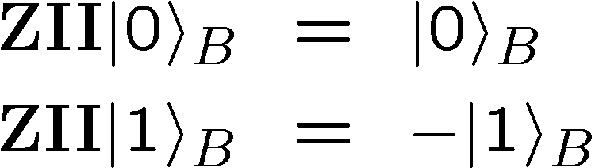
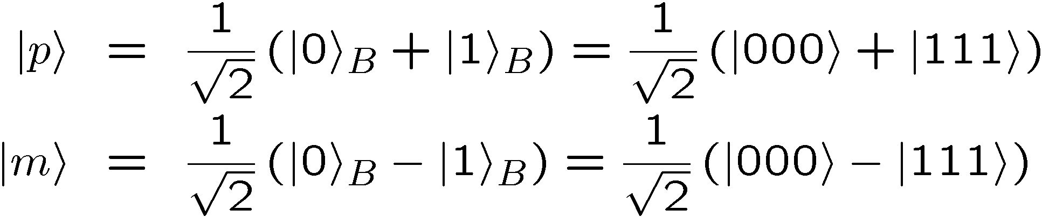
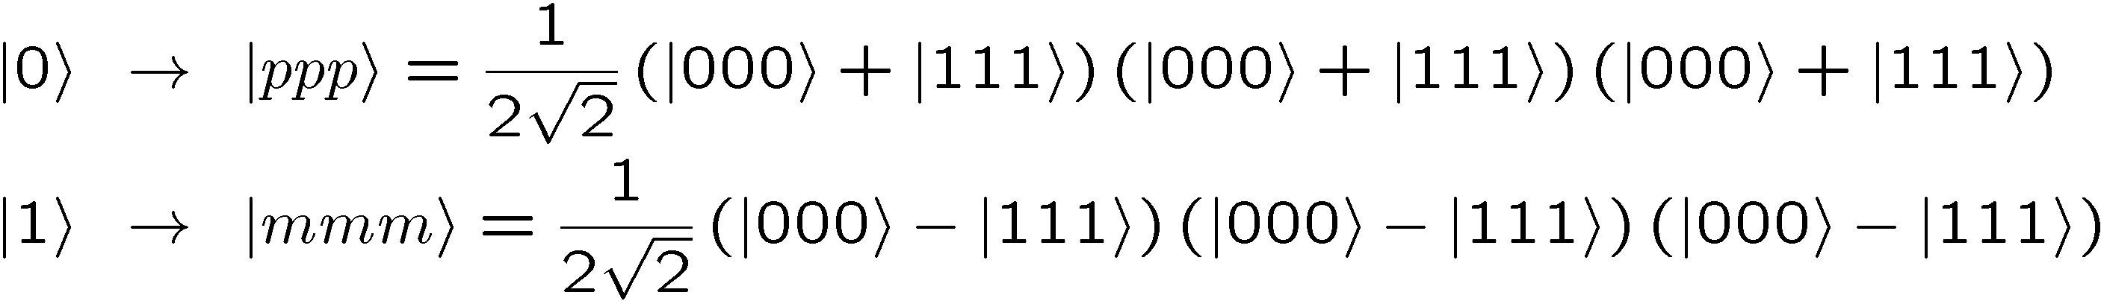
Encoding Away Your Ills
3 qubit bit flip code
3 qubit phase flip code
phase errors act as on bit flip code qubits:
define:
Shor Code: (Peter Shor, 1995)

Slide 21
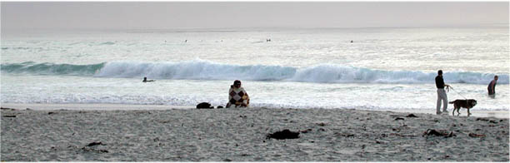


Inside Shor
H
H
H
H
H
H
bit flip code
phase flip code

Slide 22
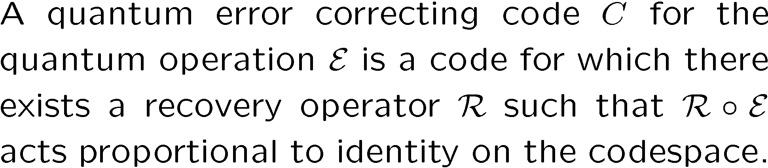
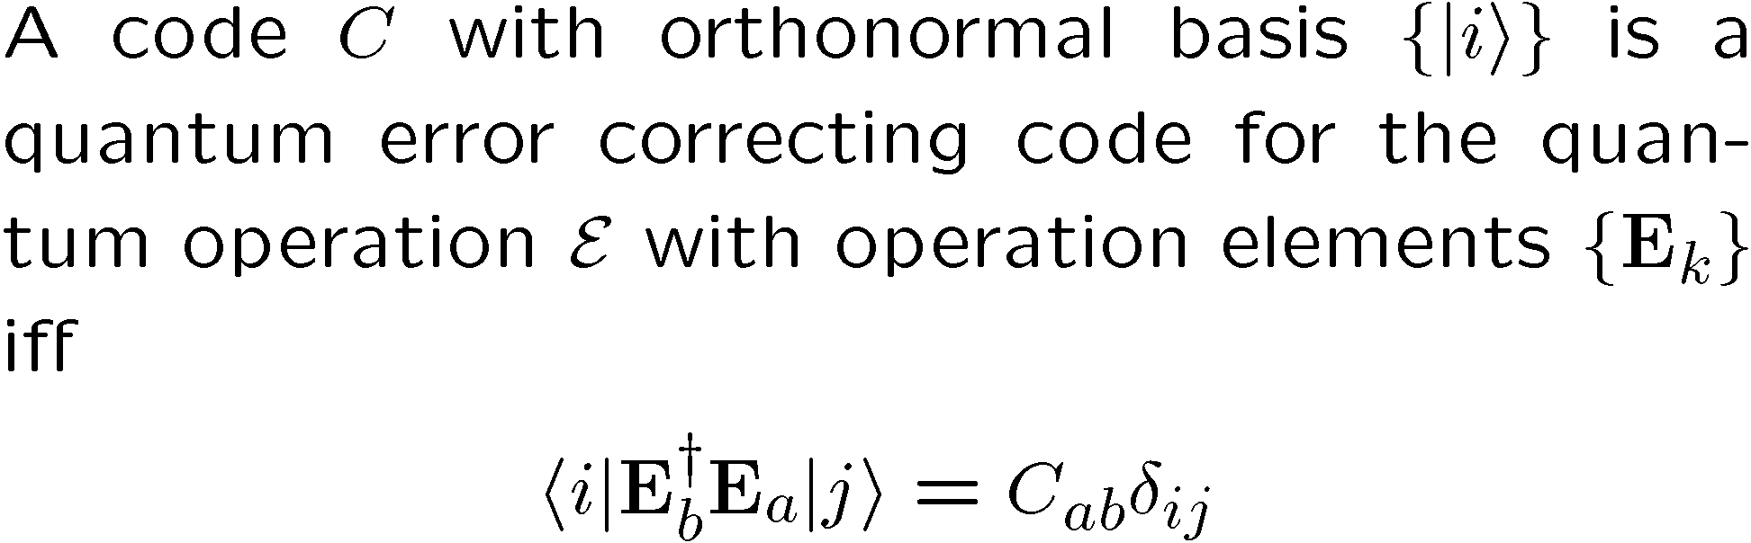
Lets Get Definitional
Quantum Error Correcting Code
Iff Condition for Quantum Error Correcting Code

Slide 23
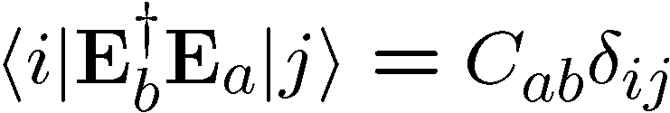


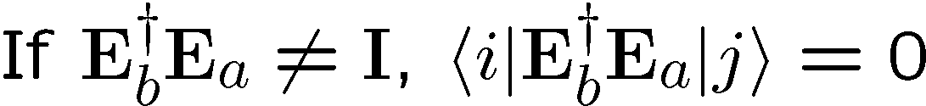
In Action

Slide 24
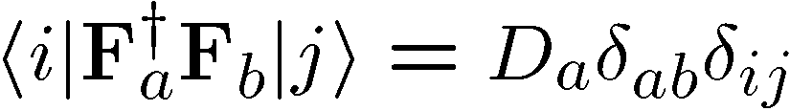
Pictures
Orthogonality maintained
Orthogonality not maintained
codespace
Orthogonal subspaces
Errors not distinguishable
BAD
GOOD

Slide 25

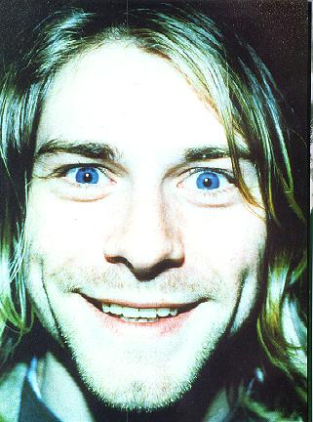

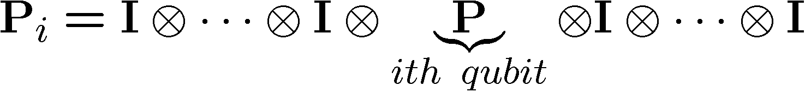

Pauli Want a Cracker?

Slide 26
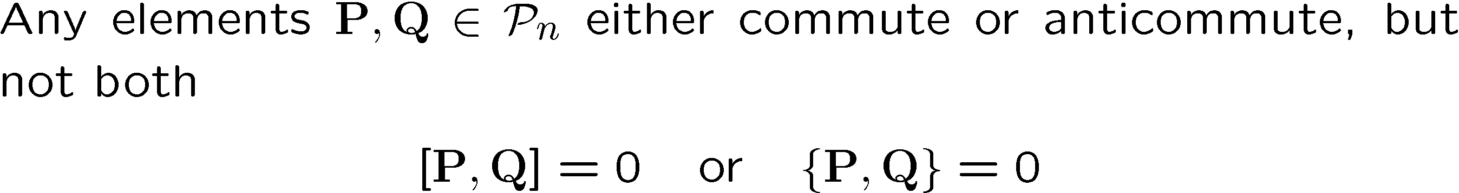



Pauli Group Facts

Slide 27
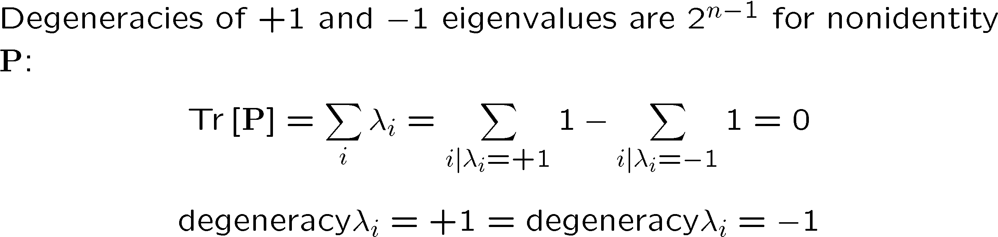




Set Your Square Phasors to +1

Slide 28




Abelian not Reptilian

Slide 29


Pauli Stabilizer Code

Slide 30



Truth By Example

Slide 31



Sizing Up The Code

Slide 32







Stabilizer Subspaces

Slide 33


Stabilizer Nerror

Slide 34








Surfing The Subspaces

Slide 35



Unsurfing The Subspaces

Slide 36
Examples

Slide 37



Supercoherence
4 qubit system
1
XX
2
ZZ
ZZ
4
XX
3
System Hamiltonian:

Slide 38
























Slide 39

Supercoherence
ALL single qubit errors take degenerate ground state to higher energy levels.
Single qubit errors change value of (S₁,S₂) and hence take ground state to higher energy level.
FORBIDDEN
D. Bacon, Ph.D. thesis, U.C. Berkeley, 2001

Slide 40



Ladder Qubits
1
2
1
2
i-1
i
i+1
n-3
n-2
n-1
n
qubit (i,1)
qubit (i,2)
The Hamiltonian
X X
X X
X X
Z Z
Z Z
D. Bacon, Ph.D. thesis, U.C. Berkeley, 2001
X X
X X
X X

Slide 41





Basis Change
X X
X X
X X
Z Z
Z Z
1
New basis:
X X
X X
X X
2
i
i+1

Slide 42



Everybody’s Favorite
transverse
field
only
transverse
field
only
Ising + transverse field
Ising + transverse field

Slide 43








Grounded
Ground state is two-fold degenerate
1
X
X
2
k
Z Z Z

Slide 44











Detect and Correct
X X
X X
X X
Z Z
Z Z
X X
X X
X X

Slide 45




Into the 2nd Dimension
j-1
j
j+1
i-1
XX
XX
ZZ
ZZ
ZZ
i
XX
XX
ZZ
ZZ
ZZ
i+1
XX
XX

Slide 46



Tic-Tac-“DOH!”
XX
ZZ
XX
XX
XX
ZZ
ZZ
ZZ
ZZ
XX
XX
XX
ZZ
ZZ
ZZ
ZZ
XX
XX
XX

Slide 47

Loading 3x3
j-1
j
j+1
i-1
ZZ
ZZ
ZZ
ZZ
ZZ
i
ZZ
ZZ
ZZ
ZZ
ZZ
i+1
ZZ
ZZ
x
j-1
j
j+1
i-1
XX
XX
ZZ
ZZ
ZZ
i
XX
XX
ZZ
ZZ
ZZ
i+1
XX
XX

Slide 48





Into the Third Dimension
YY
ZZ
XX
ZZ
XX
YY
YY
ZZ
ZZ
XX
XX
YY
YY
ZZ
XX

Slide 49



Logical Operators

Slide 50


Errors
j-1
j
j+1
i-1
YY
YY
ZZ
ZZ
ZZ
i
YY
YY
ZZ
ZZ
ZZ
i+1
YY
YY

Slide 51




Order Parameter and Beyond
stabilizer
Logical qubit
Hamiltonian
Subsystem code:
This allows us to write down a subsystem order parameter.
Current project: Quantum Monte Carlo for this order parameter.

Slide 52
Fin
Error correcting codes
Geometry, Topology
classical
quantum
Statistical Physics
theory of strongly interacting
quantum systems
Fault-tolerance
local structures giving rise
to global robustness (CA)
Real Physics
physical implementation
optical lattices, squids, donor electrons, etc.
Representation theory
identification of qubits
and logic
Naturally Fault-Tolerant Quantum Computation

Slide 53


Quantum
Error
Correction!
Rolf Landauer
IBM
Threshold Theorem for Fault-Tolerant Quantum Computation

