Slide 1
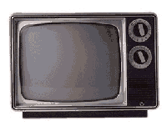
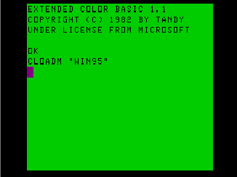
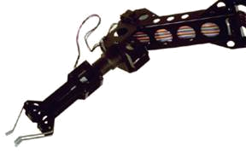
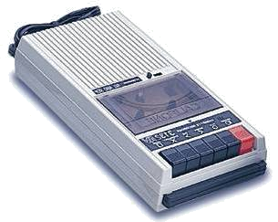

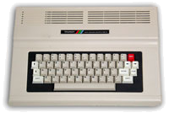
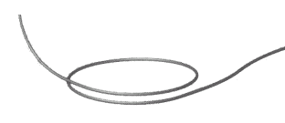


Quantum Computers
That Fix Themselves
Dave Bacon
Caltech
Department of Physics
Institute for Quantum Information

Slide 2
Outline
Introduction to Quantum Error Correction
A Supercoherent Qubit in an Ion Trap
A Supercoherent Qubit in the Solid State
An Interesting Spin Chain
Quantum Error Correcting Lattices
The Future

Slide 3
The Problem
Quantum systems are immensely fragile systems

Slide 4
Noisy Cell Phone
Hello? Hello? Hello? Hello?
I have a flat tire. I said, I have a flat tire! A flat tire.
No, I’m not trying to flatter you..No, you’re not getting fatter. I have a flat tire!
Communication over a noisy CHANNEL can be overcome via
ENCODING
“Hello?” = “Hello? Hello? Hello? Hello?” [using redundancy to encode “Hello”]

Slide 5
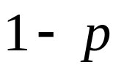




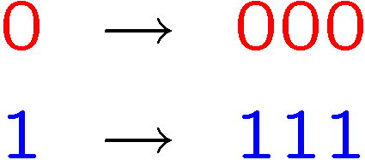








Classical Error Correction
0
0
b
1
1
1 bit
measure
Binary Symmetric Channel
Probability of error
Decode and correct:
Encode:
b
encode
b
b
b
decode
and correct
1 bit
3 bits
measure
Probability of error

Slide 6
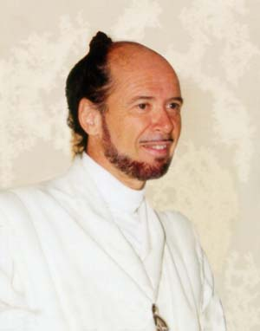





Reasons to be a Pessimist
No cloning:
Quantum Cloning Machine
“A single quantum cannot be cloned,” Wootters and Zurek, Nature, 1982
No quantum repetition code:
Measurement destroys coherence:
How can one decode without destroying the information?

Slide 7


Unrealistic Realistic Channel

Slide 8
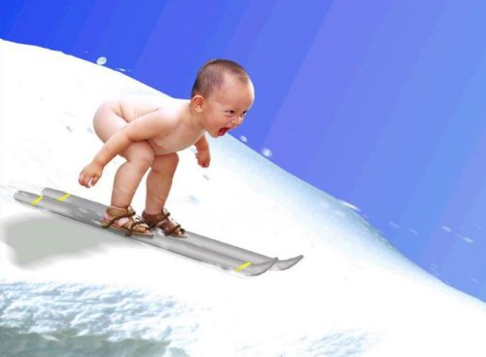
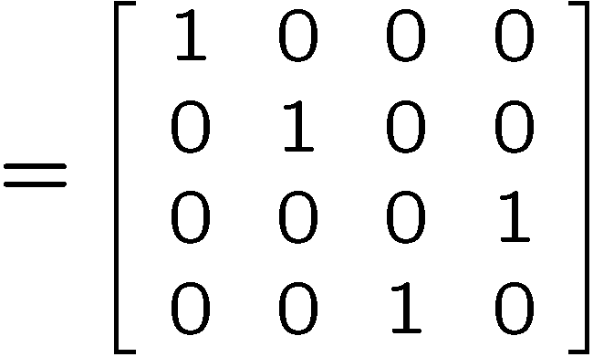
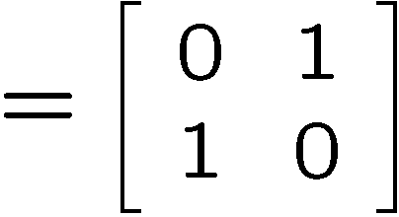
Baby Steps
WWCCD? (What Would Classical Coders Do?)
measure
b
b
0 →000, 1 → 111
0
b
0
b
encode
error
decode
fix
100 → 111→101 → 110 → 110
identities
b
b
=
b
1
0
1
1
1
=
0
error #@%

Slide 9



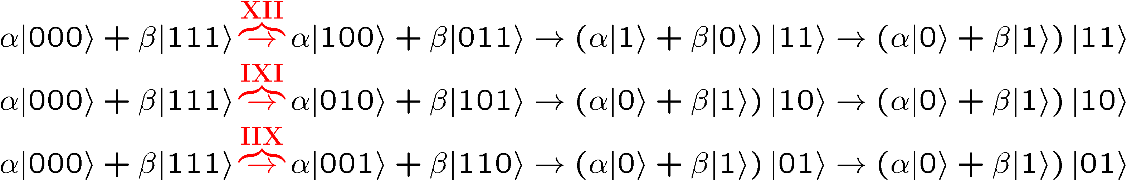
Naïve
4. operator identities still hold
Lets be naïve, take classical and move over to quantum
encode
error
decode fix
?
error
decode
fix
encoded into subspace:
2. errors take to orthogonal
subspaces + maintain orthogonality
3. syndrome
(no-cloning evaded!)

Slide 10






Identity
encode
error
decode fix

Slide 11
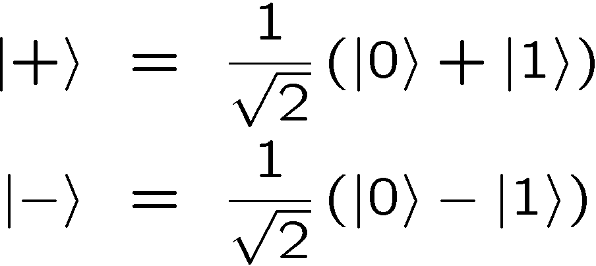
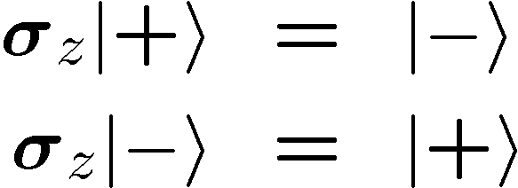


OK Wise Guy
What about “phase” errors?
…sort of not classical error
phase error:
Wise guy says “basis change please”:
looks like bit flit error in this new basis!
H
H
H
H
H
H
phase errors
bit flip errors

Slide 12
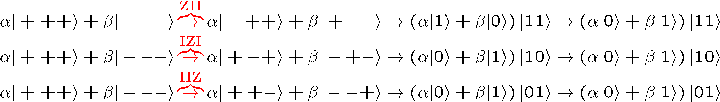
Molly: “I love you, I really love you”
Sam: “Ditto.”
encode
error
decode
fix
H
H
?
H
H
H
H
error
decode
fix
encoded into subspace:
2. errors take to orthogonal
subspaces + maintain orthogonality
3. syndrome
(no-cloning evaded!)

Slide 13


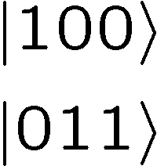




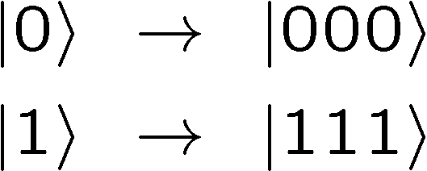

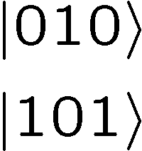



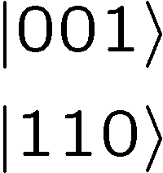

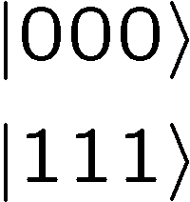
Perspective
Orthogonal subspaces can be distinguished by measurements
without measuring information encoded into the subspace!!!

Slide 14


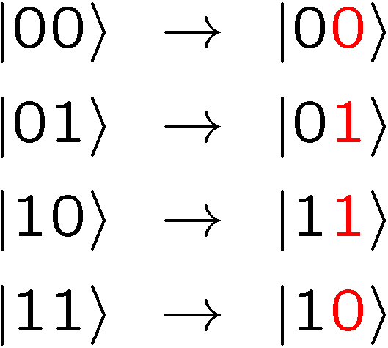
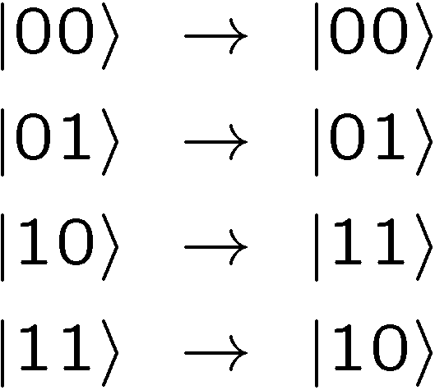



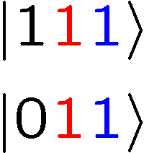
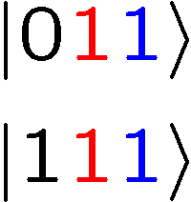
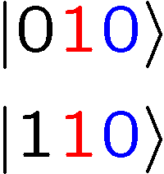
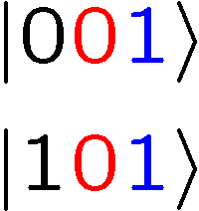
Not An Optical Illusion
fix
error

Slide 15
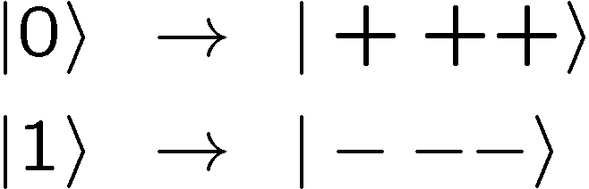


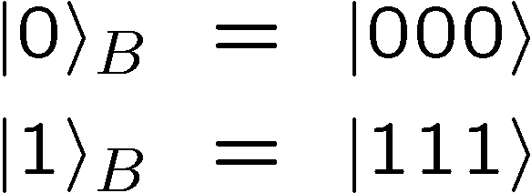
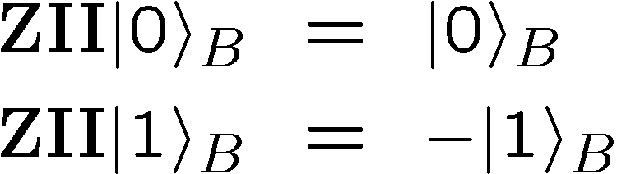
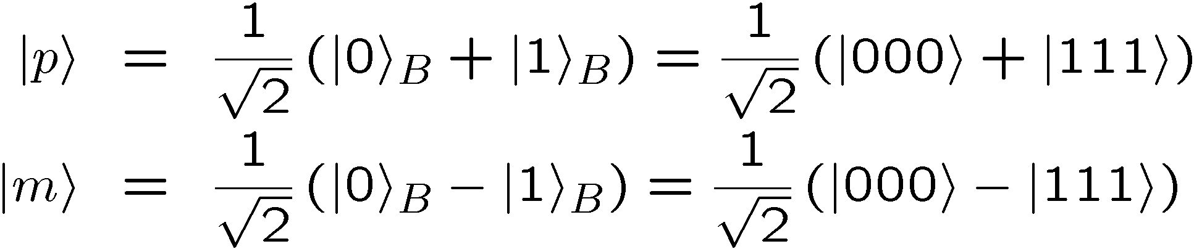
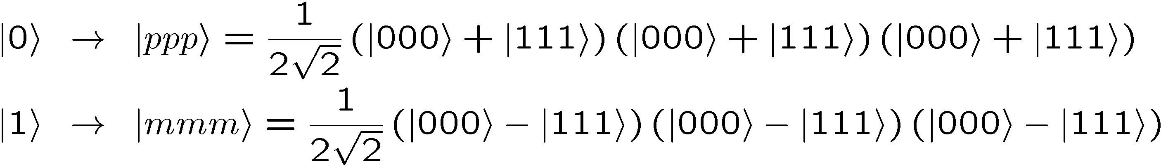
Encoding Away Your Ills
3 qubit bit flip code
3 qubit phase flip code
phase errors act as on bit flip code qubits:
define:
Shor Code: (Peter Shor, 1995)

Slide 16
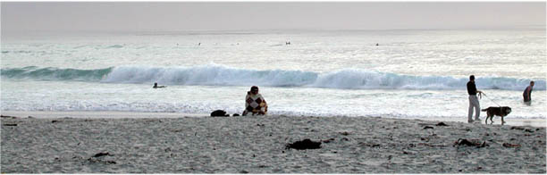


Inside Shor
H
H
H
H
H
H
bit flip code
phase flip code

Slide 17
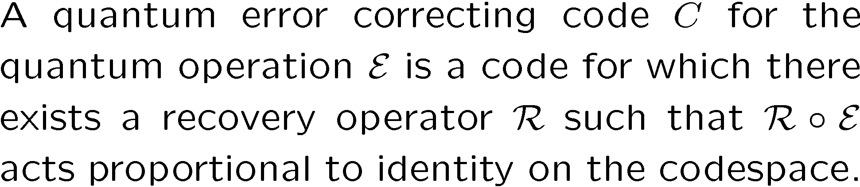
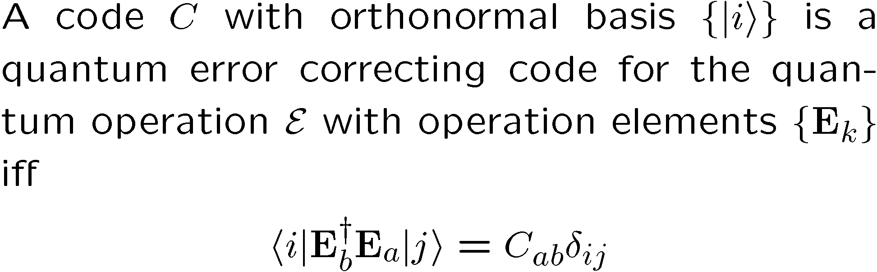
Lets Get Definitional
subsystem
Quantum Error Correcting Code
Iff Condition for Quantum Error Correcting Code

Slide 18
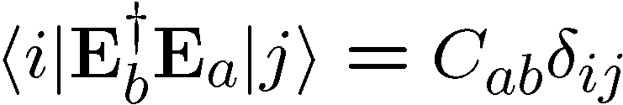


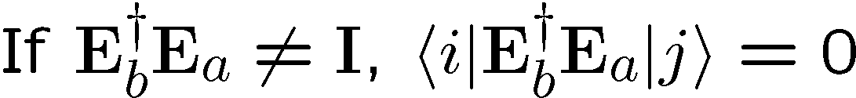
In Action

Slide 19
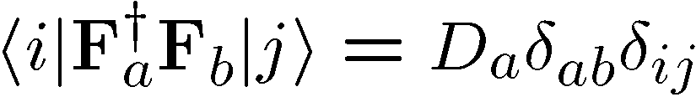
Pictures
Orthogonality maintained
Orthogonality not maintained
codespace
Orthogonal subspaces
Errors not distinguishable
BAD
GOOD

Slide 20



Supercoherence
4 qubit system
1
XX
2
ZZ
ZZ
4
XX
3
System Hamiltonian:

Slide 21
























Slide 22

Supercoherence
ALL single qubit errors take degenerate ground state to higher energy levels.
Single qubit errors change value of (S₁,S₂) and hence take ground state to higher energy level.
FORBIDDEN
D. Bacon, Ph.D. thesis, U.C. Berkeley, 2001

Slide 23
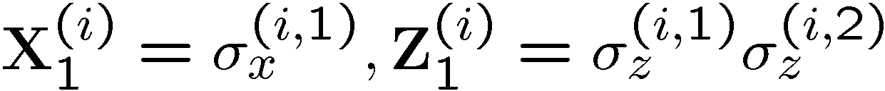
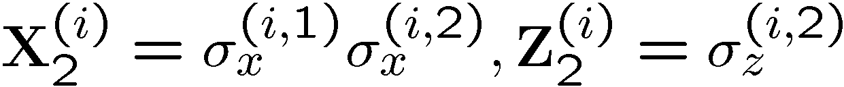
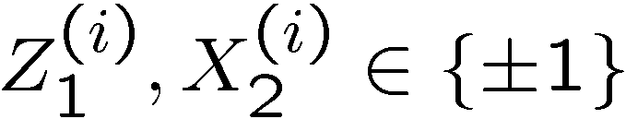
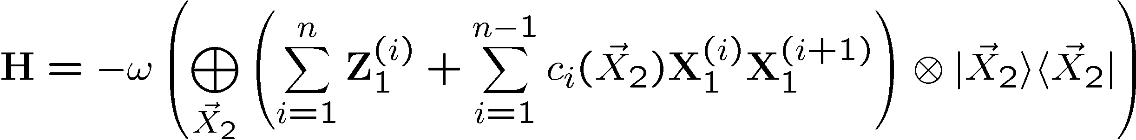
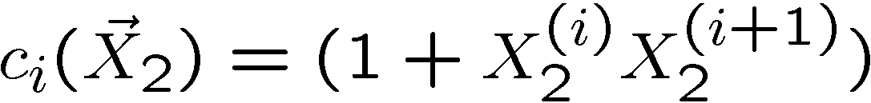
Basis Change
X X
X X
X X
Z Z
Z Z
1
New basis:
X X
X X
X X
2
i
i+1

Slide 24
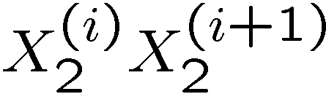
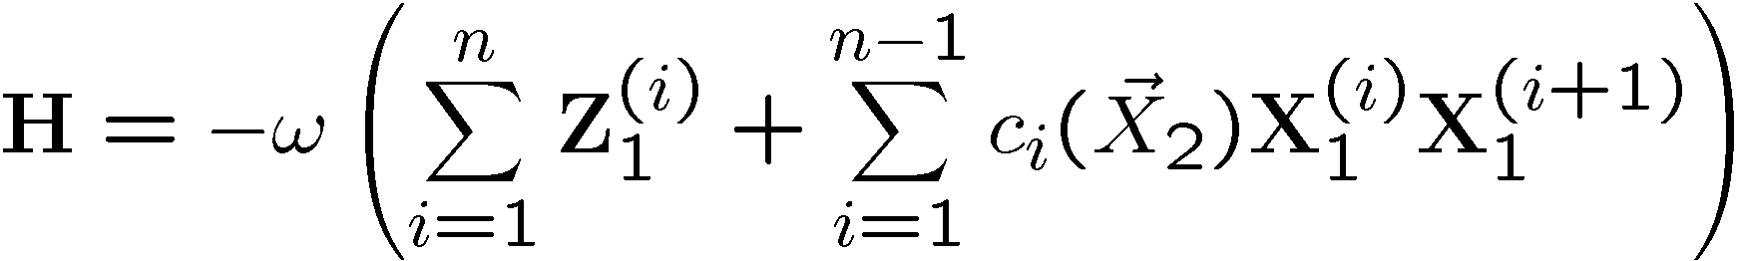
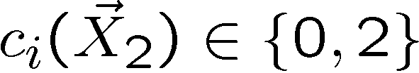
Everybody’s Favorite
transverse
field
only
transverse
field
only
Ising + transverse field
Ising + transverse field

Slide 25
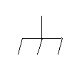

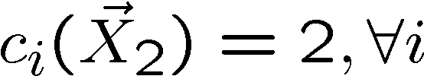
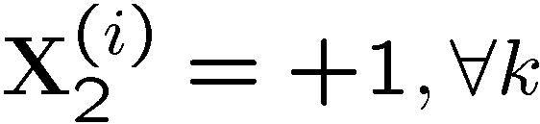
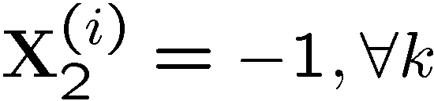



Grounded
Ground state is two-fold degenerate
1
X
X
2
k
Z Z Z

Slide 26











Detect and Correct
X X
X X
X X
Z Z
Z Z
X X
X X
X X

Slide 27




Into the 2nd Dimension
j-1
j
j+1
i-1
XX
XX
ZZ
ZZ
ZZ
i
XX
XX
ZZ
ZZ
ZZ
i+1
XX
XX

Slide 28



Tic-Tac-“DOH!”
XX
ZZ
XX
XX
XX
ZZ
ZZ
ZZ
ZZ
XX
XX
XX
ZZ
ZZ
ZZ
ZZ
XX
XX
XX

Slide 29

Loading 3x3
j-1
j
j+1
i-1
ZZ
ZZ
ZZ
ZZ
ZZ
i
ZZ
ZZ
ZZ
ZZ
ZZ
i+1
ZZ
ZZ
x
j-1
j
j+1
i-1
XX
XX
ZZ
ZZ
ZZ
i
XX
XX
ZZ
ZZ
ZZ
i+1
XX
XX

Slide 30





Into the Third Dimension
YY
ZZ
XX
ZZ
XX
YY
YY
ZZ
ZZ
XX
XX
YY
YY
ZZ
XX

Slide 31



Logical Operators

Slide 32


Errors
j-1
j
j+1
i-1
YY
YY
ZZ
ZZ
ZZ
i
YY
YY
ZZ
ZZ
ZZ
i+1
YY
YY

Slide 33




Order Parameter and Beyond
stabilizer
Logical qubit
Hamiltonian
Subsystem code:
This allows us to write down a subsystem order parameter.
Current project: Quantum Monte Carlo for this order parameter.

Slide 34
Fin
Error correcting codes
Geometry, Topology
classical
quantum
Statistical Physics
theory of strongly interacting
quantum systems
Fault-tolerance
        local structures giving rise
to global robustness (CA)
Real Physics
physical implementation
optical lattices, squids, donor electrons, etc.
Representation theory
identification of qubits
and logic
Naturally Fault-Tolerant Quantum Computation

