Slide 1
sihT esraP oT yrT

Slide 2

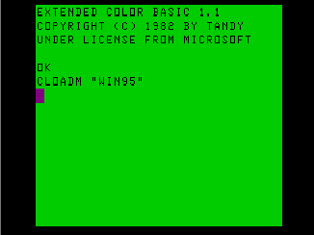
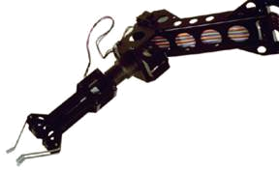
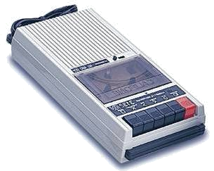

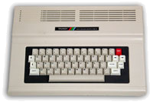
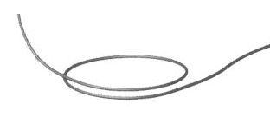


Quantum Computers
That Fix Themselves
Dave Bacon
Caltech
Department of Physics
Institute for Quantum Information

Slide 3
TRS-80 Color Computer
The Trash 80
What happens when you try to
simulate orbits but you don’t know
trigonometry (circa 1984)

Slide 4
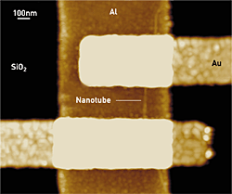
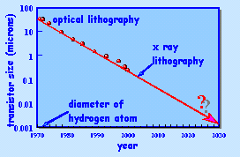
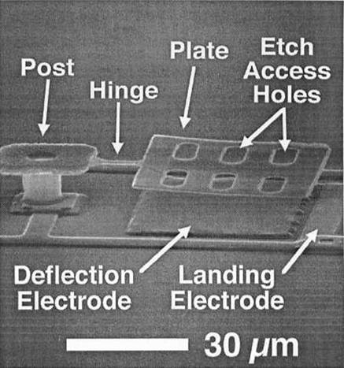
Quantum Machines
Dekker, Delft University
Molecular Transistors
Moore’s Law
ICL, Stanford University
MEMS
The coming of the age of quantum machines.

Slide 5
Outline
Introduction to Quantum Error Correction
Stabilizer Codes
Quantum Codes in Physical Systems
The Future

Slide 6
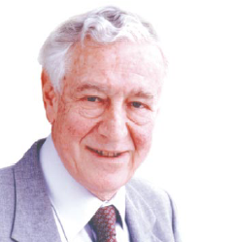
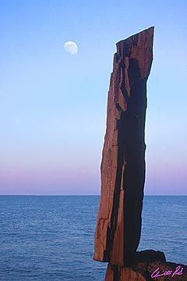
A Critical Ghost
All papers on quantum computing should carry a footnote: “This proposal, like all proposals for quantum computation, relies on speculative technology, does not in its current form take into account all possible sources of noise, unreliability and manufacturing error, and probably will not work.”
Rolf Landauer
IBM
Get around Landauer’s objections by finding systems which naturally enact quantum error correction.
Nature abhors a quantum computer?

Slide 7

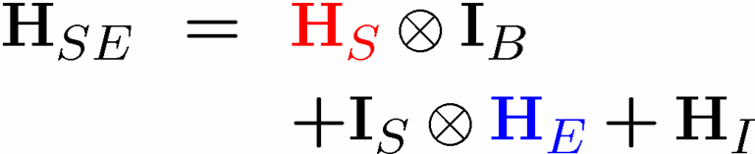



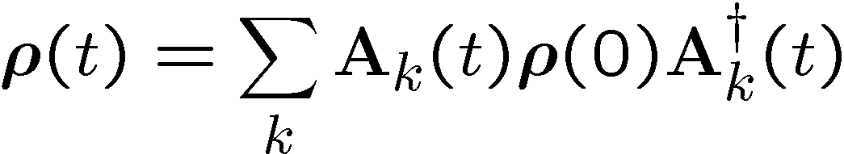

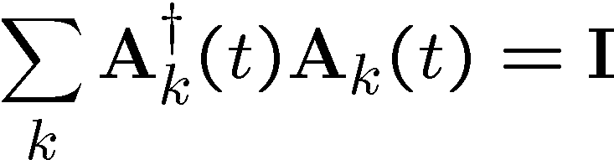
The Problem
T/F? The evolution of a quantum system is always unitary.
system
system
environment
Hamiltonian
Evolution

Slide 8


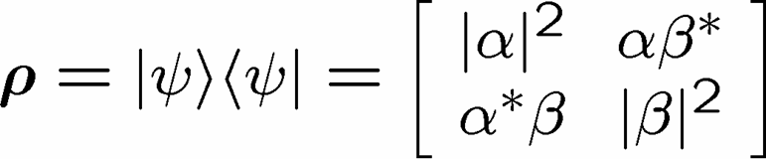

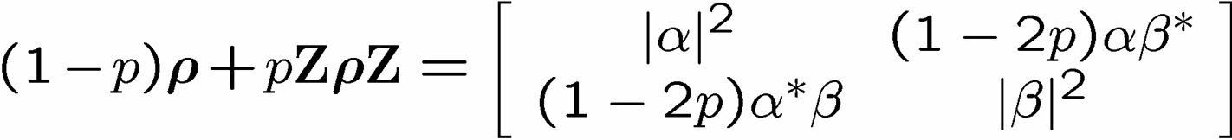
Evolution
Paulis:
Operator Sum Representation (a.k.a. Superoperator)
Example: dephasing channel
decay of off-diagonal elements

Slide 9
Noisy Cell Phone
Hello? Hello? Hello? Hello?
I have a flat tire. I said, I have a flat tire! A flat tire.
No, I’m not trying to flatter you..No, you’re not getting fatter. I have a flat tire!
Communication over a noisy CHANNEL can be overcome via
ENCODING
“Hello?” = “Hello? Hello? Hello? Hello?” [using redundancy to encode “Hello”]

Slide 10
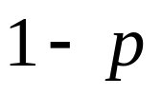




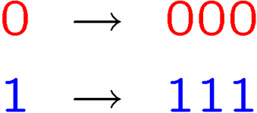








Classical Error Correction
0
0
b
1
1
1 bit
measure
Binary Symmetric Channel
Probability of error
Decode and correct:
Encode:
b
encode
b
b
b
decode
and correct
1 bit
3 bits
measure
Probability of error

Slide 11
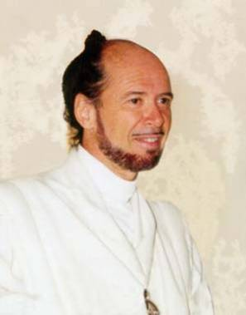




Reason to be a Pessimist
No cloning:
Quantum Cloning Machine
“A single quantum cannot be cloned,” Wootters and Zurek, Nature, 1982
No quantum repetition code:

Slide 12



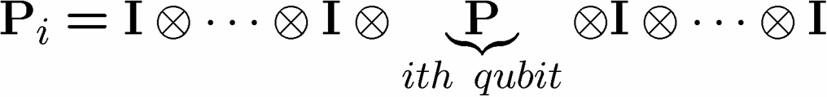
Unrealistic Realistic Channel

Slide 13

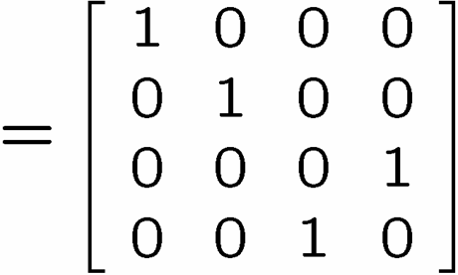
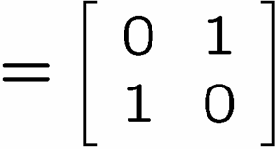
Baby Steps
WWCCD? (What Would Classical Coders Do?)
measure
b
b
0 →000, 1 → 111
0
b
0
b
encode
error
decode
fix
100 → 111→101 → 110 → 110
identities
b
b
=
b
1
0
1
1
1
=
0
error #@%

Slide 14



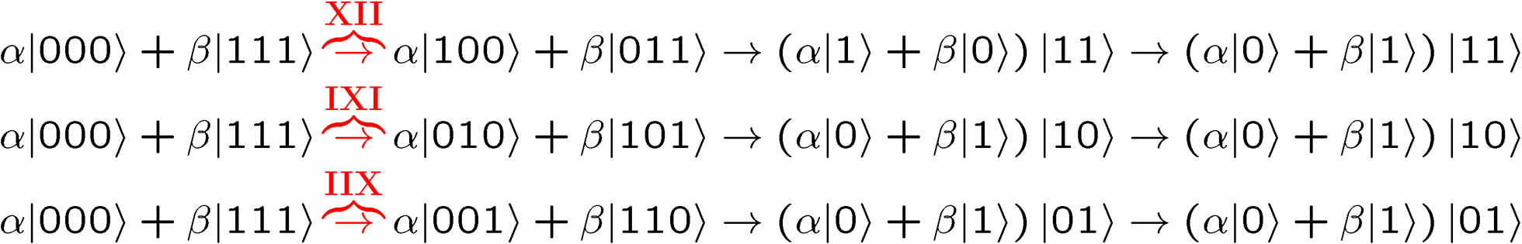
Naïve
4. operator identities still hold
Lets be naïve, take classical and move over to quantum
encode
error
decode fix
?
error
decode
fix
encoded into subspace:
2. errors take to orthogonal
subspaces + maintain orthogonality
3. syndrome
(no-cloning evaded!)

Slide 15
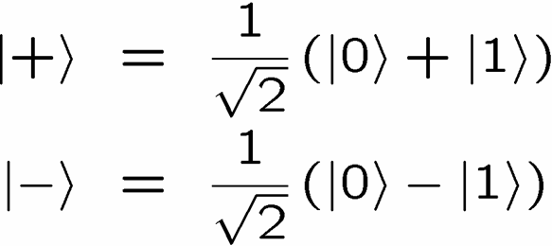
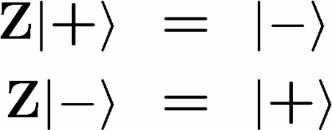


OK Wise Guy
What about “phase” errors?
…sort of not classical error
phase error:
Wise guy says “basis change please”:
looks like bit flip error in this new basis!
H
H
H
H
H
H
phase errors
bit flip errors

Slide 16
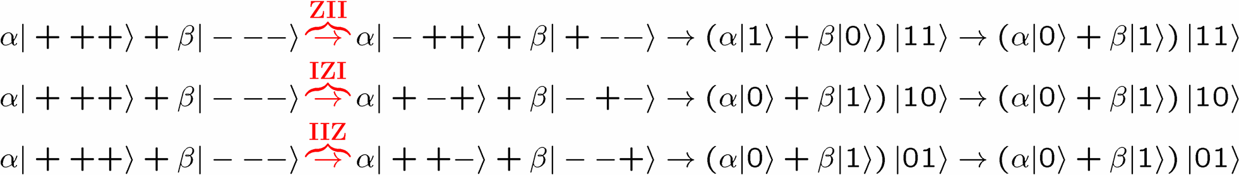
Molly: “I love you, I really love you”
Sam: “Ditto.”
encode
error
decode
fix
H
H
?
H
H
H
H
error
decode
fix
encoded into subspace:
2. errors take to orthogonal
subspaces + maintain orthogonality
3. syndrome
(no-cloning evaded!)

Slide 17


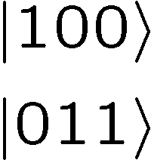




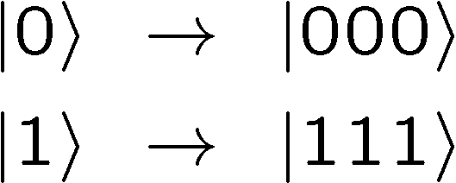

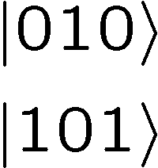



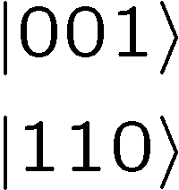

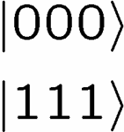
Perspective
Orthogonal subspaces can be distinguished by measurements
without measuring information encoded into the subspace!!!

Slide 18

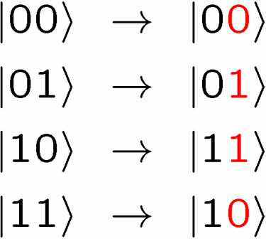
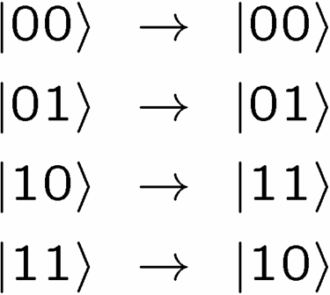



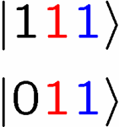
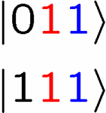
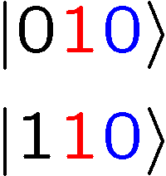
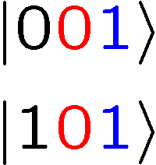
Not An Optical Illusion
fix
error

Slide 19
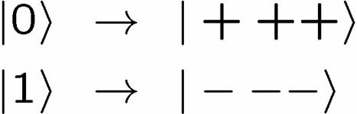


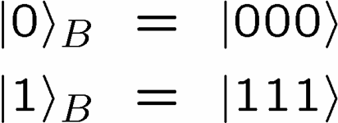
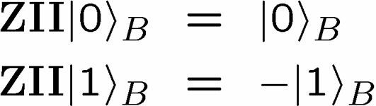
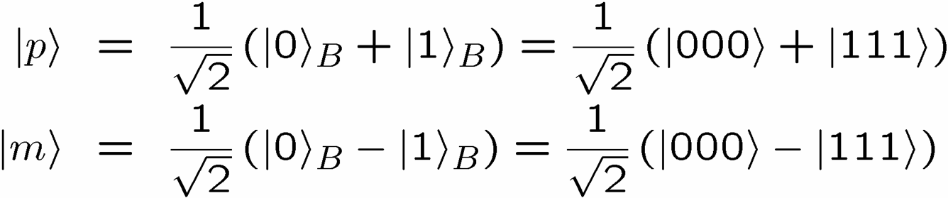
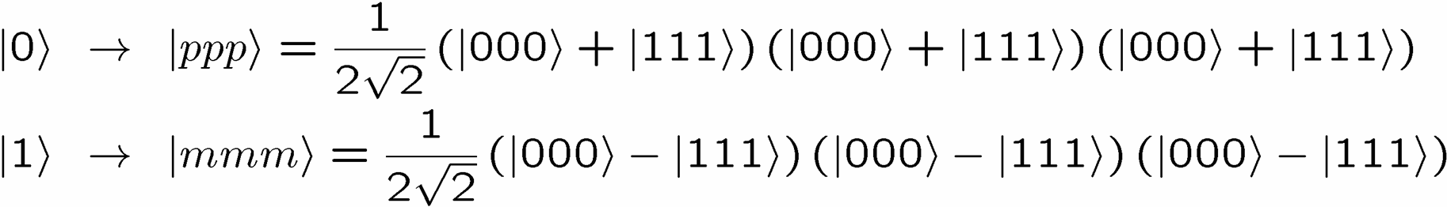
Encoding Away Your Ills
3 qubit bit flip code
3 qubit phase flip code
phase errors act as on bit flip code qubits:
define:
Shor Code: (Peter Shor, 1995)

Slide 20
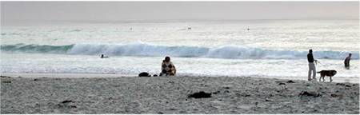


Inside Shor
H
H
H
H
H
H
bit flip code
phase flip code

Slide 21
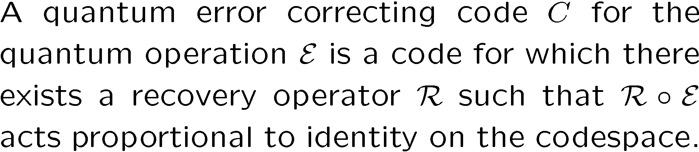
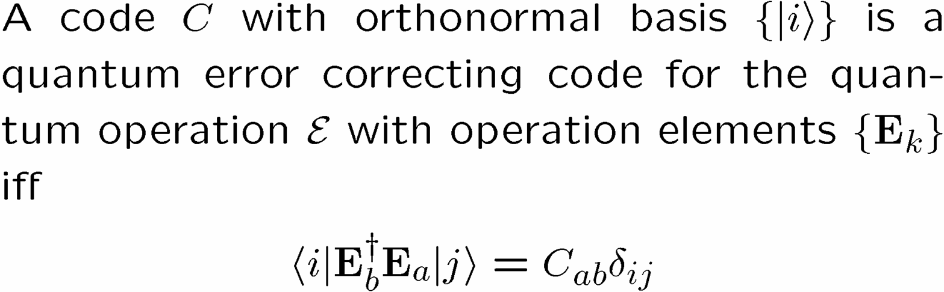
Lets Get Definitional
Quantum Error Correcting Code
Iff Condition for Quantum Error Correcting Code

Slide 22
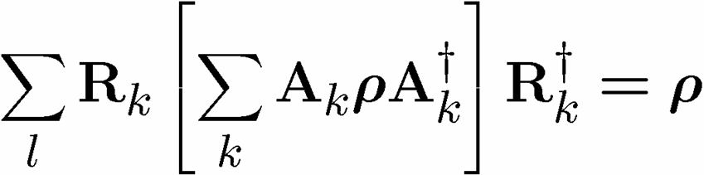
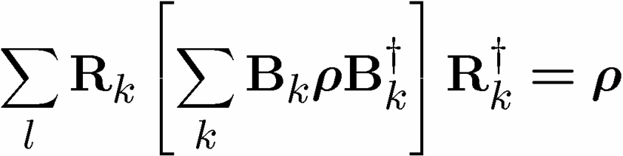
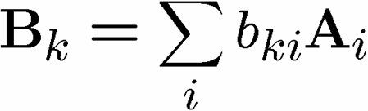
Linear Combination of Errors
Quantum Error Correcting Code
If
then
This allows us to digitize the errors

Slide 23
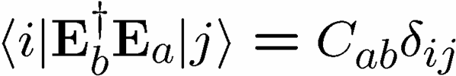


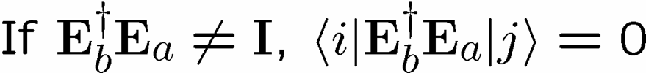
In Action

Slide 24

Pictures
Orthogonality maintained
Orthogonality not maintained
codespace
Orthogonal subspaces
Errors not distinguishable
BAD
GOOD

Slide 25
A Code
A five qubit code which protects against one quantum error:
Better way to talk about the code than the states:
the Stabilizer formalism

Slide 26



Pauli Want a Cracker?

Slide 27
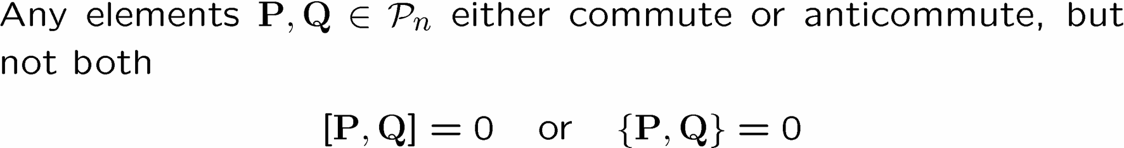



Pauli Group Facts

Slide 28





Set Your Square Phasors to +1

Slide 29




Abelian not Reptilian

Slide 30


Pauli Stabilizer Code

Slide 31



Truth By Example

Slide 32







Stabilizer Subspaces

Slide 33


Stabilizer Nerror

Slide 34








Surfing The Subspaces

Slide 35
Examples

Slide 36



Pauli Want a Qubit?
Modulo the stabilizer S

Slide 37


Modulo the stabilizer S
Feel free to randomly insert “Modulo the stabilizer S” into my sentence
Logical Operators for a Stabilizer Code

Slide 38
So Far
Introduction to Quantum Error Correction
Stabilizer Codes
Next
Quantum Error Correction in Physical Systems

Slide 39



Supercoherence
4 qubit system
Stabilizer:
1
XX
2
Single qubit error detecting code
ZZ
ZZ
4
XX
3
Encoded operations:
System Hamiltonian:

Slide 40























Slide 41

Supercoherence
ALL single qubit errors take degenerate ground state to higher energy levels.
Single qubit errors change value of (S₁,S₂) and hence take ground state to higher energy level.
FORBIDDEN
D. Bacon, Ph.D. thesis, U.C. Berkeley, 2001

Slide 42



Ladder Qubits
1
2
1
2
i-1
i
i+1
n-3
n-2
n-1
n
qubit (i,1)
qubit (i,2)
The Hamiltonian
X X
X X
X X
Z Z
Z Z
D. Bacon, Ph.D. thesis, U.C. Berkeley, 2001
X X
X X
X X

Slide 43





Basis Change
X X
X X
X X
Z Z
Z Z
1
New basis:
X X
X X
X X
2
i
i+1

Slide 44



Everybody’s Favorite
transverse
field
only
transverse
field
only
Ising + transverse field
Ising + transverse field

Slide 45








Grounded
Ground state is two-fold degenerate
1
X
Encoded operations
X
2
k
Z Z Z

Slide 46











Detect and Correct
X X
X X
X X
Z Z
Z Z
X X
X X
X X

Slide 47




Into the 2nd Dimension
j-1
j
j+1
i-1
XX
XX
ZZ
ZZ
ZZ
i
XX
XX
ZZ
ZZ
ZZ
i+1
XX
XX

Slide 48



Tic-Tac-“DOH!”
XX
ZZ
XX
XX
XX
ZZ
ZZ
ZZ
ZZ
XX
XX
XX
ZZ
ZZ
ZZ
ZZ
XX
XX
XX

Slide 49

Loading 3x3
j-1
j
j+1
i-1
ZZ
ZZ
ZZ
ZZ
ZZ
i
ZZ
ZZ
ZZ
ZZ
ZZ
i+1
ZZ
ZZ
x
j-1
j
j+1
i-1
XX
XX
ZZ
ZZ
ZZ
i
XX
XX
ZZ
ZZ
ZZ
i+1
XX
XX

Slide 50




Into the Third Dimension
YY
ZZ
XX
ZZ
XX
YY
YY
ZZ
ZZ
XX
XX
YY
YY
ZZ
XX

Slide 51



Logical Operators

Slide 52


Errors
j-1
j
j+1
i-1
YY
YY
ZZ
ZZ
ZZ
i
YY
YY
ZZ
ZZ
ZZ
i+1
YY
YY

Slide 53




Order Parameter and Beyond
stabilizer
Logical qubit
Hamiltonian
Subsystem code:
This allows us to write down a subsystem order parameter.
Current project: Quantum Monte Carlo for this order parameter.

Slide 54


Quantum
Error
Correction!
Rolf Landauer
IBM
Natural Fault Tolerance

Slide 55



Fin
Quantum Computers Which Fix Themselves
Dave Bacon, Caltech

Slide 56



Unsurfing The Subspaces

Slide 57



Sizing Up The Code

Slide 58






Identity
encode
error
decode fix

