Slide 1
Test Slide
SAT
MCAT
GRE
TOEFL

Slide 2
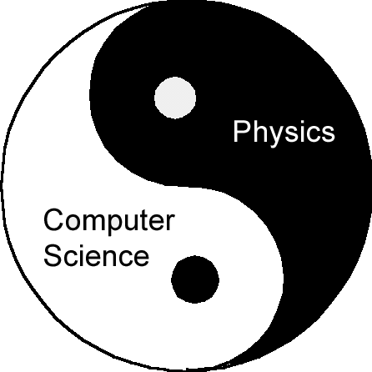


Tales from the Boundary of
Physics and Computer Science
Dave Bacon
Caltech
Department of Physics
Institute for Quantum Information

Slide 3
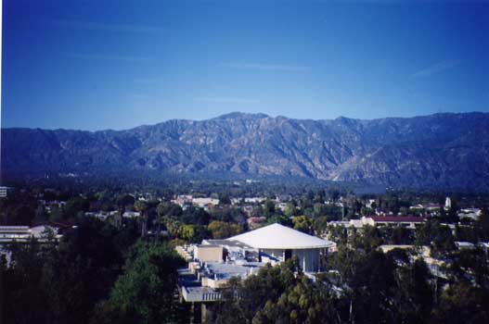
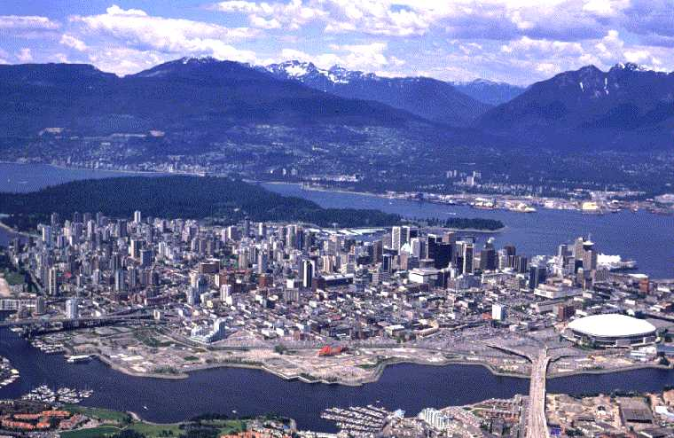
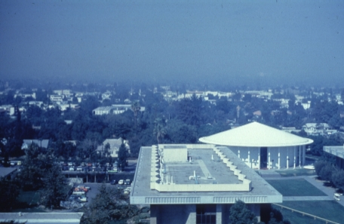
Mountains

Slide 4
Talk Outline

Slide 5
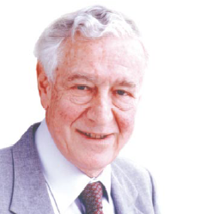
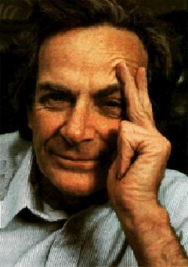

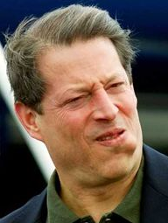
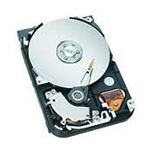
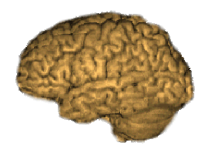
In the Beginning
Err..I mean: Information carriers obey physics!
Information is physical!
Physics is quantum!
Rolf Landauer
(IBM)
Richard Feynman
Information is “fungible”:
Al Gore
George Bush
Ralph Nader
Pat Buchanan
“How can we simulate quantum mechanics?...Can we do
it with a new kind of computer…a quantum computer? It’s
not a Turing machine but a machine of a different kind”
(Richard Feynman, 1981)
Al Gore

Slide 6
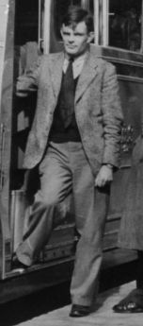
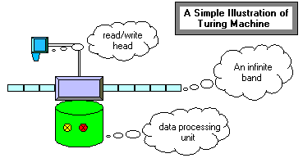
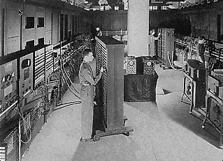
Not All Computer’s Are Equal
(apologies to Turing)
Where are all the quantum computers?
Where are all the classical computers?
“On Computable Numbers with an
Application to the Entscheidungsproblem.” (1938)
Alan Turing
18000 vacuum tubes
Failure rate:
50 tubes / day
Electronic Numerical Integrator
and Computer (ENIAC, 1943)

Slide 7
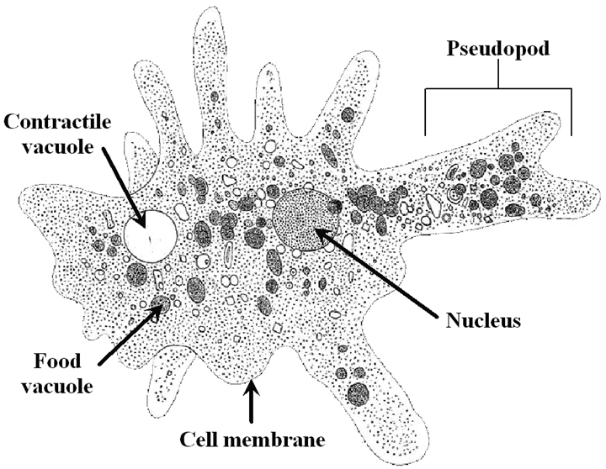
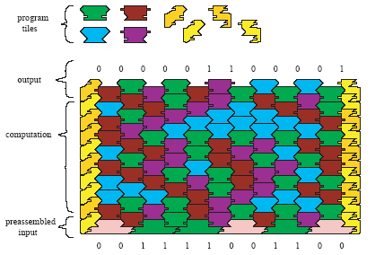
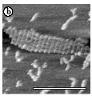
Is it a ROBUST Computer?
Is it a Computer?
Universal DNA Computing
(pics from Eric Winfree’s Caltech lab)

Slide 8
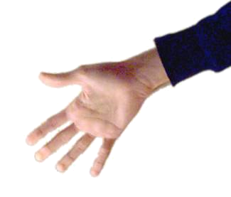
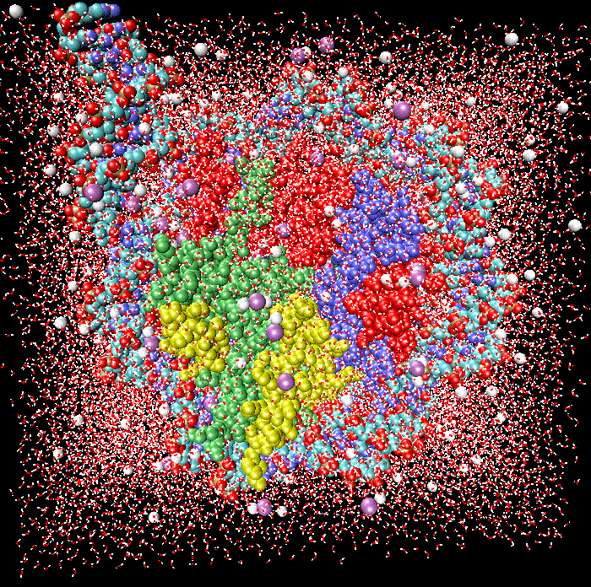
The Robust Computer Phase
A phase of matter?
Control
System
Controllable yet Decoupled
Switching, Digital
Regular yet Complex
Reducible yet Irreducible
Computerology
Environment

Slide 9
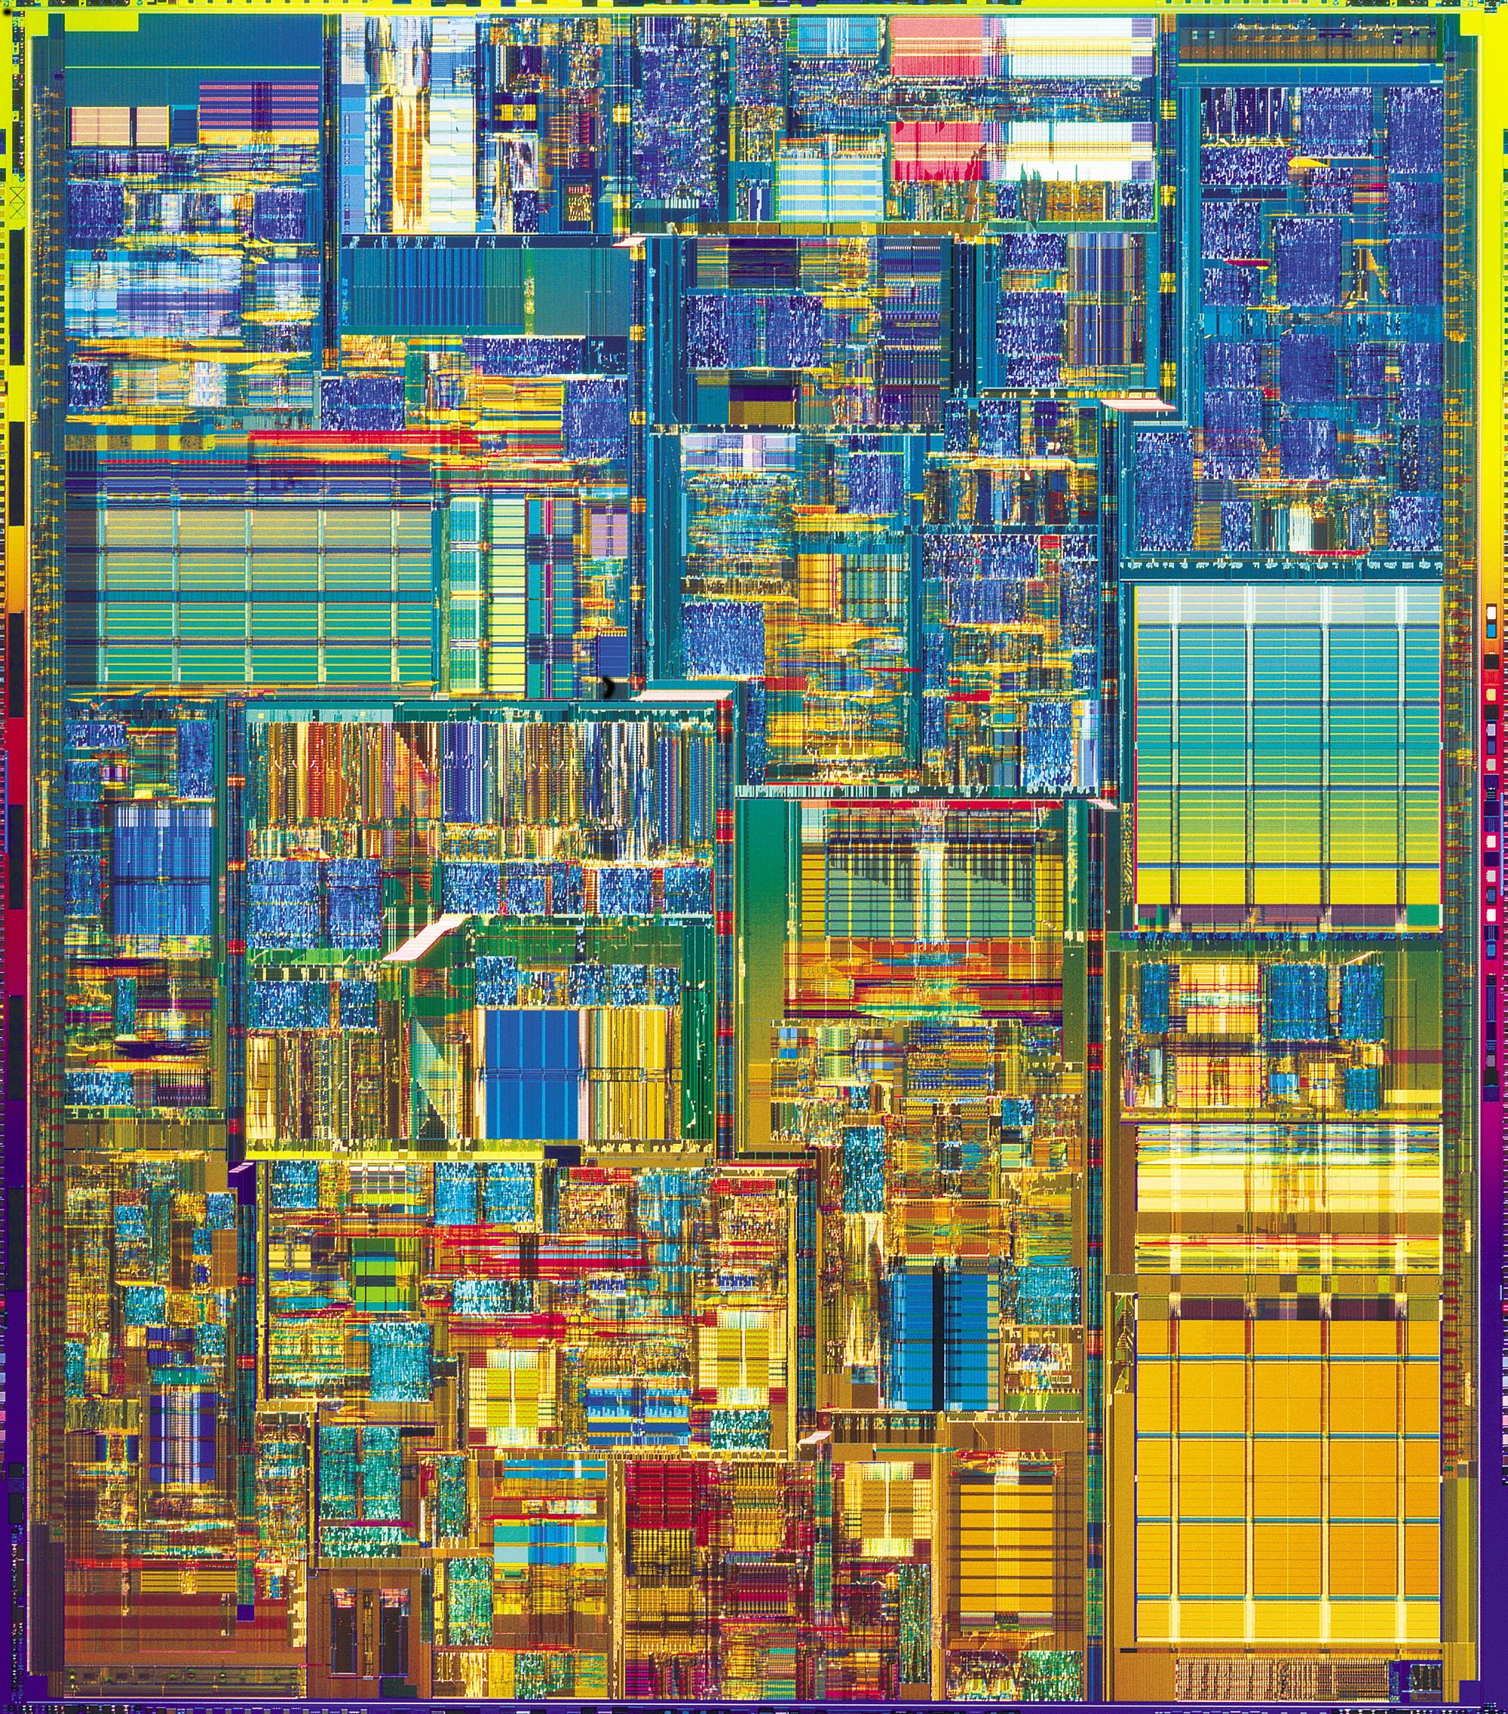
The Answer Key
Theory:
“A Mathematical Theory of Communication” - Shannon (1948)
“Probabilistic logics and the synthesis of reliable organisms
from unreliable components” - von Neumann (1956)
If control is precise enough and noise is small enough, robust classical computation is possible
Practice:
Integrated Circuit
Hard Drive

Slide 10
The Physics Guarantee
Rant mode ON
What is the phase of matter corresponding to the computer?
There are distinct PHYSICAL and DYNAMICAL reasons why
robust classical computation is possible.
not all physical systems are equally good for computation:
there exists systems whose PHYSICS guarantees
their ability to enact robust classical computation.

Slide 11
Two Paths
Hard Drive
Integrated Circuit
Coding: majority vote of
magnetism
Coding: majority vote of
current
Error correction: local energy
minimization
Error correction: amplification
Fault-tolerant: macro applied
field.
Fault-tolerant: conducting / insulating phase transition

Slide 12
The Physics Guarantee
Rant mode ON
What is the phase of matter corresponding to the computer?
There are distinct PHYSICAL and DYNAMICAL reasons why
robust classical computation is possible.
not all physical systems are equally good for computation:
there exists systems whose PHYSICS guarantees
their ability to enact robust classical computation.
THE BILLION DOLLAR QUANTUM QUESTION:
Are there (or can we engineer) physical systems whose
PHYSICS guarantees robust quantum computation?

Slide 13
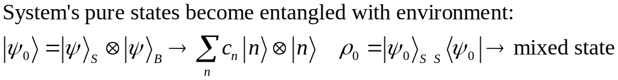
What is the Problem?
Where are all the quantum computers?
Real quantum systems are open quantum systems!
system
environment
Interaction causing
DECOHERENCE
System evolution
environment evolution
Hamiltonian:
System evolution (by itself) is no longer unitary
Coherent properties of system’s quantum information lost
Problem for quantum computers: [Unruh, Phys. Rev. A 51, 992 (1995)]

Slide 14

What Is The Problem?
Decoherence is a lot like classical noise, BUT:
Strong coupling to
control devices
needed to enact
computations
Strong coupling to
environment
causes
decoherence
Yingyang of quantum computing

Slide 15
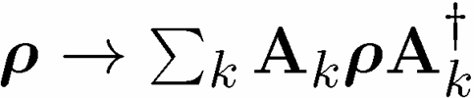
Quantum Computing is Bunk
(1994 edition)
Ways Quantum Computers Fail to Quantum Compute
Decoherence
Lack of Unitary Control
attempting to apply unitary evolution U instead results in V
or (worse) results in non-unitary evolution
Measurements are faulty
measurement result is noisy, incorrect result obtained
Quantum Computing Disappearing Act
qubits disappear (leakage of computing states)

Slide 16
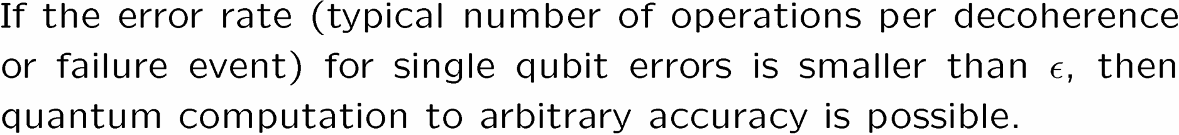
The Quantum Solution (1995-96)
Fault Tolerant Quantum Computing is Possible!
Threshold Theorem:
QC
Error Rate
BUT:
,
?

Slide 17





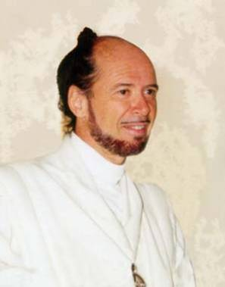



No Quantum Transistor
Quantum Cloning Machine
“A single quantum cannot be cloned,” Wootters and Zurek, Nature, 1982

Slide 18




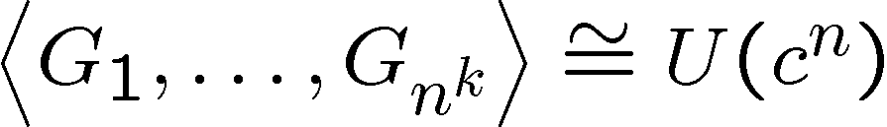
The Quantum Hard Drive?
[Bacon, Ph.D. Thesis, U.C. Berkeley Physics “Decoherence, Control, and
Symmetry in Quantum Computers,” (2001)]
Do there exist (or can we engineer) quantum systems whose
physics guarantees fault-tolerant quantum computation?
1. Coherence preserving.
2. Accessible Fault-Tolerant
Operations
“self-correcting”
3. Universality

Slide 19
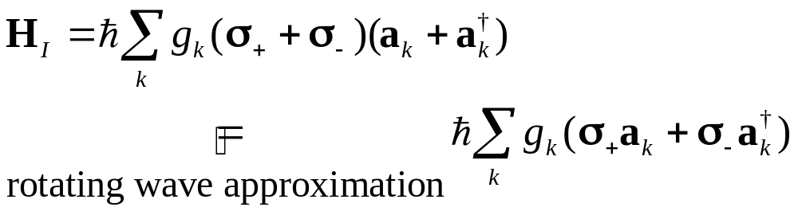
First Steps Towards Using Physics
[Bacon, Brown, and Whaley, Phys. Rev. Lett. 87, 247902 (2001)]
system
bath
E_{sys}
~
E_{bath}
H_{I} = perturbative system-bath coupling
H_{I} energy small compared to E_{sys} and E_{bath} implies decoherence dominated by pathways that conserve unperturbed energies
|1⟩
“cooling”
|0⟩
|1⟩
“heating”
|1⟩
e^{is}|1⟩
|0⟩
|0⟩
“non-dissipative”
|0⟩
[e.g. Prokof’ev and Stamp, J. Phys. Cond. Mat. 5, 663 (1993))]

Slide 20

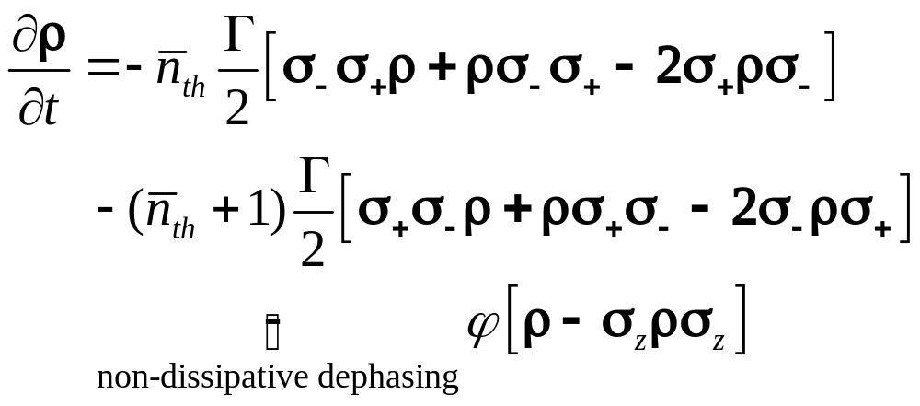

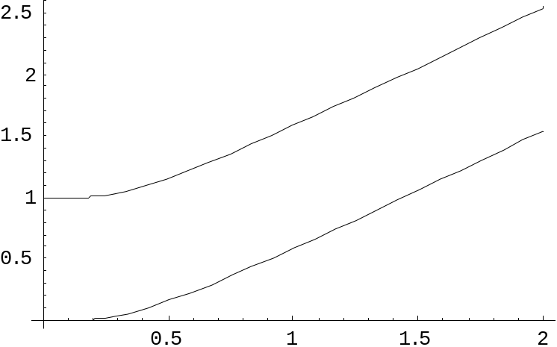
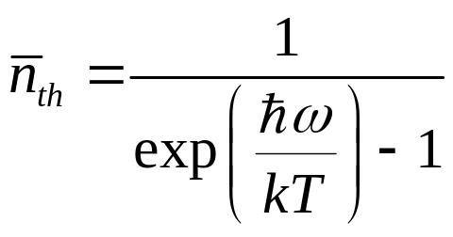

two-level atom radiatively coupled to a thermal reservoir:
“heating”
“cooling”
“non-dissipative”
At low bath temperatures, heating disappears……..
Can We Make Quantum Errors Run Uphill?

Slide 21
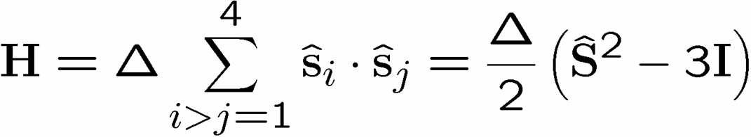








A Supercoherent Qubit
[Bacon, Brown, and Whaley, Phys. Rev. Lett. 87, 247902 (2001)]
[Bacon, U.C. Berkeley Ph.D. Thesis (2001)]
1
2
4
3
= exchange
interaction
1
J=2
1
total
spin
1
3
1
2
J=1
1
2
n
J=0
1
2
3
4
number of qubits
Supercoherent Qubit

Slide 22

Run Uphill
J=2
J=1
J=0
Supercoherent Qubit
All single qubit operators take J=0 states to J>0 states
Supercoherence:
made all single qubit prosses “heating”!
At kT< single qubit decoherence mechanisms suppressed

Slide 23






Quantum Error Correction
Threshold Theorem:
QC
Error Rate
Classical code
Quantum code
Probability of error
qubit encoded into quantum error
correcting subspace

Slide 24





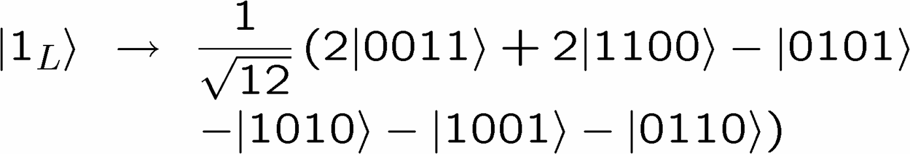
There’s a Code in My Hamiltonian
J=2
classical error
detecting code:
J=1
J=0
Supercoherent Qubit
the degenerate ground state = quantum error detecting code
supercoherent qubit code:

Slide 25

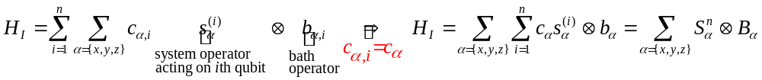
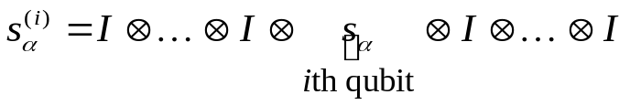



Decoherence-Free Subspaces
[Zanardi and Rasetti, Phys. Rev. Lett. 79, 1953 (1997)]
[Lidar, Bacon, and Whaley, Phys. Rev. Lett. 82, 4556 (1999)]
[Bacon, Kempe, Lidar, and Whaley, Phys. Rev. Lett. 85, 1758 (2000)]
[Kempe, Bacon, Lidar, and Whaley, Phys. Rev. A 63, 042307 (2001)]
[Bacon, U.C. Berkeley Ph.D. Thesis (2001)]
1
2
bath mode
4
3
collective spin operators:
bath couples identically to each qubit
Collective errors do not err the decoherence-free subspace

Slide 26

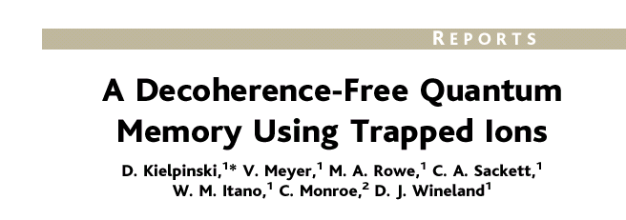
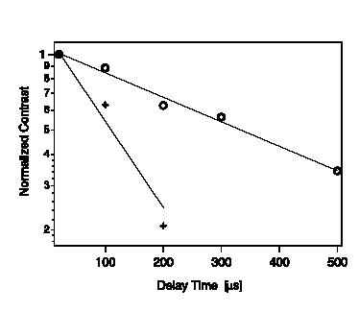

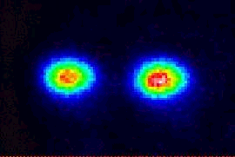

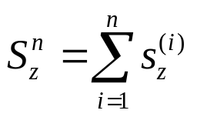
Decoherence-Free In Practice
ambient conditions!
collective phase errors:
DFS
non-DFS

Slide 27
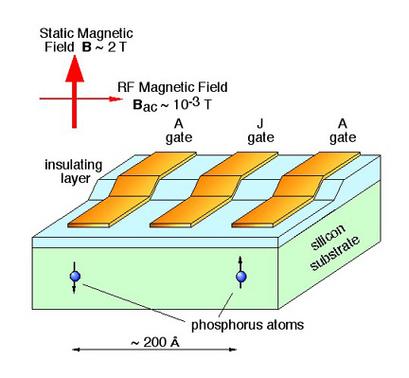
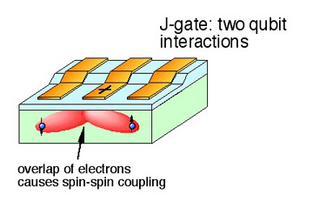
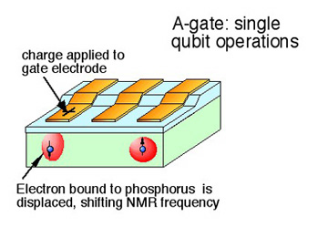
Spintronic Supercoherent
(Kane model)
Kane, Nature 393, 133 (1998)
~0.1 meV exchange interaction
1
2
4
3
T<1K supercoherence
diagrams: Los Alamos Quantum Institute

Slide 28

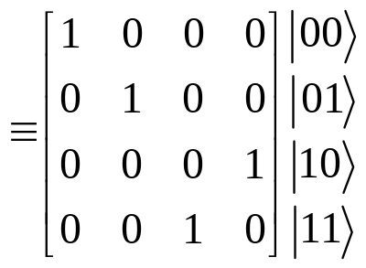
The Full Computer
1
2
?
full quantum
architecture
= 1 (encoded)
qubit
4
3
Universal Quantum Computer
a quantum computer which can be programmed to perform any algorithmic manipulation on quantum information.
SU(2)
The Royal King and Queen of Universal Quantum Gates
CNOT and 1-qubit rotations
Set of Universal Quantum Gates
a set of operations/gates which, acting on the quantum information, can be used to implement (to any desired accuracy) any unitary evolution of the quantum info.
SU(2)

Slide 29
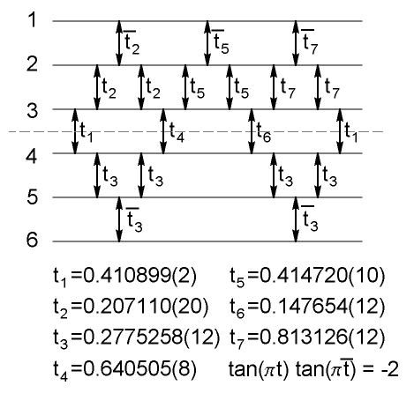

Encoded Universality
[Bacon, Kempe, Lidar, and Whaley, Phys. Rev. Lett. 85, 1758 (2000)]
[Bacon, Kempe, DiVincenzo, Lidar, and Whaley, Proc. of the Int. Conf. on Exp.
Imp. of Quant. Comp., Sydney, Australia (2001)]
[DiVincenzo, Bacon, Kempe, Burkard, and Whaley, Nature 408, 339 (2001)]
[Bremner, Dodd, Nielsen, and Bacon, Phys. Rev. A 69 012313 (2004)]
Exchange cannot implement
all unitary operations
If we use encoded subspaces
exchange is universal!
1
2
4
3
encoded controlled-not

Slide 30
Use Physics!
Supercoherent Qubits
Quantum Error Detecting
Codes
Decoherence-Free Subspaces
Solid State Implementation
Encoded Universality
Supercoherent Quantum Computing Architecture

Slide 31



The Physics Guarantee

Slide 32

















Self Fixing

Slide 33
The Quantum Hard Drive?
[Bacon, Ph.D. Thesis, U.C. Berkeley Physics “Decoherence, Control, and
Symmetry in Quantum Computers,” (2001)]
Do there exist (or can we engineer) quantum systems whose
physics guarantees fault-tolerant quantum computation?
1. Coherence preserving.
2. Accessible Fault-Tolerant
Operations
“self-correcting”
3. Universality

Slide 34




Quantum Error Correcting
Order Parameter
The quantum information is
still here. How do we see it?
diagnose
fix
measure encoded info
j
Encoded quantum information

Slide 35




Quantum Computing Phase
Alexei Kitaev (Caltech)
Michael Freedman (Microsoft)
John Preskill (Caltech)
Zhenghan Wang (Indiana)
Lev Ioffe (Rutgers)
Michael Larsen (Indiana)
Chetan Nayak (UCLA)
Fei Zhou (UBC)
interactions
qubits
Lacking: Self-correcting (natural fault-tolerance)
(exception 4D toric code of Preskill et. al.)

Slide 36



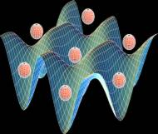
Into the Third Dimension
YY
ZZ
XX
ZZ
XX
YY
YY
ZZ
ZZ
XX
XX
YY
Ground state = quantum error correcting codespace
encodes 1 qubit, can correct up to n errors
Numerical evidence for self-correction (string-like excitations)
Does this system exhibit “natural fault-tolerance?”
Optical lattice as natural fault tolerant testbed:
Demler and Zhou, Phys. Rev. Lett. 88, 163001(2002).
Duan, Demler, and Lukin, Phys. Rev. Lett. 91, 090402 (2003).

Slide 37
Error correcting codes
Geometry, Topology?
classical
quantum
Statistical Physics
theory of strongly interacting
quantum systems
renormalization group methods
new order parameters?
Fault-tolerance
local structures giving rise
to global robustness
Implementation Physics
Representation theory
let physics guide
optical lattices, donor
electrons, superconducting
circuits, ion traps, etc.
identification of qubits
and logical operations
Naturally Fault-Tolerant Quantum Computation
But WHAT do we do when we get there?

Slide 38
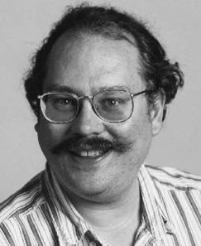
Shor’s Algorithm (1994)
Peter Shor
188198812920607963838697239461650439807163563379417382700763356422988859715234665485319060606504743045317388011303396716199692321205734031879550656996221305168759307650257059
=
398075086424064937397125500550386491199064362342526708406385189575946388957261768583317
×
472772146107435302536223071973048224632914695302097116459852171130520711256363590397527
Quantum computer’s can efficiently factor numbers
(and hence break RSA cryptosystems)
(It is widely suspected that classical computers cannot
efficiently factor numbers.)

Slide 39
?
Where are the
Quantum Algorithms?

Slide 40

Quantum Power?
Quantum Parallelism? NOT REALLY
Quantum computers don’t “check all possible factors”
Shor’s insight: Period finding can be used to factor numbers
period
f(x)
x

Slide 41

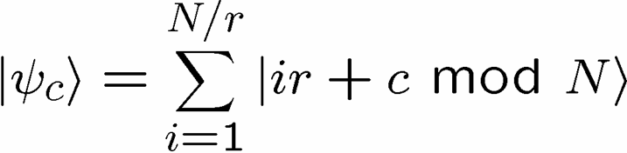

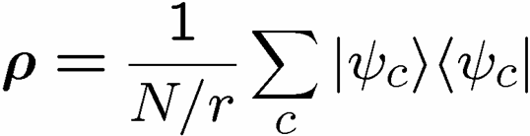




Symmetry
f(x)
period
x
is invariant under the abelian group of displacements
invariance under displacement
work in (discrete) momentum basis
Symmetries
change of basis

Slide 42

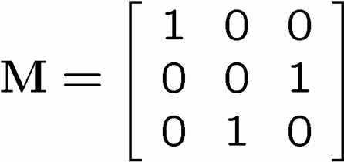
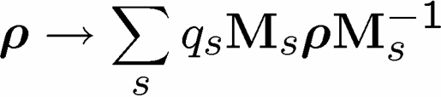


Negative Probabilities
Classical:
some transitions elements
must be negative
Classically we cannot achieve basis change of an arbitrary symmetry
Quantum:
Quantum we can (almost always) change basis for arbitrary symmetry.
Quantum computers can exploit symmetries of problem
which a classical computer cannot exploit.
see for example Schützhold and Unruh, quant-ph/0304090

Slide 43
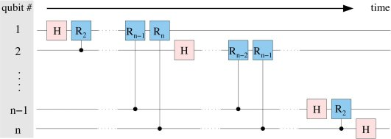













Efficient Circuits
displacement symmetry
Quantum Circuit for the Fourier Transform (Z₂^{n})
other symmetries?

Slide 44


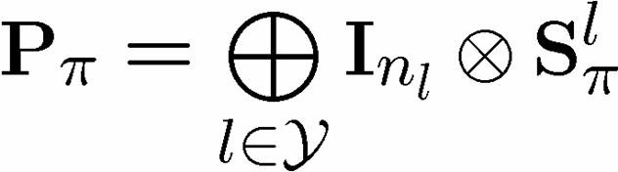
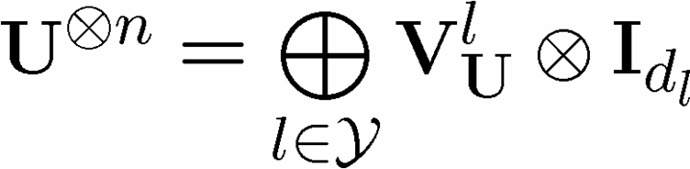


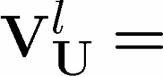







Schur Duality Transform
[Bacon, Chuang, and Harrow, in preparation (2004)]
n identical copies of a state:
independent of basis:
permutation symmetry
unitary symmetry
irrep of
irrep of
set of all partitions of n
(all Young Diagrams with n rows)
Our result: An efficient quantum circuit for Schur Duality Transform

Slide 45


Applications
Spectrum Estimation:
[Keyl and Werner, Phys. Rev. A 64 052311 (2001)]
Task: estimate eigenvalues of
Perform
Measure
Estimate
Quantum Universal Variable Length Source Coding
[Hayashi and Matsumoto, quant-ph/0209124]
Quantum Hypothesis Testing
[Hayashi, quant-ph/0107004]
State Estimation
[Gill and Masar, quant-ph/9902063]
Encoding Into Decoherence-Free Subspaces
[Bacon, Kempe, Lidar, and Whaley, Phys. Rev. Lett. 85, 1758 (2000)]
[Kempe, Bacon, Lidar, and Whaley, Phys. Rev. A 63, 042307 (2001)]

Slide 46







Universal Entanglement Concentration
[Hayashi and Matsumoto, quant-ph/0209030]
unknown entangled state
measure
measure
Von Neumann entropy
Maximally entangled states are the “currency” of bipartite entanglement.

Slide 47










Bell Experiment
-1
-1
+1
+1
A
B
ALICE
BOB
A B Probability
- 1 - 1 - 1 +1 +1 - 1 +1 +1

Slide 48

A Conversation
Computer Scientist: “How are these correlations different than shared
random variables?”
Physicist: “John Bell showed that these correlations cannot be
created using shared random variables. We physicists
say `there is no local hidden variable theory for these
correlations.’”
Computer Scientist: “OK. So how much communication in addition
to shared random variables is needed in order
to produce these correlations?”
Physicist: “What a silly question! This communication would have
to be superluminal signals.”
Computer Scientist: “But I only care about comparing resources.”
[Brassard, Cleve, and Tapp, Phys. Rev. Lett 83, 1874 (1999)]

Slide 49
Why Is It Hard?
Stop running up my
phone bill, Bob!
ALICE
BOB

Slide 50



Simulating Quantum Correlations
[Masar, Bacon, Cleve, and Cerf, Phys. Rev. A 63, 052305 (2001)]
[Bacon and Toner, Phys. Rev. Lett. 90, 157904 (2003)]
[Toner and Bacon, Phys. Rev. Lett. 91, 187904 (2003)]

Slide 51

Quantum Communication
Complexity
F(x,y)
How much (how many bits) do they
need to communicate to compute F?
x
y
ALICE
BOB
If they share entangled quantum states, then there are F(x,y)’s such that A and B need exponentially less communication than if they did not share entanglement.
Ran Raz
[Raz, Proceeding of the 31st STOC, 358 (1999)]
The communication cost of simulating quantum correlations!

Slide 52
Detector Inefficiency
[Toner and Bacon, Phys. Rev. Lett. 91, 187904 (2003)]
Bell experiment
ALICE
BOB
If detectors sometimes do not fire, then there may be a local hidden
variable explanation of the experiment = detector inefficiency loophole
Example:
efficiency<82.8% = LHV
Limit on detector inefficiency!

Slide 53
Theoretical Computer Science Giving
Back to Physics!

Slide 54
Our Path
Information is physical
Quantum computation
What physics allows classical computation?
What makes quantum so hard?
Supercoherent qubits
Quantum codes in physical systems
Decoherence-free subspaces
Spintronic architecture
Encoded universality
Natural fault-tolerant quantum computing
Quantum algorithms
Symmetry exploiting
Schur transform
Entanglement concentration
Quantum correlations
Detector inefficiency in Bell experiments

Slide 55







The Path Ahead (I)
Quantum Computers that Fix Themselves

Slide 56

The Path Ahead (II)
Quantum Algorithm’s and Symmetry

Slide 57



The Path Ahead (III)
ALICE
BOB
Towards a Theory of Quantum Correlations

Slide 58
Bigger Picture
Quantum computation
building
exploiting
understanding
Quantum computation
what can we learn about
physics from theoretical
computer science?

Slide 59



Collaboratorium
David DiVincenzo
(IBM TJ Watson)
Richard Cleve
(Calgary)
Guido Burkard
(IBM TJ Watson)
Daniel Lidar
(Toronto)
K. Birgitta Whaley
(Berkeley)
Andrew Childs
(MIT)
Isaac Chuang
(MIT)
Xinlan Zhou
(Stanford)
Aram Harrow
(MIT)
Ken Brown
(MIT)
Debbie Leung
(Caltech)
Ben Toner
(Caltech)
Michael Nielsen
(Queensland)
Nicholas Cerf
(Brussels Free University)
Mic Bremmer
(Queensland)
Serge Massar
(Brussel’s Free University)
Jennifer Dodd
(Queensland)
Julia Kempe
(Universite de Paris-Sud)

Slide 60


Fin

