Slide 1
Test Slide
SAT
MCAT
GRE
TOEFL

Slide 2
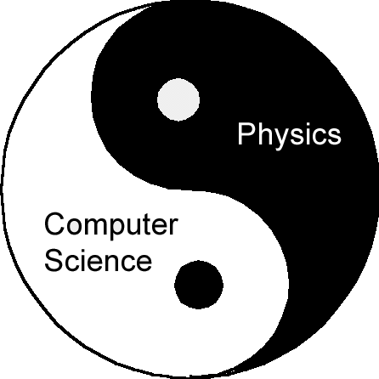


Tales from the Boundary of
Physics and Computer Science
Dave Bacon
Caltech
Department of Physics
Institute for Quantum Information

Slide 3
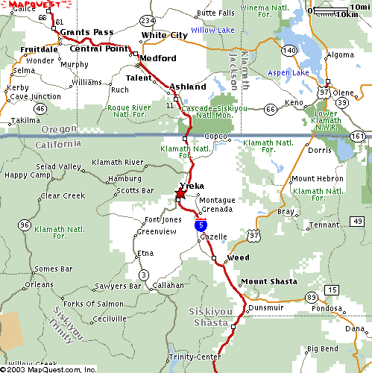
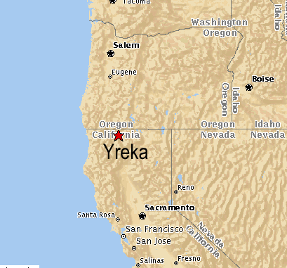
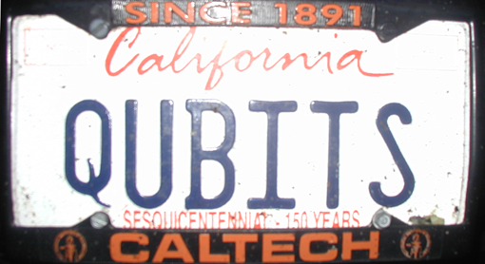
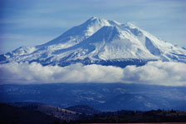
All Apologies

Slide 4
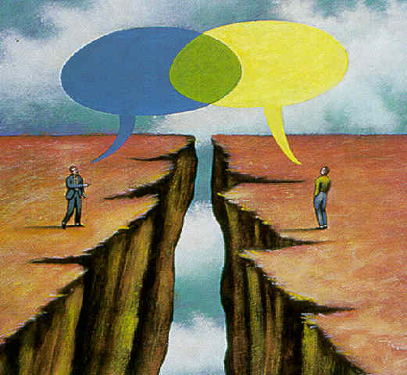
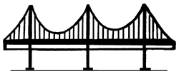
The Boundary
Computer
Science
Physics
Quantum Computation

Slide 5
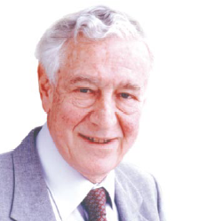
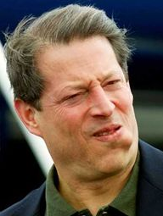

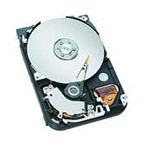
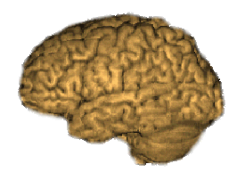
In the Beginning
Err..I mean: Information carriers obey physics!
Information is physical!
Rolf Landauer
(IBM)
Al Gore
Information is “fungible” adj. being of such a nature that one
part or quantity may be replaced by another equal part or quantity
in the satisfaction of an obligation.
Al Gore
George Bush
Ralph Nader
Pat Buchanan

Slide 6
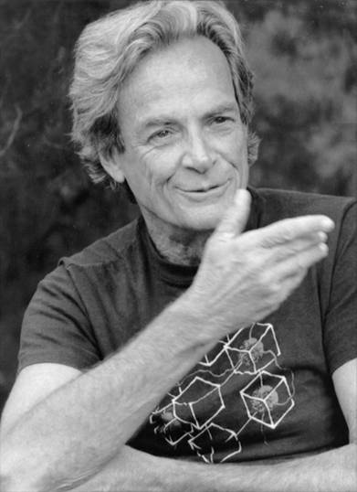
In the Beginning
Information carriers obey physics!
Physics is quantum!
Rolf Landauer
(IBM)
“How can we simulate quantum mechanics? ...Can we do it with a new kind of computer… a quantum computer? It’s not a Turing machine but a machine of a different kind” - Richard Feynman (1981)
Richard
Feynman
Information in a quantum setting

Slide 7
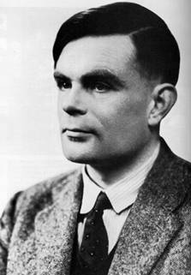
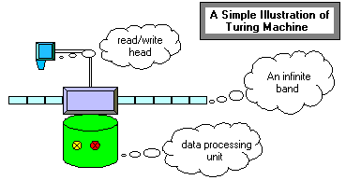
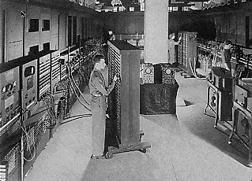
Before the Beginning
Where are all the quantum computers?
Where are all the classical computers?
“On Computable Numbers with an
Application to the Entscheidungsproblem.” (1938)
Alan Turing
18000 vacuum tubes
Failure rate:
50 tubes / day
Electronic Numerical Integrator
and Computer (ENIAC, 1943)
NOT ROBUST

Slide 8

How to Build a Computer
…if there is noise and faulty components?
Theory: error correction and fault-tolerance
“A Mathematical Theory of Communication” - Shannon (1948)
“Probabilistic logics and the synthesis of reliable organisms
from unreliable components” - von Neumann (1956)
If control is precise enough and noise is small enough, robust classical computation is possible
faulty components
Almost certainly not faulty
Notes:
Ben says not well connected
Jen says answer key strange

Slide 9
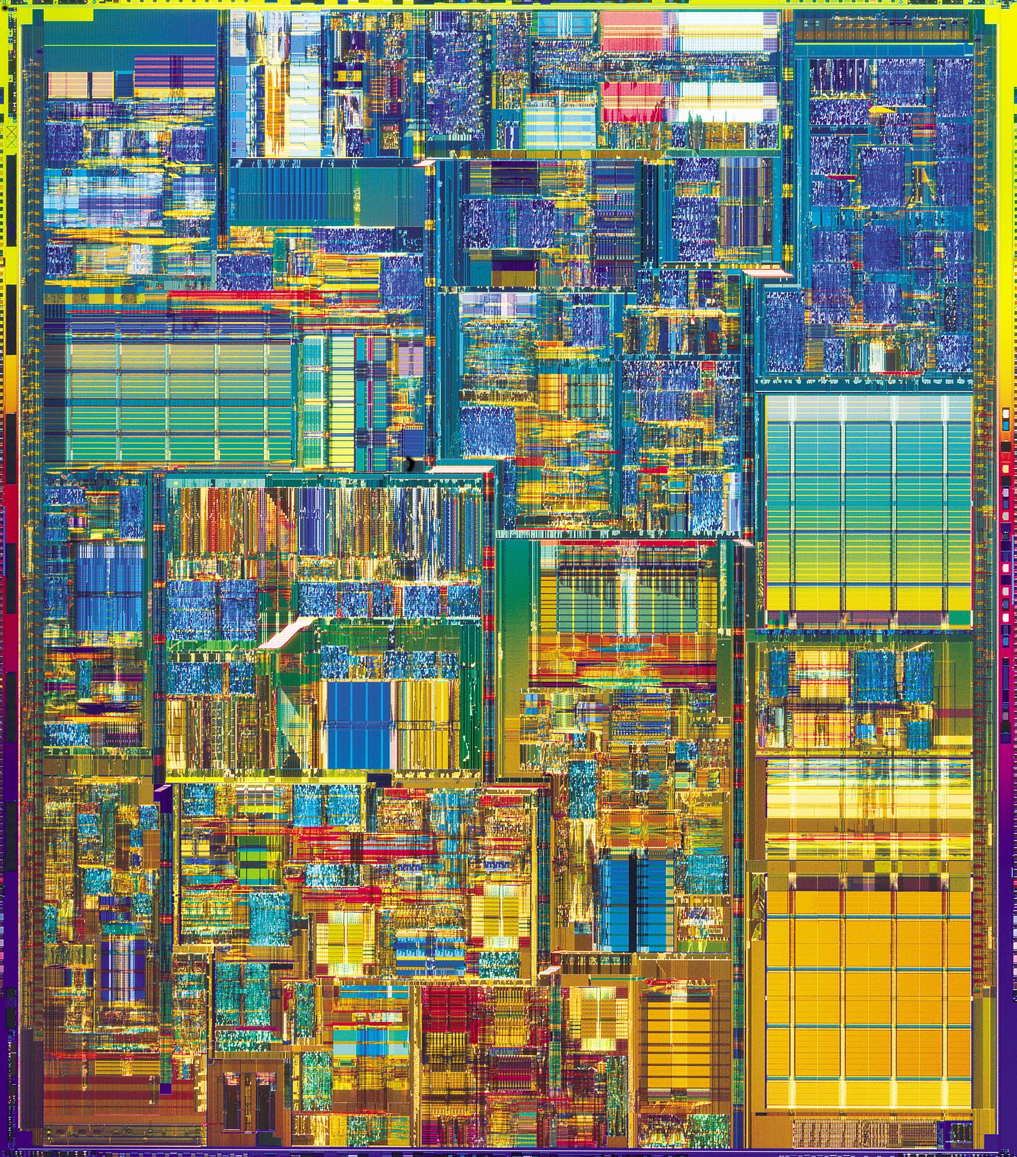
In Practice
Hard Drive
Integrated Circuit
Coding: majority vote of
magnetism
Coding: majority vote of
current
Error correction: local energy
minimization
Error correction: amplification
tolerance guaranteed by
conducting-insulating
phase transition
Notes:
Unclear how ft is different

Slide 10
The Physics Guarantee
Rant mode ON
What is the phase of matter corresponding to the computer?
There are distinct PHYSICAL and DYNAMICAL reasons why
robust classical computation is possible.
not all physical systems are equally good for computation:
there exist systems whose PHYSICS guarantees
their ability to enact robust classical computation.
What is the phase of matter corresponding to the
quantum computer?
Are there (or can we engineer) physical systems whose
PHYSICS guarantees robust quantum computation?

Slide 11
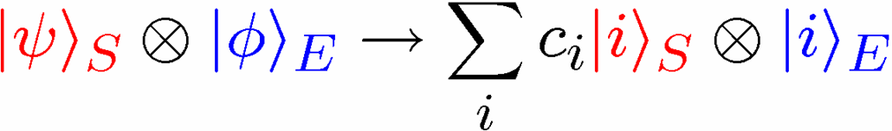

What is the Problem?
Where are all the quantum computers?
Real quantum systems are open quantum systems!
system
environment
Interaction causing
DECOHERENCE
Hamiltonian:
System evolution
environment evolution
Coherent properties of system’s quantum information lost
Notes:
This needs to be fixed.

Slide 12
The Quantum Solution (1995-97)
Fault Tolerant Quantum Computing is Possible!
[Shor, Gottesman, Preskill, Aharonov, Ben-Or, Kitaev, Knill, Laflamme, Zurek]
Threshold Theorem:
If the error rate (typical number of operations per decoherence
time/ accuracy in quantum evolution / measurement error rate)
is smaller than a certain value (the threshold), then quantum
computation to arbitrary accuracy can be efficiently enacted.
QC
Error Rate
Quantum Computation is NOT Analog Computation
Notes:
names

Slide 13
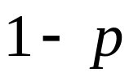




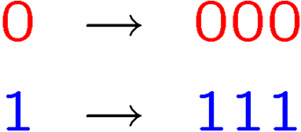








Classical Error Correction
0
0
b
1
1
1 bit
measure
Binary Symmetric Channel
Probability of error
Decode and correct:
Encode:
b
encode
b
b
b
decode
and correct
1 bit
3 bits
measure
Probability of error

Slide 14



Quantum Error Correction
1 qubit
measure
complete depolarizing channel
decoherence
Probability of error
5 qubit quantum error correcting code
encode
diagnose
error
fix
measure
quantum error correction
entropy
Probability of error

Slide 15
THE Quantum Solution?
Fault Tolerant Quantum Computing is Possible!
Threshold Theorem:
If the error rate (typical number of operations per decoherence
time/ accuracy in quantum evolution / measurement error rate)
is smaller than a certain value (the threshold), then quantum
computation to arbitrary accuracy can be efficiently enacted.
QC
Error Rate
BUT:
,
?
Notes:
names

Slide 16





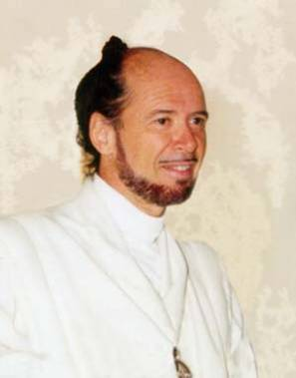



No Quantum Transistor
Quantum Cloning Machine
“A single quantum cannot be cloned,” Wootters and Zurek, Nature, 1982
Notes:
Click on time

Slide 17




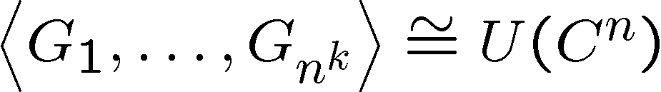
The Quantum Hard Drive?
D. Bacon, Ph.D. Thesis, Berkeley Physics, “Decoherence, Control, and
Symmetry in Quantum Computers,” (2001)
Do there exist (or can we engineer) quantum systems whose
physics guarantees fault-tolerant quantum computation?
Natural Fault-Tolerant Quantum Computation Conditions
1. Coherence preserving.
2. Accessible Fault-Tolerant
Operations
“self-correcting”
3. Universal Quantum
Computation

Slide 18



First Steps Towards Using Physics
D. Bacon, K.R. Brown, and K.B. Whaley, Phys. Rev. Lett. 87, 247902 (2001)
system
bath
E_{sys}
~
E_{bath}
H_{I} = perturbative system-bath coupling
H_{I} energy small compared to E_{sys} and E_{bath} implies decoherence dominated by pathways that conserve unperturbed energies
|1⟩
“cooling”
|0⟩
|1⟩
“heating”
|1⟩
e^{is}|1⟩
|0⟩
|0⟩
“non-dissipative”
|0⟩
Notes:
Fix fonts

Slide 19


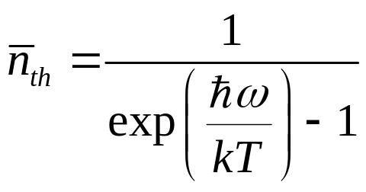

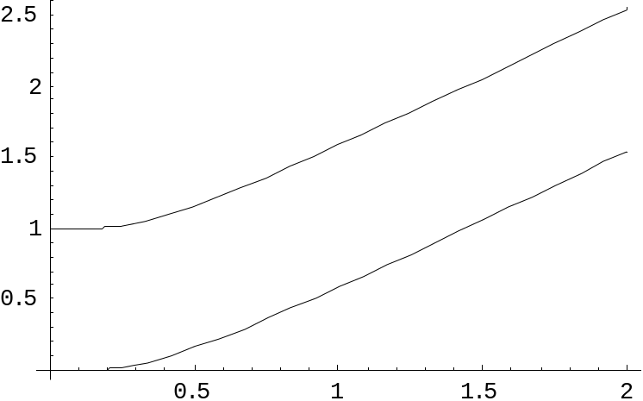

two-level atom radiatively coupled to a thermal reservoir:
“heating”
“cooling”
“non-dissipative”
At low bath temperatures, heating disappears……..
Can We Make Quantum Errors Run Uphill?

Slide 20
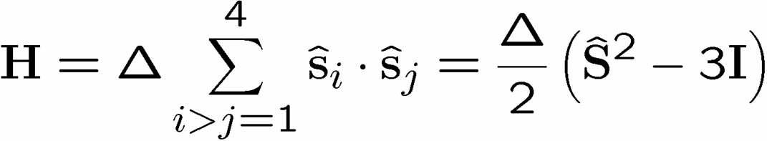
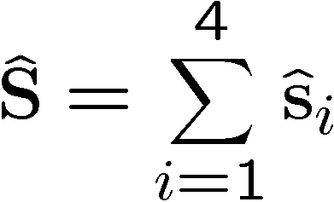








A Supercoherent Qubit
D. Bacon, K.R. Brown, and K.B. Whaley, Phys. Rev. Lett. 87, 247902 (2001)
D. Bacon, Ph.D. Thesis, Berkeley Physics (2001)
1
2
total spin
4
3
= exchange
interaction
1
S=2
1
total
spin
1
3
1
2
S=1
1
2
n
S=0
1
2
3
4
number of qubits
Supercoherent Qubit

Slide 21



Run Uphill
“heating”
S=2
1
2
S=1
4
3
S=0
“nondissipative”
Supercoherent Qubit
All single qubit operators take S=0 states to S>0 states
Supercoherence:
made all single qubit processes “heating”!
At kT< single qubit decoherence mechanisms suppressed
Notes:
Show errors going up
Fix fonts
Talk about local errors

Slide 22


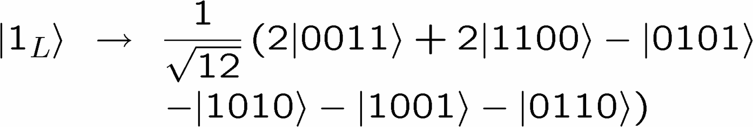
There’s a Code in My Hamiltonian
S=2
classical error
detecting code:
S=1
S=0
Supercoherent Qubit
the degenerate ground state = quantum error detecting code
supercoherent qubit code:

Slide 23
Decoherence Models
Interaction causing
DECOHERENCE
System evolution
environment evolution
spin-oscillator
oscillator modes
= environment
qubit system
spin-spin
spins
= environment
qubit system
independent environments
collective environments

Slide 24
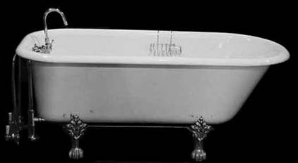


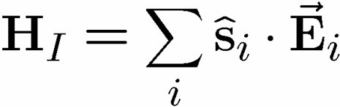
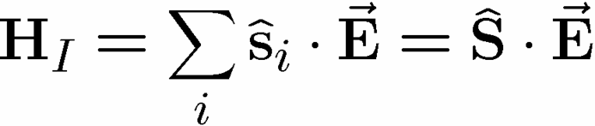




Decoherence-Free Subspaces
P. Zanardi and M. Rasetti, Phys. Rev. Lett. 79, 1953 (1997)
D.A. Lidar, D. Bacon, and K.B. Whaley, Phys. Rev. Lett. 82, 4556 (1999)
D. Bacon, D.A. Lidar, and K.B. Whaley, Physical Review A, 60, 1944 (1999)
D. Bacon, J. Kempe, D.A. Lidar, and K.B. Whaley, Phys. Rev. Lett. 85, 1758 (2000)
J. Kempe, D. Bacon, D.A. Lidar, and K.B. Whaley, Phys. Rev. A 63, 042307 (2001)
D.A. Lidar, D. Bacon, J. Kempe, and K.B. Whaley, Physical Rev. A, 63, 022306 (2001)
1
2
4
3
bath modes
collective
decoherence
spin 0 supercoherent qubit:
when in
the ground state
collective errors do not err the decoherence-free subspace
Notes:
Fix fonts
Summarize (next slide?)

Slide 25

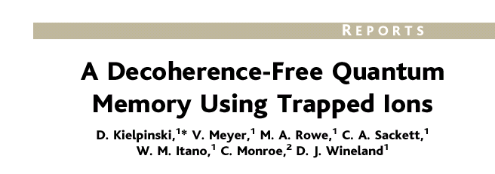
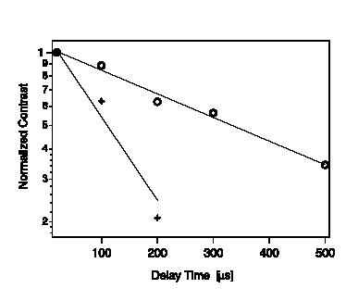

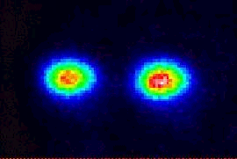


Decoherence-Free In Practice
collective phase errors:
non-DFS
DFS
Notes:
Flip times

Slide 26
So Far
1
2
supercoherent
decoherence-free
4
3
How to Implement?

Slide 27
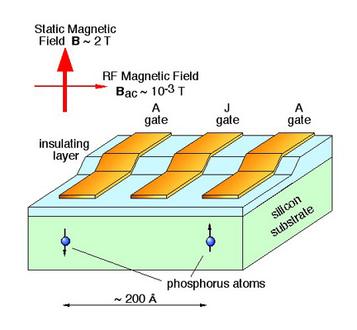
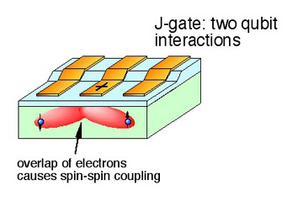
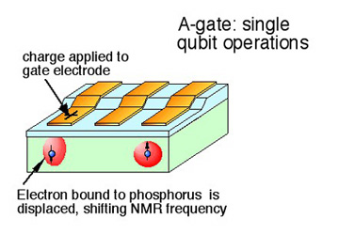
Spintronic Kane Model
B. Kane, Nature 393, 133 (1998)
two qubit gates
~0.1 meV exchange interaction
one qubit gates
Kane quantum computer
diagrams: Los Alamos Quantum Institute

Slide 28
Supercoherent Quantum Computer
exchange interaction
supercoherent qubit
supercoherent qubits
How to quantum compute on encoded qubits?
Perform single and two qubit gates to enact appropriate
operations on encoded qubits.
Problem: leaves supercoherent ground state

Slide 29

A Surprise
Exchange commutes with
total spin:
Exist operations exchange
cannot do.
(like change total spin)
Exchange only quantum computer?
If we use encoded subspaces exchange alone
can quantum compute!
D. Bacon, J. Kempe, D.A. Lidar, and K.B. Whaley, Phys. Rev. Lett. 85, 1758 (2000)
D.P. DiVincenzo, D. Bacon, J. Kempe, G. Burkard, and K.B. Whaley, Nature 408,
339 (2001)
“The speed of the computer…is limited by the rate at which
the single spin operations can be performed.”
B. Kane, Fortschritte Der Physik 48, 1023
vary exchange strength to quantum
compute on the supercoherent qubits

Slide 30
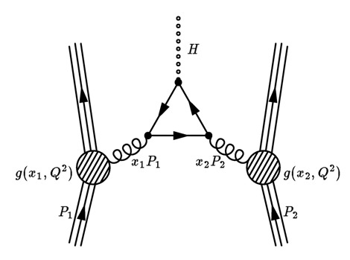
Encoded Universality
D. Bacon, J. Kempe, D.A. Lidar, and K.B. Whaley, Phys. Rev. Lett. 85, 1758 (2000)
D. Bacon, J. Kempe, D.P. DiVincenzo, D.A. Lidar, and K.B. Whaley, Proc. of the Int.
Conf. on Exp. Imp. of Quant. Comp., Sydney, Australia (2001)
D.A. Lidar, D. Bacon, J. Kempe, and K.B. Whaley, Physical Rev. A, 63, 022307 (2001)
D.P. DiVincenzo, D. Bacon, J. Kempe, G. Burkard, and K.B. Whaley, Nature 408,
339 (2001)
J. Kempe, D. Bacon, D.P. DiVincenzo, and K.B. Whaley, Quant. Info. Comp. 1, 33 (2001)
M.J. Bremner, J.L. Dodd, M.A. Nielsen, and D. Bacon, Phys. Rev. A 69 012313 (2004)
Fungible nature
of quantum information
physics of the strongest interactions
encoded universal
quantum computation
encoded
qubit 1
encoded
qubit 2

Slide 31
Use Physics!
Supercoherent Qubits
Quantum Error Detecting
Codes
Decoherence-Free Subspaces
Solid State Implementation
Encoded Universality
(Use Physics!)
Supercoherent Quantum Computing Architecture

Slide 32
The Quantum Hard Drive?
Do there exist (or can we engineer) quantum systems whose
physics guarantees fault-tolerant quantum computation?
1. Coherence preserving.
2. Accessible Fault-Tolerant
Operations
“self-correcting”
3. Universality

Slide 33
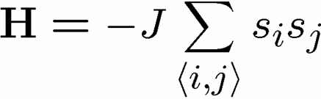





The Physics Guarantee
classical Ising memory
one dimensional Ising model
two dimensional Ising model
redundancy code:
ground states are codewords:
order parameter is total magnetization:
indication that the information is “still there”
1D memories bad
2D memories good

Slide 34

















Self Fixing
Notes:
Make A and B better bouncing ball

Slide 35


Quantum Error Correcting
Order Parameter
physical system
quantum error correcting
code ground state
encoded qubit(s)
errors
The quantum information is
still here. How do we see it?
Order parameter?
diagnose
fix
measure encoded info
j
Encoded quantum information

Slide 36
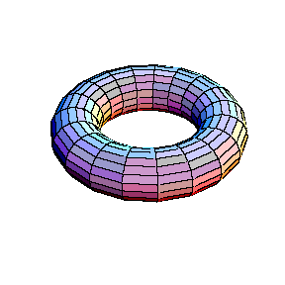


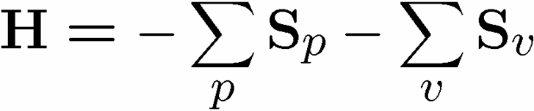





Kitaev’s Toric Codes
qubits on links
ground state is gapped and is a
quantum error correcting code
(corrects # errors = toric length)
quantum error correcting
order parameter big nonlocal
operator.
vertex operators
plaque operators

Slide 37
Are There Quantum Error Correcting Codes in Existing Physical Systems?

Slide 38



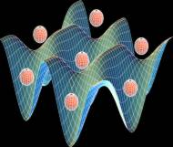
Quantum Computing Phase
Alexei Kitaev (Caltech)
Michael Freedman (Microsoft)
John Preskill (Caltech)
Zhenghan Wang (Indiana)
Lev Ioffe (Rutgers)
Michael Larsen (Indiana)
Chetan Nayak (UCLA)
Fei Zhou (UBC)
Lacking: Self-correcting (natural fault-tolerance)
YY
ZZ
XX
ZZ
XX
YY
YY
ZZ
ZZ
XX
XX
YY
Optical lattice as natural fault tolerant testbed?
Duan, Demler, and Lukin, Phys. Rev. Lett. 91, 090402 (2003)
Notes:
Say WE WEE wee

Slide 39
Error correcting codes
Geometry, Topology?
classical
quantum
Statistical Physics
theory of strongly interacting
quantum systems
renormalization group methods
new order parameters?
Fault-tolerance
local structures giving rise
to global robustness
Implementation Physics
Representation theory
let physics guide
optical lattices, donor
electrons, superconducting
circuits, ion traps, etc.
identification of qubits
and logical operations
Naturally Fault-Tolerant Quantum Computation
But WHAT do we do when we get there?

Slide 40
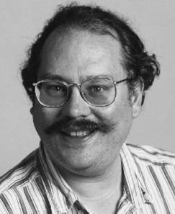
Shor’s Algorithm (1994)
188198812920607963838697239461650439807163563379417382700763356422988859715234665485319060606504743045317388011303396716199692321205734031879550656996221305168759307650257059
=
398075086424064937397125500550386491199064362342526708406385189575946388957261768583317
×
472772146107435302536223071973048224632914695302097116459852171130520711256363590397527
Quantum computer’s can efficiently factor
Numbers (and hence break RSA cryptosystems)
(It is widely suspected that classical computers cannot
efficiently factor numbers.)
Peter Shor
Notes:
They do not know what RSA is.

Slide 41
?
Where are the
Quantum Algorithms?
“If I had a good idea about quantum algorithms, that is what
I would be working on.” – John Preskill (Caltech) 2004

Slide 42

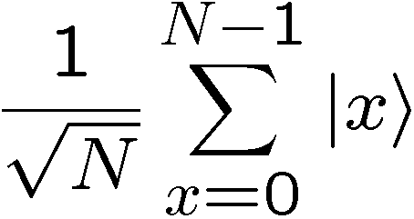
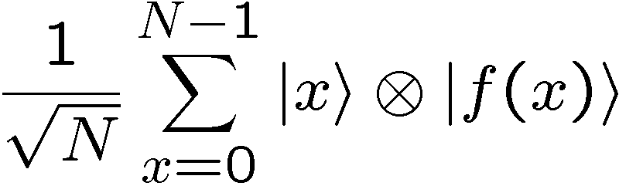


Quantum Power?
Number theory: period finding can be used to factor numbers
period
f(x)
x
Non-important observation: we have simultaneously computed
the value of the function on all possible inputs.
measurement collapses to single computation
Notes:
Fix what shor really did

Slide 43




Symmetry
f(x)
period
x
displacement operator:
state first register is invariant under displacements on the first register:
symmetry under displacement
work in momentum space

Slide 44
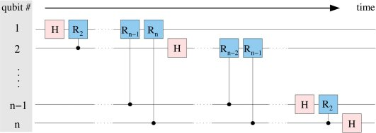

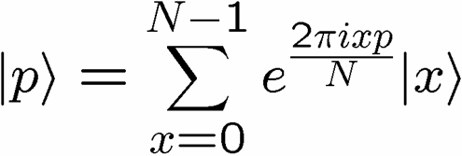

Efficient Circuits for Symmetries
Efficient Quantum Circuit for the Fourier Transform
Quantum computers get their power by exploiting symmetries

Slide 45
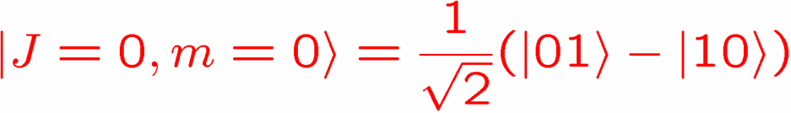
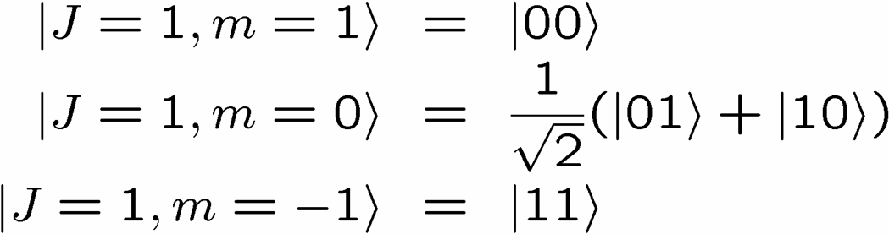


A Physicist’s Symmetry
singlet
triplets
Efficient quantum circuit for Clebsch-Jordan transforms?
Symmetries
n identical copies of a state:
independent of basis:
permutation symmetry S_{n}
unitary symmetry SU(d)

Slide 46







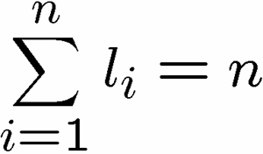


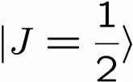

















Schur Transform
D. Bacon, I.L. Chuang, and A.W Harrow, in preparation (2004)
set of all partitions of n
(all Young Diagrams with n rows)
Our result: An efficient quantum circuit for the Schur Transform
garbage bits

Slide 47

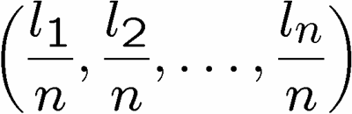
Applications
Optimal Spectrum Estimation:
M. Keyl and R. Werner, Phys. Rev. A 64 052311 (2001)
Task: estimate eigenvalues of
Perform
Measure
Estimate
Without an efficient circuit for
the Schur transform these are
not practical schemes.
Quantum Universal Variable Length Source Coding
M. Hayashi and K. Matsumoto, quant-ph/0209124
Quantum Hypothesis Testing
M. Hayashi, quant-ph/0107004
State Estimation
R.D. Gill and S. Masar, quant-ph/9902063
Encoding Into Decoherence-Free Subspaces
D. Bacon, J. Kempe, D.A. Lidar, and K.B. Whaley, Phys. Rev. Lett. 85, 1758 (2000)
J. Kempe, D. Bacon, D.A. Lidar, and K.B. Whaley, Phys. Rev. A 63, 042307 (2001)
Universal Entanglement Concentration
M. Hayashi and K. Matsumoto, quant-ph/0209030

Slide 48

Our Path
Information is physical
Quantum computation
What physics allows classical computation?
What makes quantum so hard?
Supercoherent qubits
Quantum codes in physical systems
Decoherence-free subspaces
Spintronic architecture
Encoded universality
Natural fault-tolerant quantum computing
Quantum algorithms
Symmetry exploiting
Schur transform
Efficient protocols for
quantum information theory
?
Notes:
Path can continue

Slide 49
Computer
Science
The Boundary
Physics
Fault-Tolerant
Quantum
Computation
Statistical
Physics
Error Correcting
Codes
Quantum Algorithms
Communication
Complexity
Decoherence
Theory
Solid State Qubits
Efficient Quantum Circuits
Quantum Communication Complexity
Computational
Complexity
Quantum Control
Decoherence
Experiments
Fault-tolerance
Quantum Correlations
AMO
Qubits
Universal
Computation
Strongly Interacting
Quantum Systems
Universal
Quantum
Computation
Quantum Information Theory
Circuit
Complexity
Solid State Physics
AMO Physics
Information
Theory
Quantum Foundations
Quantum Error Correction
Spintronics

Slide 50







The Path Ahead (I)
Quantum Computers that Fix Themselves

Slide 51

The Path Ahead (II)
Quantum Algorithms and Symmetry

Slide 52
Bigger Picture
Quantum computation
building
exploiting
understanding
Quantum computation
what can we learn about
physics from theoretical
computer science?

Slide 53



Collaboratorium
Calgary
Richard Cleve
MIT
Ken Brown
Andrew Childs
Isaac Chuang
Aram Harrow
Berkeley
K. Birgitta Whaley
Toronto
Daniel Lidar
Stanford
Xinlan Zhou
IBM TJ Watson
Guido Burkard
David DiVincenzo
Caltech
Debbie Leung
John Preskill
Ben Toner
Queensland
Mic Bremner
Jennifer Dodd
Michael Nielsen
Brussels Free University
Nicholas Cerf
Serge Massar
Universite de Paris-Sud
Julia Kempe

Slide 54


Fin
Tales from the Boundary of
Physics and Computer Science
Dave Bacon, Caltech

