Slide 1



In Search of a Magic Bottle of Error-Be-Gone
Decoherence
errosol
Dave Bacon
Caltech
Department of Physics
Institute for Quantum Information

Slide 2
Precognition
Visualize 2040:
what will a quantum computer look like?
Experimentalists all just thought
Linear Optics + a bit
Ion Traps
Josephson Junctions
Optical Lattices
Electron
Spins
Quantum Architecture?

Slide 3
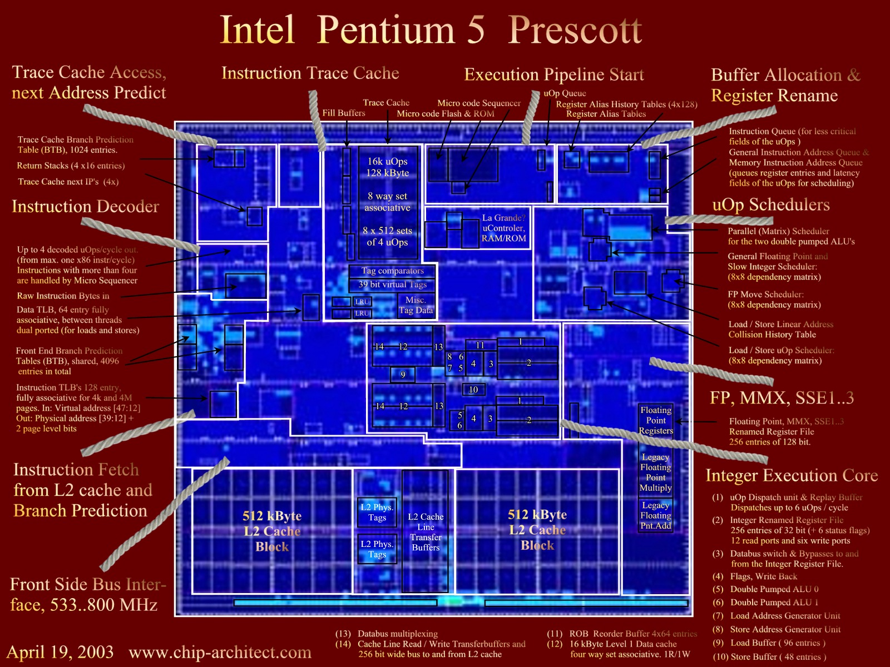
We have to work even harder!

Slide 4
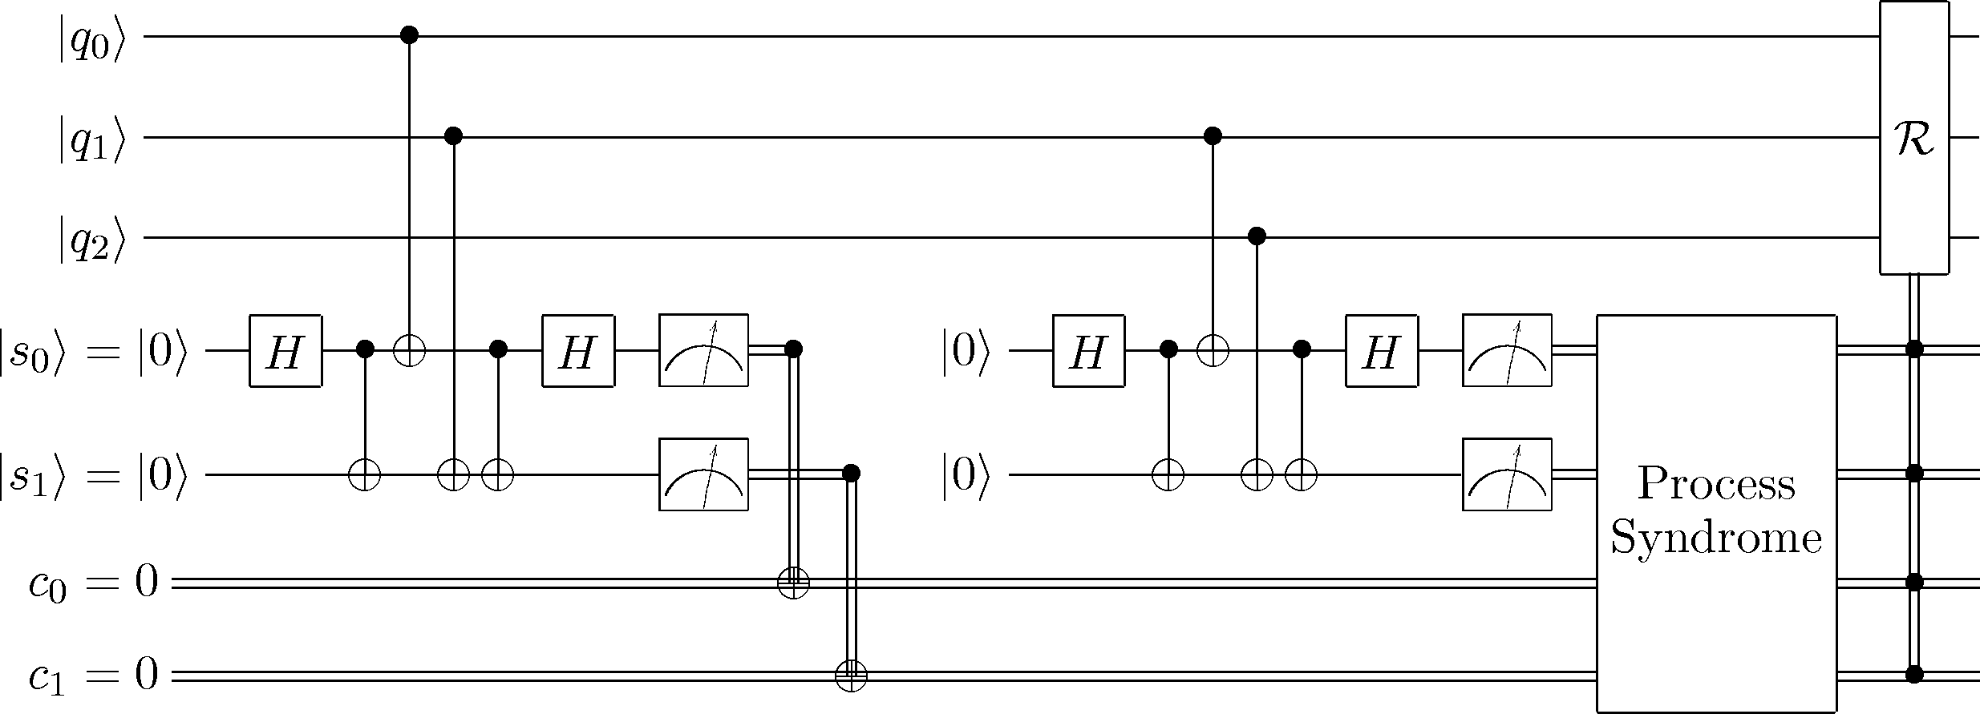
Fault Tolerant Quantum
Architecture?
At the lowest level we must perform quantum error
correction and use fault-tolerant techniques.
What is the “best” way to do this?

Slide 5
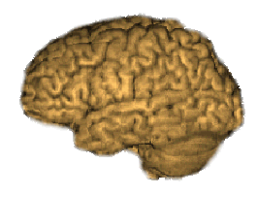
“Best?”
Objection: BEST depends on strengths and weaknesses
of particular physical implementations
theory brain trust
physical implementation
gate speeds
gate accuracies
gate costs
forms of decoherence
decoherence times
shuttling speeds
shuttling accuracies
cooling rates
calibration errors
degree of parallelism
geometric constraints
fabrication constraints
quantum architecture specification
plans suitable for founding qIntel

Slide 6
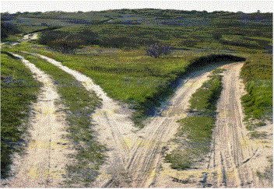
Two Paths
concatenation
local codes
even today TWO styles are emerging

Slide 7
Concatenation
probability
of failure
level
qubits
0
1 qubit
p
1
n qubits
cp²
2
n² qubits
c(cp²)²
k
2^{k}
n^{k} qubits
(cp) /c
exponential decrease
in # qubits if
p<1/c=p_{thresh}

Slide 8

Threshold Theorem
A quantum circuit with
k gates
can be simulated with
error probability e
using
O(k poly(log(k/e))) gates
on hardware whose components fail with probability
p less than some threshold p_{thresh}
under caveats A, B, C, D,…
faulty components
almost certainly not faulty

Slide 9
Concatenation and Locality
Concatenation is hierarchical
how to merge with local bare qubits?
despite: moving or swapping qubits creates error rate
proportional to distance moved
THERE IS STILL A THRESHOLD THEOREM
Daniel Gottesman, 1999

Slide 10
Are there non-hierarchical ways to
do fault-tolerant quantum computation?

Slide 11
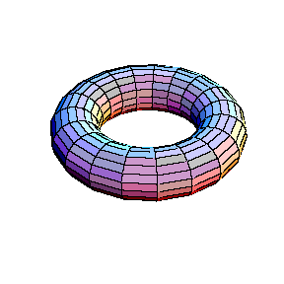







Kitaev’s Toric Codes
qubits on links
2 encoded qubits
1 encoded qubit
syndrome measurements
involve only four qubit local
measurements!
vertex operators
BUT: diagnosing error
is not a local process.
plaque operators

Slide 12
Local Codes
Can we find a fully local code?
syndrome
+
diagnosis and correction
+
fault-tolerant
In 4 dimensions there is a fully local code
(sit down silly string theorists)

Slide 13
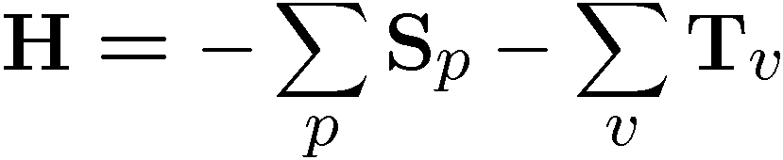
Physics and Toric Codes
qubits on links
1 encoded qubit
ground state is the toric code!
energy required to excite out
of code: at low temperatures
we can freeze out errors.
error correction still needed
vertex operators
plaque operators

Slide 14
The Physics Guarantee
Rant mode ON
What is the phase of matter corresponding to the computer?
There are distinct PHYSICAL and DYNAMICAL reasons why
robust classical computation is possible.
not all physical systems are equally good for computation:
there exist systems whose PHYSICS guarantees
their ability to enact robust classical computation.

Slide 15
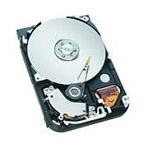
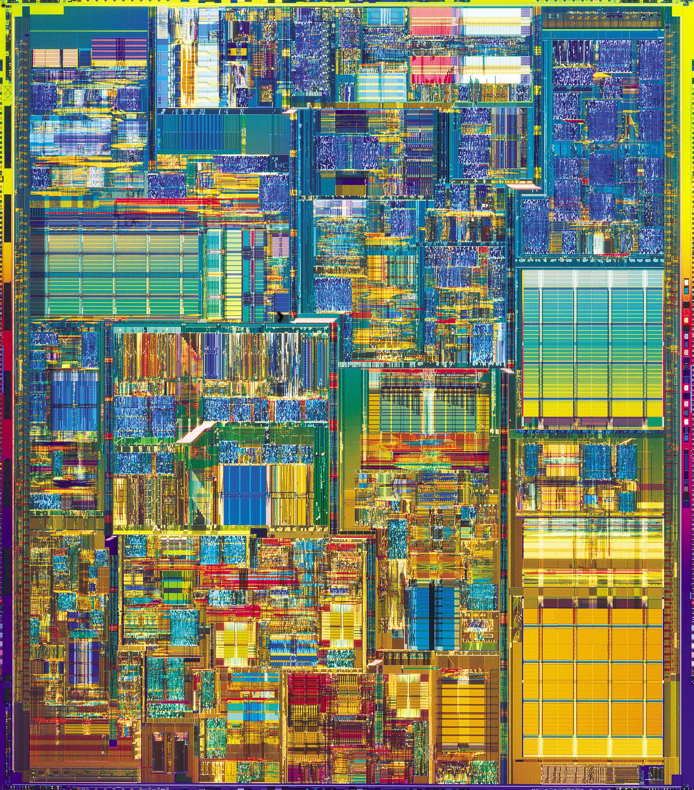
In Practice
Hard Drive
Integrated Circuit
Coding: majority vote of
magnetism
Coding: majority vote of
current
Error correction: local energy
minimization
Error correction: amplification
fault-tolerance guaranteed
by conducting-insulating
phase transition
Notes:
Unclear how ft is different

Slide 16
The Physics Guarantee
Rant mode ON
What is the phase of matter corresponding to the computer?
There are distinct PHYSICAL and DYNAMICAL reasons why
robust classical computation is possible.
not all physical systems are equally good for computation:
there exist systems whose PHYSICS guarantees
their ability to enact robust classical computation.
What is the phase of matter corresponding to the
quantum computer?
Are there (or can we engineer) physical systems whose
PHYSICS guarantees robust quantum computation?

Slide 17




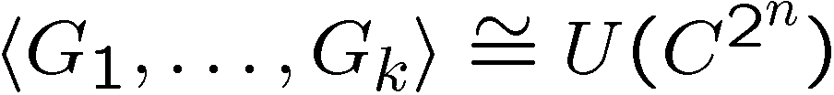
Rant mode ON
The Quantum Hard Drive?
Do there exist (or can we engineer) quantum systems whose
physics guarantees fault-tolerant quantum computation?
1. Coherence preserving.
2. Accessible Fault-Tolerant
Operations
“self-correcting”
3. Universality

Slide 18
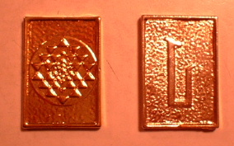
Two Paths
Rant mode OFF
concatenation
Engineering?
local codes
Physics?
CuBits

