Slide 1
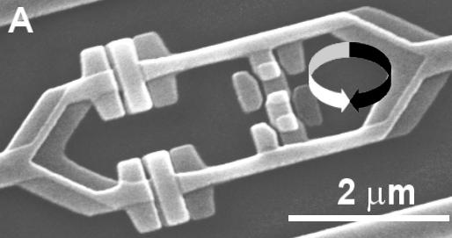

Quantum Algorithms
18819881292060796383869
72394616504398071635633
79417382700763356422988
85971523466548531906060
65047430453173880113033
96716199692321205734031
87955065699622130516875
9307650257059
Past,
Present,
and Future
3980750864240649
3739712550055038
6491199064362342
5267084063851895
7594638895726176
8583317
4727721461074353
0253622307197304
8224632914695302
0971164598521711
3052071125636359
0397527

Dave Bacon
Santa Fe Institute

Slide 2
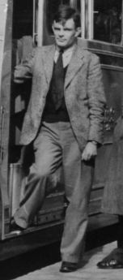
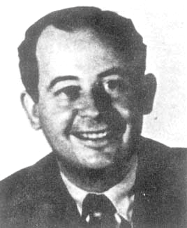
Computation and Science
John von Neumann
Alan Turing
Blue state
Red state
The invention of the modern computer
changed the way we do science.

Slide 3
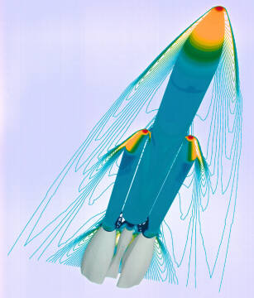
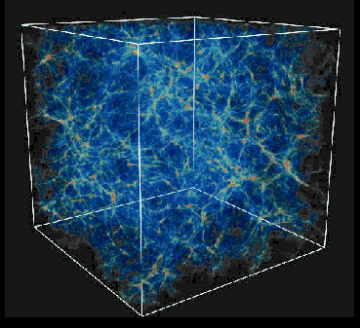
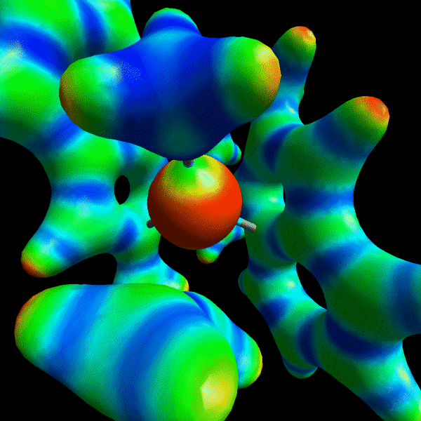
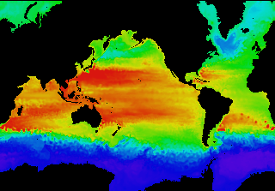
Simulation Revolution
copyright © ONERA 1996-2004
Bryan and Norman (UIUC, NCSA, GC3)
Rene Windiks, Bernard Delley (PSI)
Computer Hardware, Advanced Mathematics
and Model Physics (DOE)

Slide 4
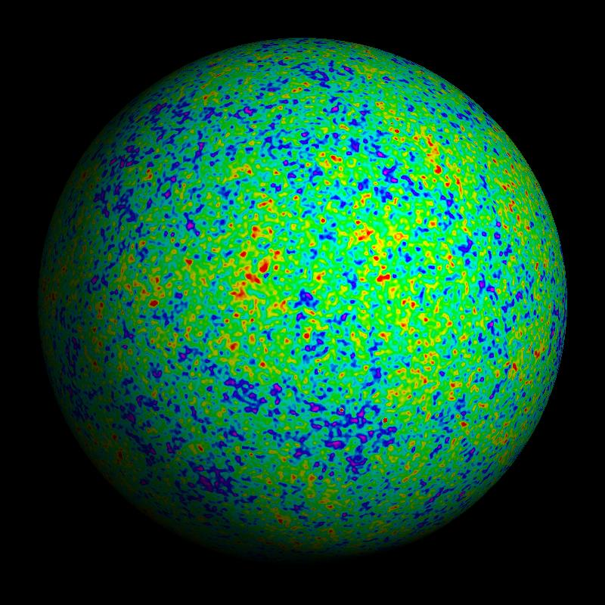
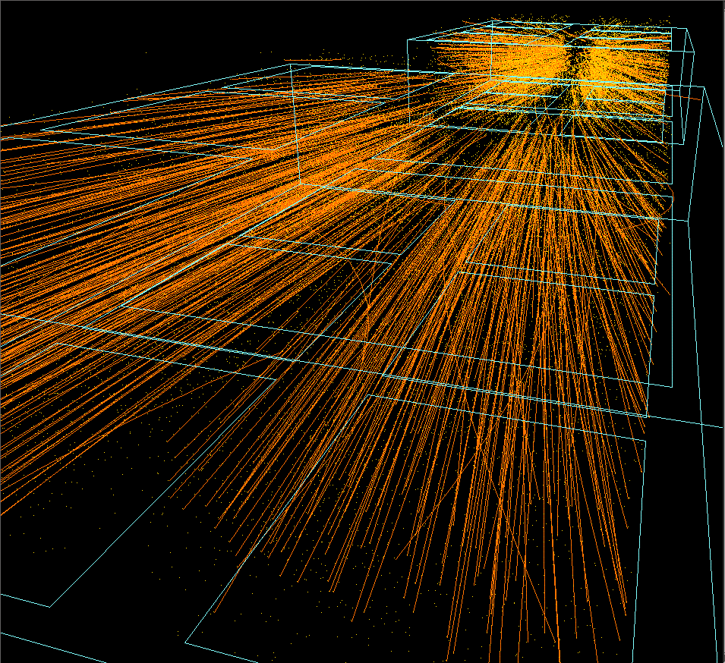
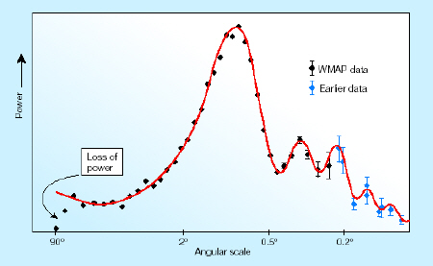
Data Revolution
WMAP
Cern NA49 experiment

Slide 5
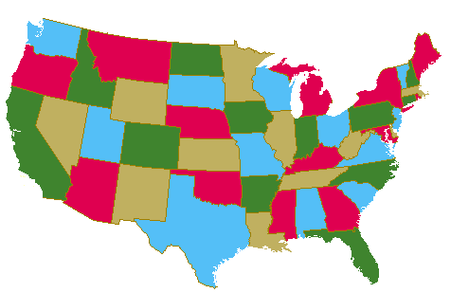
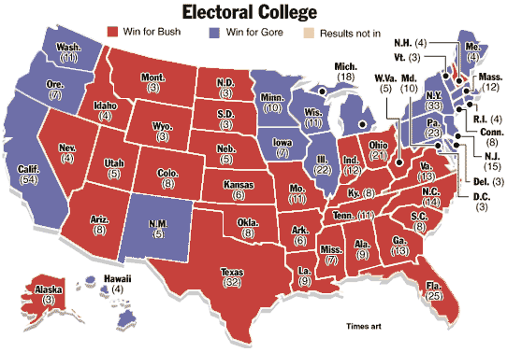
Symbolic Revolution
Four Color Theorem

Slide 6
Not Our Universe
Suppose:
a computer could search an unordered list of size N in time log(N)
Then:
Find a short proof of the Reimann hypothesis (unemployment for mathematicians?)
Find the smallest polynomial time program for reproducing a data set
(unemployment for theorists?)
Perform near perfect pattern recognition, language comprehension, and many learning tasks
(unemployment for humanity?)

Slide 7
Our Universe
“NATURE ISN'T CLASSICAL, damn it, and if you want
to make a simulation of nature, you'd better MAKE IT
QUANTUM MECHANICAL, and by golly it's a wonderful
problem because it doesn't look easy.” – Richard Feynman
Quantum Computer: a computer whose evolution obeys the
laws of quantum theory.
Time
1926
1982
1994
2000
Worry Era
Cite Feynman Era
Cite Shor Era
SciFi Era
-1
0
1
7
Size of Quantum Computer (qubits)

Slide 8
Quantum Science
Will quantum computation change the way we perform science?
What can a quantum computer do?

Slide 9

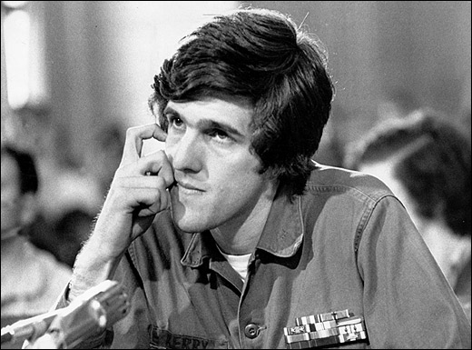
A Game
The Physicist’s Game

Slide 10

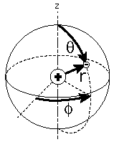
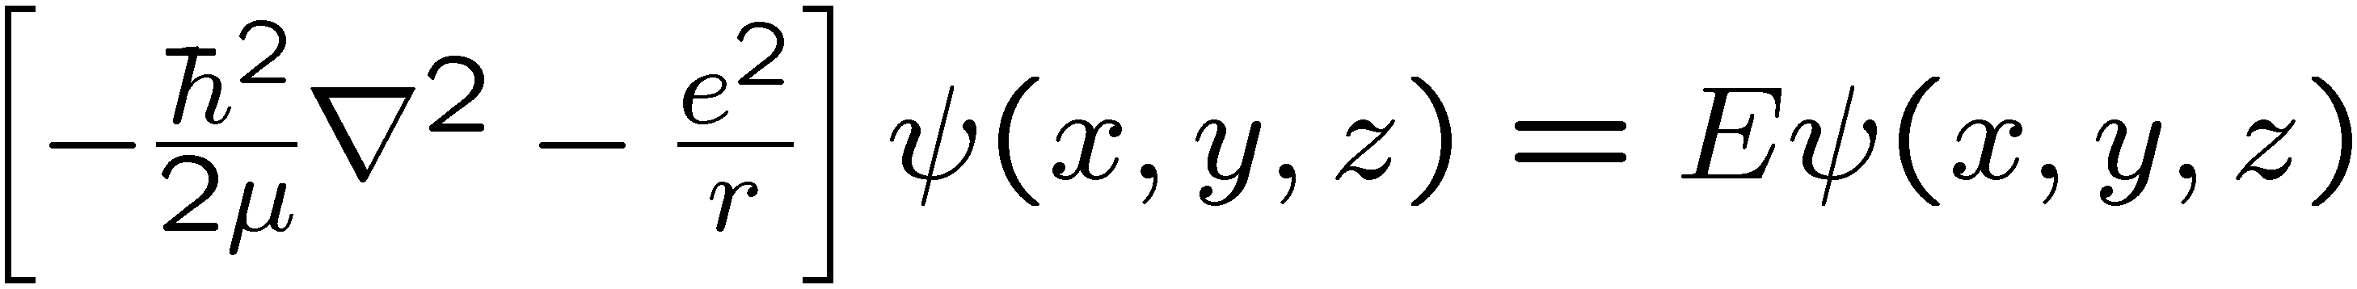
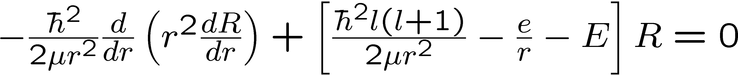
Mmmm…Symmetry
What are physicists good at?
symmetry
symmetry
Why are physicists good at this?
Nature is often symmetric!
Symmetric problems are solvable problems!
Example: Hydrogen atom
spherical symmetry

Slide 11
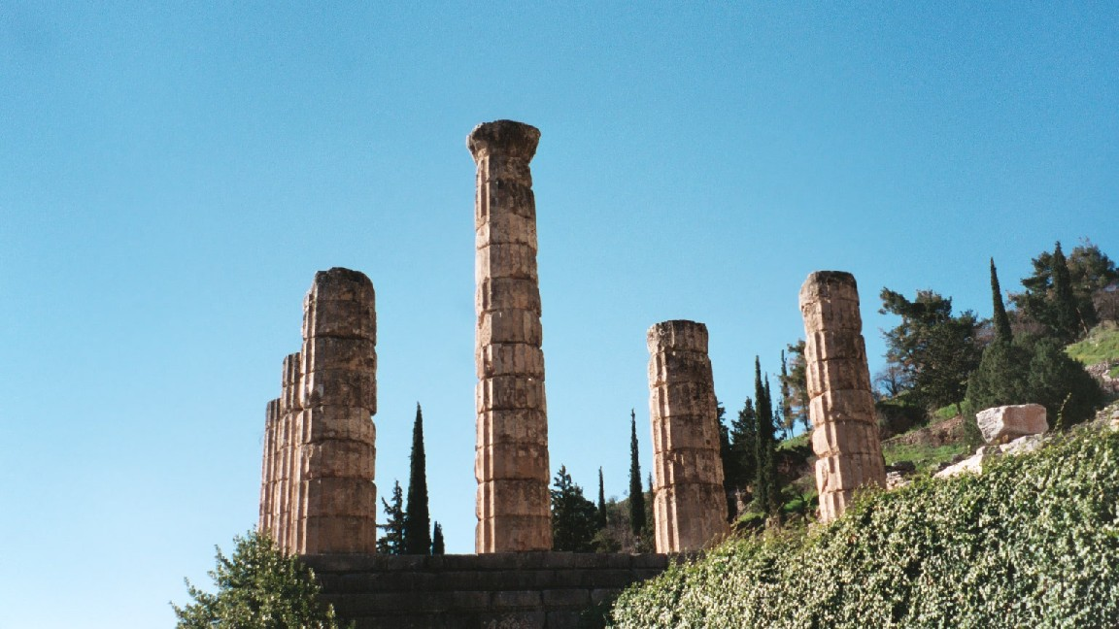

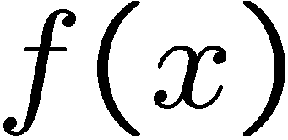

A Guessing Game
period

Slide 12









Period Finding
quantum
oracle
Problem: find in as few
queries as possible
….in as few uses of the
quantum oracle as possible
Period Finding Problem
a symmetric problem!
computer sciencese:

Slide 13
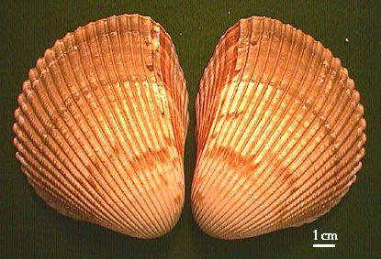
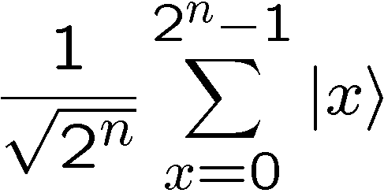
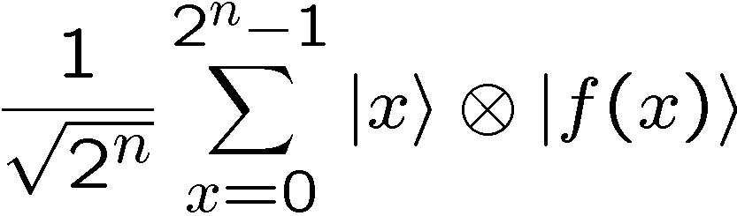


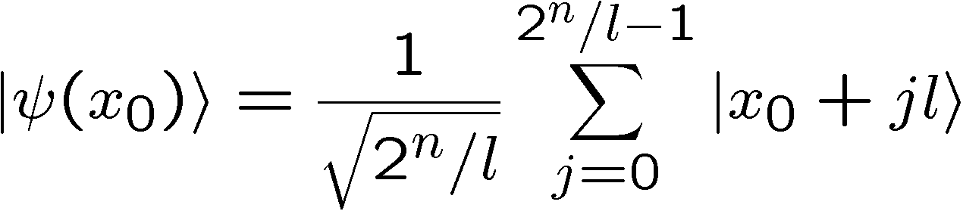
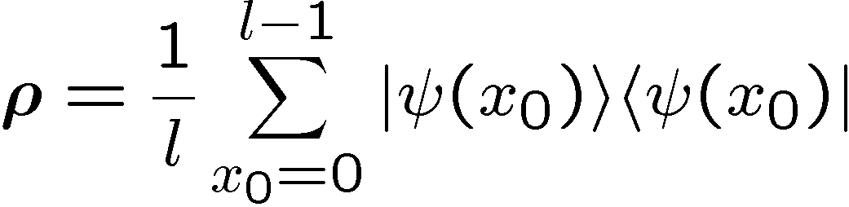

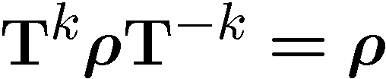
Explicit Symmetry
measure second register, randomly obtain
first register:
translational invariance
work in momentum basis

Slide 14
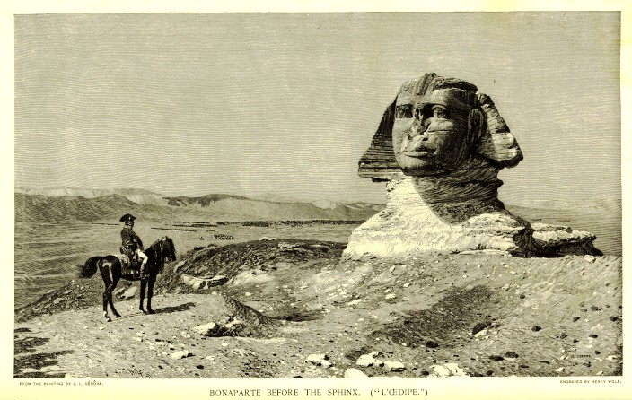
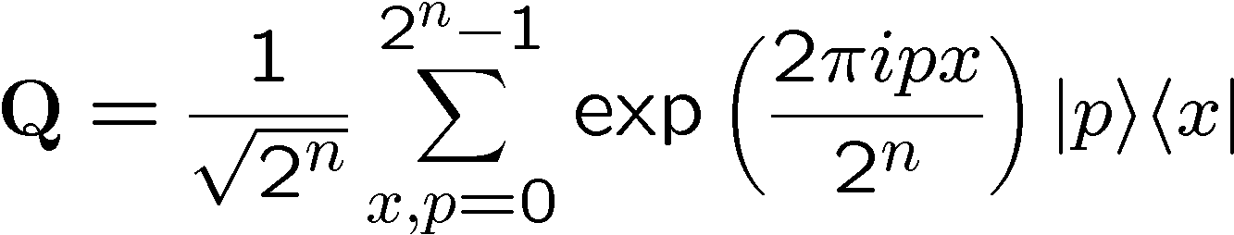
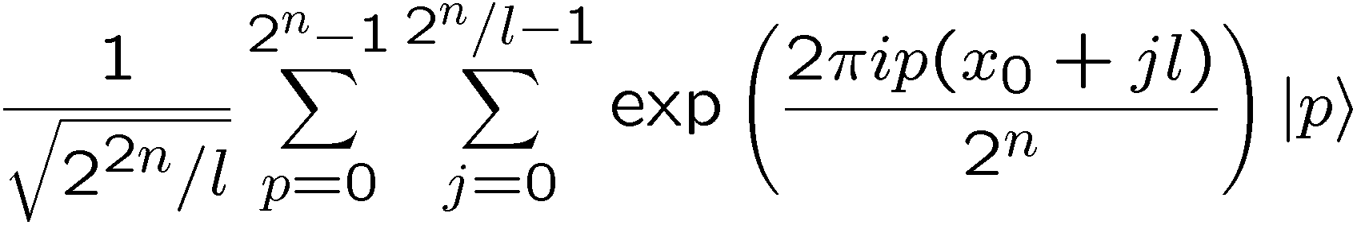


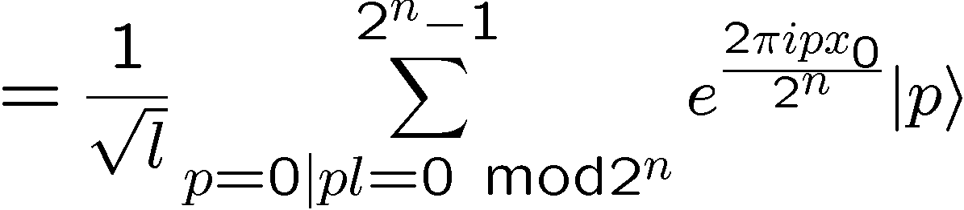


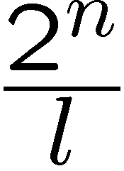
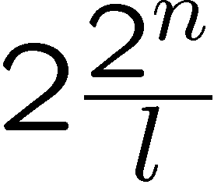
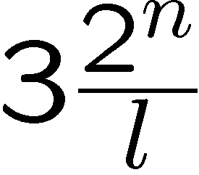
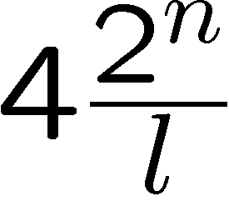
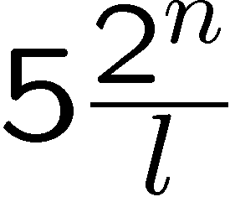
Fourier
To The Rescue
probability

Slide 15
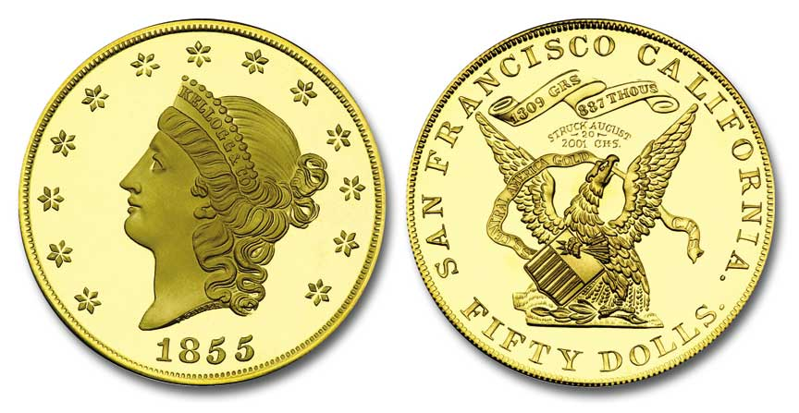
The Wrong Answer
“If it were possible to achieve the appropriate superposition of
250 particles, then a quantum computer could perform 10^75
simultaneous computations, completing them in one second! Oops!”
-anonymous web source
n coins
phase space size is 2^{n}

Slide 16
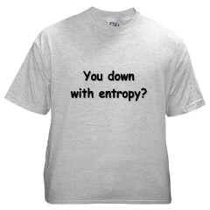


You Down With Entropy?
State:
Entropy:
The quantum algorithm has measured the entropy!
Are quantum computers good at finding the entropy?

Slide 17
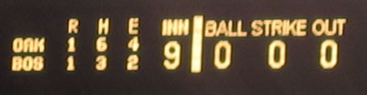



1 to 1 or 2 to 1?
1 to 1
2 to 1
Theorem (Aaronson 2002): A quantum computer must query f(x) at
least 2^{n/5} (since improved to 2^{n/3}) times to distinguish between
these two alternatives.
Experimentalists beware: measuring entropy is HARD!

Slide 18

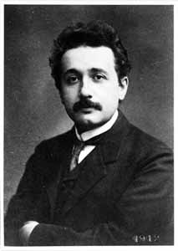
Useful Symmetry
Today we are engaged in a great search for:
1. Computational problems with symmetry.
2. Efficient quantum transforms to exploit symmetry.

Slide 19


1-way Functions
computing f(x) is easy
(can be done in time polynomial in n)
computing f⁻¹(x) is hard
(suspected that it takes a time exponential in n)

Slide 20




1-way Subset Sum
Randomly selected
i^{th} bit of b
easy
hard

Slide 21
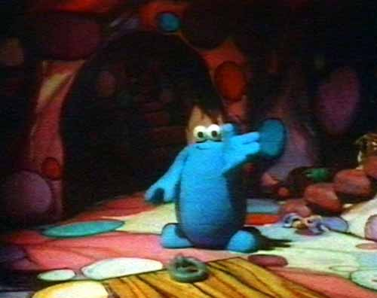




Trapdoor
easy
don’t know t: hard
know t: easy

Slide 22




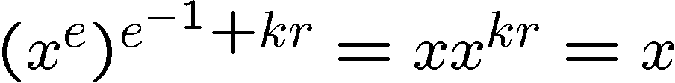
Order Finding
where’s the symmetry?
f not periodic
period=r

Slide 23
Factoring
18819881292060796383869
72394616504398071635633
79417382700763356422988
85971523466548531906060
65047430453173880113033
96716199692321205734031
87955065699622130516875
9307650257059
3980750864240649
3739712550055038
6491199064362342
5267084063851895
7594638895726176
8583317
4727721461074353
0253622307197304
8224632914695302
0971164598521711
3052071125636359
0397527

Quantum computers can efficiently factor numbers (Shor 1994)

Slide 24

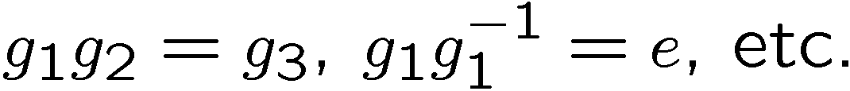








The Hidden Subgroup Problem
Finite group:
Given:
which is constant and distinct on left cosets of some subgroup
Find:
generators for

Slide 25
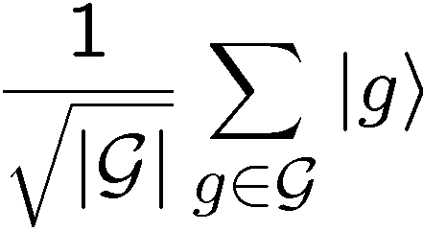
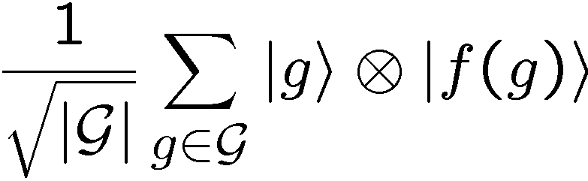

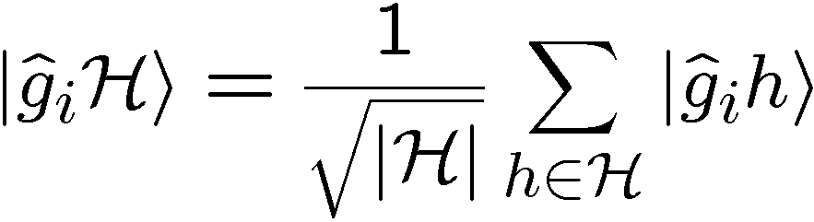
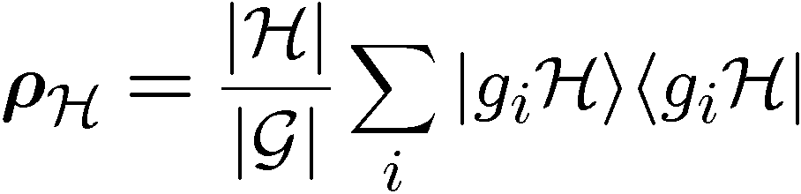
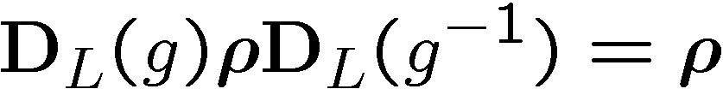
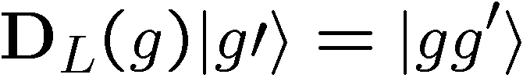
Symmetry and the HSP
function register outcome
regular representation:
SYMMETRY!

Slide 26




We Care About HSP Because…
Group .
classical problem
Abelian
period finding
order finding
factoring
discrete logarithm
Abelian groups
efficiently solvable
efficiently solvable?
dihedral group
certain shortest vector
in a lattice problems
symmetric group
graph isomoprhism
non-Abelian

Slide 27

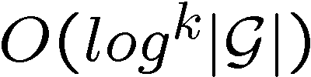

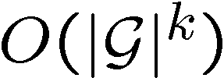
Frustration!
It is known that if we have copies of
then there exists a measurement to find generators of [Knill, Ettinger, Hoyer]
the description of this measurement is circuit of depth
better description of this measurement?

Slide 28




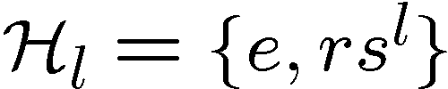

Dihedral HSP
: symmetry group on N sided regular polygon
Hidden reflection problem: the hidden subgroup is of the form
Best known quantum algorithm [Kuperberg 2003, Regev 2004]
time[Kuperberg] and space[Regev]
DHSP is important because solving it would solve certain shortest
vector in a lattice problems [Regev] (and break a cryptosystem!)

Slide 29
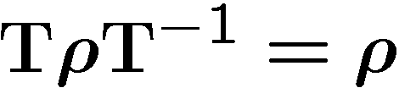











Hidden Phase Problem
symmetry
period finding:
form an Abelian group
non-Abelian
Fourier transform over
quantum
dihedral
machine(qdm)
uniform random between
0 and N
Hidden Phase Problem: find using few queries to the qdm.
Notes:
for

Slide 30






1 Use of the QDM
[joint work with Andrew Childs (Caltech) and Wim van Dam (UCSB)]
random
Examples
8
3
10
1 5 9
1
5
0 1 2 3 4
5 6 7 9
10 11
6
0
2 6 10
0 4 8
11
7
4
2
3 7 11
9
What is the optimal measurement for finding the hidden reflection?
(maximize probability of correctly identifying l)

Slide 31







1 Copy Optimal Measurement
(assume J≠0)
define non-normalized states
8
3
10
1
5
6
0
generalized measurement
11
7
4
2
9
this measurement is optimal (from Holevo 1973, Ip 2004)
best J (J coprime to N)
k

Slide 32



Multicopy Optimal Measurement
q copies
optimal generalized measurement [Bacon, Childs, van Dam 2004]
if q = log (N) then implementing this measurement solves DHSP.

Slide 33


Optimal Measurement and
Subset Sum
What makes implementing hard?
subset sum!
hard
Theorem [Bacon, Childs, van Dam 2004]: If we can implement the
measurements for q queries then we can
solve subset sum for q numbers of size N.

Slide 34





Subset Sum
classically efficiently solvable
1 to 1
Many to 1
efficiently implementing measurement would expand region
of solvable subset sum problems

Slide 35
Review
Quantum Algorithms Exploit Symmetry
Symmetric Problems with Applications?
Optimal Measurements for the Dihedral
Hidden Subgroup Problem
Efficient Implementation of this Measurement
Would Solve Certain Subset Sum Problems

Slide 36

A New Hope
Problems a Quantum Computer
Might Efficiently Solve
Graph Isomorphism
Restricted Subset Sum Problems
Polynomial Reconstruction
Restricted Shortest Vector in a Lattice Problems
Restricted NP-complete Problems?
Change How We Do Science

