Slide 1

Entanglement and the Sign Problem in Quantum Monte Carlo
Dave Bacon
Department of Computer Science & Engineering
University of Washington

Slide 2
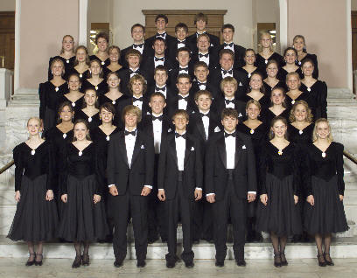
Motivation
Preach to the choir
properly accounting for entanglement can
result in superior numerical methods for
simulating the physics of quantum systems
Examine previous simulation failures in light of this insight?
Quantum Monte Carlo

Slide 3
Quantum Monte Carlo
Schwarz

