Slide 1
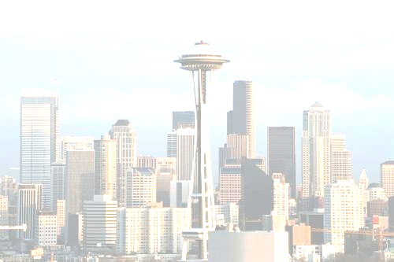
The Quantum Compass Model
Dave Bacon
Department of Computer Science & Engineering
University of Washington

Slide 2


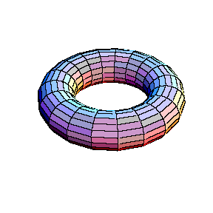








Kitaev’s Idea
Are there many-body quantum systems which can be used
to robustly store quantum information and keep this
information coherent during fault-tolerant computation with
this information?

Slide 3
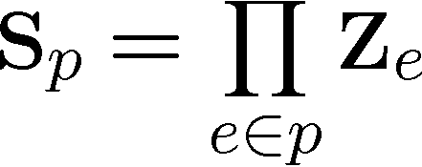
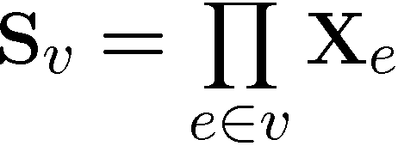
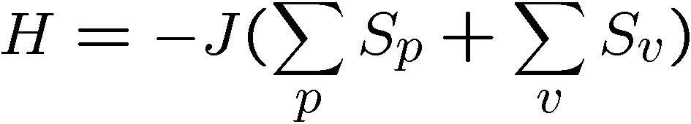
Kitaev’s Toric Codes
Qubits on the edges of a lattice on a torus
(torus condition can be removed)
Plaque operators:
Vertex operators:
Stabilizer code: plaque and vertex opertors commute
degenerate +1 eigenspace is quantum error correcting code

Slide 4
Kitaev’s Toric Codes
Energy spectrum has gap between
ground and first excited states
degeneracy is lifted by perturbations only at n^{th} order
Can be used to robustly store quantum information in
ground state degeneracy if the temperature is less than
the gap.
Something I worry about: if you enact operations on such a
system, you’re errors will become thermal excitations and
will disorder the quantum information

Slide 5
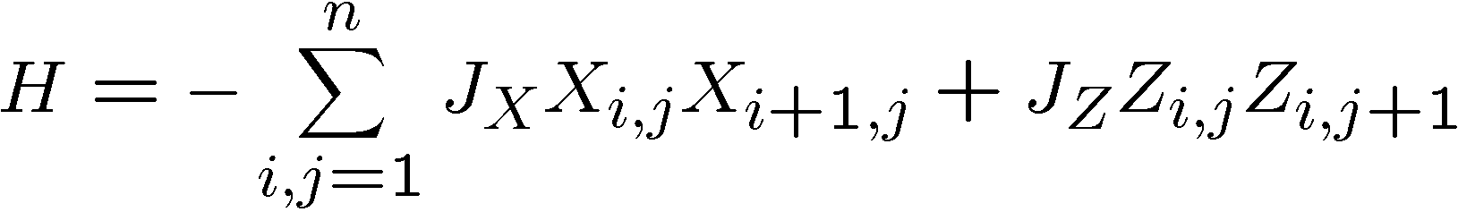
Quantum Compass Model
[B. Douçot, M. V. Feigel’man, L. B. Ioffe, and A. S. Ioselevich 05]
[Dourier, Becca, Mila 05]
ZZ
ZZ
ZZ
XX
XX
XX
XX
n by n
square
lattice
ZZ
ZZ
ZZ
XX
XX
XX
XX
ZZ
ZZ
ZZ
XX
XX
XX
XX
ZZ
ZZ
ZZ

Slide 6
Quantum Compass Model
ZZ
ZZ
ZZ
XX
XX
XX
XX
n by n
square
lattice
ZZ
ZZ
ZZ
XX
XX
XX
XX
ZZ
ZZ
ZZ
XX
XX
XX
XX
ZZ
ZZ
ZZ
1. The quantum error correcting subsystem
2. Gapped or not gapped?
Green’s function quantum monte carlo
3. More interesting systems…fodder for you all?

Slide 7
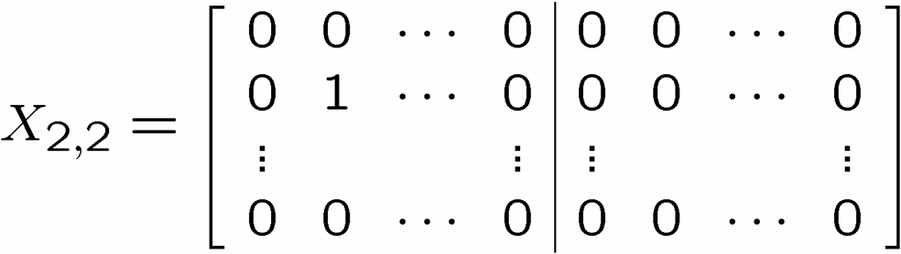
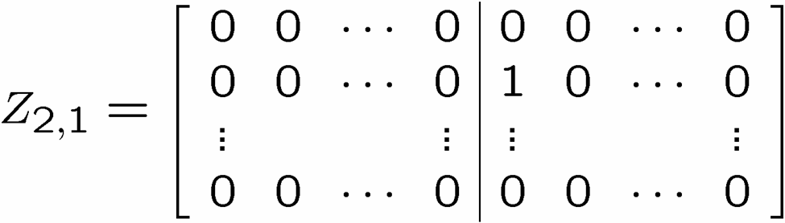
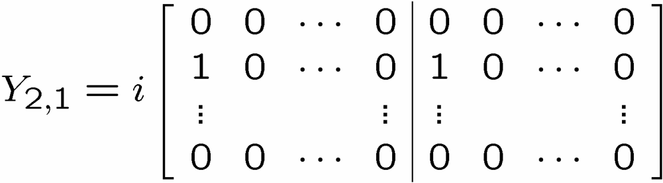

Flatland
X
Z
n by n cubic
lattice of qubits:
generic Pauli group operator on cubic lattice:
A, B n by n 0,1 matrices

Slide 8

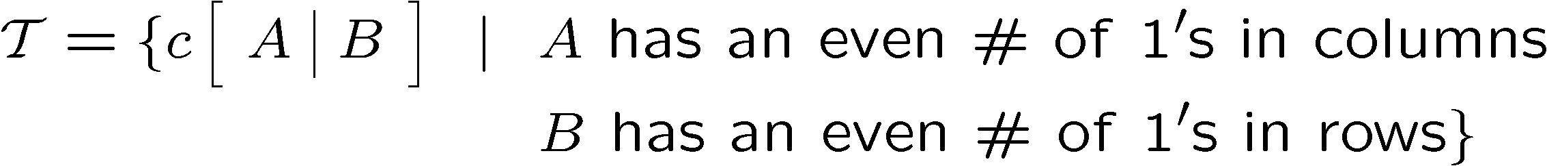
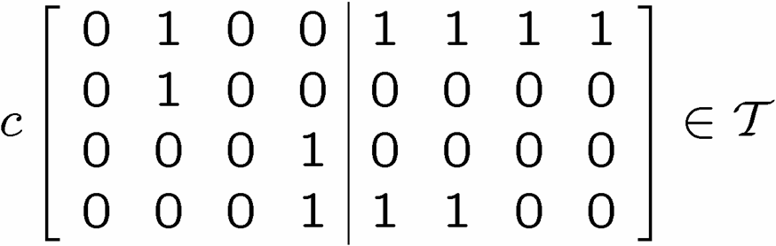

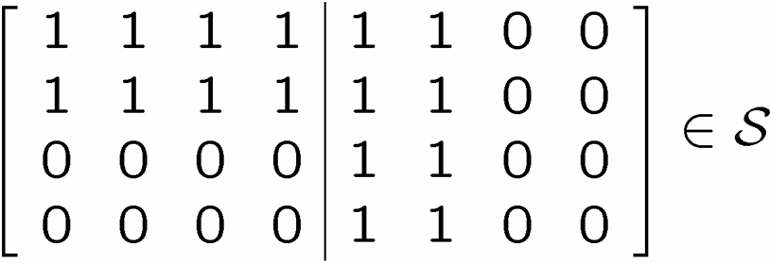
X Columns, Z Rows
X
Z
ZZ
ZZ
XX
XX
XX
ZZ
ZZ
XX
XX
XX
ZZ
ZZ
X
X
X
X
X
X

Slide 9
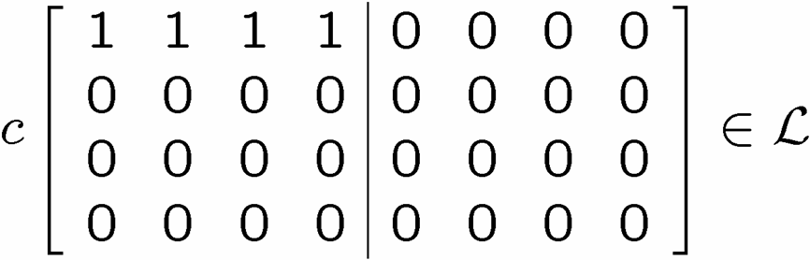

X Columns, Z Rows
Z
X
X
X
Z
Z

Slide 10
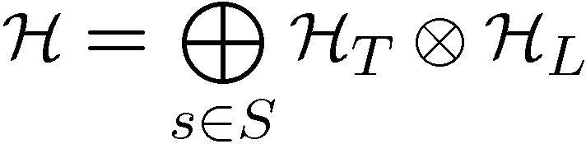


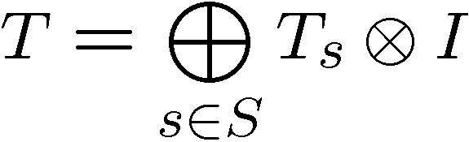
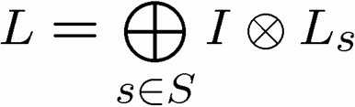
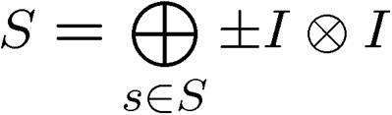
A Little Representation Theory

Slide 11
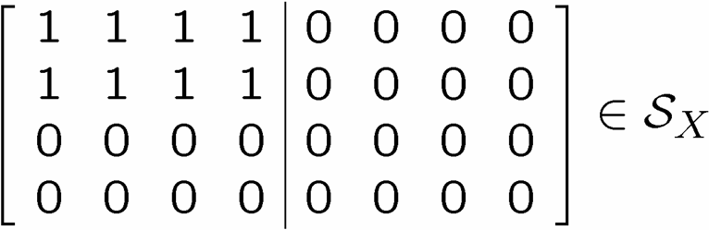
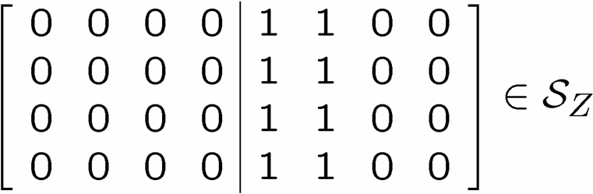
Quantum Error Correcting Subsystems

Slide 12

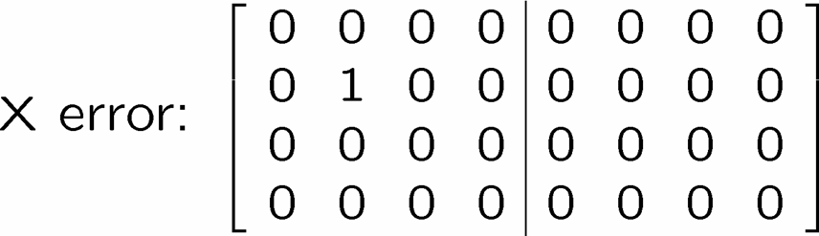
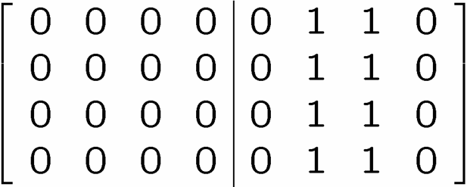
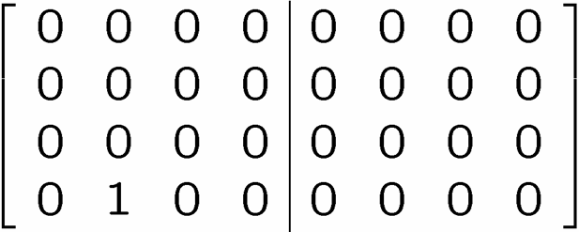
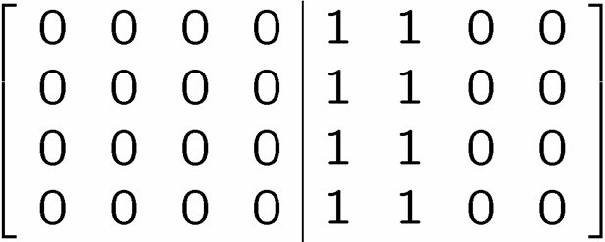
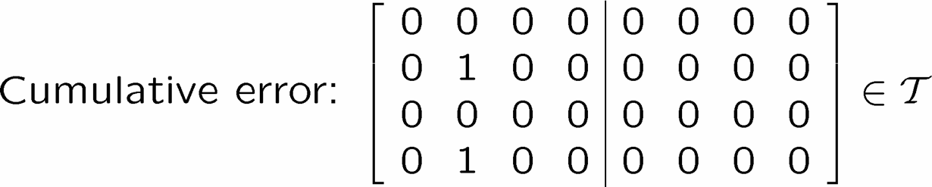

Diagnose and Pseudo-Fix
1
2
3
4

Slide 13
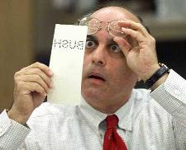
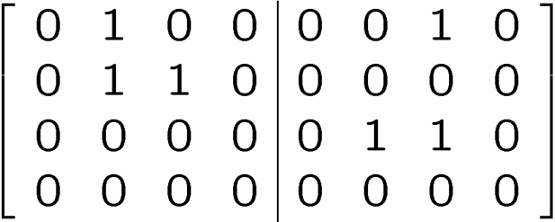



Detailing The Fix

Slide 14
Subsystem Quantum Error Correction
Codes are not really different from subspace codes,
but the error recovery routine can be different.
Does this lead to better codes?
(memory and fault-tolerant thresholds)

Slide 15


Properties of the Code
No memory threshold.
  Why? Number of correctible errors scales like linear
  dimension. Even “typical” errors (unlike toric code.)
2. Still, we can use subsystem code to define order parameter
this might be all right if the
system is “self-correcting”

Slide 16
Quantum Compass Model
[B. Douçot, M. V. Feigel’man, L. B. Ioffe, and A. S. Ioselevich 05]
[Dourier, Becca, Mila 05]
If this system has a gap, then we can encode quantum
information in its degenerate ground state and it might be
protected at low enough temperature.
Is it gapped?

Slide 17
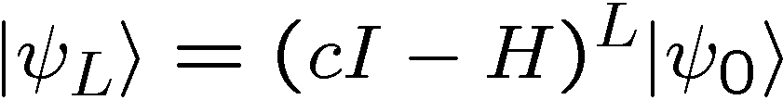
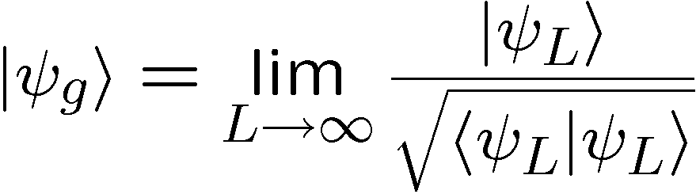
Green’s Function Quantum
Monte Carlo
powering method:
ground state:

Slide 18


Green’s Function Quantum Monte Carlo
powering method:
ground state:
assume has all positive entries
decompose as
diagonal
positive
stochastic

Slide 19
Green’s Function Quantum Monte Carlo
decompose as
diagonal
positive
stochastic
random walk, plus keeping track of weights
Choose new configuration according to M
Update weight depending on configuration

Slide 20
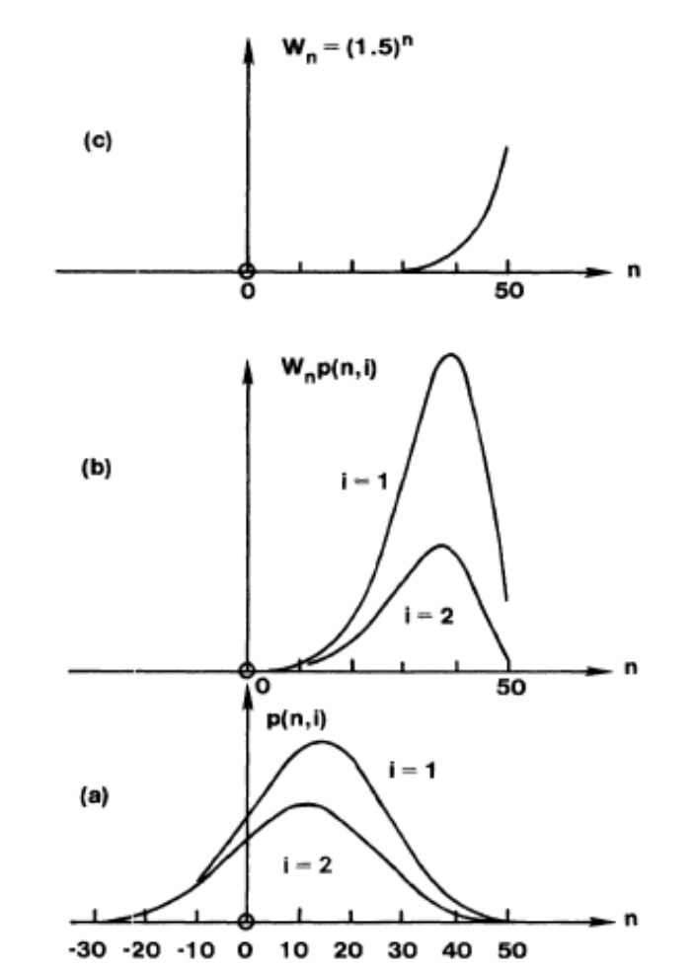
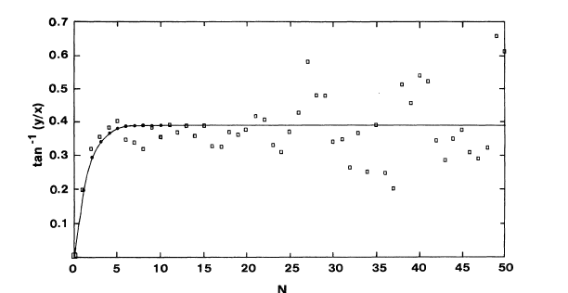
Green’s Function Quantum Monte Carlo
Problem, while Markov process has nice convergence
properties, the weights grow exponentially
[Hetherington 84]
[Hetherington 84]

Slide 21
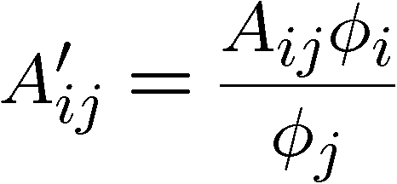
Green’s Function Quantum Monte Carlo
One method for alleviating this problem is to work
with multiple simultaneous walkers, and when the
variance of the walkers grows too high, to couple the
walkers and reset their weights to most important weights.
[Buonaura and Sorella 98]
Also very useful is to use a guiding wavefunction

Slide 22
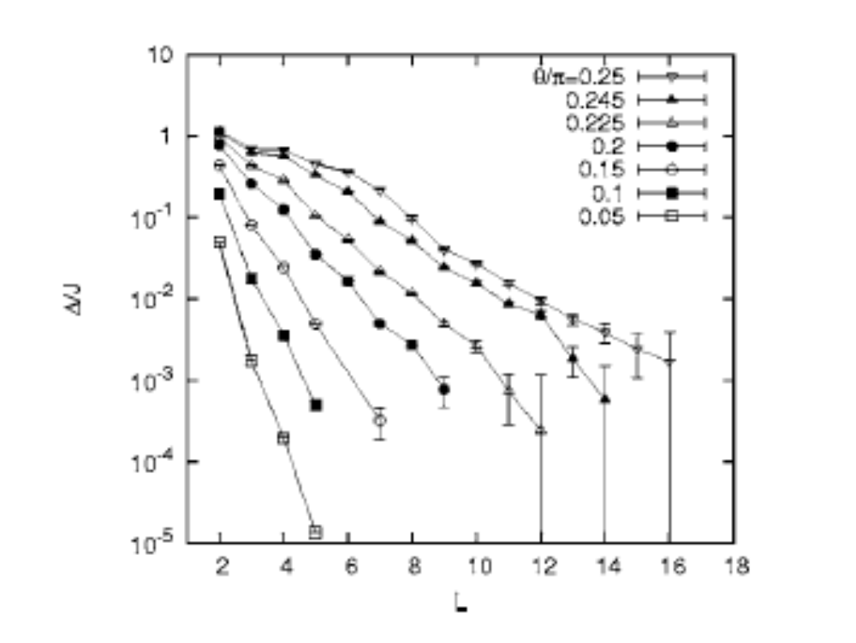
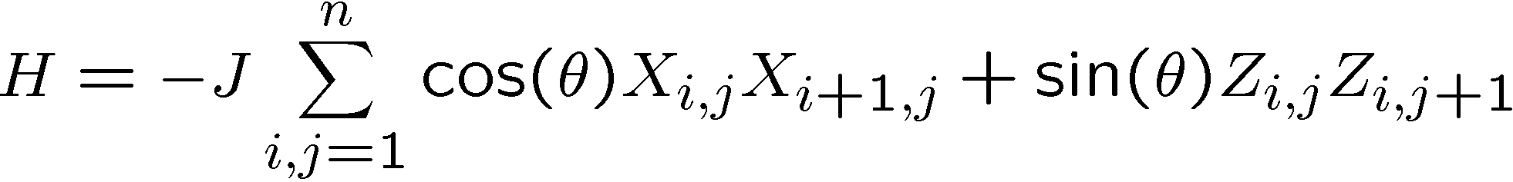
Quantum Compass Model [GFQMC]
[Dourier, Becca, Mila 05]
no gap in the thermodynamic limit

Slide 23
Quantum Compass Model
ZZ
ZZ
ZZ
XX
XX
XX
XX
n by n
square
lattice
ZZ
ZZ
ZZ
XX
XX
XX
XX
ZZ
ZZ
ZZ
XX
XX
XX
XX
ZZ
ZZ
ZZ
Not very interested in this model in the first place, because excitations are probably point-like.

Slide 24
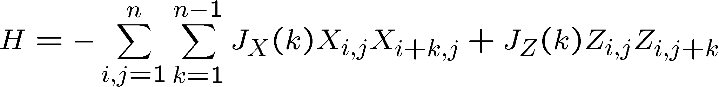
Beyond the QCM
ZZ
ZZ
ZZ
XX
XX
XX
XX
n by n
square
lattice
ZZ
ZZ
ZZ
XX
XX
XX
XX
ZZ
ZZ
ZZ
XX
XX
XX
XX
ZZ
ZZ
ZZ
Long range interactions. May possibly protect ground state
Implementation in ion traps?

Slide 25





Back to the Third Dimension
Possible excitations string-like? Has “sign problem”!

Slide 26
Kitaev’s Idea
Are there many-body quantum systems which can be used
to robustly store quantum information and keep this
information coherent during fault-tolerant computation with
this information?
It would be disappointing that in order to verify Kitaev’s idea we actually need to build the quantum computer.
Perhaps the new techniques described today
can save the day?

