Slide 1

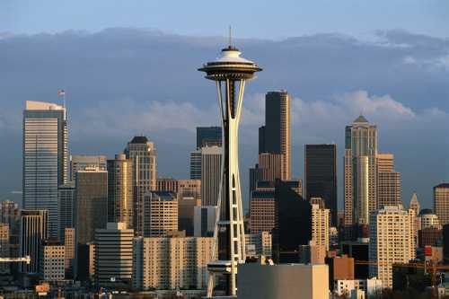
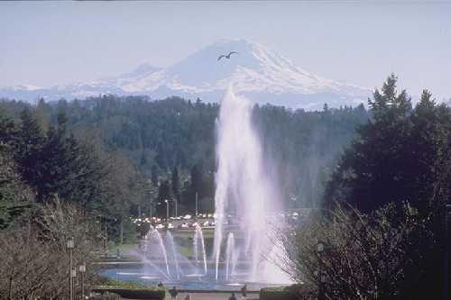
Big Issues in Quantum Algorithms
and Quantum Error Correction
Dave Bacon
Principal Research Scientist
Department of Computer Science & Engineering
University of Washington

Slide 2
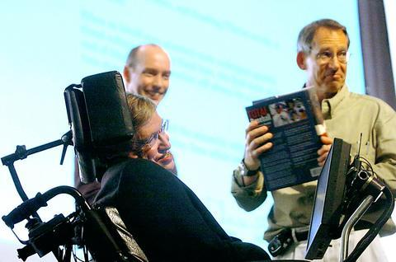
Quantum Algorithms
“If I had a good idea in quantum algorithms, that is
what I’d be working on” – John Preskill 2004

Slide 3
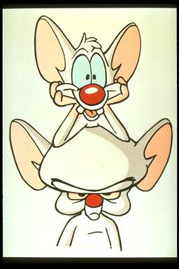
Quantum Algorithms
1. The Question is easy: where are all the quantum algorithms?
There has been no second quantum algorithms revolution.
Why? What should we do to fix this?
Scott Aaronson (Waterloo)
Dorit Aharonov (Hebrew U)
Andris Ambainis (Waterloo)
Dave Bacon (Washington)
Bob Beals (Princeton)
Charlie Bennett (IBM)
André Berthiaume (DePaul)
Ethan Bernstein
Thomas Beth (Karlsruhe)
Eli Biham (Technion)
Ofer Biham (Hebrew U)
Mark Byrd (SIU)
David Biron (Hebrew U)
Michel Boyer (Montreal)
Gilles Brassard (Montreal)
Samuel Braunstein (York)
Harry Buhrman (CWI)
Nicolas Cerf (Brussels)
Andrew Childs (Caltech)
Isaac Chuang (MIT)
Richard Cleve (Waterloo)
Don Coppersmith (IBM)
Claude Crépeau (McGill)
Wim van Dam (Santa Barbara)
Christopher Dawson (UQ)
David Deutsch (Oxford)
Alejandro Díaz-Caro (UNR)
Thomas G. Draper (Maryland)
David DiVincenzo (IBM)
Thomas Decker (Karlsruhe)
Christoph Dürr (LRI)
Artur Ekert (Cambridge)
Veit Elser (Cornell)
Mark Ettinger (Los Alamos)
Edward Farhi (MIT)
Stephen Fenner (South Carolina)
Lance Fortnow (Chicago)
Michael Freedman (Microsoft)
Dmitry Gavinsky (Calgary)
Jeffrey Goldstone (MIT)
Markus Grassl (Karlsruhe)
Frederic Green (Clark)
Lov Grover (Bell Labs)
Samuel Gutmann (Northeastern)
Lisa Hales (UC Berkeley)
Sean Hallgren (NEC)
Aram Harrow (MIT)
Henry Haselgrove (UQ)
Mark Heiligman (ARDA)
Andrew Hines (UQ)
Tad Hogg (HP)
Steve Homer (BU)
Peter Høyer (Calgary)
Lawrence Ip (Berkeley)
Gabor Ivanyos (Budapest)
Dominik Janzing (Karlsruhe)
Richard Jozsa (Bristol)
Andreas Klappenecker (Texas)
Elham Kashefi (Waterloo)
Kiran S. Kedlaya (MIT)
Julia Kempe (LRI)
Iordan Kerenidis (MIT)
Alexei Kitaev (Caltech)
Emanuel Knill (NIST)
Greg Kuperberg (UC Davis)
Samuel Kutin (Princeton)
Yoshifumi Inui (Tokyo)
Raymond Laflamme (Perimeter)
Andrew Landahl (MIT)
Sophie Laplante (LRI)
François Le Gall (Tokyo)
Daniel Lidar (USC)
Seth Lloyd (MIT)
Samuel Lomonaco (Maryland)
Chris Lomonte (Cybernet)
Frédéric Magniez (LRI)
David Meyer (San Diego)
Mehdi Mhalla (Calgary)
Carlos Mochon (Caltech)
Duncan Mortimer (UQ)
Cris Moore (Santa Fe)
Michele Mosca (Waterloo)
Sanjeev Naguleswaran (Adelaide)
Ashwin Nayak (Waterloo)
Michael Nielsen (UQ)
Tobias J. Osborne (UQ)
Wolfgang Polak
John Preskill (Caltech)
Ran Raz (Weizmann)
Jaikumar Radhakrishnan (TIFR)
Eric M. Rains (UC Davis)
Oded Regev (Tel-Aviv)
Eleanor Rieffel (FXPAL)
Dan Rockmore (Dartmouth)
Hein Röhrig (Calgary)
Martin Rötteler (NEC)
Alex Russell (Connecticut)
Miklos Santha (LRI)
Leonard Schulman (Caltech)
Pranab Sen (Waterloo)
Daniel Shapira (Hebrew U)
Peter Shor (MIT)
Daniel Simon (Microsoft)
Yaoyun Shi (Michigan)
John Smolin (IBM)
Amnon Ta-Shma (Tel-Aviv)
Krysta Svore (Columbia)
R. R. Tucci
Robert Spalek (CWI)
Alain Tapp (Montreal)
Barbara Terhal (IBM)
Dieter van Melkebeek (Wisconsin)
Umesh Vazirani (UC Berkeley)
Haobin Wang (UC Berkeley)
John Watrous (Calgary)
Avi Wigderson (IAS)
Lianao Wu (Toronto)
Ronald de Wolf (CWI)
Andrew Yao (Tsinghua)
Christof Zalka (Waterloo)

Slide 4
Where Are the Quantum Algorithms?
Early days, TWO tools:
  quantum Fourier transform (used in Shor’s algorithm)
  amplitude amplification (used in Grover’s algorithm)
New tools have been developed:
quantum random walks
adiabatic algorithms
“Tools” or “tricks” for quantum algorithms are still limited.
More work on primitives, circuit constructions
Example: the use of quantum random walks lead to algorithms
for element distinctness, finding triangle in graphs,
matrix multiplication verification…
[Decker, Janzing, Roetteler 04]
Efficient circuits for symmetric POVMs
[Bacon, Harrow, Chuang 05]
Efficient circuits for the Schur transform

Slide 5

Where Are the Quantum Algorithms?
B. (Pure state) entanglement is necessary (but not sufficient)
for quantum speedups.
Better language for entanglement (and interference)
We are missing an effective machine language
Lesson: multipartite entanglement classification hard.
Quantum data structures
[Aaronson 03]
Note: In current quantum algorithms, the oracle call hides the
role entanglement is playing

Slide 6
Where Are the Quantum Algorithms?
C. Where is the boundary between classical efficiently
simulatable and quantum speedup?
In addition to learning about the quantum speedup
Teaches us why our classical algorithms succeed and fail
at simulating quantum systems.
Better classical algorithms.
[Vidal 03, Osborne 05] Efficient simulation of one-dimensional
quantum many-body systems
2. Teaches us what is and what is not a quantum computer.
Practical consequences

Slide 7
Impact of Quantum Algorithms
Classical computational complexity problems approached from a quantum perspective.
[Kerenidis,de Wolf 2003], [de Wolf, Wehner 2005]
bounds for locally decodable codes, private information retrieval
[Aaronson 2004]
simple proof of closure of PP under intersection
[I. Kerenidis, 2005]
lower classical circuit bounds from quantum communication
complexity
[S. Laplante, T. Lee, and M. Szegedy, 2005]
formula size lower bounds from quantum lower bounds
[van Dam 2004]
quantum circuits and the Reiman hypothesis
Quantum complexity is to classical complexity
as complex analysis is to real analysis?

Slide 8
Future Quantum Algorithms?
Sampling of open problems (mostly from Scott Aaronson’s list:
http://www.scottaaronson.com/writings/qchallenge.html )
1. PAC learnability of AC⁰ or TC⁰ circuits?
2. Graph isomorphism
3. Linear code isomorphism
4. Certain shortest vector in a lattice problems
5. Better than Grover speedups for total functions?
6. Questions in classes like PPP, PPA, PPAD, PLS?
(finding Nash equilbria, market eqiulibria, …)
What advantages do the polynomial speedups offer?
A quantum 1Hz computer vs a classical 10 GHz computer?

Slide 9
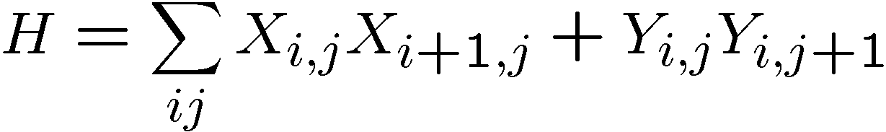
Quantum Error Correction
Heretic: the fundamental question in quantum error correction is
not what the threshold is.
The fundamental question is either
(1) what is the proper architecture for quantum error correction?
or
(2) What is the proper physics for quantum error correction?
Example: Quantum error correction is essentially cooling.
XX
XX
YY
YY
YY
Quantum error correcting subsystem.
If cooling faster than decoherence,
then this is equivalent to a single qubit
quantum error correcting code.
XX
XX
YY
YY
YY
XX
XX

