Slide 1





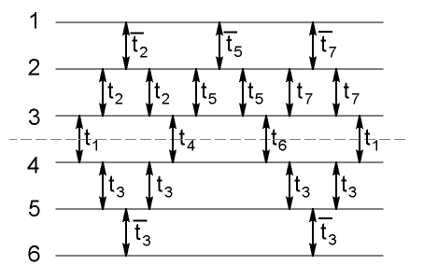
Decoherence-Free Subspaces
Bath mode
Symmetry of system-environment
coupling…..
DFS
Hilbert
space
…induces a protected space where
quantum computing is safe
Solving the question of how to quantum
compute on DFSs
DiVincenzo, Bacon, Kempe, Burkard, and Whaley,
Nature 408, 339 (2001)
Bacon, Kempe, Lidar, and Whaley,
Physical Review Letters 85, 1758 (2000)
Quantum DFS gate

